Slide 1


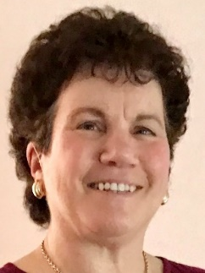
https://hhrecny.org/
Helen Rubel,
GenerationsForward
Helen Rubel is the daughter and granddaughter of Holocaust survivors. Helen
shares her mother’s first-person account of being hidden in an attic in
Amsterdam to escape being captured during the Nazi takeover of Holland. The family had lived in harmony with their Christian neighbors in Hadamar, Germany prior to Hitler’s rule. After Kristallnacht in 1938, the night of broken glass when the Nazis destroyed Jewish homes businesses and synagogues, their lives changed, and the family fled to Holland. :
Quoting her mother's letters and writing, Helen's narrative provides a first-hand testimony.
An important theme is the value of being an “upstander”, someone who stands up for what is just. This concept is illustrated by the courage of the Dutch family who risked their lives to hide Helen’s mother and grandmother. Helen also explores the themes of perseverance, resourcefulness, risk taking, and luck that contributed to her family’s survival.
Since 1987 Helen has spoken to a wide variety of groups about her family’s experiences as well as the impact of growing up as a child of survivors and as a first generation American. She has made visits to her parents’ hometowns in Germany and participated in remembrance programs
[location]
[date]
[time]
Event held at:

