Slide 1


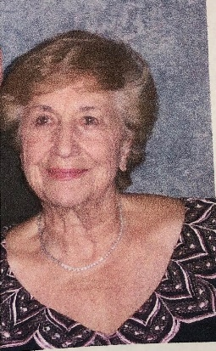
https://hhrecny.org/
Hanne Holsten,
Speakers Bureau
Hanne Holsten lived a normal life in Nuremberg, Germany in
1938 with her mother, father, sister, and brother--until the Nazis
came on Kristallnacht (Night of Broken Glass). The Nazis destroyed
everything they owned, and Hanne, her parents, and her siblings were rounded up and placed in an overnight jail. The next morning would begin a long two-year journey for Hanne, fleeing from the Nazis, traveling all over Europe, and at one point being hidden by smugglers.
Hanne’s story is filled with moments of unbelievable luck. She tells her story today so that no one ever forgets the terrors of the Shoah, the Holocaust. Hanne lives in Hartsdale and has been blessed with 3 children, 10 grandchildren, and 2 great-grandchildren.
[location]
[date]
[time]
Event held at:

