Slide 1


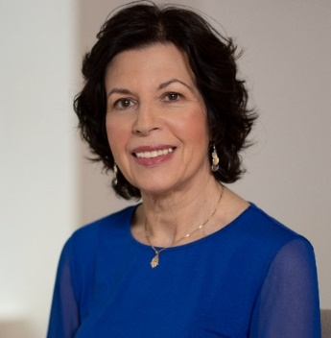
https://hhrecny.org/
Gloria Lazar,
GenerationsForward
Gloria Lazar tells the story of her father, Arthur, whose courage,
determination and cunning were key to his survival after the Nazis
Invaded his town in southern Poland in September 1939. Gloria’s story
traces his escape from the Nazis, imprisonment in a Soviet concentration camp, daring leap from a Polish troop train and the remaining years of the war working on a Soviet commune. Arthur broke his silence 35 years after the end of the war and recorded his story as an oral memoir so that his only child would write about his survival and the endurance of the human spirit.
Gloria works in private practice as a speech-language pathologist, public speaking coach and speech writer in Tarrytown. Gloria has published freelance articles in The New York Times, The Washington Post, The Chicago Tribune, and poetry in literary journals. She has completed a young adult novel, All The Falling Stars, about the uprising of the Warsaw ghetto and is working on a screenplay adaptation. Her screenplay, Djambul, grew out of her father’s Holocaust experience.
[location]
[date]
[time]
Event held at:

