Slide 1


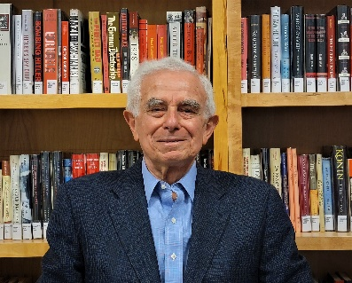
https://hhrecny.org/
Fred Schoenfeld
Holocaust Survivor
Fred Schoenfeld was born in 1936, to Simcha (Simon) and Ilonka (Ellen) Schoenfeld in Kosice, Czechoslovakia. He shares the story of how his family moved to Presov in the newly created Slovak puppet state in 1939, after Kosice was ceded to Hungary as part of the post-Munich dismemberment of Czechoslovakia, initially avoided the deportation of Jews that began in 1942 owing to Simcha’s employment with a chemical and dye company that was deemed essential to the Slovak economy, and survived numerous close calls as the noose tightened around Slovakia’s Jews, moving first to a rural farming area and ultimately finding refuge in the Tatra mountains during Autumn and Winter 1944/45, where they were liberated by Czech partisans and Soviet forces in February 1945. The family immigrated to the United States in 1948 as the communists took power in the reunited Czechoslovakia. Since 2014, Fred has lectured about his story of survival to numerous public and private middle school and high school students in the greater New York area.
[location]
[date]
[time]
Event held at:

