Slide 1


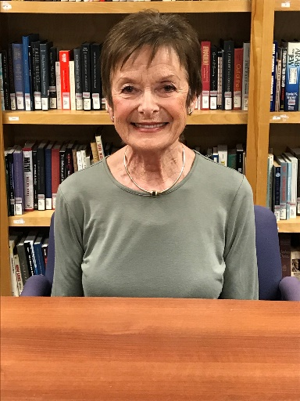
https://hhrecny.org/
Eta Levin Hecht,
Holocaust Survivor
Born in Kovno, Lithuania, Eta was forced to enter
a ghetto with her mother and father in July of 1941.
Her parents arranged for Eta to be hidden with a
Christian family. Her mother and father were sent to
camps. They were later reunited and placed in a DP
(displaced persons) camp near Munich, Germany. They spent time in France before emigrating to the United States in 1952.
[location]
[date]
[time]
Event held at:

