Slide 1
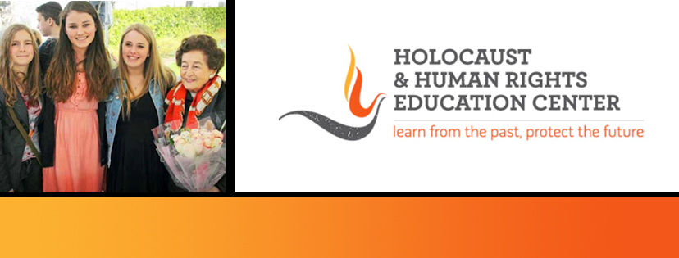


https://hhrecny.org/
Ernest Brod,
Holocaust Survivor
Ernest “Ernie” Brod was born in 1938 in Vienna, Austria. As a young boy who
grew up during the Holocaust, his father was among the first Jews killed, and his
four year-old brother was sent on a Kindertransport to England. Through a series
of near-miracles, he and his mother avoided a concentration camp, made their
way to Lisbon, Portugal, and reached Ellis Island in America in March of 1941.
Ernie’s tells the story of how he and his family survived and resettled in Brighton Beach, Brooklyn, of meeting his brother when he was 21 to become remarkably close to this day, and how they have developed careers with international companies on both sides of the Atlantic. A lawyer by training, Ernie has spent the past 40 years as a corporate investigator and has been widely recognized as a leading expert in the field.
[location]
[date]
[time]
Event held at:

