Slide 1


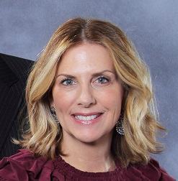
https://hhrecny.org/
Ellen Kaidanow,
GenerationsForward Speaker
Ellen Kaidanow is the daughter-in-law of two Holocaust survivors. Her
mother in law, also named Ellen Kaidanow, was only 5 years old when her
mother, father and two sisters were all forced to move from their beautiful home in Dubno, Ukraine to a walled Jewish ghetto.
Ellen tells the story of her mother in law’s life as a young girl in the ghetto and her miraculous tale of becoming the sole survivor of her family at age 6. She was saved by a Christian woman who hid her for two years.
Ellen feels that part of her fate and purpose is to be a witness for her mother in law’s story. She wants to honor her and help others of all religions have a personal connection to the Holocaust so they become witnesses. Most important, she wants to influence others to be “upstanders”, not bystanders. She also wants to show those who are struggling with tragedy that her mother in law was able to be resilient under the worst circumstances and went on to have great joy and love in her life despite the devastating experiences she had as a child. She wants to inspire others to never give up hope and to be grateful for what you do have.
[location]
[date]
[time]
Event held at:

