Slide 1
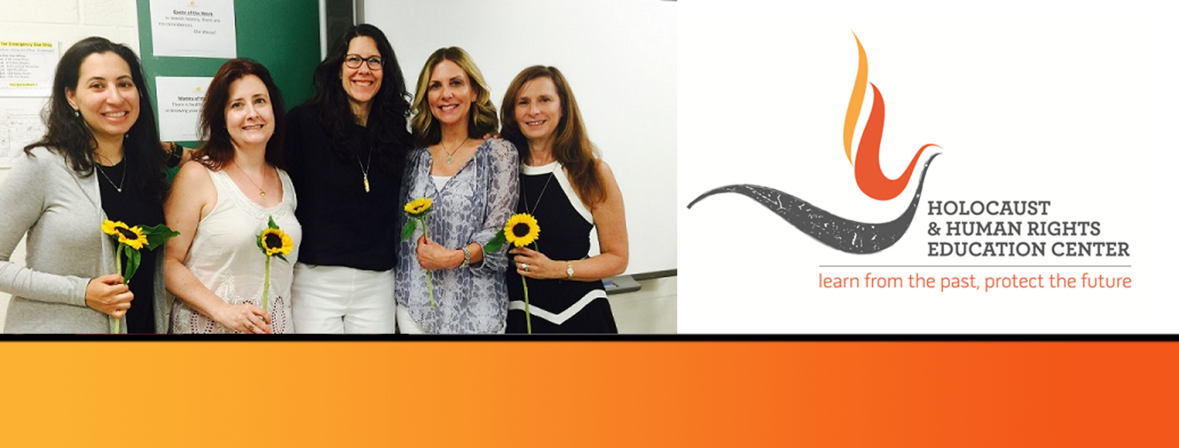

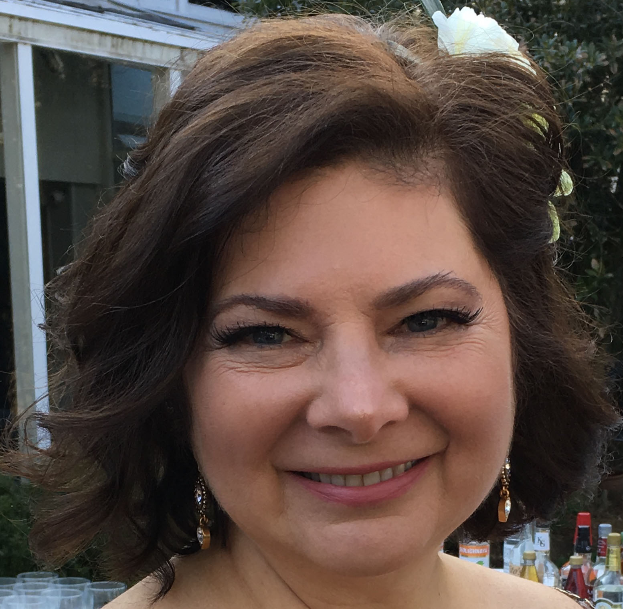
https://hhrecny.org/
Debra Nancy Lewis,
GenerationsForward Speaker
Debra Nancy Lewis is the child of two Polish Holocaust survivors. Her mother, Rose, was born in Lodz and survived the Lodz Ghetto, Birkenau, Oederon (Flossenburg) and Terezin before emigrating to London in 1945 with a group of 732 orphans known as “The Boys”. Debra’s father, Benjamin, was born in Opatow and was a prisoner at a subcamp of Buchenwald known as Skarjisko Kamienna where he was able to survive thanks to his skills as a tailor.
Debra is a graduate of the Workmans Circle Mitlshul, and holds degrees in Social Work (Columbia University) and Education (Manhattanville College). She participated in the Holocaust and Resistance Jewish Teachers Program in 2017 and the Belfer National Conference for Educators (United States Holocaust Memorial Museum) and holds membership in the 45 Aid Society (London). She currently works as a teacher of remedial reading at Mildred E. Strang Middle School in Yorktown Heights, where she also has conducted Holocaust presentations and consulted on the development of Holocaust curriculum for 20 years. Debra presents her mother’s story.
[location]
[date]
[time]
Event held at:

