Slide 1


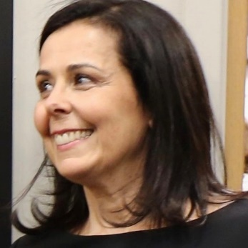
https://hhrecny.org/
Debby Ziering,
GenerationsForward Speaker
Debby is the daughter of two Holocaust survivors.
Her father Herman was born in Kassel, Germany and
was sent to the Riga Ghetto in Latvia. Herman was a
teen when the Nazis invaded Germany.
He survived the Riga Ghetto and Kaiserwald, a work camp in Riga
Ghetto and he dedicated his life to the exposure, deportation, and eventual trial of Nazi War Criminals.
Debby recounts her father's story from the perspective of a young teen as well as how her father's wartime story has impacted her.
Event held at:
[location]
[date]
[time]

