Slide 1
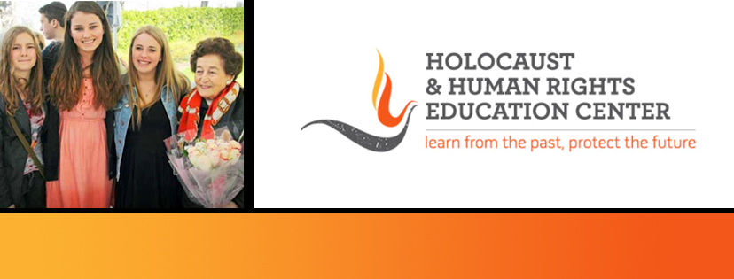

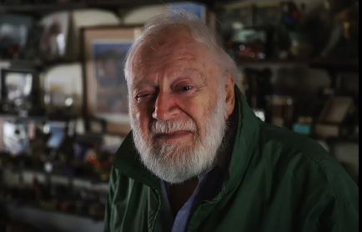
https://hhrecny.org/
Charles Srebnik,
Holocaust Survivor
Charles Srebnik was born on October 31, 1934 in Brussels, Belgium to
Maria and Leon Srebnik. On May 10, 1940 German forces invaded Belgium,
and by October the occupying military government began instituting anti-
Jewish measures. The Srebnik family went into hiding at a cottage overlooking
a lake near Genval. One night, they heard screams coming from the lake.
Although Leon suspected that this was a German ruse to flush out Jews in
hiding, he investigated and found an inebriated priest drowning. The family took him in overnight and the next day the grateful priest asked what he might do for them in return. Leon requested false baptism papers for Charles, which would allow him to be placed safely in a Catholic orphanage. These were provided, and throughout the war Charles was hidden in three different orphanages. His name was changed in the first orphanage.
On June 26, 1946, Charles and his mother came to the USA. Charles’ father, Leon, died at Auschwitz before the war ended. Although Charles’ mother who died in 2004 never learned what had happened to her husband, she continued to search for him, even stocking the cottage near the lake in Genval with food in case he returned.
[location]
[date]
[time]
Event held at:

