Slide 1
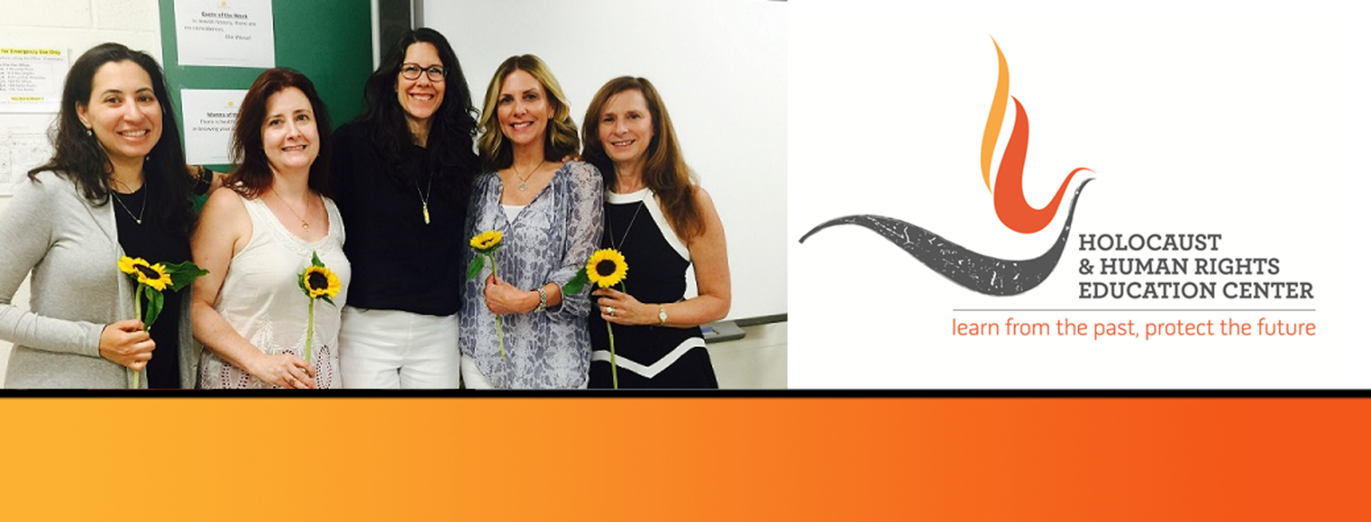

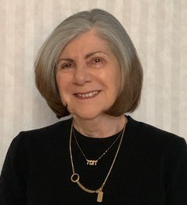
https://hhrecny.org/
Anna Leiser-Kleinhaus
Holocaust Survivor
Anna Leiser-Kleinhaus, born in 1936 in Antwerp, Belgium, describes her life while in hiding during the war, her times in a French orphanage, posing as a Catholic in a French town with her mother and returning to Antwerp with her mother after the war and reuniting with her father after his liberation from a concentration camp.
She studied in Geneva, Switzerland where she met her husband. Immigrated to the US where she received a doctorate in pharmacology and had a productive career while raising three children.
Now retired she enjoys the company of her grandchildren.
[location]
[date]
[time]
Event held at:

