Slide 1

Volunteer Training

Slide 2

for your support!

Slide 3

agenda
Introduction
Timeline
Positions
Set Up
Registration
Food Service
Fundraising Team
CF Booth
Activities
Walk Marshalls
Tear Down
4. Moneris Machines
5. Q&A

Slide 4
working together
We want to provide support, training, collaboration and knowledge sharing to help us have continued successes for this years event.
We will live our values, as a team:
VALUES
COLLABORATIVE
BOLD
IMPACTFUL
INCLUSIVE

Slide 5
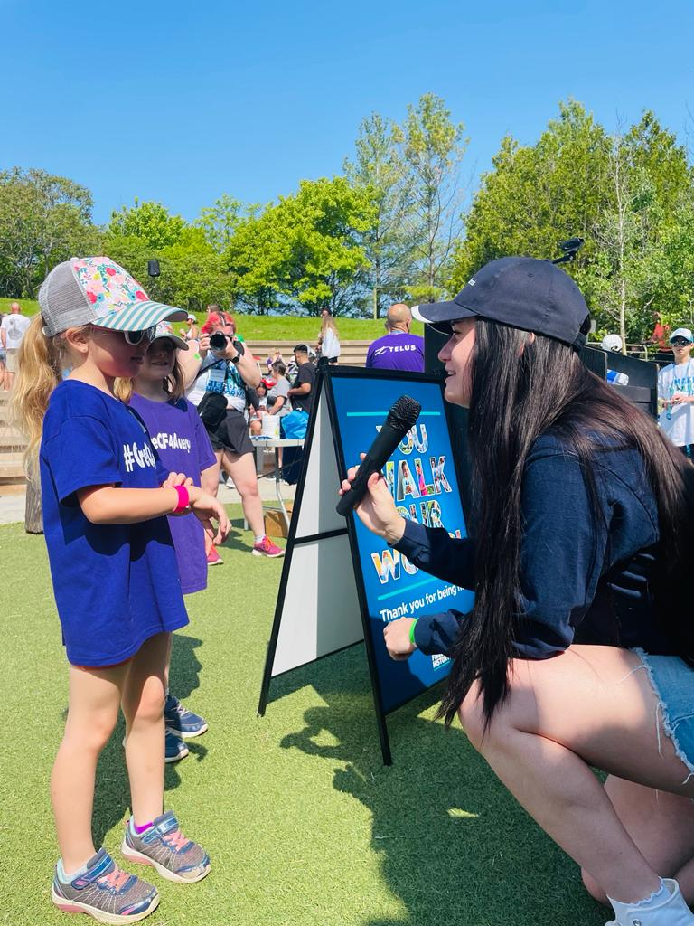
Event Day Timeline:
Set up:
Registration:
Opening Ceremonies:
Walk Start:
Food Service:
Closing Ceremonies:
Finish:
Strike:
ADD CUSTOM TIMELINE BASED ON SITE NEEDS

Slide 6
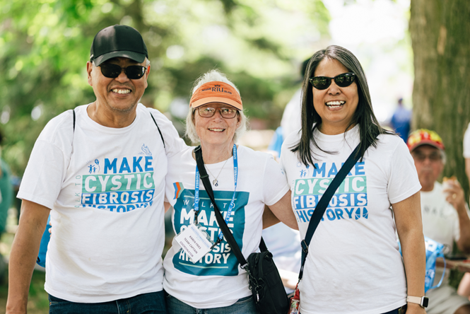
Positions – SET Up *Some heavy lifting may be required.
Some heavy lifting required
Unloading event supplies
Setting up tents
Setting up tables, chairs, banners & signage
Following site map to ensure accuracy of placement
Food station set up, along with hand washing stations as per Health Authority specifications
Activity Set up
Registration Set Up

Slide 7
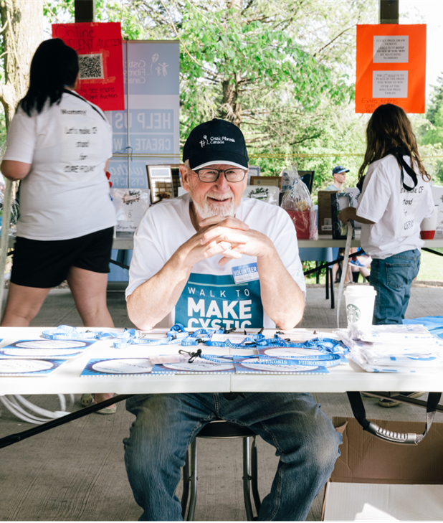
Positions – Registration
Checking participants in
CF Guests receive verification bandana
Handing out Swag
Collecting pledges
Check in Team Captains and Individuals (*Note: Team captains to check in their entire team to reduce congestion at registration)
Wayfinding
Ensuring all personal information is being handled properly

Slide 8
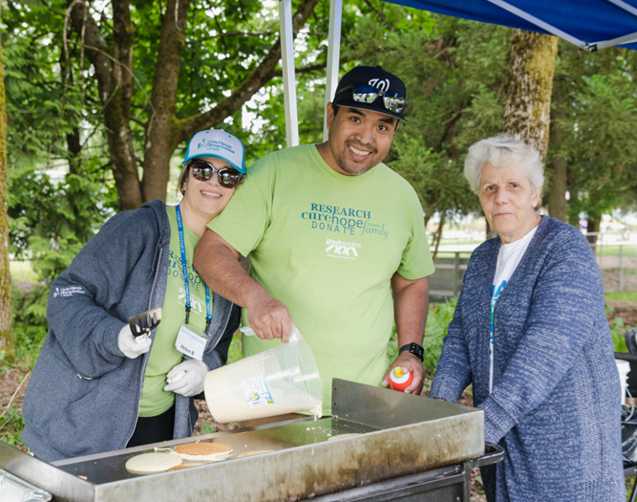
Positions – Food Station
Preparing food according to infection control policies, food safety and all low contact measures
Handing out plates
Cleaning tables
Organizing recycling & garbage
Ensuring all supplies are topped up as needed
Handing out snacks & fruit
Cleaning up once food service is complete

Slide 9
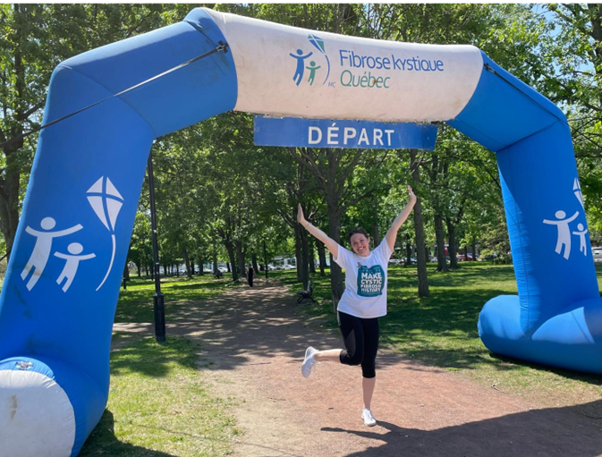
Positions – Fundraising team
Drawing in guests to participate in fundraising activities
Selling tickets on ipad
Answering any questions & assisting with purchases as needed

Slide 10
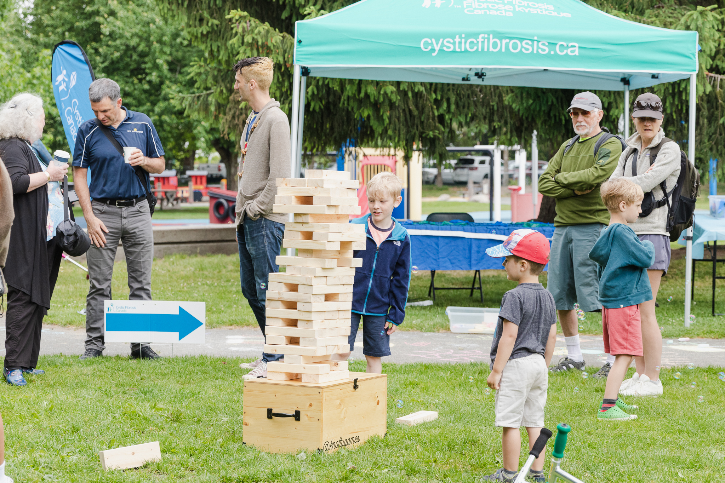
Positions – Activities
Guiding participants game rules
Ensuring prizes/swag are always stocked
Cleaning game pieces between usage
Managing superhero stations

Slide 11
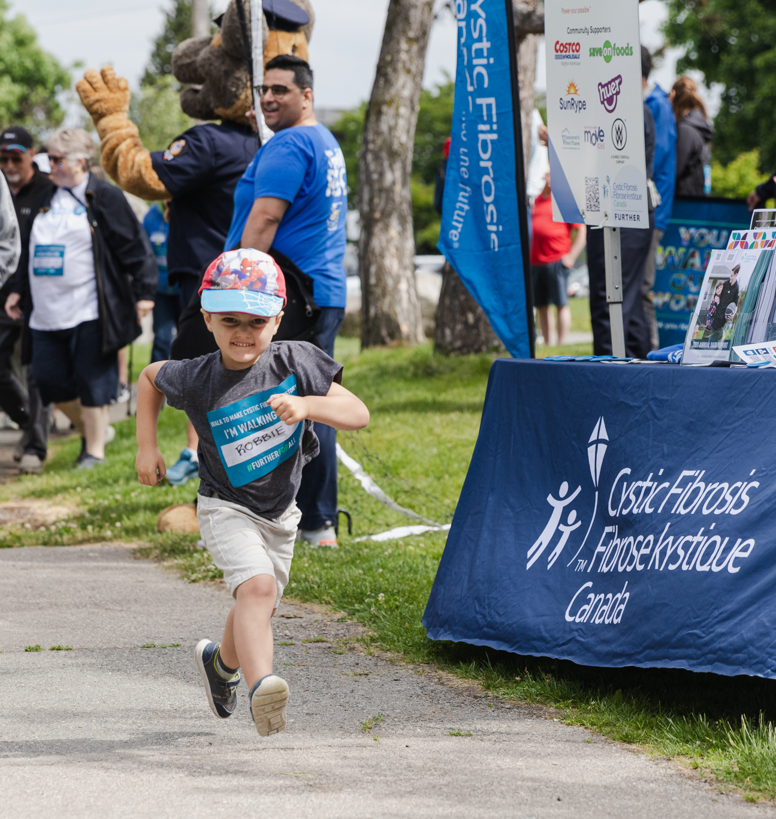
Positions – Walk Marshals
Setting up route markers
Leading walkers along the route
Cheering participants on as they walk
Cleaning up route markers once walkers finish

Slide 12
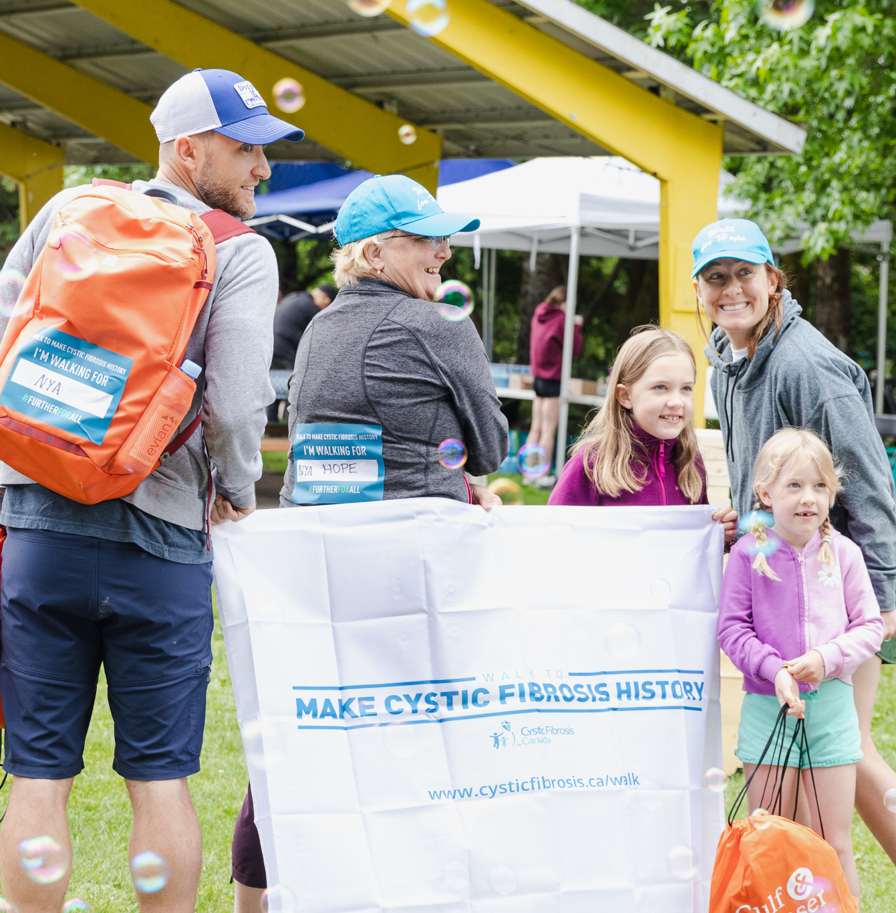
Positions – Strike/Clean Up *Some heavy lifting may be required
Taking down tables, chairs & tents
Repacking bins according to packing lists and making notations of anything missing
Cleaning up all garbage (organized between recycling, returnable items & garbage)
Loading up all event materials in truck
Checking park to ensure nothing is left behind

Slide 13
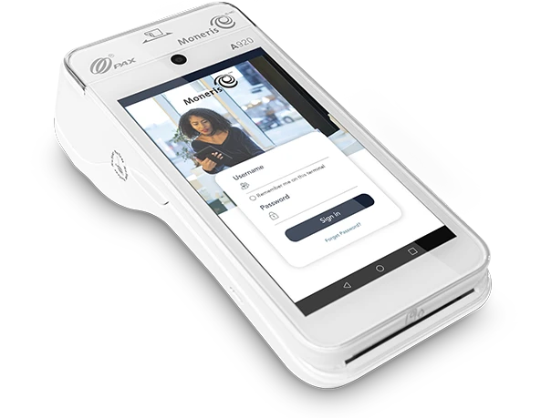
Moneris Machines
Various areas use Moneris machines:
50/50 Ticket Sales
Food Sales
Registration
*Note: These machines are unable to take donations if the donor would like a tax receipt. Please direct them to the Walk website to donate online if they want a tax receipt.
Each site will have a Finance Coordinator who will have received a training on how to use these machines. That person will be responsible for training any volunteers onsite that need to use these machines.

Slide 14
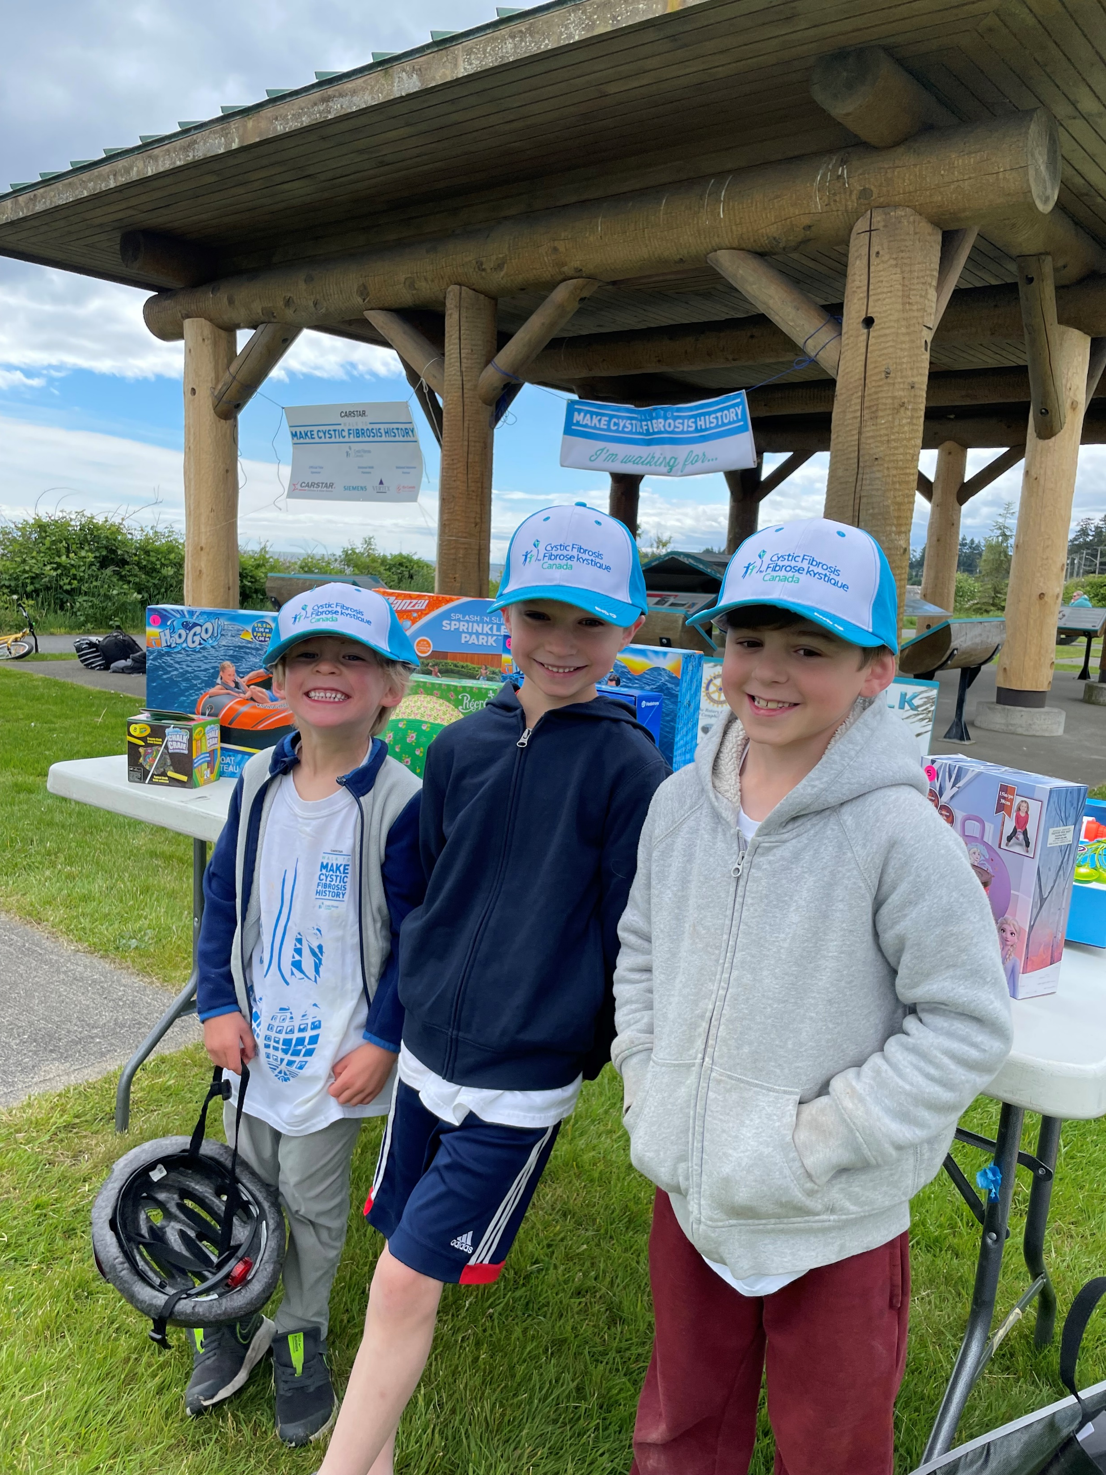
WHAT TO BRING ON WALK DAY
Water Bottle – we will have water to refill. Stay hydrated!
Weather Appropriate clothing – make sure you wear layers and check the weather forecast before the day.
Comfortable shoes – expect to be on your feet.

Slide 15
What to expect on walk day
(if food provided)
(if water provided)
*put in information about what is included for our volunteers so they know what to expect.
** In the event that you are unable to attend, for any reason, please contact the Volunteer Coordinator.

Slide 16

questions? VOLUNTEER COORDINATOR AND NUMBER TO CALL IF QUESTIONS BEFORE OR ON WALK DAY: (insert NAME AND number)
Please add this name and number to your cell phone right now ☺

Slide 17
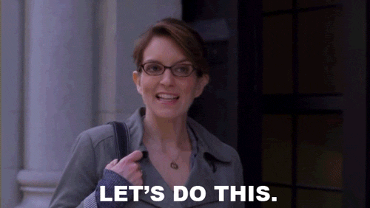
LET’S GO
#WalkToMakeCFHistory
Sunday May 25, 2025

