Slide 1

St. Mary’s Episcopal Church
Welcome to Sunday Service
To participate fully, it is recommended that you have at hand the Bible, Book of Common Prayer, and the Bulletin found on the church website (stmarysedmond.org).

Slide 2
Proper 19
September 14, 2025

Slide 3
PRELUDE
Simple Gifts
Setting by Lyn Joyner

Slide 4
Hymn in Procession
Sing praise to God who reigns above
(H 408)

Slide 5
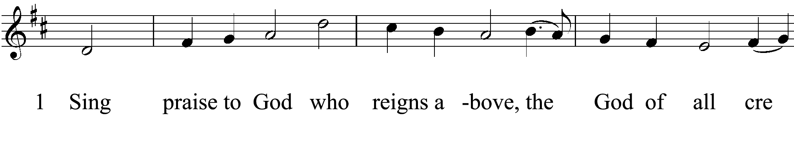
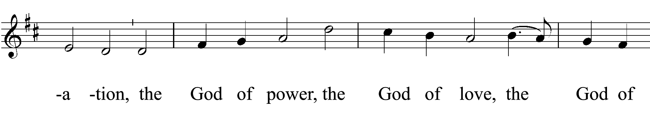

Slide 6
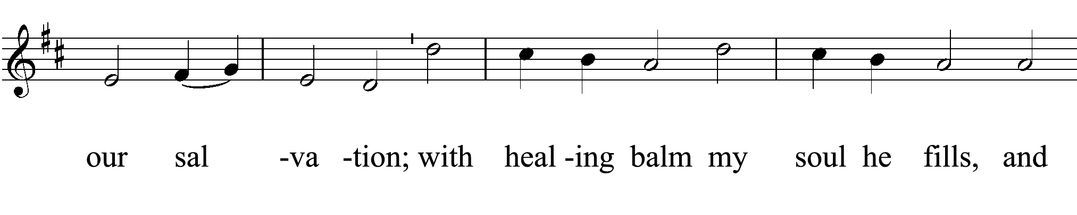
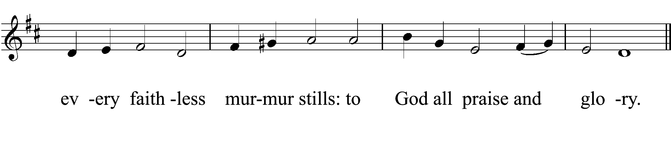

Slide 7
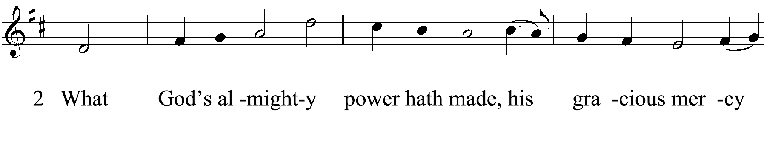
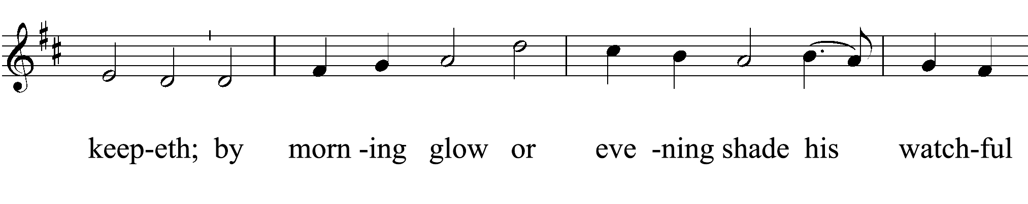

Slide 8
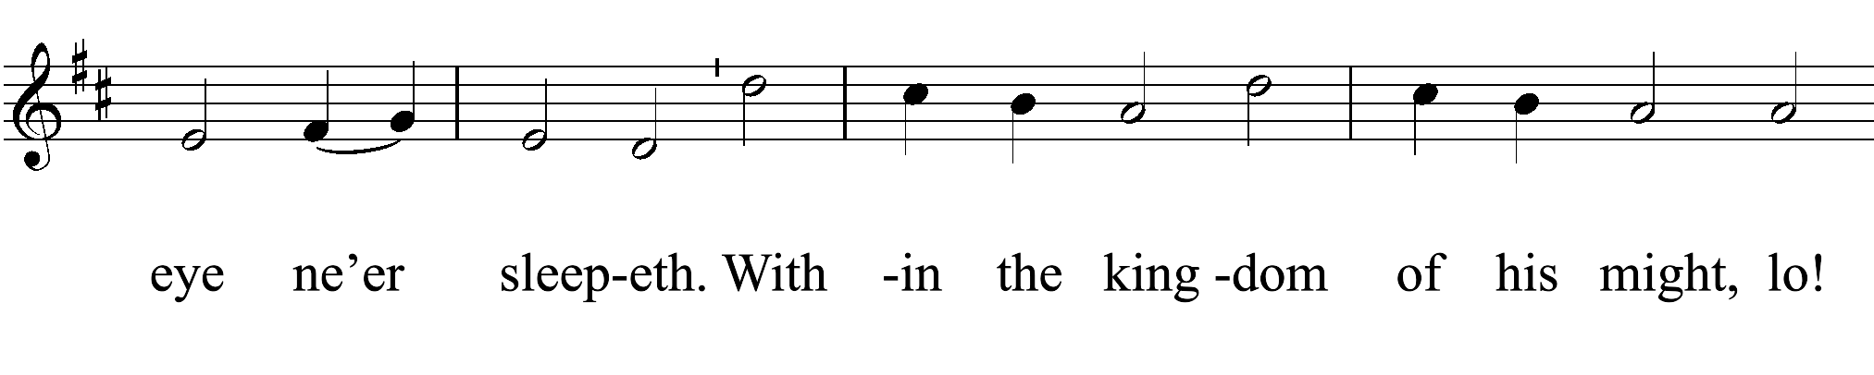
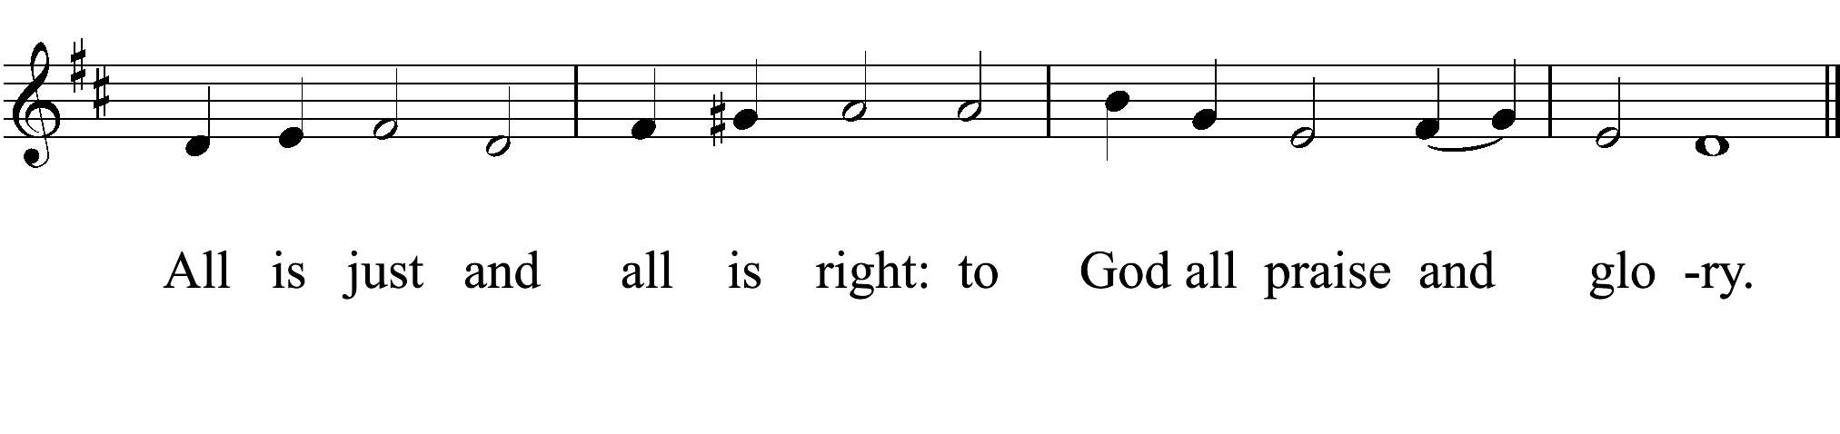

Slide 9
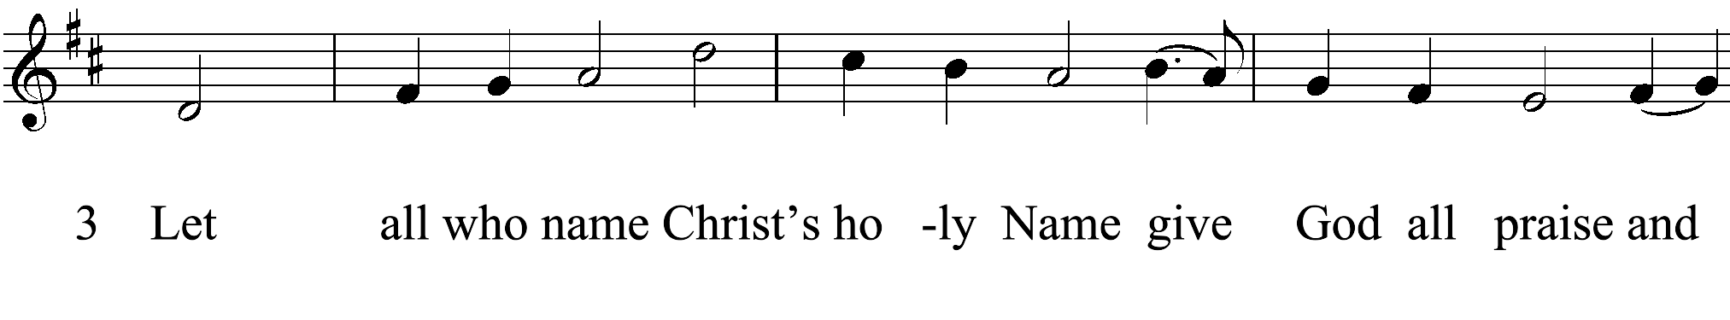
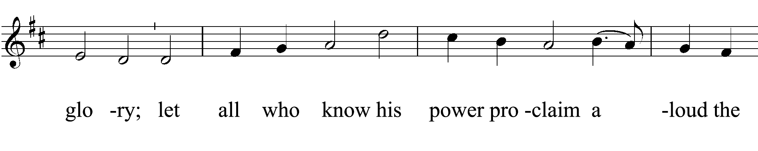

Slide 10
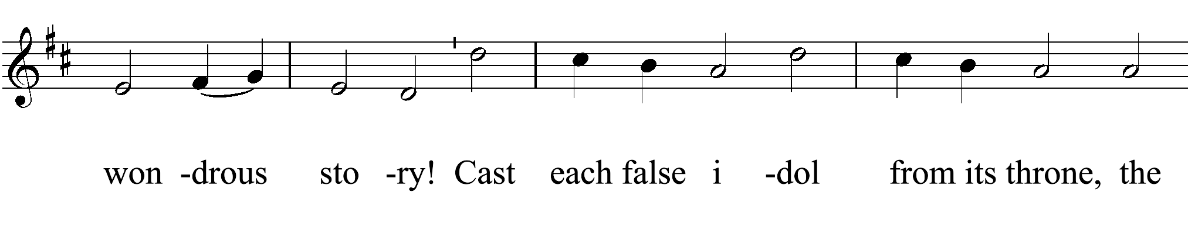
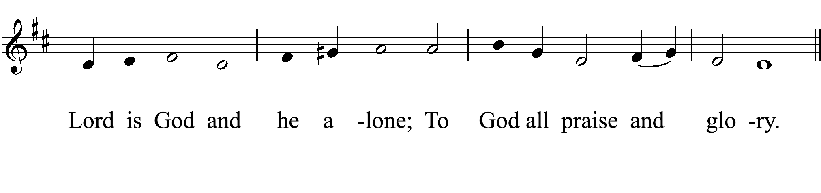

Slide 11
OPENING ACCLAMATION
The Deacon or Celebrant Says
Celebrant Blessed be God: Father, Son, and Holy Spirit.
People And blessed be his kingdom, now and for ever. Amen.

Slide 12
COLLECT FOR PURITY
The celebrant may say
Almighty God, to you all hearts are open, all desires known, and from you no secrets are hid: Cleanse the thoughts of our hearts by the inspiration of your Holy Spirit, that we may perfectly love you, and worthily magnify your holy Name; through Christ our Lord. Amen.

Slide 13
GLORIA
Glory to God
(S 280)

Slide 14
Glory to God in the highest,
and peace to his people on earth.
2. Lord God, heavenly King,
almighty God and Father,
we worship you, we give you thanks,
we praise you for your glory.

Slide 15
3. Lord Jesus Christ, only Son of the Father,
Lord God, Lamb of God,
4. you take away the sin of the world;
have mercy on us;
5. you are seated at the right hand of the Father;
receive our prayer.

Slide 16
6. For you alone are the Holy One,
you alone are the Lord,
7. you alone are the Most High,
Jesus Christ,
with the Holy Spirit,
in the glory of God the Father. Amen.

Slide 17
THE COLLECT OF THE DAY
Celebrant The Lord be with you.
People And also with you.
Celebrant Let us pray.

Slide 18
O God, because without you we are not able to please you mercifully grant that your Holy Spirit may in all things direct and rule our hearts; through Jesus Christ our Lord, who lives and reigns with you and the Holy Spirit, one God, now and for ever. Amen.

Slide 19
The Lessons
Jeremiah 4:11-12, 22-28
The people sit.
A Reading from the book of the prophet Jeremiah.

Slide 20
¹¹At that time it will be said to this people and to Jerusalem: A hot wind comes from me out of the bare heights in the desert toward my poor people, not to winnow or cleanse—¹²a wind too strong for that. Now it is I who speak in judgment against them.
²²“For my people are foolish,
they do not know me;
they are stupid children,

Slide 21
they have no understanding.
They are skilled in doing evil,
but do not know how to do good.”
²³I looked on the earth, and lo, it was waste and void;
and to the heavens, and they had no light.
²⁴I looked on the mountains, and lo, they were quaking,
and all the hills moved to and fro.

Slide 22
²⁵I looked, and lo, there was no one at all,
and all the birds of the air had fled.
²⁶I looked, and lo, the fruitful land was a desert,
and all its cities were laid in ruins
before the Lord, before his fierce anger.
²⁷For thus says the Lord: The whole land shall be a desolation; yet I will not make a full end.

Slide 23
²⁸Because of this the earth shall mourn,
and the heavens above grow black;
for I have spoken, I have purposed;
I have not relented nor will I turn back.

Slide 24
Reader The Word of the Lord.
People Thanks be to God.
Silence may follow.

Slide 25
Psalm 14
Remain seated.
¹The fool has said in his heart, “There is no God.” *
All are corrupt and commit abominable acts;
there is none who does any good.
²The Lord looks down from heaven upon us all, *
to see if there is any who is wise,
if there is one who seeks after God.

Slide 26
³Everyone has proved faithless;
all alike have turned bad; *
there is none who does good; no, not one.
⁴Have they no knowledge, all those evildoers *
who eat up my people like bread
and do not call upon the Lord?

Slide 27
⁵ See how they tremble with fear, *
because God is in the company of the righteous.
⁶Their aim is to confound the plans of the afflicted, *
but the Lord is their refuge.

Slide 28
⁷Oh, that Israel’s deliverance would come out of Zion! *
when the Lord restores the fortunes of his people,
Jacob will rejoice and Israel be glad.

Slide 29
1 Timothy 1:12-17
The people sit.
A Reading from Paul’s First letter to Timothy.

Slide 30
¹²I am grateful to Christ Jesus our Lord, who has strengthened me, because he judged me faithful and appointed me to his service, ¹³even though I was formerly a blasphemer, a persecutor, and a man of violence. But I received mercy because I had acted ignorantly in unbelief, ¹⁴and the grace of our Lord overflowed for me with the faith and love that are in Christ Jesus.

Slide 31
¹⁵The saying is sure and worthy of full acceptance, that Christ Jesus came into the world to save sinners—of whom I am the foremost. ¹⁶But for that very reason I received mercy, so that in me, as the foremost, Jesus Christ might display the utmost patience, making me an example to those who would come to believe in him for eternal life. ¹⁷To the King of the ages, immortal, invisible, the only God, be honor and glory forever and ever. Amen.

Slide 32
Reader The Word of the Lord
People Thanks be to God
Silence may follow.

Slide 33
Sequence Hymn
What wondrous love is this
(H 439)

Slide 34
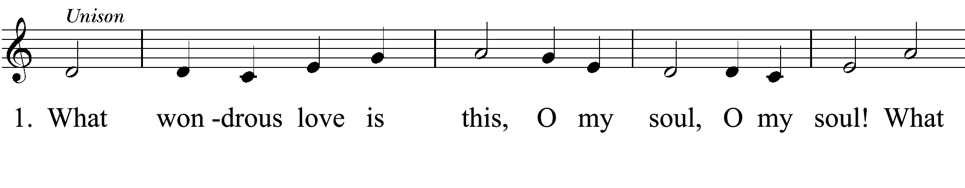
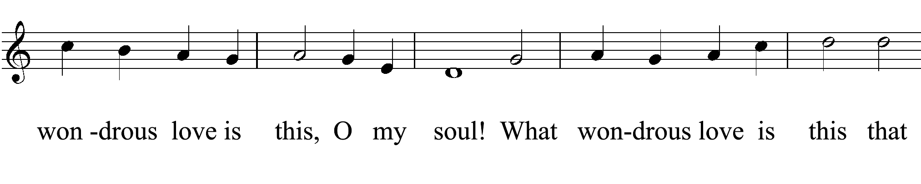

Slide 35
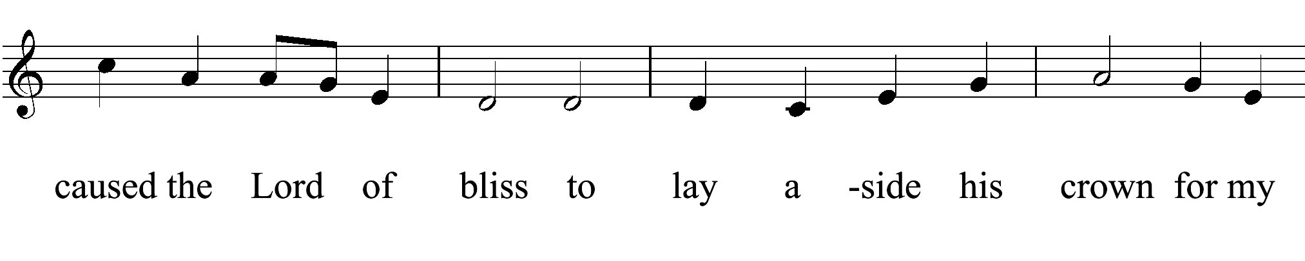
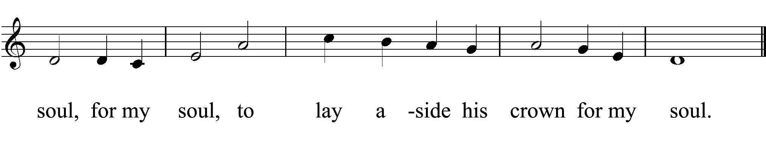

Slide 36
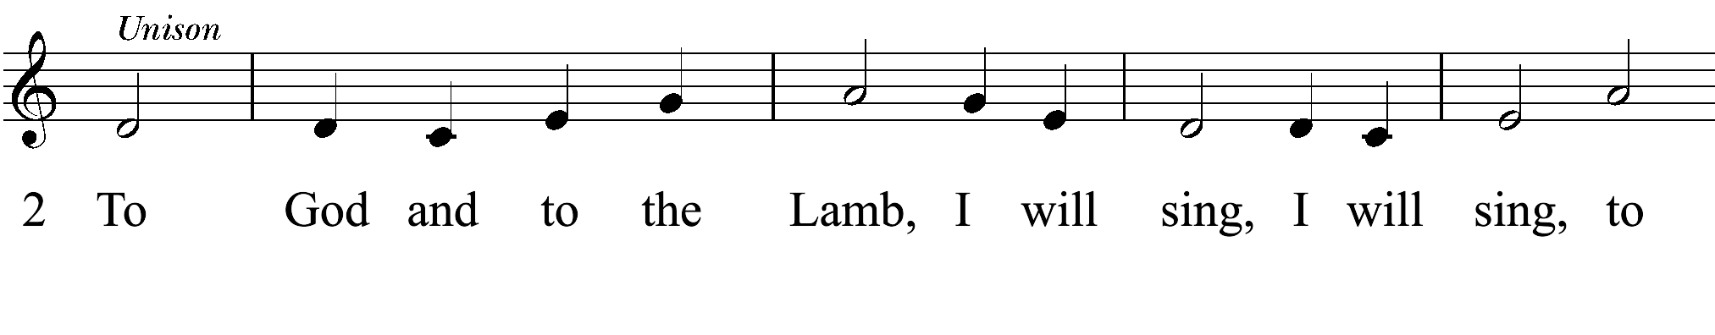
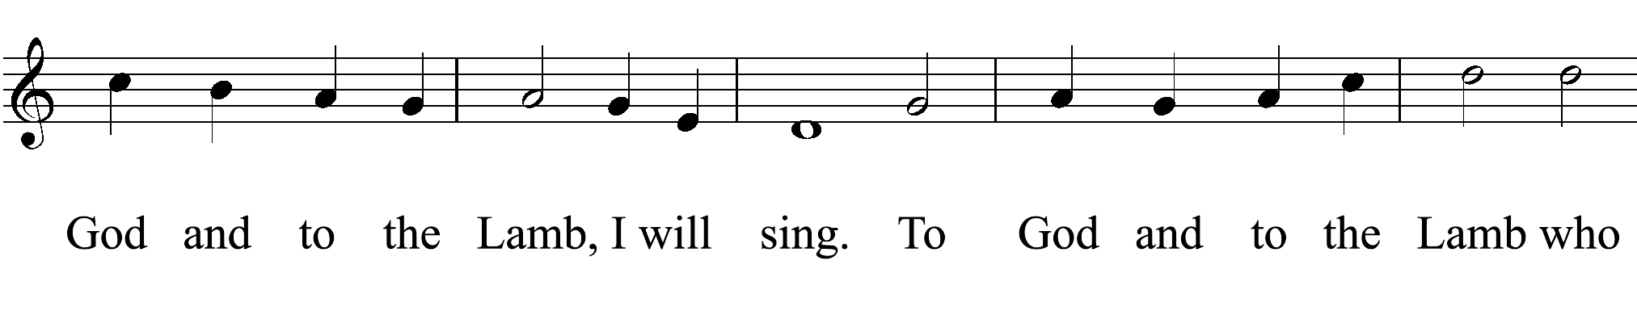

Slide 37
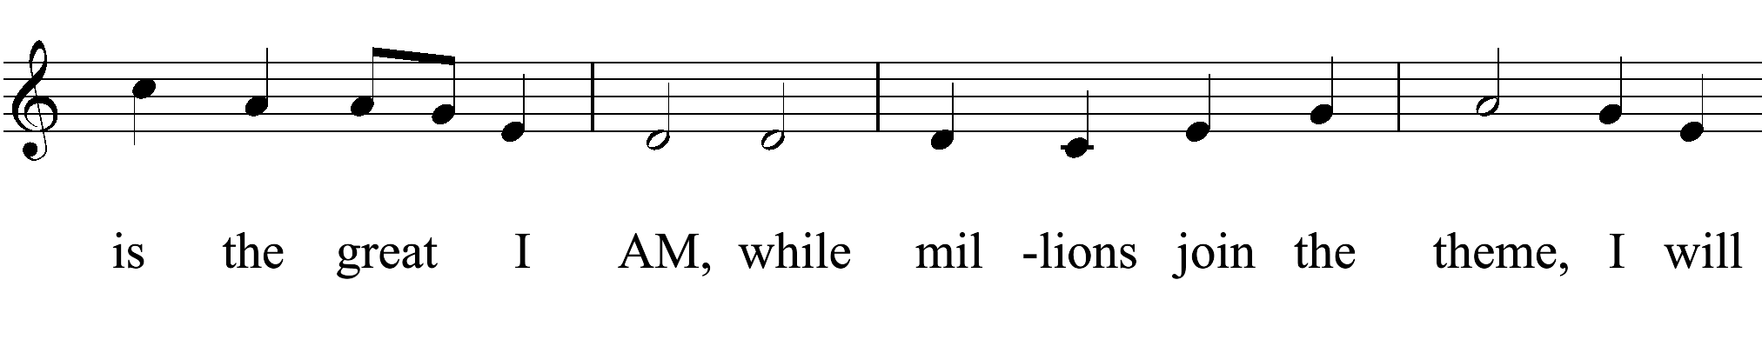
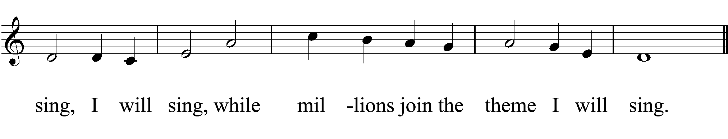

Slide 38
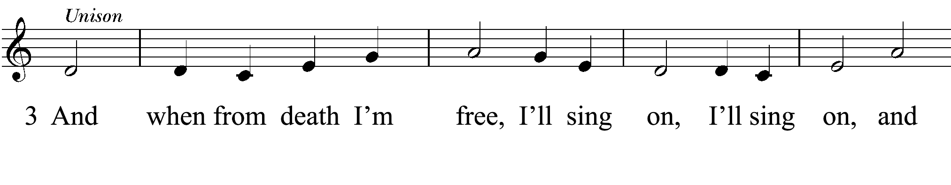
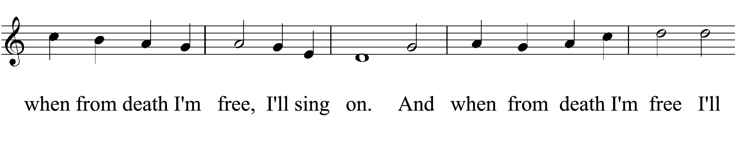

Slide 39
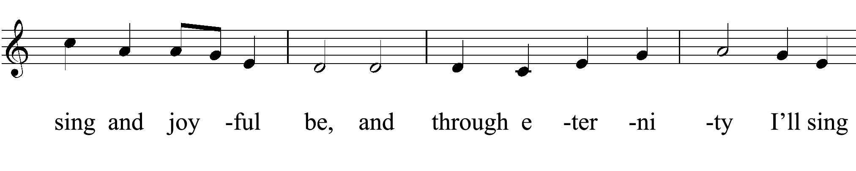
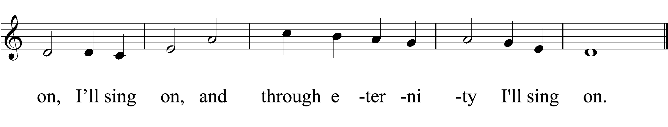

Slide 40
GOSPEL: Luke 15:1-10
All Stand.
Deacon The Holy Gospel of our Lord Jesus Christ according to Luke.
People Glory to you, Lord Christ.

Slide 41
¹Now all the tax collectors and sinners were coming near to listen to [Jesus.] ²And the Pharisees and the scribes were grumbling and saying, “This fellow welcomes sinners and eats with them.”
³So he told them this parable: ⁴“Which one of you, having a hundred sheep and losing one of them, does not leave the ninety-nine in the wilderness and go after the one that is lost until he finds it? ⁵When he has found it, he lays it on his shoulders and rejoices.

Slide 42
⁶And when he comes home, he calls together his friends and neighbors, saying to them, ‘Rejoice with me, for I have found my sheep that was lost.’ ⁷Just so, I tell you, there will be more joy in heaven over one sinner who repents than over ninety-nine righteous persons who need no repentance.
⁸“Or what woman having ten silver coins, if she loses one of them, does not light a lamp, sweep the house, and search carefully until she finds it?

Slide 43
⁹When she has found it, she calls together her friends and neighbors, saying, ‘Rejoice with me, for I have found the coin that I had lost.’ ¹⁰Just so, I tell you, there is joy in the presence of the angels of God over one sinner who repents.”

Slide 44
Deacon The Gospel of the Lord.
People Praise to you, Lord Christ.

Slide 45
THE HOMILY
The Rev. Dr. Mark D. Story

Slide 46
The Nicene Creed
All stand
We believe in one God,
the Father, the Almighty,
maker of heaven and earth,
of all that is, seen and unseen.
We believe in one Lord, Jesus Christ,
the only Son of God,
eternally begotten of the Father,
God from God, Light from Light,
true God from true God,

Slide 47
true God from true God,
begotten, not made,
of one Being with the Father.
Through him all things were made.
For us and for our salvation
he came down from heaven:
by the power of the Holy Spirit
he became incarnate from the Virgin Mary,
and was made man.

Slide 48
For our sake he was crucified under Pontius Pilate;
he suffered death and was buried.
On the third day he rose again
in accordance with the Scriptures;
he ascended into heaven
and is seated at the right hand of the Father.
He will come again in glory to judge the living and the dead,
and his kingdom will have no end.

Slide 49
We believe in the Holy Spirit, the Lord, the giver of life,
who proceeds from the Father and the Son.
With the Father and the Son he is worshiped and glorified.
He has spoken through the Prophets.
We believe in one holy catholic and apostolic Church.

Slide 50
We acknowledge one baptism for the forgiveness of sins.
We look for the resurrection of the dead,
and the life of the world to come.
Amen.

Slide 51
The Prayers of the People
All remain standing.
Let us pray for the Church and for the world.
Grant, Almighty God, that all who confess your Name may be united in your truth, live together in your love, and reveal your glory in the world.
Silence

Slide 52
Lord, in your mercy
Hear our prayer.
Guide the people of this land, and of all the nations, in the ways of justice and peace; that we may honor one another and serve the common good.
Silence

Slide 53
Lord, in your mercy
Hear our prayer.
Give us all a reverence for the earth as your own creation, that we may use its resources rightly in the service of others and to your honor and glory.
Silence

Slide 54
Lord, in your mercy
Hear our prayer.
Bless all whose lives are closely linked with ours, and grant that we may use its resources rightly in the service of others and to your honor and glory.
Silence

Slide 55
Lord, in your mercy
Hear our prayer.
Comfort and heal all those who suffer in body, mind, or spirit; give them courage and hope in their troubles, and bring them the joy of your salvation.
Silence

Slide 56
Lord, in your mercy
Hear our prayer.
We commend to your mercy all who have died, that your will for them may be fulfilled; and we pray that we may share with all your saints in your eternal kingdom.
Silence

Slide 57
Lord, in your mercy
Hear our prayer.
The Celebrant adds a concluding Collect.

Slide 58
Confession of Sin
The Deacon or Celebrant says
Let us confess our sins against God and our neighbor.
Silence may be kept.

Slide 59
Minister and People
God of all mercy,
we confess that we have sinned against you,
opposing your will in our lives.
We have denied your goodness in each other,
in ourselves, and in the world you have created.

Slide 60
We repent of the evil that enslaves us,
the evil we have done,
and the evil done on our behalf.
Forgive, restore, and strengthen us
through our Savior Jesus Christ,
that we may abide in your love
and serve only your will. Amen.

Slide 61
The Priest stands and says
Almighty God have mercy on you, forgive you all your sins through our Lord Jesus Christ, strengthen you in all goodness, and by the power of the Holy Spirit keep you in eternal life. Amen.

Slide 62
THE PEACE
All stand.
Celebrant The peace of the Lord be always with you.
People And also with you.
Then the Ministers and the People may greet one another in the name of the Lord.

Slide 63
The Holy Communion
OFFERTORY SENTENCE and OFFERTORY
Simple Gifts
Traditional Shaker Song
arr. Robert Lehman

Slide 64
'Tis the gift to be simple, 'tis the gift to be free,
'Tis the gift to come down where we ought to be;
And when we find ourselves in the place just right,
'Twill be in the valley of love and delight.
When true simplicity is gained,
To bow and to bend we shan't be ashamed;
to turn, turn, will be our delight.
Till by turning, turning we come round right.

Slide 65
Doxology
Praise God, from whom all blessings flow;
praise him, all creatures here below;
praise him above, ye heavenly host:
praise Father, Son, and Holy Ghost.

Slide 66
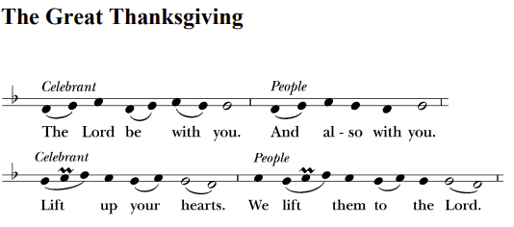
The people remain standing (S 120)

Slide 67
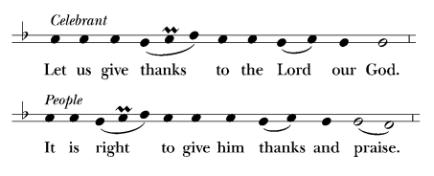

Slide 68
Facing the Holy Table, the Celebrant proceeds
It is right, and a good and joyful thing, always and everywhere to give thanks to you, Father Almighty, Creator of heaven and earth.
Through Jesus Christ our Lord; who on the first day of the week overcame death and the grave, and by his glorious resurrection opened to us the way of everlasting life.

Slide 69
Therefore we praise you, joining our voices with Angels and Archangels and with all the company of heaven, who for ever sing this hymn to proclaim the glory of your Name:

Slide 70
SANCTUS Holy, holy, holy (S 129)
Celebrant and People
Holy, holy, holy Lord, God of power and might,
heaven and earth are full of your glory.
Hosanna in the highest.
Blessed is he who comes in the name of the Lord.
Hosanna in the highest.

Slide 71
The People stand or kneel.
The Celebrant continues
Holy and gracious Father: In your infinite love you made us for yourself; and, when we had fallen into sin and become subject to evil and death, you, in your mercy, sent Jesus Christ, your only and eternal Son, to share our human nature, to live and die as one of us, to reconcile us to you, the God and Father of all.

Slide 72
He stretched out his arms upon the cross, and offered himself in obedience to your will, a perfect sacrifice for the whole world.
On the night he was handed over to suffering and death, our Lord Jesus Christ took bread; and when he had given thanks to you, he broke it, and gave it to his disciples, and said, “Take, eat: This is my Body, which is given for you. Do this for the remembrance of me.”

Slide 73
After supper he took the cup of wine; and when he had given thanks, he gave it to them, and said, “Drink this, all of you: This is my Blood of the new Covenant, which is shed for you and for many for the forgiveness of sins. Whenever you drink it, do this for the remembrance of me.”

Slide 74
Therefore we proclaim the mystery of faith:
Celebrant and People
Christ has died.
Christ is risen.
Christ will come again.

Slide 75
The Celebrant continues
We celebrate the memorial of our redemption, O Father, in this sacrifice of praise and thanksgiving. Recalling his death, resurrection, and ascension, we offer you these gifts.

Slide 76
Sanctify them by your Holy Spirit to be for your people the Body and Blood of your Son, the holy food and drink of new and unending life in him. Sanctify us also that we may faithfully receive this holy Sacrament, and serve you in unity, constancy, and peace; and at the last day bring us with all your saints into the joy of your eternal kingdom.

Slide 77
All this we ask through your Son Jesus Christ. By him, and with him, and in him, in the unity of the Holy Spirit all honor and glory is yours, Almighty Father, now and for ever. AMEN.

Slide 78
THE LORD’S PRAYER
And now as our Savior Christ has taught us, we are bold to say,
People and Celebrant
Our Father, who art in heaven,
hallowed be thy Name,
thy kingdom come,
thy will be done, on earth as it is in heaven.

Slide 79
Give us this day our daily bread.
And forgive us our trespasses,
as we forgive those who trespass against us.
And lead us not into temptation,
but deliver us from evil.
For thine is the kingdom,
and the power, and the glory,
forever and ever. Amen.

Slide 80
The Breaking of the Bread
S154 Christ our Passover (Hurd)

Slide 82
INVITATION
The Celebrant says
The Gifts of God for the People of God.

Slide 83
Pre-Communion Hymn
In your mercy, Lord, you called me
(H 706)

Slide 84
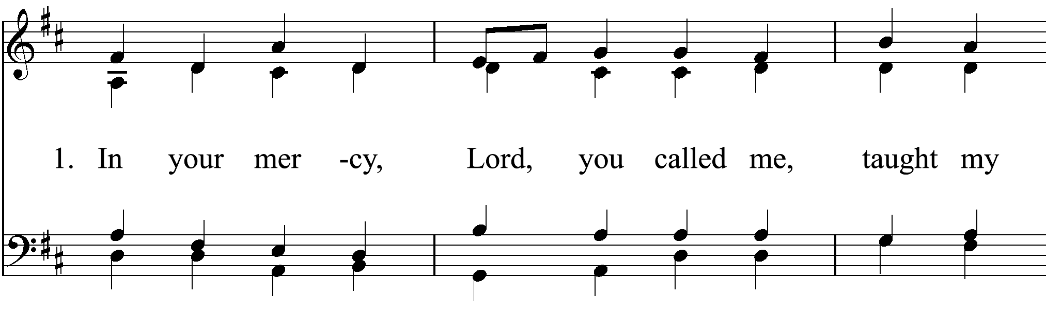

Slide 85
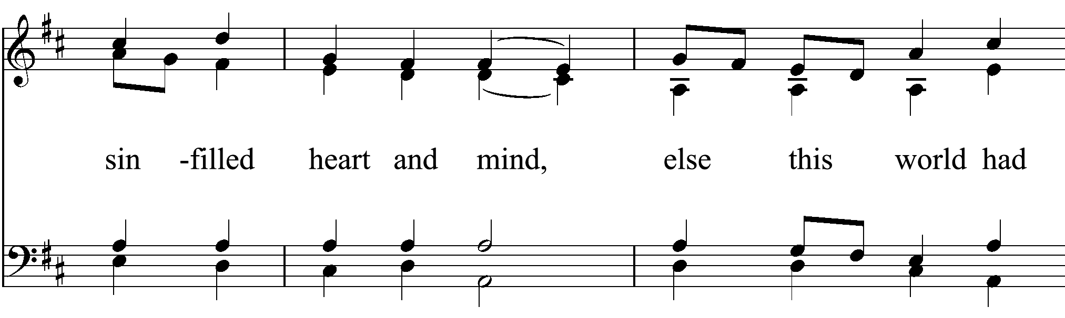

Slide 86
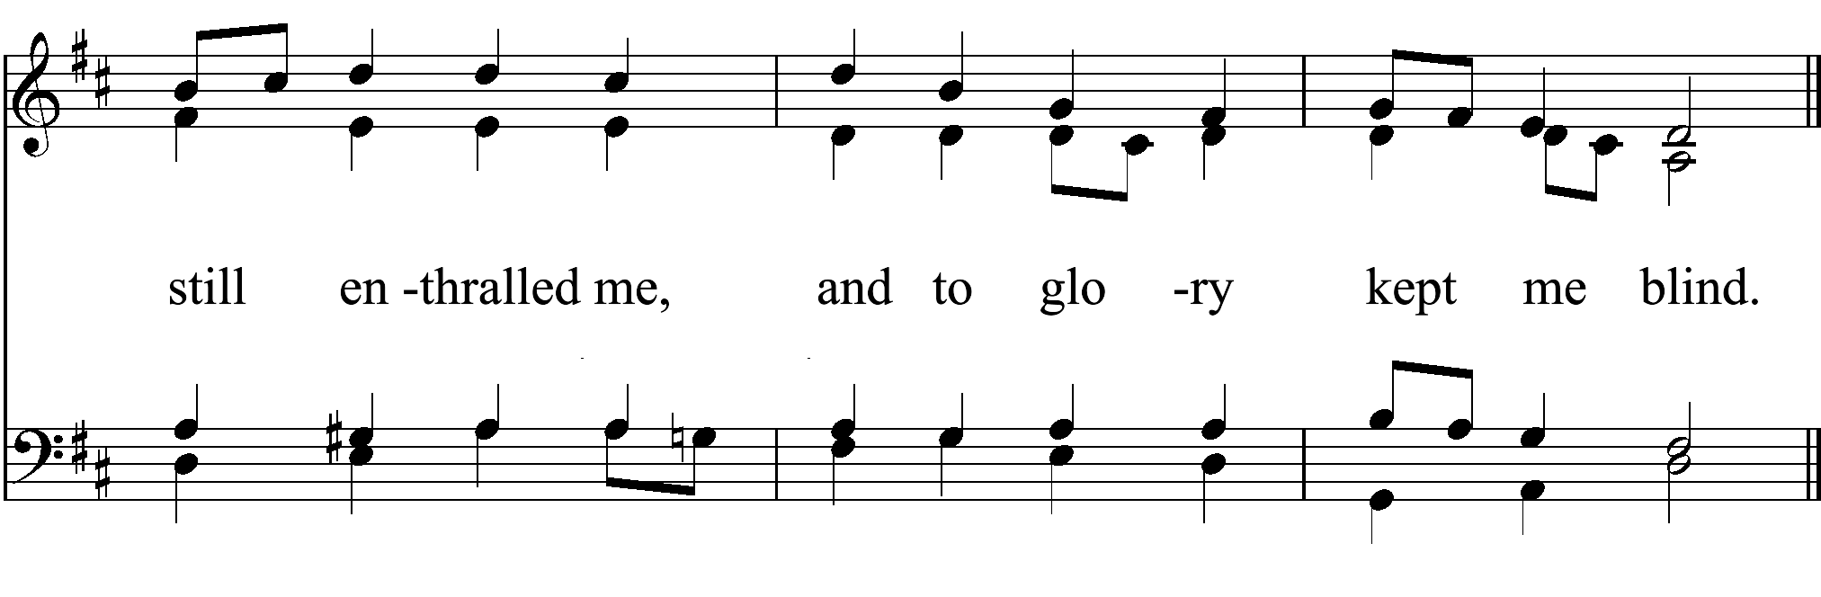

Slide 87
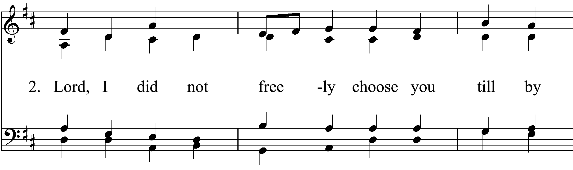

Slide 88
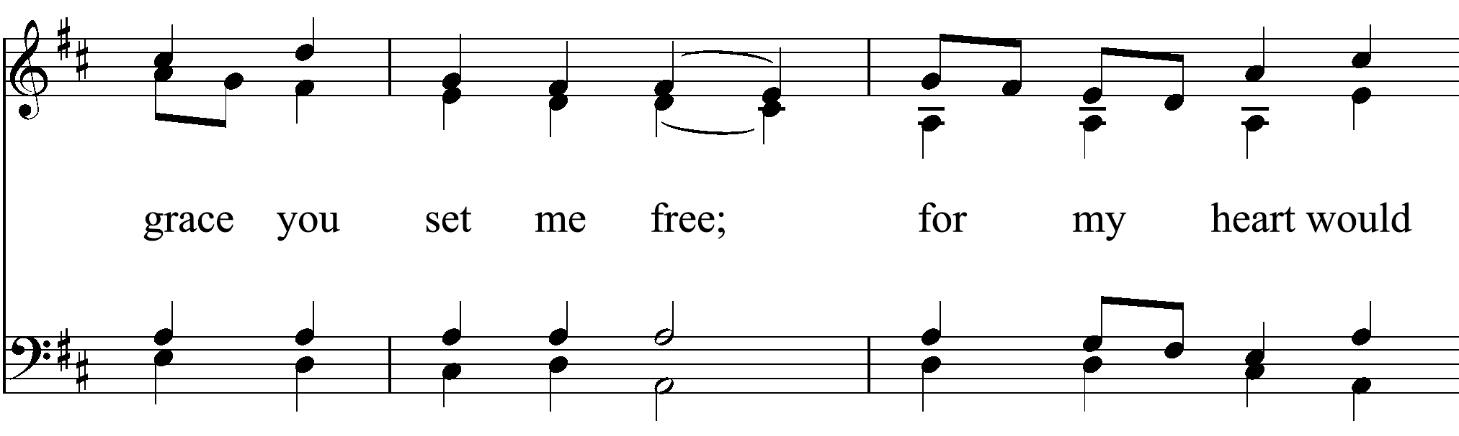

Slide 89
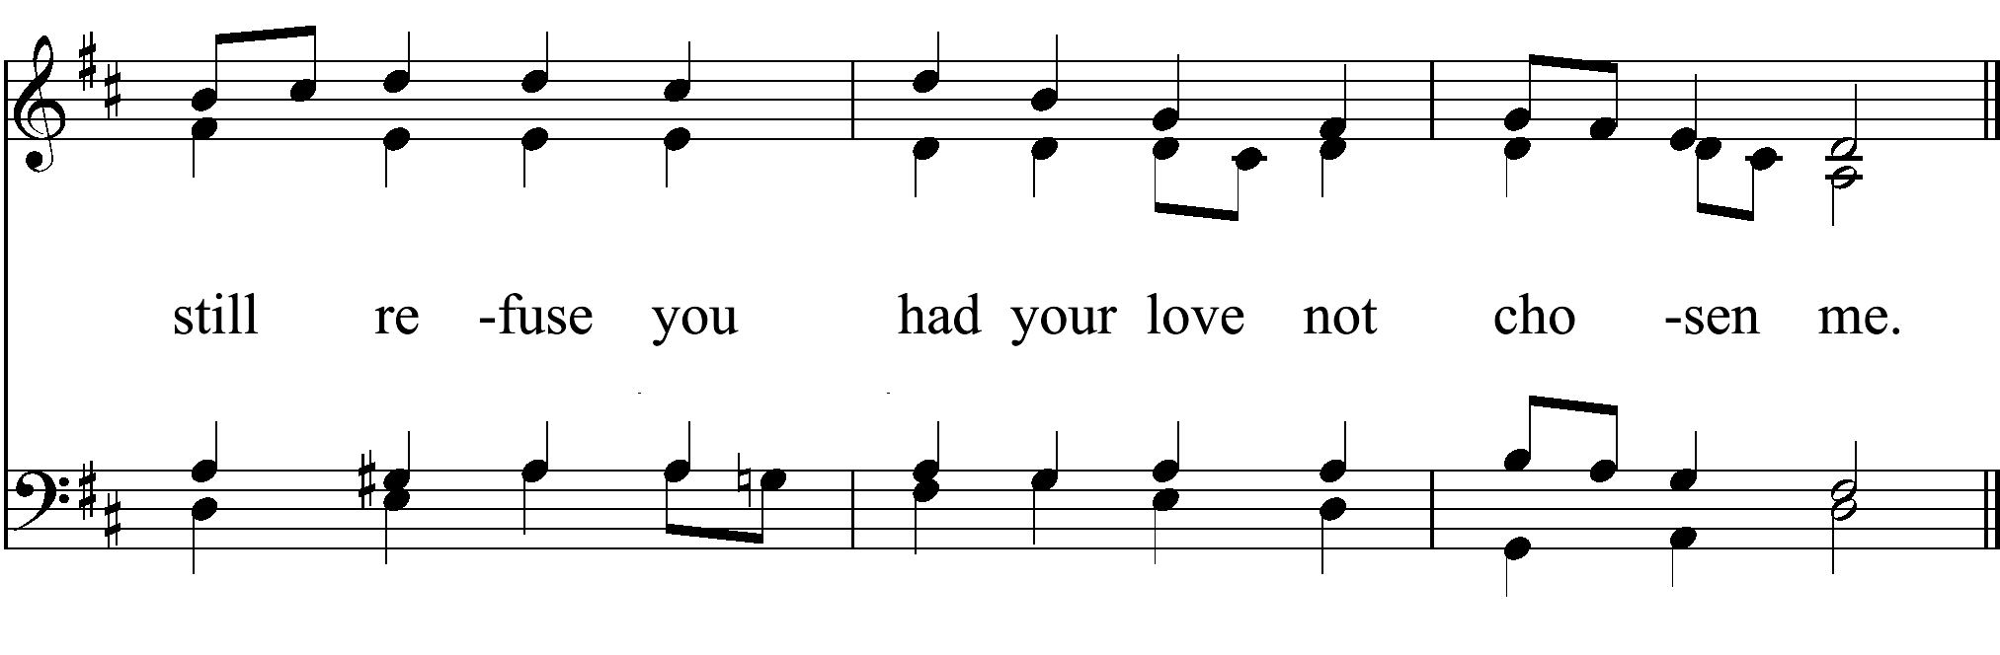

Slide 90
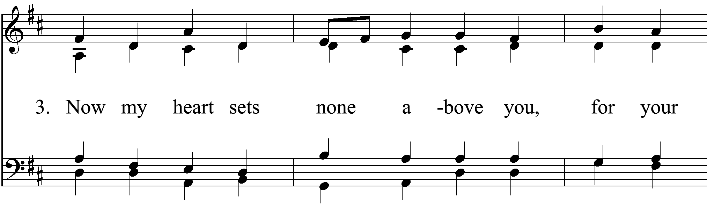

Slide 91
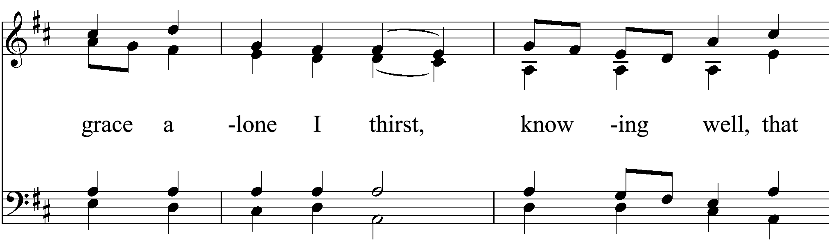

Slide 92
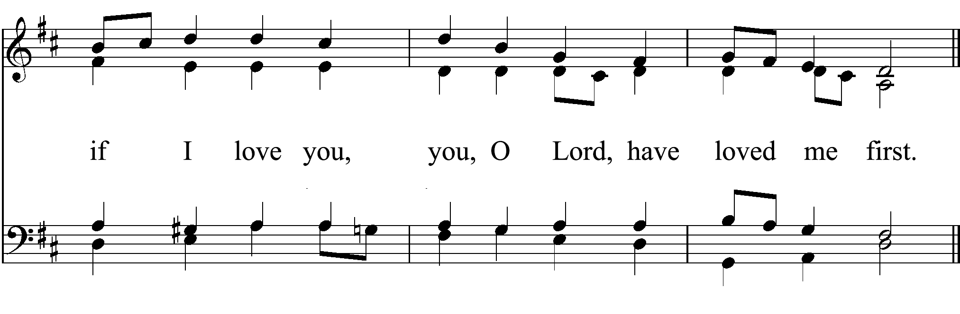

Slide 93
POST-COMMUNION PRAYER
After Communion, the Celebrant says
Let us pray.
Celebrant and People
Eternal God, heavenly Father,
you have graciously accepted us as living members of your Son our Savior Jesus Christ,
and you have fed us with spiritual food
in the Sacrament of his Body and Blood.

Slide 94
Send us now into the world in peace,
and grant us strength and courage
to love and serve you
with gladness and singleness of heart;
through Christ our Lord. Amen.

Slide 95
Anniversaries
Watch over thy child, O Lord, as his days increase; bless and guide him wherever he may be. Strengthen him when he stands; comfort him when discouraged or sorrowful; raise him up if he fall; and in his heart may thy peace which passeth understanding abide all the days of his life;
through Jesus Christ our Lord. Amen.
BLESSING
The Priest blesses the people

Slide 96
Recessional Hymn
Glorious things of thee are spoken
(H 523)

Slide 97
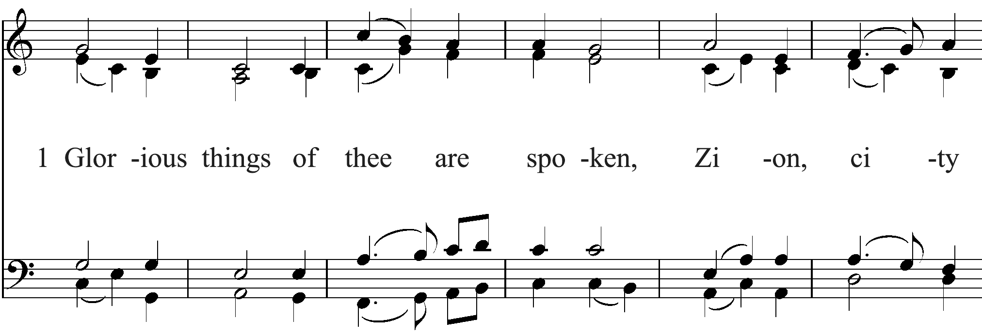

Slide 98
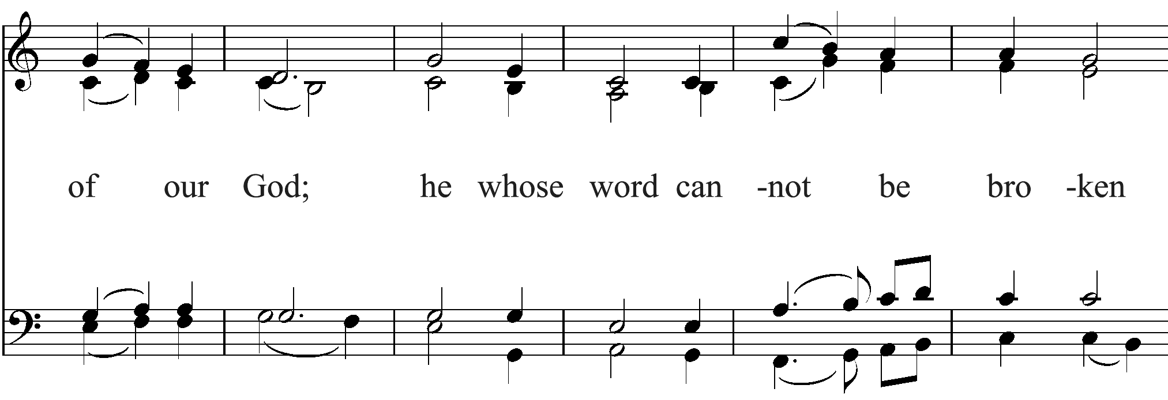

Slide 99
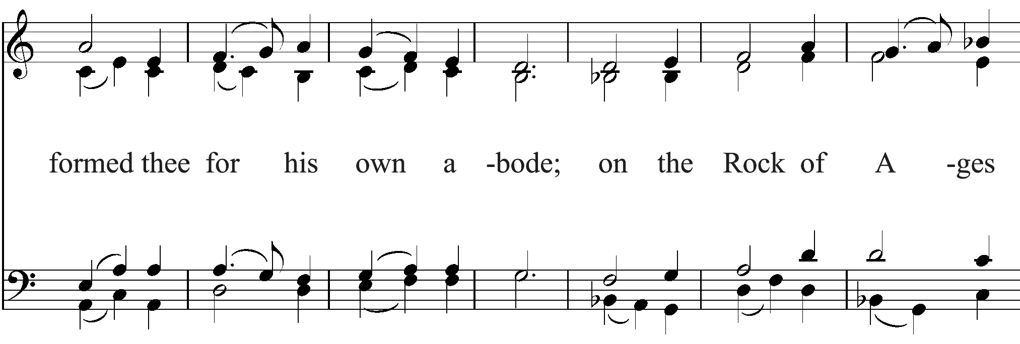

Slide 100
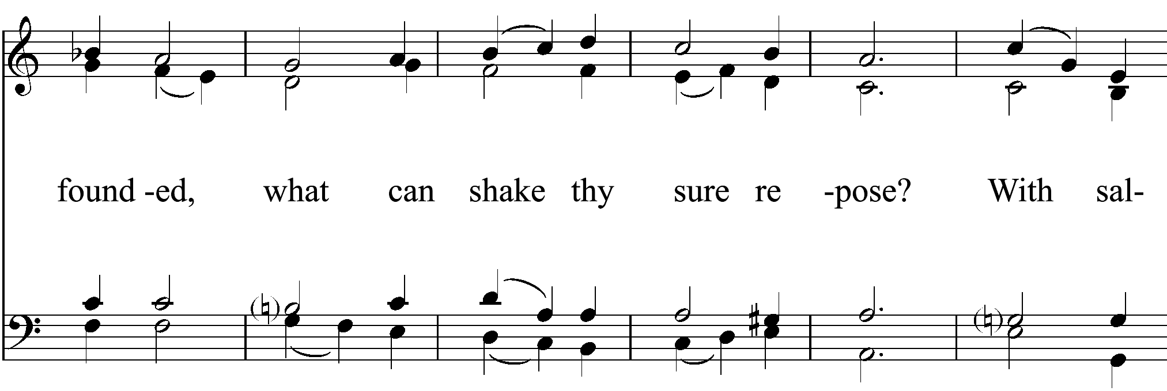

Slide 101
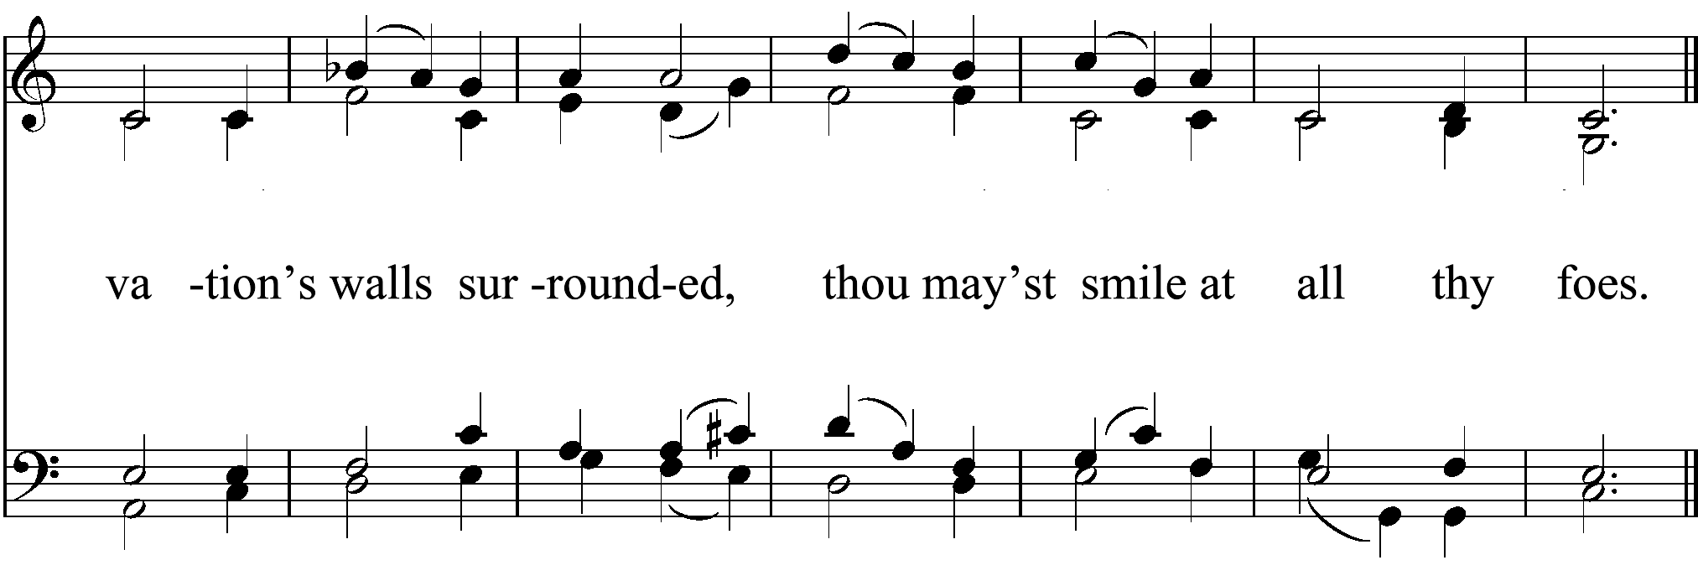

Slide 102
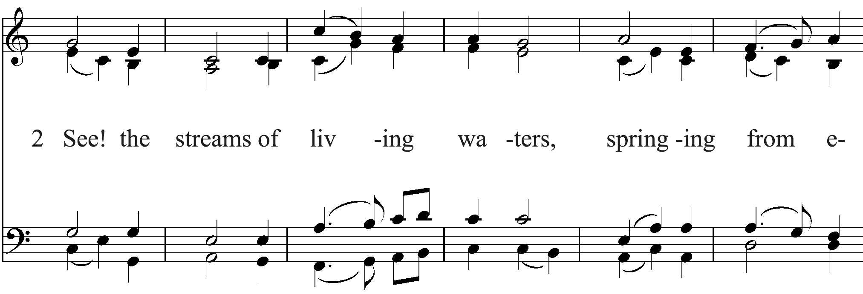

Slide 103
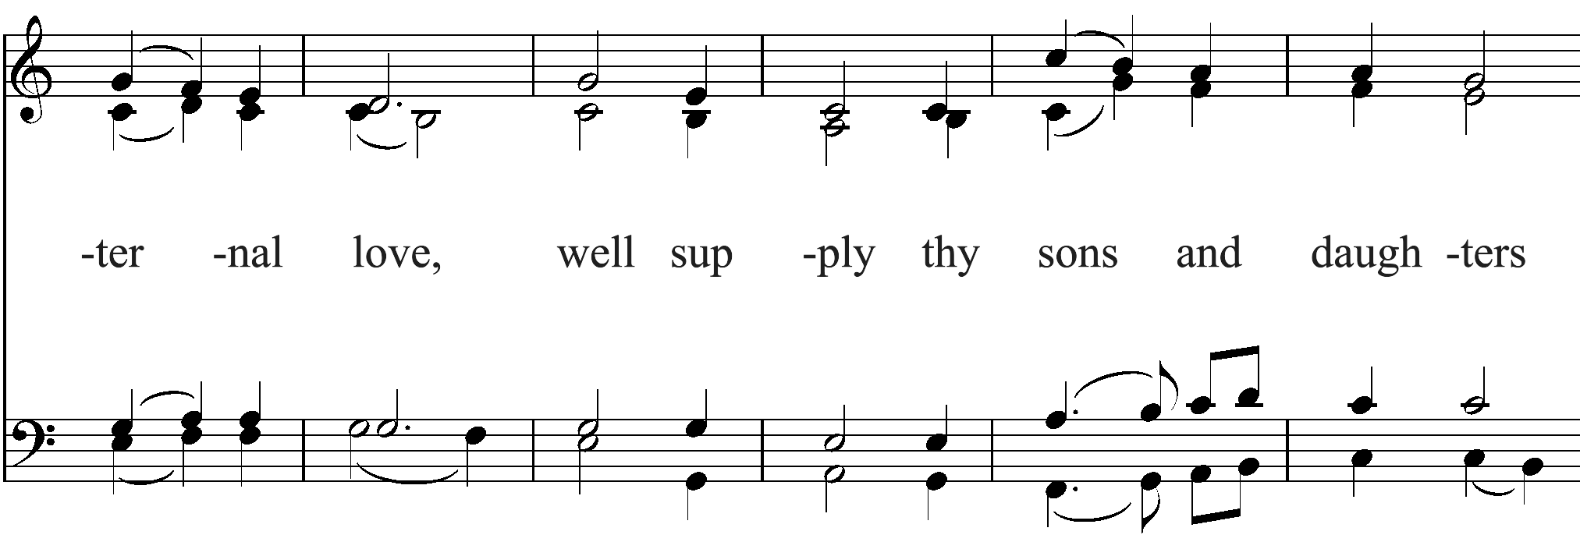

Slide 104
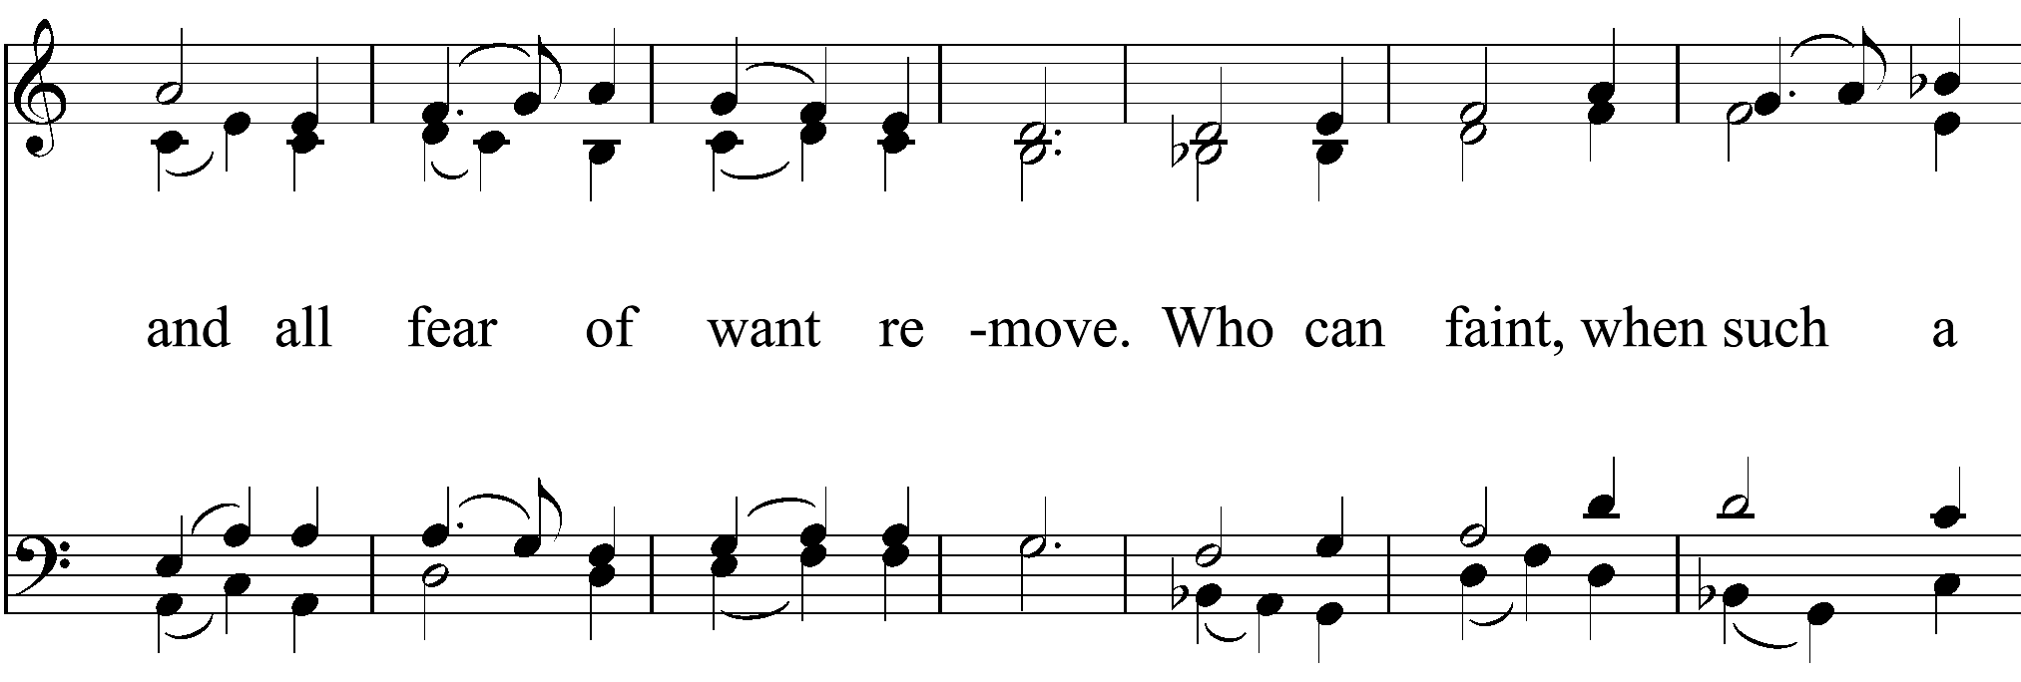

Slide 105
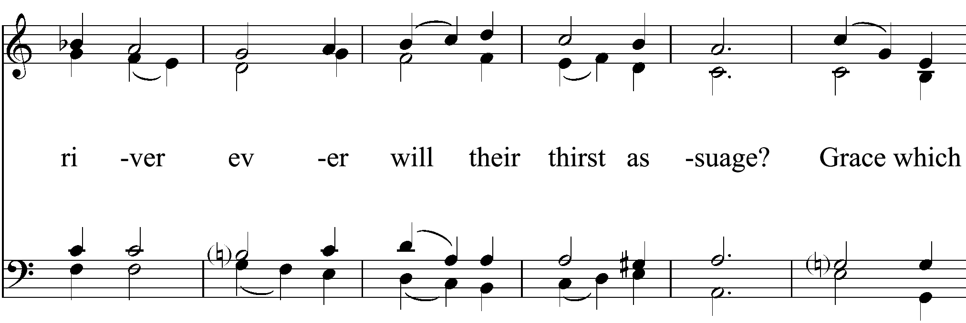

Slide 106
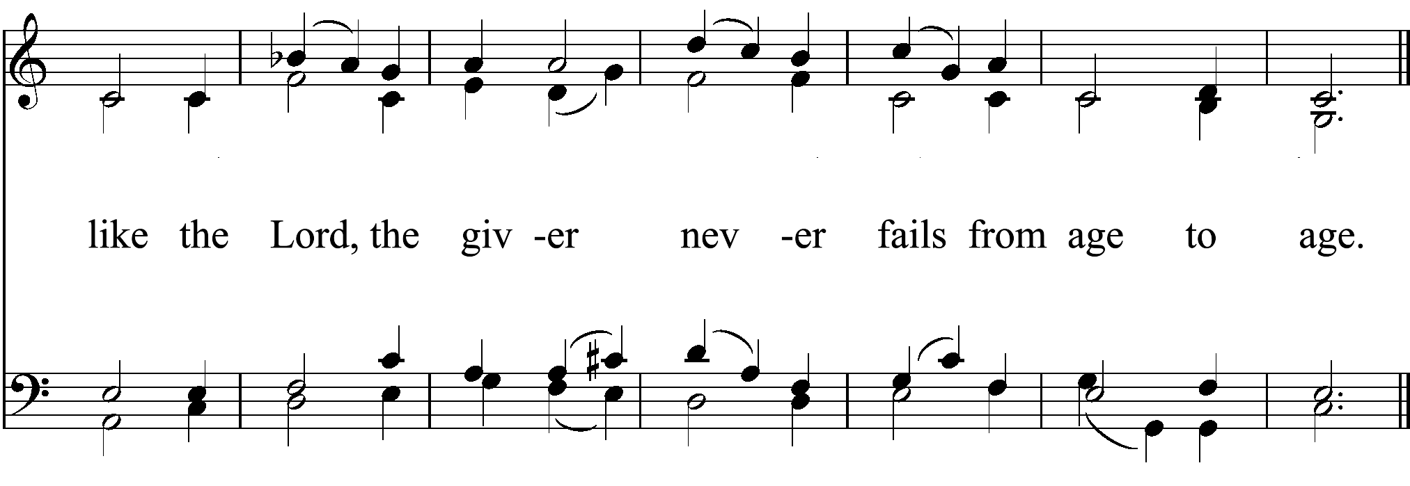

Slide 107
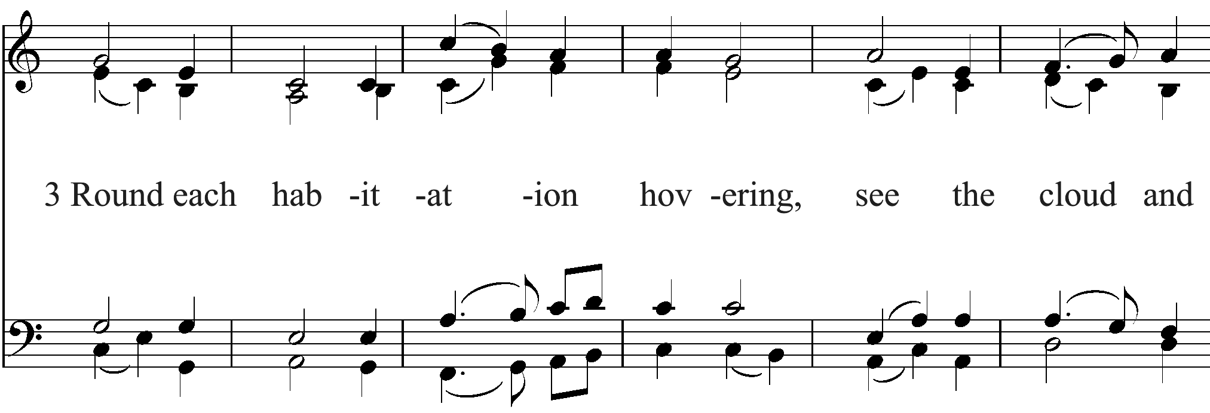

Slide 108
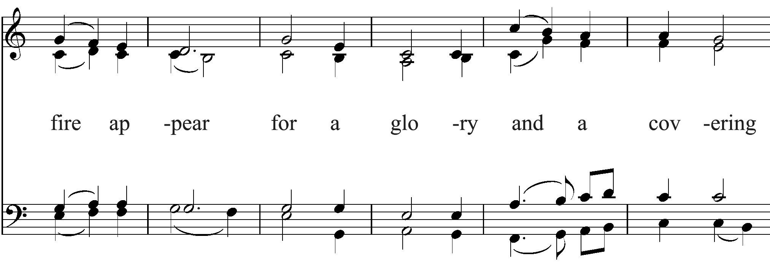

Slide 109
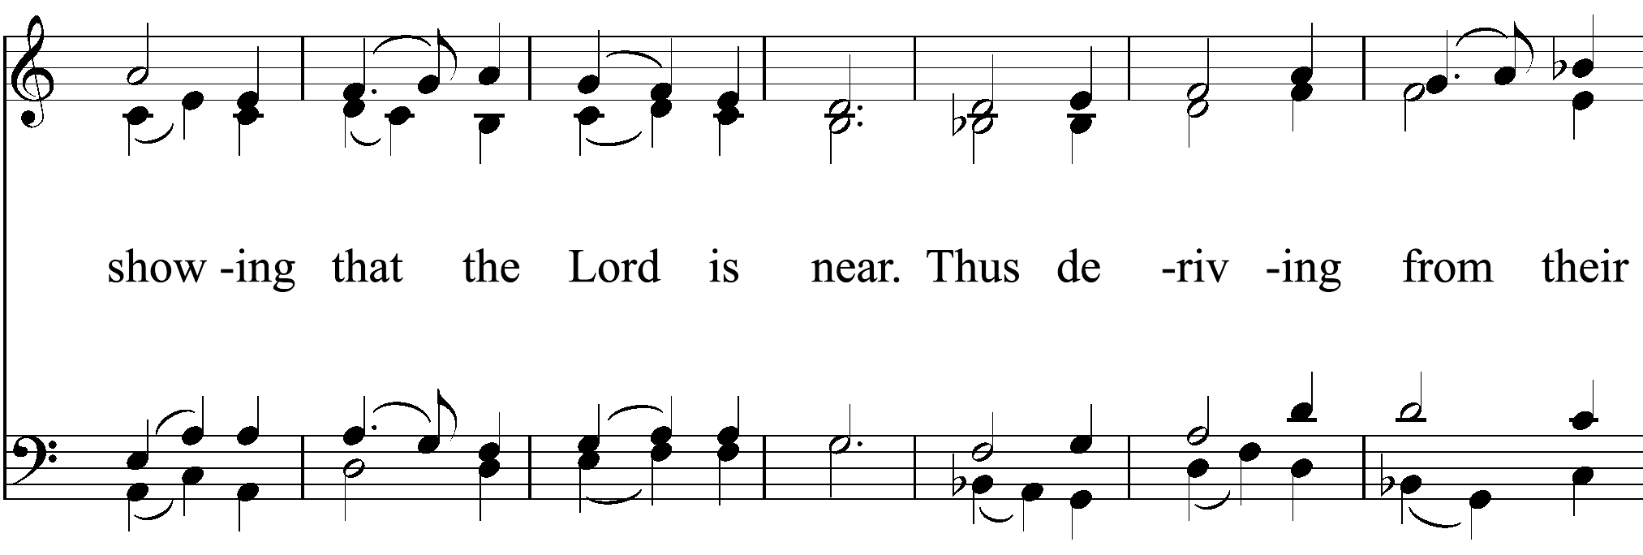

Slide 110
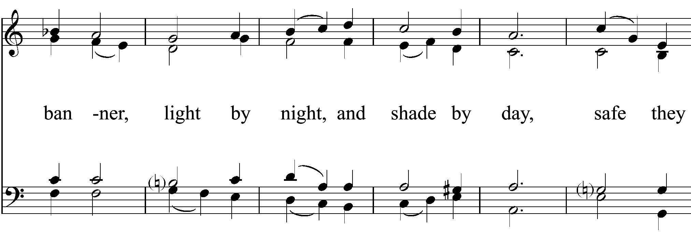

Slide 111
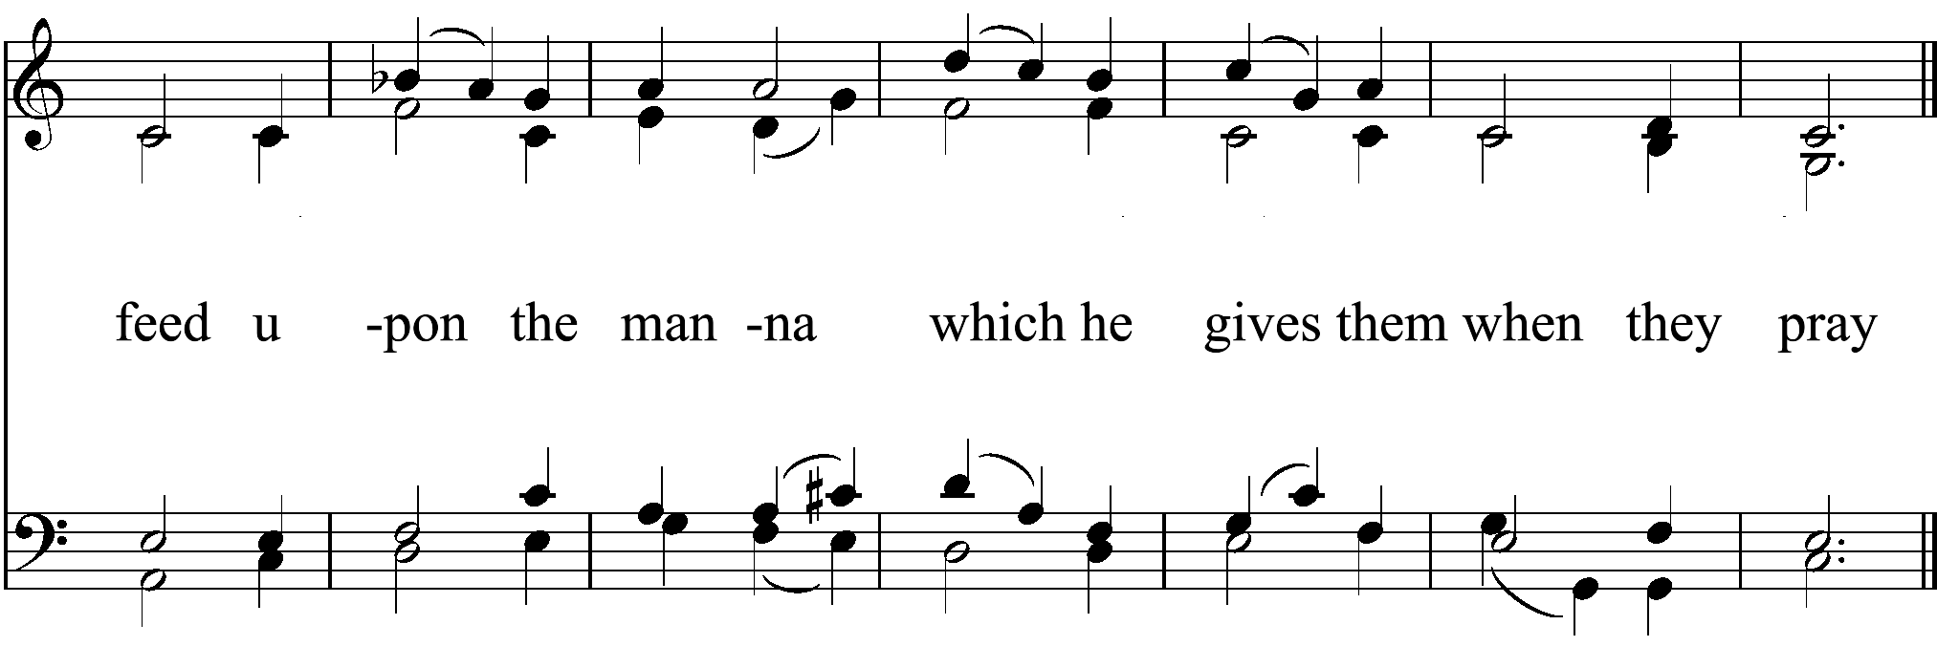

Slide 112


Slide 113


Slide 114


Slide 115


Slide 116


Slide 117
DISMISSAL
Let us go forth in the name of Christ.
People Thanks be to God.

Slide 118
POSTLUDE
Verses from the Te Deum
Anonymous

