Slide 1



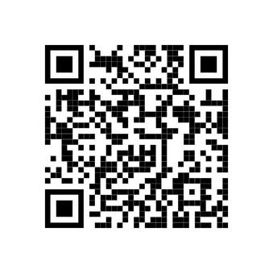



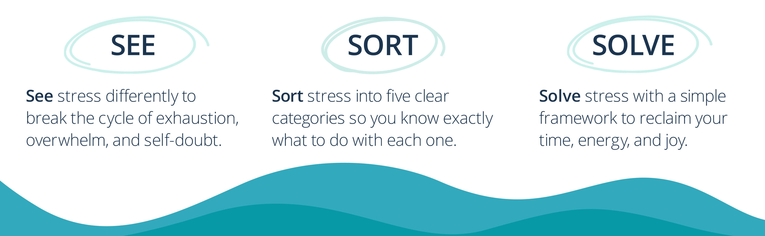

Slide 2
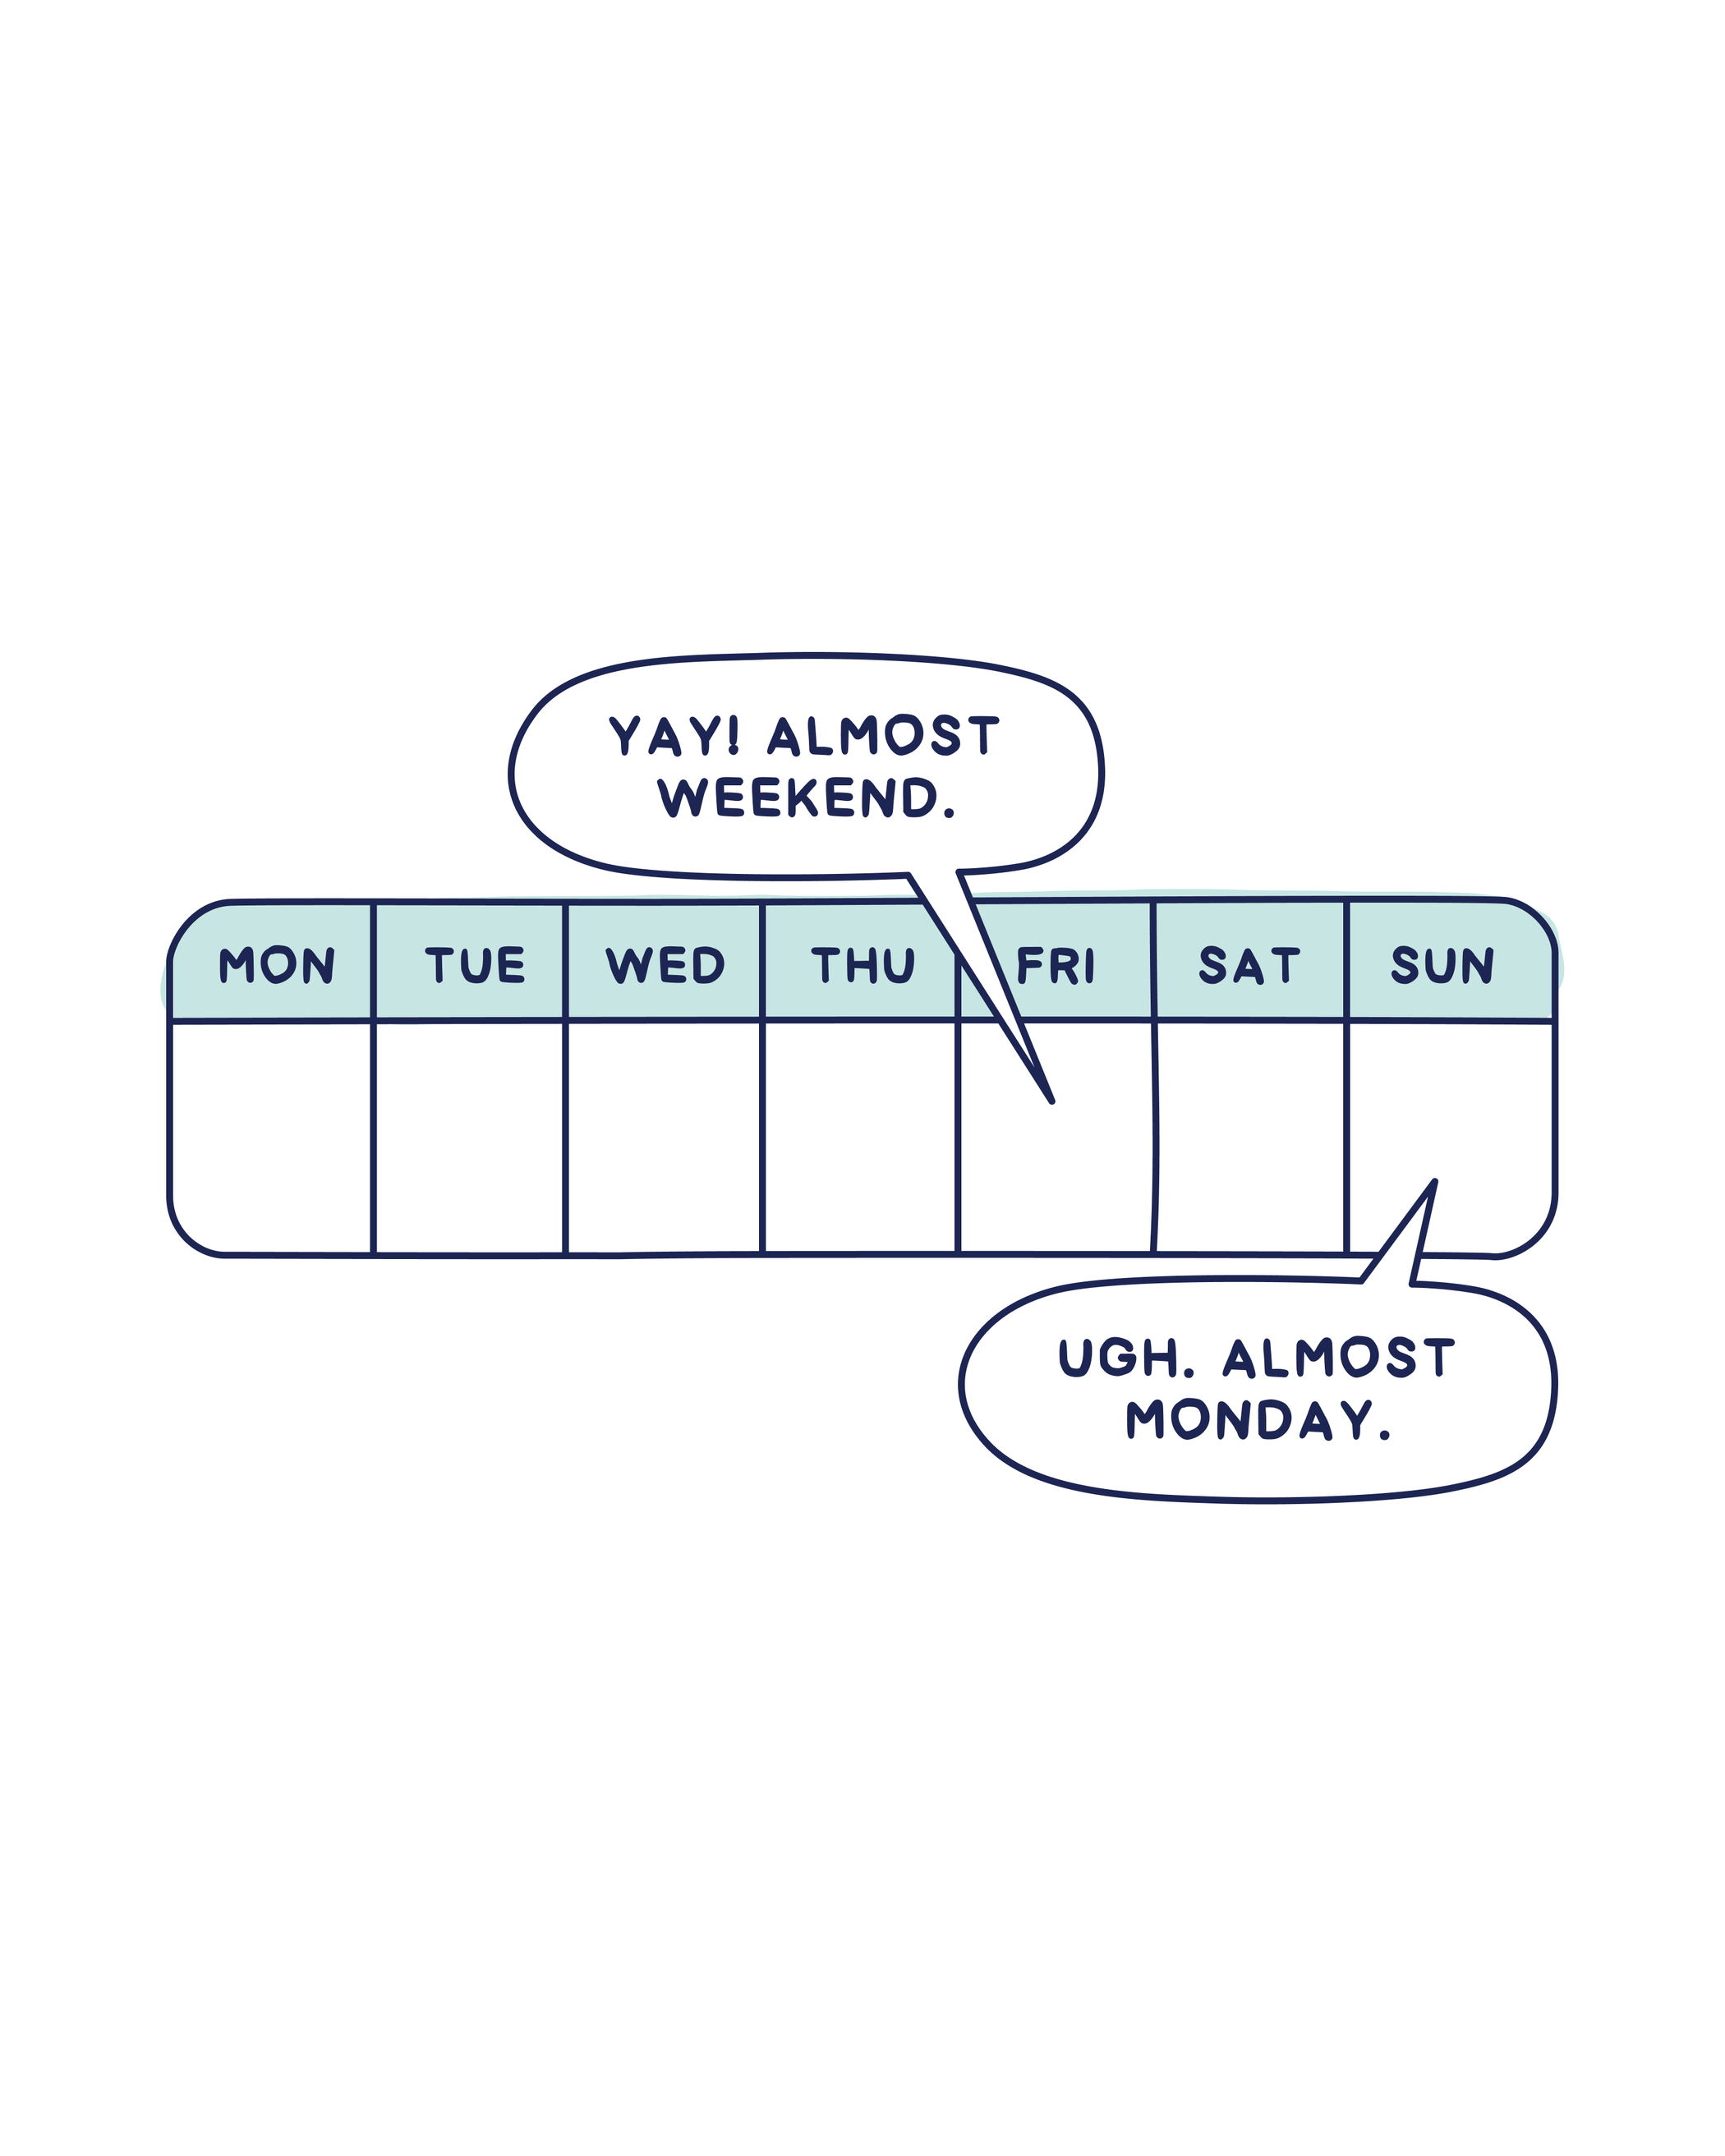

Source: Cheers to Monday, Amy Leneker (Wiley, 2026)
The Center for Joyful Work
AmyLeneker.com

Slide 3

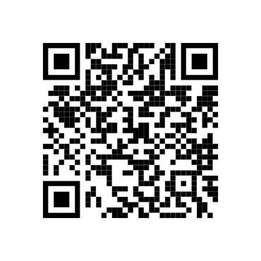


Slide 4

A hard truth—and a hopeful one.
The Center for Joyful Work
AmyLeneker.com

Slide 5

Stress is undermining success;
is part of the solution.
JOY
The Center for Joyful Work
AmyLeneker.com

Slide 6

Outside of work,
what’s one good thing
in your life right now?
The Center for Joyful Work
AmyLeneker.com

Slide 7

The Center for Joyful Work
AmyLeneker.com

Slide 8
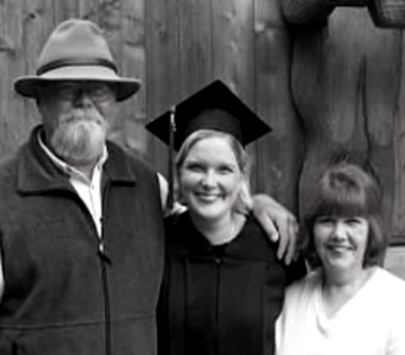
The Center for Joyful Work
AmyLeneker.com

Slide 9
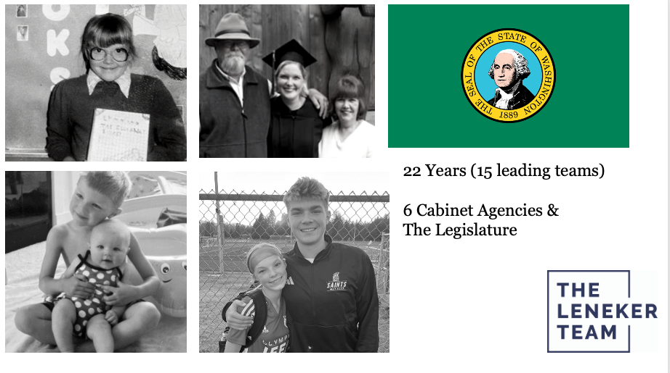
The Center for Joyful Work
AmyLeneker.com

Slide 10
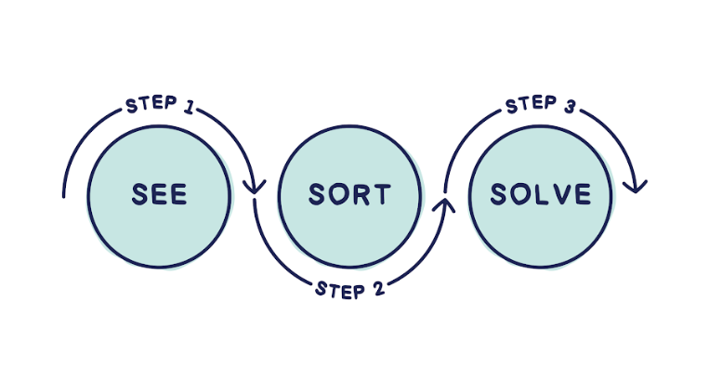
Source: Cheers to Monday, Amy Leneker (Wiley, 2026)
The Center for Joyful Work
AmyLeneker.com

Slide 11
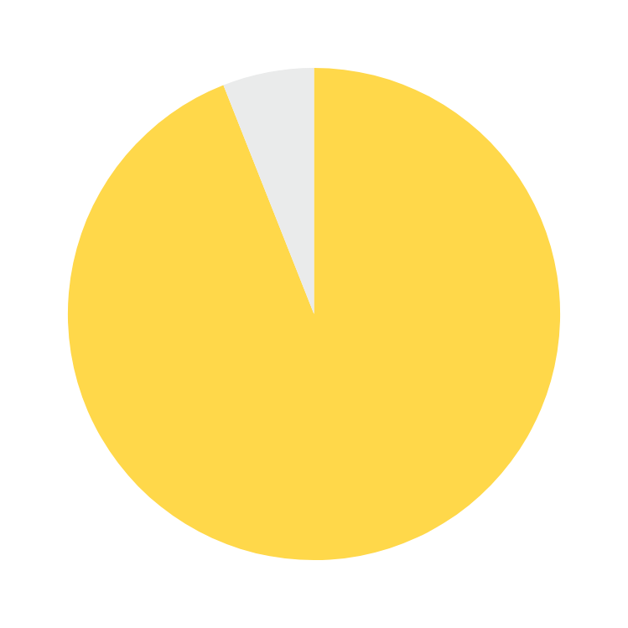
94% of working Americans found
The Un-Stressing Method™ effective
94%
Source: The Center for Generational Kinetics, 2026
The Center for Joyful Work
AmyLeneker.com

Slide 12

Source: Cheers to Monday, Amy Leneker (Wiley, 2026)
The Center for Joyful Work
AmyLeneker.com

Slide 13
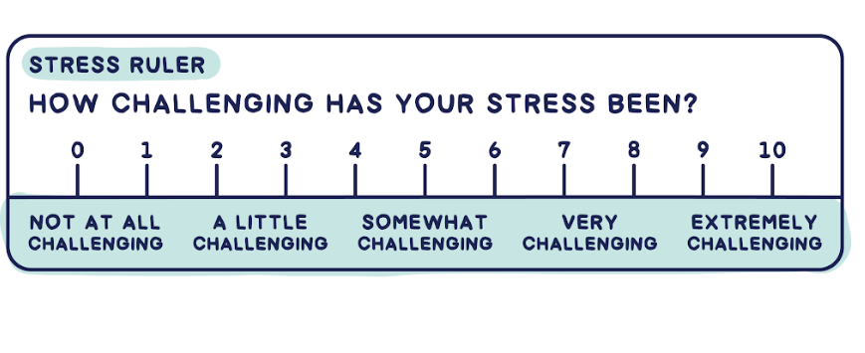
Source: Cheers to Monday, Amy Leneker (Wiley, 2026)
The Center for Joyful Work
AmyLeneker.com

Slide 14
Share:
What was your number and why?
Source: Cheers to Monday, Amy Leneker (Wiley, 2026)
The Center for Joyful Work
AmyLeneker.com

Slide 15
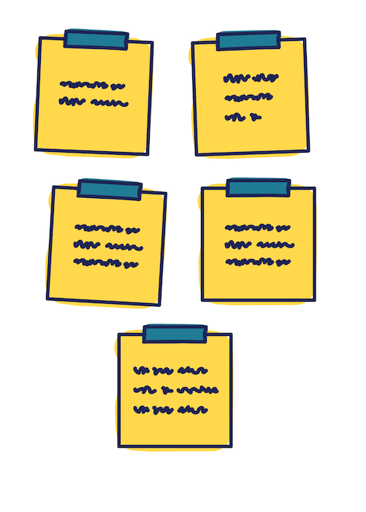
Write down your stressors -
one per note
Source: Cheers to Monday, Amy Leneker (Wiley, 2026)
The Center for Joyful Work
AmyLeneker.com

Slide 16
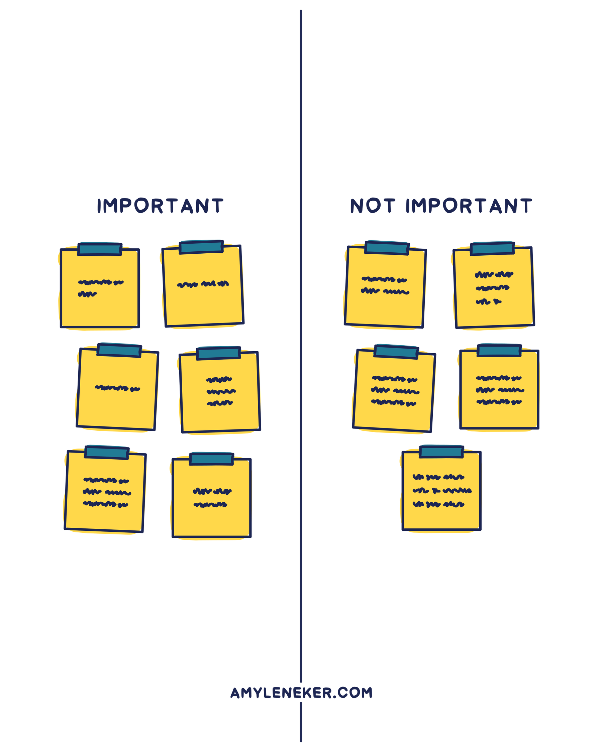
Source: Cheers to Monday, Amy Leneker (Wiley, 2026)
The Center for Joyful Work
AmyLeneker.com

Slide 17
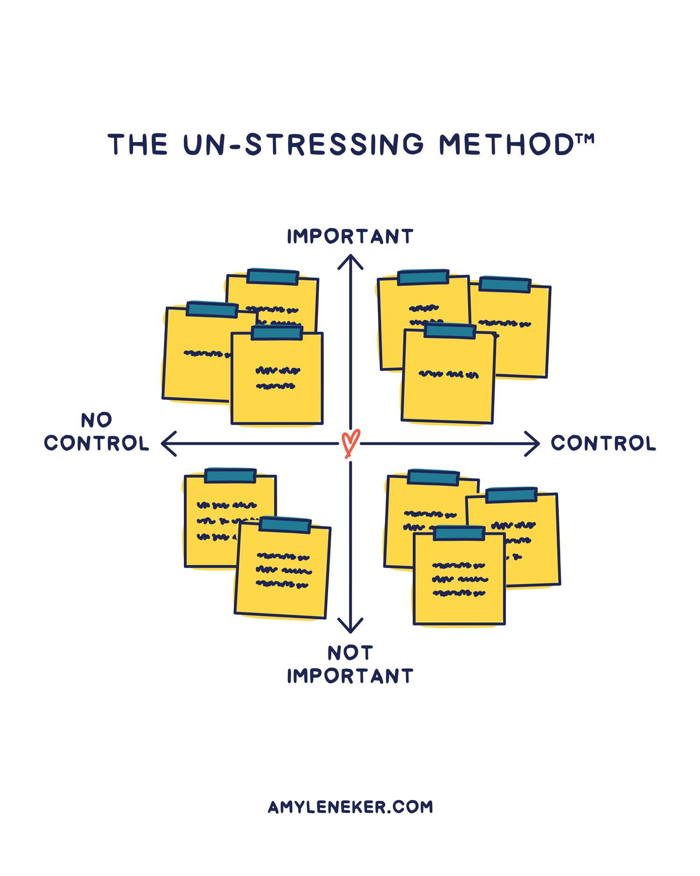
Source: Cheers to Monday, Amy Leneker (Wiley, 2026)
The Center for Joyful Work
AmyLeneker.com

Slide 18
Source: Cheers to Monday, Amy Leneker (Wiley, 2026)
The Center for Joyful Work
AmyLeneker.com

Slide 19
5 Types of Work Stress
Source: Cheers to Monday, Amy Leneker (Wiley, 2026)
The Center for Joyful Work
AmyLeneker.com

Slide 20
5 Types of Work Stress
  Schedule
Source: Cheers to Monday, Amy Leneker (Wiley, 2026)
The Center for Joyful Work
AmyLeneker.com

Slide 21
5 Types of Work Stress
  Schedule
  Suspense
Source: Cheers to Monday, Amy Leneker (Wiley, 2026)
The Center for Joyful Work
AmyLeneker.com

Slide 22
5 Types of Work Stress
  Schedule
  Suspense
  Social
Source: Cheers to Monday, Amy Leneker (Wiley, 2026)
The Center for Joyful Work
AmyLeneker.com

Slide 23
5 Types of Work Stress
  Schedule
  Suspense
  Social
  Sudden
Source: Cheers to Monday, Amy Leneker (Wiley, 2026)
The Center for Joyful Work
AmyLeneker.com

Slide 24

5 Types of Work Stress
  Schedule
  Suspense
  Social
  Sudden
Source: Cheers to Monday, Amy Leneker (Wiley, 2026)
The Center for Joyful Work
AmyLeneker.com

Slide 25
5 Types of Work Stress
  Schedule
  Suspense
  Social
  Sudden
  System
Source: Cheers to Monday, Amy Leneker (Wiley, 2026)
The Center for Joyful Work
AmyLeneker.com

Slide 26
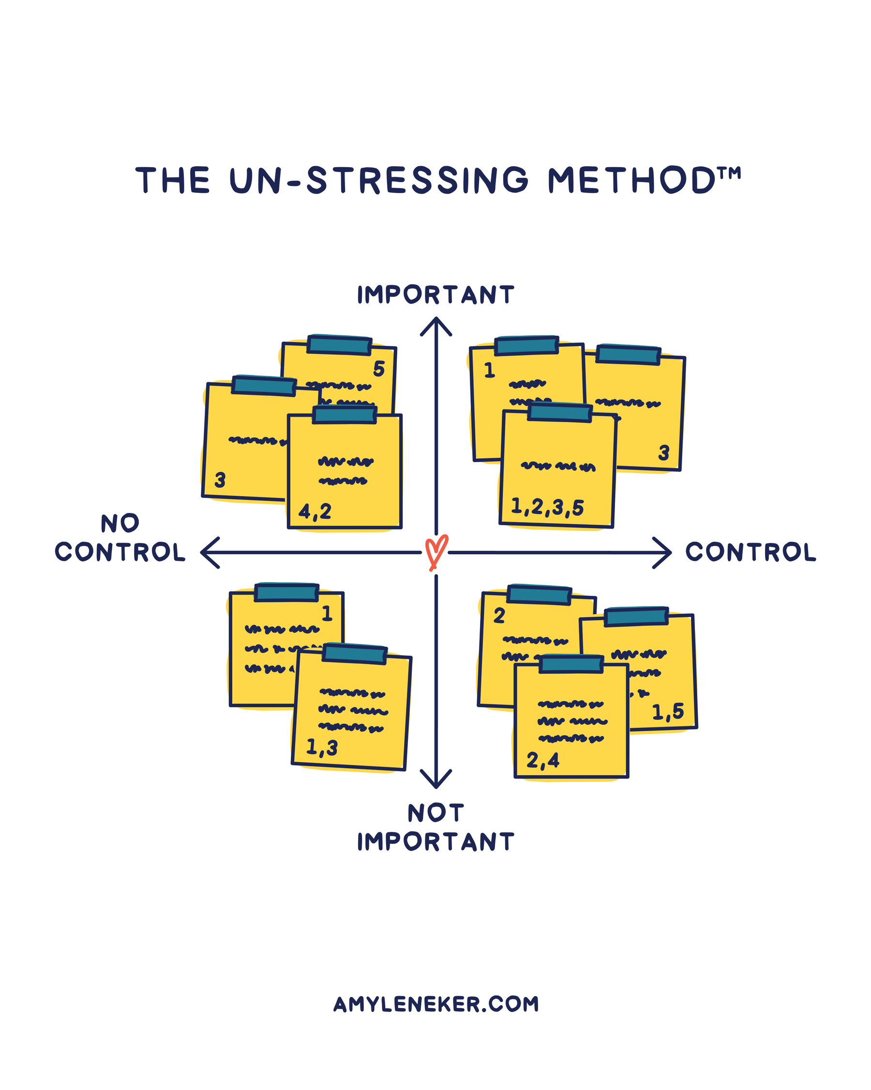
Source: Cheers to Monday, Amy Leneker (Wiley, 2026)
The Center for Joyful Work
AmyLeneker.com

Slide 27
Source: Cheers to Monday, Amy Leneker (Wiley, 2026)
The Center for Joyful Work
AmyLeneker.com

Slide 28
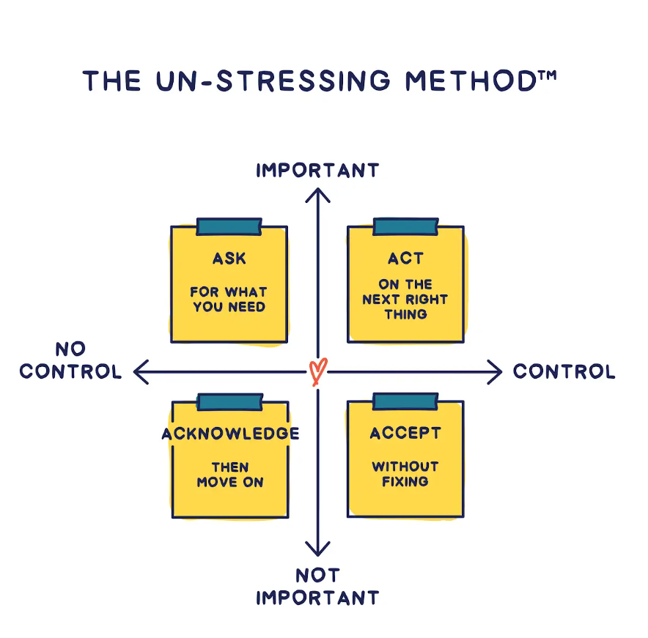
Source: Cheers to Monday, Amy Leneker (Wiley, 2026)
The Center for Joyful Work
AmyLeneker.com

Slide 29
Joy
Source: The State of Stress and Joy at Work, Amy Leneker, 2026.
The Center for Joyful Work
AmyLeneker.com

Slide 30

Meaning
Source: The State of Stress and Joy at Work, Amy Leneker, 2026.
The Center for Joyful Work
AmyLeneker.com

Slide 31
Meaning
Mattering
Source: The State of Stress and Joy at Work, Amy Leneker, 2026.
The Center for Joyful Work
AmyLeneker.com

Slide 32
Meaning
Mattering
Momentum
Source: The State of Stress and Joy at Work, Amy Leneker, 2026.
The Center for Joyful Work
AmyLeneker.com

Slide 33
  Joy helps me cope with stress: 75%
Momentum
Source: The State of Stress and Joy at Work, Amy Leneker, 2026.
The Center for Joyful Work
AmyLeneker.com

Slide 34
  Joy helps me cope with stress: 75%
  I need joy in order to do my best work:
Momentum
Source: The State of Stress and Joy at Work, Amy Leneker, 2026.
The Center for Joyful Work
AmyLeneker.com

Slide 35
  Joy helps me cope with stress: 75%
  I need joy in order to do my best work:
    Employees: 79%
Momentum
Source: The State of Stress and Joy at Work, Amy Leneker, 2026.
The Center for Joyful Work
AmyLeneker.com

Slide 36
  Joy helps me cope with stress: 75%
  I need joy in order to do my best work:
    Employees: 79%
    Executive leaders: 89%
Momentum
Source: The State of Stress and Joy at Work, Amy Leneker, 2026.
The Center for Joyful Work
AmyLeneker.com

Slide 37
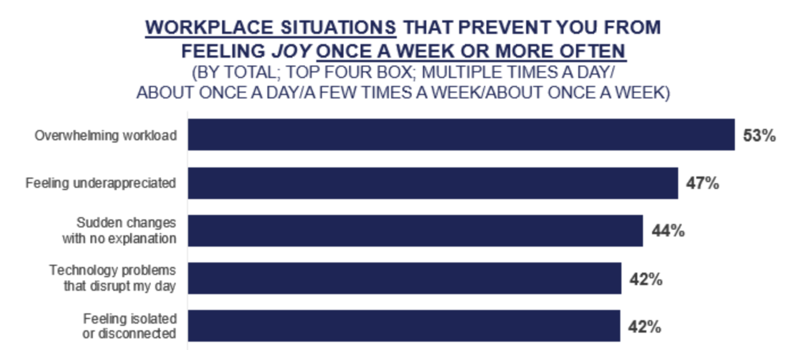
Workplace Situations That Prevent
Joy Once a Week or More
Feeling isolated or
disconnected
Source: The State of Stress and Joy at Work, Amy Leneker, 2026.
The Center for Joyful Work
AmyLeneker.com

Slide 38
Workplace Situations That Prevent
Joy Once a Week or More
Technology problems
Feeling isolated or
disconnected
Source: The State of Stress and Joy at Work, Amy Leneker, 2026.
The Center for Joyful Work
AmyLeneker.com

Slide 39
Workplace Situations That Prevent
Joy Once a Week or More
Sudden changes with
no explanation
Technology problems
Feeling isolated or
disconnected
Source: The State of Stress and Joy at Work, Amy Leneker, 2026.
The Center for Joyful Work
AmyLeneker.com

Slide 40
Workplace Situations That Prevent
Joy Once a Week or More
Feeling
underappreciated
Sudden changes with
no explanation
Technology problems
Feeling isolated or
disconnected
Source: The State of Stress and Joy at Work, Amy Leneker, 2026.
The Center for Joyful Work
AmyLeneker.com

Slide 41
Workplace Situations That Prevent
Joy Once a Week or More
Overwhelming
Workload
Feeling
underappreciated
Sudden changes with
no explanation
Technology problems
Feeling isolated or
disconnected
Source: The State of Stress and Joy at Work, Amy Leneker, 2026.
The Center for Joyful Work
AmyLeneker.com

Slide 42
Source: Cheers to Monday, Amy Leneker (Wiley, 2026)
The Center for Joyful Work
AmyLeneker.com

Slide 43

Source: Cheers to Monday, Amy Leneker (Wiley, 2026)
The Center for Joyful Work
AmyLeneker.com

Slide 44


Source: Cheers to Monday, Amy Leneker (Wiley, 2026)
The Center for Joyful Work
AmyLeneker.com

Slide 45
Source: Cheers to Monday, Amy Leneker (Wiley, 2026)
The Center for Joyful Work
AmyLeneker.com

Slide 46

Source: Cheers to Monday, Amy Leneker (Wiley, 2026)
The Center for Joyful Work
AmyLeneker.com

Slide 47
Source: Cheers to Monday, Amy Leneker (Wiley, 2026)
The Center for Joyful Work
AmyLeneker.com

Slide 48
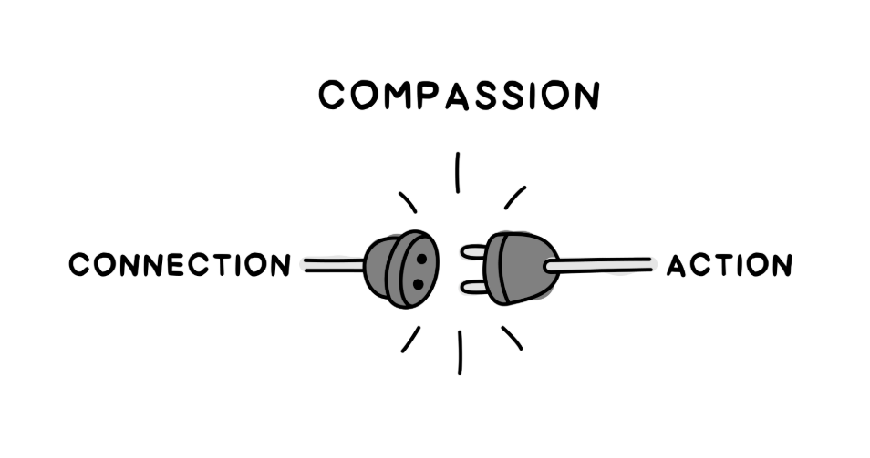
Compassion
Source: Cheers to Monday, Amy Leneker (Wiley, 2026)
The Center for Joyful Work
AmyLeneker.com

Slide 49
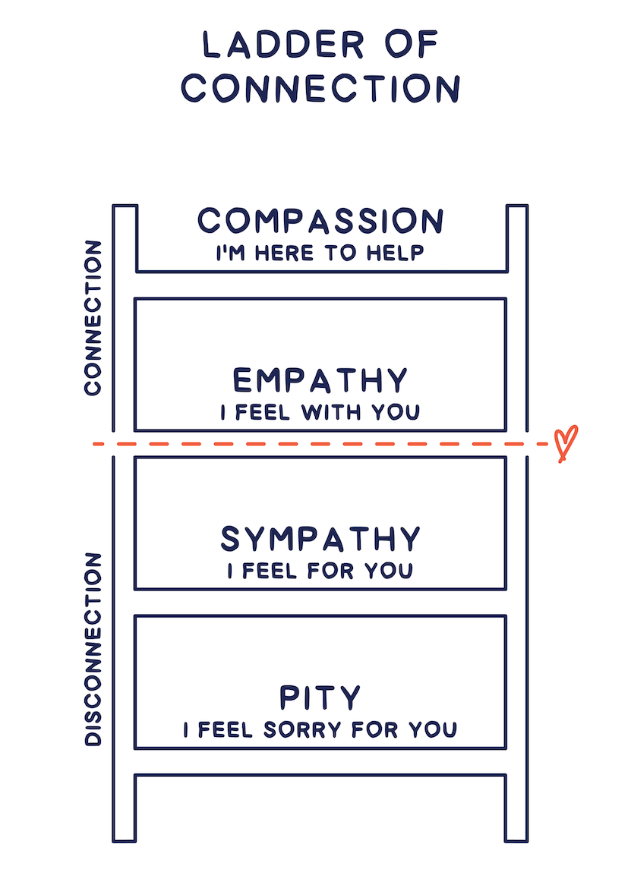
Ladder of
Connection
Source: Cheers to Monday, Amy Leneker (Wiley, 2026)
Research from Harvard Business Review,Rasmus Hougaard, Jacqueline Carter and Marissa Afton, Dec.2021
The Center for Joyful Work
AmyLeneker.com

Slide 50
Ladder of
Connection
Source: Cheers to Monday, Amy Leneker (Wiley, 2026)
Research from Harvard Business Review,Rasmus Hougaard, Jacqueline Carter and Marissa Afton, Dec.2021
The Center for Joyful Work
AmyLeneker.com

Slide 51
Ladder of
Connection
Source: Cheers to Monday, Amy Leneker (Wiley, 2026)
Research from Harvard Business Review,Rasmus Hougaard, Jacqueline Carter and Marissa Afton, Dec.2021
The Center for Joyful Work
AmyLeneker.com

Slide 52
Ladder of
Connection
Source: Cheers to Monday, Amy Leneker (Wiley, 2026)
Research from Harvard Business Review,Rasmus Hougaard, Jacqueline Carter and Marissa Afton, Dec.2021
The Center for Joyful Work
AmyLeneker.com

Slide 53
Ladder of
Connection
Source: Cheers to Monday, Amy Leneker (Wiley, 2026)
Research from Harvard Business Review,Rasmus Hougaard, Jacqueline Carter and Marissa Afton, Dec.2021
The Center for Joyful Work
AmyLeneker.com

Slide 54


Slide 55

Ladder of
Connection
Source: Cheers to Monday, Amy Leneker (Wiley, 2026)
Research from Harvard Business Review,Rasmus Hougaard, Jacqueline Carter and Marissa Afton, Dec.2021
The Center for Joyful Work
AmyLeneker.com

Slide 56
Ladder of
Connection
Source: Cheers to Monday, Amy Leneker (Wiley, 2026)
Research from Harvard Business Review,Rasmus Hougaard, Jacqueline Carter and Marissa Afton, Dec.2021
The Center for Joyful Work
AmyLeneker.com

Slide 57
Ladder of
Connection
Source: Cheers to Monday, Amy Leneker (Wiley, 2026)
Research from Harvard Business Review,Rasmus Hougaard, Jacqueline Carter and Marissa Afton, Dec.2021
The Center for Joyful Work
AmyLeneker.com

Slide 58
Ladder of
Connection
Source: Cheers to Monday, Amy Leneker (Wiley, 2026)
Research from Harvard Business Review,Rasmus Hougaard, Jacqueline Carter and Marissa Afton, Dec.2021
The Center for Joyful Work
AmyLeneker.com

Slide 59
Stress thrives in isolation.
Relief comes through connection.
Source: Cheers to Monday, Amy Leneker (Wiley, 2026)
The Center for Joyful Work
AmyLeneker.com

Slide 60
Source: Cheers to Monday, Amy Leneker (Wiley, 2026)
The Center for Joyful Work
AmyLeneker.com

Slide 61






Amy Leneker
Amy@AmyLeneker.com
(360) 529-0290
with

