Slide 1






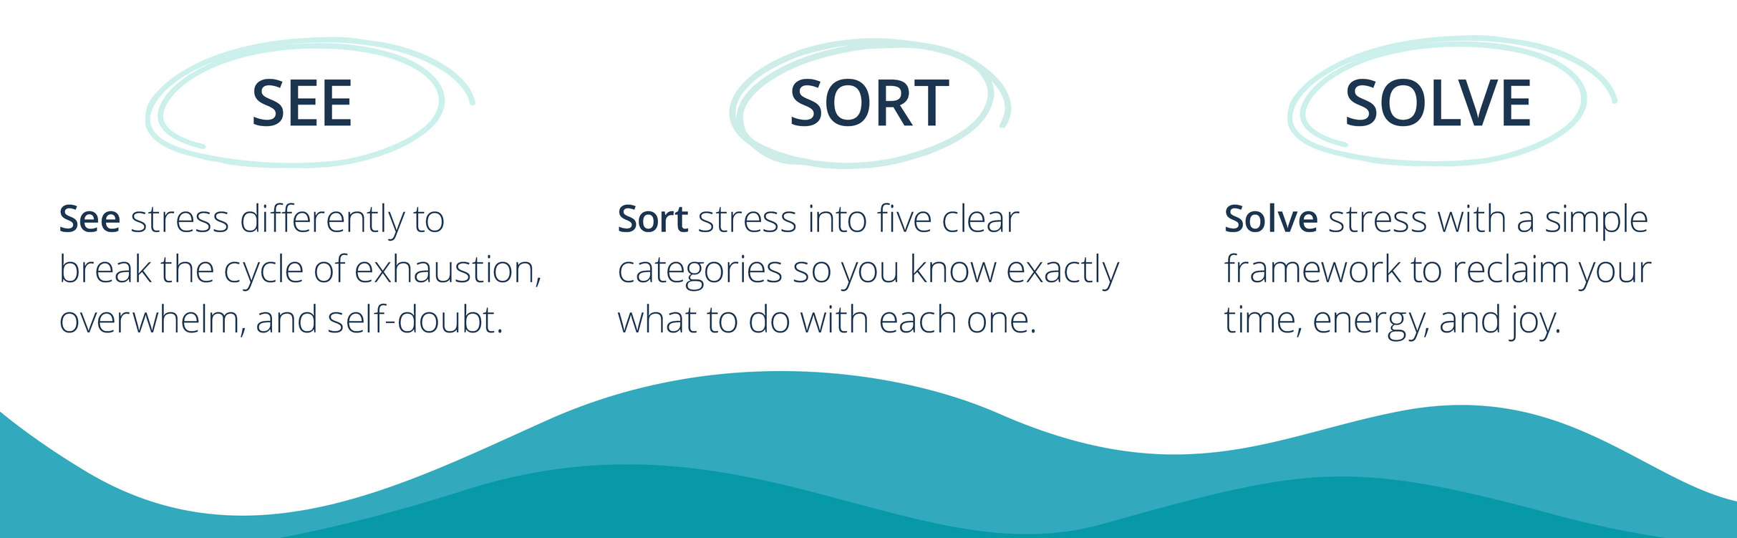

Slide 2
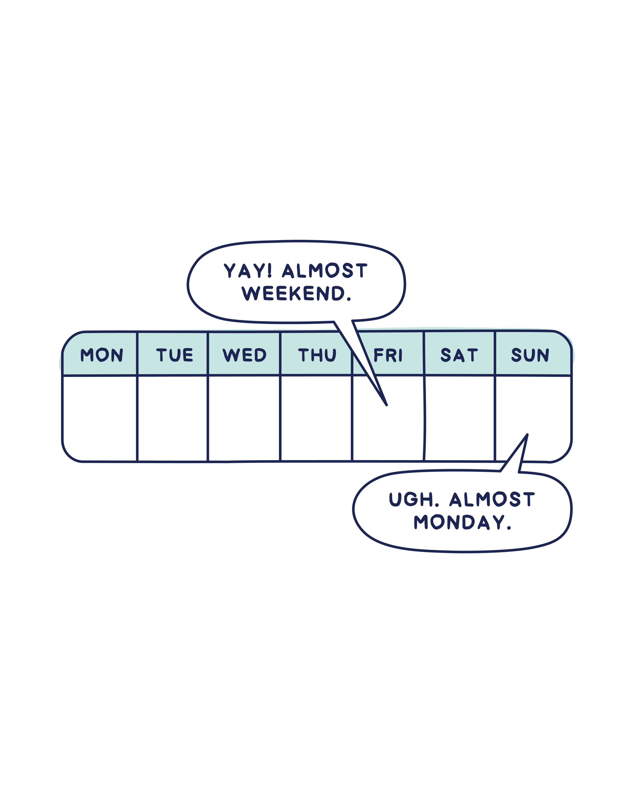

Source: Cheers to Monday, Amy Leneker (Wiley, 2026)
The Center for Joyful Work
AmyLeneker.com

Slide 3


Slide 4

A hard truth—and a hopeful one.
The Center for Joyful Work
AmyLeneker.com

Slide 5

Stress is undermining success;
is part of the solution.
JOY
The Center for Joyful Work
AmyLeneker.com

Slide 6

One good thing?
The Center for Joyful Work
AmyLeneker.com

Slide 7

The Center for Joyful Work
AmyLeneker.com

Slide 8

The Center for Joyful Work
AmyLeneker.com

Slide 9

The Center for Joyful Work
AmyLeneker.com

Slide 10
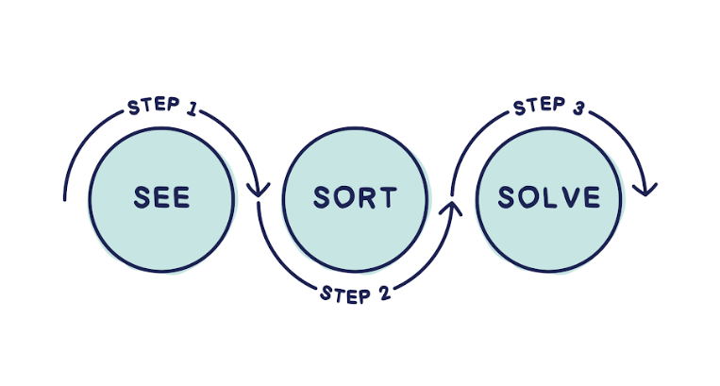
Source: Cheers to Monday, Amy Leneker (Wiley, 2026)
The Center for Joyful Work
AmyLeneker.com

Slide 11

Source: Cheers to Monday, Amy Leneker (Wiley, 2026)
The Center for Joyful Work
AmyLeneker.com

Slide 12
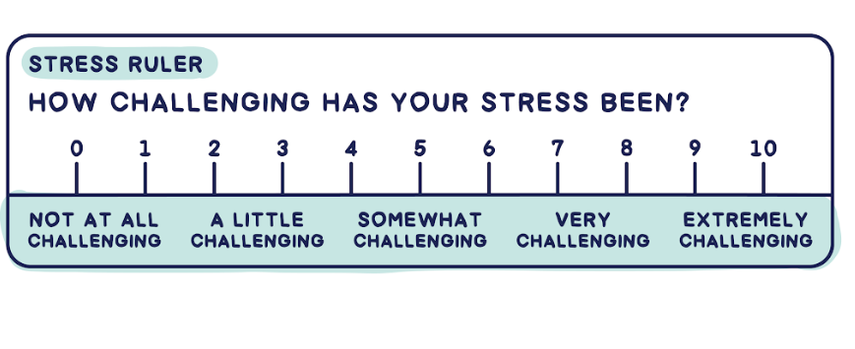
Source: Cheers to Monday, Amy Leneker (Wiley, 2026)
The Center for Joyful Work
AmyLeneker.com

Slide 13
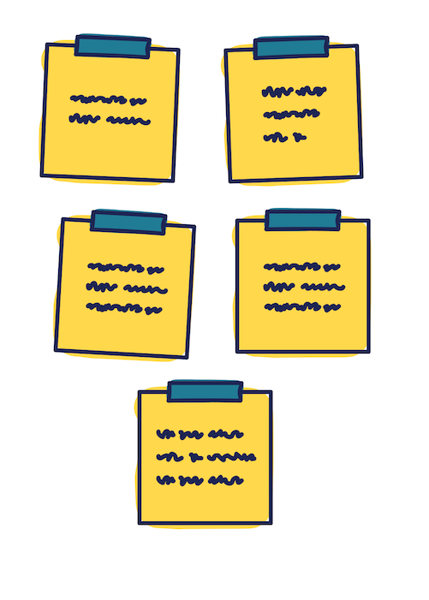
Source: Cheers to Monday, Amy Leneker (Wiley, 2026)
The Center for Joyful Work
AmyLeneker.com

Slide 14
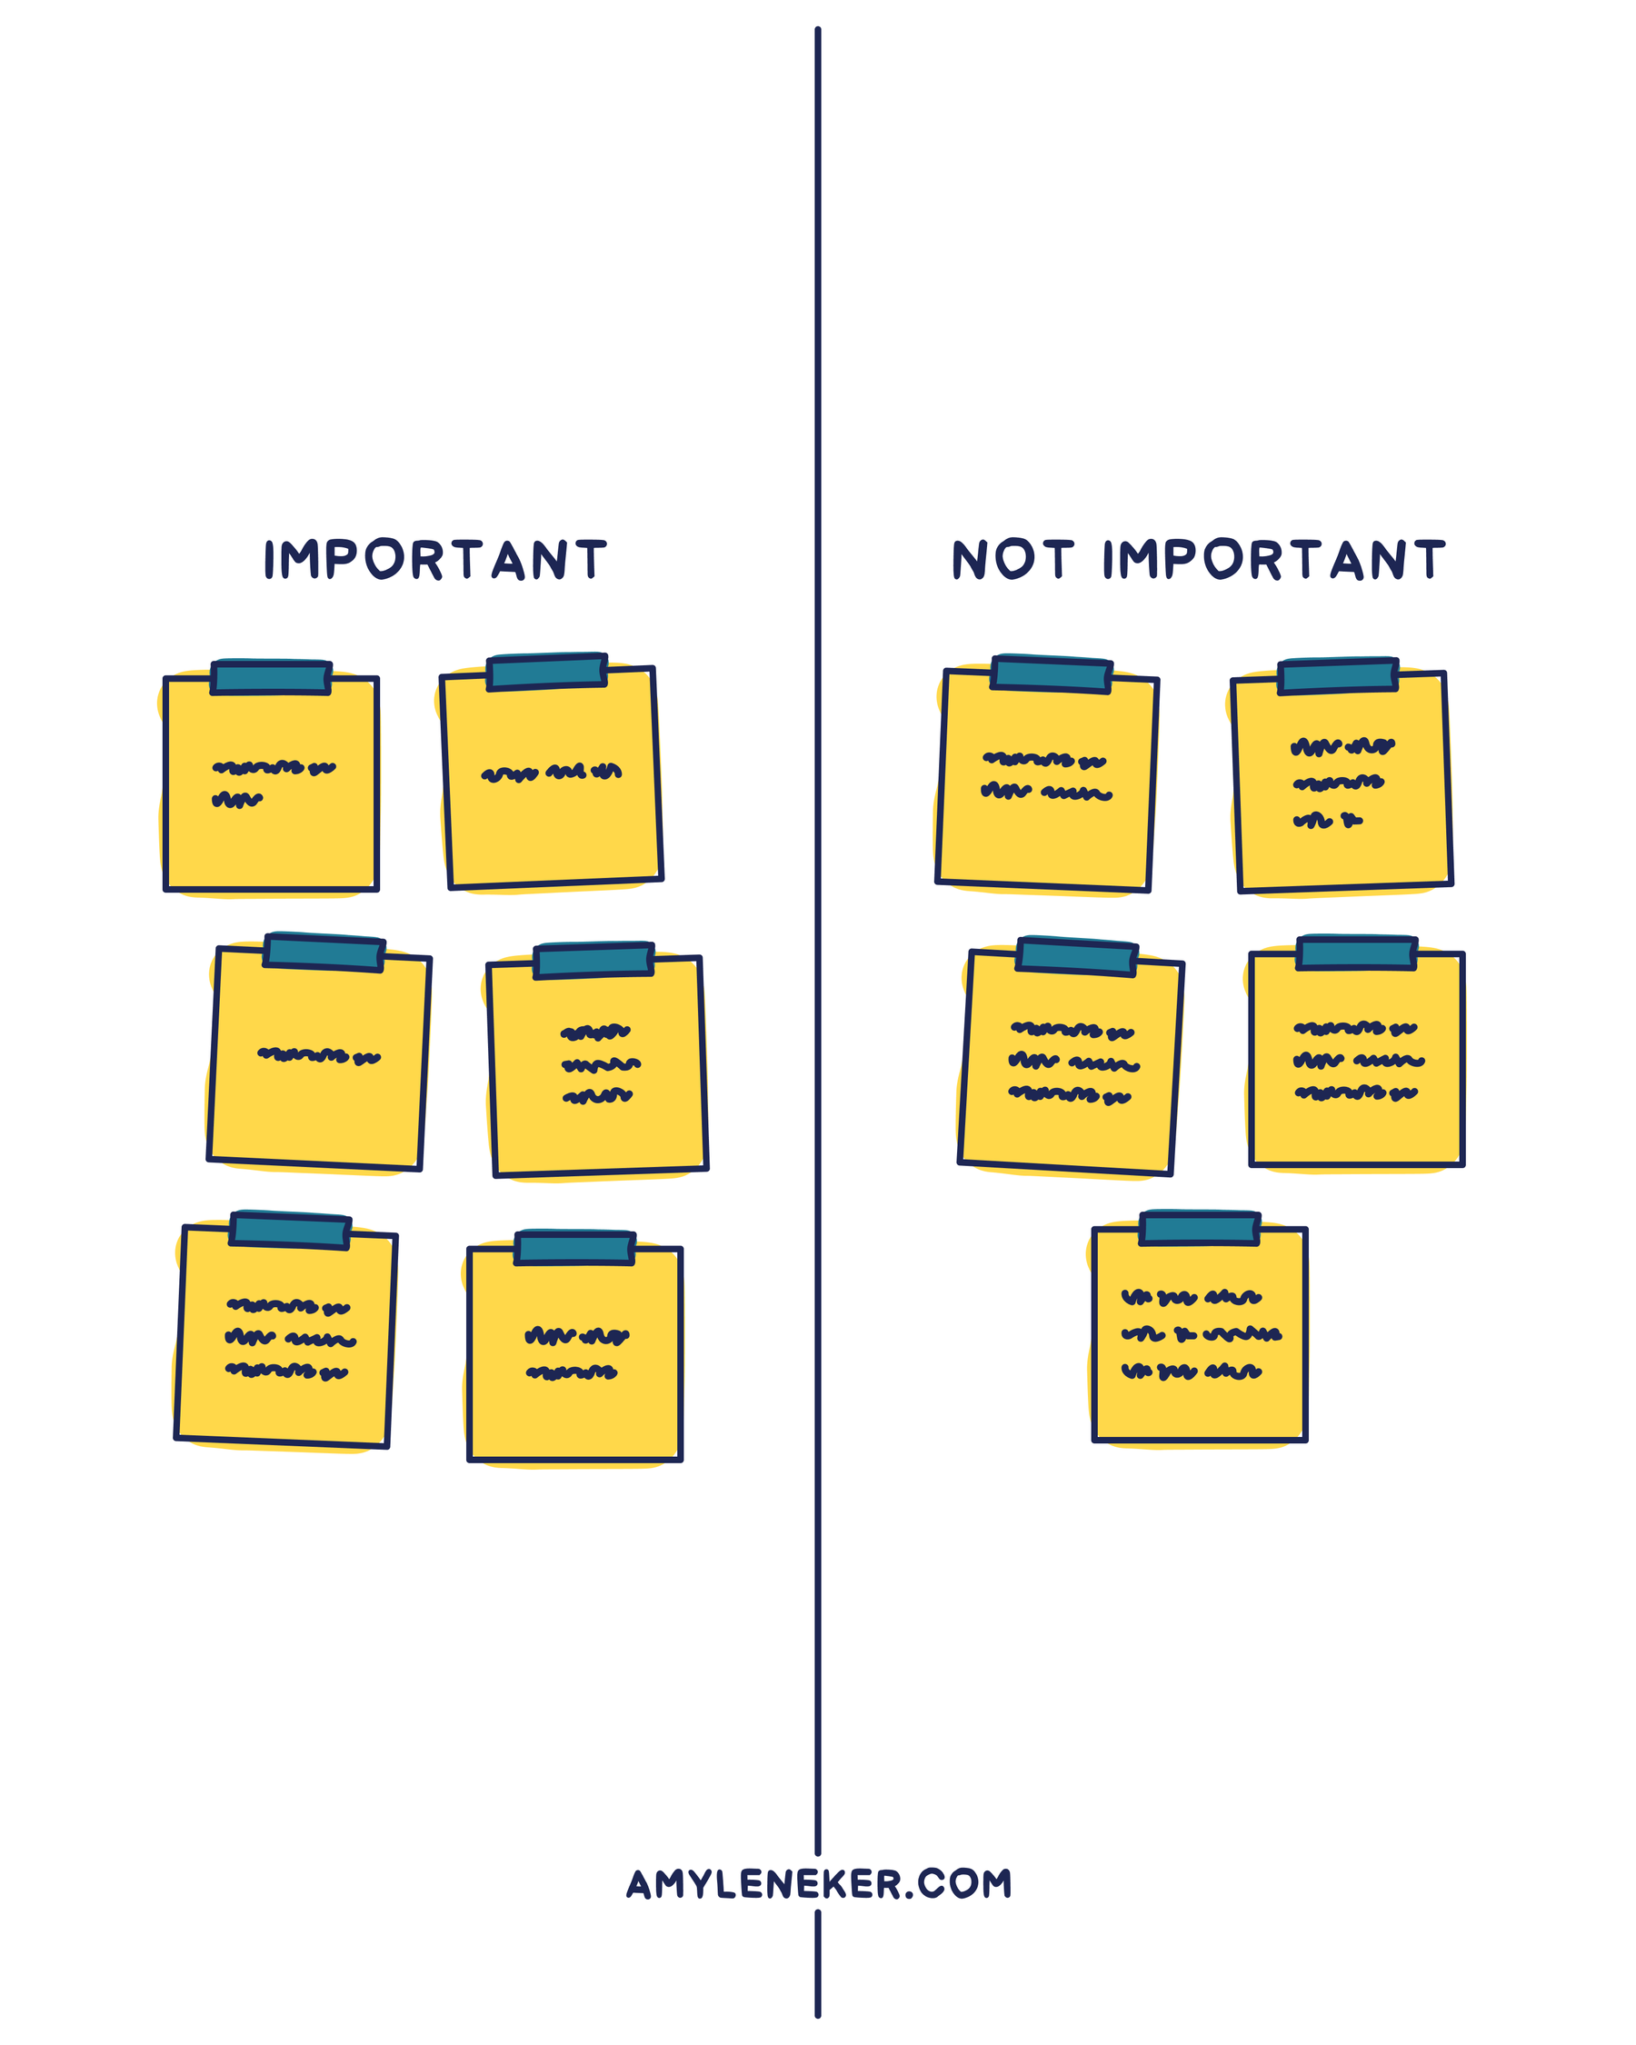
Source: Cheers to Monday, Amy Leneker (Wiley, 2026)
The Center for Joyful Work
AmyLeneker.com

Slide 15
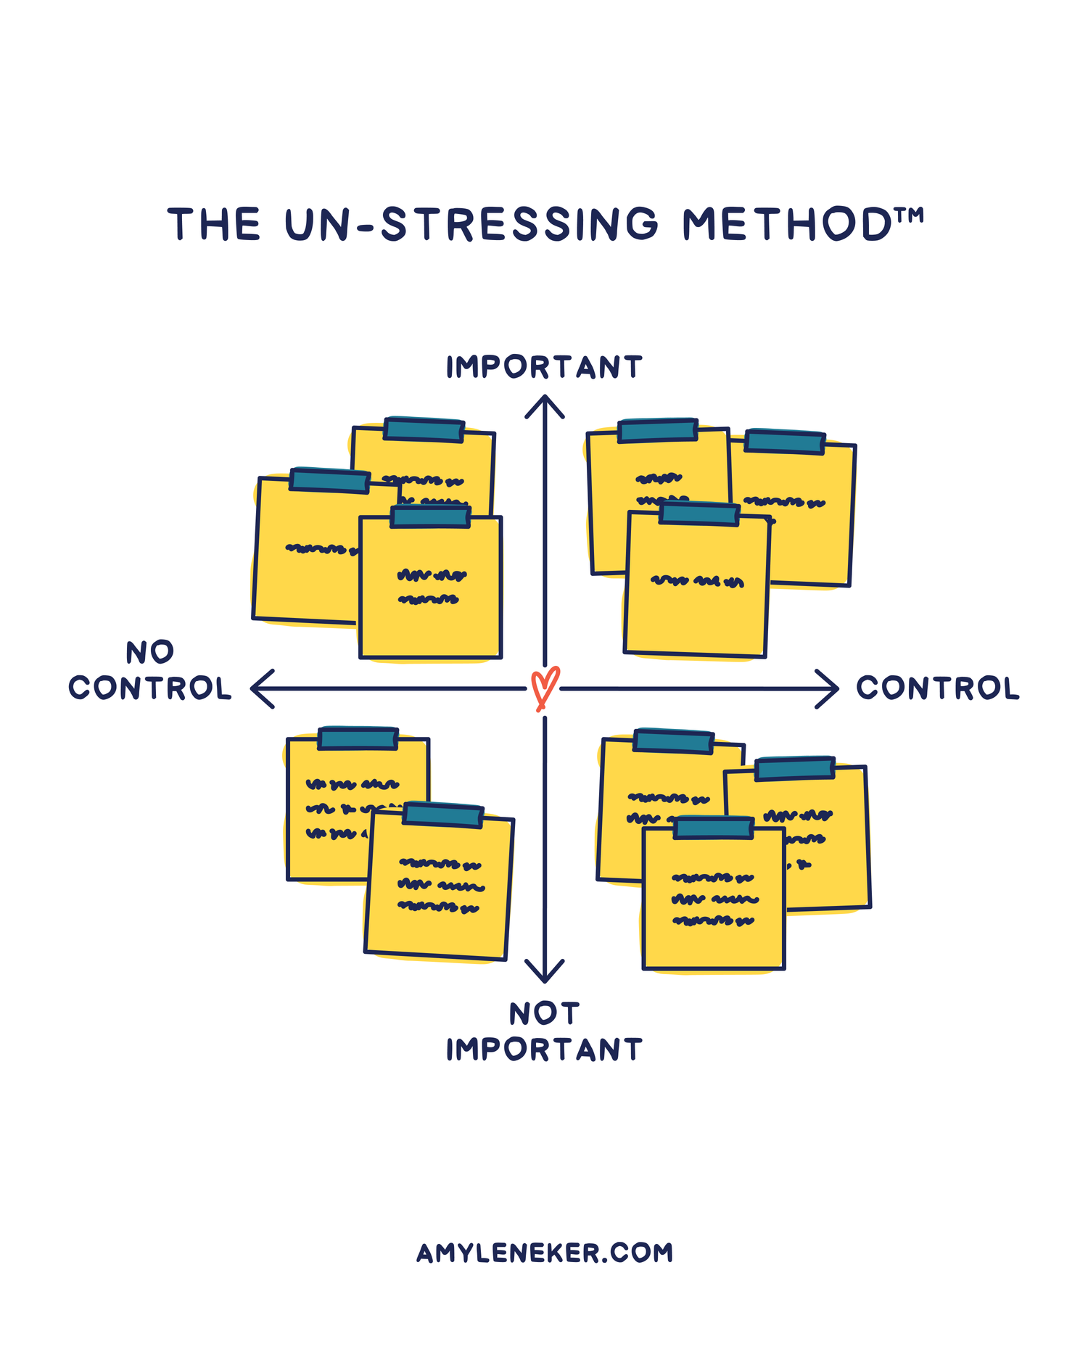
Source: Cheers to Monday, Amy Leneker (Wiley, 2026)
The Center for Joyful Work
AmyLeneker.com

Slide 16
Source: Cheers to Monday, Amy Leneker (Wiley, 2026)
The Center for Joyful Work
AmyLeneker.com

Slide 17


Source: Cheers to Monday, Amy Leneker (Wiley, 2026)
The Center for Joyful Work
AmyLeneker.com

Slide 18

The Center for Joyful Work
AmyLeneker.com

Slide 19
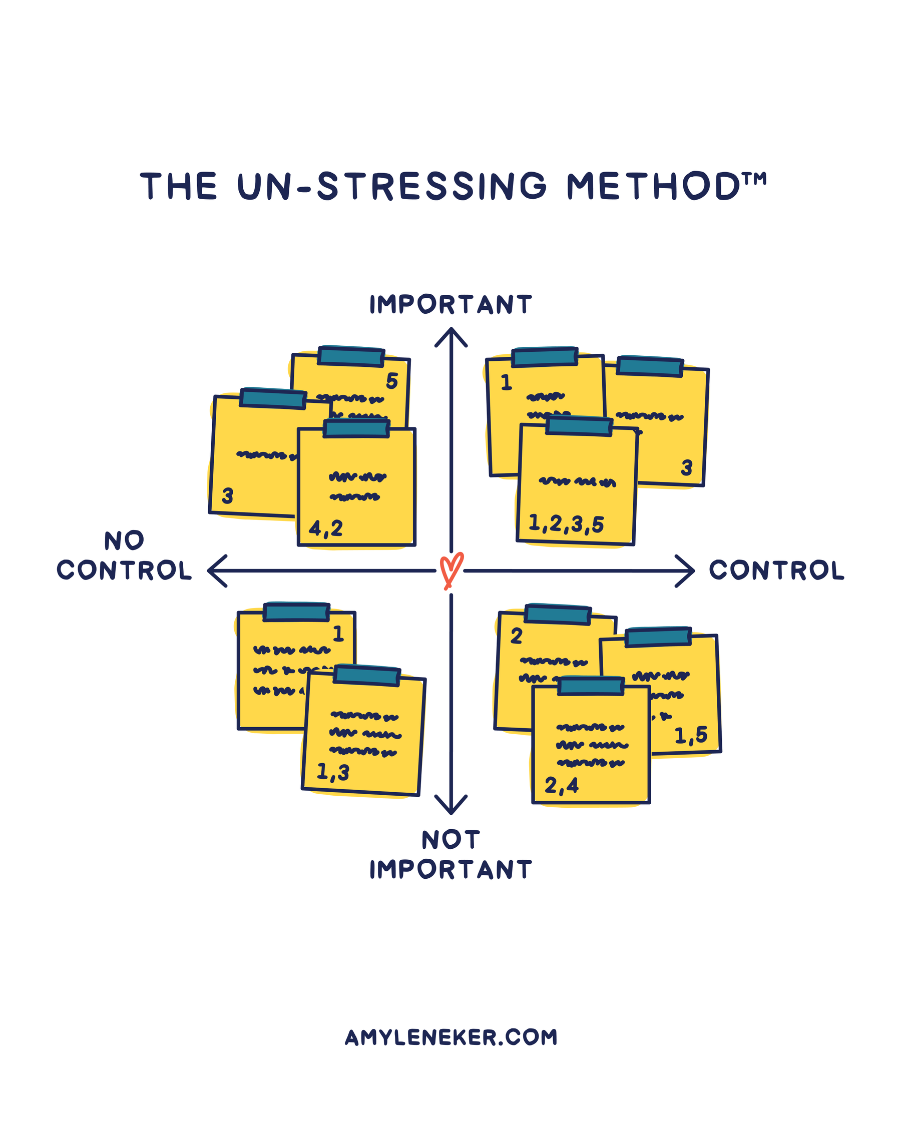
Source: Cheers to Monday, Amy Leneker (Wiley, 2026)
The Center for Joyful Work
AmyLeneker.com

Slide 20
Source: Cheers to Monday, Amy Leneker (Wiley, 2026)
The Center for Joyful Work
AmyLeneker.com

Slide 21
Joy
Source: The State of Stress and Joy at Work, Amy Leneker, 2026.
The Center for Joyful Work
AmyLeneker.com

Slide 22
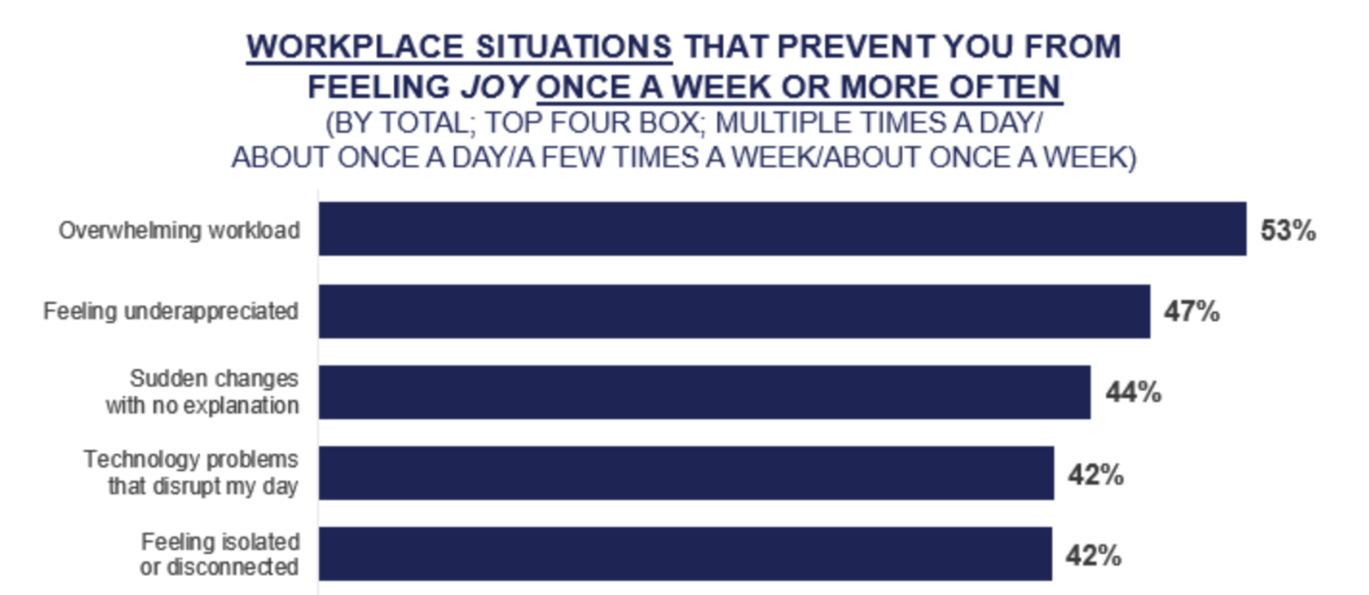
Workplace Situations That Prevent
Joy Once a Week or More
Feeling isolated or
disconnected
Source: The State of Stress and Joy at Work, Amy Leneker, 2026.
The Center for Joyful Work
AmyLeneker.com

Slide 23
Workplace Situations That Prevent
Joy Once a Week or More
Technology problems
Feeling isolated or
disconnected
Source: The State of Stress and Joy at Work, Amy Leneker, 2026.
The Center for Joyful Work
AmyLeneker.com

Slide 24
Workplace Situations That Prevent
Joy Once a Week or More
Sudden changes with
no explanation
Technology problems
Feeling isolated or
disconnected
Source: The State of Stress and Joy at Work, Amy Leneker, 2026.
The Center for Joyful Work
AmyLeneker.com

Slide 25
Workplace Situations That Prevent
Joy Once a Week or More
Feeling
underappreciated
Sudden changes with
no explanation
Technology problems
Feeling isolated or
disconnected
Source: The State of Stress and Joy at Work, Amy Leneker, 2026.
The Center for Joyful Work
AmyLeneker.com

Slide 26
Workplace Situations That Prevent
Joy Once a Week or More
Overwhelming
Workload
Feeling
underappreciated
Sudden changes with
no explanation
Technology problems
Feeling isolated or
disconnected
Source: The State of Stress and Joy at Work, Amy Leneker, 2026.
The Center for Joyful Work
AmyLeneker.com

Slide 27
75% of Working Americans:
Joy helps me cope with work stress
The Center for Joyful Work
AmyLeneker.com

Slide 28
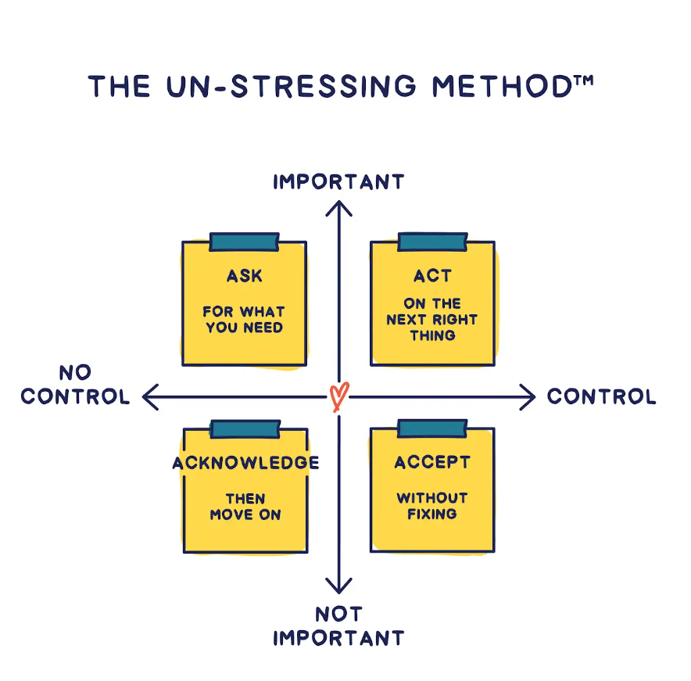


Source: Cheers to Monday, Amy Leneker (Wiley, 2026)
The Center for Joyful Work
AmyLeneker.com

Slide 29


Source: Cheers to Monday, Amy Leneker (Wiley, 2026)
The Center for Joyful Work
AmyLeneker.com

Slide 30
Source: Cheers to Monday, Amy Leneker (Wiley, 2026)
The Center for Joyful Work
AmyLeneker.com

Slide 31
Source: Cheers to Monday, Amy Leneker (Wiley, 2026)
The Center for Joyful Work
AmyLeneker.com

Slide 32
Source: Cheers to Monday, Amy Leneker (Wiley, 2026)
The Center for Joyful Work
AmyLeneker.com

Slide 33
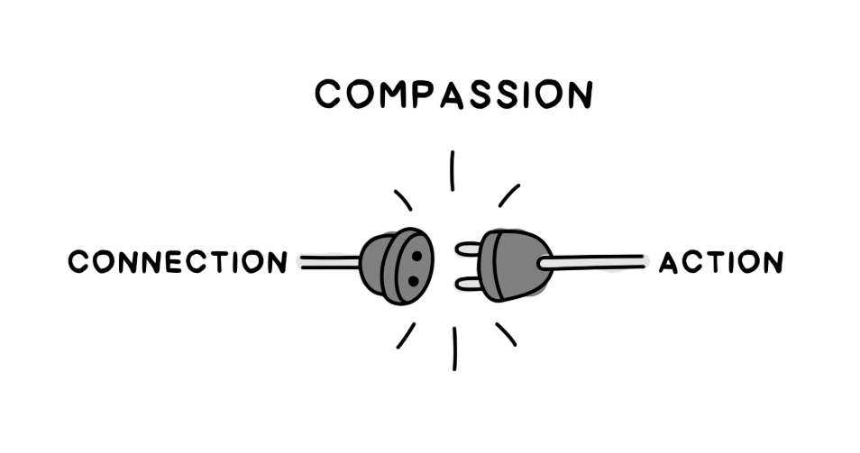
Compassion
Source: Cheers to Monday, Amy Leneker (Wiley, 2026)
The Center for Joyful Work
AmyLeneker.com

Slide 34
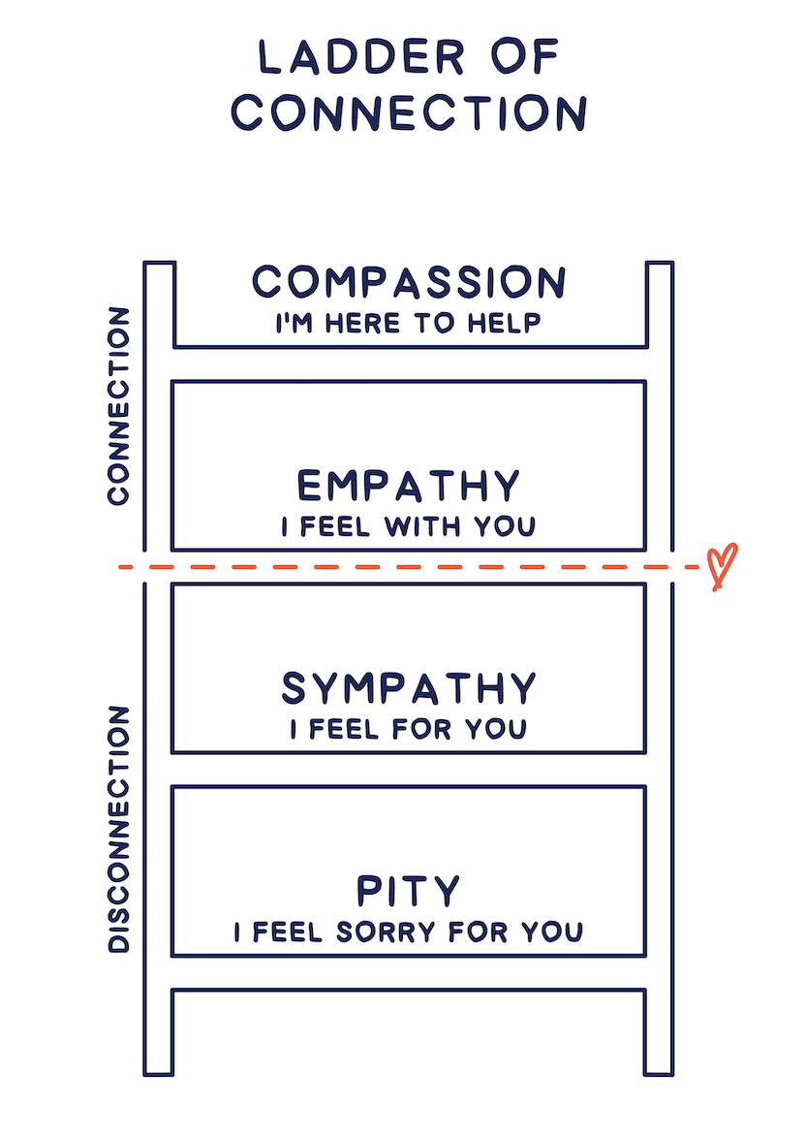
Ladder of
Connection
Source: Cheers to Monday, Amy Leneker (Wiley, 2026)
Research from Harvard Business Review,Rasmus Hougaard, Jacqueline Carter and Marissa Afton, Dec.2021
The Center for Joyful Work
AmyLeneker.com

Slide 35
Ladder of
Connection
Source: Cheers to Monday, Amy Leneker (Wiley, 2026)
Research from Harvard Business Review,Rasmus Hougaard, Jacqueline Carter and Marissa Afton, Dec.2021
The Center for Joyful Work
AmyLeneker.com

Slide 36
Ladder of
Connection
Source: Cheers to Monday, Amy Leneker (Wiley, 2026)
Research from Harvard Business Review,Rasmus Hougaard, Jacqueline Carter and Marissa Afton, Dec.2021
The Center for Joyful Work
AmyLeneker.com

Slide 37
Ladder of
Connection
Source: Cheers to Monday, Amy Leneker (Wiley, 2026)
Research from Harvard Business Review,Rasmus Hougaard, Jacqueline Carter and Marissa Afton, Dec.2021
The Center for Joyful Work
AmyLeneker.com

Slide 38
Ladder of
Connection
Source: Cheers to Monday, Amy Leneker (Wiley, 2026)
Research from Harvard Business Review,Rasmus Hougaard, Jacqueline Carter and Marissa Afton, Dec.2021
The Center for Joyful Work
AmyLeneker.com

Slide 39


Slide 40

Ladder of
Connection
Source: Cheers to Monday, Amy Leneker (Wiley, 2026)
Research from Harvard Business Review,Rasmus Hougaard, Jacqueline Carter and Marissa Afton, Dec.2021
The Center for Joyful Work
AmyLeneker.com

Slide 41
Ladder of
Connection
Source: Cheers to Monday, Amy Leneker (Wiley, 2026)
Research from Harvard Business Review,Rasmus Hougaard, Jacqueline Carter and Marissa Afton, Dec.2021
The Center for Joyful Work
AmyLeneker.com

Slide 42
Ladder of
Connection
Source: Cheers to Monday, Amy Leneker (Wiley, 2026)
Research from Harvard Business Review,Rasmus Hougaard, Jacqueline Carter and Marissa Afton, Dec.2021
The Center for Joyful Work
AmyLeneker.com

Slide 43
Ladder of
Connection
Source: Cheers to Monday, Amy Leneker (Wiley, 2026)
Research from Harvard Business Review,Rasmus Hougaard, Jacqueline Carter and Marissa Afton, Dec.2021
The Center for Joyful Work
AmyLeneker.com

Slide 44
Stress thrives in isolation.
Relief comes through connection.
Source: Cheers to Monday, Amy Leneker (Wiley, 2026)
The Center for Joyful Work
AmyLeneker.com

Slide 45






Amy Leneker
Amy@AmyLeneker.com
(360) 529-0290
with

