Slide 1

Welcome

Slide 2
Myths
To be old is to be sick.
You can’t teach an old dog new tricks.
The horse is out of the barn.
The secret to successful aging is to choose your parents wisely.
The lights may be on, but the voltage is low.
The elderly do not pull their own weight.

Slide 3
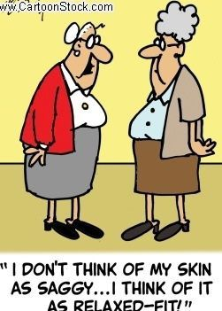
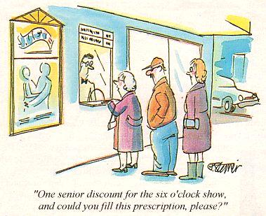

Slide 4

Myth #1: To be old is to be sick
a. Most experts in aging have played a part in stereotyping the aging person by focusing on late life disease and disability.
b. Many elderly people today suffer from what geriatricians call chronic, long term disease.

Slide 5
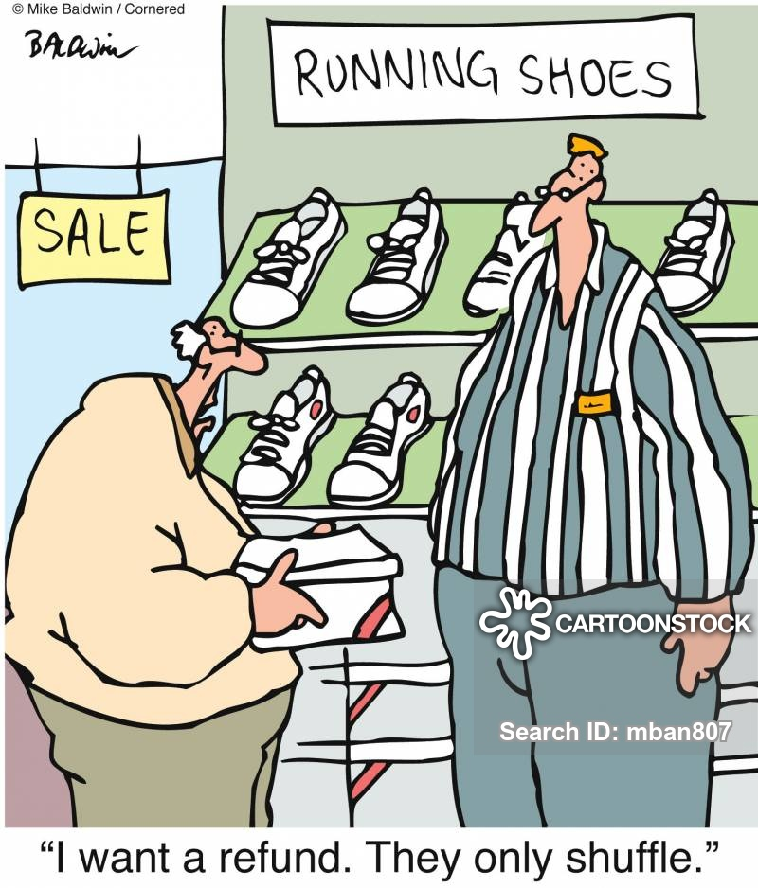
I want a refund. They only shuffle

Slide 6
Myth #1: To be old is to be sick
c. Reality…. Leading experts in aging report major reductions in the prevalence of three key forerunners to chronic disease: high blood pressure, high cholesterol levels and smoking.
d. Dental health has improved significantly.

Slide 7
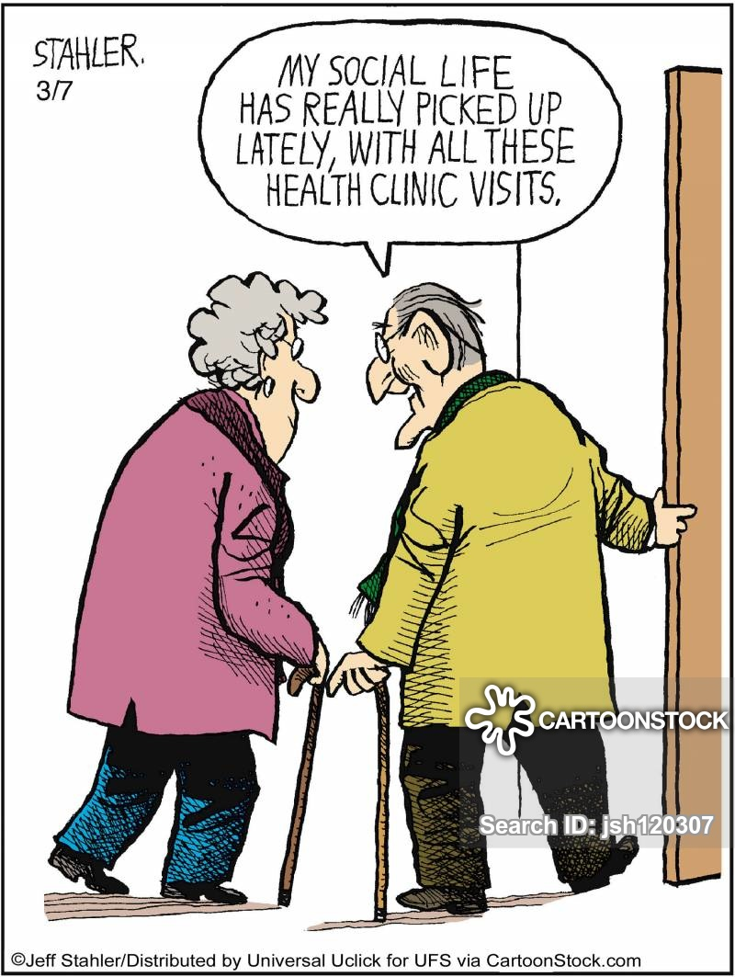
My social life has really picked up lately with all these health clinic visits.

Slide 8
Myth #1: To be old is to be sick
e. The percent of individuals over 65 living in nursing homes continues to decline. Currently less than 5% reside in these institutions.

Slide 9
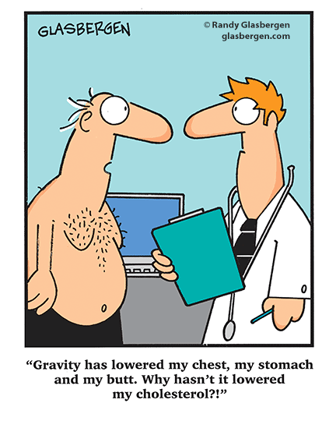
Gravity has lowered my chest, my stomach and my butt. Why hasn’t it lowered my cholesterol?

Slide 10
Myth #2: You can’t teach an old dog new tricks.
a. This myth refers to the inability of older persons to remain lifelong learners.
b. Remember our society is age graded.

Slide 11
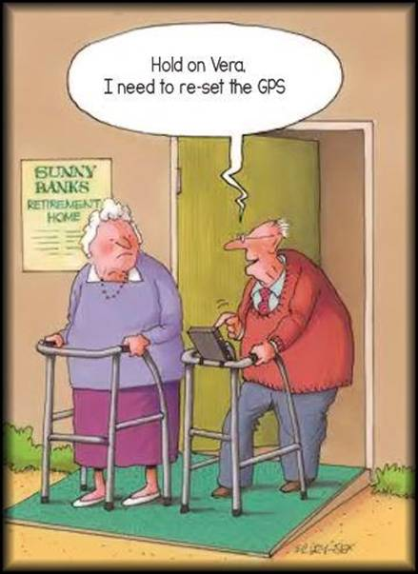
Hold on Vera. I need to re-set the GPS.

Slide 12
Myth #2: You can’t teach an old dog new tricks.
c. Young operate as if there were three distinct periods of life: education, work and retirement.
d. Most Churches also support age graded Sunday School classes.

Slide 13
Myth #2: You can’t teach an old dog new tricks.
e. Reality…. Research suggests that though seniors may require a slower pace to learn new information, but they can do it and act on it more effectively than young people.

Slide 14
Myth #2: You can’t teach an old dog new tricks.
“Add to your faith goodness; and to goodness knowledge; and to knowledge, self control; and to self control, perseverance; and to perseverance, godliness; and to godliness, brotherly kindness; and to brotherly kindness, love. For if you possess these qualities in increasing measure, they will keep you from being ineffective and unproductive in your knowledge of Jesus Christ.”
2 Peter 1:5-8

Slide 15
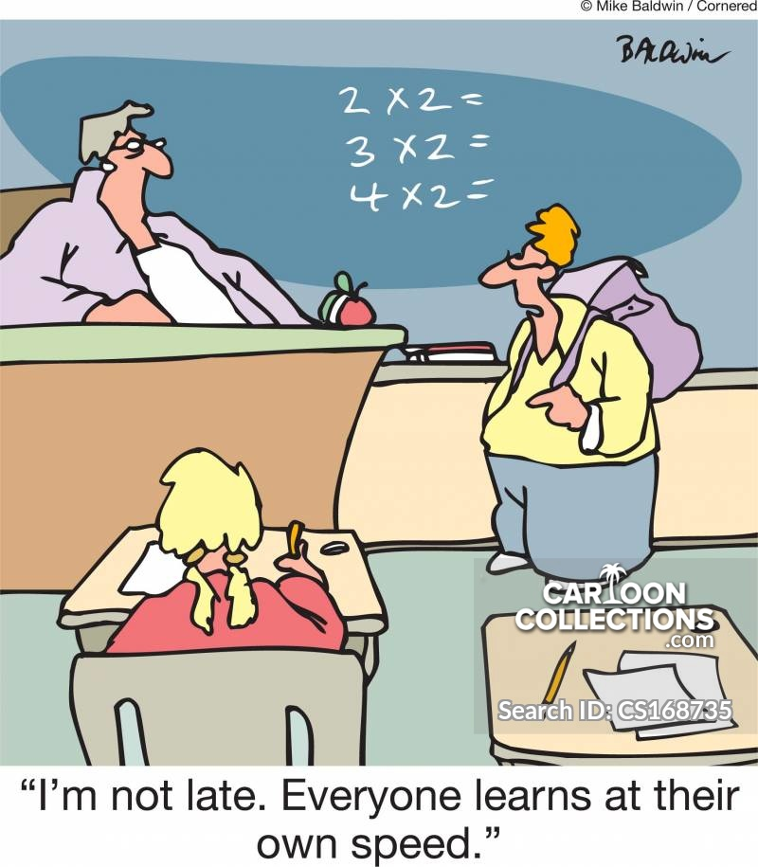
Myth #2: You can’t teach an old dog new tricks.

Slide 16
Myth #2: You can’t teach an old dog new tricks.
f. Yet the biblical model suggests that the old should teach the young. (Ps 71).
I think it is right to refresh your memory as long as I live in the tent of this body, because I know that I will soon be put aside, as our Lord Jesus Christ has made clear to me. And I will make every effort to see that after my departure you will always be able to remember these things. 2 Peter 1:13-15.

Slide 17
Myth #3: The horse is out of the barn.
a. This myth suggests that it is to late to reduce the risk of disease and disability.
b. Reality…. Older adults who lose excessive weight, stop smoking and begin to exercise experience significant health changes.

Slide 18
Myth #3: The horse is out of the barn.
c. Though with age the body does lose physical function, many reductions in physical performance are reversable.
d. It is never too late to start making healthy lifestyle changes.

Slide 19
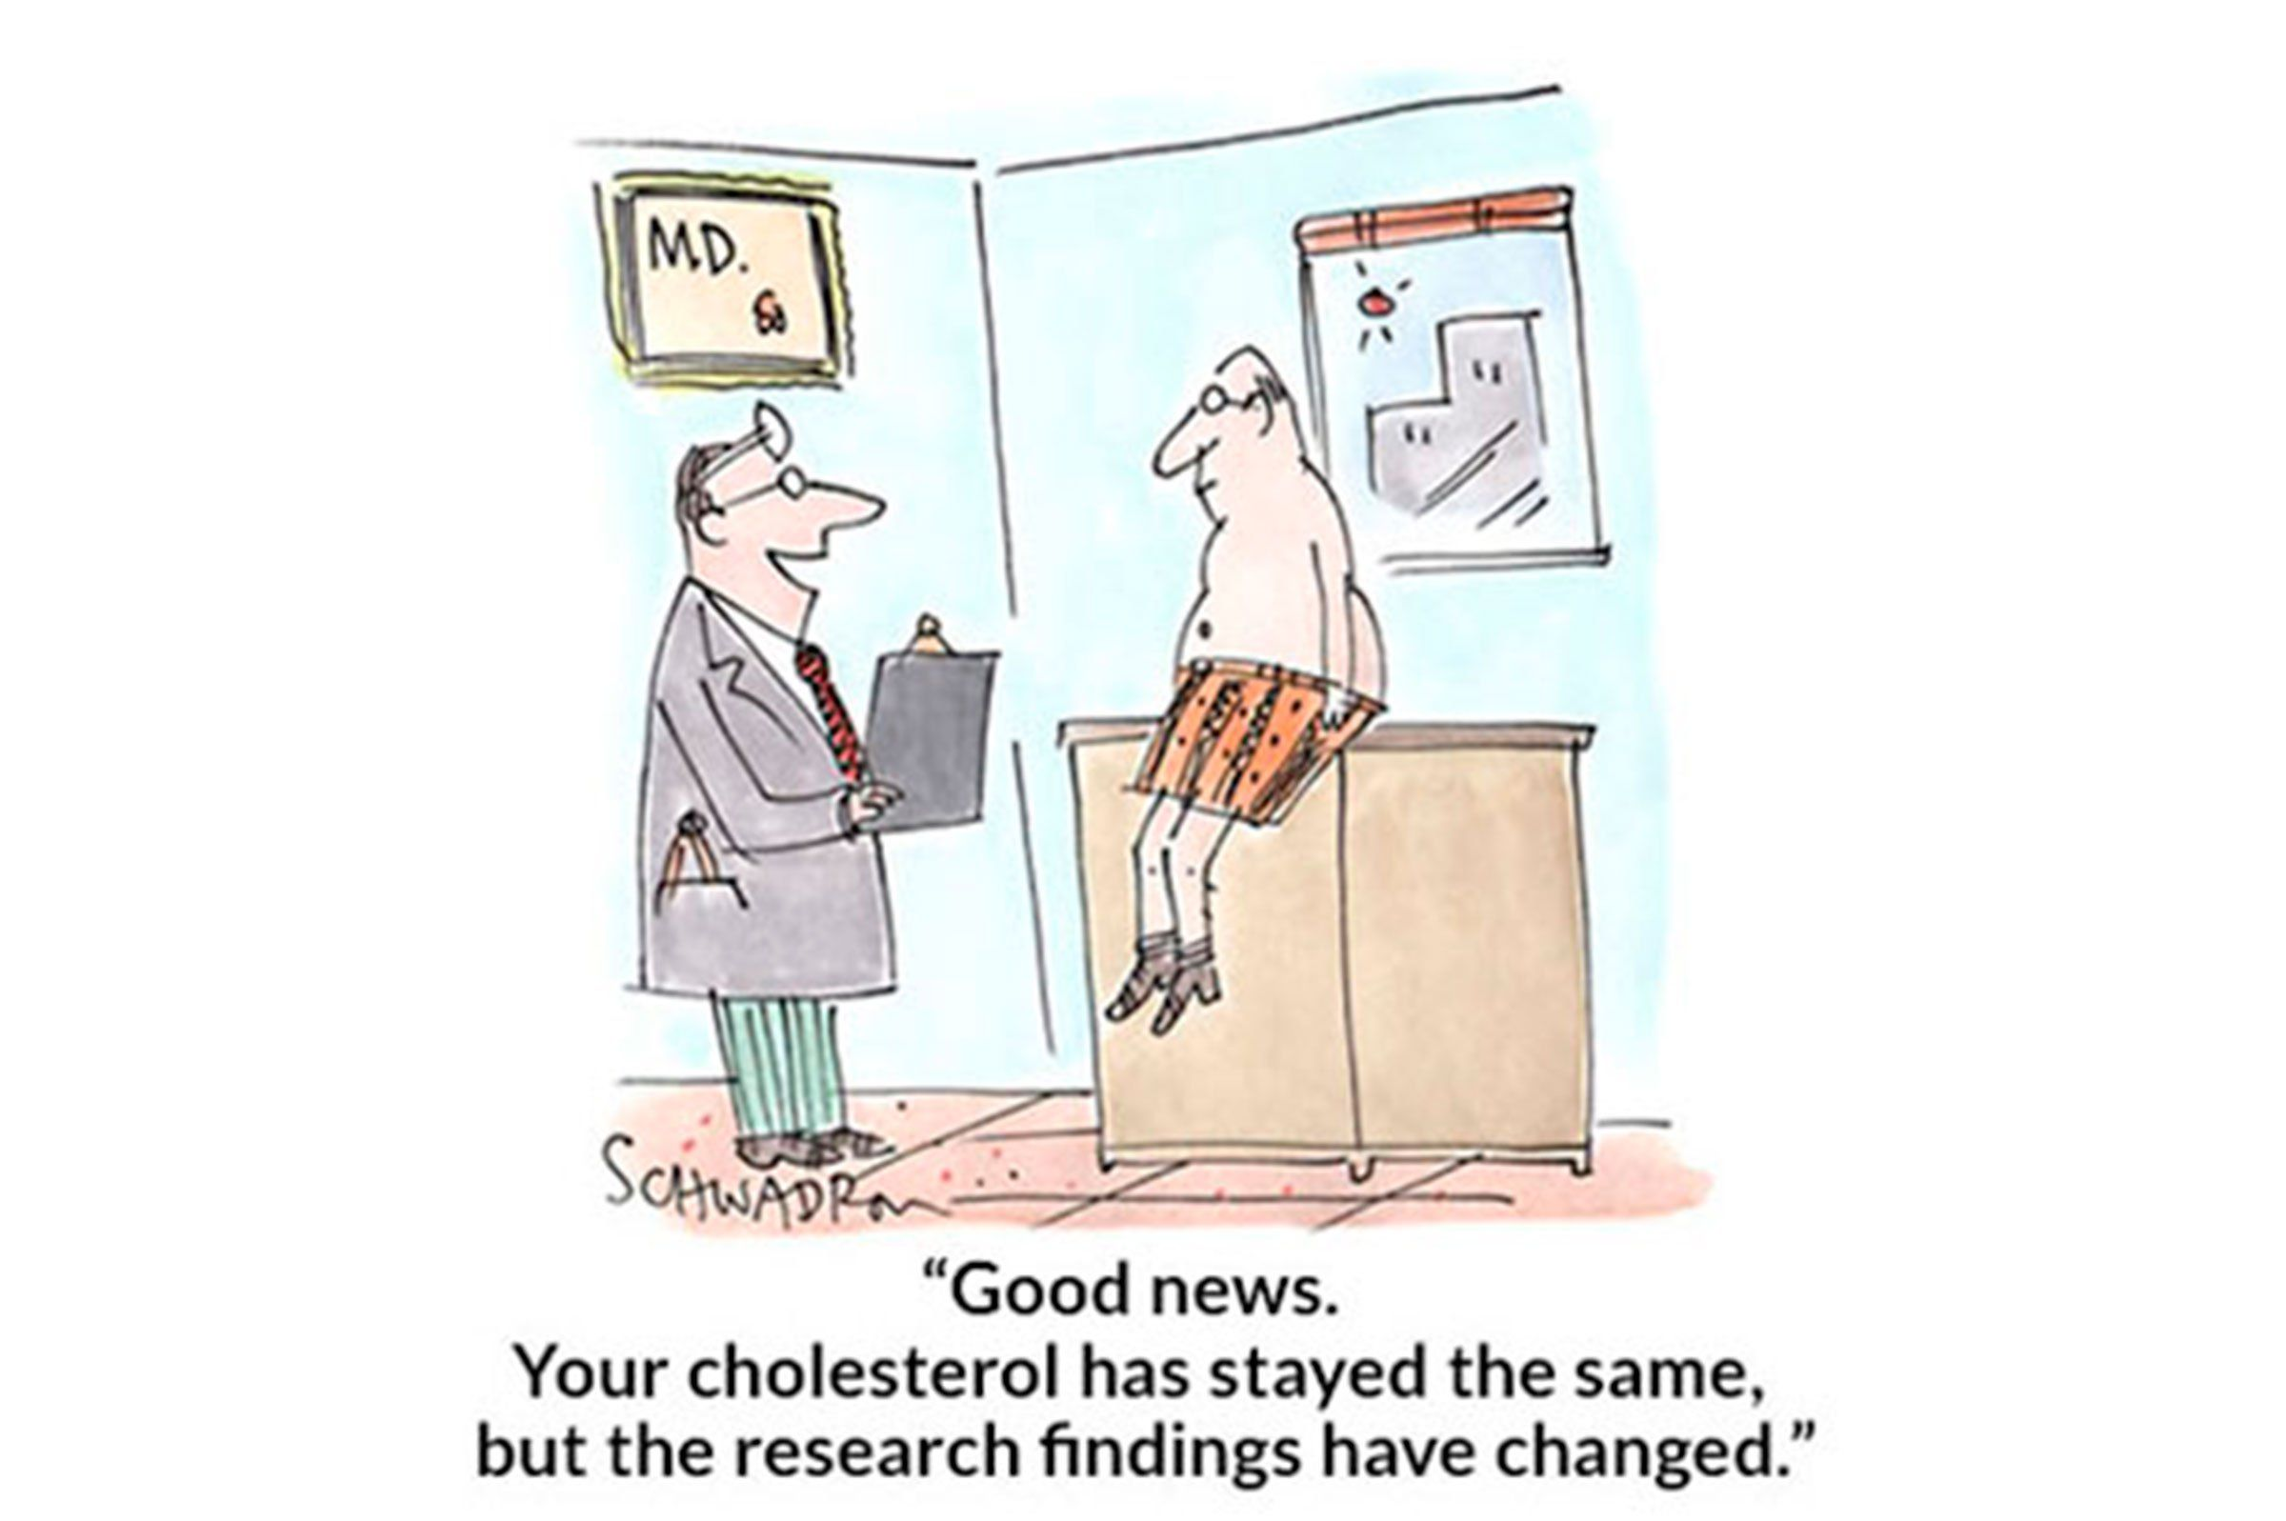

Slide 20
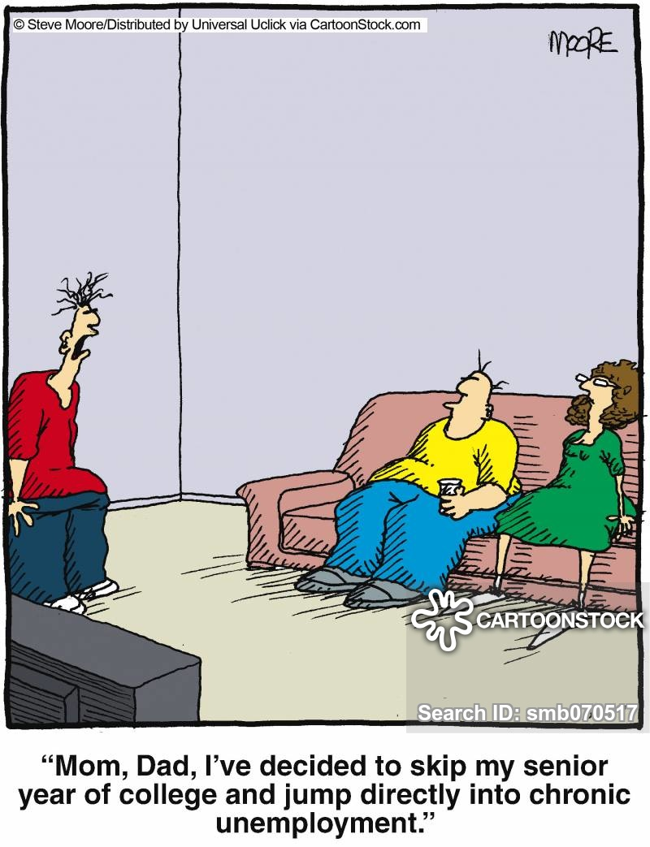
Myth #4: The secret to successful aging is to choose your parents wisely.

Slide 21
Myth #4: The secret to successful aging is to choose your parents wisely.
a. Many people say, well my parents had arthritis, Parkinson’s, eye problems or many other diseases.
b. Reality…. The role of genetics in aging has been overemphasized.

Slide 22
Myth #4: The secret to successful aging is to choose your parents wisely.
c. The good news is older people can make choices that help determine their health-related futures.
d. As we grow older, the influence of genetics becomes less important and lifestyle becomes more important.

Slide 23
Myth #5: The lights may be on, but the voltage is low.
a. This myth implies that older people suffer from inadequate physical and mental capacities and are not interested in sexual activities.

Slide 24
Myth #5: The lights may be on, but the voltage is low.
b. Reality…. Although chronological age is not the key factor, there are physiological changes and certain health conditions that can affect sexual activity.

Slide 25
Myth #5: The lights may be on, but the voltage is low.
c. The voltage is never too low for affectionate physical contact. It may help keep the lights on.

Slide 26
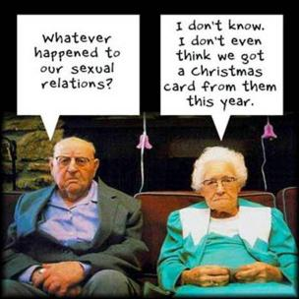
Myth #5: The lights may be on, but the voltage is low.

Slide 27
Myth #6: The elderly do not pull their own weight.
a. The last myth may be the most damaging of all, implying that the older adults do not carry their fair share of Society’s workload.

Slide 28
Myth #6: The elderly do not pull their own weight.
b. Reality…. Research suggests that approximately 3 million home care laborers would be needed if Seniors stopped providing care to the sick and the disabled.

Slide 29
Myth #6: The elderly do not pull their own weight.
c. Many of our religious institutions and volunteer-based programs would fail to operate without the help of our Seniors.
d. Grandparenting has become part-time and in increasing cases, full time-parenting for many Seniors.

Slide 30
Myth #6: The elderly do not pull their own weight.
e. Surveys suggest the over 1/3 of those over the age of 65 would prefer to work, yet they are discriminated against in competing for job positions.

Slide 31
Aging Successfully:
The role of Faith.
Religious participation later in life has been found consistently to be associated with longer life, less disease and disability and improved immune functioning.

Slide 32
Aging Successfully:
The role of Faith.
We must remind ourselves that we cannot alone in our own flesh, correct aspects of our physical and emotional lifestyle. We must believe God More and in faith hook ourselves into God’s Promises.

Slide 33
Aging Successfully:
The Grace of God.
Remind yourself of the grace by which you were saved and the same grace by which you live.
If we are to improve or maintain our emotional and physical health we must seize God’s purpose for our lives, no matter how old we are. We begin with God’s Grace.

Slide 34

Compass Foundation

Slide 35
Compass Foundation
We are indebted to the past to those who precede us. We drink from the wells we have not dug, we enjoy liberties we have not won, for those who follow us. The fruit of our decisions will be known only to others who we will not meet. At the same time we are the seeds of the future

Slide 36
Compass Foundation
Final Will &/or Trust
Memorials
Honorarium
Gifts of Stocks, Bonds or Life Insurance
Gifts of Real Property
Cash Donation in Lieu of Gift

Slide 37
Compass Foundation
Command them to do good, to be rich in good deeds and to be generous and willing to share. In this way they will lay up treasure for themselves as a firm foundation for the coming age, so that they may take hold of the life that is truly life. 1 Timothy 6:18-19

Slide 38
