Slide 1

Medicare Basics
Alma Mandujano
HICAP Program Manager
Health Insurance Counseling & Advocacy Program (HICAP)
247 Main Street, Salinas 93901
280 Dickman Avenue, Monterey 93940
This project was supported, in part by grant number 90SAPG0094-02, from the U.S. Administration for Community Living, Department of Health and Human Services, Washington, D.C. 20201. Grantees undertaking projects under government sponsorship are encouraged to express freely their findings and conclusions. Points of view or opinions do not, therefore, necessarily represent official Administration for Community Living policy.

Slide 2
Members of CA Health Advocates
Senior Medicare Patrol
Empowering Seniors to Prevent Fraud
Counseling Tools
Fact sheets
Comparison charts
California Medicare Coalition
Provides a forum for all who serve Medicare beneficiaries to get updates on Medicare and to improve education and outreach
www.cahealthadvocates.org
Notes:
www.medicare.go
Ssa.gov

Slide 3

Overview:
Enrollment
Part A and B
Supplemental/Medigap
Part D
Assistance programs
-Low Income Subsidy
-Medicare Savings Programs

Slide 4

Eligibility
Federal health care insurance program
For people 65yrs. +
Younger than 65 yrs. with disability
Younger than 65 with End Stage Renal Disease (ESRD).

Slide 5
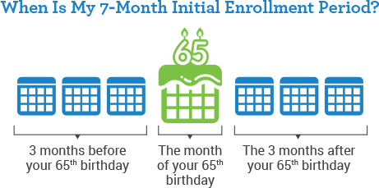
When to Enroll…
Parts A, B, C and/or D:
Note: If you delay enrollment you may have to pay a penalty.
If you or your spouse will continue to receive coverage through a current employer insurance, then your situation may be different.

Slide 6
When to enroll continued…
If you are under age 65 & entitled to Medicare due to disability, you will receive Medicare card after the 25th month of receiving Social Security Disability Insurance (SSDI).
If you have coverage through you or your spouse’s employer group health plan, you can delay enrollment into Medicare Part A and B.
Note: If you opt not to enroll in a drug coverage and do not have ‘Creditable Coverage’ during that time, you may have to pay a penalty when/if you later choose to enroll in Part D.

Slide 7
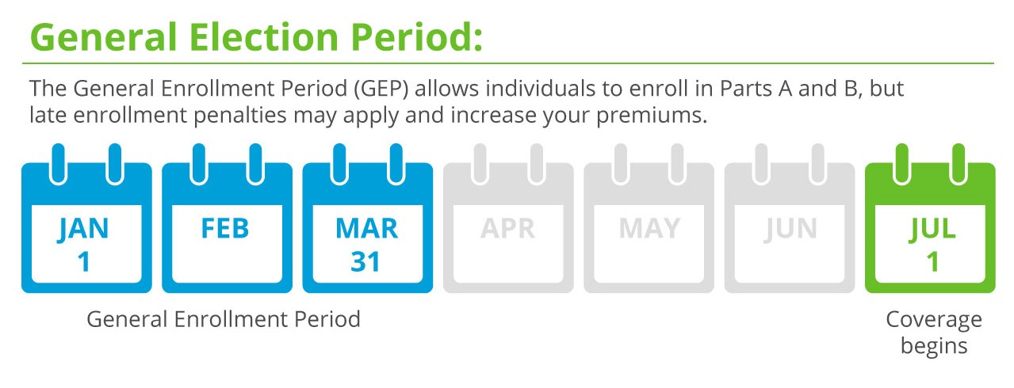
If you didn’t enroll…
Late Enrollment Penalty!

Slide 8
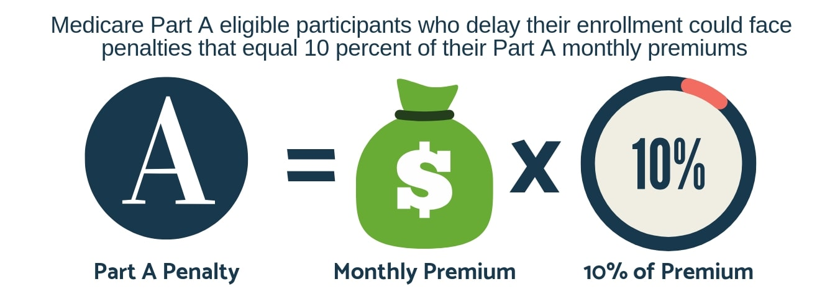
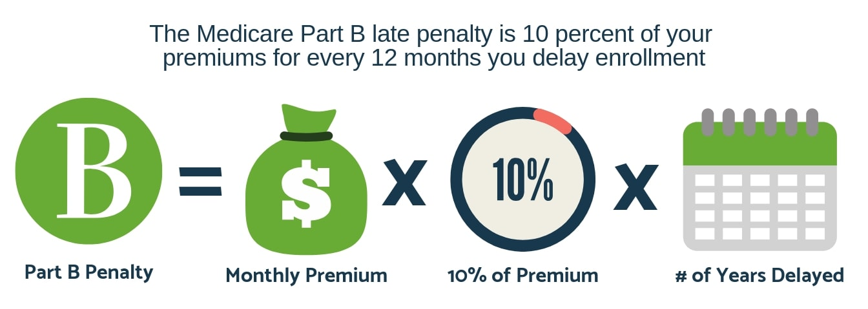
Part A & Part B Penalties

Slide 9
THUMBNAIL SKETCH OF MEDICARE 2022
Original Medicare
Medicare Advantage
Part A
Hospital Insurance
Deductible=$1,556
Hospital coinsurance
$389 (day 61-90)
Skilled Nursing Facility
coinsurance $194.50
(day 21-100)
Part D
Must have Part A or B
Part C
Medicare
Advantage
Plans
Must have
Parts A+B
Premium
Deductible≤$480
Cost-sharing
3 Medicare
Advantage w/
drug coverage
*Can include additional benefits at an extra cost.
Part B
Outpatient Medical Services
Premium=$170.10
Deductible=$233 Coinsurance=20%

Slide 10

Hospital Insurance
There is no monthly Part A premium for people who have 40+ quarters of social security credits (10yrs)
30-39 quarters = Premium of $274 per month
Less than 30 quarters = Premium of $499 per month
Inpatient hospital deductible = $1,556

Slide 11
Medicare Part A: Hospital Insurance
Part A of Medicare covers services in:
Hospital in the inpatient setting
Skilled Nursing Facility care
Home Health Care (certain circumstances)
Hospice care.
Skilled Nursing Facility Criteria
Hospitalized and admitted as an inpatient for ≥3 consecutive days prior to entering the SNF.
Medicare covers care in SNF for condition treated in the hospital.
The SNF must be certified by Medicare.
Doctor, NP or CNS certifies that beneficiary needs skilled services.
Beneficiary must need “skilled” nursing or therapy services on a daily basis.
All criteria must be met for Medicare to cover a SNF stay.

Slide 12


Medical Insurance
If your individual income is less than $88,000 or if your couple’s income is more than $176,000, your premium will be higher.
2022 Premium - $170.10/month
Part B pays a portion of Medicare approved amounts for out-patient services such as:
Doctor’s services
Outpatient hospital care
Lab tests
Physical therapy, speech therapy
Ambulance services
Durable medical equipment.
Preventative Services are billed to Part B – most have no co-pay, no co-insurance.
https://www.medicare.gov/coverage/preventive-screening-services

Slide 13


Medicare
Preventive & Screening Services
Some of the services covered are:
Diabetes screenings
Flu shots
Glaucoma tests
Lung cancer screening
Mammograms (screening)
COVID-19 vaccines
Yearly "Wellness" visit
And More!
Visit www.medicare.gov/coverage/preventive-screening-services

Slide 14
Part B for Higher Income Enrollees 2022
Income bracket (single) | Income bracket (file jointly) | Income Related Monthly Adjustment Amount (IRMAA)
≤$91,000 | ≤$182,000 | n/a ($170.10)
>$91,000 and ≤$114,000 | >$182,000 and ≤$228,000 | $238.10
>$114,000 and ≤$142,000 | >$228,000 and ≤$284,000 | $340.20
>$142,000 and ≤$170,000 | >$284,000 and ≤$340,000 | $442.30
>$170,000 and ≤$500,000 | >$340,000 and ≤$750,000 | $544.30
>$500,000 | >$750,00 | $578.30

Slide 15

Re-evaluate your coverage every year!
All plans change January 1st
Part D Prescription Drug Coverage
Number of plans available for 2022 | 25
Lowest premium: SilverScript SmartRx | $7.50
Highest premium: Blue Shield Rx Enhanced | $160.20

Slide 16
Part D for Higher Income Enrollees – 2022
File individual tax return | File joint tax return | File married & separate tax return | You pay each month
$91,000 or less | $182,000 or less | $88,000 or less | your plan premium
Above $91,000 up to $114,000 | Above $182,000 up to $228,000 | not applicable | $12.40 + your plan premium
Above $114,000 up to $142,000 | Above $228,000 up to $284,000 | not applicable | $32.10 + your plan premium
Above $142,000 up to $170,000 | Above $284,000 up to $340,000 | not applicable | $51.70 + your plan premium
Above $170,000 and less than $500,000 | Above $340,000 and less than $750,000 | above $91,000 and less than $409,000 | $71.30 + your plan premium
$500,000 or above | $750,000 and above | $409,000 and above | $77.90 + your plan premium

Slide 17
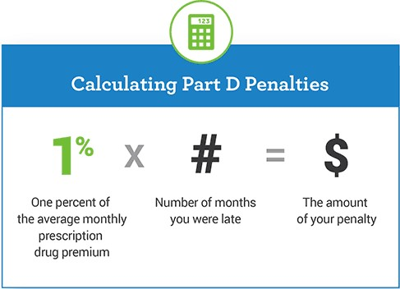
Part D Penalty
Penalty imposed for as long as beneficiary has Part D
If you are enrolled in Medicare because of a disability and currently pay a premium penalty, once you turn 65 you will no longer have to pay the penalty.

Slide 18
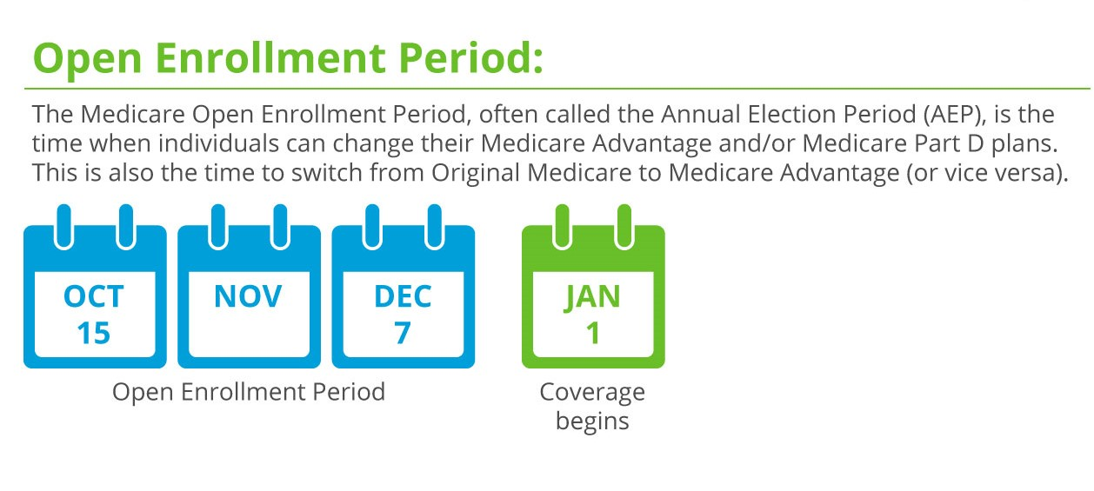
Reassess your coverage each year!

Slide 19

Medicare Advantage
 | Aspire Health Value | Aspire Health Advantage | Aspire Health Plus
Monthly Premium | $52 | $139 | $269
Annual Deductible | Medical = none Rx = $480 | Medical = none Rx = $150 | Medical = none Rx = none
Out-of-Pocket Spending Limit | $7550 In-Network Only | $5000 In-Network Only | $3450 in and out of service are combined
Choice of Doctors? | Within Network | Within Network | Within Network Some providers outside this county
Copays | $ vary | $ vary | $vary

Slide 20
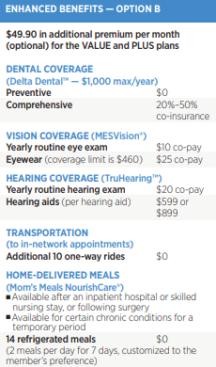
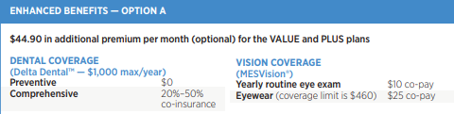
Medicare Advantage Enhanced Benefits

Slide 21
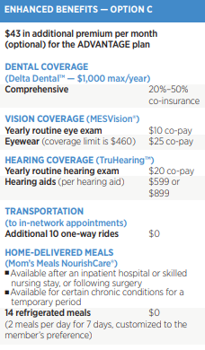
Medicare Advantage Enhanced Benefits continue…
*Only for Aspire Health Advantage plan $139/month

Slide 22
Aspire’s premium includes additional benefits, not offered by Original Medicare such as:
Additional Chiropractor
Transportation to medical appointments
Gym Membership
Wellness and disease management programs
Community Connections programs, such as Aspire Book Club, cooking and art classes
Choice of Doctors:
UCSF Medical & Stanford providers are in-network for all three of the plans.

Slide 23

Medigap/Supplemental Insurance
What are they?
Insurances to cover part or all of Original Medicare’s co-payment and deductibles.
If you have retiree plan or full Medi-Cal benefits, you do not need to buy a Medigap policy.
Is there a health screening?
You may apply for a Medigap policy at any time but companies selling Medigap plans may refuse to sell you one based on current health conditions.
There are certain times when, by law, companies must sell you a plan regardless of medical history.
IMPORTANT: If you turn 65, you have a 6-month open enrollment period that starts on the effective date of your part B benefits.

Slide 24
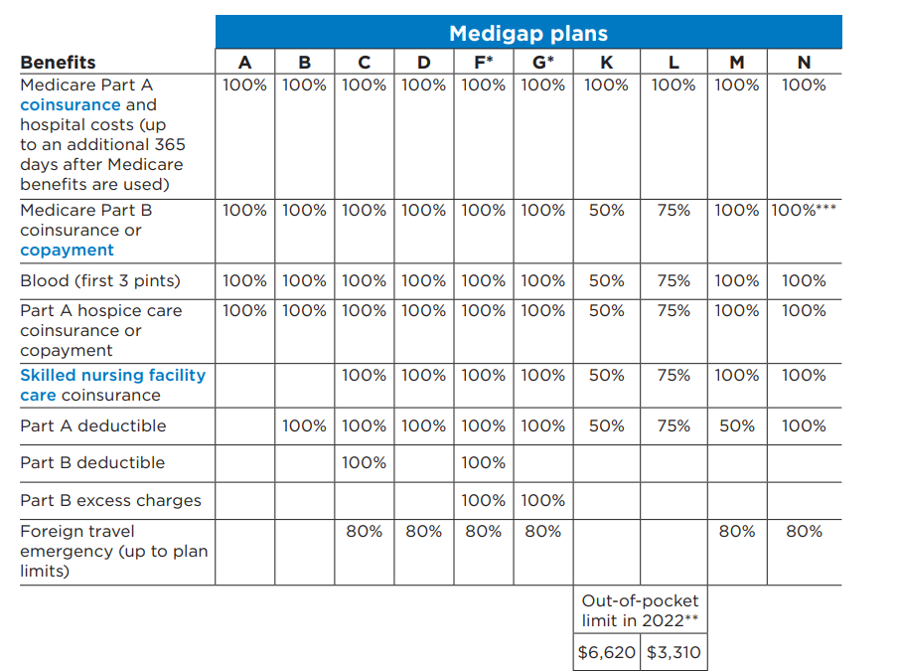
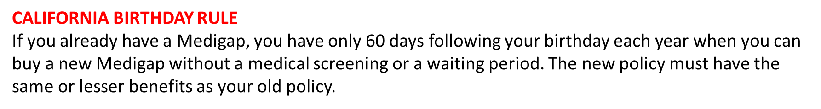
***Plan N pays 100% of the Part B coinsurance. You must pay a copayment of up to $20 for office visits and up to a $50 copayment for emergency room visits that don’t result
in an inpatient admission.
NOTE: Plans C and F are no longer available to people new to Medicare on or after January 1, 2020.
X
X
X
X
X
X
X
X
X
X
X
X
X
X
X
X
X
X
X
X
X
X
X
Notes:
** For Plans K and L, after you meet your out-of-pocket yearly limit and your yearly Part B deductible ($233 in 2022), the Medigap plan pays 100% of covered services for the rest of the calendar year.

Slide 25
Medigap/Supplemental continued…
Companies?
Contact independent insurance companies to obtain a rate quote.
The benefits within any one type of plan are standardized which means the benefits must be the same.
Cost?
It varies. The more comprehensive plan the higher the monthly rate.
In CA if you already have a Medigap plan, you can reassess your plan starting the day of your birthday. You have 60 days to reassess your plan with guaranteed issued rights.
For a detailed list of companies and rate estimates, contact HICAP.

Slide 26
It’s important to ask the question! Do you accept Medicare?
Participating Providers agree to accept Medicare-approved amount as total payment
Non-Participating Providers expect payment time service is rendered with 15% excess charge
Those who have opted out of Medicare and have no relationship with Medicare. They should provide written contract of charges… which are NOT reimbursed by Medicare

Slide 27

Programs for Low-Income Individuals “Extra Help”
Provides help with Part D costs
(premium, pharmacy co-pays, no deductible/donut hole)
Income/Resource limits-
Single: $1,699 per month / $15,510
Couple: $2,289 per month / $30,950
When to apply?
Anytime, give HICAP a call to get help with application.

Slide 28

Medicare Savings Program
What is it?
Four different steps levels that may help with original Medicare premiums, deductible, and/or copays.
Qualified Medicare Beneficiary (QMB) Program
Specified Low-Income Medicare Beneficiary (SLMB) Program
Qualifying Individual (QI) Program
Qualified Disabled and Working Individuals (QDWI) Program
Do I qualify?
Based upon income & assets - HICAP counselor can screen you
How to apply?
Medicare Savings Programs are administered through Monterey County but a HICAP counselor can help with the application.

Slide 29

In Closing
Protect your identity
Guard your Medicare Number
Read your Medicare Summary Notices
Beware of offers for free medical equipment. It’s often a scam.
Remember, Medicare does not call you!

Slide 30

Any questions?

Slide 31


For questions, appointments, and/or further information about our services at 1-800-434-0222.
Alma Mandujano
amandujano@allianceonaging.org
831-655-7567

