Slide 1
Do our Children & Grandchildren really speak English?

Slide 2
Here is the Puzzle?
Language change is functionally disadvantageous, in that it hinders communication, and it is also negatively evaluated by socially dominant groups.
Nevertheless, it is a universal fact of human history.

Slide 3
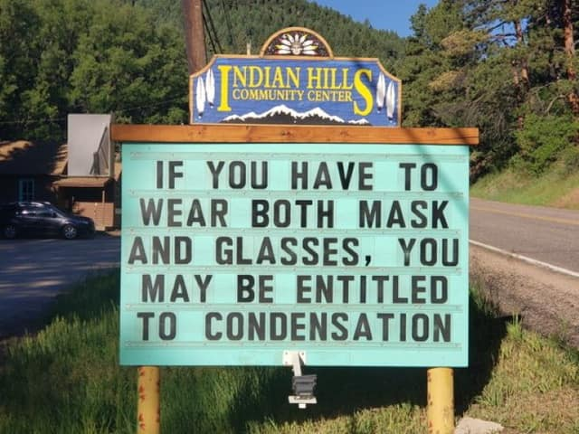

Slide 4
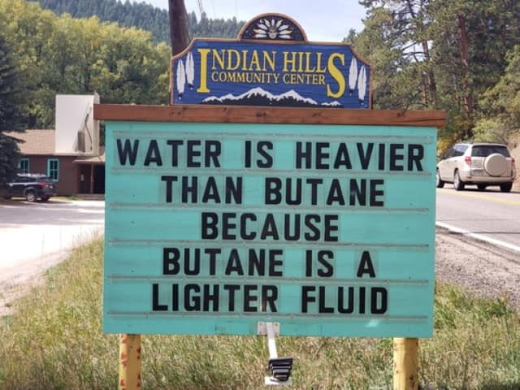

Slide 5
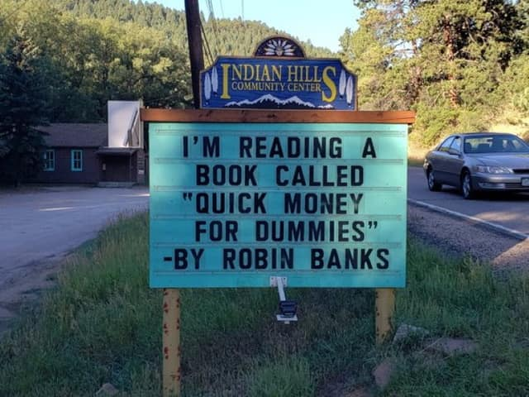

Slide 6
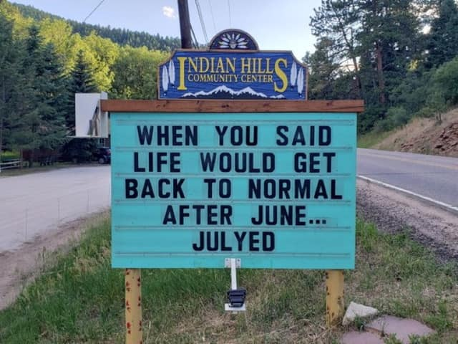

Slide 7
Do our Children & Grandchildren really speak English?
Language is always changing, right?
Wasn’t English more elegant in Shakespeare’s Day?
How Have Millennials changed the Language?
How have computers & Smartphones changed how we communicate? TEXTING

Slide 8
What I did in the Weather Service
Upr lvl rdg will wkn and mov S. A deep uppr trough movng SE will dig S Wed & dvlop ovr the next few days over the Cntrl Sierra. Cld air will dig S and sprd some precip ovr the w cst and sno to the mtns. Sno lvls will lwr & rang from 4K N to 6K S.

Slide 9
Language changes for several reasons.
The needs of the speakers change.
The technology changes.
No two people have had the same language experience.
We get them from many different places and languages, i.e. Sushi, Brunch (from breakfast & lunch),
Many changes in languages begin with teens and young adults.

Slide 10
What is Correct English
By 'correct English', people usually mean Standard English. Most languages have a standard form; it's the form of the language used in government, education, and other formal contexts. But Standard English is just one dialect of English.

Slide 11

Middle English
'Wepyng and waylyng, care and oother sorwe
I knowe ynogh, on even and a-morwe,'
Quod the Marchant, 'and so doon oother mo
That wedded been (Canterbury tales)
'Weeping and wailing, care and other sorrow
I know enough, in the evening and in the morning,'
said the Merchant, 'and so do many others
who have been married.'

Slide 12
How much has our language changed?
Shakespeare's English 1600s.
Sir, in my heart there was a kind of fighting That would not let me sleep. Methought I lay Worse than the mutines in the bilboes. Rashly— And prais'd be rashness for it—let us know Our indiscretion sometimes serves us well .. Hamlet

Slide 13
Why can’t people just use correct English?
Language is always changing.
Shakespeare’s English.
English in the 20s and 30s.
English in the 50s and 60s.
English Today.

Slide 14
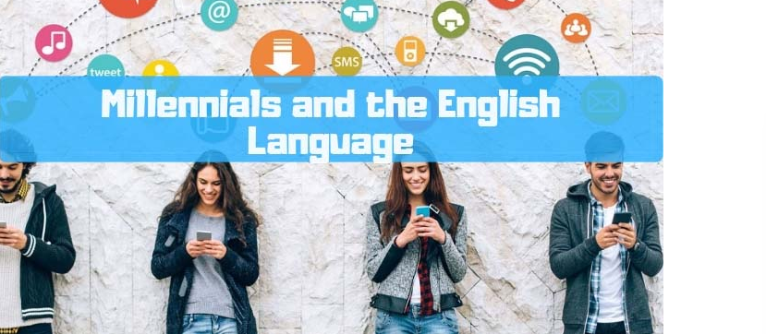
How Have Millennials changed the Language?

Slide 15
How Have Millennials changed the Language?
1. Language inevitably changes.
2. New Slang, like Woke meaning socially aware, lit meaning fun, low key meaning subtle.
3. Impacts of social media, rt meaning retweet, trolling meaning deliberately provoke someone online.
4. They have just shortened the language. LOL, YOLO, BAE.

Slide 16
How Have Millennials changed the Language?
Basically, they’re shortening it. Phrases are often abbreviated into one or two syllable words, such as YOLO (“you only live once”), FOMO (“fear of missing out”), and BAE (“before anyone else”).
Words themselves are shortened to just one syllable by cutting off the rest of the word, as in totes (“totally”) or perf (“perfect”).
However, not only are these abbreviations not ruining English, they’re actually following some very strict rules.

Slide 17
How Have Millennials changed the Language?
Do you notice that every acronym they make can be pronounced easily? That’s because they aren’t randomly combining letters, they’re choosing ones in easy consonant-vowel combinations. Millennials aren’t choosing letter combinations that are hard to say, like “gf” or “kt.”

Slide 18
How Have Millennials changed the Language?
They even apply English grammar rules to their new creations. For example, the Millennial slang word jelly (“jealous”) came from shortening “jealous” to “jeal” and then applying the –y suffix to make a new adverb. This has also happened with the word feels (“feelings”).

Slide 19
Even sentence structure is changing
Over the past few decades, three new ways of reporting speech have appeared:
(1) So Karen goes, "Wow - I wish I'd been there!"
(2) So Karen is like, "Wow - I wish I'd been there!"
(3) So Karen is all, "Wow - I wish I'd been there!"
All three are correct, but have a slightly different meaning.

Slide 20
Words to know in 2021
Sorry not sorry – making it clear how un-remorseful you are about something
Spilling a tea – sharing gossip
Swerve – in other words get lost or go away, you are not welcome
Salty – being in a bad or grumpy mood
The struggle is real – sarcastic way of expressing frustration
Thirsty – wanting attention either on social media or in real life
Trolls – people who say nasty things to others online
Basic – suggesting that your personality and opinions and physical attributes are particularly standard

Slide 21
Words to know in 2021
Goals AF – what you want to achieve or possess in life
Bae – the one you love the most
Bounce – to leave a place quickly
On fleek – on point, looking good
RT – abbreviation of retweet
Fire – great, trendy (your new shoes are fire)
Quiche – hotter than hot
Sus – acting shady
I can’t even – exclamation in response to an amazing, frustrating, surprising event
Dead – when you’ve seen or read something that’s so good or funny

Slide 22
Words to know for 2021
BIPOC—”Black, Indigenous, (and) People of Color”
“Who among us didn’t want to give the year 2020 a hard pass?”
Cancel culture Merriam-Webster defines this term as “the practice or tendency of engaging in mass canceling as a way of expressing disapproval and exerting social pressure.”

Slide 23
Words to know for 2021
You know that feeling of snuggling up on the couch in front of a flickering fire? Or wearing your favorite slippers while drinking hot tea? Well, there’s a name for that: hygge (Huega).
Gig Worker. Merriam-Webster defines the phrase as “a person who works temporary jobs typically in the service sector as an independent contractor or freelancer.
To Flex: To knowingly flaunt or show off.

Slide 24
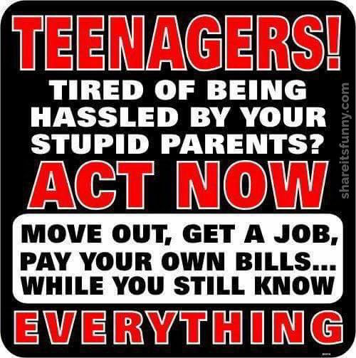

Slide 25
Texting
1. Today’s communication between young people is over the phone and they use:
a. Snapchat
b. Instagram
c. Pinterest
d. Vine
e. Twitter

Slide 26
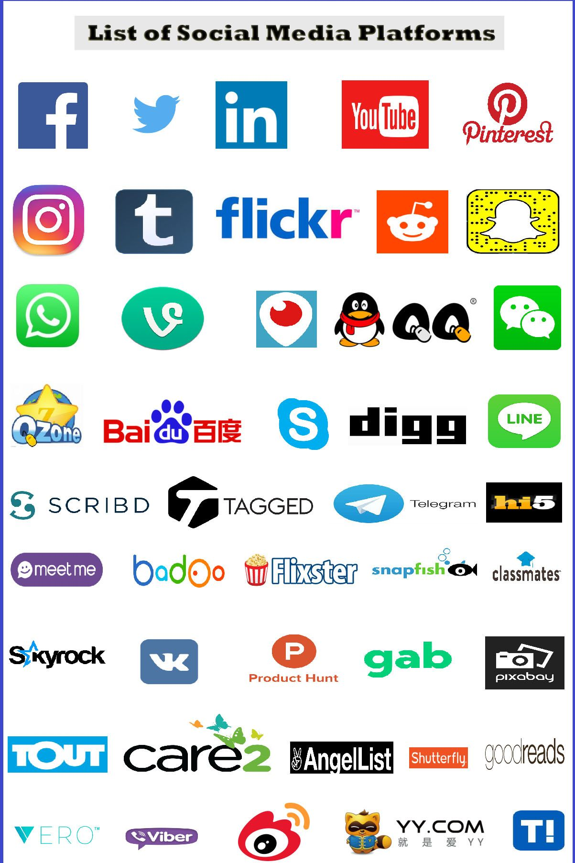
Texting
And there are more:
Some limit the number of characters, some are for advertising, marketing & a way to get a job, mainly for business, some are for only pictures and videos, some are age limiting and some are just for showing people what you are doing. There are hundreds of Platforms out there.

Slide 27

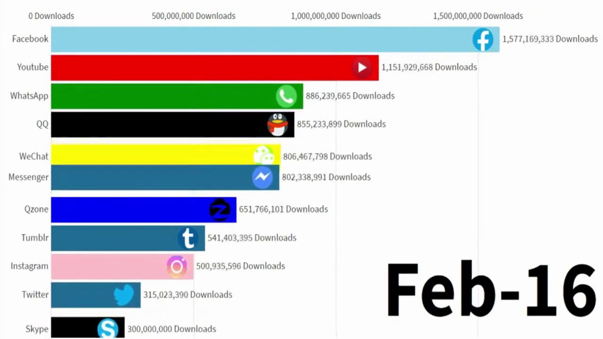
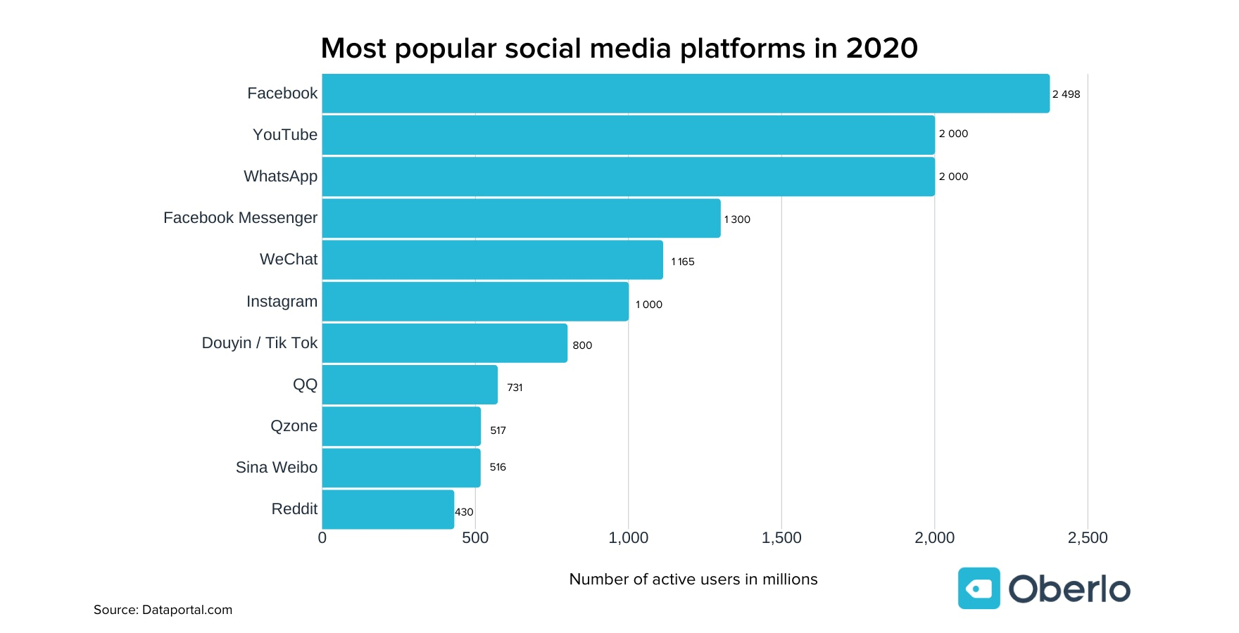
Texting

Slide 28
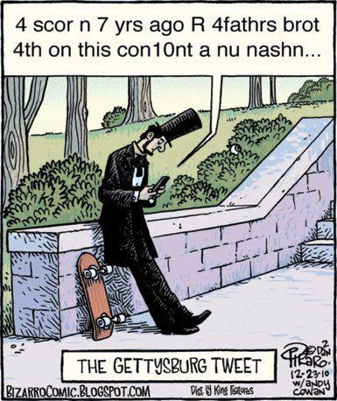
The Gettysburg tweet

Slide 29
A Few Texting Abbreviations
BTW - By the way
BRB - Be right back
OMG – Oh My god (goodness)
AFAIK – As far as I know
AMA – Ask me anything
BFF – Best Friends forever.
CSL – Can’t Stop Laughing
L8R - Later
LOL - Lots of love
MNC – Mother nature calls

Slide 30
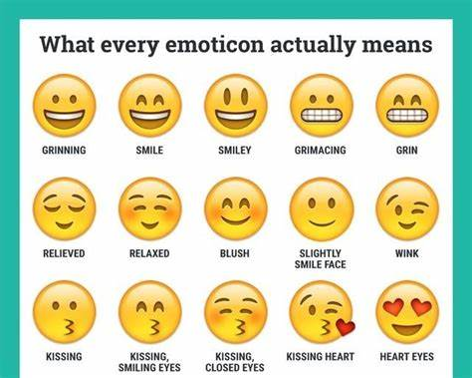
A few Emojis
There are hundreds of emojies.
You can add many to your phones.
They are shorter than words.

Slide 31
The test
OMG I am glad we r BFF it was g2cu gnite
Oh my goodness (god), I am glad we are best friends forever. It was good to see you goodnight.
BTW AFAIK Norm & Jean are BFF SEE ya L8R MNC.
By the way, as far as I know, Norm & Jean are best friends forever. See ya later, Mother Nature Calls

Slide 32
The Quiz
J2lyk I cannot make it tngt l8r
Just to let you know, I cannot make it tonight. Later.
Icymi ncis was a gr8 show tngt.
In case you missed it, NCIS was a great show tonight.
Imho this is really crzy. Good ngt. Im done
In my humble opinion, this is really crasy, good ngt. I am done.

Slide 33
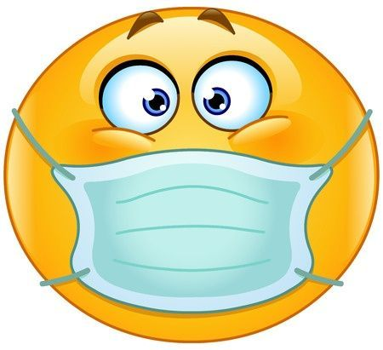
I’m done

