Slide 1

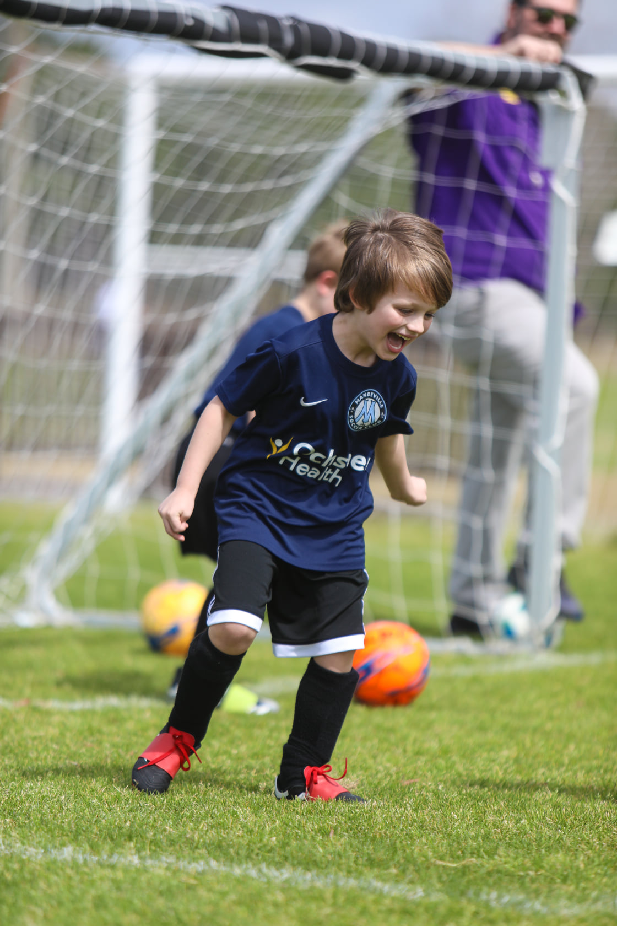
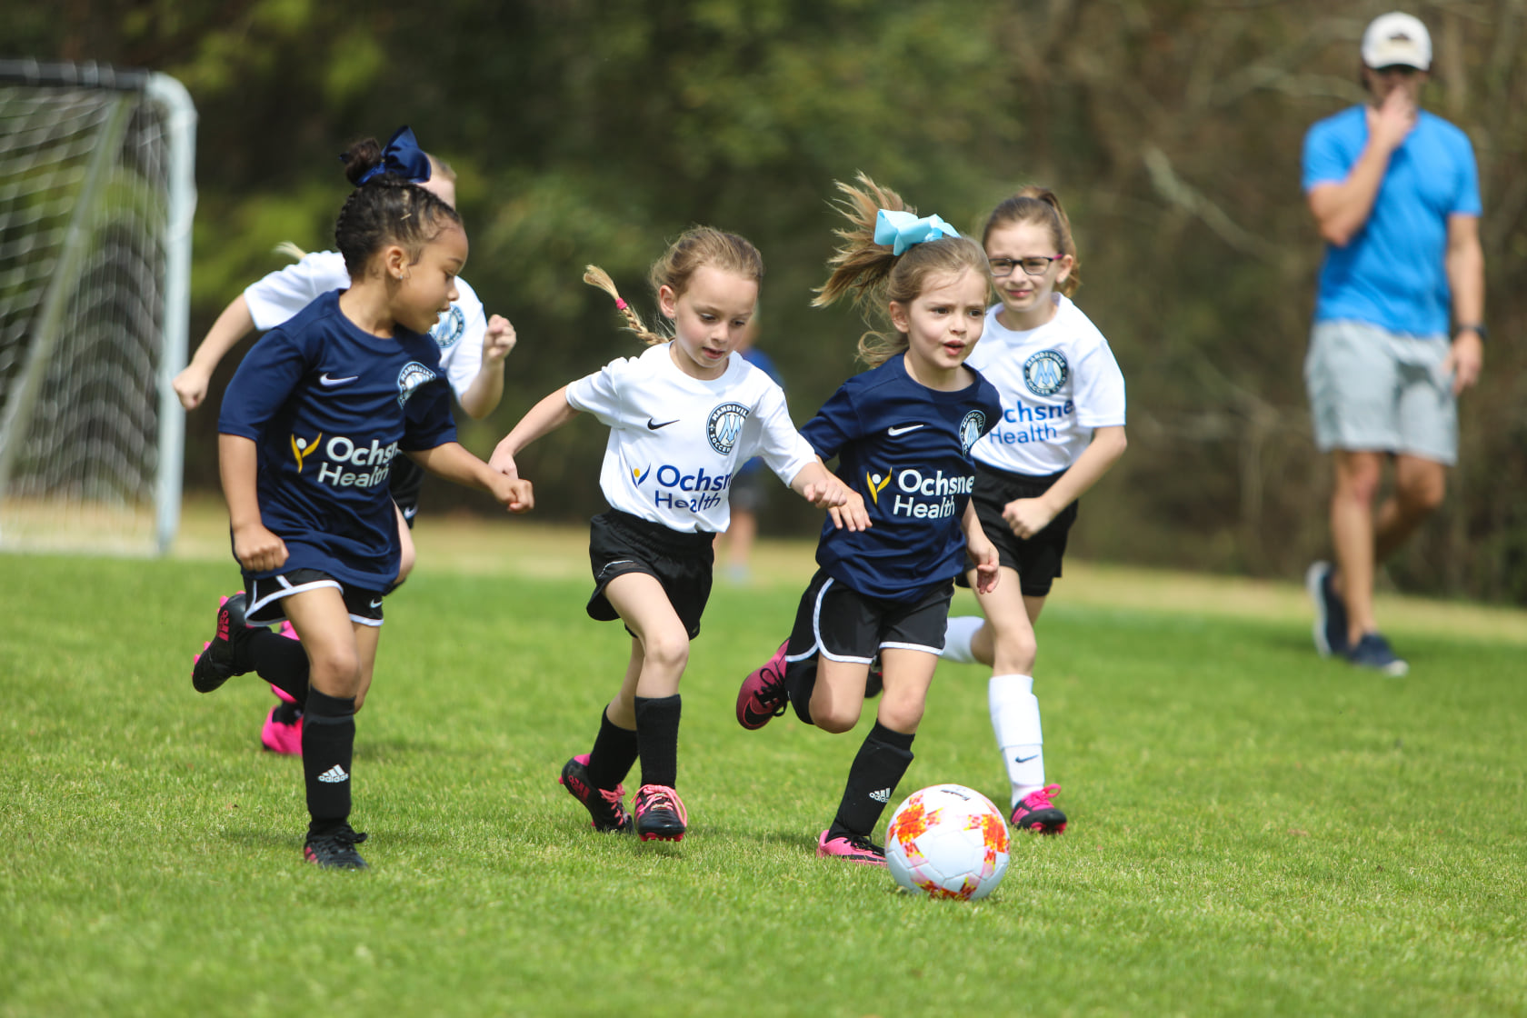

l
MSC
Recreational
Coaching
Manual
Mandeville Soccer Club Recreational Season
Fall 2025/Spring 2026

Slide 2
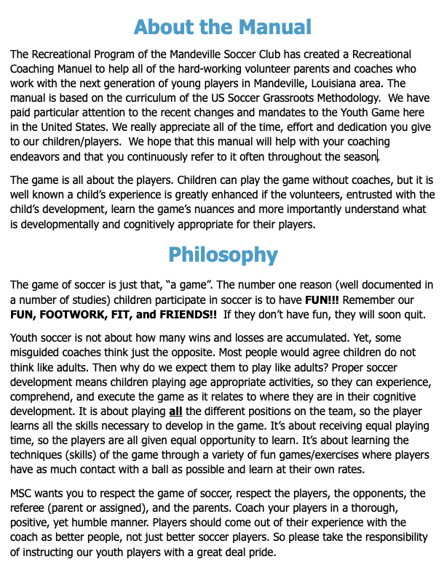

Slide 3
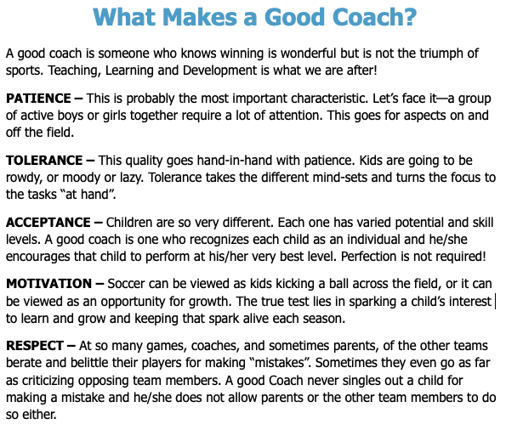
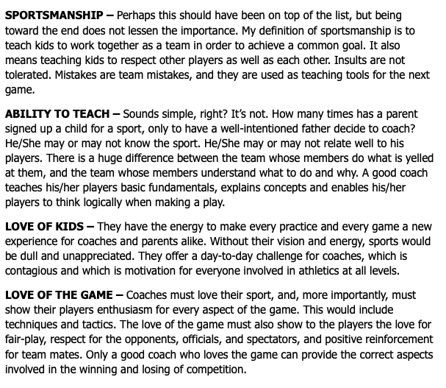
Mandeville Soccer Club Recreational Season
Fall 2025/Spring 2026

Slide 4
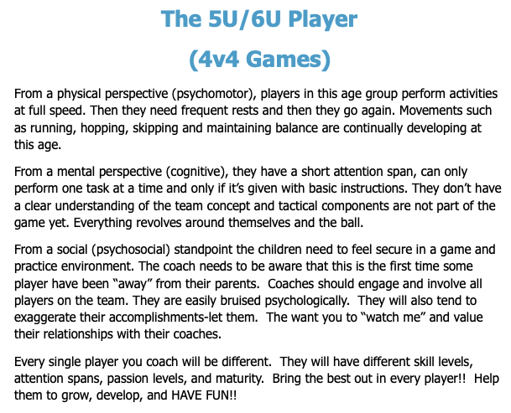
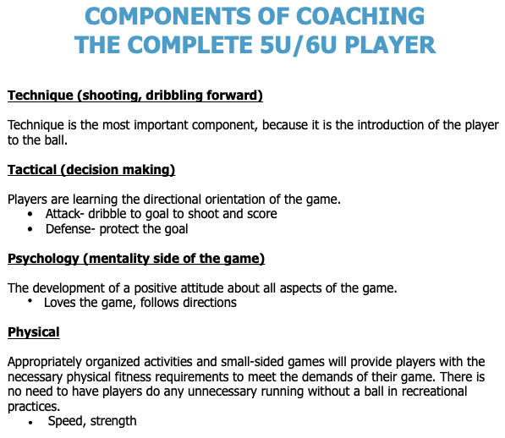
MSC 5U/6U Recreational Fall 2025/Spring 2026

Slide 5
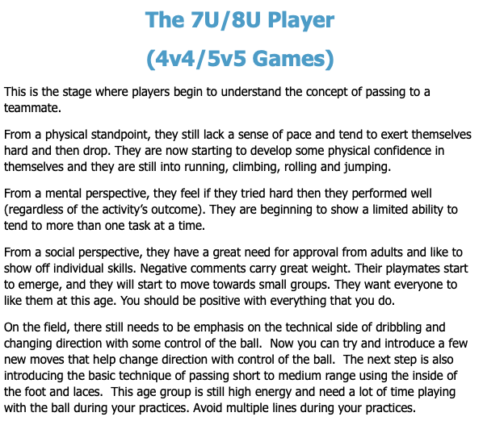
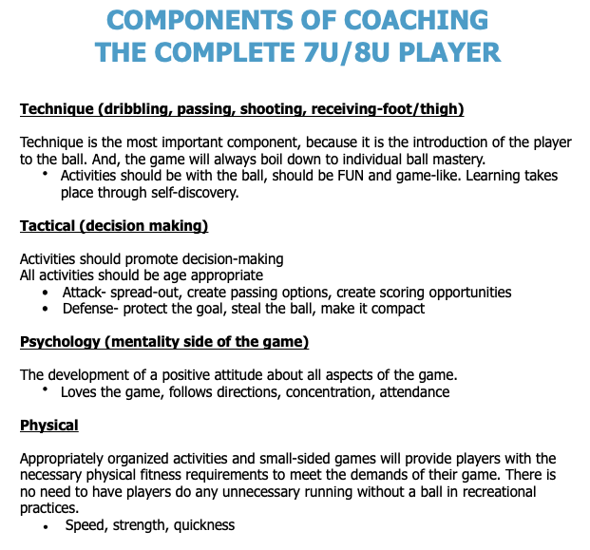
MSC 7U/8U Recreational Fall 2025/Spring 2026

Slide 6
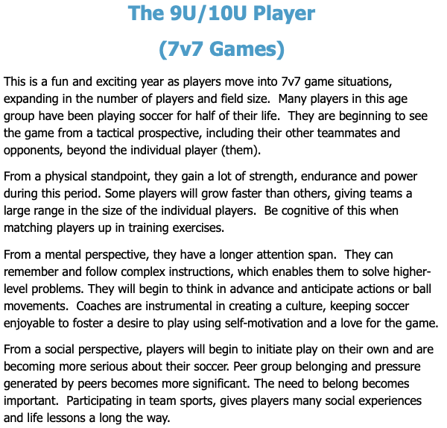
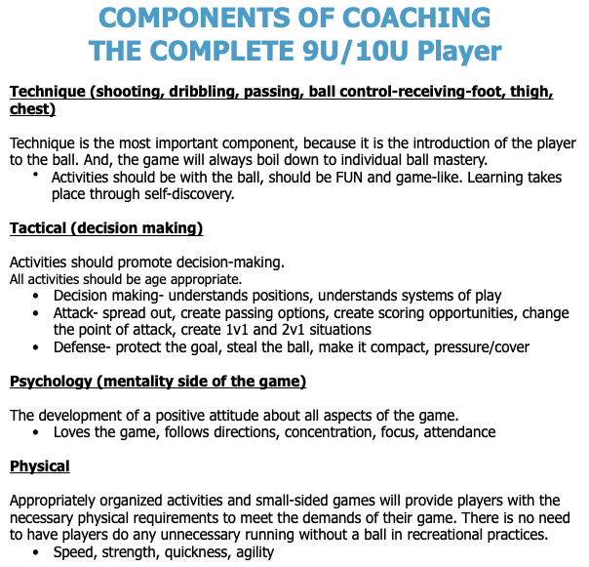
MSC 9U/10U Recreational Fall 2025/Spring 2026

Slide 7
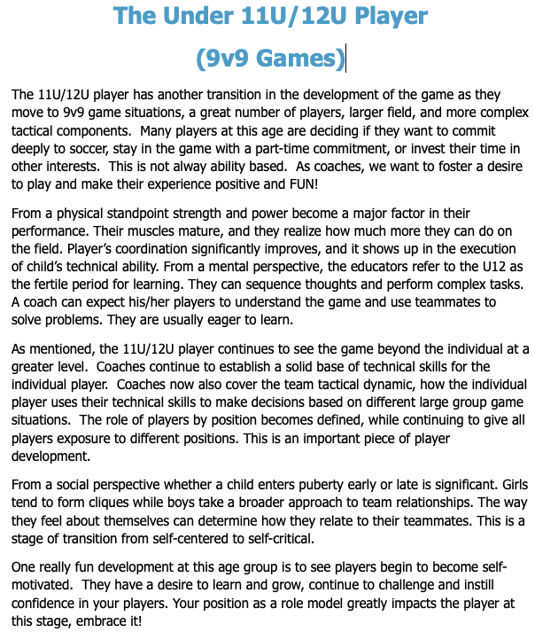
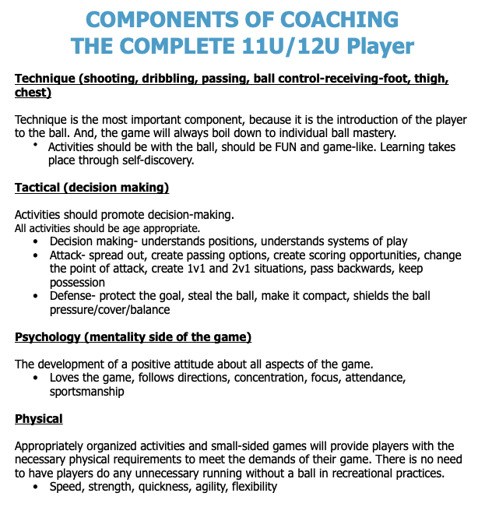
MSC 11U/12U Recreational Fall 2025/Spring 2026

Slide 8
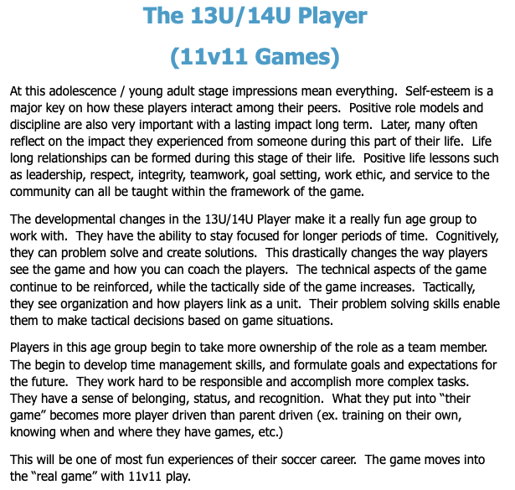
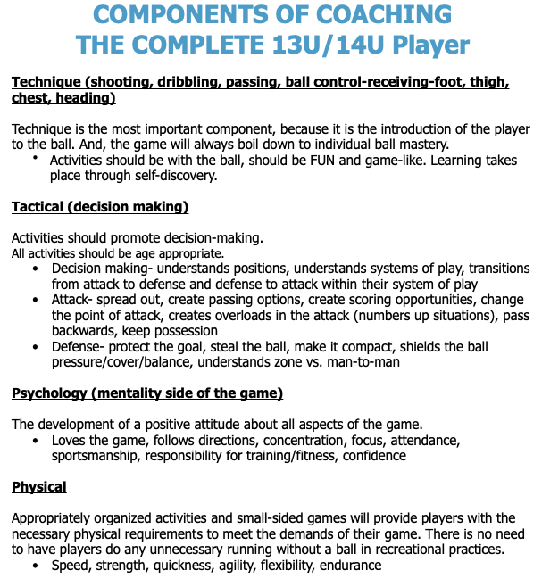
MSC 13U/14U Recreational Fall 2025/Spring 2026

