Slide 1

Catawba-Wateree Relicensing Coalition Summer Stakeholder Meeting
August 1, 2016
The Confluence, Cramerton NC
Shoreline Management Plan Update

Slide 2
Shoreline Management Plan and Guidelines Update
•Duke is required to prepare and manage a shoreline management plan for the waters within the project boundary
•Evolved over time from a very basic description to a complex set of classifications, guidelines and maps
•Habitat Enhancement Program developed
•Update required every 10 years. A workgroup convenes each year to assess status and recommend changes
•The most recent update was prepared and filed last year. Still waiting for FERC to act.
Notable items:
Mapping errors
Use of Residential Marina Preservation Program – incentives for protecting shoreline
Overnight boats
New items being introduced:
No new shoreline construction (piers, docks, etc) without house on the adjoining lot
Survey to determine dilapidated docks and vessels to begin next year

Slide 3
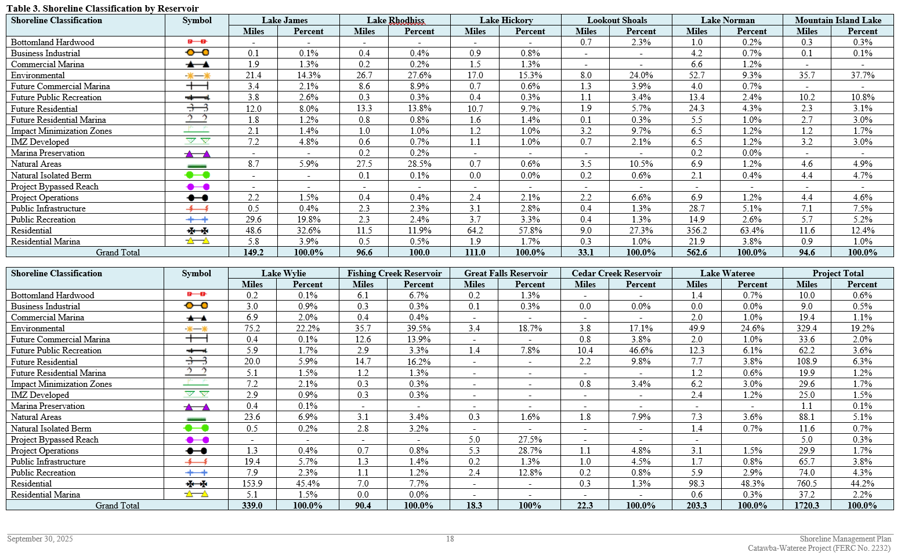

Slide 4
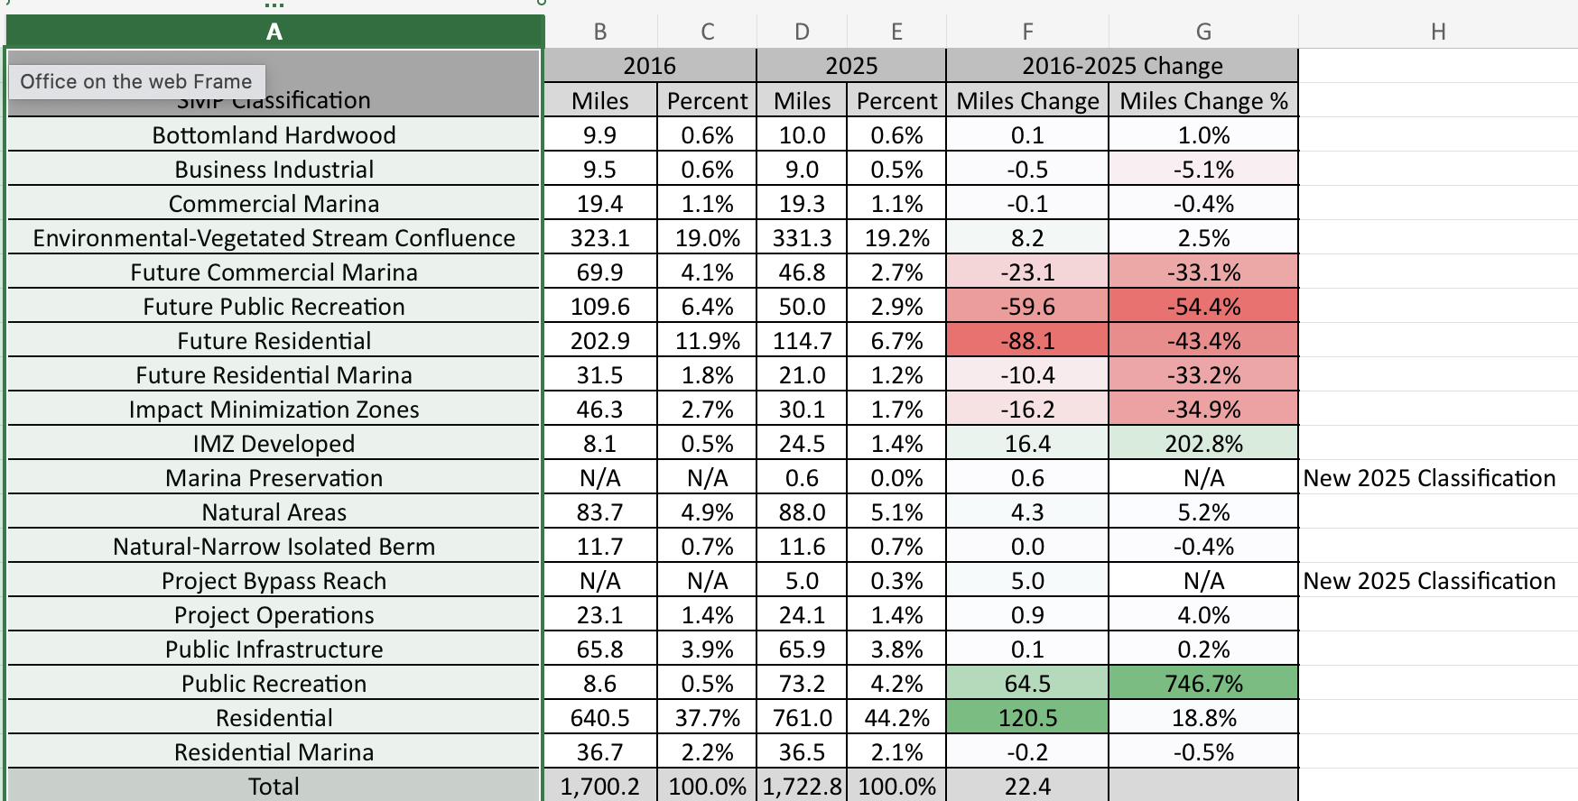
Classification Changes

Slide 5
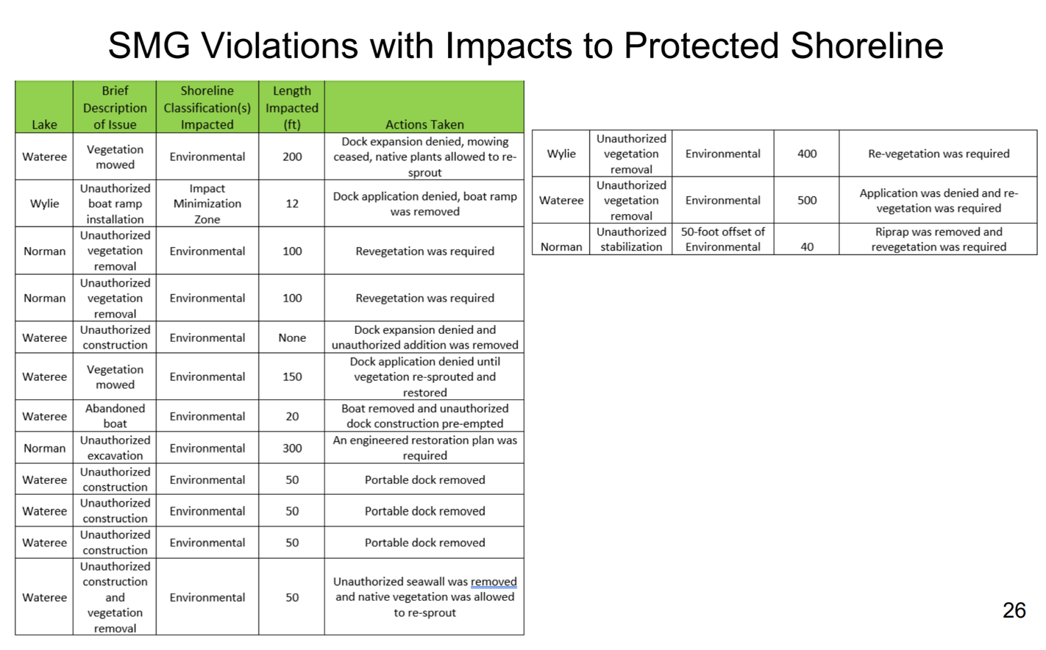

Slide 6
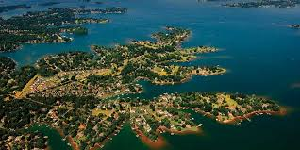
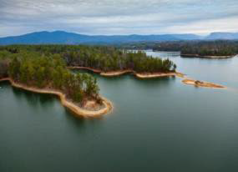
Details and the Plan can be found on the Duke Energy Website.

