Slide 1
Very Brief Update CWRC
August 1, 2026

Slide 2
Two Decades of Regional Water Supply Planning
2006
Water Supply Study & Safe Yield Study
Identified the maximum capacity of the Catawba River Basin for water supply could be reached by 2048
2014/15
Water Supply
Master Plan
Recommended strategies to extend safe yield
to 2100
2025
Integrated Water Resources Plan
Final Draft developed
Dec 2025
Added water quality evaluations
Notes:
There’s something to be really proud of here.
Developing a river basin plan is a hard thing and this is the 3rd time around for this river basin.
The first two iterations were very focused on water quantity. Quality mattered and is certainly related but you gotta start somewhere.
This time, the IWRP is also working on water quality issues.

Slide 3

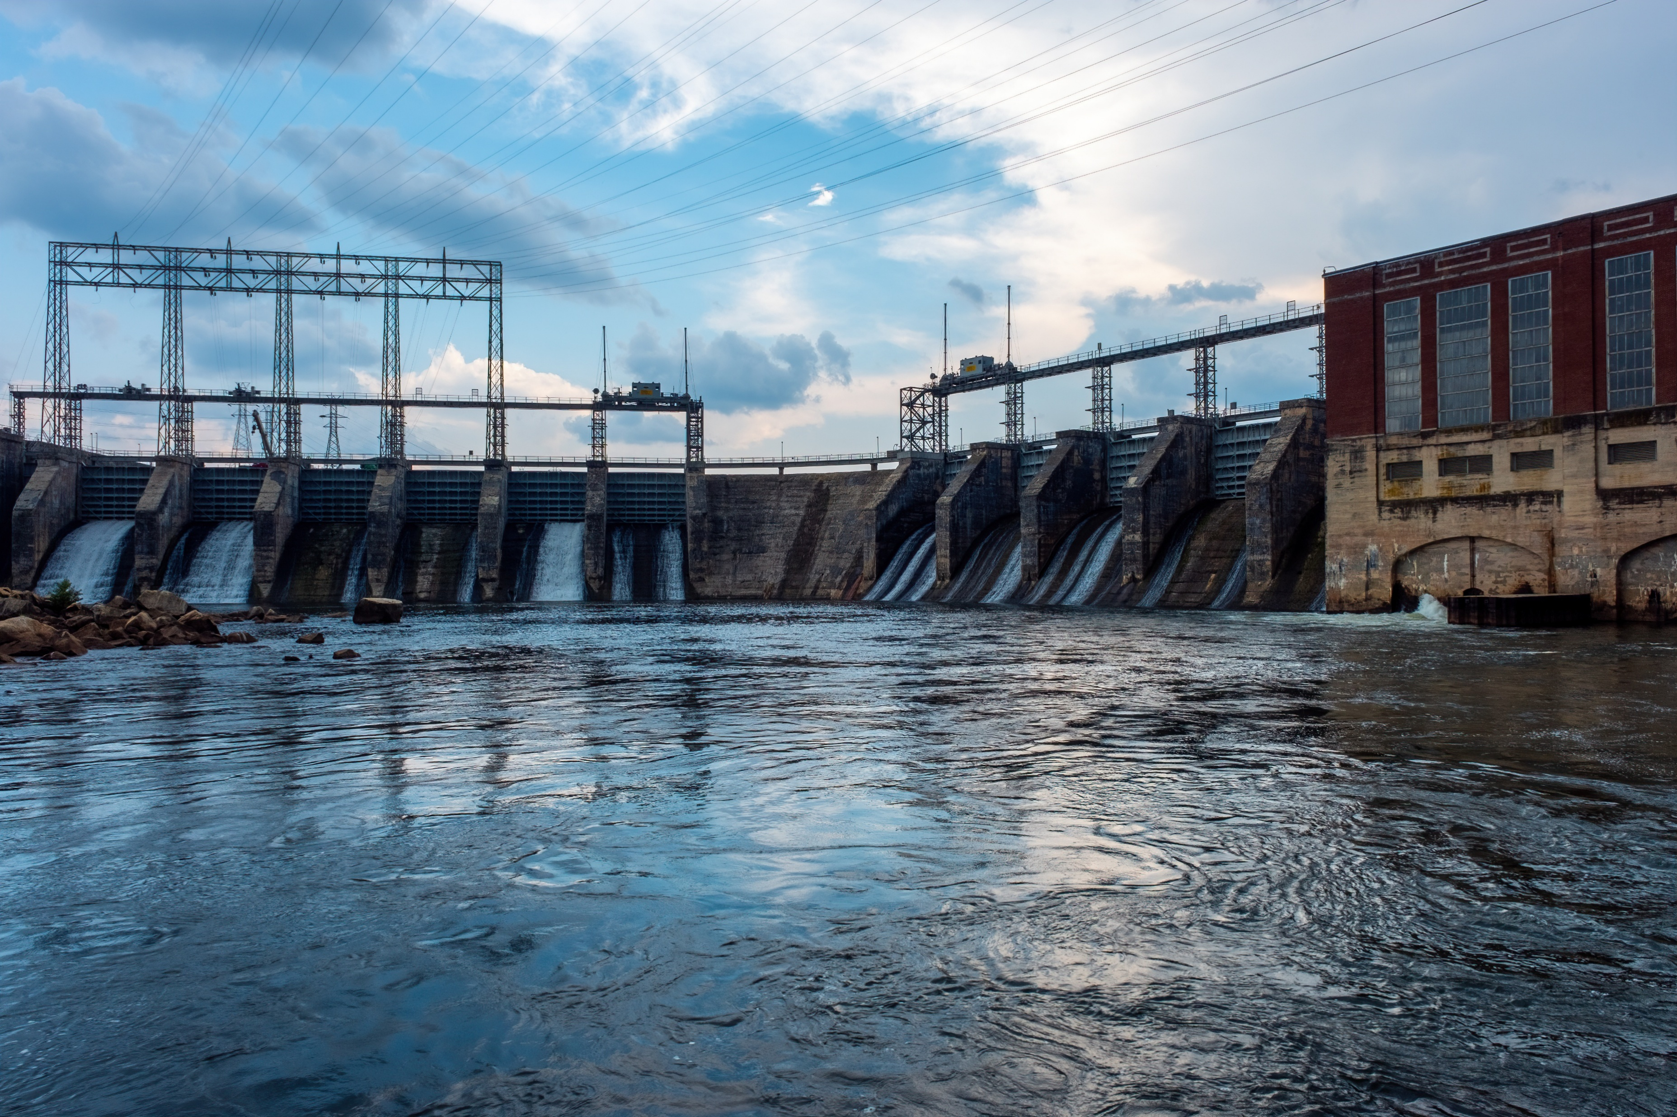
So, What did we learn from the IWRP?
Water Quantity
Net Water Demand is growing by 0.8% to 1.6% per year (base case = 1.2%)
  Projected energy production withdrawals are down from WSMP, municipal demands are up
Climate variability will have impacts
  Causes temperatures and evaporation to increase
  Rainfall at least in NC is expected to increase 5-10% per year by 2100. If it comes in large events, can we store it?
Reservoir inflow less than WSMP (methodology change)
Quantity v. Accessibility
  Total water quantity in the 11 reservoirs is adequate; water accessibility is not.
  Lake Wylie (2025-2035) and Mtn Island Lake (2075-2085) reach decision points in the base case 50-yr planning horizon
  380 billion gallons below Critical Reservoir Elevations
Interbasin transfers are significant.
  Slowing IBT growth or even reversing it would help.
  Eliminating all IBTs is not a cure-all.

Slide 4
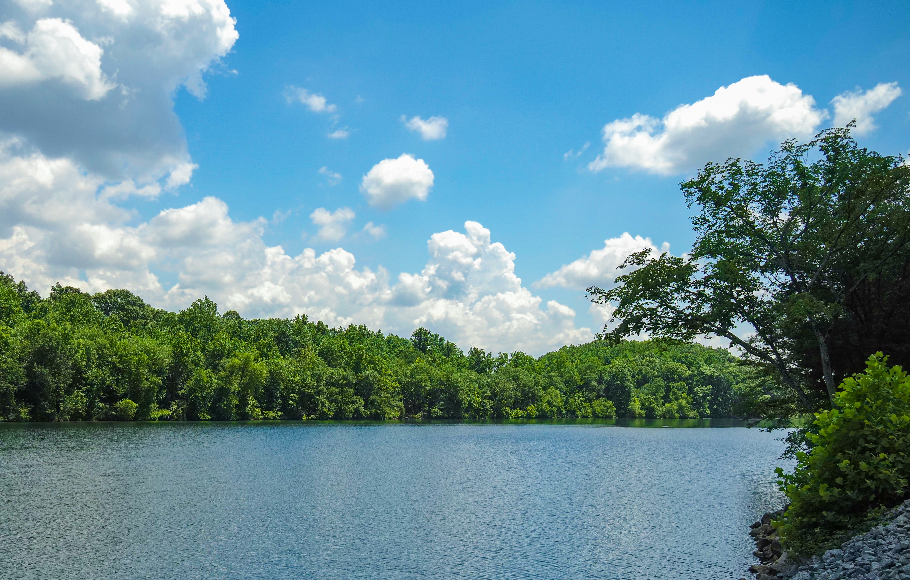
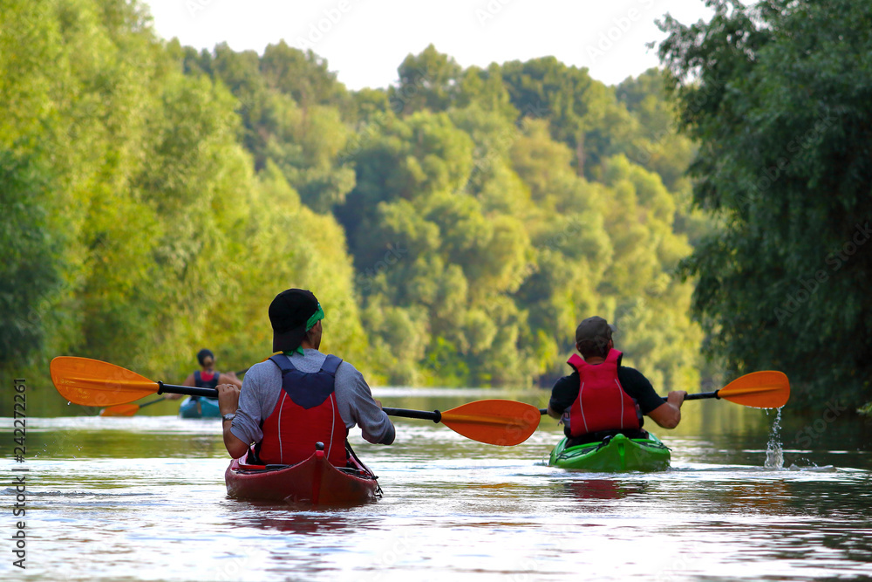
So, What did we learn from the IWRP?
Water Quality
Sedimentation is the biggest threat (nutrients/contaminants/storage loss)
  Slowing it down is really important
  Current deposition rate = 742,000 tons/yr = 455 ac-ft/yr @ 75 lbs/cubic ft = 148 million gallons per year of storage displaced = a 231-mile-long line of tandem axle dump trucks = approximate driving distance from Richburg, SC to Knoxville, TN!!!!!
Nutrients are a growing issue
  Compounding effects as you move down-river.
  Lower Catawba TMDL determination remains ongoing after work that began in the early 2000s.
Diligence and coordination are needed to monitor/address invasive/nuisance species
Source water protection needs area-focused plans (hot spots = best bang for the buck).

Slide 5
So, What did we learn from the IWRP?
Collaboration
Focusing together on high priorities will have the greatest positive impact
Policy/regulatory changes and more $$$ will be required
We need to think and act across the River Basin (beyond political boundaries)

Slide 6
A. Policy, Legislative, & Regulatory
RECOMMENDATIONS
An all-hands-on-deck, same-page approach to riparian buffers across the Basin.
Change Interbasin transfer (IBT) regulations to eliminate the unintended consequence of stifling river basin-level water management.
Designate a leadership-level champion within both NCDEQ and SCDES accountable for SC v. NC settlement agreement compliance.
Notes:
What would be your 1 wish for water quality protection in this River Basin? Mine would be a consistent, effective, regulatory-supported buffer on every perennial stream in the Basin. We need to get serious about doing that and make it happen.
IBTs are always emotional and that’s not likely to change. But what can change is the laws that govern them and the options chosen to meet the needs. There is no reason why an existing pipeline that serves utility customers in a major river basin cannot serve customers of another utility in that same river basin. We have got to make better common sense out of the way regulatory river basins are defined in NC and eliminate roadblocks. We also have to consider total costs, not just construction and operational costs, when selecting preferred solutions to IBTs. Our long-term goal should be to reduce not increase IBTs from this small, heavily used river.
And finally, the 2010 Supreme Court Settlement Agreement stopped a brewing water war. That agreement has tremendous value and it needs to be supported and relationships nurtured. The ask in the IWRP is for leadership level champions at those 2 state agencies to be tapped to protect that agreement. Water wars are a waste of valuable resources that none of us can afford.

Slide 7
B. Planning & Coordination
RECOMMENDATIONS
Establish a clearer, stronger system to evaluate whether source water protection strategies are actually working.
Coordinate land conservation and water supply protection at the subbasin level — growth and protection cannot operate in silos.
Elevate conservation as a shared regional priority, not just a communications effort.
Notes:
Per the Open Space Institute, at least 66% forested cover is needed to avoid nitrogen spikes in a river basin. Our river basin is already below that and headed downward.
We need more tangible effort and yes more money to invest in land conservation initiatives in this River Basin.
You saw from Jimmy’s slides that the CWWMG has started investing some money with our wonderful land trust partners on land-related source water protection.
But we need to think and act bigger on that front. Time is running out to protect hot spots that the IWRP has identified, to slow down sedimentation and keep the bad stuff out of our water.

Slide 8
C. Technical & Program Actions
RECOMMENDATIONS
Build a coordinated, Basin-wide monitoring system so decisions are based on shared, reliable data.
Use stronger science to guide buffer and protection policies.
Improve system efficiency before expanding infrastructure — reduce water loss, optimize plants, and expand reuse.
Plan for industrial and economic growth with eyes wide open to long-term water demand.
Update reservoir and storage data so planning reflects reality.
Tailor strategies to the unique needs and pressures of each subbasin.
Notes:
Lots of technical recommendations here and I won’t talk about them individually.
I expect we would all agree that these make good sense and would be very impactful if implemented.
These take money. We need to do just as good a job planning and budgeting and prioritizing things like this as we do the next pumping station, water plant or power plant.

Slide 9
D. Drought Planning & Response
RECOMMENDATIONS
Strengthen and act earlier under the Low Inflow Protocol (LIP) when drought conditions begin.
Ensure all significant water users participate in LIP-driven drought response.
Improve coordination across utilities and states during low-flow conditions.
Update contingency plans and conduct exercises before drought conditions escalate.
Prepare intake infrastructure for lower water levels.
Prioritize drought-related investments based on risk and long-term resilience, not reaction.
Notes:
How we prepare for and act when in drought can keep water intakes from becoming uncovered. We proved that with the fist LIP implementation in 2006-2009.
Our goal over time in lake use permitting is to drive down all critical intake elevations to as low as the hydro station can go.
In fact we are doing that with new and existing power plant intakes as well, including looking at McGuire Nuclear Station’s critical intake elevation.
If we are successful, together we can increase the usable water storage available to all of us without having to build a new lake.

Slide 10
From Plan to Action

