Slide 1
Carbon Reduction Plan
2025-2026
AMER LOGISTICS

Slide 2

Executive Summary
Our Sustainability Journey
Emission Reduction Target
March 2023: Achievements, Footprint, Targets
March 2024: Achievements, Footprint, Targets
March 2025: Achievements, Footprint, Targets
Targets
Established Focus
Declaration
Contents
CARBON REDUCTION PLAN 2025-2026

Slide 3
Executive Summary
This Carbon Reduction Plan marks an important milestone, as it brings together two years of verified emissions data to provide a clear picture of our progress to date and a stronger foundation for the future. For the first time, we are able to reflect not only on the reductions we have already achieved, but also on how we can continue to evolve and define what carbon reduction truly means for us as a business.
During this reporting period (capturing our 2023-2024 data), we transitioned from Emitwise to Neutral Carbon Zone (NCZ) as our carbon accounting partner. While Emitwise enabled us to establish a validated baseline, NCZ provides us with a more detailed suite of metrics and insights, giving us the precision we need to set robust, evidence-based targets. This shift allows us to underpin our reduction roadmap with more specific data and create meaningful actions that are both measurable and transparent.
The report includes a breakdown of emissions by each of our business units, enabling us to identify operational hotspots and opportunities for targeted intervention. This deeper analysis has directly shaped our targets and aspirations for 2025/26, ensuring that our strategy reflects both our organisational growth and our commitment to reducing carbon intensity.
Looking ahead, we are preparing to begin the collection and validation of our 2024/25 data in the autumn, which will provide further clarity on our trajectory and inform the next phase of our carbon reduction strategy. This continuous cycle of measurement, reflection, and action demonstrates our commitment not just to compliance, but to embedding sustainability into every aspect of our operations and creating long-term value for our clients, partners, and communities.
CARBON REDUCTION PLAN 2025-2026

Slide 4


Ad Hoc
Responds when pushed
No formal sustainability function or strategic approach
No emissions measuring
Sustainability viewed as peripheral to core operations
Developing
Some proactivity in relation to requests
At least one individual has been assigned and accountable for sustainability actions
Informal measuring of emissions
Basic goals, policies and guidelines
Established
Sustainability ingrained in organisational DNA
Clearly defined goals and programmes aligned with key material issues
Incorporating sustainability considerations into all business decisions
Transparency and accountability are prioritised
Emissions formally measured
Transformative
Bold ambitious goals that propel towards industry leadership
Shift from mitigation of negative impact to creation of positive value
Fully integrated Organisation-wide sustainability mandate
Pioneering the development of innovative sustainability programmes
Leveraging sustainability as a catalyst for driving business expansion and success
Transparent reporting of emissions data
Our Sustainability Journey
CARBON REDUCTION PLAN 2025-2026

Slide 5

Established
Recognising How Far We’ve Come
In the established stage, sustainability is deeply ingrained on our organisational DNA. We fortified our commitment by integrating sustainability considerations into our core business strategies and decision-making processes. Sustainability goals and targets have been set, aligning with industry standards and best practices, and are integrated into our overall business objectives.
Investments in technology and infrastructure enable us to implement more sophisticated sustainability initiatives, such as energy-efficient upgrades, waste reduction programmes, and supply chain optimisation efforts. Collaboration with stakeholders, including suppliers, customers, and community partners, is integral to our approach, fostering innovation and driving collective action.
A huge step for us in 2024 was further granulating and focussing the way we track and report on our emissions data.

Slide 6
Targets
2030
Net Zero at an organisational level
Emissions reduced by 50% across the business
2045
Emissions reduced by 75% across the business
2050
Net Zero across the business
CARBON REDUCTION PLAN 2025-2026

Slide 7
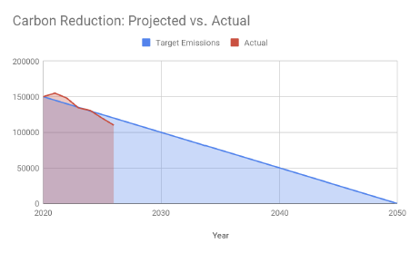
Emission Reduction Target
To continue our progress to achieving Net Zero, we have adopted the following carbon reduction targets.
We project that carbon emissions will decrease over the next five years to 3507 tCO2e by 2030. This is a reduction of 50%.
NB. The company is in growth so we have introduced an additional measurement of emissions per £1,000 to ensure that we can track a true picture of our Carbon emissions.
Progress against these targets can be seen in this graph:
CARBON REDUCTION PLAN 2025-2026
Notes:
Example of slide with icons – icon usage to reflet the copy. The client’s name and the title of the presentation should sit in the bottom left in capital letters, separated by the vertical bar.

Slide 8
March 2023
Introduction – Our Position in March 2023
March 2023 marks a major milestone for Johnsons Asset 360 as we publish our first Carbon Reduction Plan. At this stage, carbon reporting is brand new to us, and our focus is on establishing a clear and credible foundation for our sustainability journey. We collate and verify our baseline emissions data for 2021–2022, giving us the first accurate picture of our carbon footprint. From this starting point, we define meaningful targets for 2023–2024 and begin embedding carbon reduction into the way we operate as a business.
Carbon Reduction Achievements
Year One: Baseline Emissions Footprint 2021-2022
Carbon Reduction Targets
CARBON REDUCTION PLAN 2025-2026
Notes:
Coloured pages to be used – THEY LOOK BEST AS A SET OF 3. Page titles to reflect your agenda / contents. Subtitle to be used where necessary. The client’s name and the title of the presentation should sit in the bottom left in capital letters, separated by the vertical bar.

Slide 9
Carbon Reduction Achievements
Based on Data From: N/A (first year)
We reflect on the early steps we are already taking to reduce our footprint. These include researching the upgrade of our premises with low-energy PIR lighting and improved heating systems, embedding hybrid working practices to reduce commuting emissions, and continuing to invest in ISO 14001 certification to strengthen our environmental governance. We also want to modernise our fleet through the introduction of electric and hybrid vehicles, supported by a charging infrastructure and a robust maintenance programme, while adopting paperless systems to reduce resource use. Together, these first steps lay the groundwork for the more structured, data-driven approach we commit to in this first published report.
CARBON REDUCTION PLAN 2025-2026
Notes:
Example of slide with icons – icon usage to reflet the copy. The client’s name and the title of the presentation should sit in the bottom left in capital letters, separated by the vertical bar.

Slide 10
Year One: Baseline Emissions Footprint 2021 - 2022
Baseline Year: 01st April 2021 – 31st March 2022
Baseline emissions are a record of the greenhouse gases that have been produced in the past and were produced prior to the introduction of any strategies to reduce emissions. Baseline emissions are the reference point against which emissions reduction can be measured.
Additional Details Relating to the Baseline Emissions Calculations
Baseline Year Emissions
*Please note that this is the same as our 2022- 2023 data as we have now received the validated records from EMITWISE for this period.
EMISSIONS | TOTAL (tCO2e)
Scope 1 | 817
Scope 2 | 20
Scope 3 | 4187
Total Emissions | 5024
CARBON REDUCTION PLAN 2025-2026
Notes:
To adjust to JBM / JLL / JIS data

Slide 11
Carbon Reduction Targets
Based on Data From: April 2021 – March 2022
Target Set: March 2023
To be Achieved By: March 2024
Improve energy efficiency across sites by investing in renewable energy solutions, piloting solar panel installations, and upgrading building insulation to reduce energy demand.
Strengthen data accuracy and transparency by partnering with an independent verifier to validate carbon emissions data in line with recognised reporting standards.
Engage our supply chain by encouraging key suppliers to develop and share their own carbon reduction strategies, creating a ripple effect of emissions reduction across our value chain.
Support our clients in sustainable outcomes by developing initiatives that prioritise reuse, recycling, and donation over disposal when removing furniture and other assets.
Achieve external recognition by targeting industry awards for sustainability and circular economy practices, demonstrating leadership in the sector.
Maintain and enhance our environmental governance through continued certification to ISO 14001, embedding environmental management within our Integrated Management System.
Align with international sustainability frameworks by committing to the UN Global Compact and integrating its 10 principles into our strategies, policies, and processes.
Publicly pledge to Net Zero by joining the SME Climate Hub and collaborating with other organisations to accelerate collective progress towards achieving net zero by 2050.
CARBON REDUCTION PLAN 2025-2026
Notes:
Coloured pages to be used – THEY LOOK BEST AS A SET OF 3. Page titles to reflect your agenda / contents. Subtitle to be used where necessary. The client’s name and the title of the presentation should sit in the bottom left in capital letters, separated by the vertical bar. This page demonstrates how a table should be used.

Slide 12
March 2024
By March 2024, we had taken another significant step forward by engaging a third-party partner to independently verify our 2022–2023 emissions data. This independent validation has been an exciting development for us, strengthening both the accuracy and credibility of our reporting. Over the past year, we have worked hard to ensure that our day-to-day activities align with the targets we set in 2023, and the results of this approach are reflected in the outcomes outlined below:
Carbon Reduction Achievements
Year Two Emissions Reporting 2022-2023
Carbon Reduction Targets
CARBON REDUCTION PLAN 2025-2026
Notes:
Coloured pages to be used – THEY LOOK BEST AS A SET OF 3. Page titles to reflect your agenda / contents. Subtitle to be used where necessary. The client’s name and the title of the presentation should sit in the bottom left in capital letters, separated by the vertical bar.

Slide 13
Carbon Reduction Achievements
Based on Data From: April 2021 – March 2022
Target Set In: March 2023
Target Achieved: March 2024
Energy Efficiency in Premises
Our target was to improve energy efficiency across our sites by exploring renewable energy, solar panels, and insulation upgrades. As a result, we invested in site improvements that reduced energy demand, including the installation of low-energy PIR lighting and heating systems across our premises.
Accurate Carbon Data & Verification
We set out to strengthen the accuracy and transparency of our emissions data by working with a specialist verification partner. This was achieved through our partnership with Emitwise, which enabled us to validate our CO₂ emissions and build a reliable foundation for future reporting.
CARBON REDUCTION PLAN 2025-2026
Notes:
Example of slide with icons – icon usage to reflet the copy. The client’s name and the title of the presentation should sit in the bottom left in capital letters, separated by the vertical bar.

Slide 14
Carbon Reduction Achievements
Supply Chain Engagement
A key target was to engage our supply chain and encourage them to take steps to reduce their own emissions. We achieved this by working directly with suppliers to share strategies, creating a ripple effect of carbon reduction across our value chain.
Client Education on Reuse & Recycling
We aimed to support our clients in making more sustainable decisions when disposing of assets. This was delivered by actively educating clients on the environmental benefits of reuse, recycling, and donation, ensuring these options were prioritised over disposal.
Recognition for Sustainability Leadership
We sought to achieve recognition for our circular economy practices and sustainability leadership. In October 2023, this was realised when we received a Highly Commended award at the IWFM Impact Awards for our partnership project with DEFRA, which successfully reused 45% of furniture, diverted 40 tonnes of waste from landfill, and delivered savings of over £300k.
CARBON REDUCTION PLAN 2025-2026
Notes:
Example of slide with icons – icon usage to reflet the copy. The client’s name and the title of the presentation should sit in the bottom left in capital letters, separated by the vertical bar.

Slide 15
Carbon Reduction Achievements
Maintaining ISO 14001 Certification
Another target was to maintain strong environmental governance through ISO 14001 certification. We successfully achieved this, continuing to embed ISO 14001 into our Integrated Management System to ensure robust environmental management practices remain in place.
Commitment to International Frameworks
We aimed to align our operations with international standards for sustainability. This was achieved through our commitment to the United Nations Global Compact, integrating its ten principles into our strategies, policies, and procedures.
Public Commitment to Net Zero
Our target was to make a clear and public commitment to Net Zero, supported by collaboration with other businesses. We delivered on this by pledging to reduce emissions via the SME Climate Hub, joining a growing network of organisations working collectively towards achieving Net Zero by 2050.
CARBON REDUCTION PLAN 2025-2026
Notes:
Example of slide with icons – icon usage to reflet the copy. The client’s name and the title of the presentation should sit in the bottom left in capital letters, separated by the vertical bar.

Slide 16

Year Two: Emissions Reporting 2022-2023
Reporting Year: 01st April 2022 – 31st March 2023
Welcoming Emitwise
We selected Emitwise to verify our data because of their expertise in providing accurate, high-quality carbon accounting. Their platform allowed us to build a reliable baseline by delivering detailed insights across Scope 1, 2 and 3 emissions, giving us confidence that our reporting was both robust and transparent. Working with Emitwise enabled us to track our footprint more effectively, highlight key areas of impact, and begin setting meaningful targets. This partnership provided the foundation for our first steps into carbon reduction planning and gave us the assurance that our data was independently validated to industry standards.
CARBON REDUCTION PLAN 2025-2026
Notes:
Example of slide with icons – icon usage to reflet the copy. The client’s name and the title of the presentation should sit in the bottom left in capital letters, separated by the vertical bar.

Slide 17
Year Two: Emissions Reporting 2022-2023
Reporting Year: 01st April 2022 – 31st March 2023
Please note that this is the same as our 2022- 2023 data as we have now received the validated records from EMITWISE for this period.
Year Two Emissions
EMISSIONS | TOTAL (tCO2e)
Scope 1 | 817
Scope 2 | 20
Scope 3 | 4187
Total Emissions | 5024
CARBON REDUCTION PLAN 2025-2026
Notes:
To update with JBM/ JLL / JIS data

Slide 18
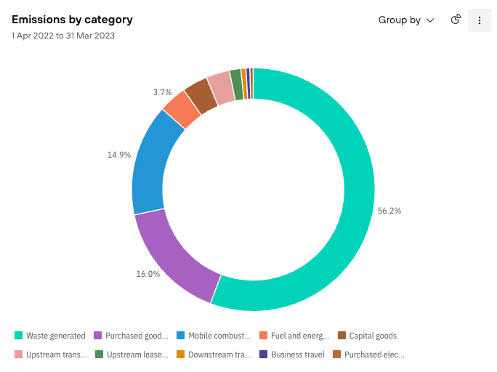
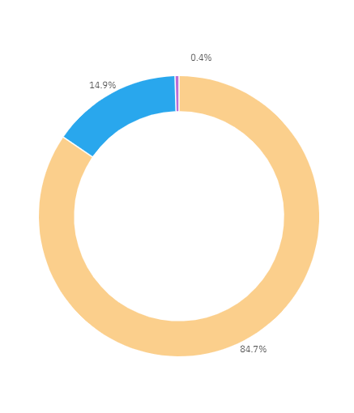
Year Two: Emissions Reporting 2022-2023
Reporting Year: 01st April 2022 – 31st March 2023
CARBON REDUCTION PLAN 2025-2026
Notes:
Example of slide with icons – icon usage to reflet the copy. The client’s name and the title of the presentation should sit in the bottom left in capital letters, separated by the vertical bar.

Slide 19
Carbon Reduction Targets
Based on Data From: April 2022 – March 2023
Target Set: March 2024
To be Achieved By: March 2025
Continuing to research & develop alternative transport options for our fleet & employee commuting
Research & implement where possible, energy efficient technology; smart thermostats & efficient lighting
Review our supplier policy & further build knowledge for our supply chain
Review and include employee commuting into our emissions reporting
CARBON REDUCTION PLAN 2025-2026
Notes:
Coloured pages to be used – THEY LOOK BEST AS A SET OF 3. Page titles to reflect your agenda / contents. Subtitle to be used where necessary. The client’s name and the title of the presentation should sit in the bottom left in capital letters, separated by the vertical bar. This page demonstrates how a table should be used.

Slide 20
March 2025
This latest Carbon Reduction Plan reflects the progress we continue to make as we strengthen our approach to carbon management and embed sustainability more deeply into our operations. Over the past year, we have transitioned from working with Emitwise to partnering with Neutral Carbon Zone for the independent verification of our emissions data. This move provides us with more detailed and specific metrics, enabling us to set sharper, evidence-based targets and build even greater confidence in the accuracy of our reporting. Alongside meeting the commitments set in last year’s plan, we have achieved a number of tangible outcomes across our sites, supply chain, and client projects. From energy efficiency upgrades and fleet modernisation to embedding environmental governance and achieving external recognition, these results demonstrate how our strategy is translating into measurable progress.
Importantly, we have also gone over and above the targets originally set, conducting further research and analysis to identify additional opportunities for improvement. This includes a detailed review of our fleet, which has given us greater insight into its composition and performance, and provided the basis for enhancing our sustainable transport strategy moving forward. By continually building on our achievements and extending our scope of action, we are positioning ourselves not only to meet our carbon reduction targets but to play a leading role in shaping sustainable practice within our industry.
Carbon Reduction Achievements
Year Two Emissions Reporting 2022-2023
Carbon Reduction Targets
CARBON REDUCTION PLAN 2025-2026
Notes:
Coloured pages to be used – THEY LOOK BEST AS A SET OF 3. Page titles to reflect your agenda / contents. Subtitle to be used where necessary. The client’s name and the title of the presentation should sit in the bottom left in capital letters, separated by the vertical bar.

Slide 21
Carbon Reduction Achievements
Based on Data From: April 2022 – March 2023
Target Set In: March 2024
Target Achieved By: March 2025
1. Continuing to research & develop alternative transport options for our fleet & employee commuting:
We have created and fully implemented a Carbon Reduction Strategy to underpin out business unit carbon reduction plans.
We have implemented an ESG team with levels of authority and ownership throughout the business.
Our Sustainability Manager, QHSE Director and Strategic Governance Manager have attended several events in the past year pertaining to sustainability in the workplace:
EBIS Environmental Law, Policy and Practice 2024
Decarbonisation Solutions Forum 18th April 2024
Reset Connect 25 – 26 June 2024
CARBON REDUCTION PLAN 2025-2026
Notes:
Example of slide with icons – icon usage to reflet the copy. The client’s name and the title of the presentation should sit in the bottom left in capital letters, separated by the vertical bar.

Slide 22
Carbon Reduction Achievements
Net Zero and Science based targets webinar – 2nd July 2024
Embedding sustainability into your organisation – 8th July 2024
Delivering Circular Solutions with ISG – webinar 18th July 2024
FORS webinar: HVO fuels explained – 8th August 2024
East Midlands Sustainibility Summit – 12th September 2024
An introduction to environmental legislation for business – 2nd Oct 2024
Tackling the challenge of scope 3 emissions – 30th Sept 2024
4th annual Sustainability Week: Countdown to COP29 – webinar 7th Oct 2024
Net Zero Journey: Understanding & Implementing Carbon Reduction Planning with Science-Based Targets – 23rd Oct 2024
How to Measure Social Value- Webinar – 15th Oct 2024
COP 29 series: Introduction to Climate Change and Carbon – Webinar 4th Nov 2024
Carbon Footprinting, the Next Steps webinar – 14th November 2024
Reducing carbon emissions through Operational Excellence – Webinar 19th Nov 2024
Simpler Recycling - Upcoming Legislation Changes – webinar 13th Jan 2025
Managing Climate Anxiety and Denial – 5th March
Integrating ESG in Contracts: Managing Risks and Compliance – 18th March 2025
How Occupant Behaviour Impacts Workplace Energy Use & Ways to Reduce It - 27th March
We have further invested in electric vehicles for our staff to transport to and from client sites in.
CARBON REDUCTION PLAN 2025-2026
Notes:
Example of slide with icons – icon usage to reflet the copy. The client’s name and the title of the presentation should sit in the bottom left in capital letters, separated by the vertical bar.

Slide 23
Carbon Reduction Achievements
2. Research & implement where possible, energy efficient technology; smart thermostats & efficient lighting:
Following several months of bidding, we were successful in obtaining a grant from Cheshire East Council to fit solar panels on our office in Winsford. However, due to unforeseen circumstances around the integrity of the current roof, we were unable to proceed with the grant awarded. We continue to inspect the levels of investment this might involve facilitating an upgrade in the future.
Meanwhile, we are in conversations with local Councils of our other premises to see if they offer a similar scheme.
We have upgraded our Haydock warehouse with safety and PIR lighting.
We have updated our Croydon office with a fit out, complete with PIR office lighting upstairs.
Furthermore, we have strengthened our position in the furniture field and across all sectors, donated, GovReuse, sold for reuse, we have managed:
Quantity of items | 19,453
Estimated Resale Value | £2,418,766
Estimated New Carbon CO2e kg saving | 1,491,855
Total Weight (kg) diverted from landfill | 432,044
CARBON REDUCTION PLAN 2025-2026
Notes:
Example of slide with icons – icon usage to reflet the copy. The client’s name and the title of the presentation should sit in the bottom left in capital letters, separated by the vertical bar.

Slide 24
Carbon Reduction Achievements
3. Review our supplier policy & further build knowledge for our supply chain:
Our Strategic Governance Manager has produced a 12-month communications strategy around ESG, which reiterates where our values lie, what our targets are, our achievements, our near misses, updates in legislation and regulation, and how we are looking further afield at what lies ahead.
This communications strategy features:
Monthly emails with a specific theme
Quarterly internal reports summarising the last three months in ESG
Quarterly external reports summarising the last three months in ESG
The external reports are circulated to our supply chain. We hope this provides them with a forum to which they can move forward down their own ESG avenues, encourages them to ask questions, and feedback to us anything which they can offer to support everyone’s ESG Journey.
We have reached out to our supply chain through our partnership with Neutral Carbon Zone.
4. Review and include employee commuting into our emissions reporting:
This is an action which is now included in our Neutral Carbon Zone reporting.
CARBON REDUCTION PLAN 2025-2026
Notes:
Example of slide with icons – icon usage to reflet the copy. The client’s name and the title of the presentation should sit in the bottom left in capital letters, separated by the vertical bar.

Slide 25
Over and Above Research
Fleet Analysis and Low-Carbon Transition
As part of our commitment to going beyond our core targets, we have undertaken a detailed analysis of our company fleet to better understand opportunities for decarbonisation. Our fleet currently comprises 103 vehicles in total, of which 36 are cars and 27 of these are either electric or hybrid. This means that 75% of our car fleet is now low-emission, reflecting a strong shift towards cleaner transport. When measured across the entire fleet, 25% of vehicles are hybrid or electric, a figure which demonstrates meaningful progress despite the current lack of infrastructure and technology to support the conversion of HGVs and LGVs to hybrid or electric alternatives. This analysis provides us with a clear picture of where we stand today and helps inform our sustainable transport strategy for the years ahead.
CARBON REDUCTION PLAN 2025-2026
Notes:
Example of slide with icons – icon usage to reflet the copy. The client’s name and the title of the presentation should sit in the bottom left in capital letters, separated by the vertical bar.

Slide 26

Year Three: Emissions Reporting 2023-2024
Reporting Year: 01st April 2023 – 31st March 2024
Welcoming Neutral Carbon Zone
In 2023/24, we transitioned our carbon accounting partner from Emitwise to Neutral Carbon Zone (NCZ). While Emitwise provided us with a strong foundation for understanding and verifying our emissions, NCZ offered us a broader range of metrics and more granular data insights that better aligned with our evolving sustainability strategy. This move has enabled us to track emissions in greater detail across our operations and supply chain, providing the level of specificity required to underpin our carbon reduction roadmap and create targeted, measurable objectives. By adopting NCZ’s platform, we are now equipped with the tools to validate our progress with even greater accuracy and set more meaningful, actionable goals as we continue our journey towards Net Zero.
CARBON REDUCTION PLAN 2025-2026
Notes:
Example of slide with icons – icon usage to reflet the copy. The client’s name and the title of the presentation should sit in the bottom left in capital letters, separated by the vertical bar.

Slide 27
Year Three: Emissions Reporting 2023-2024
Reporting Year: 01st April 2023 – 31st March 2024
The below figures from 23-24 show a 57% reduction in our total emissions, which achieves our 2030 target to reduce the company emissions by 50%.
Year Three Emissions
Total Emissions | Total Kg CO2e
Total Scope-1 | 582,405
Total Scope-2 | 25,003
Total Scope-3 | 1,428,691
Totals | 2,036,100
CARBON REDUCTION PLAN 2025-2026
Notes:
Example of slide with icons – icon usage to reflet the copy. The client’s name and the title of the presentation should sit in the bottom left in capital letters, separated by the vertical bar.

Slide 28
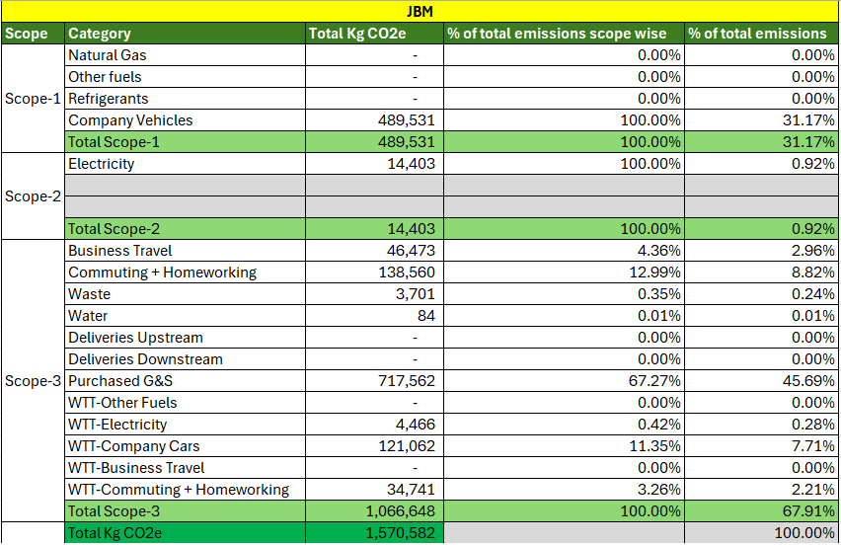
Year Three: Emissions Reporting 2023-2024
Reporting Year: 01st April 2023 – 31st March 2024
Johnsons Asset 360 / JBM
CARBON REDUCTION PLAN 2025-2026

Slide 29
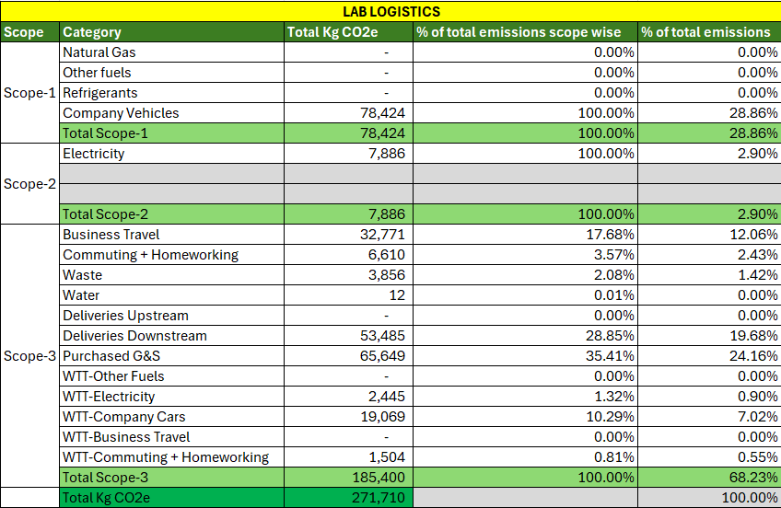
Year Three: Emissions Reporting 2023-2024
Reporting Year: 01st April 2023 – 31st March 2024
Johnsons Laboratory Logistics
CARBON REDUCTION PLAN 2025-2026

Slide 30

Year Three: Emissions Reporting 2023-2024
Reporting Year: 01st April 2023 – 31st March 2024
Johnsons Installation Services
CARBON REDUCTION PLAN 2025-2026
Notes:
Example of slide with icons – icon usage to reflet the copy. The client’s name and the title of the presentation should sit in the bottom left in capital letters, separated by the vertical bar.

Slide 31
Carbon Reduction Targets
Based on Data From: April 2023 – March 2024
Target Set: March 2025
To be Achieved By: March 2026
Roll Out ESG Communications Strategy Across All Business Unit
Fully implement the 12-month internal and external ESG communications strategy.
Measure engagement with monthly email themes and quarterly reports (e.g., open rates, feedback volume).
Introduce a feedback mechanism to monitor supply chain engagement and identify opportunities for collaboration.
Roll Out Complimentary ReUse Initiatives across the NHS, Universities, Council, and MOD.
Support the public sector in the management and smart storage of their assets
Deliver a targeted approach to them utilising our positions on public-sector frameworks
Strengthen partnership with Assets4Change and onboard as a supplier to key FM providers
Educating clients to reduce waste on projects and encourage reuse and resale of items
CARBON REDUCTION PLAN 2025-2026
Notes:
Coloured pages to be used – THEY LOOK BEST AS A SET OF 3. Page titles to reflect your agenda / contents. Subtitle to be used where necessary. The client’s name and the title of the presentation should sit in the bottom left in capital letters, separated by the vertical bar. This page demonstrates how a table should be used.

Slide 32
Carbon Reduction Targets
Embed the Think Green – Act Green Campaign into Daily Operations
Integrate the campaign into onboarding and induction processes for all new employees.
Launch a “Green Champions” programme across departments to drive ownership and localised initiatives.
Deliver two all-staff sustainability engagement activities per quarter (e.g., eco-challenges, webinars, or workshops).
Advance Sustainable Transport Planning
Develop and publish a Sustainable Transport Action Plan, addressing:
Low-carbon fleet transition timeline
Greener commuting incentives for employees (e.g., car-share schemes, cycle-to-work, EV leasing)
Conduct a trial of alternative fuels or vehicle types within at least one operational unit.
CARBON REDUCTION PLAN 2025-2026
Notes:
Coloured pages to be used – THEY LOOK BEST AS A SET OF 3. Page titles to reflect your agenda / contents. Subtitle to be used where necessary. The client’s name and the title of the presentation should sit in the bottom left in capital letters, separated by the vertical bar. This page demonstrates how a table should be used.

Slide 33

Carbon Reduction Targets
Improve Energy Efficiency and Pursue Renewable Energy Solutions
Complete a feasibility study and investment plan for upgrading the owned office roofs to enable solar panel installation.
Identify 1–2 additional depots or offices for potential renewable energy or energy efficiency improvements.
Implement at least one new energy-saving technology per site where feasible (e.g., smart thermostats, motion-sensitive lighting, energy dashboards).
Expand Scope 3 Emissions Monitoring
Include all relevant employee commuting data within emissions reporting for a full 12-month cycle.
Start scoping supplier emissions and initiate a pilot programme to collect Scope 3 data from at least 5 key suppliers.
Enhance ESG Capability and Culture
Deliver a minimum of four ESG-specific training sessions for staff, including one focused on legislation and compliance
Encourage senior leaders and managers to attend at least two sector-specific sustainability conferences or working groups during the year.
Introduce an annual ESG survey to assess staff awareness, attitudes, and suggestions for improvement.
CARBON REDUCTION PLAN 2025-2026
Notes:
Coloured pages to be used – THEY LOOK BEST AS A SET OF 3. Page titles to reflect your agenda / contents. Subtitle to be used where necessary. The client’s name and the title of the presentation should sit in the bottom left in capital letters, separated by the vertical bar. This page demonstrates how a table should be used.

Slide 34
Declaration
This Carbon Reduction Plan has been completed in accordance with PPN 06/21 and associated guidance and reporting standard for Carbon Reduction Plans.
Emissions have been reported and recorded in accordance with the published reporting standard for Carbon Reduction Plans and the GHG Reporting Protocol corporate standard and uses the appropriate Government emission conversion factors for greenhouse gas company reporting .
Scope 1 and Scope 2 emissions have been reported in accordance with SECR requirements, and the required subset of Scope 3 emissions have been reported in accordance with the published reporting standard for Carbon Reduction Plans and the Corporate Value Chain (Scope 3) Standard.
This Carbon Reduction Plan has been reviewed and signed off by the board of directors (or equivalent management body).
Signed on behalf of Amer Logistics:
Name | Darren Pardy
Designation | Sales Director
Signature
Publication date | April 2025
Review date | March 2026
JOHNSONS 1871 | CARBON REDUCTION PLAN 2025-2026

