Slide 1
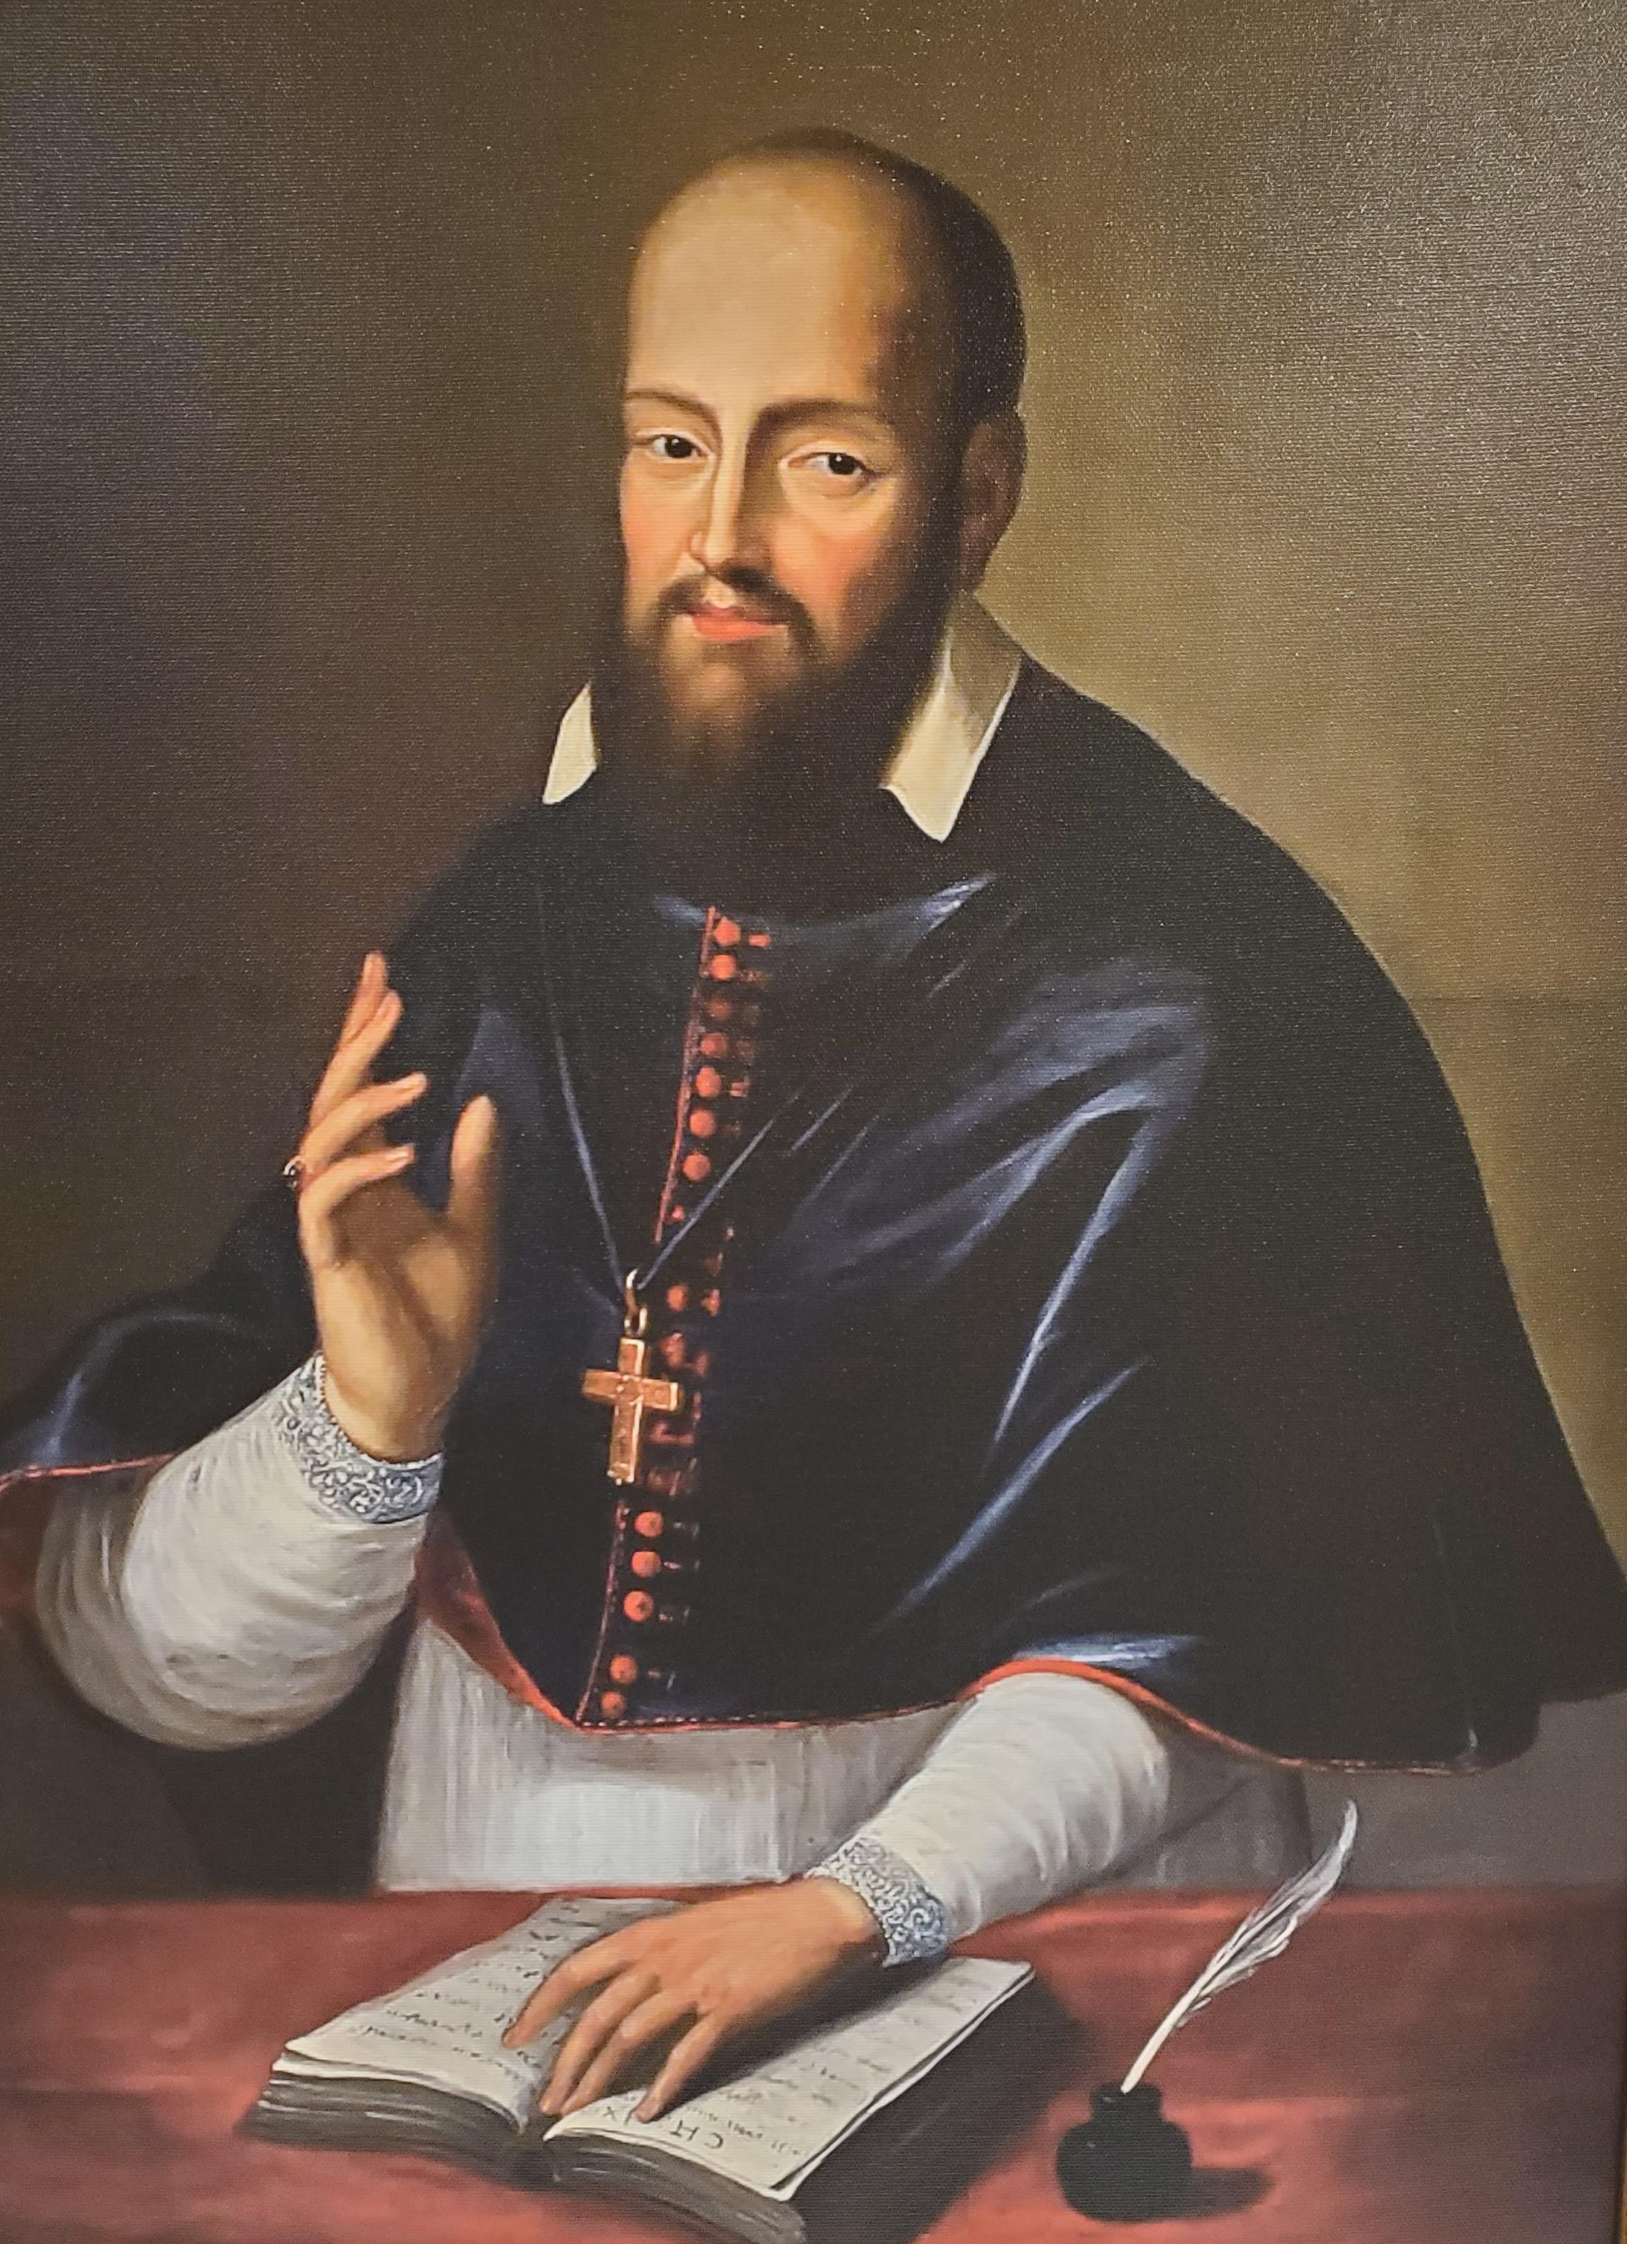
On Appreciating Christmas & Loving Enemies
+
It is an understatement that the mystery we celebrate every Christmas is a BIG deal.
God could have redeemed man in any number of ways; but, in the economy of salvation that has been revealed to us, all we know is that unless God became Incarnate in the Person of Jesus, we would still be living in darkness under the shadow of death; a very sad plight.
The Incarnation changes EVERYTHING! As the third Mass of Christmas reads, “Grant, we beseech Thee, almighty God, that the new birth of Thine only begotten Son in the flesh may set us free, who are held by the old bondage under the yoke of sin.” Albeit, this Christmas prayer is incomplete without considering the Passion, Death, Resurrection & Ascension of Christ, the Infant born on this Day remains a visible promise of GREAT things to come!
Understanding this, it is disappointing that the BOON of Christmas has been robbed, somewhat, of its AWESOME meaning by the world’s meaningless phrases: “Season’s Greetings” & “Happy Holidays.” It is somehow worse, however, that Christians themselves complain so much about these & like petty things (i.e., any scandal) so as to forget the GIFT of Christmas: God has become man to save us from our sin! which deserves our greater attention & attachment, our source of joy & peace, not just now, but all year round.
The saints understand this WONDERFUL reality, so wonderfully as to produce wonderful results… which introduces our second topic: Forgiving Enemies.
The first three days of Christmas, Mother Church celebrates three wonderful Feasts: Dec. 26, St. Stephen, the proto (first) martyr; Dec. 27, St. John the Apostle (the Beloved Disciple); Dec. 28, the Holy Innocents.
Of these, the Feast of St. Stephen, the first Christian martyr, spotlights the life of a true
Christian, as the prayer of that Mass reads: “Grant us, we beseech Thee, O Lord, so to imitate what we revere, that we may love even our enemies: for we celebrate the heavenly Birthday of him who knew how to pray for his very persecutors to our Lord Jesus Christ...”
St. Stephen was one of the seven deacons chosen to help the apostles; he so worked miracles & preached Christ as to draw the ire of the Jews from 5 synagogues, who stoned him to death. While suffering this punishment, he pleaded on their behalf, “O Lord, lay not this sin to their charge.”
There are two wonderful miracles here: the act of dying for Christ & the act of praying for the forgiveness of the very men unjustly stoning him (even before they asked for pardon); of these, the more important seems prayer for enemies as it alone is advertised for our imitation.
“How could he do this?” Because he appreciated the STUPENDOUS mystery of Christmas.
God became man to rescue men from the yoke of sin. St. Stephen suffers from men while simultaneously praying for their pardon. This is awesome. Indeed, it is Christ again on His Cross crying out, “Father, forgive them for they know not what they do.”
We say that the acorn does not fall far from the tree. As a son resembles his father, so in Stephen we see a brother to Christ & another son of the Father.
“How did he do this?” He appreciated Christmas & lived its meaning, God became man not to judge the world, but to save it; which He did by laying down His life for it while, at the same time, pleading the pardon of sinners… even those then harming Him.
To end, of all religions, the Christian precept to love our enemies is truly unique & praiseworthy; but it is useless unless we practice it in thought, word & deed.
The more we appreciate Christmas, the more we will love our neighbor, even an enemy. This a “Happy Holidays” will never do; only a sincere “Merry Christmas” can change the world.
St Francis de Sales Catholic Church
An apostolate of the Priestly Fraternity of St. Peter in the Archdiocese of Atlanta preaching the Gospel & sanctifying souls according to the liturgical books of 1962.
587 Landers Dr SW
Mableton, GA 30126
770-948-6888
www.fsspatl.com
Fourth Sunday of Advent
December 21, 2025, A.D.
Pastor: Fr Chris Hathaway, FssP – pastor@fsspatl.com Parochial Vicar: Fr. Joseph Favole, FssP – assistant@fsspatl.com Fr. Brian Austin, FssP, - in residence Rev. Mr. Doug Anderson, Deacon Office Manager: Mrs. Leslie Riney – secretary@fsspatl.com Director of Religious Education: Thomas Cole- DRE@fsspatl.com Church Office Hours: 8:00 am to 4:00 pm, Monday – Friday Bookstore – open Sundays after the 8 am & 10:30 am Masses and 1st Saturdays after the 9 am Mass. Baptism: Contact the parish at least three months before birth. Marriage: Contact the parish at least six months before the wedding. Inquiring about the Catholic Faith? Call the office.
Daily Mass Times Mon. & Wed.: 6:30 am & 9 am. Tues. & Thurs.: 6:30 am & 12 noon. Fri.: 6:30 am & 7 pm (followed by Holy Hour). Sat.: 7 am & 9 am. Sunday Mass Times 7 am low Mass (at the church) 8 am low Mass (at the gym) 10:30 am high Mass (at the gym) 1 pm low Mass (at the church) Confessions are heard in the confessional box ½ hour before each Mass. | Church Hours Mon.-Thurs.: 6 am - 7 pm Fri.: 6 am - 9 pm Sat.: 6:30 am -7 pm Sun.: 7 am - 7 pm Office Hours Mon. - Fri.: 8 am - 4 pm. Closed on Holy Days

Slide 2
Liturgical Calendar for the Upcoming Week
Last week’s collection: cash $7,125.00; online $2,980.00 total: $10,105.00
Attendance: 7 am-53; 8 am-152; 10:30 am-295; 1 pm-141; 641 total souls
Christmas carols to be sung (see booklet): 1) Silent Night, 2) Away in a Manger, 3) Angels we have heard on high, 4) The first Noel, 5) Hark the herald angels sing, 6) It came upon a Midnight clear, 7) What Child is this, 8) Lo, how a rose e'er blooming, 9) God rest ye merry gentlemen, 10) O little town of Bethlehem.
Today, after all Masses, the KoC will sell baked goods to support the Monastery of the Holy Spirit. Cash, check or card accepted. Also, its Advent Food Drive ends after the 1 pm Mass. Please place only non-perishable food items in the bins located in the church & gym (preferably in bags).
Please pick up your donation envelope boxes from the social hall.
Catehcism students may offer their poinsettias from now until Christmas.
Please pray for: Michael Keyes Jr (12/17), Leslie Riney (12/7) & Jim Viney (11/23).
On the Feast of St John, wine may be blessed after Mass. If you desire this, before Mass, place your wine, labeled with your name, beneath St Joseph.
From now until January 5, the office is accepting requests for the Home Epiphany Blessing (to be given from Jan. 6 through Jan. 13). As blessings will be done by area, so requests need to be received before Jan. 6, otherwise your request may not be granted. Also, homes not so blessed w/in 3 years will be favored. Blessing kits (holy chalk, holy water, & a program) will be available for you to bless your home yourself. [Epiphany water will be made, in the church, on Jan. 5 at 5:30 pm; you may take this water home in a bottle, no bigger than a quart, which you have brought. Also, you may bring salt, gold, incense, & myrrh to be blessed.
DATE FEAST CLASS/COLOR COMMEMORATION
4th Sunday of Advent
Greater Feria of Advent
Greater Feria of Advent
Vigil of Christmas
Nativity of the Lord
St Stephen, Deacon & Martyr
St John the Evangelist, Apostle
Sunday in the Octave of Christmas
Anastasia (Dawn Mass)
Octave
Octave
Holy Innocents
Sun 12-21
Mon 12-22
Tues 12-23
Wed 12-24
Thu 12-25
Fri 12-26
Sat 12-27
Sun 12-28
1/V
2/V
2/V
1/V
1/W
2/R
2/W
2/W
Mass Intentions for the Upcoming Week
Sun 12-21
Mon 12-22
Tues 12-23
Wed 12-24
Thu 12-25
Fri 12-26
Sat 12-27
Sun 12-28
(7 am) Vicki Yamasaki (frf) rb R Fidero
(8 am) Fr Austin’s intention (fra)
(10:30 am) Pro-populo (frh)
(1 pm) SFdS priests (frf) rb C Sihombing
(6:30 am) Jean-Marie Zigui rb M-T Zigui
(9 am) Olga Torres rb D Anderson
(6:30 am) Bob Kelly+ rb J Graebner
(12 noon) Concetta DeJesso+ rb M Markich
(6:30 am) Boris Kalcic rb D Chancey
(9 am) Vicki Yamasaki
(12 am Midnight Mass, at the gym) Pro-populo (frh)
(8 am Dawn Mass, at the gym) Fr Austin’s intention (fra)
(10:30 am Day Mass, at the church) Thanksgiving (frf) rb V Stephens
(6:30 am) Linda Light+ rb C Conger
(7 pm) The Calta family rb D Anderson
(7 am) no Mass
(9 am) The Zigui family rb M-T Zigui
(11 am) wedding Mass (frf)
(7 am) Maria Theresa Jimanez Luna (frh) rb M Diaz
(8 am) Fr Austin’s intention (fra)
(10:30 am) Lucille Hagan (frf) rb H Hagan
(1 pm) Pro-populo (frh)
ISAIAH. Author of the longest prophetic book in the Olt Testament. He was the son of Amoz, born about 760 B.C. in Jerusalem. His writing paralleled the reigns of three Judean kings, Jotham, Ahaz, & Hezekiah. His mission was to proclaim the fall of Isreal & Judah and the punishment that would befall the nation because of its sinfulness. The beauty of his style and the constant nobility of his message made him one of the most revered of biblical writers. Constantly he pleaded with his people to place their trust in God and not in military achievements. No other prophet foreshadowed as convincingly the coming of the Messiah, who would be a descendant of David. Biblical students point out numerous incidents in Jesus’ life which were foreshadowed in Isaiah’s prophetic lines (see Isaiah 2:1-5, 7:10-17, 9:1-6, 11:1-5). (ref. Modern Catholic Dictionary by Fr John A Hardon, S.J.)
This week, (the office will be mostly closed from 12/22/25 through 1/4/26, phone calls, however, will be monitored): Monday, set-up for Christmas w/ Fr Favole (10 am); Tuesday, staff meeting (1 pm); Wednesday, Vigil of Christmas, Carols (11:30 pm); Thursday, Christmas Day, Midnight Mass (12 am at the gym), Dawn Mass (8 am at the gym), Day Mass (10:30 am at the church); Saturday, no 7 am Mass, 9 am Mass (& traditional blessing of wine in honor of St John), wedding Mass (11 am).
Maxim of St Francis de Sales
I see you with your vigorous heart which loves & wills powerfully. I like it, for what are those half-dead hearts good for? We must make a particular exercise once every week of willing to love the will of God more tenderly, more affectionately than anything in the world, and that too not only in bearable but in the most unbearable events.

