Slide 1
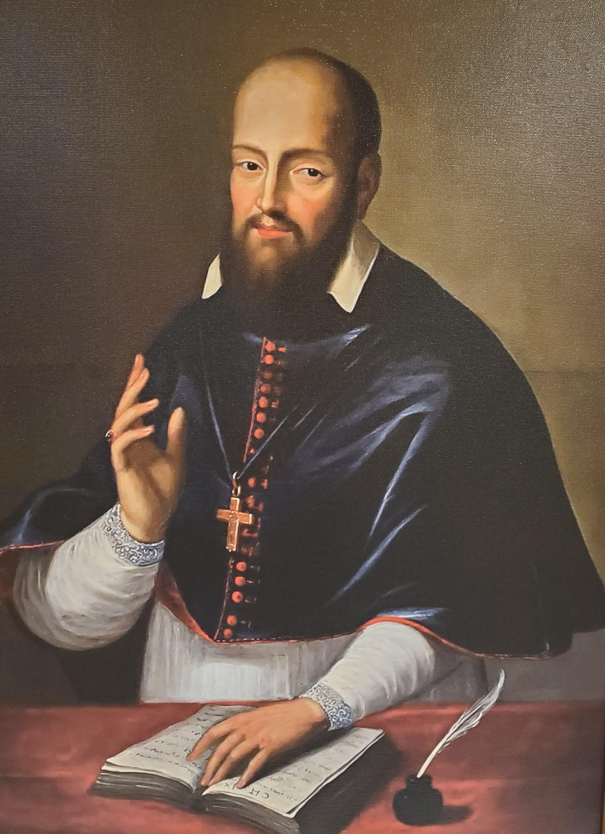
On Matrimony & a model for our times?
In our day, as we know, marriage is under assault; it was at the time of Council of Trent, also. In its defense, the Council met in its 24th session, under pope Pius IV, on November 11, 1563, to solemnly restate her doctrine on matrimony and to decree 12 canons against its enemies. Let us review what the Council taught and read some canons. Imagine the Church blasting canons like this today! Many would welcome the doctrinal clarity, but most would be stirred to wrath; perhaps, that is why synods no longer speak so.
The Council first establishes Church doctrine noting that matrimony is a perpetual & indissoluble bond first observed by Adam who, under divine influence, said: “This now is bone of my bones and flesh of my flesh. Wherefore a man shall leave father and mother and shall cleave to his wife, and they shall be two in one flesh.” (Gn 2:23) At the fulness of time, Jesus Christ reaffirmed this teaching, adding, “they are not two, but one flesh. Therefore, what God has joined together, let no man separate.” (Mt 19:6) Again, marriage is meant to be an icon of God’s love for His Church as expressed by St Paul, “Husbands love your wives, as Christ also loved the Church, and delivered himself up for it” adding, “This is a great sacrament, but I speak in Christ and in the Church.” (Eph 5:25,32) Moreover, the Fathers, the Councils, and the tradition of the universal Church, have always taught that marriage is one of the sacraments of the New Law. Against this, the ungodly men of Trent’s time (1500’s), raving madly, introduced, by word and writing, many false teachings against the apostolic Church. To restrain their boldness & eradicate errors, Trent issued, among others, the following anathemas:
Canon I. If anyone says that matrimony is not truly and properly one of the seven sacraments of the evangelical law, instituted by Christ the Lord, but has been devised by men in the Church and does not confer grace, let him be anathema.
Can. 5. If anyone says that the bond of matrimony can be dissolved on account of heresy, or irksome cohabitation, or by reason of the voluntary absence of one of the parties, let him be anathema.
Can. 7. If anyone says that the Church errs in that she taught and teaches that in accordance with evangelical and apostolic doctrine the bond of matrimony cannot be dissolved by reason of adultery on the part of one of the parties, and that both, or even the innocent party who gave no occasion for adultery, cannot contract another marriage during the lifetime of the other, and that he is guilty of adultery who, having put away the adulteress, shall marry another, and she also who, having put away the adulterer, shall marry another,(Mt 5:32) let him be anathema.
Can. 8. If anyone says that the Church errs when she declares that for many reasons a separation may take place between husband and wife with regard to bed and with regard to cohabitation for a determinate or indeterminate period, let him be anathema.
Can. 10. If anyone says that the married state excels the state of virginity or celibacy, and that it is better and happier to be united in matrimony than to remain in virginity or celibacy, (Mt 19:11) let him be anathema.
Can. 12. If anyone says that matrimonial causes do not belong to ecclesiastical judges, let him be anathema.
To end, today’s Gospel likens the kingdom of heaven to a king who made a marriage for his son; & as those invited did not come, so others were invited. Currently, we are those “others” who now are invited to this great marriage; let us go worthily, conforming ourselves to God’s rules & not making up our own. Said again, wearing what we want to this great feast, will get us kicked out!
St Francis de Sales Catholic Church
An apostolate of the Priestly Fraternity of St. Peter in the Archdiocese of Atlanta preaching the Gospel & sanctifying souls according to the liturgical books of 1962.
587 Landers Dr SW
Mableton, GA 30126
770-948-6888
www.fsspatl.com
19th Sunday after Pentecost
October 19, 2025 A.D.
Pastor: Fr Chris Hathaway, FssP – pastor@fsspatl.com Parochial Vicar: Fr. Joseph Favole, FssP – assistant@fsspatl.com Fr. Brian Austin, FssP, - in residence Rev. Mr. Doug Anderson, Deacon Office Manager: Mrs. Leslie Riney – secretary@fsspatl.com Director of Religious Education: Thomas Cole- DRE@fsspatl.com Church Office Hours: 8:00 am to 4:00 pm, Monday – Friday Bookstore – open Sundays after the 8 am & 10:30 am Masses and 1st Saturdays after the 9 am Mass. Baptism: Contact the parish at least three months before birth. Marriage: Contact the parish at least six months before the wedding. Inquiring about the Catholic Faith? Call the office.
Daily Mass Times Mon. & Wed.: 6:30 am & 9 am. Tues. & Thurs.: 6:30 am & 12 noon. Fri.: 6:30 am & 7 pm (followed by Holy Hour). Sat.: 7 am & 9 am. Sunday Mass Times 8:00 am low; 10:30 am sung & 1:00 pm Low Masses. Confessions are heard in the confessional box ½ hour before each Mass. | Church Hours Mon.-Thurs.: 6 am - 7 pm Fri.: 6 am - 9 pm Sat.: 6:30 am -7 pm Sun.: 7 am - 7 pm Office Hours Mon. - Fri.: 8 am - 4 pm. Closed on Holy Days

Slide 2
Liturgical Calendar for the Upcoming Week
Next Sunday, following the 10:30 am Mass, there will be a procession in honor of Christ the King.
Last week’s collection: cash $8,115.00; online $4,326.00 total: $12,441.00
Attendance: 8 am-201; 10:30 am-368; 1 pm-118; total 687 souls.
All Souls Novena begins October 24; turn in envelopes before that date.
Heads up! All Saints’ party on Saturday, November 1 after the 9 am high Mass. Crafts, activities, treats & fellowship. Dress as your favorite saint!
DATE FEAST CLASS/COLOR COMMEMORATION
Sun 10-19
Mon 10-20
Tues 10-21
Wed 10-22
Thu 10-23
Fri 10-24
Sat 10-25
Sun 10-26
19th Sunday after Pentecost
St John Cantius, Confessor
St Ursula & Comp., Virgins & Martyrs
Feria
St Anthony Mary Claret, Bishop & Confessor
St Raphael the Archangel
St Isidore the Farmer, Confessor
Christ the King
2/G
3/W
3/R
4/G
3/W
3/W
3/W
1/W
St. Hilarion
Ss. Chrysanthus & Daria
SFdS Annual Fiscal Year Report July 2024-June 2025 Anno Domini
Income:
Offertory $642,177
Donations $6,104
Interest D&L $51,402
Votive Candles $6,840
Other Income $9,813
Altar Flowers $100
Building Fund $1,500
Gain/Loss Endowment $15,447
Endowment Contributions $5,159
CFNGA Grants $1,000
Total Revenue $739,542
Expenses:
Liturgical
Priests’ (2) Salary $72,000
Liturgical Supplies $29,753
Miscellaneous $12,540
Total $107,156
Administrative & General
Lay Salary & Benefits $73,475
Supplies & Services $35,057
Online Giving Fees $11,804
Insurance $15,036
Endowment Fund $2,001
Total $137,373
Facilities
Supplies $6,670
Maintenance $62,058
Utilities $19,151
Miscellaneous $16,126
Total $106,111
Rectory & Residence
Priests’ (3) Table $17,600
Maintenance $13,386
Total 30,668
Music
Lay Salary $10,615
Benefits $7,500
Supplies $4,151
Total $22,266
Total Expenses $313,892
Total Assets $3,016,875
Total Labilities $8,771
Net Assets $3,008,104
Thank you for your support of St Francis de Sales!
Mass Intentions for the Upcoming Week
Sun 10-19
Mon 10-20
Tues 10-21
Wed 10-22
Thu 10-23
Fri 10-24
Sat 10-25
Sun 10-26
(8 am) Fr Austin’s intention (fra)
(10:30 am) Pro-populo (frh)
(1 pm) William Mumma (frf) rb C Held
(6:30 am) John Wingate rb H Wingate
(9 am) Owen & Caroline Elliot rb E Wells
(6:30 am) Chris Sullivan rb C Frazier
(12 noon) Joe & Abby Cocco rb J Cvitovic
(6:30 am) Rachel Gerli rb C Held
(9 am) Charles & Anna Meyer++ rb S Calta
(6:30 am) Tim Rausch + rb D Bunnell
(12 noon)Lucy D’Souza rb A-M Fernandes
(6:30 am) In Honor of St Raphael the Archangel rb S Calta
(7 pm) All Souls Novena rb Anonymous
(7 am) Josephine Heiser rb I Goodrich
(9 am) All Souls Novena rb Anonymous
(8 am) All Souls Novena (frf) rb Anonymous
(10:30 am) Fr Austin Intention (fra)
(1 pm) Pro-populo (frh)
Today, after Sunday Vespers at 4:30 pm, there will be a short ceremony to bless new members to the Confraternity of St Peter. During this ceremony, any members who joined the Confraternity within the last year, will recite the confraternity prayer at the communion rail and receive a blessing and a certificate from the priest.
This week, Monday, staff meeting (1pm), Wednesday, Inquiry Class (7:30pm); Friday, Begin Novena for All Souls, FNE Campout (10/24-26).
Maxim of St Francis de Sales
God knows what we are and will hold out Hs paternal hand to us in a difficult step, in order that nothing may arrest us.

