Slide 1
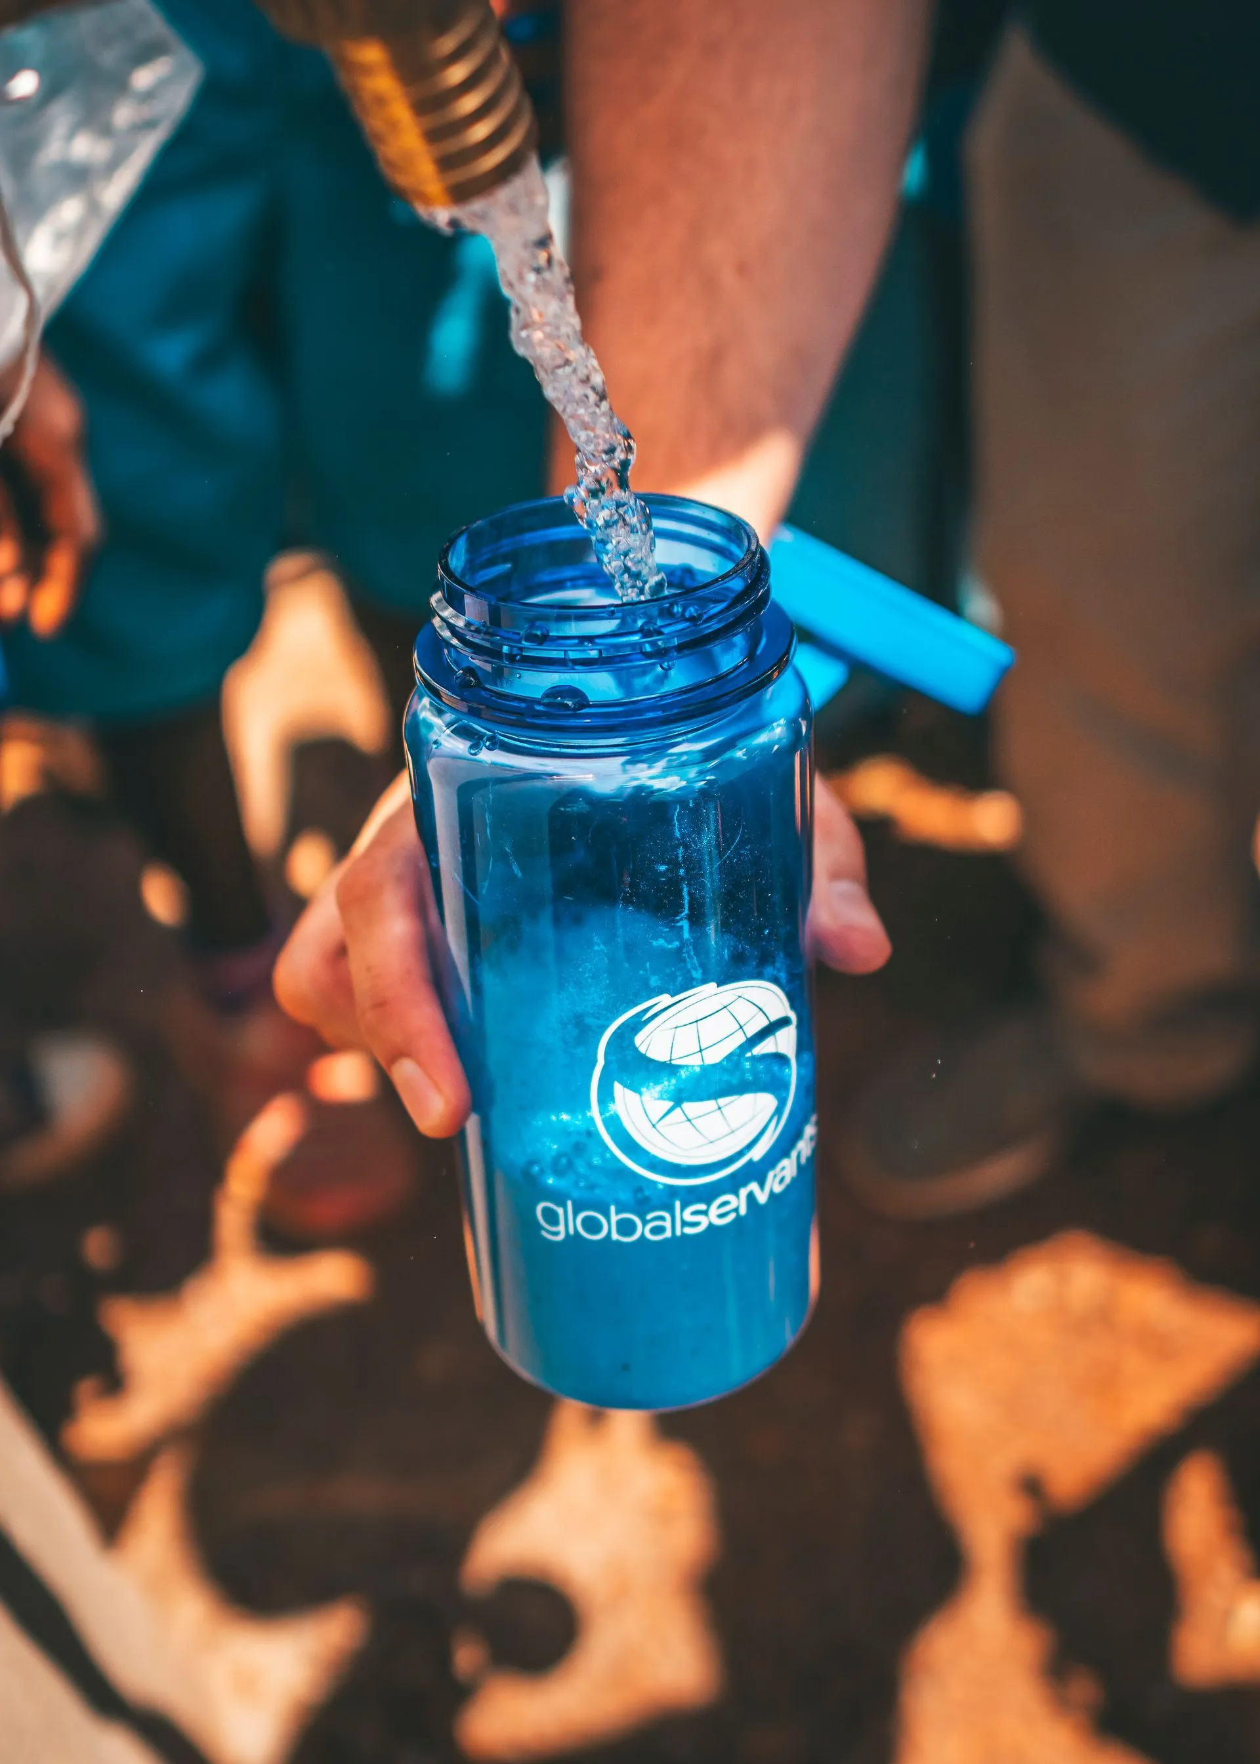
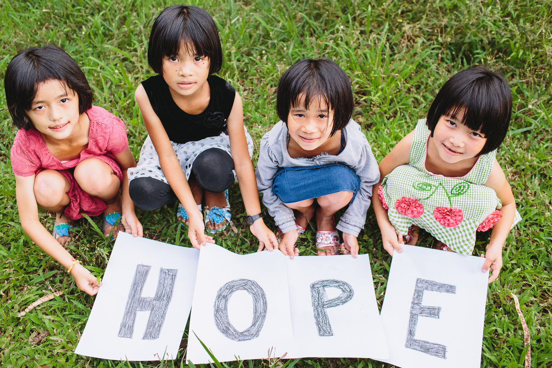



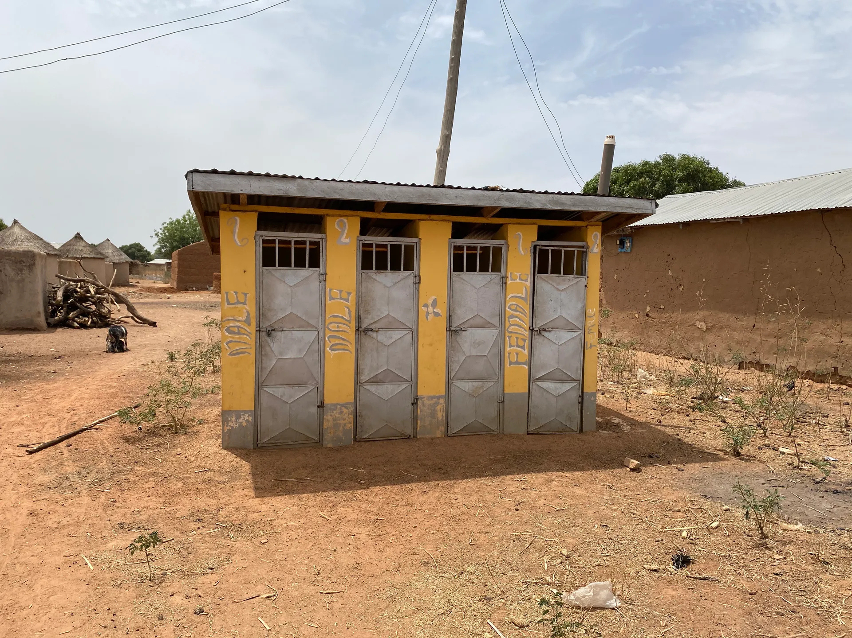
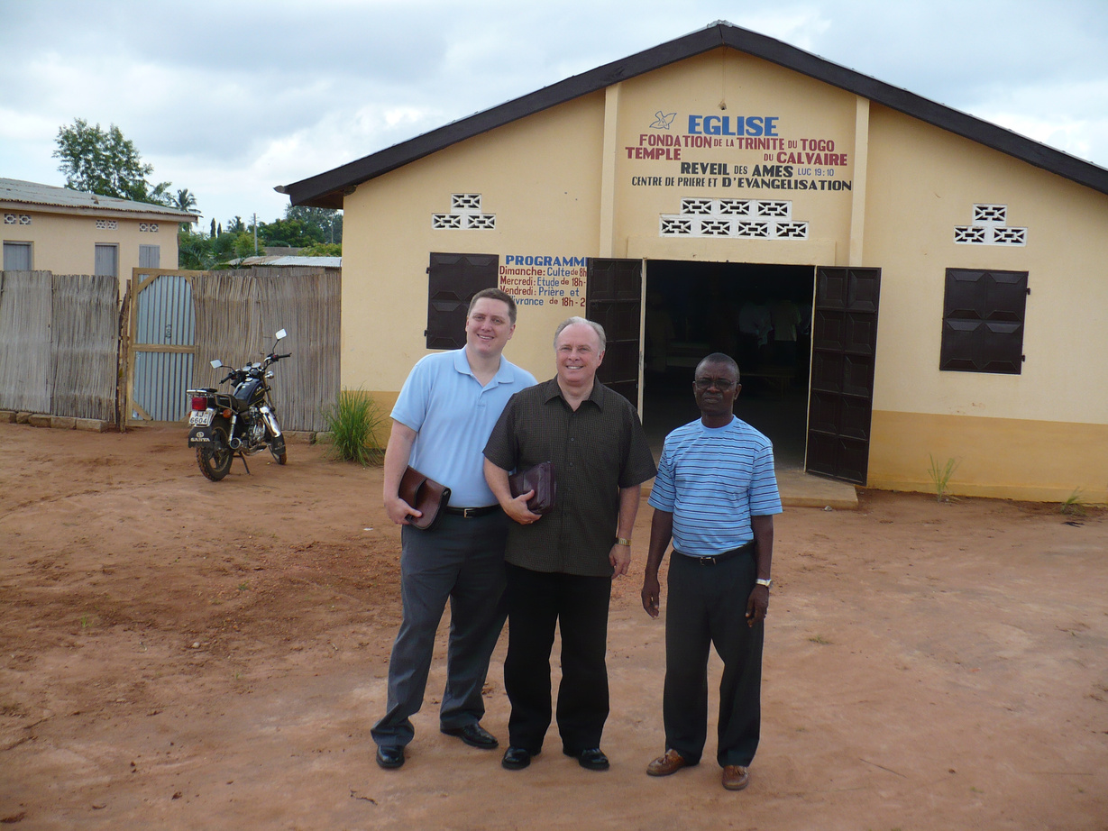
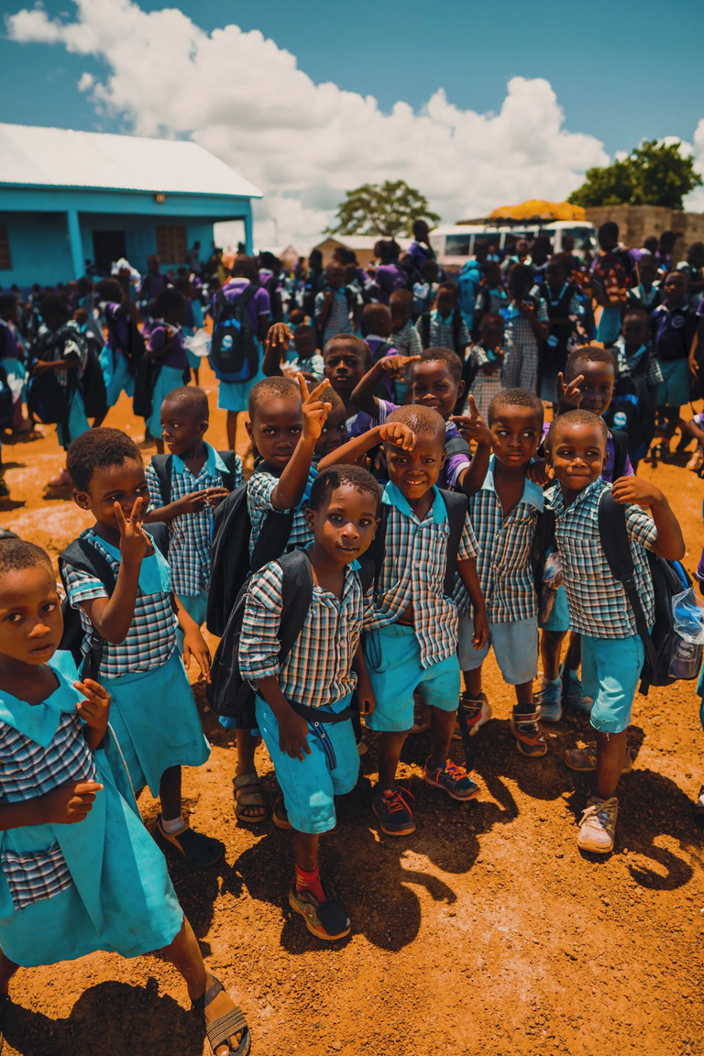

Welcome to Global Servants
A Legacy of Sharing God's Love Around The World Since 1977
www.globalservants.org

Slide 2
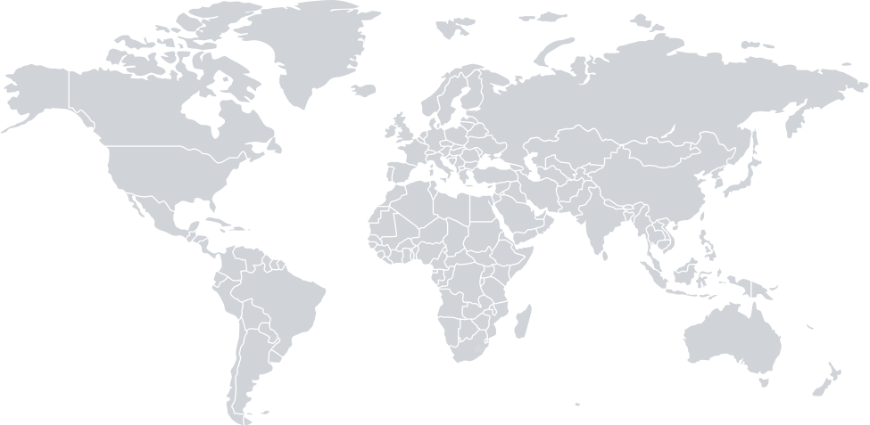
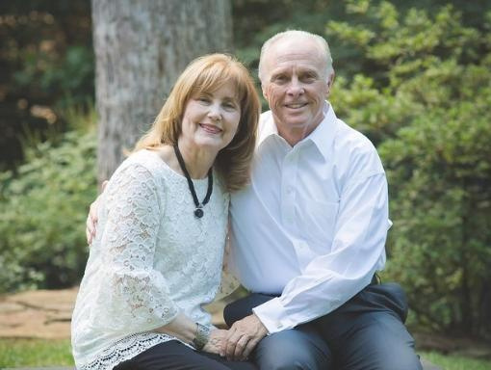

  Global Servants was founded by Dr. Mark and Alison Rutland in 1977.
Global Servants exists to help individuals and communities primarily in West Africa and Southeast Asia. We serve others through our girls’ homes, education initiatives, investing in rural villages, and spreading the Gospel. We are committed to doing all that we can to improve the lives of people now and for generations to come. Our efforts are chiefly centered around our Houses of Grace, building schools and providing educational resources, offering micro-investments, constructing wells and toilets, and building churches.

Slide 3

  More than 40 Years of Ministry
From our founding in 1977 to the opening of each House of Grace, these key moments mark the growth of Global Servants and the faithful journey that continues to transform lives around the world.
  1977
  2025
Trinity Foundation launched in 1977
New Dorm Middle Girls Dorm in Thailand
  1995
Trinity Foundation changes its name to Global Servants
  2017
Global Servants celebrates its 40th anniversary.
  2011
House of Grace Ghana opens
  1988
  2023
Global Servants surpasses 1,000 girls served through Houses of Grace.
In 1988, Global Servants established House of Grace Thailand
  2018
Travis Rutland becomes the 2nd President of Global Servants
  2015
The Trinity Foundation School is built in Kumasi, Ghana

Slide 4


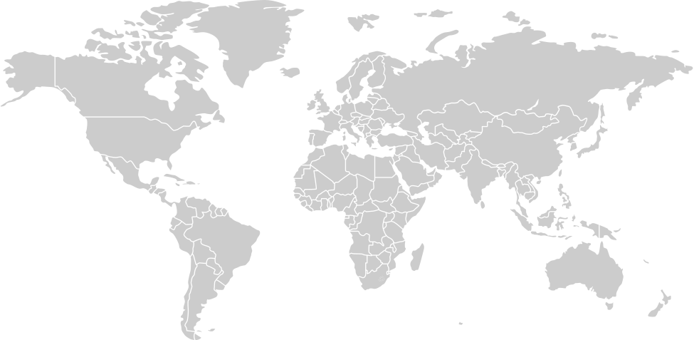




House of Grace
Clean Water Initiative
What We Do
Global Servants exists to rescue, restore, and empower those in need through practical ministry rooted in the love of Christ. From saving at-risk girls to providing clean water, education, and the Gospel, each initiative is designed to bring lasting transformation to individuals and communities around the world.
Sanitation Stations
Education Initiatives
Evangelism & Outreach

Slide 5
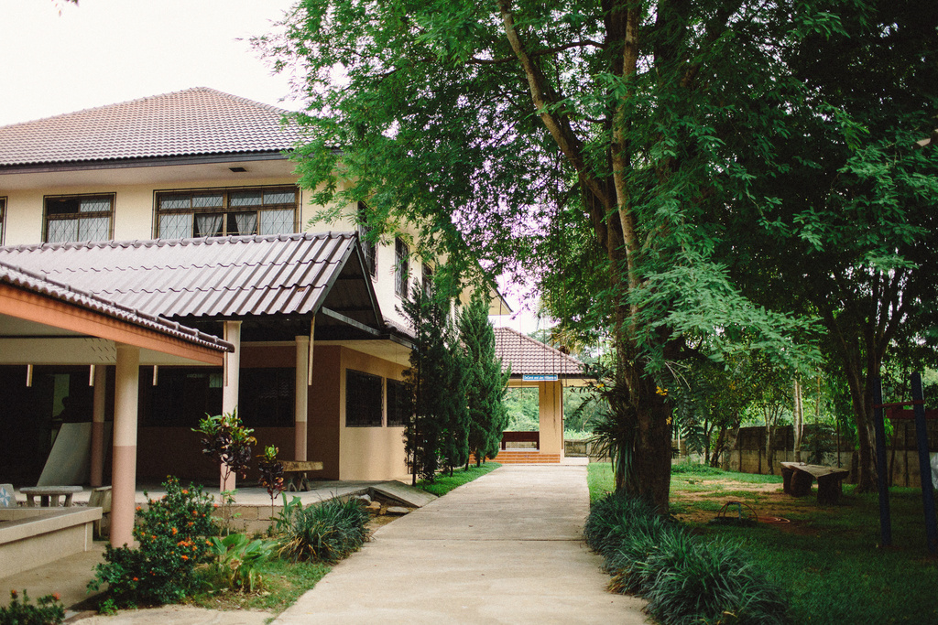
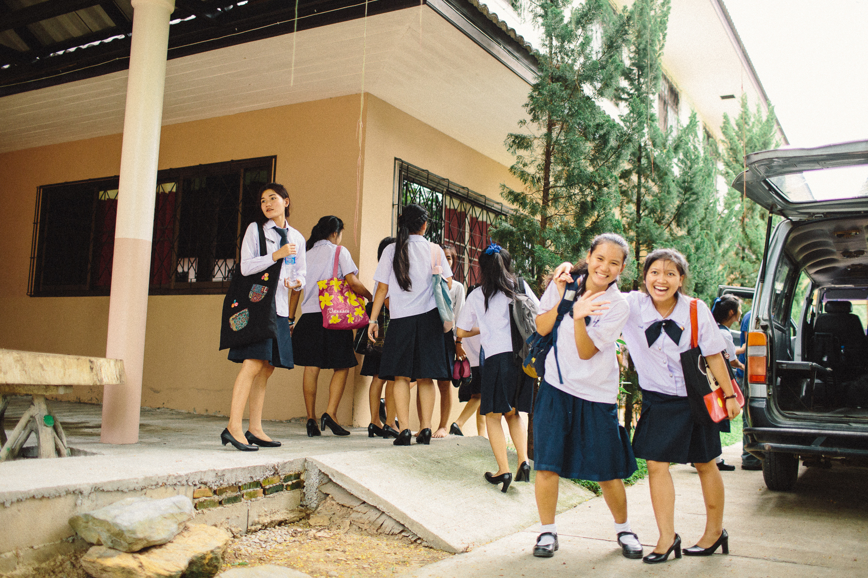
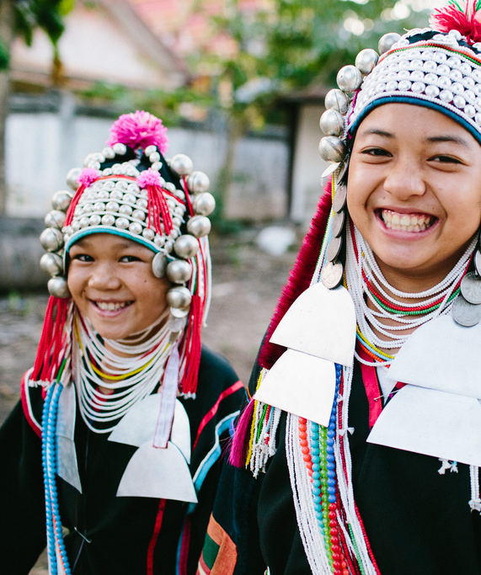
Thailand
www.globalservants.org

Slide 6
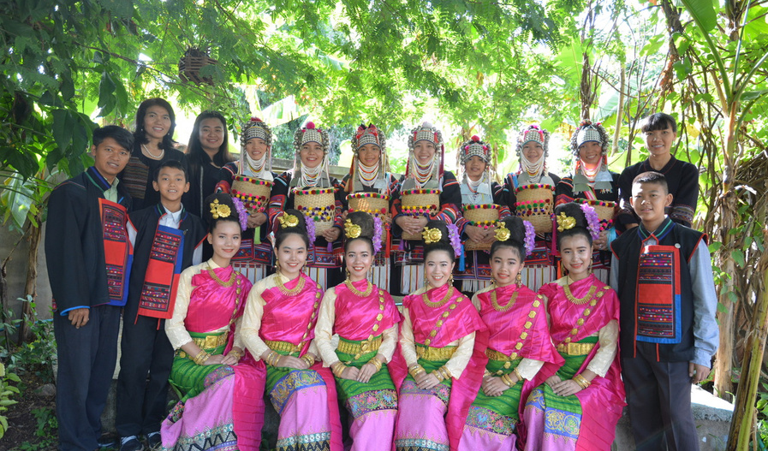
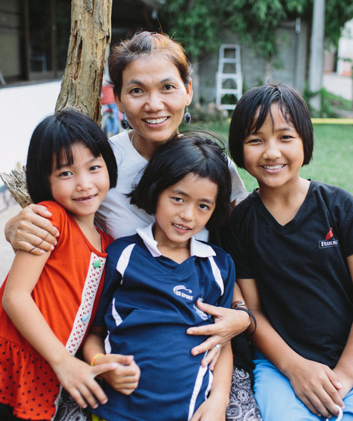
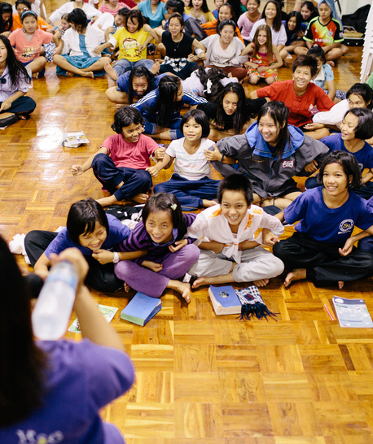
House of Grace Thailand
A Place of Rescue, Restoration, and Hope
House of Grace is more than a shelter—it’s a safe, loving home where at-risk girls are rescued from exploitation and given a chance to thrive. Through education, counseling, and discipleship, each girl is nurtured in a Christ-centered environment that promotes healing and growth. With campuses in Thailand and Ghana, House of Grace empowers young women to break cycles of abuse and poverty. Every life changed is a testimony of God’s redeeming love at work.

Slide 7
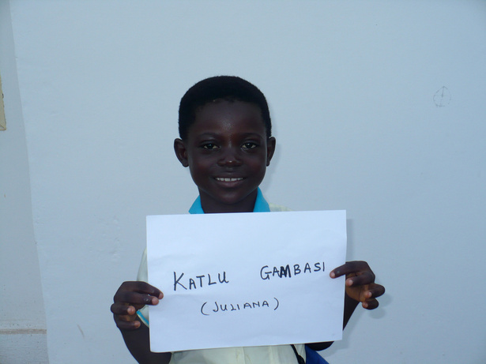
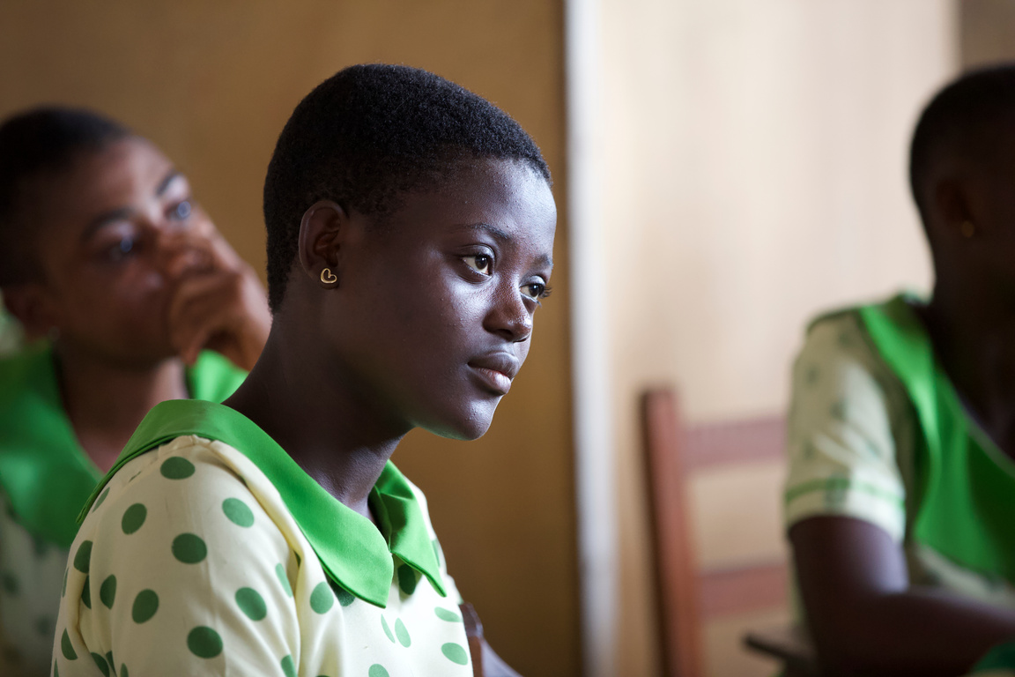
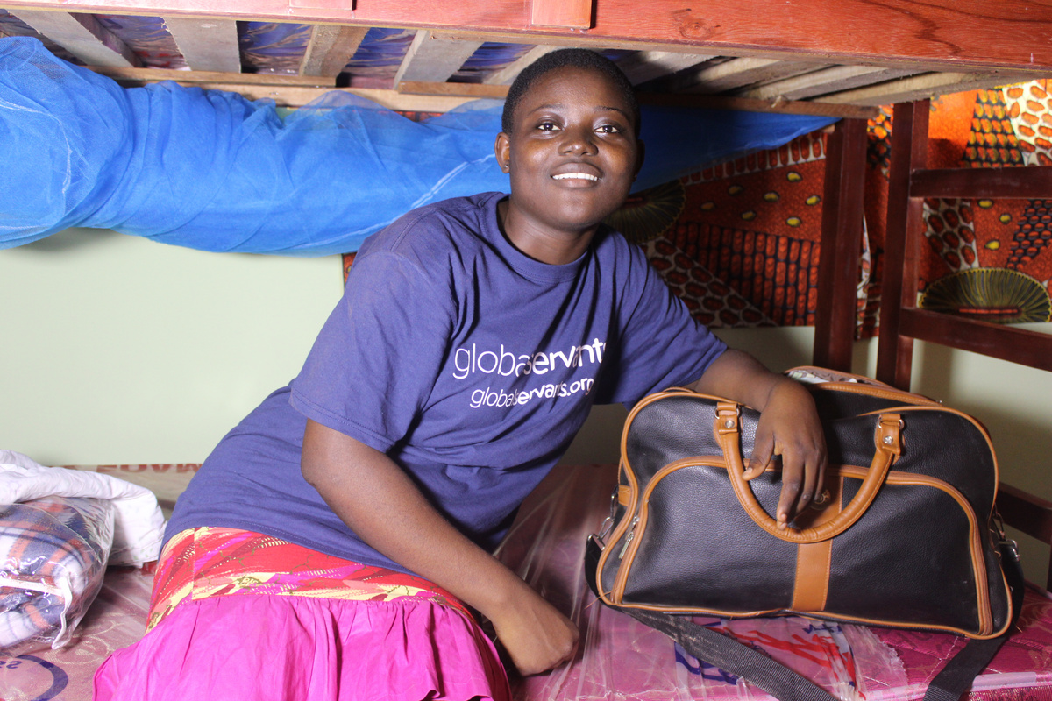
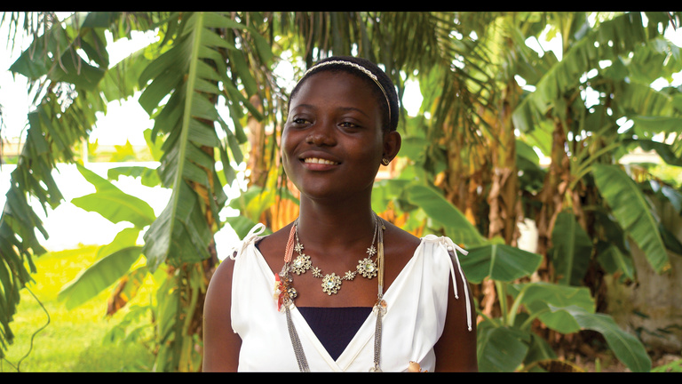
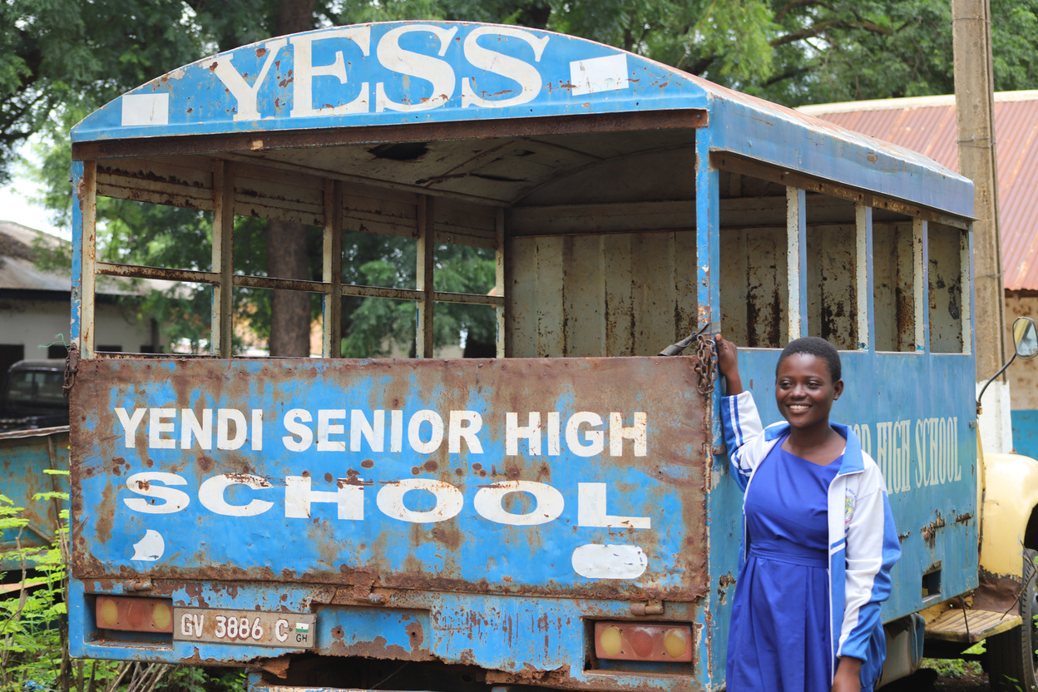
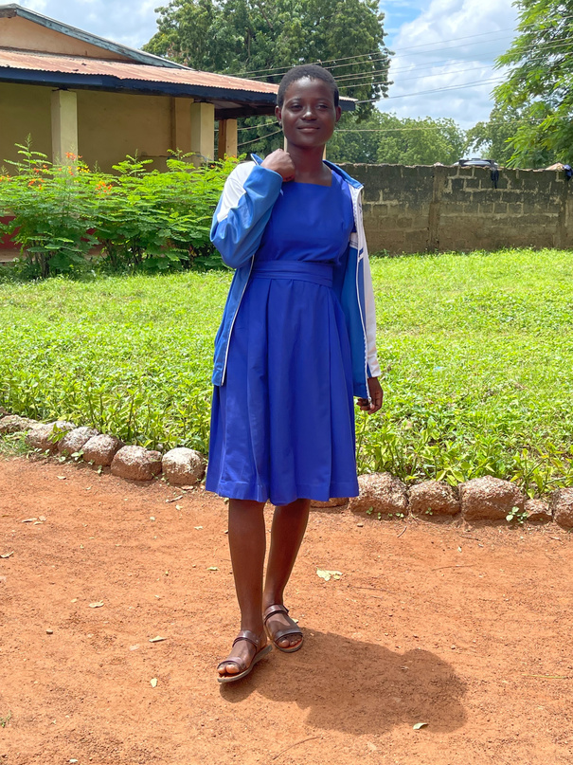
IMPACT STORY
Julianna’s Story
From Orphaned Girl to Future Leader
In 2011, Julianna became the first girl to arrive at House of Grace–Ghana. She was just seven years old, orphaned after her mother tragically killed her father and was sentenced to life in prison.
With no family and nowhere to go, Julianna was taken in by a local Pastor who knew Julianna needed more—she needed stability, love, and the opportunity to thrive. So, he made a long journey across Ghana with Julianna to Kumasi to the newly founded House of Grace.
Julianna had no idea she was about to walk into the place that would change her life forever.
She spoke only her tribal language, Dagbani, and was frightened and alone, but Julianna quickly learned Twi, becoming a mentor and translator for the next nine girls—each from remote villages, each dealing with their own trauma

Slide 8

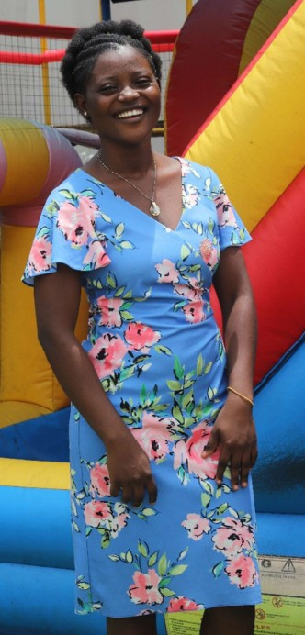
Julianna helped the other girls adapt, grow, and find comfort in their new home. She remained at House of Grace through 9th grade, finished high school, and is now in her second year of university, studying to become a social worker. Her dream? To return as the future Director of House of Grace–Ghana.
Julianna’s story is one of hope, transformation, and purpose—but it’s also a story made possible by people who gave generously.
There are more children just like Julianna—waiting for a safe place to land, a loving hand to guide them, and the chance to discover the purpose God has for their lives.
Your sponsorship can help write the next story.
  Give a child safety.
  Give a child access to education.
  Give a child a future.
When you sponsor a child —you help them find their BIG DESTINY.

Slide 9
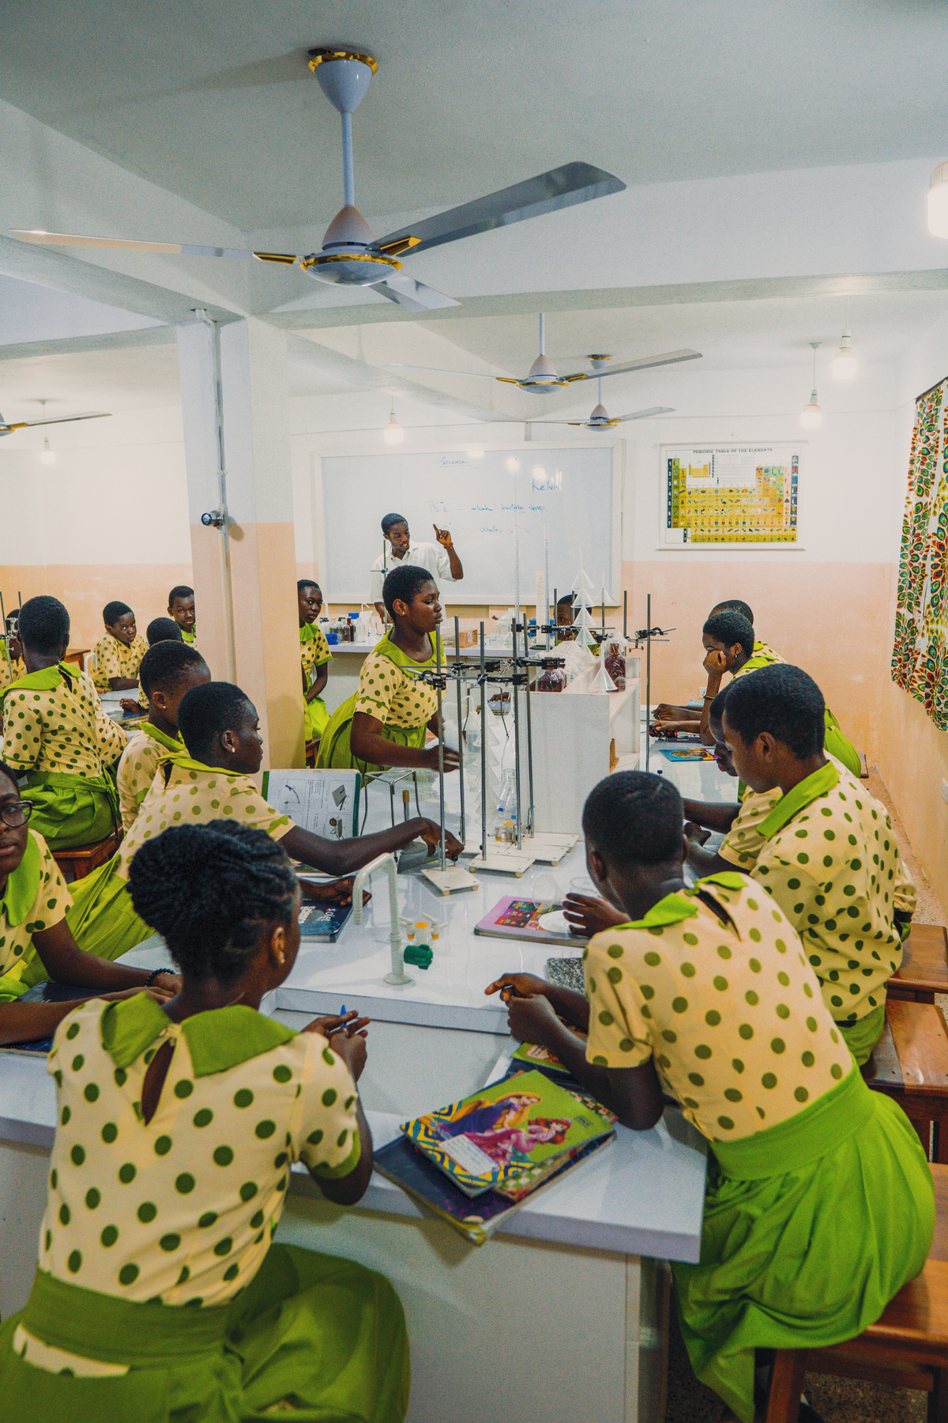
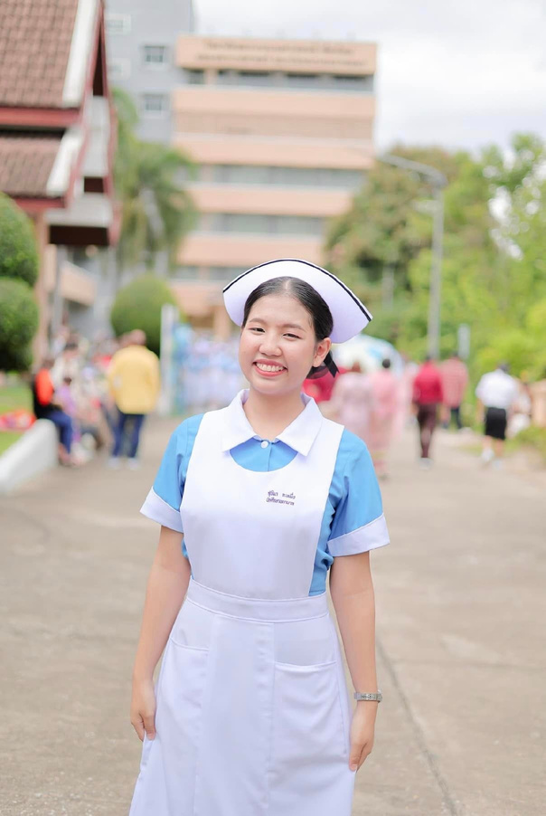

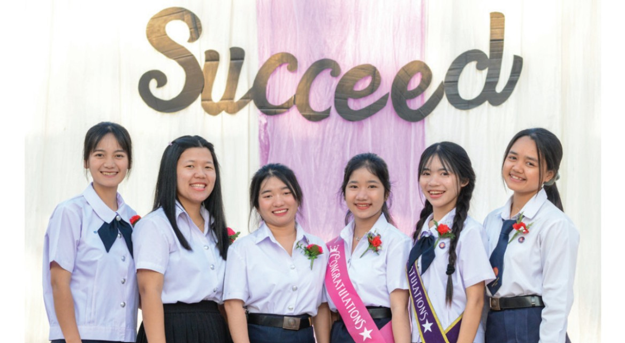


Our Impact
House of Grace Saves Little Girls For Big Destinies
House of Grace Thailand currently has 103 girls and House of Grace Ghana currently has 30 girls. Global Servants has built dormitories, cafeterias, kitchens, gyms, playgrounds and anything else girls might need as they grow. Global Servants pays all the medical bills and all the school fees. By investing in these wonderful girls,
120+
At Risk House of Grace girls continually rescued from human trafficking, sexual abuse, child marriage, child labor, and child prostitution while given all the benefits of a loving home and Christ-centered family
100%
of our girls were giving educational opportunities all the way through university. These girls were rescued through House of Grace-Ghana and House of Grace-Thailand.
200+
Girls empowered through financial independence & sustainable living so they can live the life they desire.

Slide 10
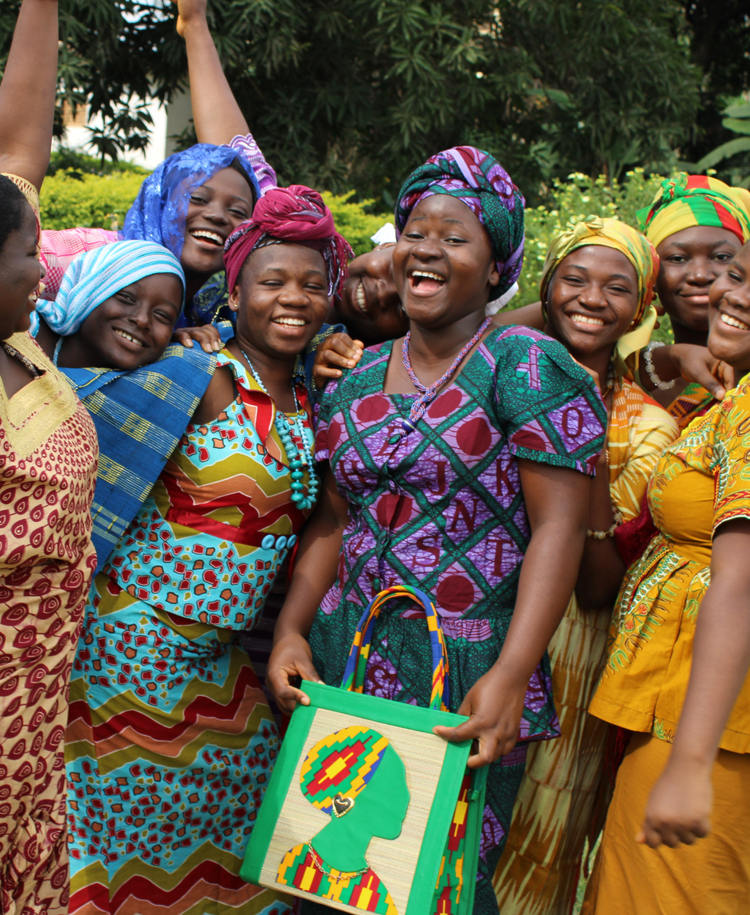
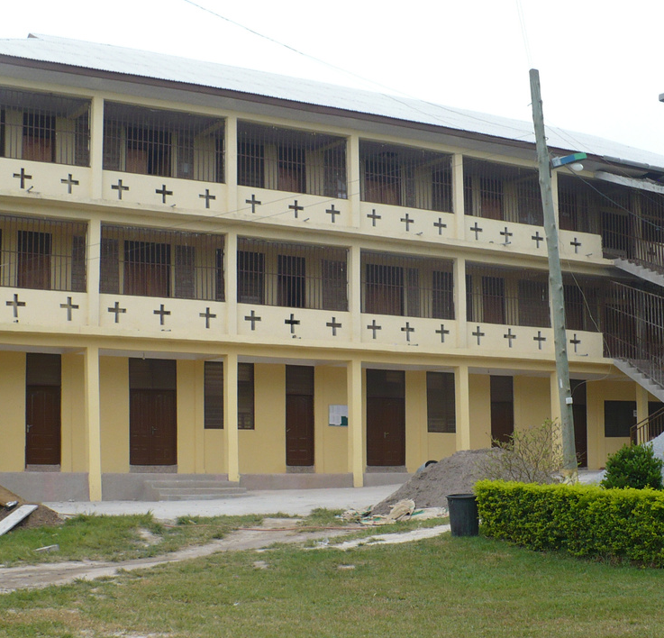
House Of Grace
Ghana
www.globalservants.org

Slide 11
Clean Water
www.globalservants.org

Slide 12
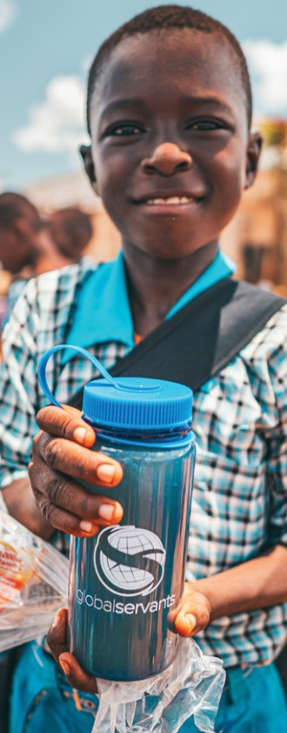
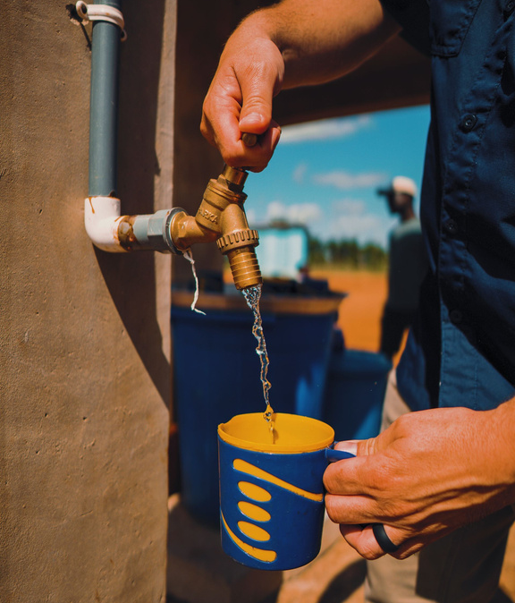
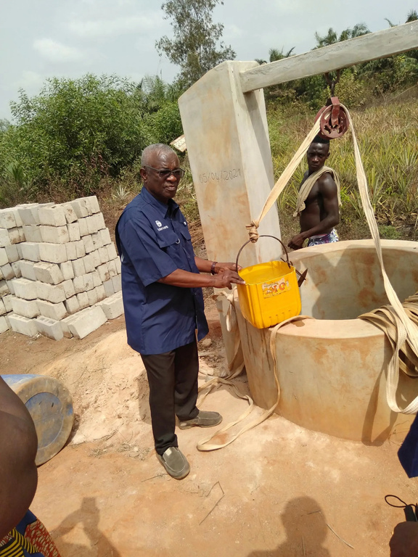
Clean Water Initiative
Transforming Lives Through Access to Clean Water
Clean water is not a luxury, but a necessity. Access to clean water is essential for health, dignity, and opportunity. Through our Clean Water Initiative, Global Servants builds and maintains wells in remote villages—bringing safe drinking water, improving hygiene, and reducing disease. Each well transforms a community, opening the door to better education, stronger families, and Gospel-centered outreach. Clean water is more than a resource—it’s a gift that brings life and hope to those who need it most.

Slide 13
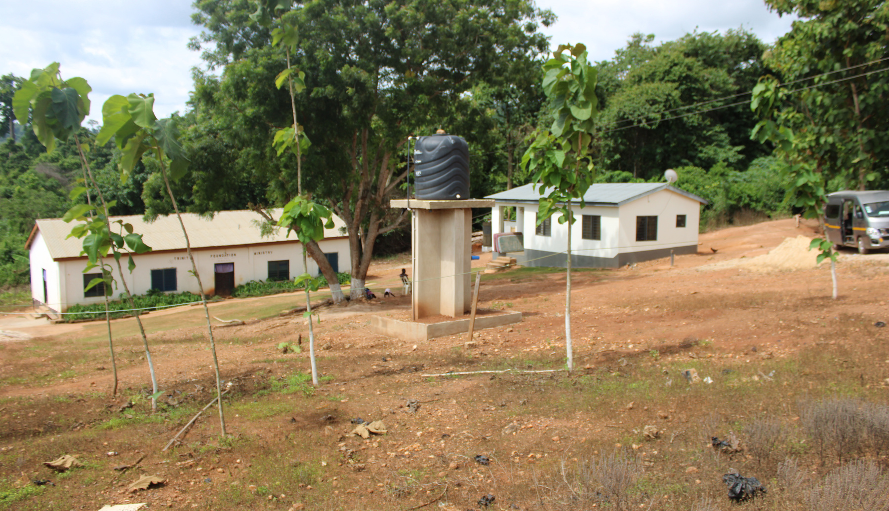
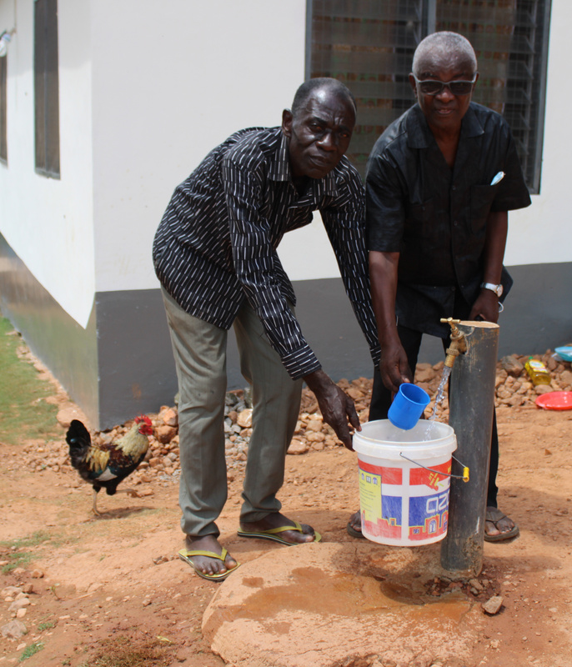
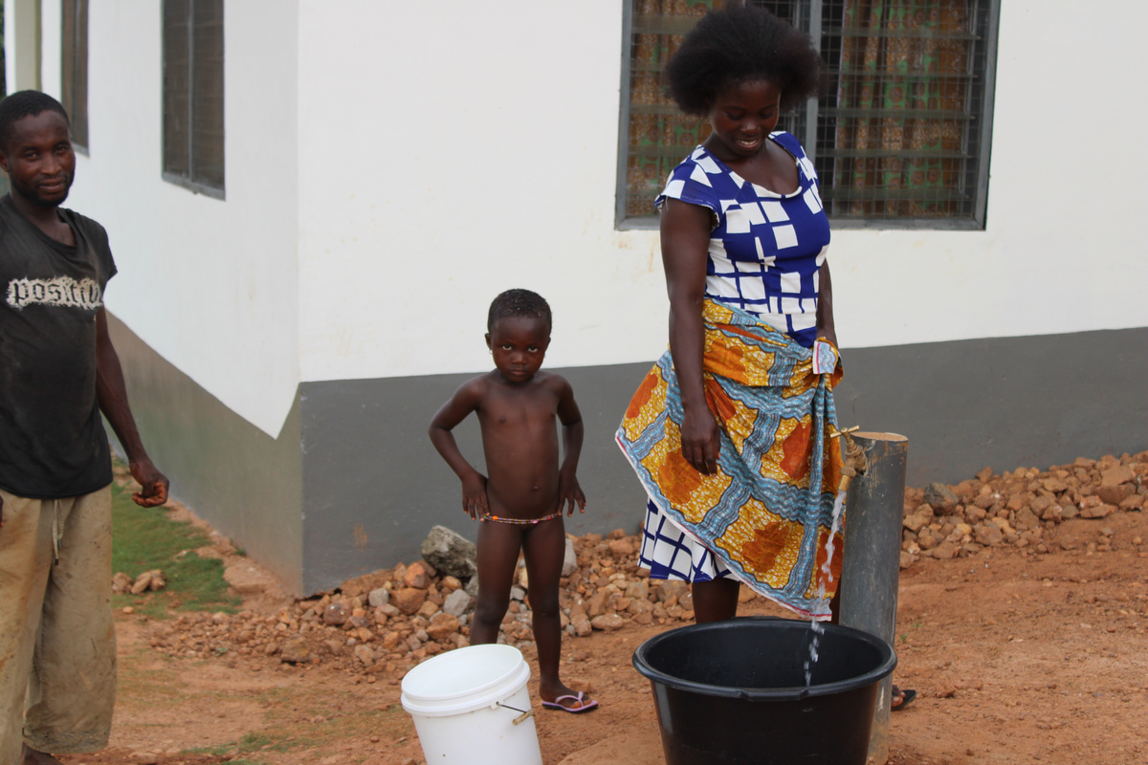
Clean Water Impact Story
A Well of Hope in Gbimsi
Because of our supporters, lives are forever changed
In the remote village of Gbimsi, on the edge of Ghana’s northern desert, access to water was a daily struggle. The village church and school—serving over 350 children—had no well. Students walked miles to the river just to get water or hold class under the scorching sun. Teachers and pastors did what they could, but the need was overwhelming.
That changed when Global Servants stepped in.
Thanks to the generosity of our partners, a clean water well was drilled in Gbimsi. Today, children can stay in school, teachers can focus on learning—not survival—and the entire village now has reliable access to safe, life-sustaining water. A sanitation station was also built, and electricity is on the way, multiplying the impact for years to come.

Slide 14
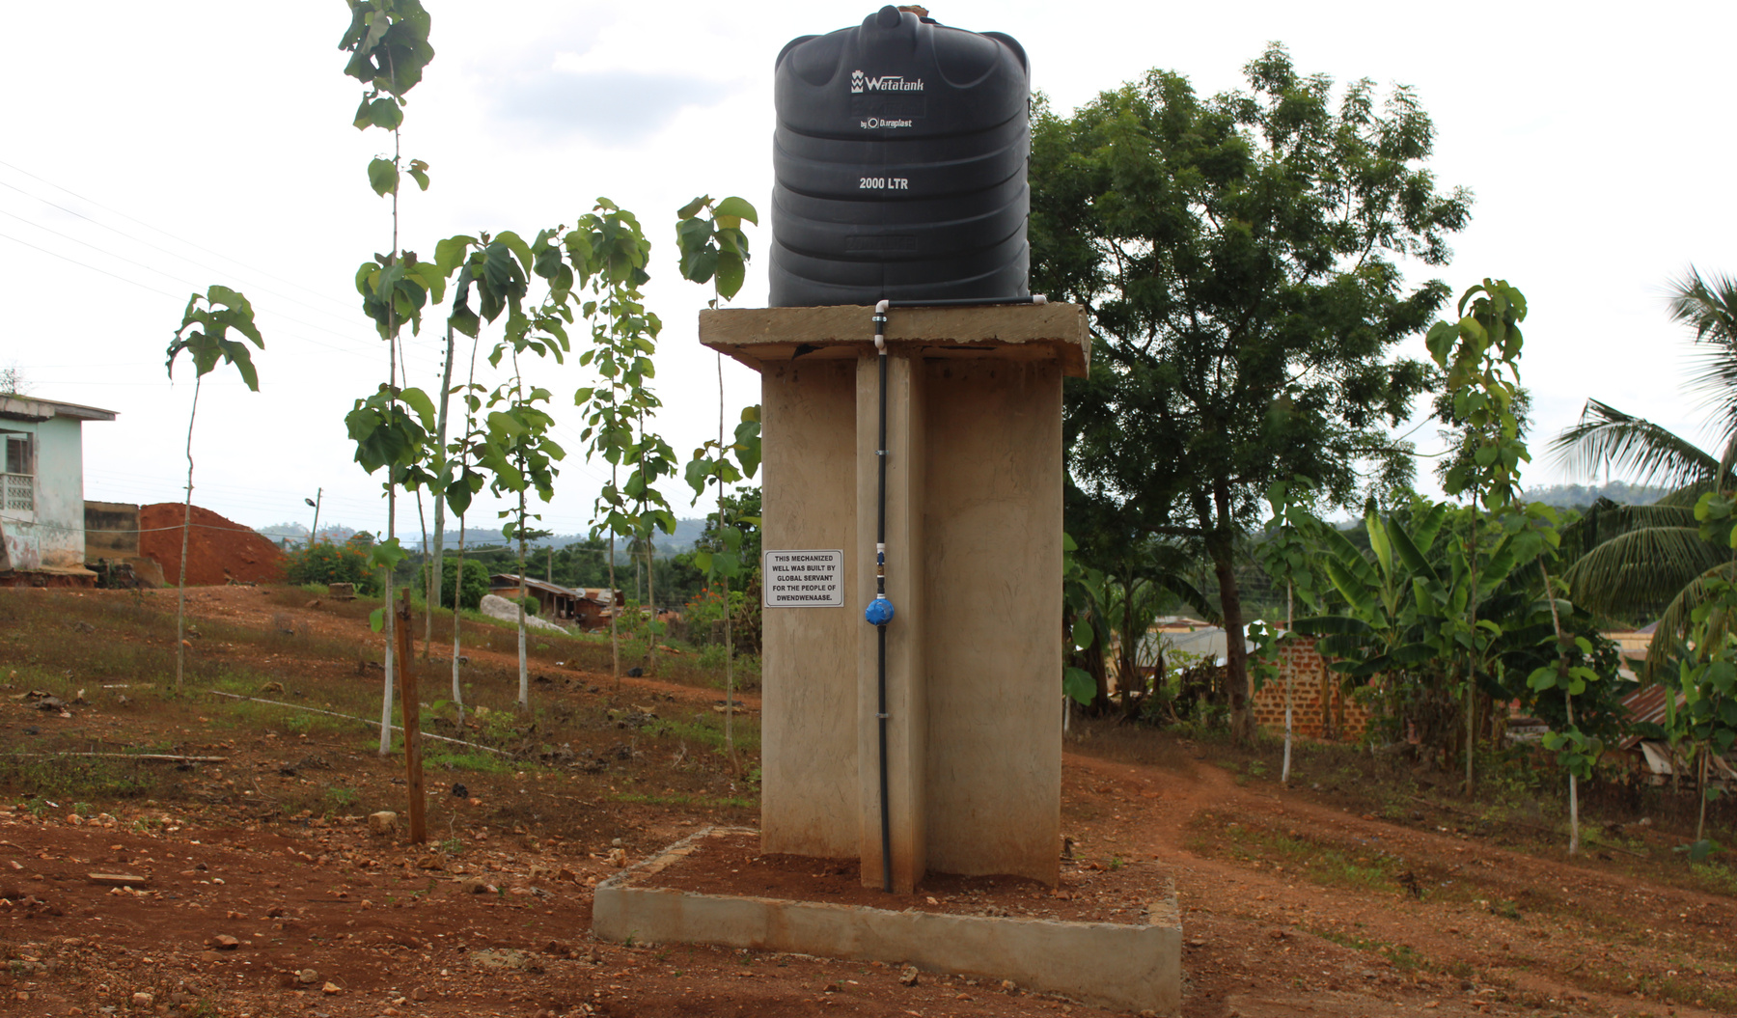
Clean Water Impact Story
A Well of Hope in Gbimsi
Because of our supporters, lives are forever changed
This one well is more than a convenience—it’s a symbol of dignity, opportunity, and God’s provision. It is blessing not just a school, but a community.
Because of your faithfulness, a village once desperate for water now overflows with hope.

Slide 15
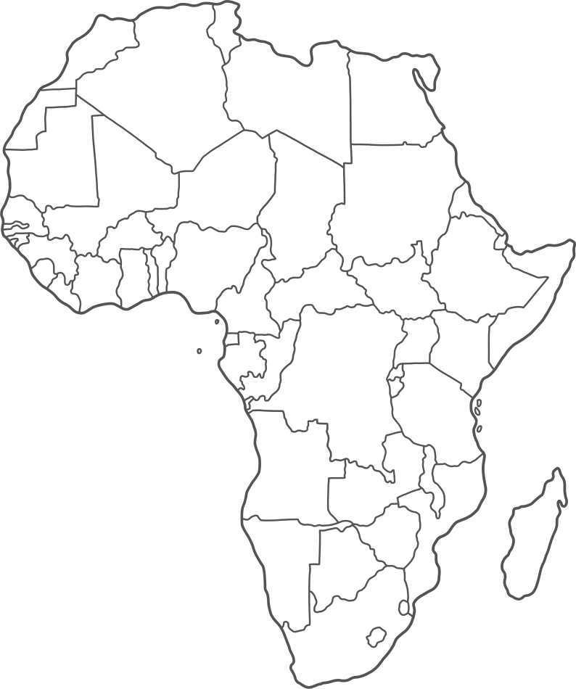







Our Impact
Our Clean Water Initiatives Transform Communities
Behind every well we drill is a story of transformation. Clean water doesn’t just quench thirst—it reduces disease, restores dignity, and unlocks opportunity for entire communities. These numbers represent lives changed, villages strengthened, and futures made possible through your generosity and God’s grace.
34
Wells Drilled
30+
Villages and Schools Served
20k+
Thousands now drink clean water every day
Togo - 4 wells
Benin - 2 wells
Cote D’ Voire - 1 well
Ghana - 27 wells

Slide 16
Sanitation Stations
www.globalservants.org

Slide 17
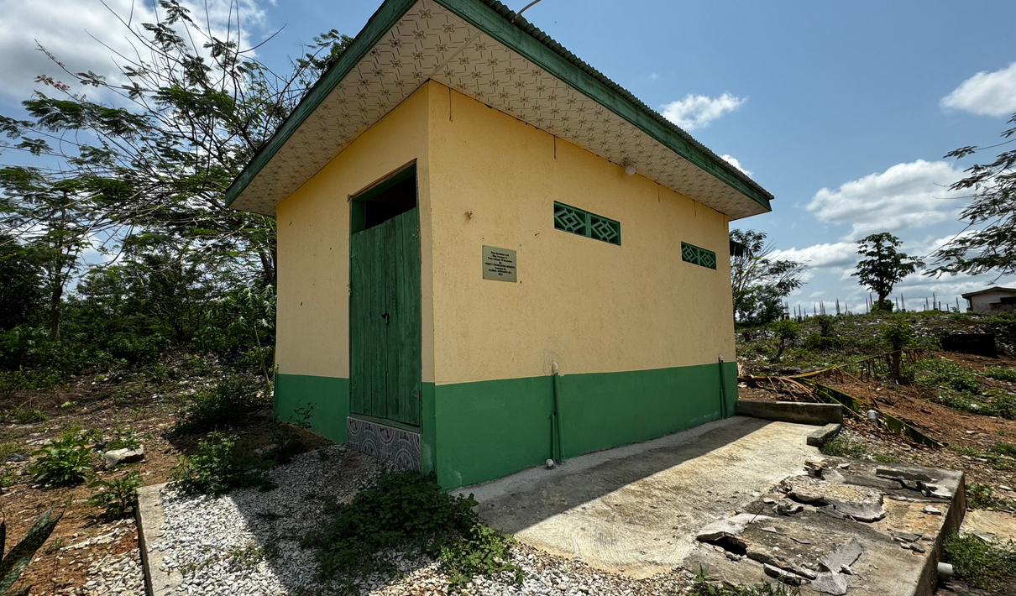
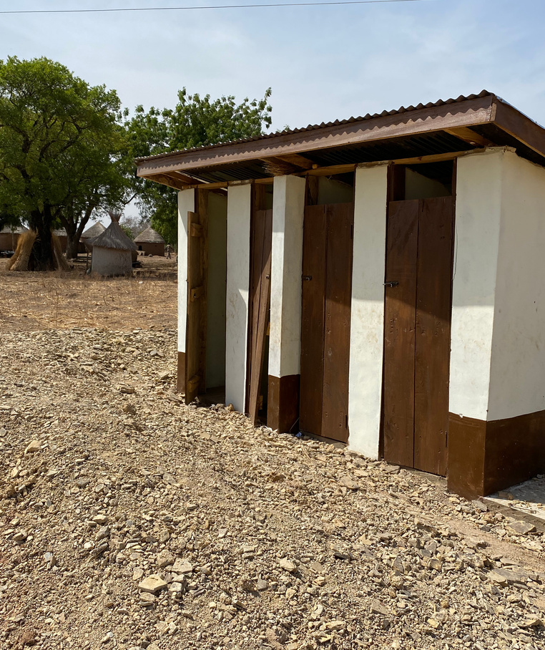
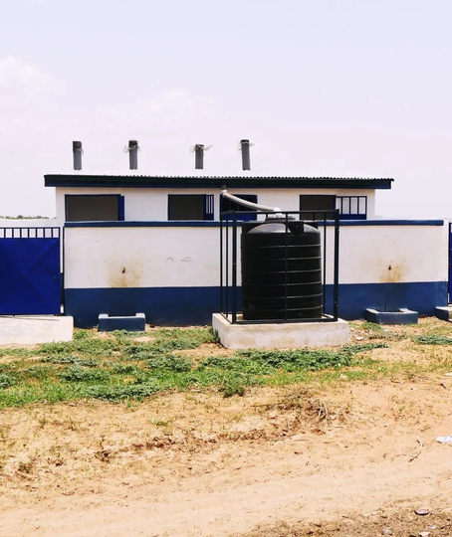
Sanitation Stations
Protecting Health, Preserving Dignity
Sanitation Stations are vital tools in preventing disease and promoting community well-being. By building restrooms and hygiene facilities in villages and at ministry sites, Global Servants addresses one of the most overlooked but critical needs in underserved regions. These stations reduce health risks, improve quality of life, and create cleaner, safer environments—especially for women and children. Each Sanitation Station is a practical expression of God’s love, meeting physical needs with compassion and care.

Slide 18
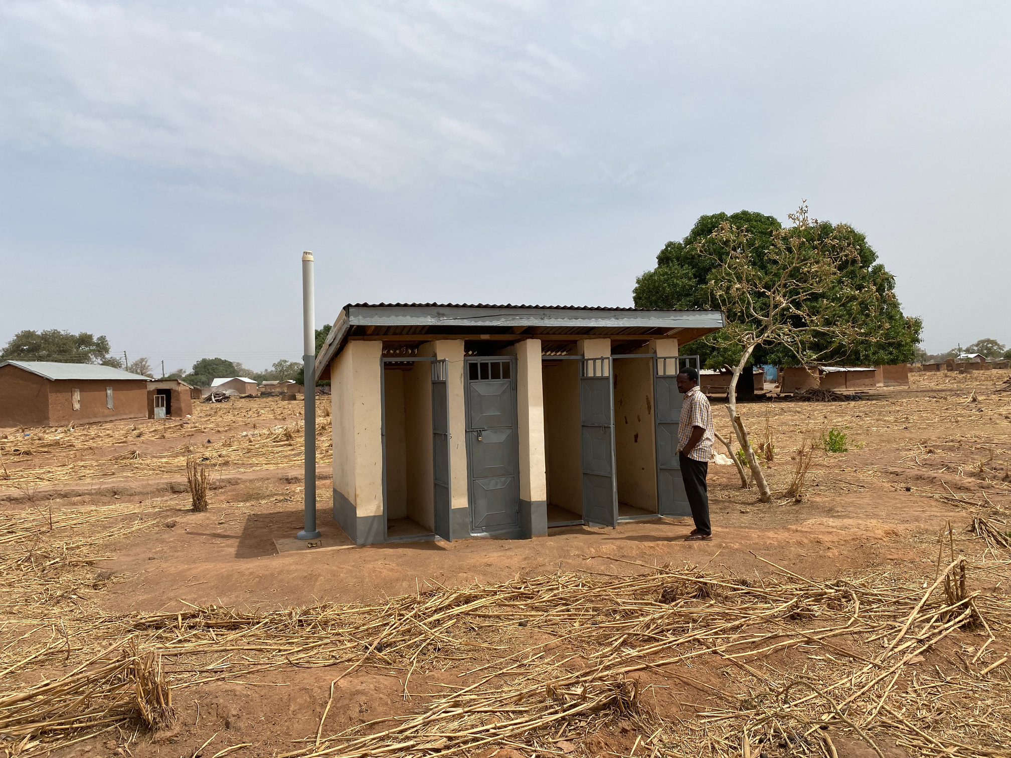

Our Impact
We Build Sanitation Stations That Prevent Disease and Promote Well-Being
Access to proper sanitation is a basic human need—yet in many of the rural communities we serve, it’s a daily challenge. Our Sanitation Stations Initiative brings clean, safe, and private restroom facilities to villages and schools in West Africa and Thailand. These stations reduce the spread of disease, improve hygiene, and restore dignity—especially for women and girls who often suffer most without them. What may seem simple is, in reality, life-changing.
120+
Sanitation Stations Built across three countries in West Africa
30+
Remote villages, churches, and schools impacted
Countless
lives improved through restored dignity and better health

Slide 19
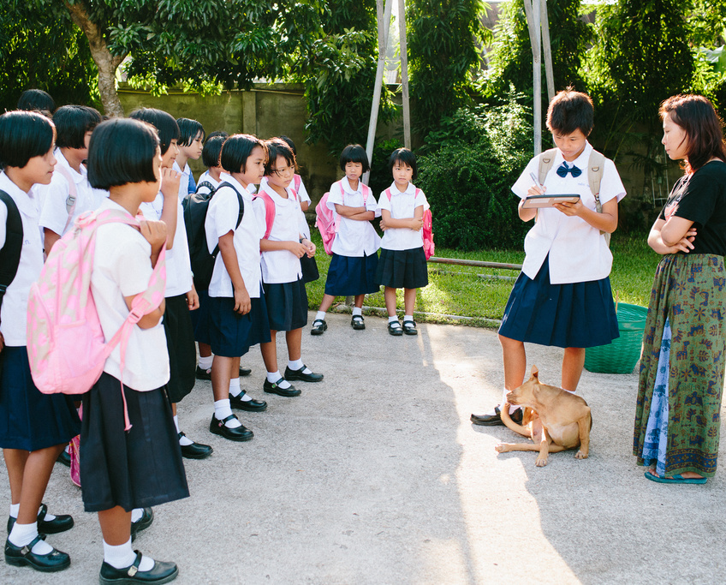
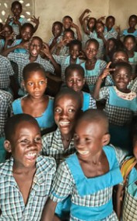
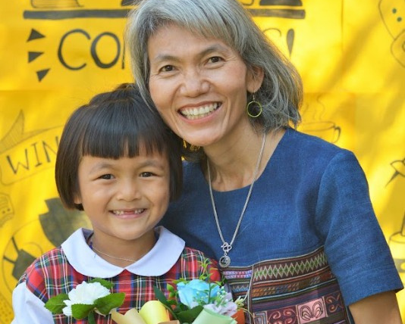
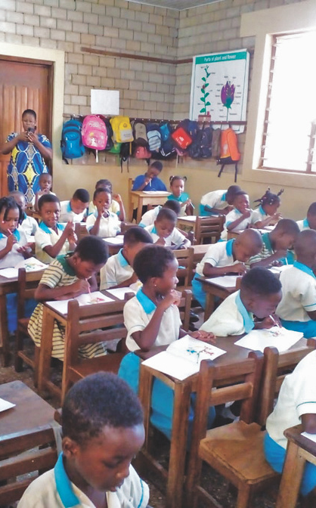
Education Initiatives
www.globalservants.org

Slide 20
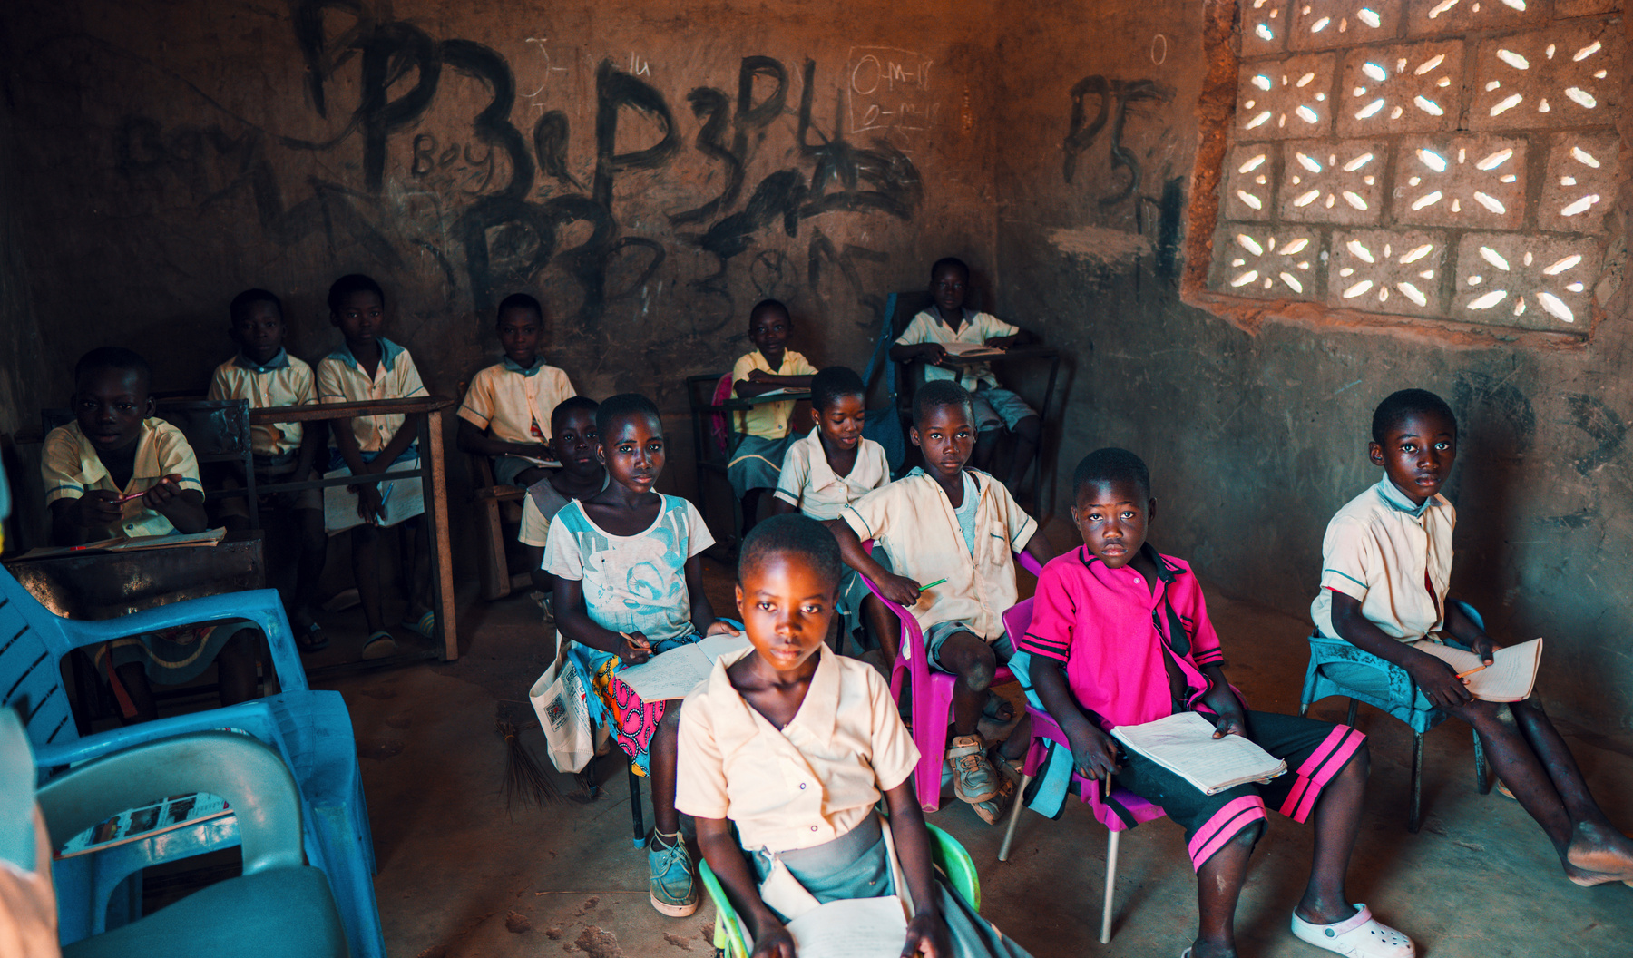
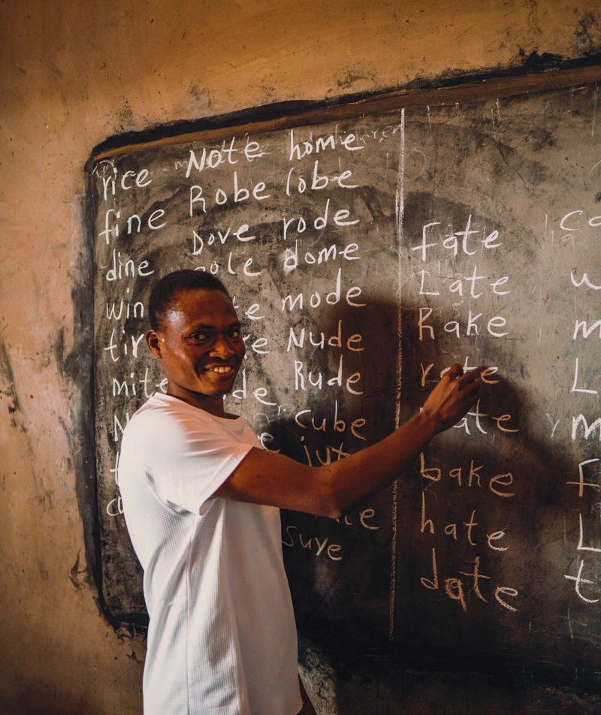
Education Initiatives
Invest in education. Change a Life.
Education support through Global Servants provides at-risk girls with everything they need to thrive in school—tuition, uniforms, supplies, and a supportive learning environment. Many of these girls are the first in their families to receive an education, opening the door to a future filled with hope and opportunity. Your investment not only changes a life—it empowers a young woman to rise above poverty and walk confidently in their God-given purpose. When you invest in education, you create a lasting transformation.

Slide 21
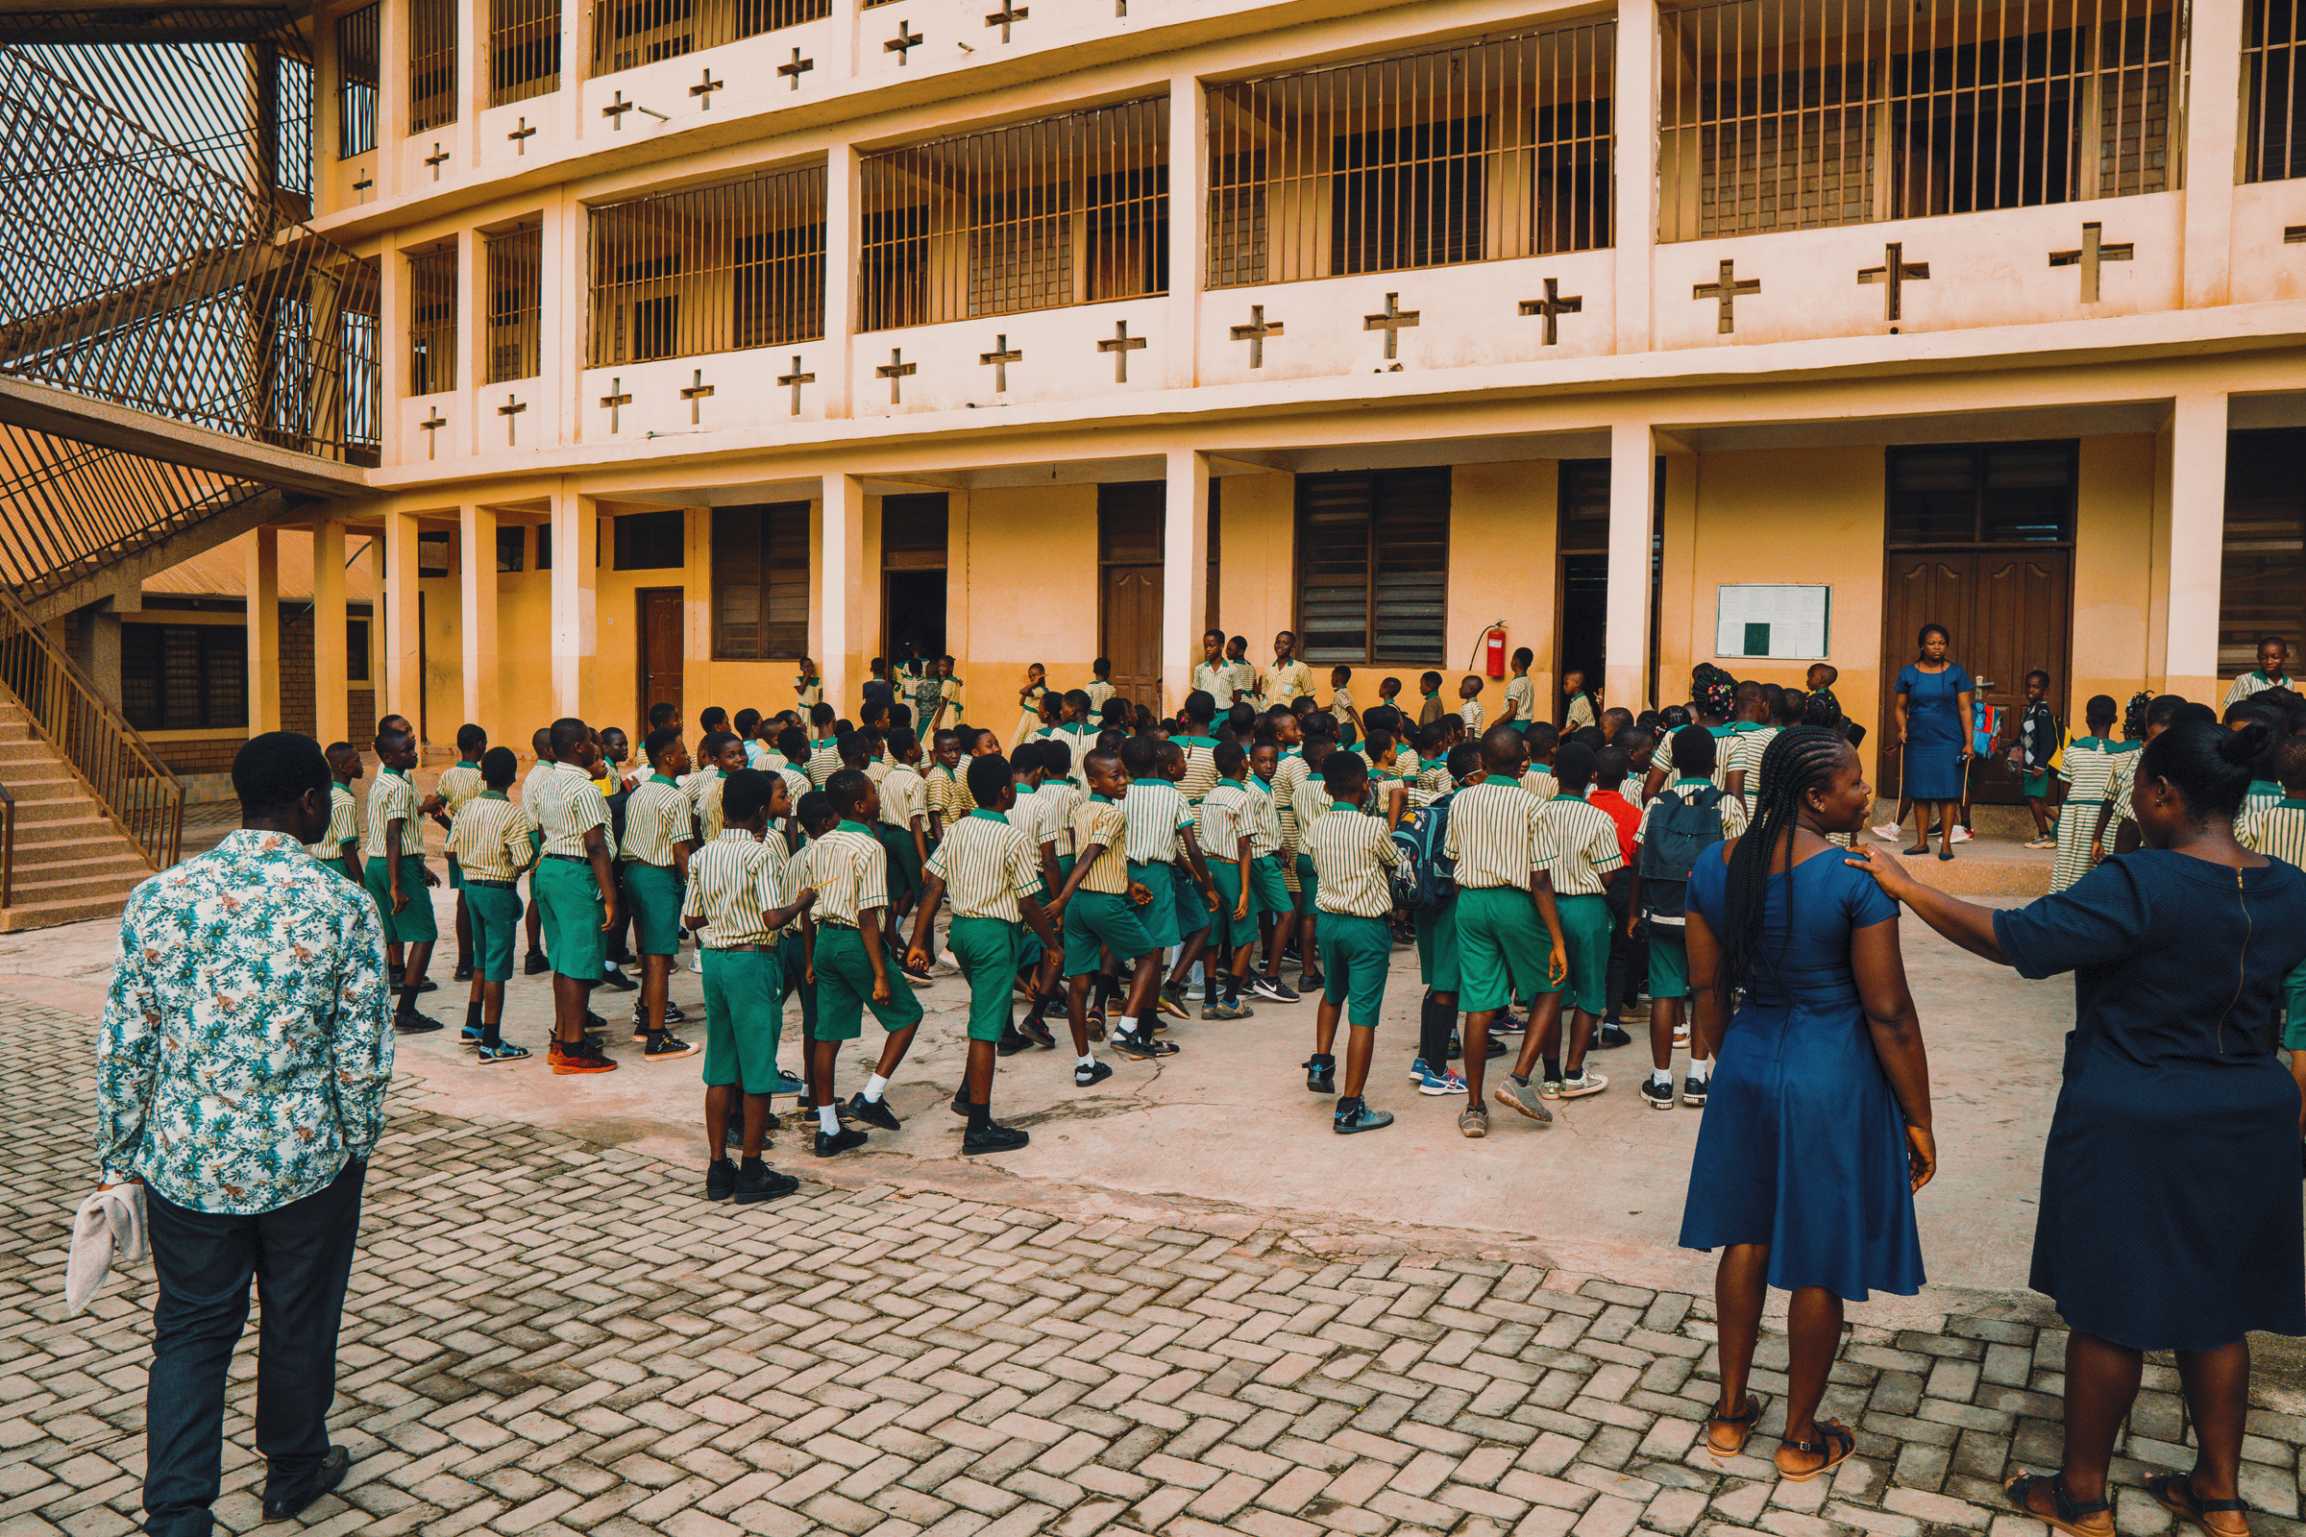


Our Impact
Our Education Initiatives Breaks The Cycle of Poverty
From building schools and classrooms to providing uniforms, supplies, and scholarships, we are investing in the next generation of leaders, teachers, and changemakers. Education enables students to rise above poverty, escape cycles of exploitation, and realize their God-given potential. When we educate a child, we don't just change one life—we influence families, communities, and future generations.
1000+
Teachers and students equipped each year through Global Servants education initiatives
Thousands
backpacks filled with school supplies given away
3500+
students served by Trinity Foundation School built in Kumasi, Ghana

Slide 22
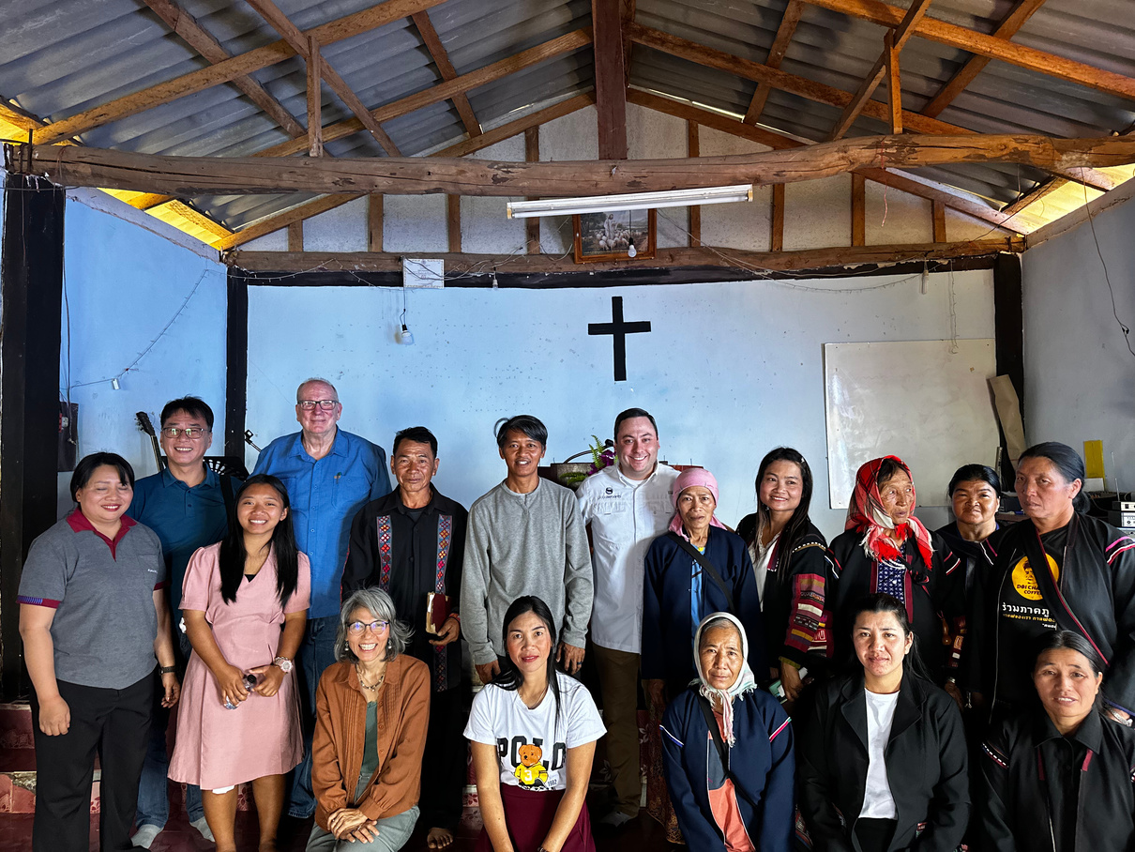
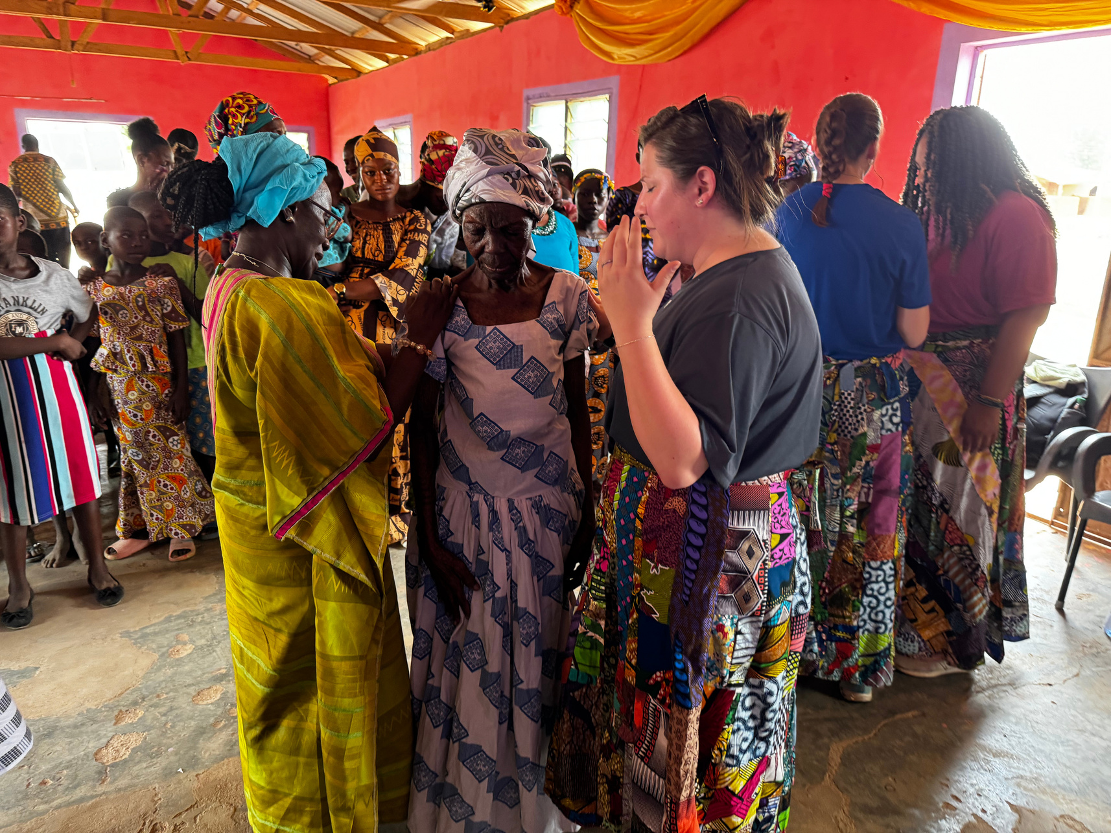
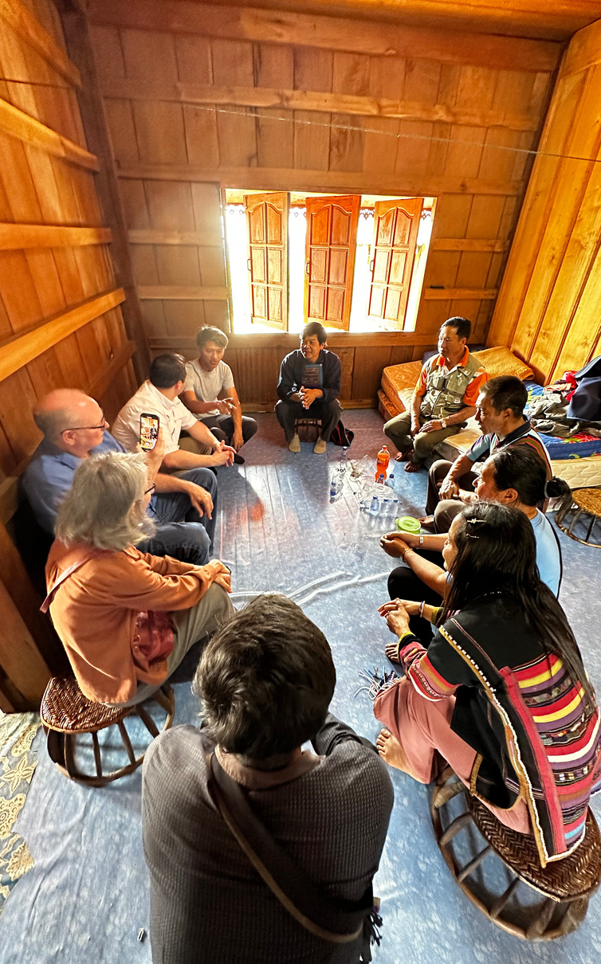
Evangelism & Church Planting
www.globalservants.org

Slide 23
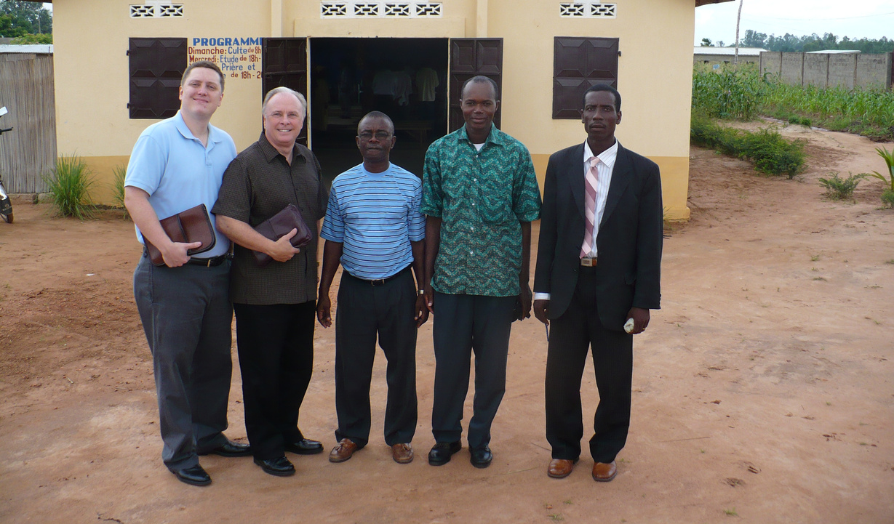
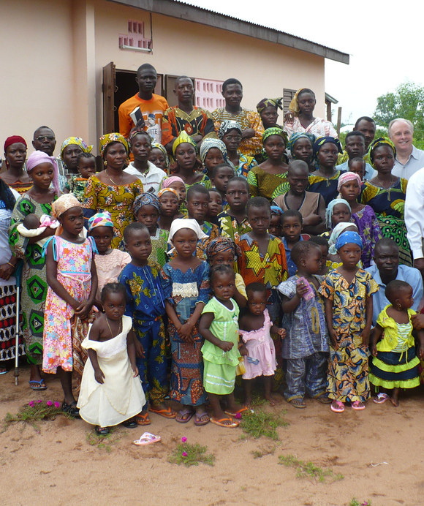

Evangelism & Outreach
Sharing the Gospel. Planting Hope.
Evangelism and church planting are at the heart of Global Servants’ mission. For over 40 years, we have preached the Gospel, trained local pastors, and established churches across West Africa and Southeast Asia. Through leadership conferences, ministry events, and strategic church builds, we equip communities to grow in faith and spread the message of Jesus. Every church planted becomes a light in the darkness—bringing hope, healing, and the truth of God's Word to people around the world.

Slide 24




Our Impact
We Equip Communities to Grow in Faith
Through crusades, leadership training, church planting, and local discipleship, we are seeing lives transformed and entire communities awakened to the hope of Christ. We don’t just preach—we plant. We train pastors, equip leaders, and establish churches that will continue to carry the message of Jesus for generations. Whether it’s a rural village or a growing city, we go where the Spirit leads, sharing the Good News and watching the Church rise.
100+
local pastors trained and equipped for ministry
Thousands
people have heard the Gospel through Global Servants evangelism and outreach efforts
10+
churches planted in West Africa and Southeast Asia

Slide 25

Financial Responsibility
EXPENSE SUMMARY
11.4% General & Administrative
1.5% Fundraising
We are grateful for our partnership with our faithful supporters, who have entrusted us with resources that allow us to serve thousands of people worldwide every year. We could not do what we do without this generosity and support. We remain committed to stewarding every donation wisely, ensuring that every dollar goes towards making a lasting difference in the lives of those we serve
87.1% Direct
Mission Support
For the Fiscal Year Ended March 31, 2024

Slide 26



Trusted. Transparent. Accountable.
ECFA (Evangelical Council for Financial Accountability) – Upholding the highest standards of financial transparency, ethical fundraising, and board governance.
At Global Servants, we take financial integrity seriously. That’s why we’re proud to be recognized by some of the most trusted organizations in nonprofit accountability:
Charity Navigator – 4-Star Rating (the highest possible rating) – Recognized for our efficient use of donor funds and dedication to mission-driven results.
Candid (GuideStar Platinum) – Demonstrating our commitment to openness by sharing detailed organizational and impact data.

Slide 27
"Do all the good you can, by all the means you can, in all the ways you can, in all the places you can, at all the times you can, to all the people you can, as long as you can."
John Wesley

Slide 28


Be Part of the Mission
Become A Global Servant.
You don’t have to travel across the world to make a global impact—you can start right where you are. Whether you choose to give, sponsor a girl’s education, fund a well, or support a church plant, every gift you give helps rescue, restore, and empower lives in Jesus’ name. You can also partner with us through prayer, share our mission with others, or host a donor gathering in your home or church. However you choose to help, your involvement makes transformation possible—one life, one village, one soul at a time.
Become a Partner in Life-Changing Impact
With your partnership, your gift helps rescue girls, provide education, build clean water systems, support local churches, and bring lasting hope to communities in need.

Slide 29



Become A Prayer Partner
Become A Sponsor
Ways To Partner
Support House of Grace
At Global Servants, you can make a difference by giving, going, praying, or sharing. Your support helps rescue girls, provide clean water, and spread the Gospel. Join us through sponsorship, mission trips, or by sharing our mission with others.
Fund A Clean Water Project
Fund An Education Initiative
Plan A Mission Trip
Become A Home Team Member

Slide 30
Becoming a Global Servants Partner is simple—but the impact is eternal.
Why Partner Monthly?
  Sustain long-term ministry with dependable support
  Receive regular updates, stories, and testimonies
  Be part of something bigger than yourself
  See the direct impact of your generosity around the world
Ways to Partner
  Churches – Support Global Servants as part of your global missions giving
  Organizations & Businesses – Align your brand with purpose through recurring support
  Small Groups – Sponsor a girl or fund a project together
  Individuals & Families – Give monthly to help us rescue and restore lives through Christ
Start Your Partnership Today!

Slide 31





Ways To Give
Your generosity fuels everything we do—from rescuing at-risk girls, to providing clean water and sanitation, to planting churches and sharing the Gospel. Every gift, large or small, makes a lasting difference in the lives of those we serve. Whether you're looking to give monthly, make a one-time contribution, or invest in the future through legacy giving, there's a way for you to be part of this life-changing mission.
Make a One-Time Gift
Give Monthly
Sponsorship
Legacy Giving
A single gift can rescue a girl, build a well, supply a classroom, or support a village in crisis. Choose where to make a difference today.
Become a sustaining partner by setting up a recurring monthly donation. Monthly gifts provide reliable support for our ongoing initiatives, allowing us to plan and grow our impact with confidence.
Sponsor a child and provide food, shelter, education, and hope. Your monthly gift transforms lives and empowers children to create lasting change in their communities.
Ensure your impact continues for generations through estate gifts, wills, trusts, or planned giving. Endowments help fund long-term sustainability and expand the reach of our mission.

Slide 32


Every Gift Makes a Difference
When you give to Global Servants, you become a vital part of a mission that rescues the vulnerable, builds strong communities, and spreads the Gospel around the world. Whether you’re making a one-time donation or setting up a recurring gift, every dollar helps bring hope, healing, and transformation to those who need it most. Explore the ways you can give and find the option that best fits your heart and your capacity.

Slide 33


Thank You
Thank you for taking the time to learn about the mission and heart of Global Servants. Whether you are a longtime friend or just discovering our work, I want you to know how deeply grateful we are for your interest, your prayers, and your potential partnership. The lives we touch through rescue, education, clean water, and the Gospel are only possible because of generous people like you.
Together, we can continue to reach the unreached, rescue the vulnerable, and raise up the next generation of leaders. From all of us at Global Servants—thank you for being part of this life-changing journey.
Travis Rutland

Slide 34



Steve Birmingham
Director of Donor Relations
Steve Birmingham is the Director of Donor Relations at Global Servants and has been an active supporter since 2017. He spent forty years in the construction industry, founding Birmingham & Associates, Inc. at the age of 27. After 32 years, he sold the business to pursue full-time ministry. Steve holds a Master of Arts in Ministry and Leadership. In addition to his role at Global Servants, he also serves as Missions Pastor at The Church at Liberty Square. Originally from Birmingham, Alabama, Steve now resides in Rome, Georgia. He and his wife, Sherry, have been married since 1996 and are blessed with nine children and twenty grandchildren.
Steve Birmingham
steve@globalservants.org
(205) 369-6000

