Slide 1


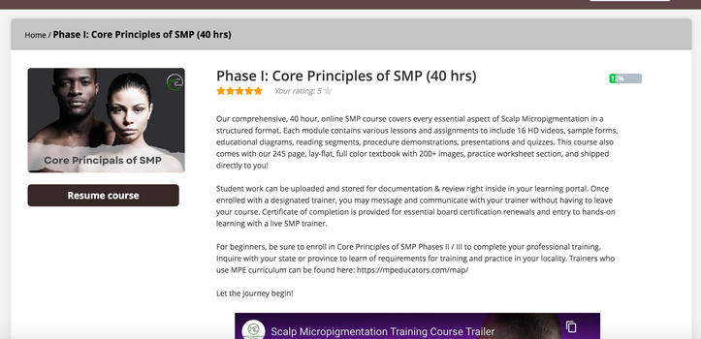


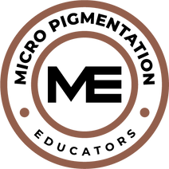
MICROPIGMENTAION EDUCATORS, LLC©
SMP Course Syllabus
Course Overview:
This hybrid course offers foundational SMP education through online and in-person training, preparing students for professional certification in line with industry standards. Core program of 115 hours with the option to add additional hours, as per state requirements.
Requirements:
Complete 16 online modules, unit quizzes, bloodborne pathogens training, final exam, and hands-on phases with a qualified trainer.
31 hours digital / video
51 Classroom hrs.
33 Homework hrs.

Slide 2


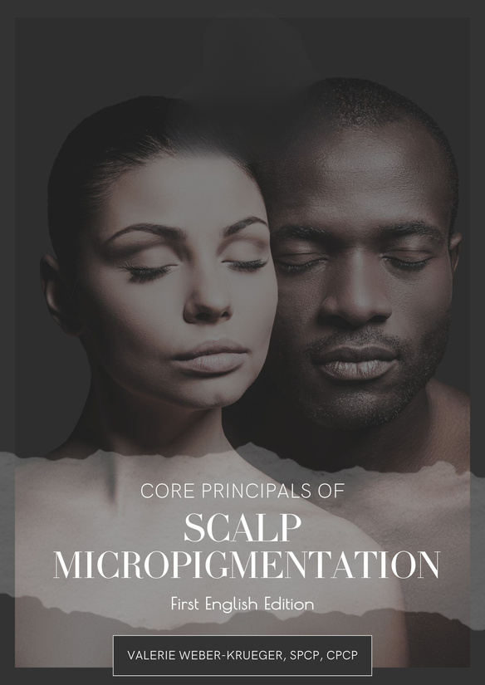

Your Course Manual
Book Title: Core Principles of Scalp Micropigmentation ©
Bookwire Rating: ★★★★★
ISBN: 979-8-9917557-0-2
Preview Sample Link: Core Principles of Scalp Micropigmentation on Book2Look
Online Course Curriculum Link: https://mpeducators.talentlms.com/learner/courseinfo/id:127

Slide 3

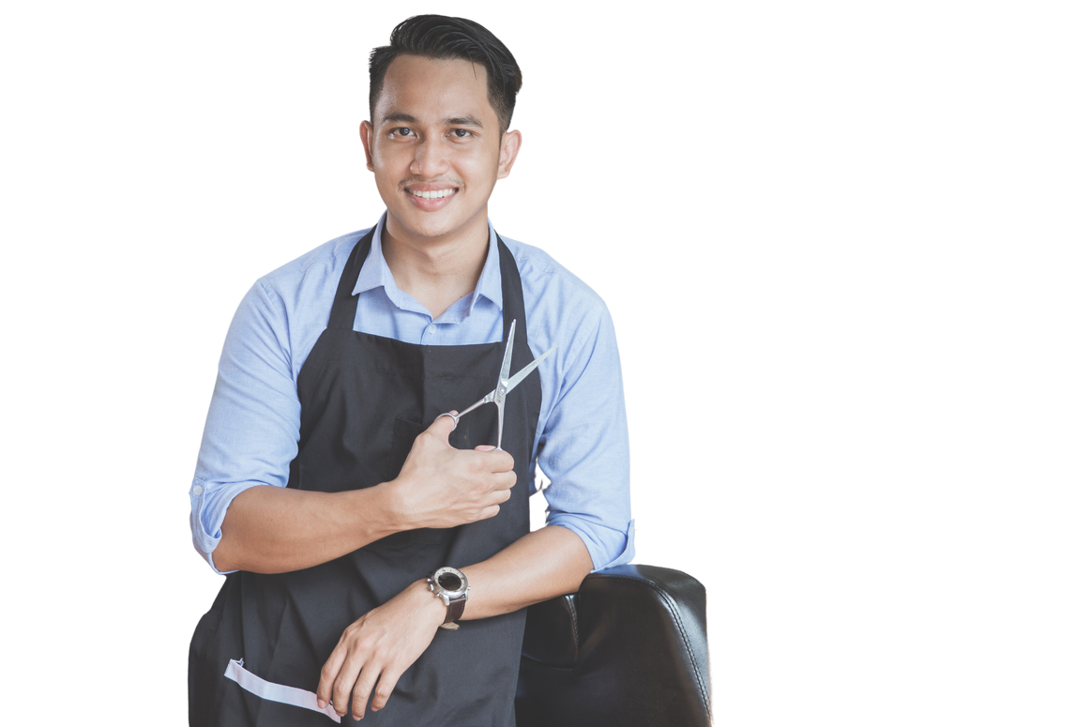

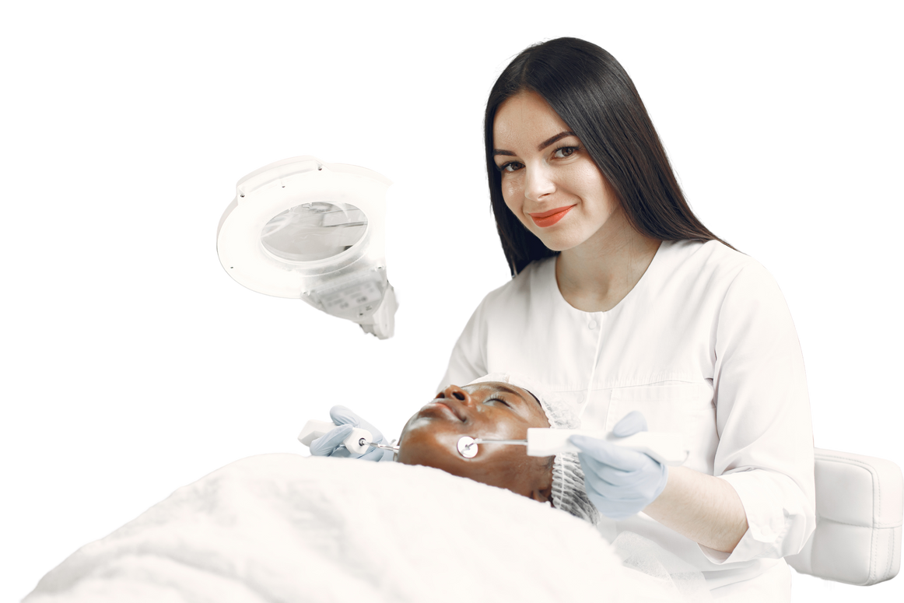
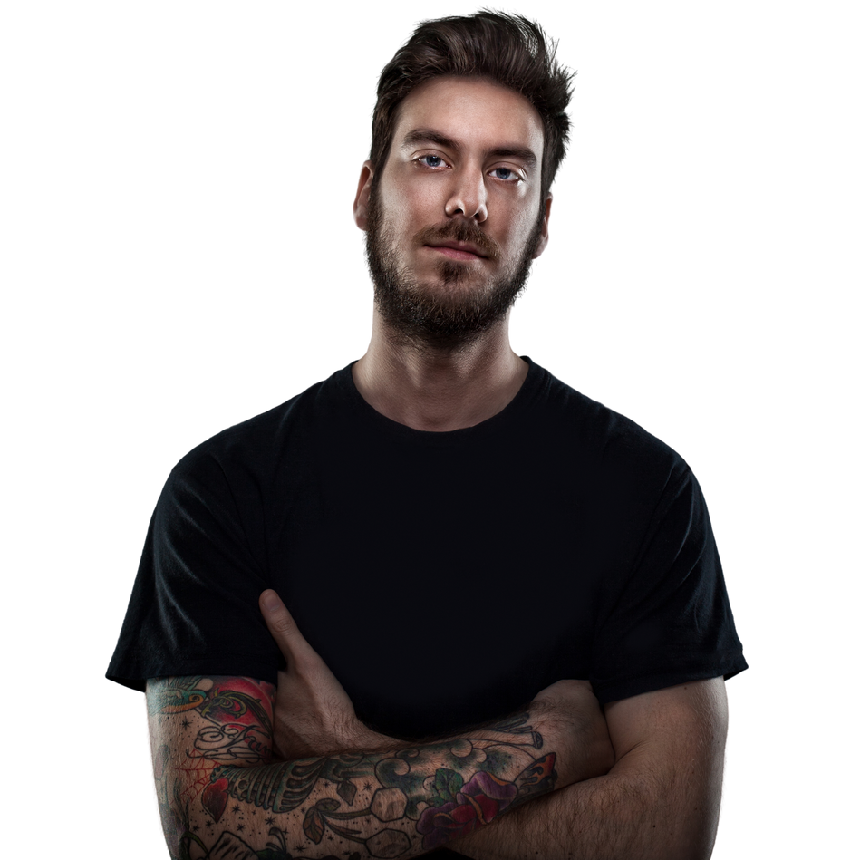
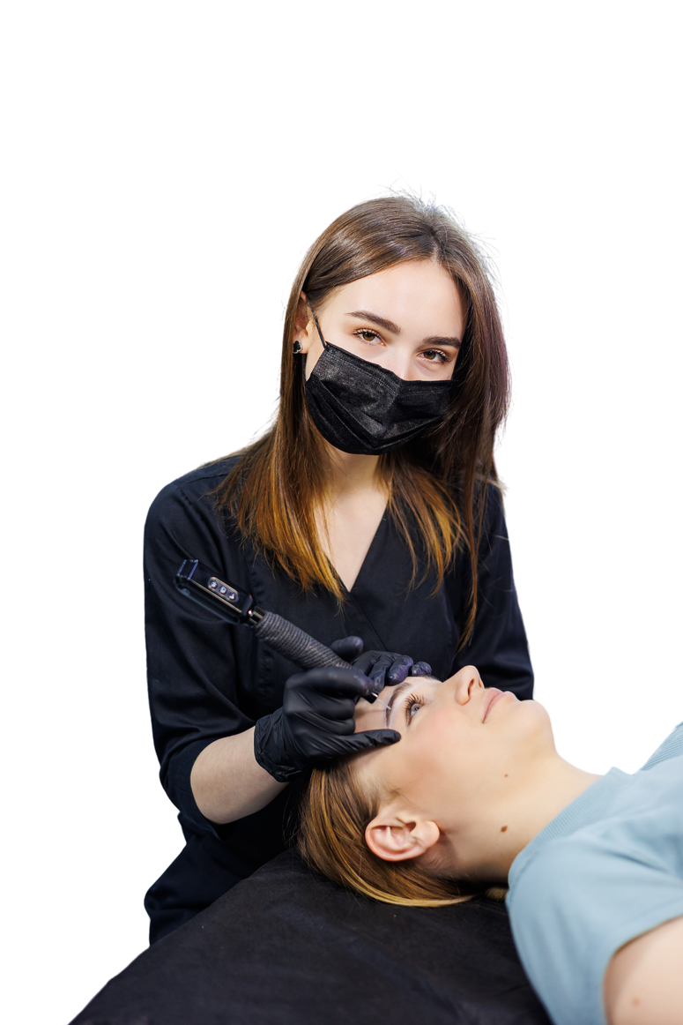
Who Is This Hybrid Course For?
This course is for Barbers, Cosmetologists, Estheticians, Medical Professionals, Trichologists, Wig Specialists, looking to enter the SMP industry.
This course also serves as continued education and crossover training for Existing PMU, SMP and Body Tattoo Artists looking to revisit the core foundations.

Slide 4


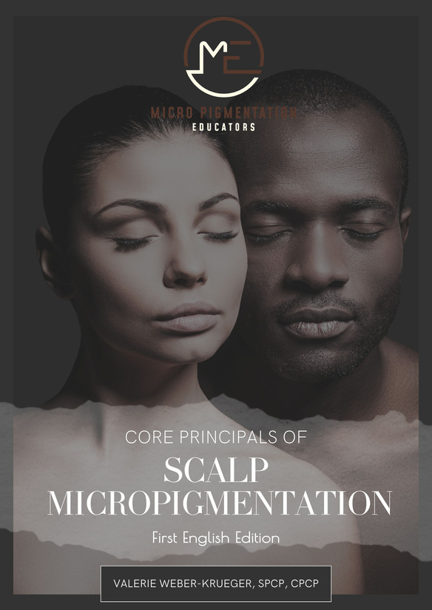
Phase I: Online Learning
  Online Modules: 20 hrs — Core readings, video lessons, and drawing exercises.
  Course Manual Exercises: 15 hrs — Assignments in the course manual.
  Bloodborne Pathogens Training: 3 hrs (additional fee).
  Virtual Instruction with Trainer: 2 hrs.
Suggested Completion Time: 15-30 days.

Slide 5

Phase II: Skill Building Workshop
  Classroom Instruction: 5 days / 35 hrs — Safety, tattoo skills, demos, practice exercises, and theory reinforcement.
  Homework: 18 hrs — Tattoo practice, drawing, and case studies.
  Virtual Calls: 2 hrs — Discussion and guidance with trainer.
  Observation: 4 hrs — Studio visitation for live procedure observation.

Slide 6
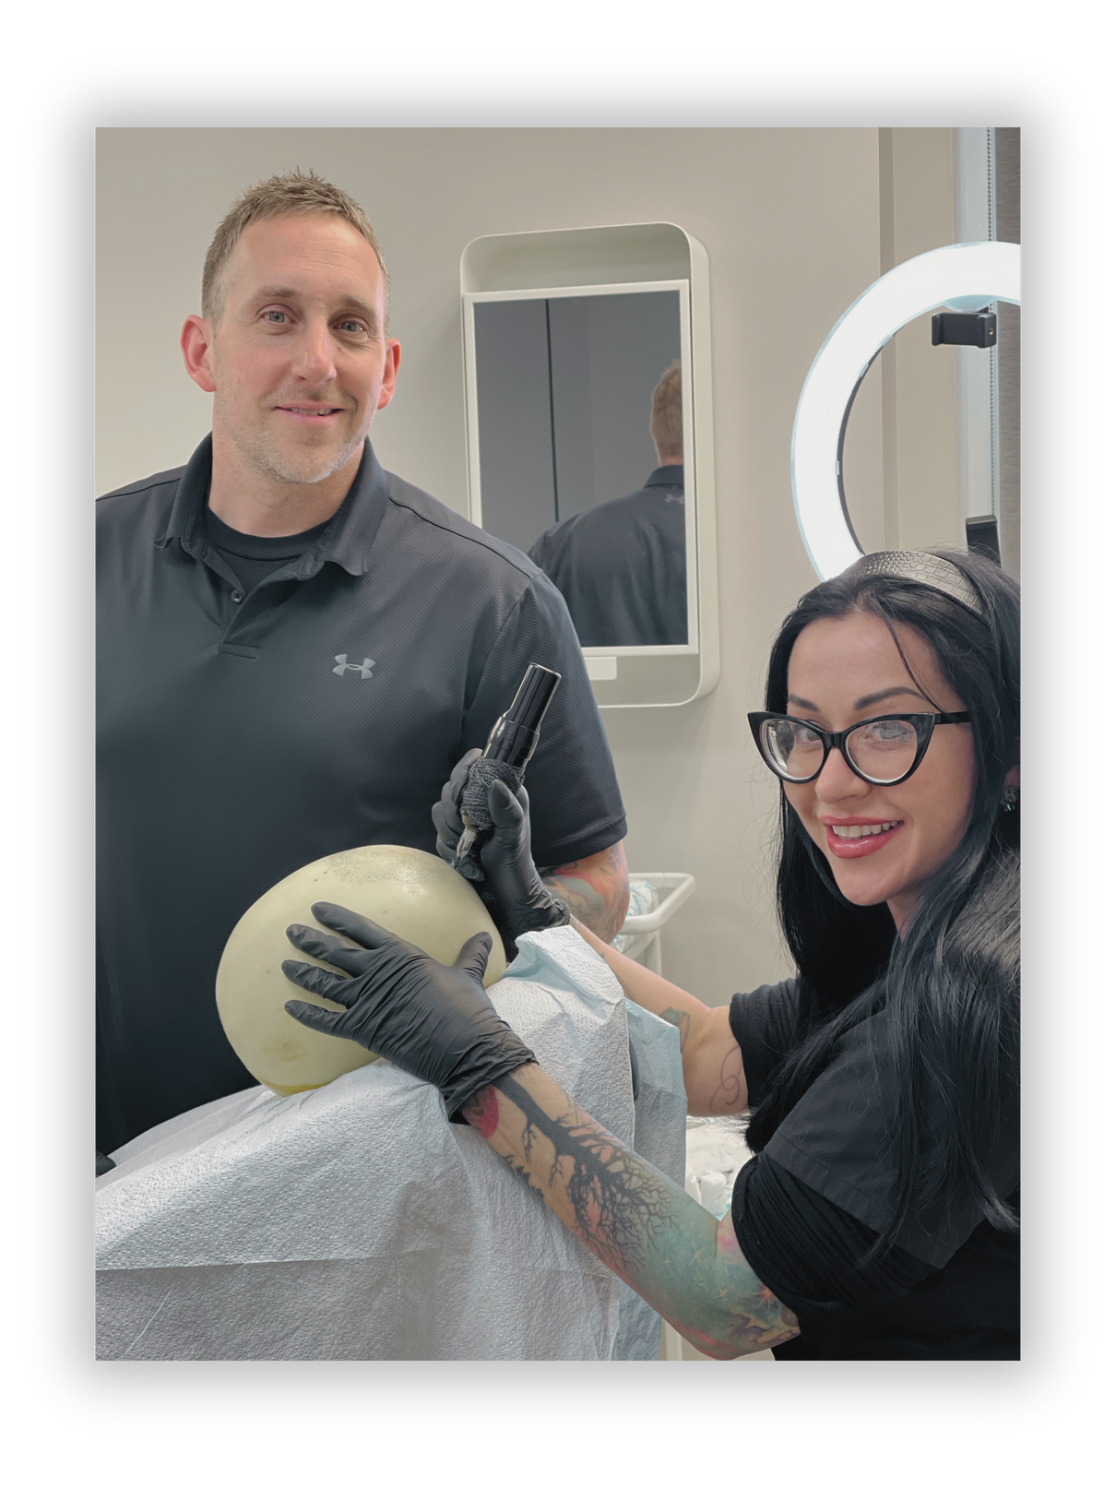

Phase III: Practical Procedures
  Practical SMP Procedures: 12 hrs / 3 Procedures — Supervised sessions with live models.
  Curriculum Review and Practical Exam: 2 hrs.
  Theoretical Exam (open-manual): 2 hrs.
Suggested Completion Time: 2-3 days (Or more if additional models are required- rates apply).

Slide 7



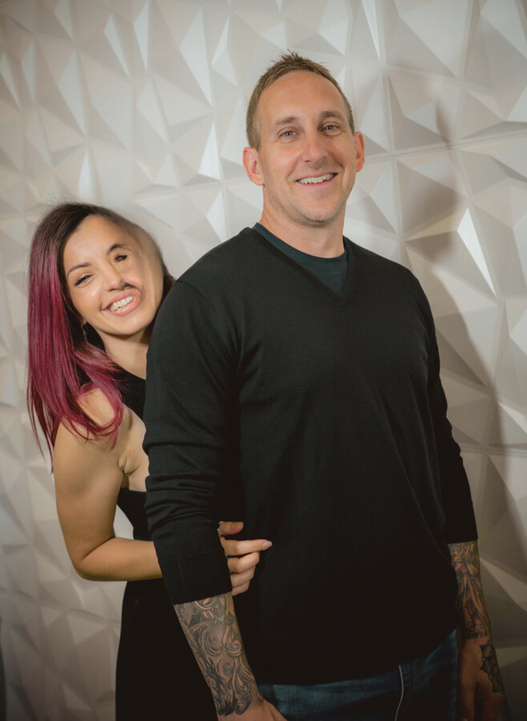
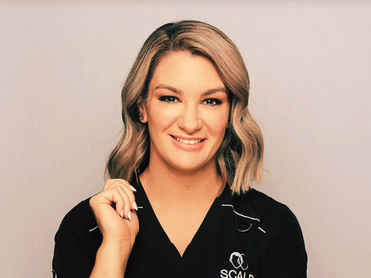
Meet Your Expert Contributers
Valerie Weber-Krueger
Ian Krueger
Caitlin James
Author, SME Contributor,
Owner & Founder
SME Contributor,
Co-Owner
SME Contributor

Slide 8

What Makes Our Class Different From Other Classes?
Our three-phased course is designed to meet entry level of students for success in the tattoo industry. It is highly structured, user-friendly, dives deep into topics while allowing trainers to showcase their unique artistic approach. Lessons are paced for learning retention and make provision for a multitude of learning styles.
Grading is documented both in theory and practical applications. Metrics used in grading are consistent to ensure equality as well as competency. A certificate of completion is awarded to graduates in order to move onto becoming an SMP practitioner.

Slide 9

Educational
Investment
Investing in our SMP training means choosing comprehensive, quality education designed for true career readiness. Unlike cheaper courses that often lack depth, our three-phase program—online learning, trainer-led workshops, and live model practice—ensures you gain the skills, confidence, and independence to succeed. Our trainers are not only skilled artists but effective educators who provide direct feedback, guiding you to understand and master techniques. This course equips you to confidently handle clients and achieve professional results, making it a worthwhile investment in your future as a trusted SMP artist.

Slide 10


Cost Investment
$65 per / Credit Hour
  Instant access to this Course
  Color Course Manual shipped to you
  Free Digital Course Manual (inside)
  Downloadable certificate file
  Add-on Courses available
  Lifetime access
BUY NOW!

Slide 11
Our Mission...
Our mission is to cultivate the most skilled and passionate community of SMP artists by empowering them with the knowledge and expertise needed to transform lives through their craft. We are committed to serving a diverse range of students, beyond just English speakers, and ensuring that standardized, high-quality education becomes a cornerstone of our industry.
Together, we can make a profound, positive impact on our clients' lives, as we lead with intention, integrity, and the power of education.

Slide 12



Get Social With Us
@micropigmentation_edu
@micropigmentation.edu

