Slide 1


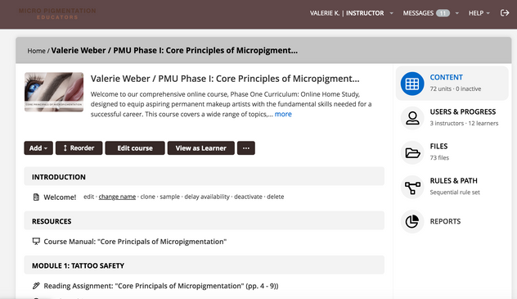


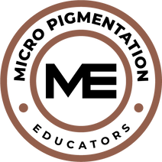
MICROPIGMENTAION EDUCATORS, LLC©
PMU Course Syllabus
Course Overview:
This comprehensive PMU course combines online theory and hands-on training to meet industry board certification and state guidelines. It provides the foundation and practical skills needed for PMU professionals, with ongoing support from our training team.
Requirements:
Complete online modules, practical classroom training, supervised model work, and a theory exam with proficiency.
27 hours digital / video
52 Classroom hrs.
33 Homework hrs.

Slide 2



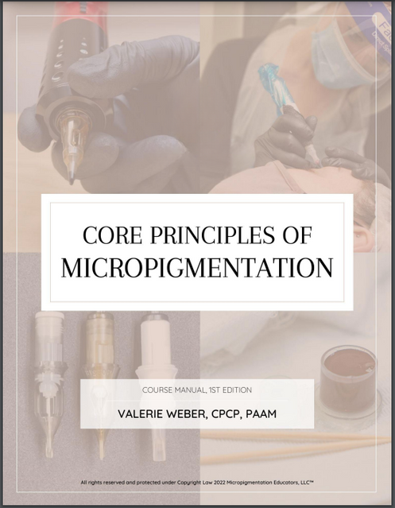

Your Course Manual
Book Title: Core Principles of Micropigmentation©
Bookwire Rating: ★★★★★
ISBN: 979-8-9917557-9-5
Online Course Curriculum Link: https://mpeducators.talentlms.com/learner/courseinfo/id:127

Slide 3



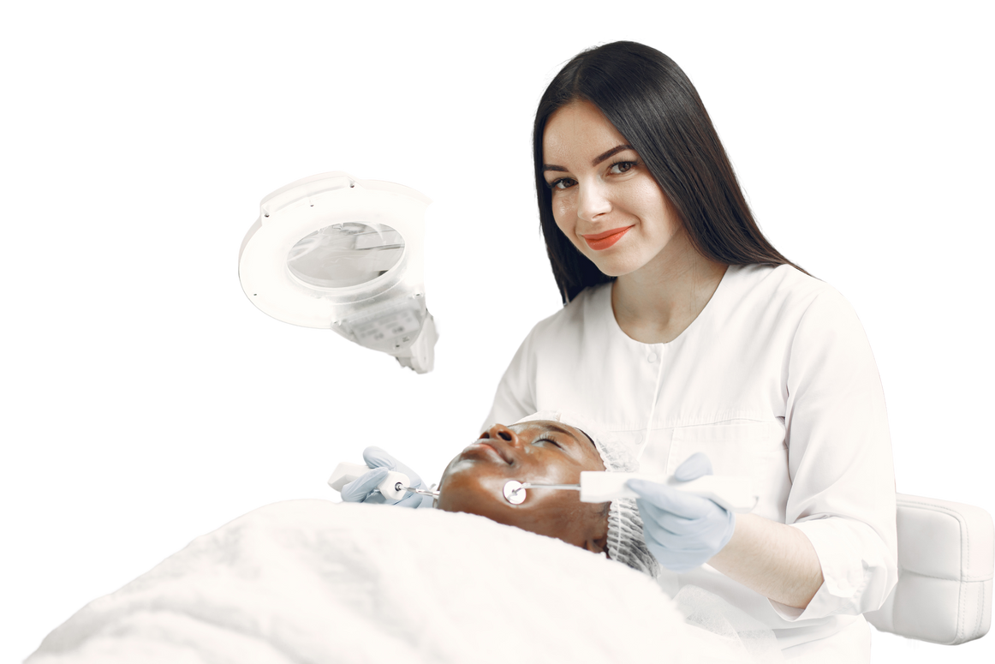
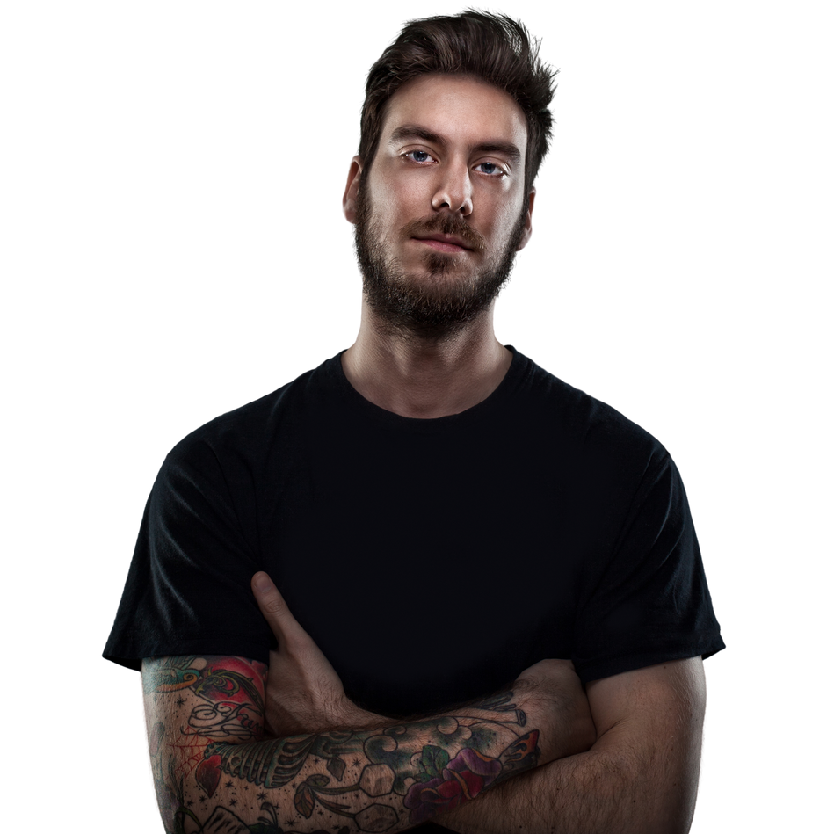
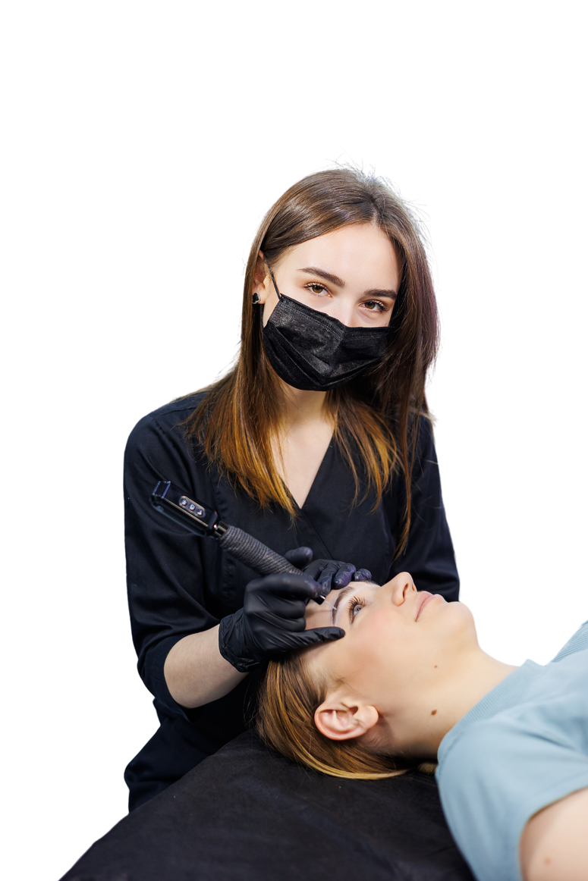
Who Is This Hybrid Course For?
This course is for Barbers, Cosmetologists, Estheticians, Medical Professionals, Trichologists, Wig Specialists, looking to enter the PMU industry.
This course also serves as continued education and crossover training for Existing PMU, SMP and Body Tattoo Artists looking to revisit the core foundations.

Slide 4


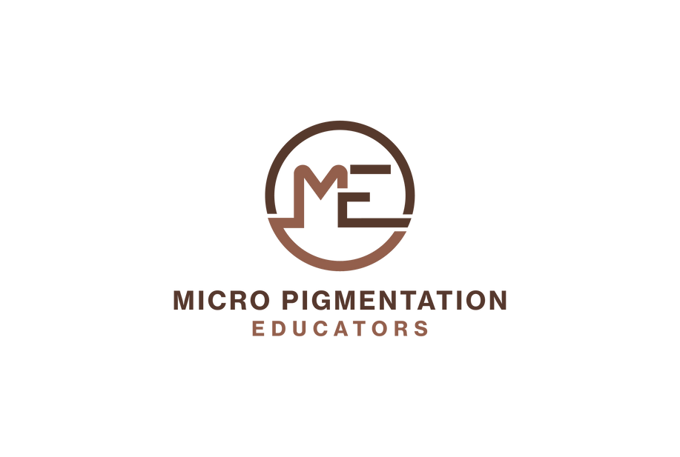
Phase I: Online Learning
  Online Modules: 20 hrs — Core readings, video lessons, and quizzes.
  Course Manual Exercises: 15 hrs — Drawing assignments in the course manual.
  Bloodborne Pathogens Training: 3 hrs (additional fee).
  Virtual Instruction with Trainer: 2 hrs.
  Format: Self-paced learning, recommended to complete within 30 days.

Slide 5
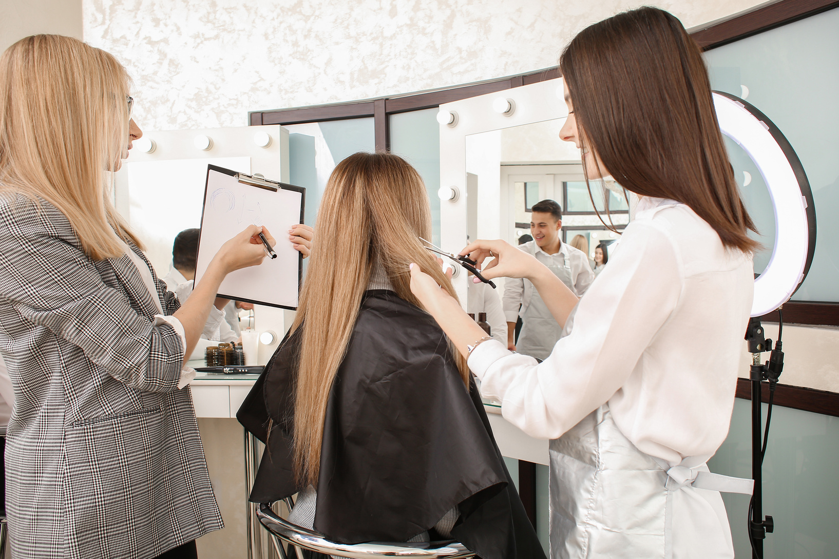
Phase II: Skill Building Workshop
  Classroom Training: 24 hrs — Includes lectures, guided practice, live demonstrations, experimentation, and skill-building exercises led by an experienced trainer.
  Homework Reinforcement: 20+ hrs — Post-classroom assignments to solidify skills, including practice on mediums and case evaluations.
  Virtual Calls: 2 hrs — Discussion and guidance with trainer.
  Observation: 4 hrs — Studio visitation for live procedure observation.

Slide 6
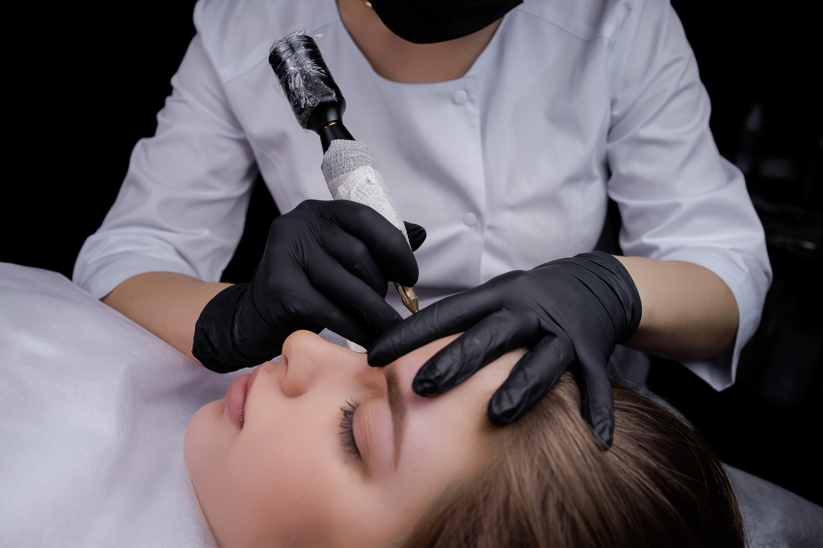
Phase III: Practical Procedures
  Supervised Model Work: Conduct procedures on live models under trainer supervision.
  Curriculum Review 2 hrs.
  Theory Exam: Complete a digitized theoretical exam to demonstrate understanding. (open-manual): 2 hrs.
  Certification: Granted upon demonstrating proficiency in live procedures and passing the theory exam
  Suggested Completion Time: 3 days (Or more if additional models are required- rates apply).

Slide 7



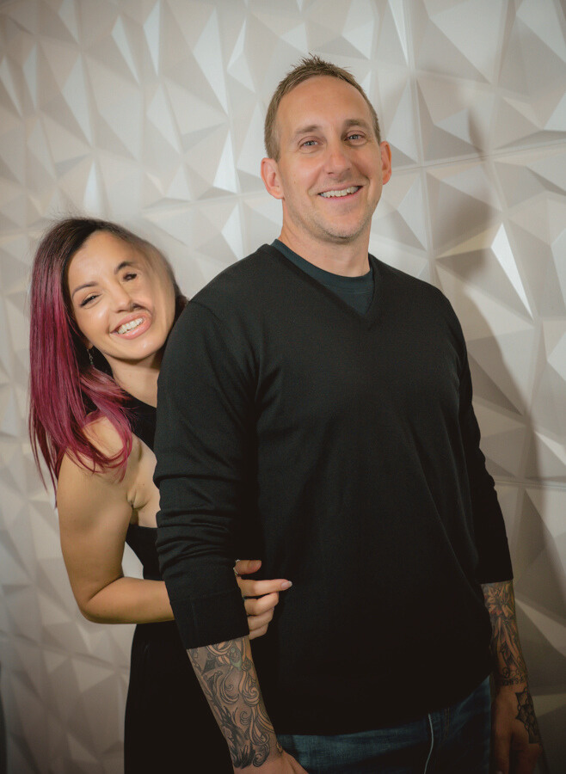
Meet the Founders
Valerie Weber-Krueger
Ian Krueger
Author, SME Contributor,
Owner & Founder
SME Contributor,
Co-Owner

Slide 8
How Our Class Differs From Other Classes?
Our three-phased course is designed to meet entry level of students for success in the tattoo industry. It is highly structured, user-friendly, dives deep into topics while allowing trainers to showcase their unique artistic approach. Lessons are paced for learning retention and make provision for a multitude of learning styles.
Grading is documented both in theory and practical applications. Metrics used in grading are consistent to ensure equality as well as competency. A certificate of completion is awarded to graduates in order to move onto becoming an PMU practitioner.

Slide 9


Why Choose Our PMU Course?
Investing in our PMU course is your path to becoming a skilled, confident, and qualified PMU professional. With board-approved curriculum, online modules, hands-on training, and personalized mentorship, you’ll gain both knowledge and practical skills.
Our program includes supervised model practice, guidance from experienced trainers, and one year of post-training support. This course provides the tools, confidence, and mentorship to elevate your career.

Slide 10


Cost Investment
$65 per / CH
  Instant access to this Course
  Color Course Manual shipped to you
  Free Digital Course Manual (inside)
  Downloadable certificate file
  Add-on Courses available
  Lifetime access
BUY NOW!

Slide 11

Our Mission...
Our mission is to cultivate the most skilled and passionate community of PMU artists by empowering them with the knowledge and expertise needed to transform lives through their craft. We are committed to serving a diverse range of students, beyond just English speakers, and ensuring that standardized, high-quality education becomes a cornerstone of our industry.
Together, we can make a profound, positive impact on our clients' lives, as we lead with intention, integrity, and the power of education.

Slide 12




Get Social With Us
@micropigmentation_edu
@micropigmentation.edu

