Slide 1

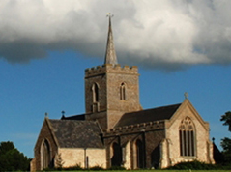
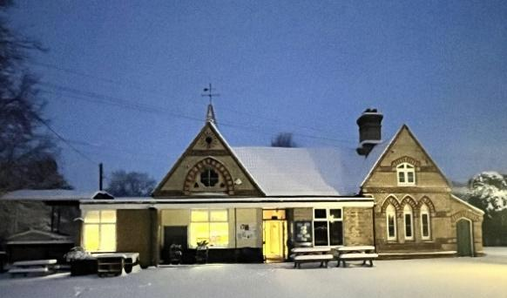
Thriplow School Newsletter
8th May 2026
We have had a lovely week in school, with lots of fun things going on!
Yesterday I went with a very enthusiastic group of Year 3/4 children to the tennis festival in Linton. They had a great afternoon practising different skills needed for tennis. They were also awarded the ‘Spirit of the Games’ award for the resilience and determination. As always, a huge thank you to the parents who drove children to and from the event. We are so grateful!
Next week is an important week for Year 6 as they sit their SATs. I have sent out an email explaining changes to the morning routine. Please make sure you have read this so that we can support our Year 6 children together. It goes without saying that we wish our Year 6 children all the best for next week. We’ll be cheering you on Year 6!
On 10th July, we will be taking part in a fun run on the cricket pitch. This will be in aid of the RNLI, the children’s chosen charity for this term. Please see the link on the poster below if you would like to sponsor them - do share the link with others!

Slide 2
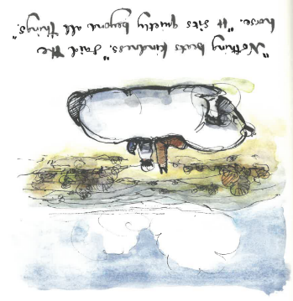




Over the next few weeks, there are various sporting competitions happening for some of Key Stage 2. If you get an email about a sporting competition, please could you ensure that you reply to us as soon as you can so that we can keep our records up to date.
I hope you all have a wonderful weekend! Best wishes, Lucy How
MAT of the Year 2024
In the same way your light must shine before people so that they will see the good things you do and praise your Father in heaven. Matthew 5:16 You are the people of God: he loved you and chose you for his own. So then, you must clothe yourselves with kindness. Colossians 3:12
 | www.facebook.com/thriplowschool
 | www.instagram.com/thriplow.school
 | x.com/thriplowschool

Slide 3
Important Dates
WB 11th May | SATS week
WB 18th May | KS2 Residential (Year 5 and 6)
22nd May | No Celebration Collective Worship
Fortnight Beginning 1st June | Multiplication Check fortnight (Year 4)
4th June | Holy Communion in the hall. 9.10am. All Welcome
4th June | Quadkids
5th June | Grace Schools Art Exhibition
WB 8th June | Phonics Screening check week (Year 1)
10th June | Year 5/6 Cricket Tournament
WB 15th June | Poetry Recital Competition
17th June | Year 3/4 girls’ football festival
18th June | Information evening for parents of Reception September 2026
23rd June | Bees Trip to St. Paul’s
24th June | Sports day (First thing – will finish 11.15ish)

Slide 4
Important Dates
30th June | Year 3/4 Cricket Tournament
30th June | Wimbledon visit
1st July | Sawston Village College Transition Day
3rd July | Reports out
8th July | Key Stage 2 Summer Production 2.30pm
9th July | Key Stage 2 Summer Production 6pm
10th July | Fun Run in aid of the RNLI
14th July | Melbourn Village College Transition Day
15th July | Year 6 trip to London
16th July | Transition morning
16th July | Year 6 Quiet morning in church Year 6 quiz
17th July | Leavers’ Service. Parents of leavers welcome to attend
19th September | Tipi Party

Slide 5
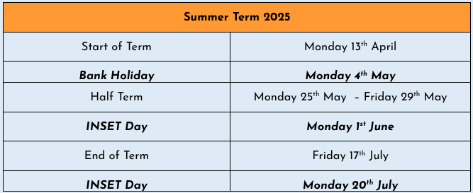
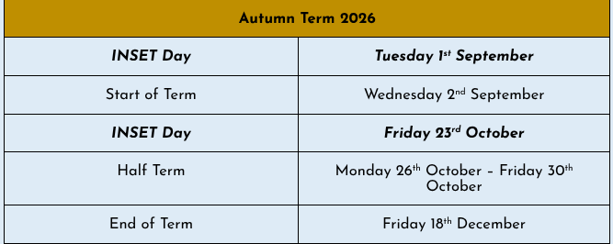
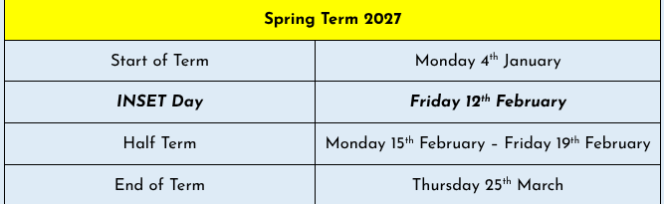
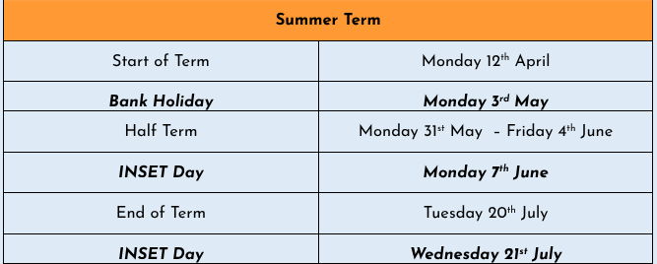
Term Dates

Slide 6

Safeguarding at Thriplow
Lucy How and Melissa Hardege are the designated safeguarding leads at Thriplow School.
If you have a concern about a child, please come and speak to or email either of us. Alternatively please speak to any member of staff who will be able to pass on information.
If you feel that a child is at immediate risk of harm you can access further advice and guidance here.
https://www.cambridgeshire.gov.uk/residents/children-and-families/children-s-social-care/safeguarding-children-and-child-protection
Useful websites:
https://www.nspcc.org.uk/advice-for-families/
https://www.ceopeducation.co.uk/

Slide 7

HAPPY
BIRTHDAY!
Happy birthday to Freddie P who has celebrated his birthday this week!

Slide 8
House Points
 | Total this Week | Total this Term
Bacon | 53 | 223
Barenton | 55 | 242
Bassett | 33 | 190
Bury | 93 | 217
Well done Barenton!

Slide 9

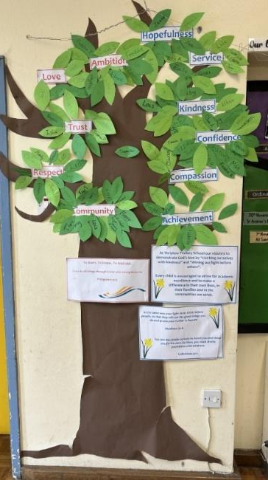
Certificate Winners
Our certificate winners this week are:
Joseph (Reception)
George (Year 1)
Hudson (Year 2)
Peter (Year 3)
Max (Year 3)
Edward (Year 4)
Annabel (Year 5)
Erin E (Year 6)
The following children were added to our ‘Vision and Values’ tree for living out our Thriplow and DEMAT values:
Maya (Kindness)
Tristan (Kindness)
Leon (Community)
Sofia (Confidence)

Slide 10


Slide 11
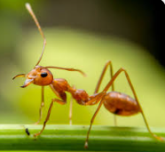
Your child’s learning
Ants:
It has been a great week in Ant's class!
For our topic, Kings & Queens, we have been learning all about King John and the Magna Carta. We learnt how King John raised taxes to make more money for himself leaving other families without. We also learnt that he wasn't a very nice or fair king and used to throw people in jail! We explored Baron's and how they were important people in creating the Magna Carta and getting the king to sign it.
In phonics this half term we have move onto unit 11. Each week we will be focusing on 2 sounds from unit 11, with a recap of the sounds learnt the week before through our sentences writing. Each day the children practice reading words, word building, writing words, and reading sentences.
For handwriting this half term, the children are practicing writing 2 CVC words a day in their phonics books. We practice and model it all together on the carpet first before the children go to the tables and have a try. We practice writing each word repeatedly at least 3 times on a line.
Our focus story for this half is The Rainbow Fish. Each week we look through the story and have a circle time to discuss the different events, characters, settings, and problems that happen. We use this book to write 3 dictated sentences a week, as well as 2 sentences from the Sounds Write phonics scheme.
In Ant's class we have a big focus on reading and sharing stories. We have dedicated reading times each day, as well as going to the Library on a Thursday. The children look forward to choosing and sharing a variety of books each week.

Slide 12
In Maths we have been looking at the area of a shape. We started the week by looking at an a4 piece of paper and exploring the different ways we can cover the whole area. The children chose their own animal shapes and a variety of resources to have a go independently. Today we have been comparing length using non-standard units by rolling out worms with playdough and comparing which ones were the shortest and the longest.
In PE on Wednesday's this half term the children have balanceability. Balanceability is a structured balance bike programme for young children that teaches them how to ride a bike safely and confidently, without stabilisers. It focuses on the fundamental skills children need before they move on to a pedal bike.
In the sessions, children learn through fun, practical activities how to:
- balance on a bike
- steer and control speed
- develop coordination and spatial awareness
- build confidence and independence
- understand road safety basics in an age-appropriate way
On Friday during our Ball Skills lesson, we looked at bouncing the ball into a space. The children began by exploring the different ways we can bounce a ball such as slapping with their palms and pushing with their fingers. We then practiced bouncing the balls around a given space, making sure to avoid each other and the cones. The children were challenge to look ahead at where they were going and to choose their next space wisely.
In PSHE our topic for this half term is Emotions. This week we read the story The Friendship Bench. We discussed the different changes that were happening in Tilly's life and how this was making her feel. The children had a think about a time when things were changing in their lives e.g. starting school, moving house, and how this made them feel. We came up with some ways that we can help ourselves and others when uncomfortable things happen, and remembered that our family, friends and teachers are always there to help us.
I hope you all have a lovely weekend!

Slide 13
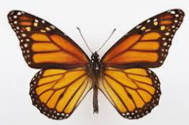
Butterflies:
The children have continued to amaze us with their learning this week. For English, we have continued to read 'The Legends of King Arthur.' Please encourage your child to discuss the first chapter with you.
In Maths, the Y2 children have continued to practise using different strategies for subtraction. They have been practising subtracting 10s from 2-digit numbers, then used this strategy to subtract tens and ones from 2-digit numbers. The Year 1 children have been practising subtracting 9 from numbers up to 20. Some have noticed that you can subtract 10 (as this is a known fact), then add 1 back on. Some of the children still need to practise using a number line to count back 9 steps.
In RE, we learnt more about Christian Baptisms and how they are different around the world. Please encourage your child to share their learning with you.
On Thursday we had our termly DT day. We learned about how to make moving pictures using levers and sliders and the children then designed and made their own moving pictures. They were very excited to bring these home to share with you. Look out for the photos on Tapestry of their finished products too.

Slide 14
Our science experiment is progressing well and the children have been taking it in turns in small groups to water the cress and to observe any changes in the pots which are either not getting water or that have been kept in the dark. They have all drawn their weekly observation onto their charts. So far the experiment is progressing as they have predicted and the cress that has had no water is looking pretty wilted and the cress in the dark is starting to lose its green colour.
In art this week we have completed charcoal drawings of the minotaur from the Greek myth and next week will be making our collages. In PSHE we have been thinking about what personal information is safe to share and what personal information we should not share. The children have also been thinking about whether they know their home address and telephone number. If your child does not already know this you may want to talk with them about it and help them to learn it in case of an emergency.
In Phonics, we practised different spellings of /ar/ Please read the attached text with your child.
We hope that you have a lovely weekend.

Slide 15
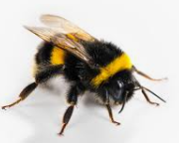
Bees:
Bees Class have had a wonderful afternoon in the Wildspace to end our week. The children really enjoyed playing a group game together, going in the mud kitchen and making friendship bracelets. It was lovely to see how well they get on as a class.
On Tuesday, in Geography, we continued our topic of the South East of England by learning about Brighton. We learnt about the pebble beaches, Victorian pier and the pavilion inspired by Indian and Chinese architecture. In Art, we continued looked at Byzantine art specifically a mosaic. This was in preparation for starting a mosaic of our own faces! The children made an excellent start to these pieces of art and will finish them next week.
On Wednesday, the children learnt about the Hindu festival of Kumbh Mela and the impacts this festival has on the environment (specifically the River Ganges). The children found this fascinating and came up with some great ideas as to how Hindus could reduce their pollution at this event. We also went to the field to practice our discus throwing before looking Latin noun endings.
Today, the children really enjoyed our History lesson when we learnt about the English Civil War. We considered the fight between the Cavaliers and the Roundheads and Charles I's execution! We also continued our Science learning based on the water cycle. So far, we have learnt about evaporation and condensation and today we learnt about precipitation in all its different forms!
Throughout this week, in Maths, we have learnt about how to work out the area of rectangles and squares. This was an excellent way to extend the children's knowledge of shape from last week when we learnt about perimeter. In English, we have started a new piece of writing after finishing our biographies. We began to consider how to write a narrative based on our book. The children are pretending to be Pellegrina - the grandma in Edward Tulane. The children are looking forward to continuing this next week.

Slide 16
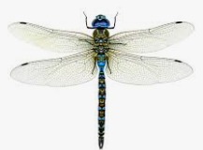
Dragonflies:
It has been a great week in Dragonflies.
In English we have continued to enjoy our class novel The Lion, the Witch and the Wardrobe. We have been thinking carefully about questions related to the story and have been continuing to reflect on the journey of the different characters. In our writing, we have been carefully redrafting a non-fiction discussion around the landscape of England.
In maths, we have been reviewing our learning on angles, in particular finding missing angles in complex problems involving shapes and different types of lines. On Friday we spent some time thinking about how to approach multi-step problem solving questions.
In our RE learning, we have been thinking about the Buddhist worldview. We spent some time researching Thich Nhat Hanh, thinking about his life through the lens of philosophy, theology and social science. We then created a poster and presented our research to a partner.
In Science, we have continued our learning on Living Things, this week we learned about the parts of a plant before dissecting a flower with our partners and applying our learning to creating a careful diagram. We were all so amazed at seeing each of the parts of the plant including the egg cells that would grow to become seeds.
A quick note to please ensure your child is as punctual next week to ensure that things run as smoothly as possible.

Slide 17
In history, we learned about children during the Industrial Revolution. We found out about the different, often dangerous, jobs children were made to do in factories and the harsh conditions they endured.
Next week is the Year 6 SATs week. I am so proud of every single child in Year 6 as they get ready for their tests. They have all worked so hard and couldn't be more ready or prepared for the coming assessments. As I told the children, the tests are an opportunity for them to show off all their knowledge and all the hard work that they have put in over their time at primary school, but that they do not represent everything about them and to remember that they are all amazing individuals with lots of incredible talents.
I look forward to seeing Year 6 parents at our Tea Party on Friday - please ensure you have signed up on the Google Sheet link shared in an email if you are planning to attend.
A quick note to please ensure your child is as punctual next week to ensure that things run as smoothly as possible.

Slide 18


Slide 19
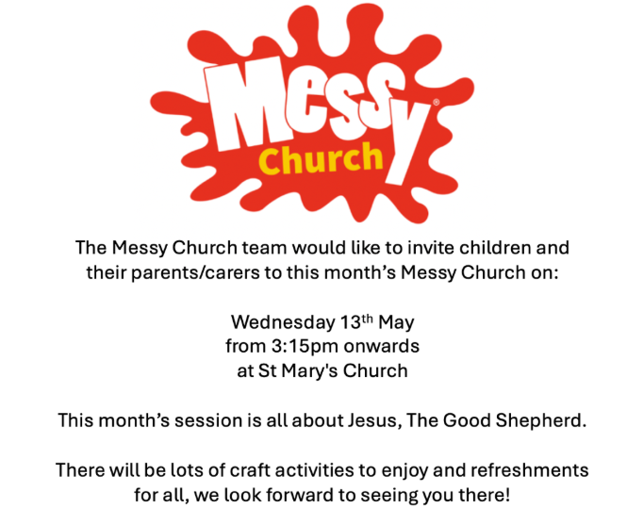

Slide 20
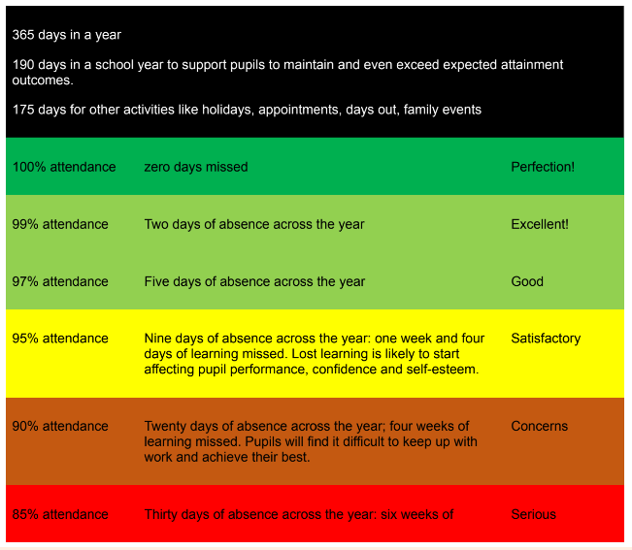
Attendance
https://www.nhs.uk/live-well/is-my-child-too-ill-for-school/
If your child needs time off for a medical appointment, please provide an appointment card or printed confirmation for our records.
Where possible, please make appointments out of school time.

Slide 21
Attendance
If your child is late for school, please ensure that you sign the late book in the entrance hall, giving a reason for the lateness.
If it is a sensitive reason and you would rather not write it down, please chat to Mrs Sandford or Mrs How.
Please do not write ‘late’ as a reason.
Minutes late per day | School days lost per year
5 minutes | 3 days
10 minutes | 6.5 days
15 minutes | 10 days
20 minutes | 13 days
30 minutes | 19 days

Slide 22
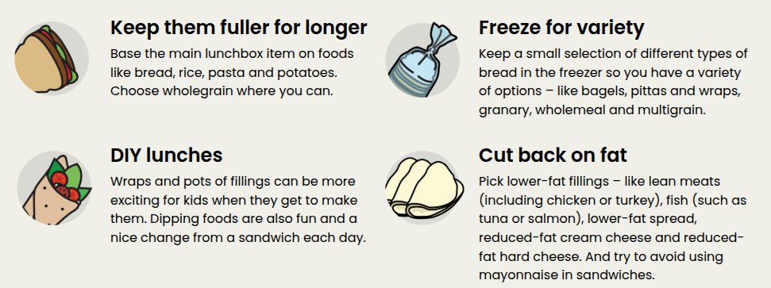
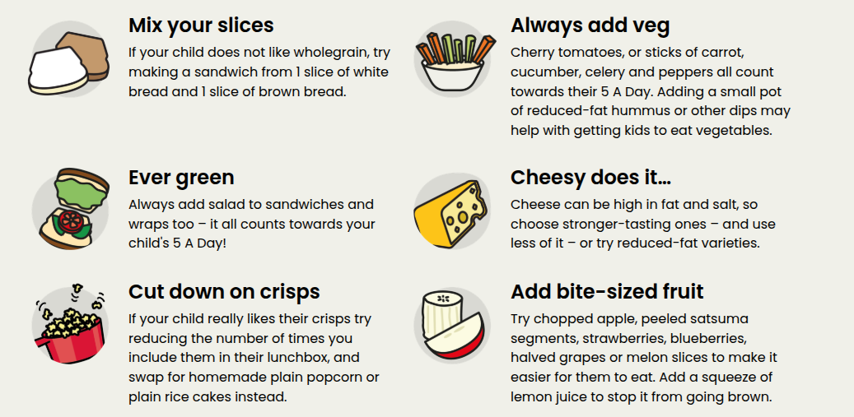
A reminder that we are a nut-aware school. Please ensure that your child’s lunchbox does not include any nuts.

Slide 23
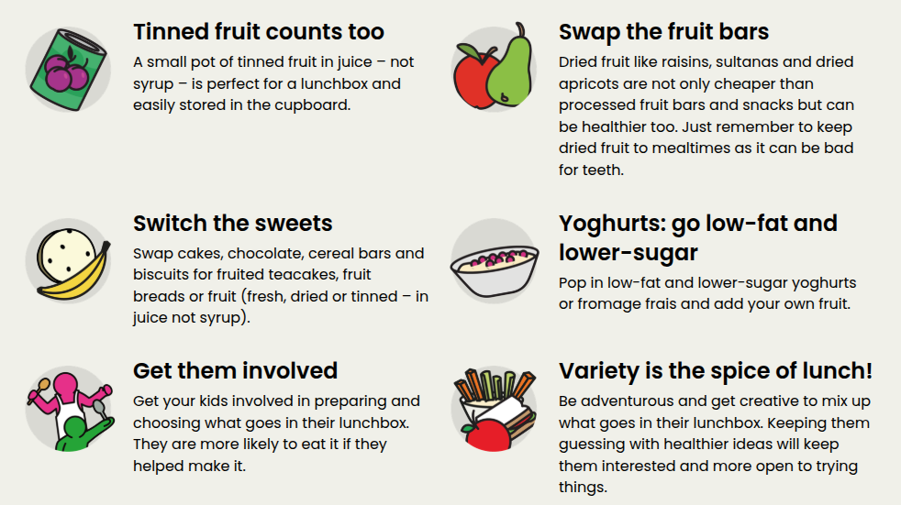
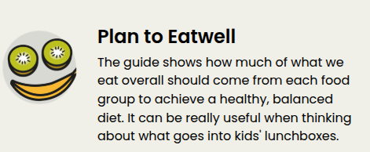
https://www.nhs.uk/live-well/eat-well/food-guidelines-and-food-labels/the-eatwell-guide/

Slide 24
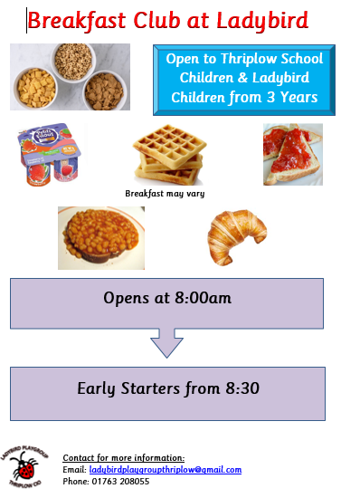

Slide 25
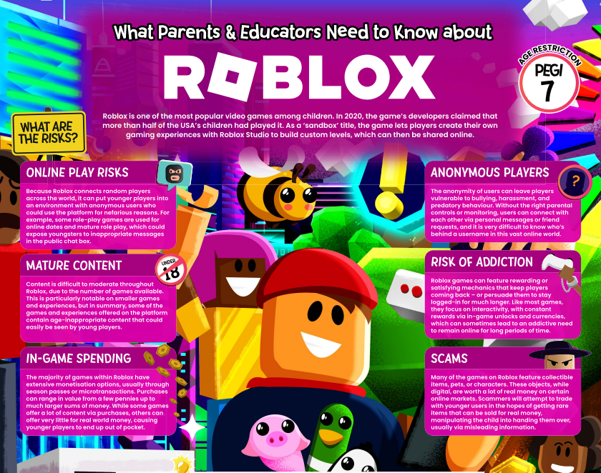
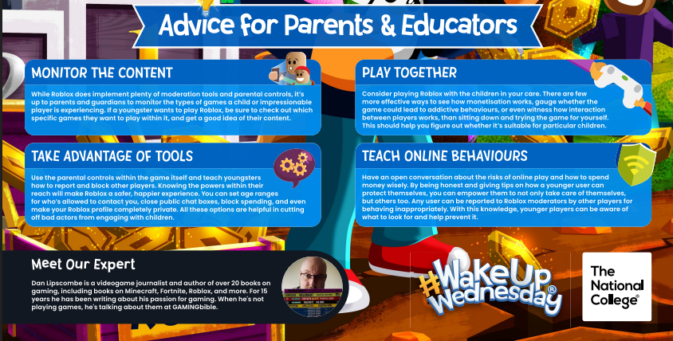

Slide 26
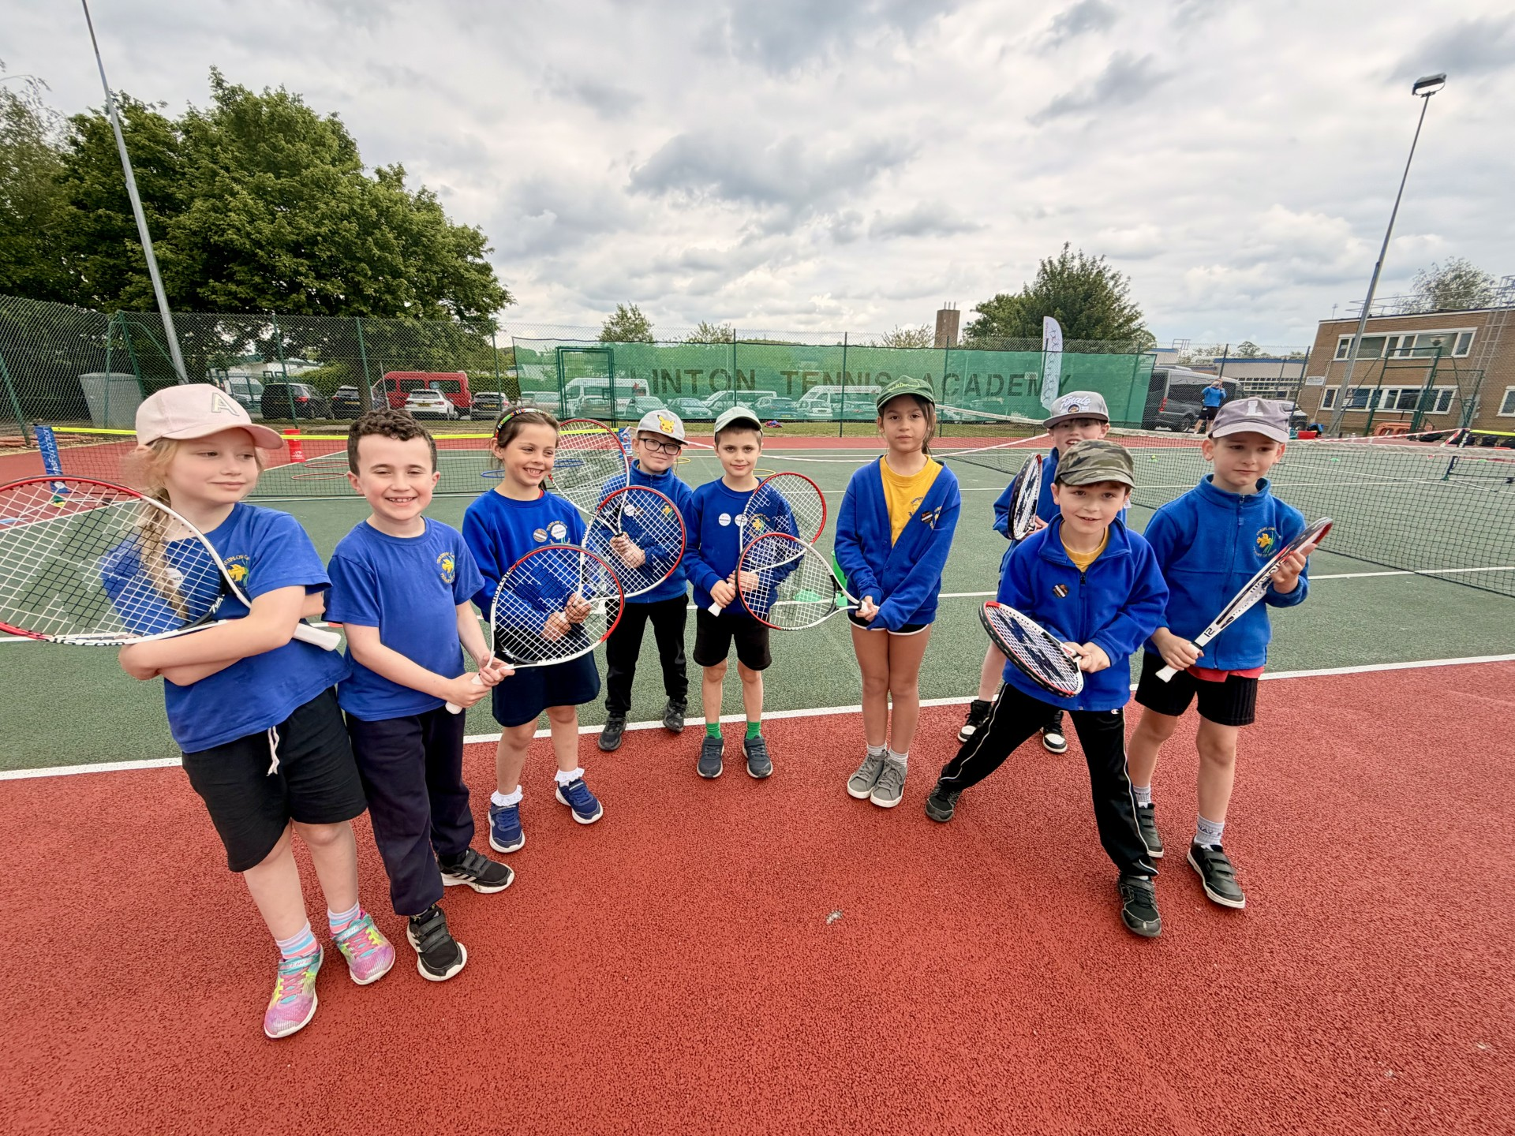
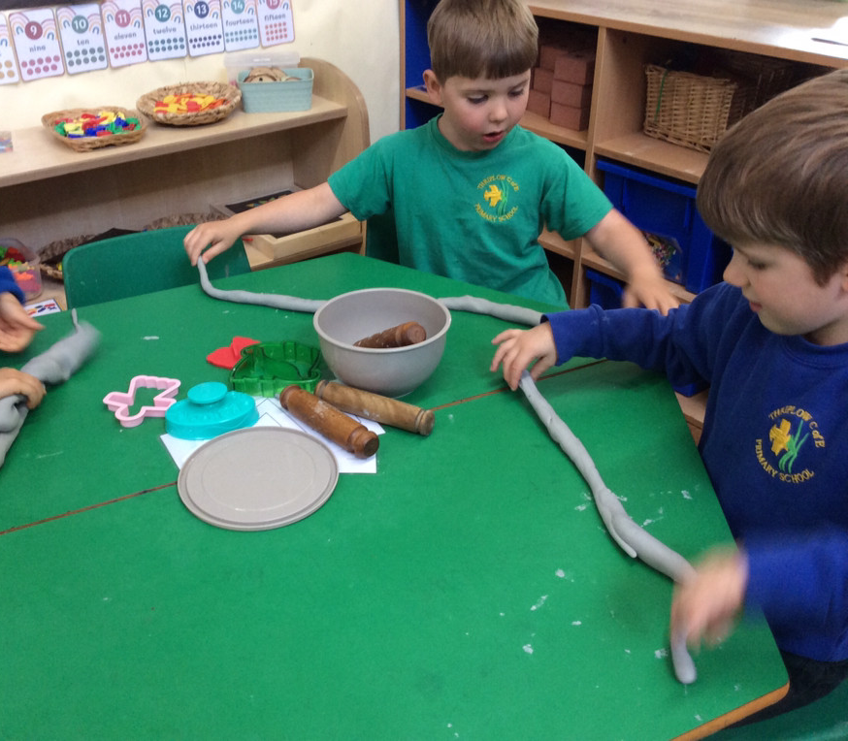
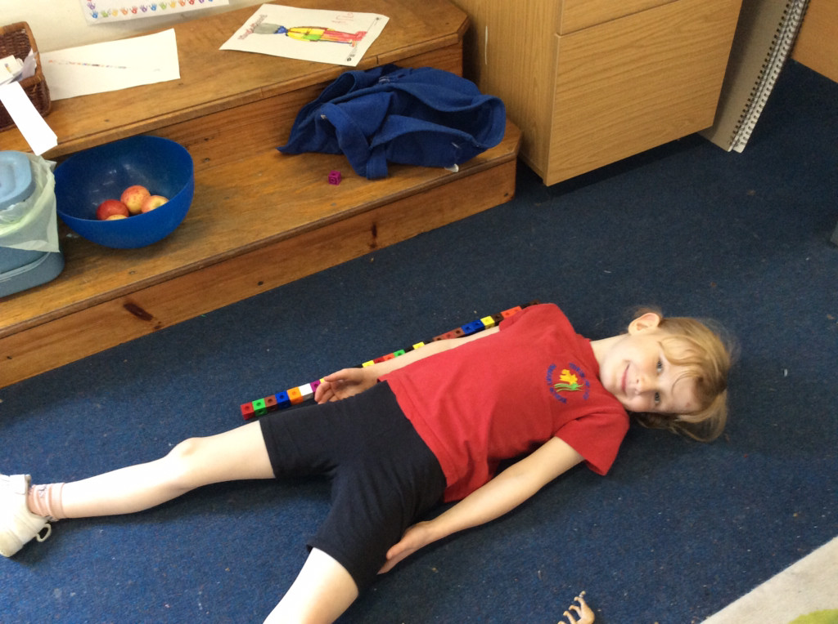

Slide 27
