Slide 1

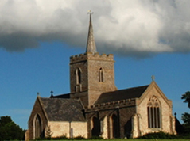
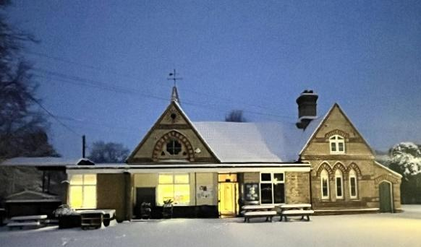
Thriplow School Newsletter
15th May 2026
We are so proud of our Year 6 children! They have given it their all this week and we know they have done their very best in their SATs. Many thanks to you all for being flexible in your morning routines to give them the very best chance. We are also very grateful to governors and members of the PTA core committee for giving up their time to oversee the administration of the SATs.
Miss Hardege, Mr Baron and I are really looking forward to spending the week with Year 5 and 6 at Hautbois next week. I will therefore not be in school If you need to contact me for any reason, please do so via the office and Mrs Sandford will pass it on to me.
To mark Mental Health Awareness Week, yesterday afternoon we got together in small groups from Reception to Year 6 to consider the question What do you do to make yourself feel happy/positive? The theme for the week, organised by the Mental Health Foundation is ‘Take Action’ and the children enjoyed sharing ideas as to what they could do to improve their own mental health and the mental health of others. Thank you to Eloise in Year 6 for championing this.

Slide 2
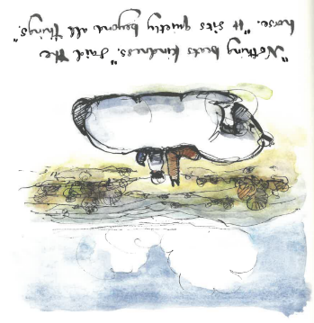




Year 6 enjoyed a wonderful tea party and cricket match with their parents this afternoon. It was a lovely way to mark the end of SATs week.
I hope you all have a wonderful weekend! Best wishes, Lucy How
MAT of the Year 2024
In the same way your light must shine before people so that they will see the good things you do and praise your Father in heaven. Matthew 5:16 You are the people of God: he loved you and chose you for his own. So then, you must clothe yourselves with kindness. Colossians 3:12
 | www.facebook.com/thriplowschool
 | www.instagram.com/thriplow.school
 | x.com/thriplowschool

Slide 3
Important Dates
WB 18th May | KS2 Residential (Year 5 and 6)
22nd May | No Celebration Collective Worship
Fortnight Beginning 1st June | Multiplication Check fortnight (Year 4)
4th June | Holy Communion in the hall. 9.10am. All Welcome
4th June | Quadkids
5th June | Grace Schools Art Exhibition
WB 8th June | Phonics Screening check week (Year 1)
10th June | Year 5/6 Cricket Tournament
WB 15th June | Poetry Recital Competition
17th June | Year 3/4 girls’ football festival
18th June | Information evening for parents of Reception September 2026
23rd June | Bees Trip to St. Paul’s
24th June | Sports day (First thing – will finish 11.15ish)

Slide 4
Important Dates
30th June | Year 3/4 Cricket Tournament
30th June | Wimbledon visit
1st July | Sawston Village College Transition Day
3rd July | Reports out
8th July | Key Stage 2 Summer Production 2.30pm
9th July | Key Stage 2 Summer Production 6pm
10th July | Fun Run in aid of the RNLI
14th July | Melbourn Village College Transition Day
15th July | Year 6 trip to London
16th July | Transition morning
16th July | Year 6 Quiet morning in church Year 6 quiz
17th July | Leavers’ Service. Parents of leavers welcome to attend
19th September | Tipi Party

Slide 5
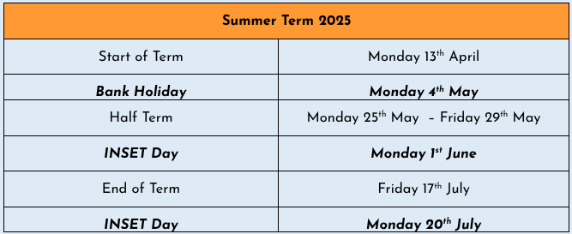
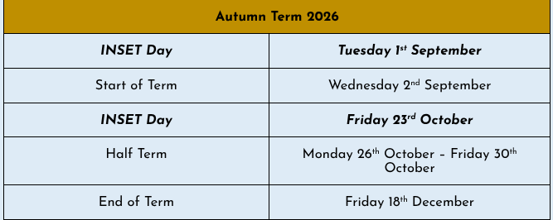
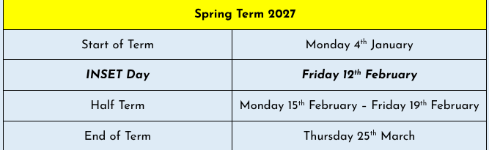
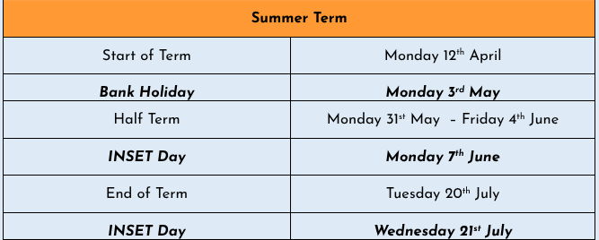
Term Dates

Slide 6

Safeguarding at Thriplow
Lucy How and Melissa Hardege are the designated safeguarding leads at Thriplow School.
If you have a concern about a child, please come and speak to or email either of us. Alternatively please speak to any member of staff who will be able to pass on information.
If you feel that a child is at immediate risk of harm you can access further advice and guidance here.
https://www.cambridgeshire.gov.uk/residents/children-and-families/children-s-social-care/safeguarding-children-and-child-protection
Useful websites:
https://www.nspcc.org.uk/advice-for-families/
https://www.ceopeducation.co.uk/

Slide 7

HAPPY
BIRTHDAY!
Happy birthday to Zanna and Erin P who have celebrated their birthdays this week!

Slide 8



Birthday Books
If you would like to donate a book to our library to celebrate your child’s birthday, then we would be so grateful. Please follow this link to see a list of books that we would like.
https://amzn.eu/ez2OYOf
Many thanks to Freddie for donating this book on the occasion of his 8th birthday.
 | Many thanks to Erin for donating this book on the occasion of her 11th birthday.
Many thanks to Susannah for donating this book on the occasion of her 9th birthday.

Slide 9
House Points
 | Total this Week | Total this Term
Bacon | 273 | 223
Barenton | 284 | 242
Bassett | 269 | 190
Bury | 275 | 217
Well done Bassett !

Slide 10

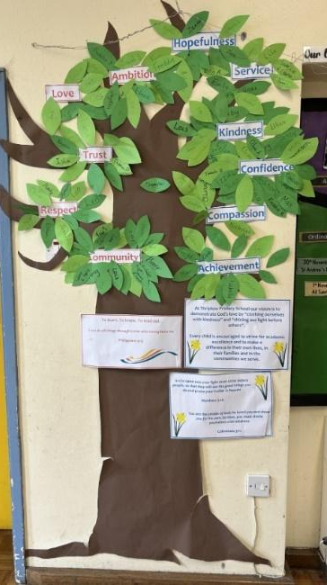
Certificate Winners
Our certificate winners this week are:
Arianna (Reception)
Finn (Year 1)
Fitz (Year 2)
Bellarita (Year 2)
Florence (Year 3)
Oliver (Year 3)
Nancy (Year 4)
All of Year 6
The following children were added to our ‘Vision and Values’ tree for living out our Thriplow and DEMAT values:
Esca (Ambition)
Josie (Ambition)
Cameron (Achievement)
Max (Hopefulness)
All of Year 5 (Community)

Slide 11


Slide 12
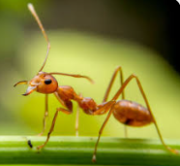
Your child’s learning
Ants:
It has been a lovely week in Ant's class!
For our topic, Kings & Queens, we have been learning all about the general election. We explored that it is not just Kings and Queens that are in charge and make all the decisions about our country, but the Prime Minister does too. We watched a video on what a general election is and discussed that it is the adults that get to vote and decide who they would like to be in charge. We looked at a ballot paper and practiced having our own election in the class, as well as discussing the important jobs a prime minister does such as spending money on schools and hospitals, and helping people in other countries.
In phonics this half term we have move onto unit 11. Each week we will be focusing on 2 sounds from unit 11, with a recap of the sounds learnt the week before through our sentences writing. Each day the children practice reading words, word building, writing words, and reading sentences.
For handwriting this half term, the children are practicing writing 2 CVC words a day in their phonics books. We practice and model it all together on the carpet first before the children go to the tables and have a try. We practice writing each word repeatedly at least 3 times on a line.
Our focus story for this half is The Rainbow Fish. Each week we look through the story and have a circle time to discuss the different events, characters, settings, and problems that happen. We use this book to write 3 dictated sentences a week, as well as 2 sentences from the Sounds Write phonics scheme.

Slide 13
In Ant's class we have a big focus on reading and sharing stories. We have dedicated reading times each day, as well as going to the Library on a Thursday. The children look forward to choosing and sharing a variety of books each week.
In Maths we have been learning all about teen numbers. We discovered that teen numbers are made from 1 lot of ten and extra ones, and that 20 is 2 lots of ten with no extra ones. The children have enjoyed making their own teen numbers through a range of activities such as building teen numbers using multilink and numicon, making teen patterns with pom poms, and making teen numbers on tens-frames.
In PE on Wednesday's this half term the children have balanceability. Balanceability is a structured balance bike programme for young children that teaches them how to ride a bike safely and confidently, without stabilisers. It focuses on the fundamental skills children need before they move on to a pedal bike.
In the sessions, children learn through fun, practical activities how to:
- balance on a bike
- steer and control speed
- develop coordination and spatial awareness
- build confidence and independence
- understand road safety basics in an age-appropriate way
On Friday during our Ball Skills lesson, we looked at pushing and rolling. This week the children worked in pairs, practicing to control the ball and keep it in their shared space. We discussed why it is important to work as a team and identified some sports that require good teamwork.
In PSHE our topic for this half term is Emotions. This week we read the story The Cloud. We discussed why the little girl in the story was feeling sad and described how we knew this by using details from the story. The children identified that another little girl in the story was trying to help make the girl feel better. We explored the different ways that she did this and if they were helpful. In our circle time all the children took it in turns to say how they would help make someone feel better if they were sad.
I hope you all have a lovely weekend!

Slide 14
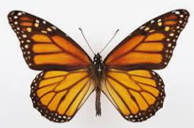
Butterflies:
The children have adapted well this week to the change of routines to accommodate Year 6 SATS.
For English, we have continued to read parts of King Arthur. The children are becoming more fluent with reading for expression. Please encourage this when children are reading speech in their books. Also ask them to point out nouns, proper nouns and adjectives from their reading books.
In Maths, the Y2 children have continued to practise subtraction facts by rounding numbers to the nearest 10, then compensating. For example, to do 34 - 19, they work out 34 - 20 = 14, then add on 1 as they have taken away an extra 1, so 34-19 = 15. Please encourage your child to explain this to you.
The year 1 children have been working on recognising a half and a quarter. They have also worked out half of numbers up to 20. It will be great to do some practical activities with your child, from cutting things into halves or quarters, to giving you half of something.
In Geography, the children learnt about the climate in Northern Europe and compared how the climates are different in different countries. They also learnt about the Sami people and why certain animals migrate. In science we have concluded our cress experiment, observing and recording the results in our observation charts. The children concluded that the best conditions for growing cress are sunlight and regular watering.
In art we have completed our Theseus and the Minotaur collages and in PSHE we have looked at ways to keep personal information safe.
For Phonics the year 1 children have been practising the different spellings of /s/- please encourage your child to 'Say the sounds and read the word,' when they come across unfamiliar words, so they become more accurate when they blend.
Please find attached a text to practise reading with your child.
We hope that you have a lovely weekend.

Slide 15
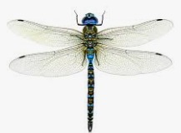
Dragonflies:
It has been a particularly busy week in Dragonflies.
On Monday - Thursday Year 6 completed their SATs assessments. I am so proud of all the children's hard work and positivity during the week. They should be so proud of themselves!
Over the course of the week, the children have been working hard considering which historical figure had the greatest impact on the history of Ely Cathedral. The children were tasked with making a 'top trumps' card and writing a persuasive paragraph with their reasoning for choosing that individual. Some of the children's work has been entered into a trust wide competition for their work to be published in an anthology.
On Friday, the Year 6 children enjoyed spending time with their parents at their end of SATs tea party. They ate lots of delicious food and enjoyed a children vs parents cricket match! Thank you to all the parents who attended.
Today, children in Year 6 auditioned for their roles in to KS2 production. All children have brought home their script in order to learn their lines ready for the first day back after half term when rehearsals will begin.
Next week, we head off on our residential. We are so excited!
It is essential that your child has a packed lunch on Monday.
Please arrive at 8:50am.
Your child must be able to carry their own suitcase up the stairs on arrival.
Medication should be handed to Miss Hardege
on arrival at school.

Slide 16


Slide 17
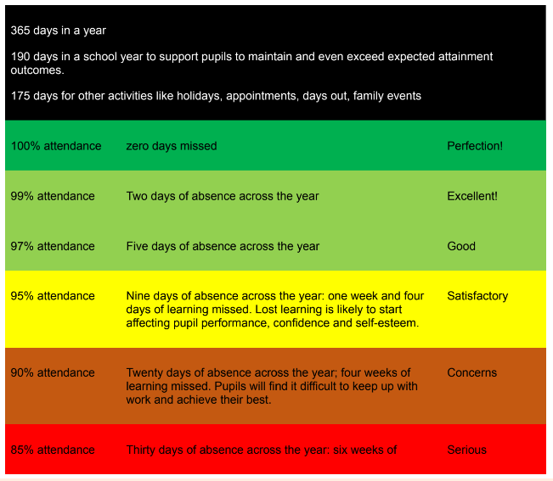
Attendance
https://www.nhs.uk/live-well/is-my-child-too-ill-for-school/
If your child needs time off for a medical appointment, please provide an appointment card or printed confirmation for our records.
Where possible, please make appointments out of school time.

Slide 18
Attendance
If your child is late for school, please ensure that you sign the late book in the entrance hall, giving a reason for the lateness.
If it is a sensitive reason and you would rather not write it down, please chat to Mrs Sandford or Mrs How.
Please do not write ‘late’ as a reason.
Minutes late per day | School days lost per year
5 minutes | 3 days
10 minutes | 6.5 days
15 minutes | 10 days
20 minutes | 13 days
30 minutes | 19 days

Slide 19
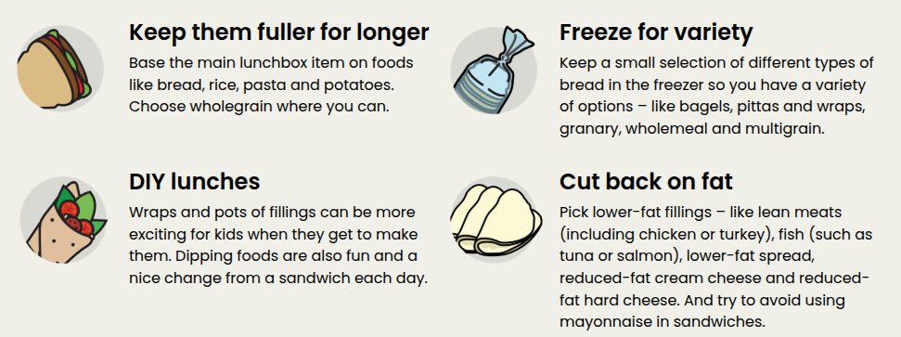
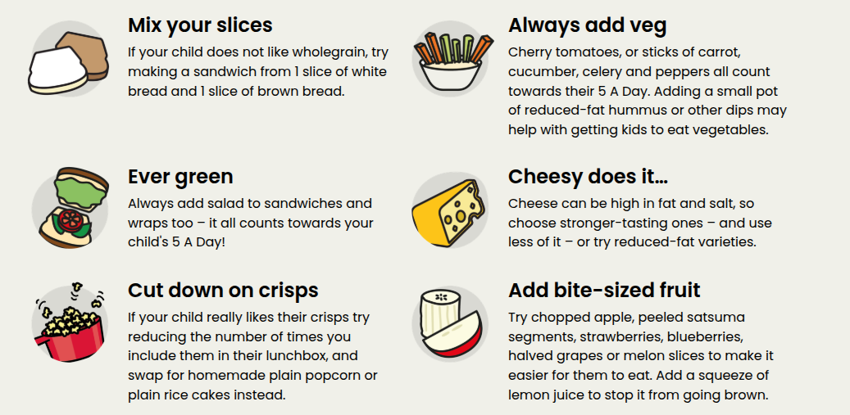
A reminder that we are a nut-aware school. Please ensure that your child’s lunchbox does not include any nuts.

Slide 20
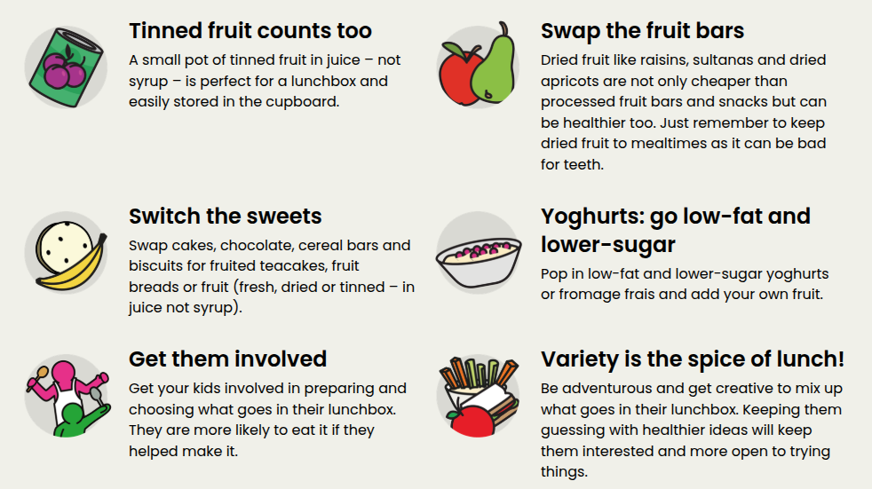
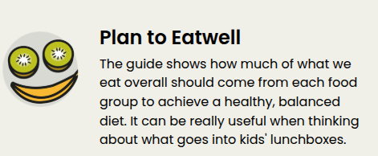
https://www.nhs.uk/live-well/eat-well/food-guidelines-and-food-labels/the-eatwell-guide/

Slide 21


Slide 22

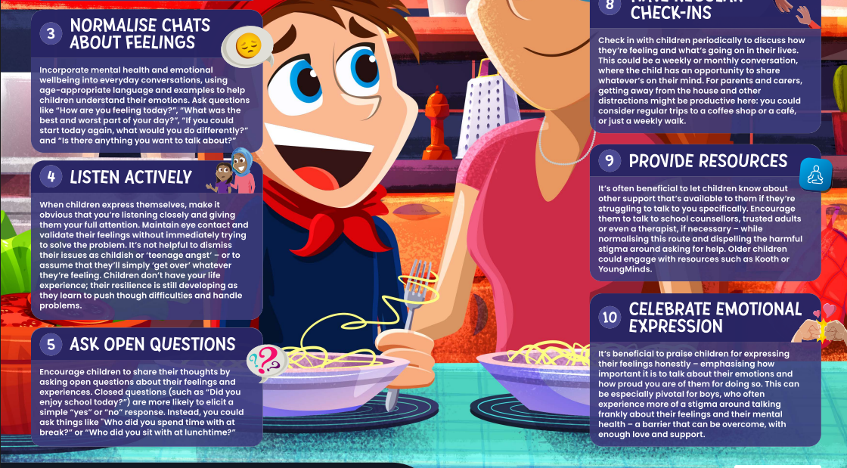

Slide 23
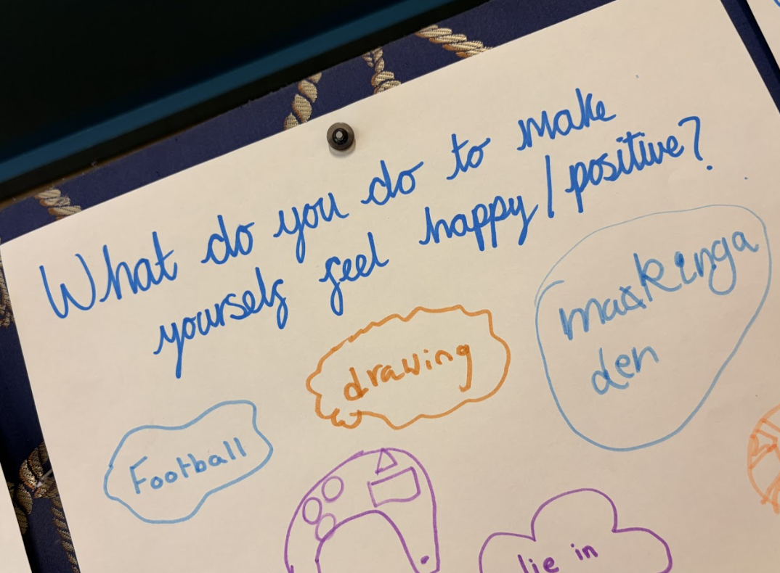
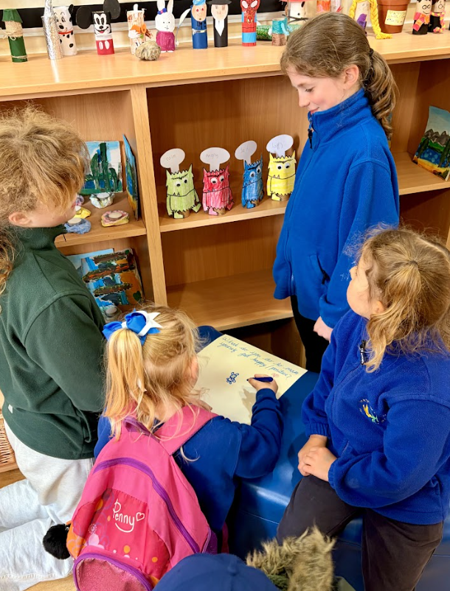
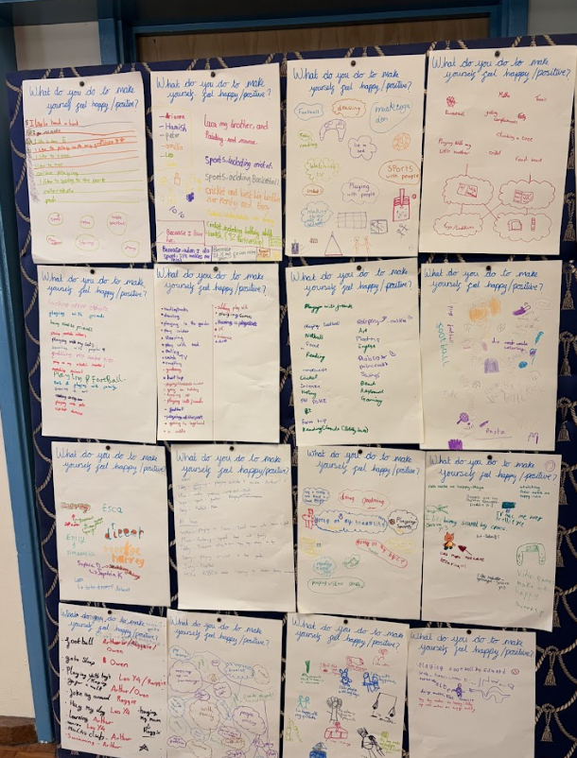

Slide 24
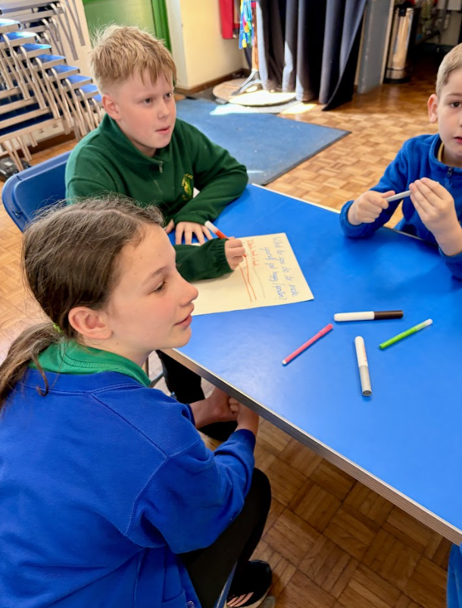
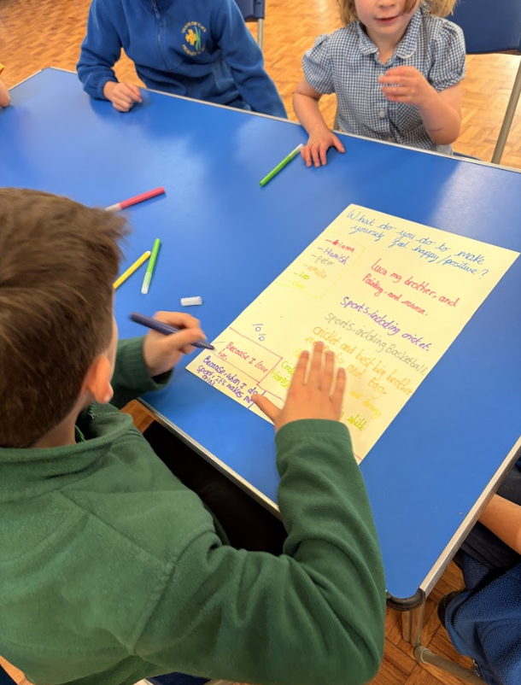
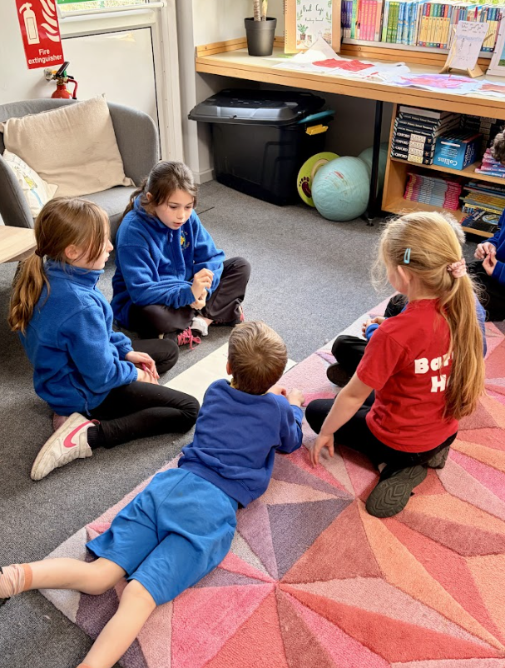
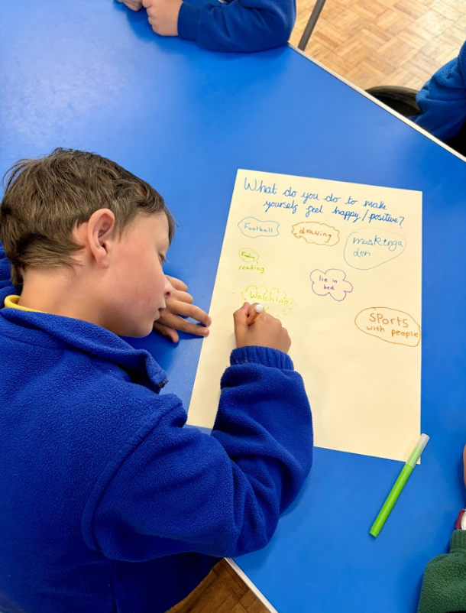

Slide 25
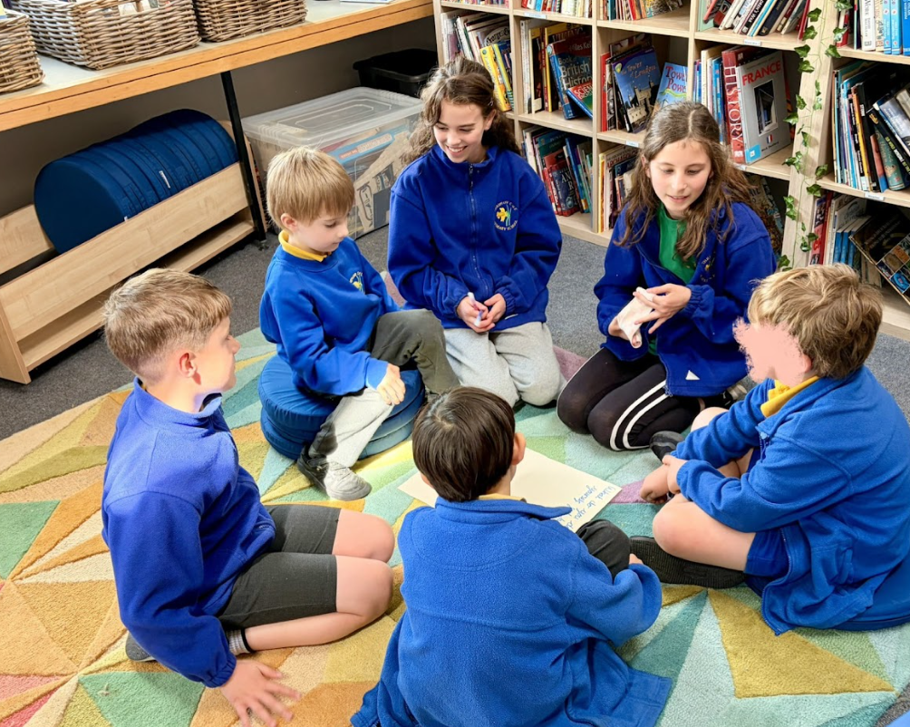
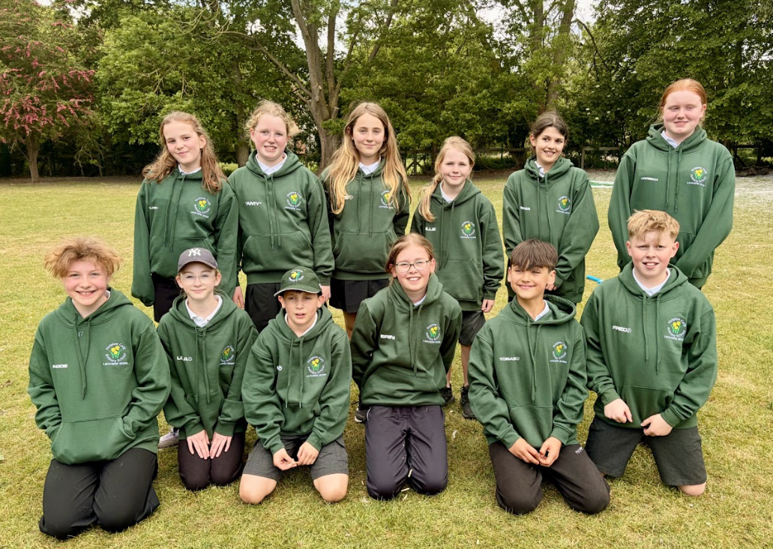

Slide 26
