Slide 1


Welcome to
Retreat 4

Slide 2

A healthy church is one that…
Engages and maintains loving relationships
Develops and mobilizes the people
Acts with clear direction and outward focus
Reproduces and multiplies his mission in other peoples and places
Pursues and obeys God passionately

Slide 3

Ten Questions
Why do we exist? (Mission)
The Great Commission focuses on the belief system which Christ taught.
The Great Commandment focuses on the behavior system which Christ modeled.

Slide 4
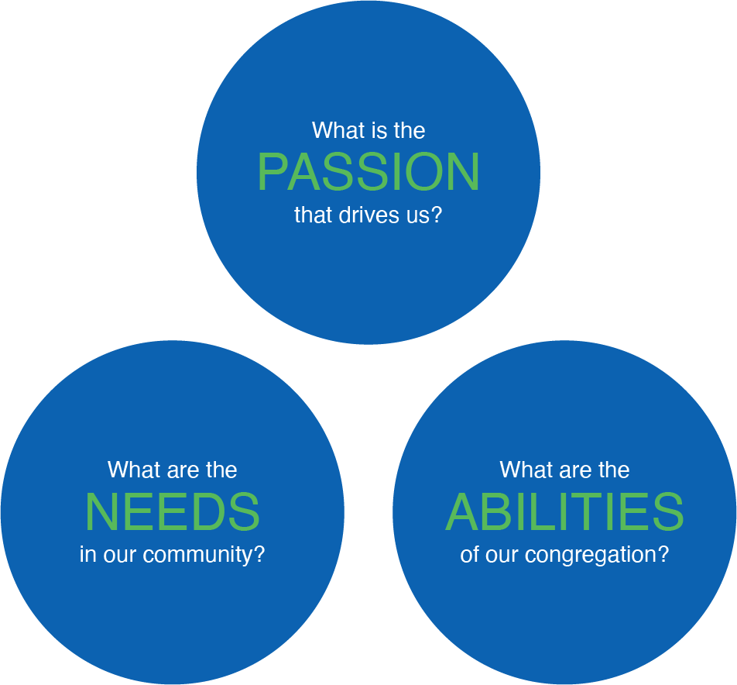
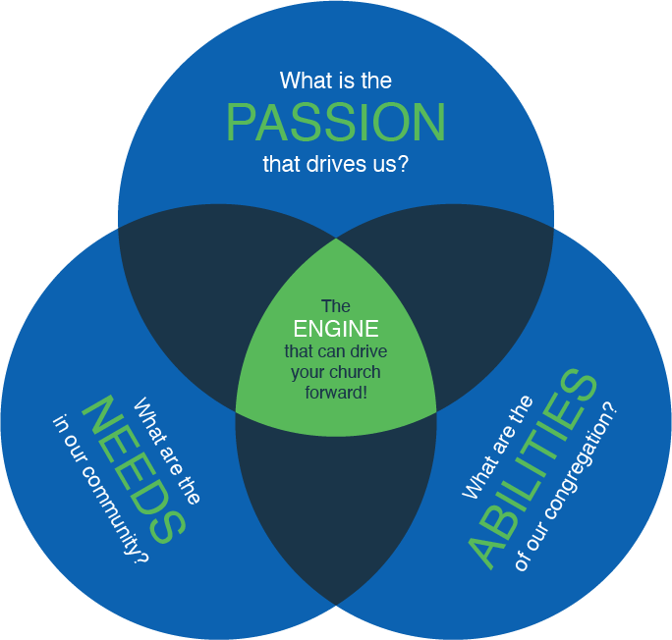
Ten Questions
Where are we going? (Vision)

Slide 5
Ten Questions
How should we behave? (Values)
More than mission or vision, core values tell those inside and outside the congregation what is distinctive and important.

Slide 6
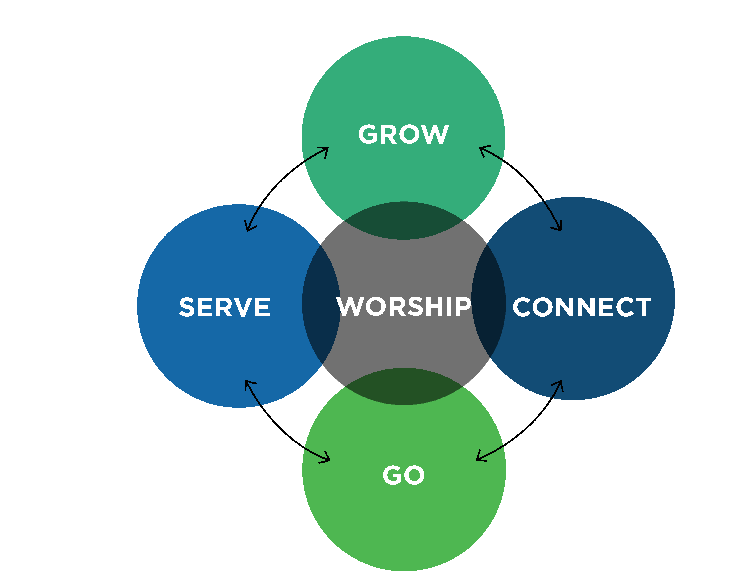
Ten Questions
How will we get there? (strategic plan)
Fellowship (CONNECT)
Discipleship (GROW)
Gift-Oriented Ministry (SERVE)
Evangelism (GO)
WORSHIP

Slide 7
Ten Questions
How will we engage new people? (GO)
How will we treat them when they arrive? (CONNECT)
How will we disciple them? (GROW)
How will we train them to serve? (SERVE)
How will we inspire them to be missional (local, global)?
How will we help them encounter God? (WORSHIP)

Slide 8
Preparing to Launch the Strategic Plan
Initial communication and planning steps
Launch Sunday

Slide 9
Initial Communication and Planning Steps
As you prepare to launch your strategic plan…
Who needs to be added to the team to prepare for implementation?
When will Launch Sunday take place?
What key communication pieces need to be prepared?
Who needs to be brought up to speed before Launch Sunday?

Slide 10
Initial Communication and Planning Steps
Three audiences for change communication:
Consumer people
Those who are primarily focused on their own needs
Ministry people
Those who help us minister to the needs of people
Missional people
Those who find their purpose in Christ’s kingdom

Slide 11
Initial Communication and Planning Steps
Missional people are motivated by love for Christ and for those He has called them to serve.

Slide 12
Initial Communication and Planning Steps
Missional people are motivated by love for Christ and for those He has called them to serve.
Missional people have found a sense of purpose, even calling, in their ministry efforts.

Slide 13
Initial Communication and Planning Steps
Missional people are motivated by love for Christ and for those He has called them to serve.
Missional people have found a sense of purpose, even calling, in their ministry efforts.
Missional people are more than ministry helpers. They lead others to give their best in serving Christ.

Slide 14
Initial Communication and Planning Steps
Missional people are motivated by love for Christ and for those He has called them to serve.
Missional people have found a sense of purpose, even calling, in their ministry efforts.
Missional people are more than ministry helpers. They lead others to give their best in serving Christ.
Missional people see needs and look to their own resources before placing expectations on others.

Slide 15
Initial Communication and Planning Steps
Missional people reflect the heart of Christ and act in the power of the Holy Spirit.

Slide 16
Initial Communication and Planning Steps
Missional people reflect the heart of Christ and act in the power of the Holy Spirit.
Missional people pursue Christ in their daily lives at their own initiative.

Slide 17
Initial Communication and Planning Steps
Missional people reflect the heart of Christ and act in the power of the Holy Spirit.
Missional people pursue Christ in their daily lives at their own initiative.
Missional people seek unity and humility rather than preference and control.

Slide 18
Initial Communication and Planning Steps
Missional people reflect the heart of Christ and act in the power of the Holy Spirit.
Missional people pursue Christ in their daily lives at their own initiative.
Missional people seek unity and humility rather than preference and control.
Missional people will stand for Christ even when alone.

Slide 19
Initial Communication and Planning Steps
Group | Percentage of Congregation | Order of communication | Setting
Consumer | Two-thirds | Last | On Launch Sunday
Ministry | One-third | Second | In a team meeting
Missional | A segment within the Ministry group | First, well before launching new initiatives | Individually over a cup of coffee

Slide 20
Initial Communication and Planning Steps
As you prepare to launch your strategic plan…
How will the preaching schedule prepare for Launch Sunday?

Slide 21
Launch Sunday
Consider the planning steps listed in your notes.

Slide 22
1 | 2 | 3 | 4 | 5 | 6 | 7
Vision | Values | Communi- cation | Skills | Resources | Action Plans | Successful Change
 | Values | Communi- cation | Skills | Resources | Action Plans | Confusion Chaos
Vision |  | Communi- cation | Skills | Resources | Action Plans | Conflict Apathy
Vision | Values |  | Skills | Resources | Action Plans | Misunder- standing
Vision | Values | Communi- cation |  | Resources | Action Plans | Anxiety Insecurity
Vision | Values | Communi- cation | Skills |  | Action Plans | Frustration
Vision | Values | Communi- cation | Skills | Resources |  | False Starts Erratic Change

Slide 23
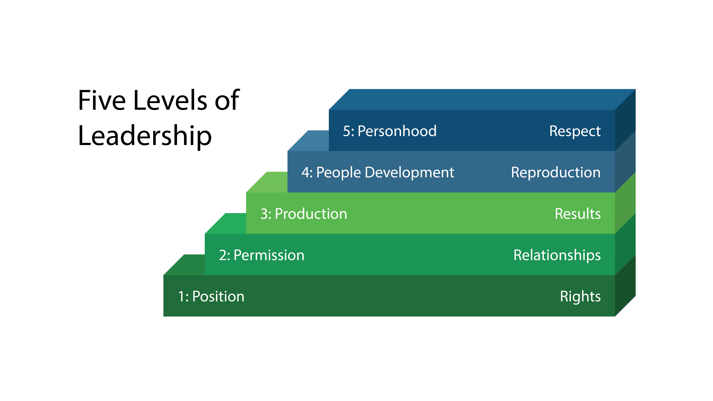
Team Members’ New Roles

Slide 24
Our Prayer for You
Hebrews 13:20-21
Now may the God of peace who brought again from the dead our Lord Jesus, the great shepherd of the sheep, by the blood of the eternal covenant, equip you with everything good that you may do his will, working in us that which is pleasing in his sight, through Jesus Christ, to whom be glory forever and ever. Amen.

