Slide 1


Welcome to
Retreat 3

Slide 2

Transformation is not a destination. For congregations it is not a place of arrival where the transformation journey can be declared as over. It is an ongoing journey. Congregations do not transform once. They are continually transforming.
George W. Bullard, Jr.

Slide 3

Mission Review
The Great Commission focuses on the belief system which Christ taught.
The Great Commandment focuses on the behavior system which Christ modeled.

Slide 4

Biblical Functions Review
Acts 2:42–47
Fellowship (CONNECT)
Discipleship (GROW)
Gift-Oriented Ministry (SERVE)
Evangelism (GO)
WORSHIP

Slide 5
Vision Review
Vision is courageously exploring possibilities.

Slide 6
Vision Review
Vision is courageously exploring possibilities.
Vision answers “Where?” and “Why?”

Slide 7
Vision Review
Vision is courageously exploring possibilities.
Vision answers “Where?” and “Why?”
Vision unites people around a common cause.

Slide 8
Vision Review
Vision is courageously exploring possibilities.
Vision answers “Where?” and “Why?”
Vision unites people around a common cause.
Vision gives clear focus on an intended destination.

Slide 9
Vision Review
Vision is courageously exploring possibilities.
Vision answers “Where?” and “Why?”
Vision unites people around a common cause.
Vision gives clear focus on an intended destination.
Vision is memorable, inspiring, ambitious, and relevant.

Slide 10
Vision Review
Vision is courageously exploring possibilities.
Vision answers “Where?” and “Why?”
Vision unites people around a common cause.
Vision gives clear focus on an intended destination.
Vision is memorable, inspiring, ambitious, and relevant.
Vision is bigger than your ability to achieve.

Slide 11
Vision Review
Does it contain the biblical functions of Acts 2?

Slide 12
Vision Review
Does it contain the biblical functions of Acts 2?
Is it clear and understandable?

Slide 13
Vision Review
Does it contain the biblical functions of Acts 2?
Is it clear and understandable?
Can your congregation make it happen?

Slide 14
Vision Review
Does it contain the biblical functions of Acts 2?
Is it clear and understandable?
Can your congregation make it happen?
Is it vital and urgent to your church?

Slide 15
Vision Review
Is it future focused?

Slide 16
Vision Review
Is it future focused?
Does it require faith to fulfill?

Slide 17
Vision Review
Is it future focused?
Does it require faith to fulfill?
Does it matter?

Slide 18
Vision Review
Is it future focused?
Does it require faith to fulfill?
Does it matter?
Will it take you to the next level?

Slide 19
Core Values Review
More than mission or vision, core values tell those inside and outside the congregation what is distinctive and important.

Slide 20
Understanding the Strategic Plan
We need a strategic plan for the leadership team.
We need an understandable plan to build the bridge of hope.

Slide 21
Understanding the Strategic Plan
Psalm 37:23, KJV “The steps of a good man are ordered by the Lord, and he delighteth in his way.”

Slide 22
Understanding the Strategic Plan
Psalm 37:23, KJV “The steps of a good man are ordered by the Lord, and he delighteth in his way.”
Proverbs 16:3, ESV “Commit your work to the Lord, and your plans will be established.”

Slide 23
Understanding the Strategic Plan
Psalm 37:23, KJV “The steps of a good man are ordered by the Lord, and he delighteth in his way.”
Proverbs 16:3, ESV “Commit your work to the Lord, and your plans will be established.”
Proverbs 16:9, ESV “The heart of a man plans his way, but the Lord establishes his steps.”

Slide 24
Understanding the Strategic Plan
Psalm 37:23, KJV “The steps of a good man are ordered by the Lord, and he delighteth in his way.”
Proverbs 16:3, ESV “Commit your work to the Lord, and your plans will be established.”
Proverbs 16:9, ESV “The heart of a man plans his way, but the Lord establishes his steps.”
Proverbs 15:22, NIV “Plans fail for lack of counsel, but with many advisors they succeed.”

Slide 25
Vision
Beliefs, Actions, Where We Are Going
Worship
Connect
Grow
Serve
Go
Values
Behaviors, Attitudes, Where We Are Now

Slide 26


Strategic Plan
BIBLICAL FUNCTIONS Worship, Connect, Grow, Serve, Go
LEADERSHIP TEAM
Staff, Board, Ministries Teams
CONGREGATION
Body of Christ
CORE VALUES
Priorities, Behaviors

Slide 27
5 Strategic Questions
How do we engage new people?

Slide 28
Finding Your “Engine”
As we have seen, most churches that have plateaued or declined are in the latter half of the life cycle. They need new life! Not every church experiences a regular flow of guests into its ministries. In fact, most don’t. We can perfect our assimilation efforts, but this is only half the battle, and it’s usually the second half. First, we must FIND NEW PEOPLE TO BRING NEW LIFE to our church. To do that, every church should identify its “engines” (the efforts that draw new people to the church).

Slide 29

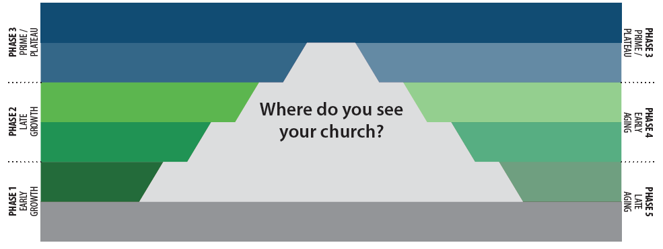
LIFE CYCLE STAGES OF A CHURCH
Prime
Adulthood (VRPM)
Maturity (vRPM)
Adolescence (VRPm)
Empty Nest (vRpM)
Childhood (VrPm)
Retirement (vrPM)
Infancy (VRpm)
Old Age (vrpM)
Birth (Vrpm)
Death (---m)
GROWTH
V – Vision
R – Relationships
P – Programs
M – Management

Slide 30
Finding Your “Engine”
To start a new life cycle, you must have new life!

Slide 31
Finding Your “Engine”
First, who are your friends?
The best place to find new friends is among those its people are meeting and connecting with every day.

Slide 32
Finding Your “Engine”
First, who are your friends?
The best place to find new friends is among those its people are meeting and connecting with every day.
Reaching people isn’t what your church pays the pastor to do.

Slide 33
Finding Your “Engine”
First, who are your friends?
The best place to find new friends is among those its people are meeting and connecting with every day.
Reaching people isn’t what your church pays the pastor to do.
It’s not why your Pastor decided to hire some staff members either.

Slide 34
Finding Your “Engine”
First, who are your friends?
The best place to find new friends is among those its people are meeting and connecting with every day.
Reaching people isn’t what your church pays the pastor to do.
It’s not why your Pastor decided to hire some staff members either.
Consider Friend Day events or opportunities for the people to target their invitations.

Slide 35
Finding Your “Engine”
Next, who are your church’s neighbors?
If you’re looking for people to love, why not start next door? These folks are right there, just walking distance from your church!

Slide 36
Finding Your “Engine”
Next, who are your church’s neighbors?
If you’re looking for people to love, why not start next door? These folks are right there, just walking distance from your church!
If the church people have little in common with those who live closest, no one expects to find friends there.

Slide 37
Finding Your “Engine”
Finally, what are your church’s ministry strengths?
What a church does well needs to be visible to its community!

Slide 38
Finding Your “Engine”
Finally, what are your church’s ministry strengths?
What a church does well needs to be visible to its community!
New people are more likely to show up when you are doing what you do.

Slide 39
Finding Your “Engine”
Finally, what are your church’s ministry strengths?
What a church does well needs to be visible to its community!
New people are more likely to show up when you are doing what you do.
At the same time, those who drift in during your lesser quality moments seldom choose to come back.

Slide 40
Finding Your “Engine”
Finally, what are your church’s ministry strengths?
Evangelistic outreach events

Slide 41
Finding Your “Engine”
Finally, what are your church’s ministry strengths?
Evangelistic outreach events
Teaching truth

Slide 42
Finding Your “Engine”
Finally, what are your church’s ministry strengths?
Evangelistic outreach events
Teaching truth
Serving their communities

Slide 43
Finding Your “Engine”
Finally, what are your church’s ministry strengths?
Evangelistic outreach events
Teaching truth
Serving their communities
Worship

Slide 44
Finding Your “Engine”
Finally, what are your church’s ministry strengths?
Evangelistic outreach events
Teaching truth
Serving their communities
Worship
Relationship building

Slide 45
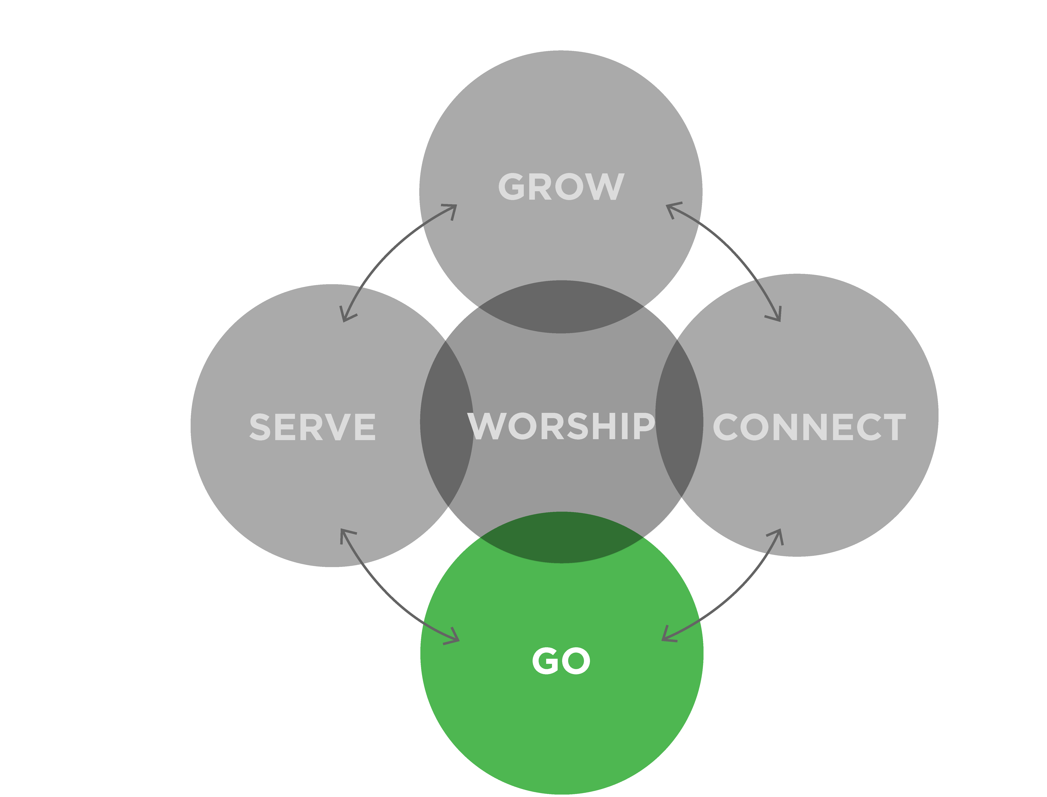
Go
Strategic Goals for Evangelism/Go:
What steps could we take in the next two to three years to fulfill your strategic plan for Evangelism?
What will you do to empower your church to reach the unchurched in the marketplace?
Decide how your church will engage with world missions, whether through a trip or through increased support of missionaries.

Slide 46
5 Strategic Questions
How do we engage new people?
How will we treat them when they walk through our doors?

Slide 47
Guest Assimilation
Guest assimilation is the process of moving new attendees to the level of Christian discipleship.

Slide 48
Guest Assimilation
The guest assimilation process takes people from the front door to strong relationship connection in six weeks, and to active discipleship through ministry involvement and small group participation within a total of eighteen weeks.

Slide 49
Guest Assimilation
Parking lot greeters

Slide 50
Guest Assimilation
Parking lot greeters
Entrance greeters

Slide 51
Guest Assimilation
Parking lot greeters
Entrance greeters
Sanctuary greeters

Slide 52
Guest Assimilation
Parking lot greeters
Entrance greeters
Sanctuary greeters
Exit greeters

Slide 53
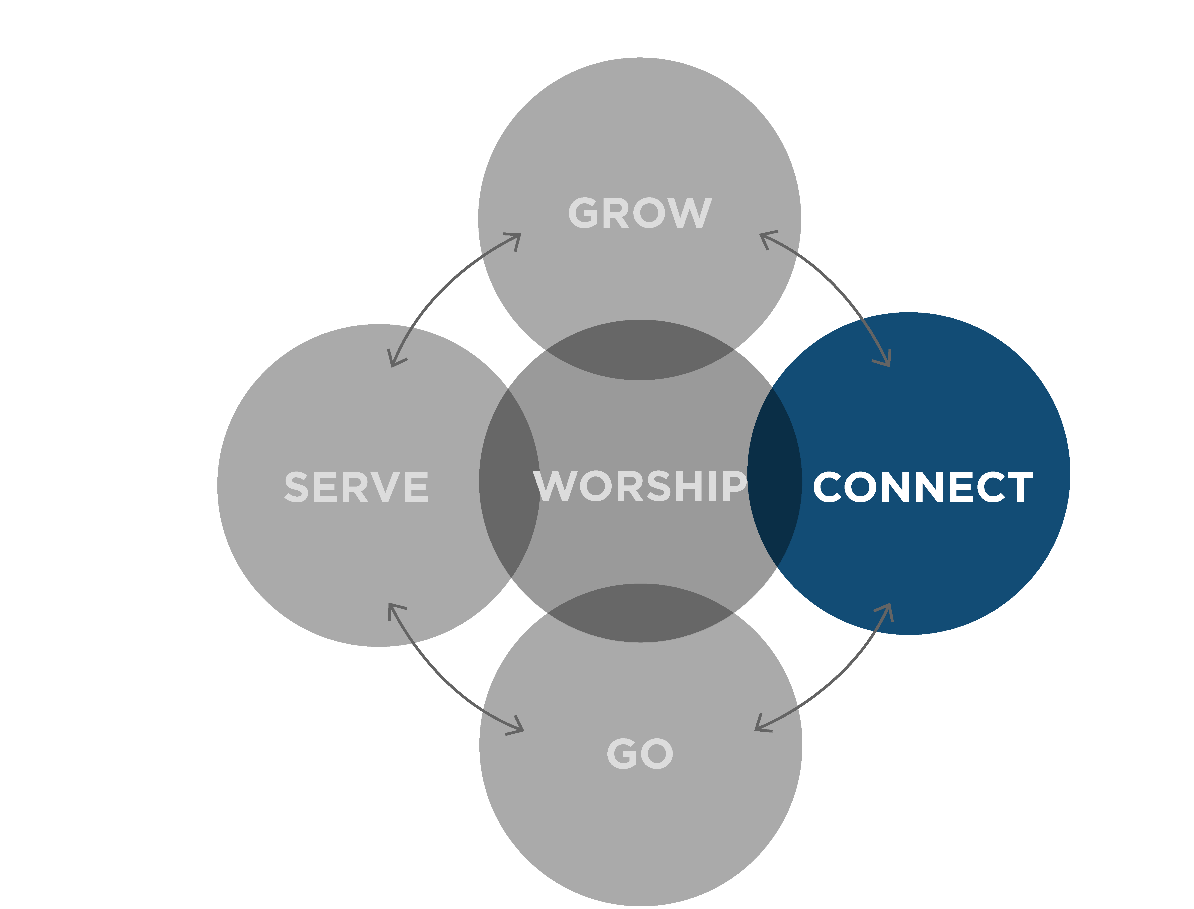
Connect
Strategic Goals for Fellowship/Connect:
What steps could you take in the next two to three years to fulfill your strategic plan for Fellowship?
How will we welcome first-time guests?
How will we follow up with them and connect them to the life our church in the first six weeks?

Slide 54
5 Strategic Questions
How do we engage new people?
How will we treat them when they walk thru our doors?
How will we teach them how to follow Jesus?

Slide 55
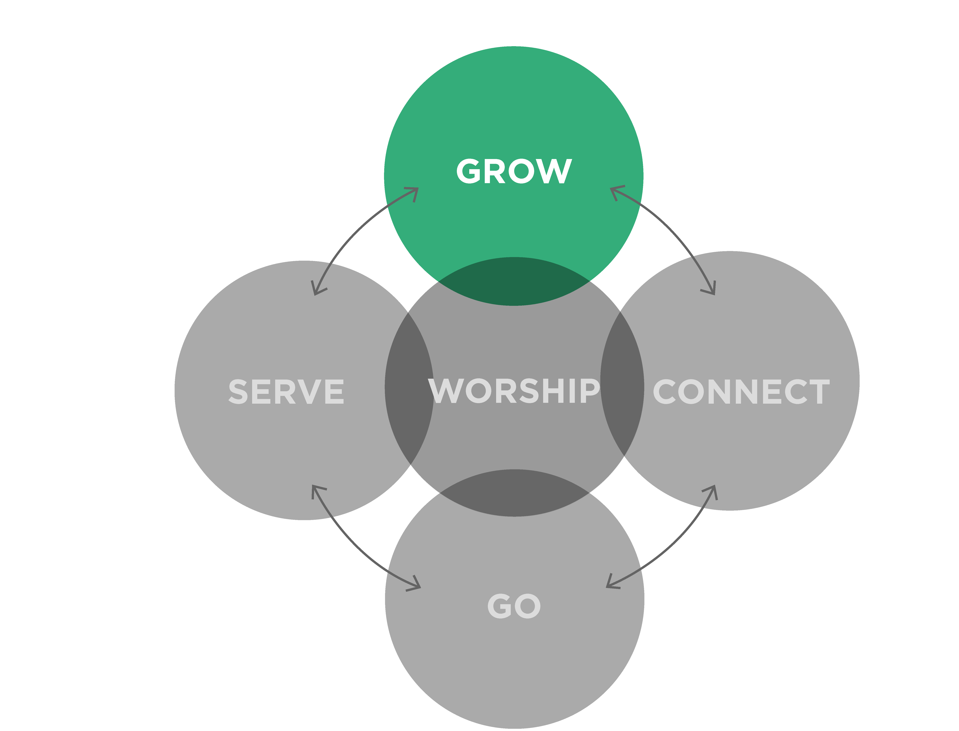
Grow
Strategic Goals for Discipleship/Grow:
What steps could you take in the next two to three years to fulfill your strategic plan for Discipleship?
What classes will we offer for adults, and what will our small group system look like?
What will we teach our children and students for the next two years?

Slide 56
Nursery & Children’s Ministry
The purpose for training up children and youth is to ensure that when they are mature, they will minister to, serve, disciple and reproduce themselves in others.

Slide 57
5 Strategic Questions
How do we engage new people?
How will we treat them when they walk thru our doors?
How will we teach them how to follow Jesus?
4. How will we help them find a place to serve?

Slide 58
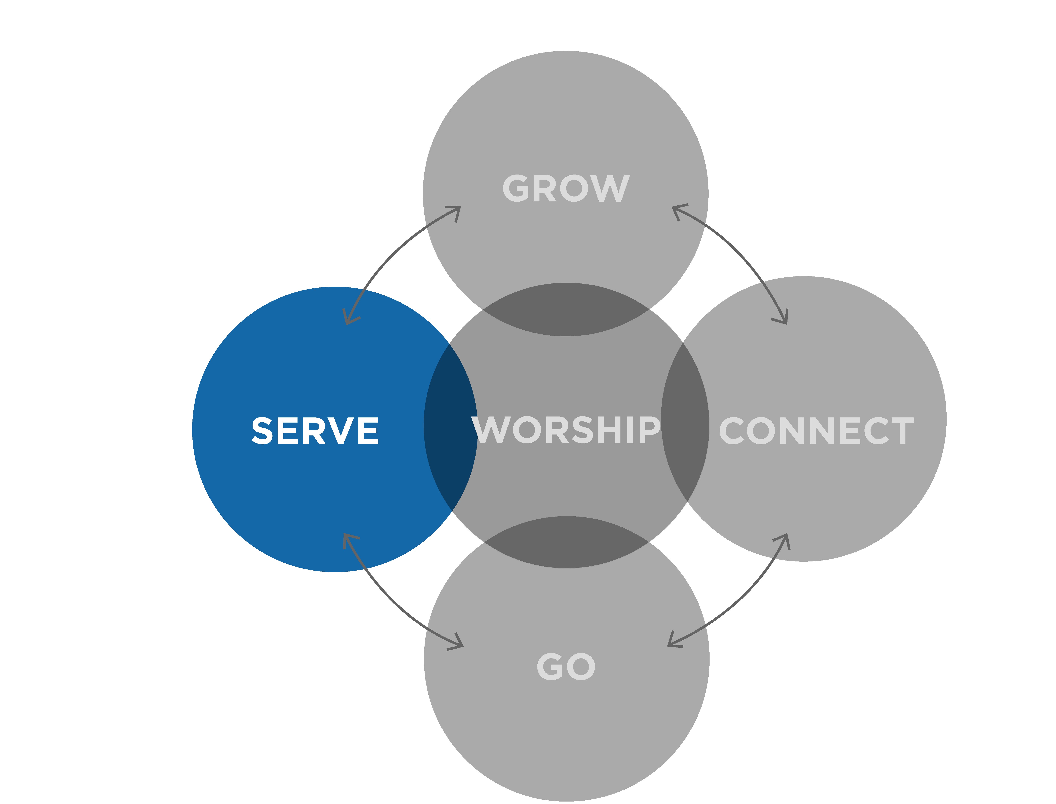
Serve
Strategic Goals for Gift-Oriented Ministry/ Serve:
What steps could you take in the next two to three years to fulfill your strategic plan for Gift-Oriented Ministry?
Decide what spiritual gifts assessment you will use to help team members discover their gifts.
What training materials should be offered to people who want to be involved in the ministries of our church?

Slide 59
5 Strategic Questions
How do we engage new people?
How will we treat them when they walk thru our doors?
How will we teach them how to follow Jesus?
4. How will we help them find a place to serve?
5. How will we teach them to pursue God?

Slide 60
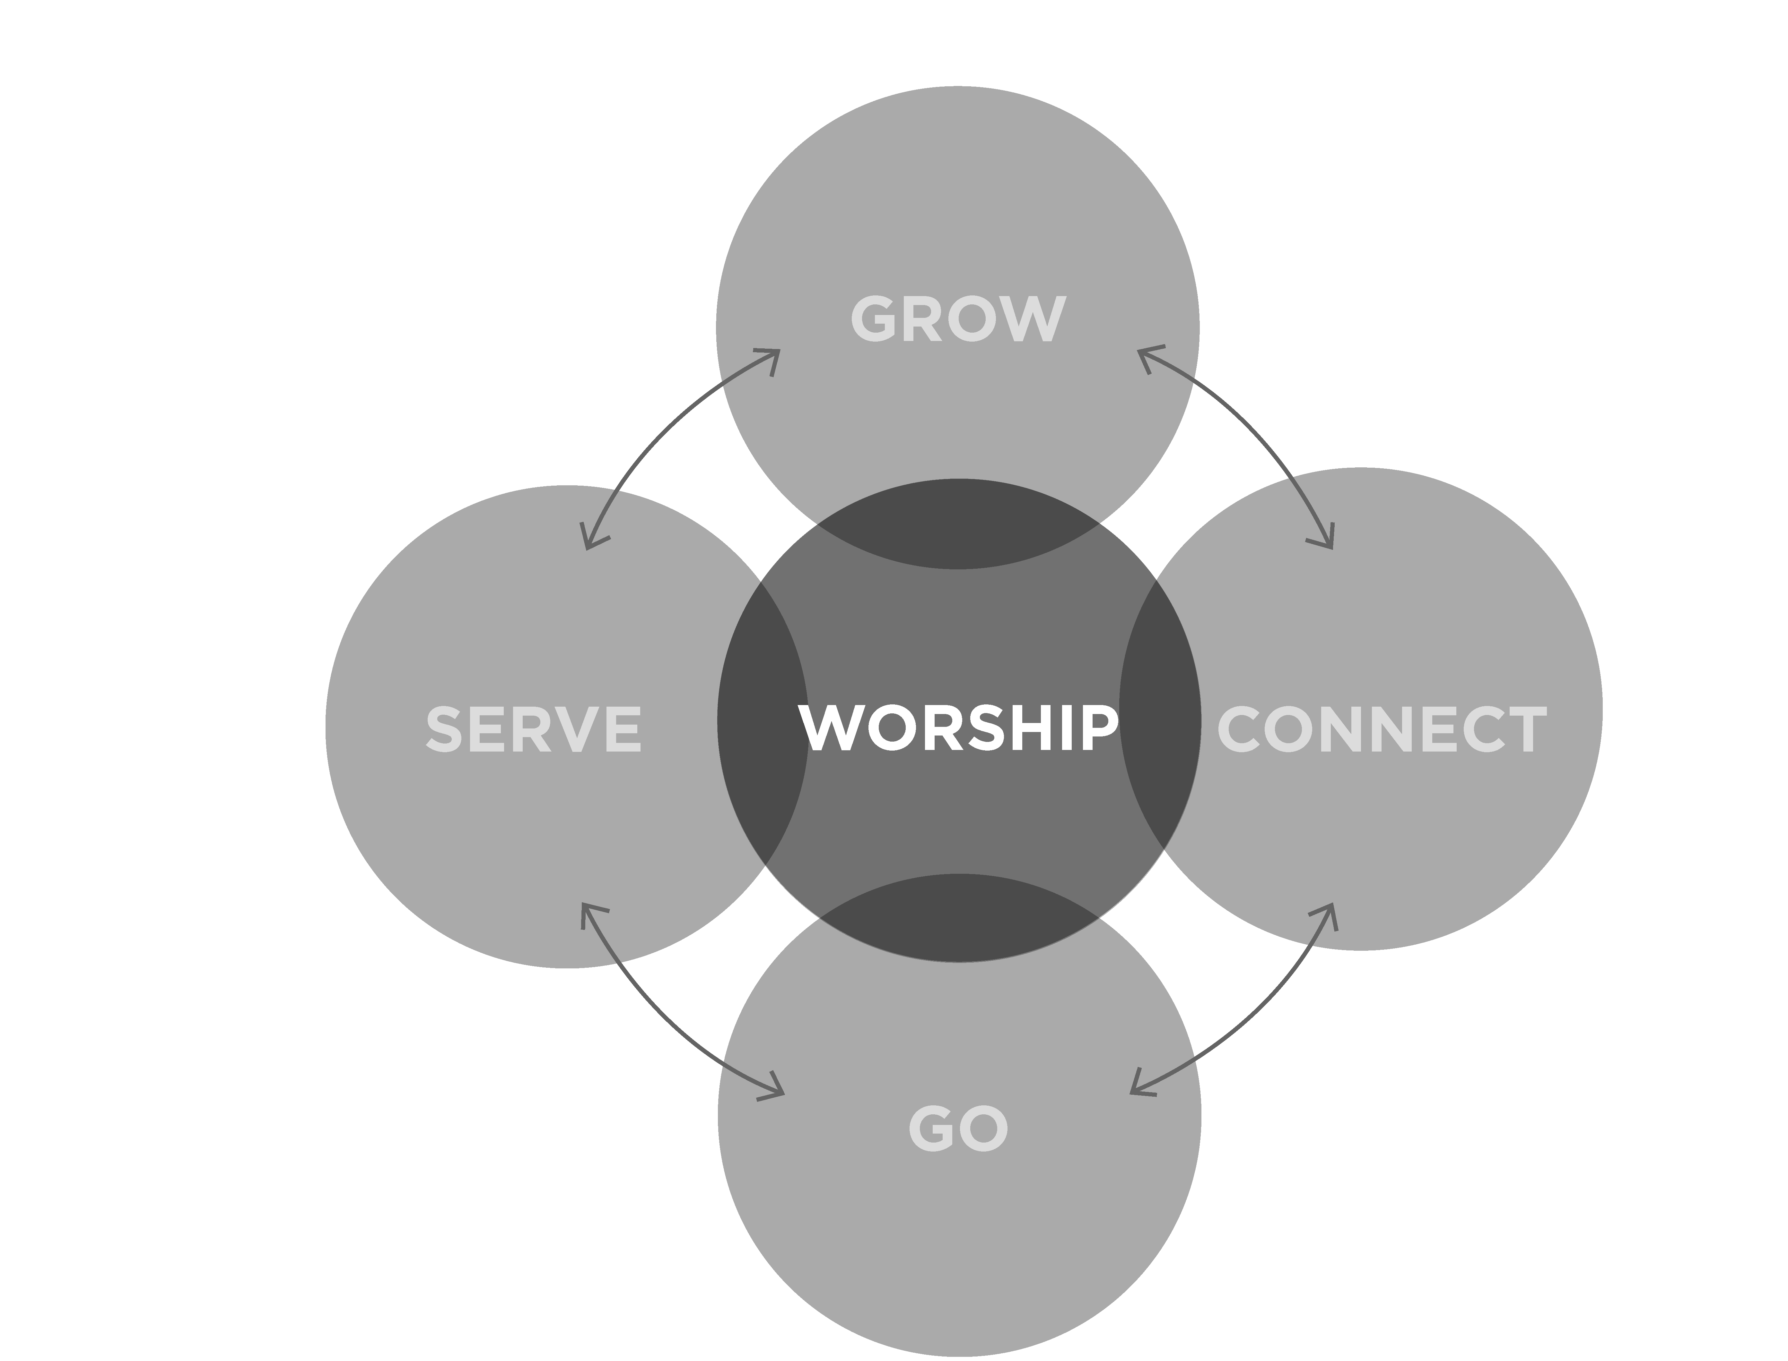
Worship
Strategic Goals for Worship:
What steps could we take in the next two to three years to move toward our dream statement for Worship?
Include a plan for how your church will pray. What will be the corporate prayer focus?
Develop a plan for the church to expand the Worship function beyond the four walls of the church.

Slide 61
 | 1 | 2 | 3 | 4 | 5
Fellowship | Initiate exit and sanctuary greeters | Create a new assimilation plan | Designate a Sunday to display opportunities.
Discipleship | Bible Engagement Project (MHC) | Develop one-to-one discipleship (THRIVE) | Scripture memorization | Personal growth plan
Gift-Oriented Ministry | Gift assessment survey | Use Acts 2 Survey | Create teams to implement each of the five functions
Evangelism | Prayer walk in community | Rural Compassion | Schedule a missions trip | One Minute Witness (Personal evangelism) | Marketplace evangelism
Worship | Annual churchwide Bible reading | Have a solemn assembly/ prayer and fasting

Slide 62
 | 1 | 2 | 3 | 4 | 5
 | Fellowship | Discipleship | Gift-Oriented Ministry | Evangelism | Worship
1
2
3
4
5

Slide 63
Planning Your New Initiatives
Include time for
Planning
Adjustment
Celebration

Slide 64
Group Assignment
Meet as a Vision Team to discuss the timing for publicly communicating the church’s vision and strategic plan to the congregation. (Strategic communication should begin soon after Retreat 4.)

Slide 65
Group Assignment
Review notes from Retreat Three. Over the next 90 days, begin to write, in detail, your church’s strategic plan for the next two to three years. (This will be comprised of the strategies for implementing the biblical functions—worship, connect, serve, grow, and go.) Bring your strategic plan to Retreat 4.

Slide 66
Group Assignment
Prepare to present your strategic plan at Retreat Four using PowerPoint®, video, or any other communication tool. Each group will have five to eight minutes to present their strategic plan. Bring a copy of your strategic plan for the presenter.

Slide 67
Group Assignment
Before the next Vision Team meeting, have each team member tour the church’s facilities as if they were guests/visitors. Make notes about observations, including issues that require immediate attention and ideas for improving the guest experience—restrooms, cleanliness of décor and furniture, ease of access, etc.

Slide 68
Group Assignment
Begin assessing your church facilities and ministries and be realistic about the transformation necessary to accomplish the goals in your strategic plan.

Slide 69
Group Assignment
Between now and Retreat 4, have each member of the Vision Team read the book of Acts and identify the transitions the Early Church made to minister to the people. (Examples of ministry by the church in Acts include healing, caretaking, inclusion, etc.)

