Slide 1


Welcome to
Retreat 2

Slide 2

Transformation is not a destination. For congregations it is not a place of arrival where the transformation journey can be declared as over. It is an ongoing journey. Congregations do not transform once. They are continually transforming.
George W. Bullard

Slide 3
While a compelling vision can certainly get the flywheel going, it takes successful progress toward the realization of the vision to keep it turning, and at an ever-increasing pace.
Bud Wrenn

Slide 4

Mission Review
The Great Commission focuses on the belief system which Christ taught.
The Great Commandment focuses on the behavior system which Christ modeled.

Slide 5
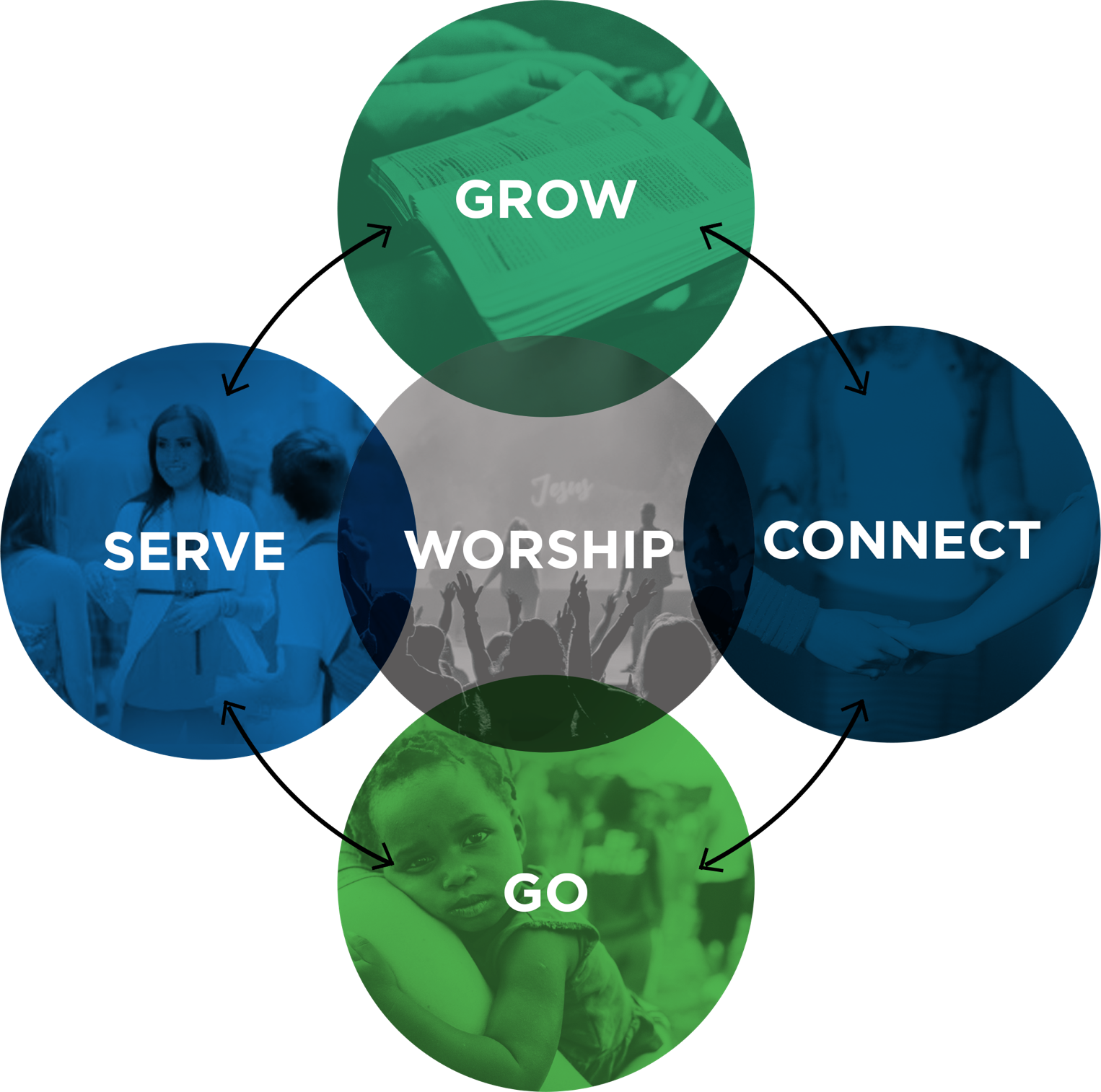
Biblical Functions Review
Acts 2:42–47
Fellowship (CONNECT)
Discipleship (GROW)
Gift-Oriented Ministry (SERVE)
Evangelism (GO)
WORSHIP

Slide 6
Vision Review
Vision is courageously exploring possibilities.

Slide 7
Vision Review
Vision is courageously exploring possibilities.
Vision answers “Where?” and “Why?”

Slide 8
Vision Review
Vision is courageously exploring possibilities.
Vision answers “Where?” and “Why?”
Vision unites people around a common cause.

Slide 9
Vision Review
Vision is courageously exploring possibilities.
Vision answers “Where?” and “Why?”
Vision unites people around a common cause.
Vision gives clear focus on an intended destination.

Slide 10
Vision Review
Vision is courageously exploring possibilities.
Vision answers “Where?” and “Why?”
Vision unites people around a common cause.
Vision gives clear focus on an intended destination.
Vision is memorable, inspiring, ambitious, and relevant.

Slide 11
Vision Review
Vision is courageously exploring possibilities.
Vision answers “Where?” and “Why?”
Vision unites people around a common cause.
Vision gives clear focus on an intended destination.
Vision is memorable, inspiring, ambitious, and relevant.
Vision is bigger than your ability to achieve.

Slide 12
Vision Review
Does it contain the biblical functions from Acts 2?
Is it clear and understandable?
Can your congregation make it happen?
Is it vital and urgent to your church?
Is it future focused?
Does it require faith to fulfill?
Does it matter?
Will it take you to the next level?

Slide 13
Vision Review
Three reasons why vision fails:
Poor communication

Slide 14
Vision Review
Three reasons why vision fails:
Poor communication
No strategic plan

Slide 15
Vision Review
Three reasons why vision fails:
Poor communication
No strategic plan
No implementation process

Slide 16

Five Levels of Leadership
Five Levels of Leadership
\
1: Position Rights

Slide 17
Five Levels of Leadership
Five Levels of Leadership
\
2: Permission Relationships
1: Position Rights

Slide 18
Five Levels of Leadership
Five Levels of Leadership
\
3: Production Results
2: Permission Relationships
1: Position Rights

Slide 19
Five Levels of Leadership
Five Levels of Leadership
\
4: People Development Reproduction
3: Production Results
2: Permission Relationships
1: Position Rights

Slide 20
Five Levels of Leadership
Five Levels of Leadership
\
5: Personhood Respect
4: People Development Reproduction
3: Production Results
2: Permission Relationships
1: Position Rights

Slide 21
Gary McIntosh’s Typology of Church Sizes One Size Doesn’t Fit All
FACTORS | SMALL CHURCH | MEDIUM CHURCH | LARGE CHURCH
Size | 15–200 worshipers | 201–400 worshipers | 401+ worshipers
Orientation | Relational | Programmatical | Organizational
Structure | Single cell | Stretched cell | Multiple cell
Leadership | Resides in key families | Resides in committees | Resides in select leaders
Pastor | Lover | Administrator | Leader
Decisions | Made by congregation; driven by history | Made by committees; driven by changing need | Made by staff and leaders; driven by vision
Staff | Bivocational or single pastor | Pastor and small staff | Multiple staff
Change | Bottom up through key people | Middle out through key committees | Top down through key leaders
Growth Patterns | Attraction model through relationships | Program model through key ministry | Proclamation model through word of mouth

Slide 22
FACTORS | SMALL CHURCH | MEDIUM CHURCH | LARGE CHURCH
Growth Obstacles | Small-church image Ineffective evangelism Inadequate programming Downward momentum Ingrown fellowship | Inadequate facilities Inadequate staff Inadequate finances Poor administration Increasing complexity | Poor assimilation Increased bureaucracy Loss of vision Lack of member care
Growth Strategies | Renew a sense of purpose Begin new ministries Cultivate evangelism Celebrate victories Start new groups/classes Involve new people | Develop distinct identity Add additional staff Use facilities multiple times Offer multiple worship services Write a long-range plan Improve quality of ministry | Renew the vision Design assimilation plan Streamline procedures Offer need-based events Adjust leadership roles Increase the number of small groups

Slide 23
A Definition of Culture
Culture can be defined as the style, substance, and shadows of a people group.
Style: how the church thinks and acts
Substance: the priorities and behaviors that the church’s leaders model to the congregation.
Shadows: The priorities and behaviors that a church’s leaders exhibit behind closed doors.

Slide 24
Values-Based Culture
“Culture eats strategy for breakfast.”
— Peter Drucker

Slide 25
Values-Based Culture
Insights from Craig Groeschel
Multiple intangibles create culture.

Slide 26
Values-Based Culture
Insights from Craig Groeschel
Multiple intangibles create culture.
More than environment

Slide 27
Values-Based Culture
Insights from Craig Groeschel
Multiple intangibles create culture.
More than environment
More than a feeling/atmosphere

Slide 28
Values-Based Culture
Insights from Craig Groeschel
Multiple intangibles create culture.
More than environment
More than a feeling/atmosphere
Healthy culture never happens by accident.

Slide 29
Values-Based Culture
Insights from Craig Groeschel
Multiple intangibles create culture.
More than environment
More than a feeling/atmosphere
Healthy culture never happens by accident.
Culture is a combination of what you create and what you allow.

Slide 30
Values-Based Culture
Insights from Craig Groeschel
Multiple intangibles create culture.
More than environment
More than a feeling/atmosphere
Healthy culture never happens by accident.
Culture is a combination of what you create and what you allow.
Culture is created and guarded by leaders.

Slide 31
Values-Based Culture
Insights from Curt Coffman
People are loyal to culture, not to strategy.

Slide 32
Values-Based Culture
Insights from Curt Coffman
People are loyal to culture, not to strategy.
Culture is more efficient than strategy.

Slide 33
Values-Based Culture
Insights from Curt Coffman
People are loyal to culture, not to strategy.
Culture is more efficient than strategy.
A brittle culture can doom even a great organization.

Slide 34
Values-Based Culture
Insights from Curt Coffman
People are loyal to culture, not to strategy.
Culture is more efficient than strategy.
A brittle culture can doom even a great organization.
When strategy and culture collide, culture will always win.

Slide 35
Values-Based Culture
Insights from Curt Coffman
People are loyal to culture, not to strategy.
Culture is more efficient than strategy.
A brittle culture can doom even a great organization.
When strategy and culture collide, culture will always win.
Cultural miscues are more damaging than strategic miscues.

Slide 36
Values-Based Culture
Insights from Curt Coffman
People are loyal to culture, not to strategy.
Culture is more efficient than strategy.
A brittle culture can doom even a great organization.
When strategy and culture collide, culture will always win.
Cultural miscues are more damaging than strategic miscues.
Culture will have a significant impact on your future bottom line.

Slide 37
Core Values
Core values are fundamental to all that the organization does. They are ministry defining and have everything to do with a ministry’s distinctiveness. . . . Values communicate what is important—the organization’s bottom line. Thus, core values define what you believe is God’s heart for your ministry or church.
Aubrey Malphurs

Slide 38
Core Values
Core values are the DNA of the church.

Slide 39
Core Values
Core values are the DNA of the church.
Core values influence behavior.

Slide 40
Core Values
Core values are the DNA of the church.
Core values influence behavior.
Core values determine attitudes and actions on a daily basis and in times of celebration and conflict.

Slide 41
Core Values
Core values are the DNA of the church.
Core values influence behavior.
Core values determine attitudes and actions on a daily basis and in times of celebration and conflict.
Core values are the priorities in the ministry programming for the future vision.

Slide 42
Core Values
Core values are to be shared and modeled to new members.

Slide 43
Core Values
Core values are to be shared and modeled to new members.
Core values are protected by staff and key leaders.

Slide 44
Core Values
Core values are to be shared and modeled to new members.
Core values are protected by staff and key leaders.
Core values are used to measure all ministry programs for spiritual effectiveness, financial commitment, and achievement of purpose.

Slide 45
Core Values
Core values are to be shared and modeled to new members.
Core values are protected by staff and key leaders.
Core values are used to measure all ministry programs for spiritual effectiveness, financial commitment, and achievement of purpose.
Core values are to be lived out in the daily lives of the congregation.

Slide 46
Core Values vs. Personal Preferences
Biblical absolutes

Slide 47
Core Values vs. Personal Preferences
Biblical absolutes
Community standards

Slide 48
Core Values vs. Personal Preferences
Biblical absolutes
Community standards
Personal convictions

Slide 49
Core Values vs. Personal Preferences
Biblical absolutes
Community standards
Personal convictions
Personal preferences

Slide 50
Present Behaviors
Faithfulness is more important than fruitfulness.

Slide 51
Present Behaviors
Faithfulness is more important than fruitfulness.
New people should fit into our ways.

Slide 52
Present Behaviors
Faithfulness is more important than fruitfulness.
New people should fit into our ways.
Our memories are bigger than our dreams.

Slide 53
Present Behaviors
What behaviors is your church embracing today that hinder growth and health? These are often unwritten and unspoken. ______________________________________ ______________________________________ ______________________________________ ______________________________________ _____________________________________ ______________________________________

Slide 54
PRIORITIES

Slide 55
PRIORITIES
+ BEHAVIORS

Slide 56
PRIORITIES
+ BEHAVIORS
= CORE VALUES

Slide 57
Priorities | Behaviors
Discipleship Worship Children’s Ministry Youth Ministry Prayer Bible Study Outreach Evangelism Small Groups ______________ | Welcoming Kind Spirit-Empowered Expressive Dedicated Joyful Servant-Hearted Loving Bold ______________

Slide 58
Core Values Examples
One Word: Integrity; Forgiving; Relevant; Serving

Slide 59
Core Values Examples
One Word: Integrity; Forgiving; Relevant; Serving
Two Words: Intentional Discipleship; Global Missions Passionate Worship; Scriptural Fluency

Slide 60
Core Values Examples
One Word: Integrity; Forgiving; Relevant; Serving
Two Words: Intentional Discipleship; Global Missions Passionate Worship; Scriptural Fluency
Short, memorable statement: Culture of honor; Every soul matters; The Bible is our guidebook to living; Equipping and empowering people; Committed to excellence

Slide 61
Core Values Description Examples
Intentional Discipleship
To help all ages grow in their knowledge of the Bible and in their relationship with Jesus Christ

Slide 62
Core Values Description Examples
Intentional Discipleship
To help all ages grow in their knowledge of the Bible and in their relationship with Jesus Christ
A Welcoming Culture
To help all feel valued and to connect people quickly into our church family

Slide 63
Core Values Description Examples
Intentional Discipleship
To help all ages grow in their knowledge of the Bible and in their relationship with Jesus Christ
A Welcoming Culture
To help all feel valued and to connect people quickly into our church family
Relevant
We strive to communicate biblical truth in a simple, understandable way

Slide 64
Group Assignment
Meet as a vision team to finalize your vision statement and clarify your 5–7 core values.
Finish writing a one-sentence explanation of each of your core values.
Read and discuss chapters 10–11 in A Spirit-Empowered Church.
As a vision team, commit to fast and pray for wisdom and discernment.

