Slide 1


Welcome to
Retreat 1

Slide 2


1. Encounter
“And they were all filled with the Holy Spirit and began to speak in other tongues as the Spirit gave them utterance” (Acts 2:4, NKJV).

Slide 3
2. Message
“But Peter, standing with the eleven, lifted up his voice and addressed them: “Men of Judea and all who dwell in Jerusalem, let this be known to you, and give ear to my words. ¹⁵ For these people are not drunk, as you suppose, since it is only the third hour of the day. ¹⁶ But this is what was uttered through the prophet Joel” (Acts 2:14-16, ESV).

Slide 4
3. Process
“And they devoted themselves to the apostles' teaching and the fellowship, to the breaking of bread and the prayers. ⁴³ And awe came upon every soul, and many wonders and signs were being done through the apostles. ⁴⁴ And all who believed were together and had all things in common. ⁴⁵ And they were selling their possessions and belongings and distributing the proceeds to all, as any had need. ⁴⁶ And day by day, attending the temple together and breaking bread in their homes, they received their food with glad and generous hearts, ⁴⁷ praising God and having favor with all the people. And the Lord added to their number day by day those who were being saved” (Acts 2:42-47, ESV).

Slide 5
A healthy church is one that…
Engages and maintains loving relationships
Develops and mobilizes the people
Acts with clear direction and outward focus
Reproduces and multiplies his mission in other peoples and places
Pursues and obeys God passionately

Slide 6
  Every church must address these issues:
    Why do we exist?
    Where are we going?
    How should we behave?
    How will we get there?
Ten Questions

Slide 7
Ten Questions
    How will we engage new people?
    How will we treat them when they arrive?
    How will we disciple them?
    How will we train them to serve?
    How will we inspire them to be missional (local, global)?
    How will we help them encounter God?

Slide 8

Acts 2 Model
Fellowship (CONNECT)
Discipleship (GROW)
Gift-Oriented Ministry (SERVE)
Evangelism (GO)
WORSHIP

Slide 9
Building the Foundation
“Transformation is not a destination. For congregations it is not a place of arrival where the transformation journey can be declared as over. It is an ongoing journey. Congregations do not transform once. They are continually transforming.”
George W. Bullard

Slide 10
A Prayer for the Future
Disturb us, Lord, when we are too well pleased with ourselves, when our dreams have come true because we have dreamed too little, when we arrive safely because we have sailed too close to the shore.
Disturb us, Lord, when with the abundance of things we possess, we have lost our thirst for the waters of life; having fallen in love with life, we have ceased to dream of eternity; and in our efforts to build a new earth, we have allowed our vision of the new Heaven to dim.
Disturb us, Lord, to dare more boldly, to venture on wider seas where storms will show your mastery; where losing sight of land, we shall find the stars. We ask you to push back the horizons of our hopes; and to push into the future in strength, courage, hope, and love.
Attributed to Sir Francis Drake (1540-1596)

Slide 11
Introduction to the Acts 2 Journey Cohort
The Acts 2 Journey is a year-long process of discovery, discernment, and development that builds on the strengths of a congregation to learn from the past and envision the future.

Slide 12
Understanding Congregational Transformation
“Congregational transformation is an ongoing spiritual and strategic journey that empowers congregations to travel in the direction of their unique full kingdom potential in response to God's call that is expressed through a captivating vision for future ministry championed by an enduring visionary leadership community.”
George W. Bullard

Slide 13
Understanding Congregational Transformation
“For Christians there is a strong theological grounding for change. We must change. The way things are in the world at any moment is never synonymous with God’s ultimate will. There is always a ‘not yet’ quality and an incompleteness about things as they are. God is always pulling us into the future with a call for an order far different from the current state of things.”
Lovett H. Weems, Jr.

Slide 14
Transformation is a Biblical principle.

Slide 15
Transformation is a Biblical principle.
Transformation is produced by the empowering work of the Holy Spirit.

Slide 16
Transformation is a Biblical principle.
Transformation is produced by the empowering work of the Holy Spirit.
Transformation is possible.

Slide 17
Transformation is a Biblical principle.
Transformation is produced by the empowering work of the Holy Spirit.
Transformation is possible.
Transformation begins in the hearts of people.

Slide 18
Transformation is a Biblical principle.
Transformation is produced by the empowering work of the Holy Spirit.
Transformation is possible.
Transformation begins in the hearts of people.
Transformation is strategic.

Slide 19
Transformation is a Biblical principle.
Transformation is produced by the empowering work of the Holy Spirit.
Transformation is possible.
Transformation begins in the hearts of people.
Transformation is strategic.
Transformation is a process.

Slide 20
A Definition of Culture
Culture can be defined as the style, substance, and shadows of a people group.
Style: how the church thinks and acts
Substance: the priorities and behaviors that the church’s leaders model to the congregation
Shadows: the priorities and behaviors that the church’s leaders exhibit behind closed doors.

Slide 21
ASSESSING CURRENT REALITY
ROW 1 | Positive, supportive attitude Vision is always in focus and the highest priority High commitment level | Strong sense of mission and purpose among every member High level of “ownership” Everybody is finding their place | High visibility and understanding of mission and vision Ministries share a common purpose Ministry leaders feel well trained for their assignments | Clarity of mission and vision seems in decline New members do not sense church’s purpose Focus has shifted to the needs and likes of members | Mission / Vision are unclear We’re looking for that “magic bullet” that can turn things around We talk more about the “good old days” than about our hopes or plans for the future
ROW 2 | Mutual dependency requires everyone to be involved or leave Nearly all members are actively serving Strong sense of team throughout | High percentage of individuals’ time and identity committed to the church Volunteers are easy to find Lots of congregational energy | New members quickly find a place to become involved Good level of enthusiasm among membership for participation Clear system for discovering my gifts | Some members assume others can get the job done More paid staff hired to lead or do ministry Original members feel “We have done our part.” | Programs eliminated for lack of participation Difficult to find volunteers Seems like10 percent of members do 90 percent of work
ROW 3 | Minimal organization Communication is very strong—everyone knows what and why of all we do Spontaneity in decision making | The “why” of ministry always determines the “how” Structure is fluid and created in response to needs Meaningful traditions are beginning to form | New programs created to respond to new needs Delegation of leadership responsibility is evident New roles and responsibilities have been created | Few new programs added The “how” of ministry has become more important than the “why” We’re a bit too busy to consider new ideas | Programs eliminated due to lack of leaders or funds Very few new ministries but more focus on those we’ve been doing for several years Primary goal is preservation/survival
ROW 4 | Members are receptive to new ideas Objectives are quickly accomplished Everything we do aligns with mission/vision | Change is easily adopted and integrated Suggestions from all levels of membership It seems we’re getting better at everything we do | New proposals given serious consideration Church leaders responsible for initiating and implementing A team of leaders makes most decisions | Few changes proposed Few changes considered that radically depart from status quo Most people prefer to keep things the same | “We’ve never done it that way before” Rationalizations often made for why things can’t be done Many think we can’t do some of the things other churches do
ROW 5 | Morale is high People are finding great value in their participation Solutions to conflict seem easy to find | Morale is higher Lots of energy and ideas Everyone pulls together to help us be successful | Morale is highest Our greatest goals are being achieved Confidence is contagious that goals can be reached | Insiders don’t always share everything with everyone else People are getting weary in their ministry efforts Commitment levels declining | People attend more out of habit than expectation Most efforts aren’t as strong as they once were Most of our efforts feel like a struggle
TOTAL

Slide 22
EXAMPLE
ROW 1 | Positive, supportive attitude Vision is always in focus and the highest priority High commitment level | Strong sense of mission and purpose among every member High level of “ownership” Everybody is finding their place | High visibility and understanding of mission and vision Ministries share a common purpose Ministry leaders feel well trained for their assignments | Clarity of mission and vision seems in decline New members do not sense church’s purpose Focus has shifted to the needs and likes of members | Mission / Vision are unclear We’re looking for that “magic bullet” that can turn things around We talk more about the “good old days” than about our hopes or plans for the future
ROW 2 | Mutual dependency requires everyone to be involved or leave Nearly all members are actively serving Strong sense of team throughout | High percentage of individuals’ time and identity committed to the church Volunteers are easy to find Lots of congregational energy | New members quickly find a place to become involved Good level of enthusiasm among membership for participation Clear system for discovering my gifts | Some members assume others can get the job done More paid staff hired to lead or do ministry Original members feel “We have done our part.” | Programs eliminated for lack of participation Difficult to find volunteers Seems like10 percent of members do 90 percent of work
ROW 3 | Minimal organization Communication is very strong—everyone knows what and why of all we do Spontaneity in decision making | The “why” of ministry always determines the “how” Structure is fluid and created in response to needs Meaningful traditions are beginning to form | New programs created to respond to new needs Delegation of leadership responsibility is evident New roles and responsibilities have been created | Few new programs added The “how” of ministry has become more important than the “why” We’re a bit too busy to consider new ideas | Programs eliminated due to lack of leaders or funds Very few new ministries but more focus on those we’ve been doing for several years Primary goal is preservation/survival
ROW 4 | Members are receptive to new ideas Objectives are quickly accomplished Everything we do aligns with mission/vision | Change is easily adopted and integrated Suggestions from all levels of membership It seems we’re getting better at everything we do | New proposals given serious consideration Church leaders responsible for initiating and implementing A team of leaders makes most decisions | Few changes proposed Few changes considered that radically depart from status quo Most people prefer to keep things the same | “We’ve never done it that way before” Rationalizations often made for why things can’t be done Many think we can’t do some of the things other churches do
ROW 5 | Morale is high People are finding great value in their participation Solutions to conflict seem easy to find | Morale is higher Lots of energy and ideas Everyone pulls together to help us be successful | Morale is highest Our greatest goals are being achieved Confidence is contagious that goals can be reached | Insiders don’t always share everything with everyone else People are getting weary in their ministry efforts Commitment levels declining | People attend more out of habit than expectation Most efforts aren’t as strong as they once were Most of our efforts feel like a struggle
TOTAL

Slide 23
VISION
Vision is the current understanding of God’s preferred future for a congregation that is cast by leadership and owned by membership.

Slide 24
VISION
Vision is the current understanding of God’s preferred future for a congregation that is cast by leadership and owned by membership.
RELATIONSHIPS
Relationships refers to activities to include people in the life of the church such as evangelism, outreach, assimilation, and discipleship.

Slide 25
VISION
Vision is the current understanding of God’s preferred future for a congregation that is cast by leadership and owned by membership.
RELATIONSHIPS
Relationships refers to activities to include people in the life of the church such as evangelism, outreach, assimilation, and discipleship.
PROGRAMS
Programs are the functional attempts to provide projects, ministries, services, activities, and training for people connected to the congregation.

Slide 26
VISION
Vision is the current understanding of God’s preferred future for a congregation that is cast by leadership and owned by membership.
RELATIONSHIPS
Relationships refers to activities to include people in the life of the church such as evangelism, outreach, assimilation, and discipleship.
PROGRAMS
Programs are the functional attempts to provide projects, ministries, services, activities, and training for people connected to the congregation.
MANAGEMENT
Management refers to the systems and structures that work to undergird the fulfillment of vision, and the implementation of relationships and programs. It includes the administration of resources, day-to-day operations and overall efficiency.

Slide 27

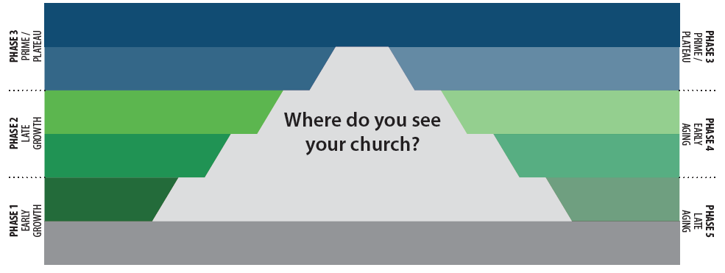
LIFE CYCLE STAGES OF A CHURCH
Birth (Vrpm)
GROWTH
V – Vision
R – Relationships
P – Programs
M – Management

Slide 28
LIFE CYCLE STAGES OF A CHURCH
Infancy (VRpm)
Birth (Vrpm)
GROWTH
V – Vision
R – Relationships
P – Programs
M – Management

Slide 29
LIFE CYCLE STAGES OF A CHURCH
Childhood (VrPm)
Infancy (VRpm)
Birth (Vrpm)
GROWTH
V – Vision
R – Relationships
P – Programs
M – Management

Slide 30
LIFE CYCLE STAGES OF A CHURCH
Adolescence (VRPm)
Childhood (VrPm)
Infancy (VRpm)
Birth (Vrpm)
GROWTH
V – Vision
R – Relationships
P – Programs
M – Management

Slide 31
LIFE CYCLE STAGES OF A CHURCH
Adulthood (VRPM)
Adolescence (VRPm)
Childhood (VrPm)
Infancy (VRpm)
Birth (Vrpm)
GROWTH
V – Vision
R – Relationships
P – Programs
M – Management

Slide 32
LIFE CYCLE STAGES OF A CHURCH
Prime
Adulthood (VRPM)
Adolescence (VRPm)
Childhood (VrPm)
Infancy (VRpm)
Birth (Vrpm)
GROWTH
V – Vision
R – Relationships
P – Programs
M – Management

Slide 33
LIFE CYCLE STAGES OF A CHURCH
Prime
Adulthood (VRPM)
Maturity (vRPM)
Adolescence (VRPm)
Childhood (VrPm)
Infancy (VRpm)
Birth (Vrpm)
GROWTH
V – Vision
R – Relationships
P – Programs
M – Management

Slide 34
LIFE CYCLE STAGES OF A CHURCH
Prime
Adulthood (VRPM)
Maturity (vRPM)
Adolescence (VRPm)
Empty Nest (vRpM)
Childhood (VrPm)
Infancy (VRpm)
Birth (Vrpm)
GROWTH
V – Vision
R – Relationships
P – Programs
M – Management

Slide 35
LIFE CYCLE STAGES OF A CHURCH
Prime
Adulthood (VRPM)
Maturity (vRPM)
Adolescence (VRPm)
Empty Nest (vRpM)
Childhood (VrPm)
Retirement (vrPM)
Infancy (VRpm)
Birth (Vrpm)
GROWTH
V – Vision
R – Relationships
P – Programs
M – Management

Slide 36
LIFE CYCLE STAGES OF A CHURCH
Prime
Adulthood (VRPM)
Maturity (vRPM)
Adolescence (VRPm)
Empty Nest (vRpM)
Childhood (VrPm)
Retirement (vrPM)
Infancy (VRpm)
Old Age (vrpM)
Birth (Vrpm)
GROWTH
V – Vision
R – Relationships
P – Programs
M – Management

Slide 37
LIFE CYCLE STAGES OF A CHURCH
Prime
Adulthood (VRPM)
Maturity (vRPM)
Adolescence (VRPm)
Empty Nest (vRpM)
Childhood (VrPm)
Retirement (vrPM)
Infancy (VRpm)
Old Age (vrpM)
Birth (Vrpm)
Death (---m)
GROWTH
V – Vision
R – Relationships
P – Programs
M – Management

Slide 38
ASSESSING CURRENT REALITY
ROW 1 | Positive, supportive attitude Vision is always in focus and the highest priority High commitment level | Strong sense of mission and purpose among every member High level of “ownership” Everybody is finding their place | High visibility and understanding of mission and vision Ministries share a common purpose Ministry leaders feel well trained for their assignments | Clarity of mission and vision seems in decline New members do not sense church’s purpose Focus has shifted to the needs and likes of members | Mission / Vision are unclear We’re looking for that “magic bullet” that can turn things around We talk more about the “good old days” than about our hopes or plans for the future
ROW 2 | Mutual dependency requires everyone to be involved or leave Nearly all members are actively serving Strong sense of team throughout | High percentage of individuals’ time and identity committed to the church Volunteers are easy to find Lots of congregational energy | New members quickly find a place to become involved Good level of enthusiasm among membership for participation Clear system for discovering my gifts | Some members assume others can get the job done More paid staff hired to lead or do ministry Original members feel “We have done our part.” | Programs eliminated for lack of participation Difficult to find volunteers Seems like10 percent of members do 90 percent of work
ROW 3 | Minimal organization Communication is very strong—everyone knows what and why of all we do Spontaneity in decision making | The “why” of ministry always determines the “how” Structure is fluid and created in response to needs Meaningful traditions are beginning to form | New programs created to respond to new needs Delegation of leadership responsibility is evident New roles and responsibilities have been created | Few new programs added The “how” of ministry has become more important than the “why” We’re a bit too busy to consider new ideas | Programs eliminated due to lack of leaders or funds Very few new ministries but more focus on those we’ve been doing for several years Primary goal is preservation/survival
ROW 4 | Members are receptive to new ideas Objectives are quickly accomplished Everything we do aligns with mission/vision | Change is easily adopted and integrated Suggestions from all levels of membership It seems we’re getting better at everything we do | New proposals given serious consideration Church leaders responsible for initiating and implementing A team of leaders makes most decisions | Few changes proposed Few changes considered that radically depart from status quo Most people prefer to keep things the same | “We’ve never done it that way before” Rationalizations often made for why things can’t be done Many think we can’t do some of the things other churches do
ROW 5 | Morale is high People are finding great value in their participation Solutions to conflict seem easy to find | Morale is higher Lots of energy and ideas Everyone pulls together to help us be successful | Morale is highest Our greatest goals are being achieved Confidence is contagious that goals can be reached | Insiders don’t always share everything with everyone else People are getting weary in their ministry efforts Commitment levels declining | People attend more out of habit than expectation Most efforts aren’t as strong as they once were Most of our efforts feel like a struggle
TOTAL

Slide 39
EXAMPLE
ROW 1 | Positive, supportive attitude Vision is always in focus and the highest priority High commitment level | Strong sense of mission and purpose among every member High level of “ownership” Everybody is finding their place | High visibility and understanding of mission and vision Ministries share a common purpose Ministry leaders feel well trained for their assignments | Clarity of mission and vision seems in decline New members do not sense church’s purpose Focus has shifted to the needs and likes of members | Mission / Vision are unclear We’re looking for that “magic bullet” that can turn things around We talk more about the “good old days” than about our hopes or plans for the future
ROW 2 | Mutual dependency requires everyone to be involved or leave Nearly all members are actively serving Strong sense of team throughout | High percentage of individuals’ time and identity committed to the church Volunteers are easy to find Lots of congregational energy | New members quickly find a place to become involved Good level of enthusiasm among membership for participation Clear system for discovering my gifts | Some members assume others can get the job done More paid staff hired to lead or do ministry Original members feel “We have done our part.” | Programs eliminated for lack of participation Difficult to find volunteers Seems like10 percent of members do 90 percent of work
ROW 3 | Minimal organization Communication is very strong—everyone knows what and why of all we do Spontaneity in decision making | The “why” of ministry always determines the “how” Structure is fluid and created in response to needs Meaningful traditions are beginning to form | New programs created to respond to new needs Delegation of leadership responsibility is evident New roles and responsibilities have been created | Few new programs added The “how” of ministry has become more important than the “why” We’re a bit too busy to consider new ideas | Programs eliminated due to lack of leaders or funds Very few new ministries but more focus on those we’ve been doing for several years Primary goal is preservation/survival
ROW 4 | Members are receptive to new ideas Objectives are quickly accomplished Everything we do aligns with mission/vision | Change is easily adopted and integrated Suggestions from all levels of membership It seems we’re getting better at everything we do | New proposals given serious consideration Church leaders responsible for initiating and implementing A team of leaders makes most decisions | Few changes proposed Few changes considered that radically depart from status quo Most people prefer to keep things the same | “We’ve never done it that way before” Rationalizations often made for why things can’t be done Many think we can’t do some of the things other churches do
ROW 5 | Morale is high People are finding great value in their participation Solutions to conflict seem easy to find | Morale is higher Lots of energy and ideas Everyone pulls together to help us be successful | Morale is highest Our greatest goals are being achieved Confidence is contagious that goals can be reached | Insiders don’t always share everything with everyone else People are getting weary in their ministry efforts Commitment levels declining | People attend more out of habit than expectation Most efforts aren’t as strong as they once were Most of our efforts feel like a struggle
TOTAL | 2 | 1 | 0 | 4 | 3

Slide 40
LIFE CYCLE STAGES OF A CHURCH
Prime
Adulthood (VRPM)
Maturity (vRPM)
Adolescence (VRPm)
Empty Nest (vRpM)
Childhood (VrPm)
Retirement (vrPM)
Infancy (VRpm)
Old Age (vrpM)
Birth (Vrpm)
Death (---m)
GROWTH
V – Vision
R – Relationships
P – Programs
M – Management

Slide 41
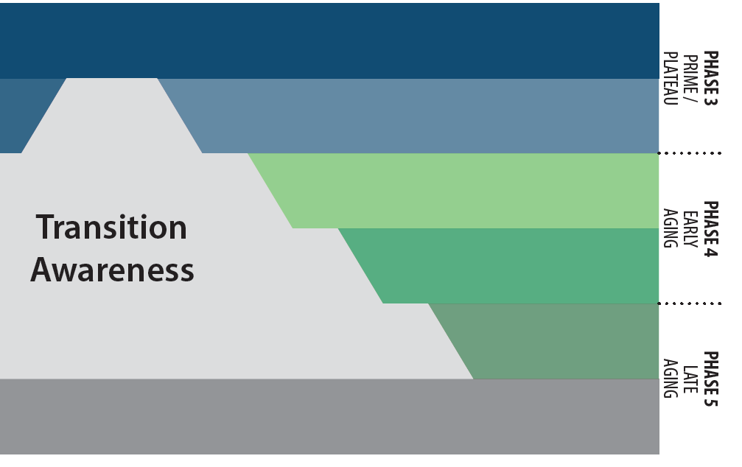
LIFE CYCLE STAGES OF A CHURCH
Leaders casting vision
GROWTH

Slide 42
LIFE CYCLE STAGES OF A CHURCH
Leaders casting vision
Vision casting before need-oriented programs
GROWTH

Slide 43
LIFE CYCLE STAGES OF A CHURCH
Leaders casting vision
Vision casting before need-oriented programs
Mandatory change process
GROWTH

Slide 44
LIFE CYCLE STAGES OF A CHURCH
Leaders casting vision
Vision casting before need-oriented programs
Mandatory change process
External assessment required
GROWTH

Slide 45
LIFE CYCLE STAGES OF A CHURCH
You are HERE

Slide 46
LIFE CYCLE STAGES OF A CHURCH
You are being
called to THERE
You are HERE

Slide 47
LIFE CYCLE STAGES OF A CHURCH
Leap of Faith
You are being
called to THERE
You are HERE

Slide 48
LIFE CYCLE STAGES OF A CHURCH
Leap of Faith
Bridge of Hope
You are being
called to THERE
You are HERE

Slide 49
Ten Questions
Today, we’ll address the first two of the ten questions:
Why do we exist?
Where are we going?

Slide 50
Mission
The Great Commission focuses on the belief system which Christ taught.

Slide 51
Mission
The Great Commission focuses on the belief system which Christ taught.
The Great Commandment focuses on the behavior system which Christ modeled.

Slide 52
Mission
The church’s mission…
Provides long-term direction and stability for the local church.

Slide 53
Mission
The church’s mission…
Provides long-term direction and stability for the local church.
Declares the church’s understanding of biblical principles that shape beliefs and actions.

Slide 54
Mission
The church’s mission…
Provides long-term direction and stability for the local church.
Declares the church’s understanding of biblical principles that shape beliefs and actions.
Captures the heart of Christ as it pertains to our actions toward all people.

Slide 55
Vision
“Vision is the best manifestation of creative imagination and the primary motivation of human action. It’s the ability to see beyond our present reality, to create, to invent what does not yet exist, to become what we not yet are. It gives us capacity to live out our imagination instead of our memory.”
—Stephen Covey, Roger Merrill, Rebecca Merrill, First Things First: To Live, to Love, to Learn, to Leave a Legacy

Slide 56
Vision
Vision is the ability to courageously explore possibilities.

Slide 57
Vision
Vision is the ability to courageously explore possibilities.
Vision understands who we are and what we are uniquely designed to do.

Slide 58
Vision
Vision is the ability to courageously explore possibilities.
Vision understands who we are and what we are uniquely designed to do.
Vision answers, “Where are we going?” and “Why are we doing it?”

Slide 59
Vision
Vision is the ability to imagine life beyond present boundaries.

Slide 60
Vision
Vision is the ability to imagine life beyond present boundaries.
Vision is based on truth, but it transcends current reality.

Slide 61
Vision
Vision is the ability to imagine life beyond present boundaries.
Vision is based on truth, but it transcends current reality.
Vision unites people around a common plan.

Slide 62
Vision
Vision is the ability to imagine life beyond present boundaries.
Vision is based on truth, but it transcends current reality.
Vision unites people around a common plan.
Vision gives people clear focus on an intended destination.

Slide 63
Vision
Vision always entails change.

Slide 64
Vision
Vision always entails change.
Vision involves risk and invites criticism.

Slide 65
Vision
Vision always entails change.
Vision involves risk and invites criticism.
Vision pushes against the status quo.

Slide 66
Vision
Vision always entails change.
Vision involves risk and invites criticism.
Vision pushes against the status quo.
Vision is memorable, inspiring, ambitious, and relevant.

Slide 67
Vision
Vision always entails change.
Vision involves risk and invites criticism.
Vision pushes against the status quo.
Vision is memorable, inspiring, ambitious, and relevant.
Vision is bigger than your ability to achieve.

Slide 68
The Road to Biblical Vision
DIRECTION

Slide 69
The Road to Biblical Vision
DIRECTION
+ PACE

Slide 70
The Road to Biblical Vision
DIRECTION
+ PACE
+ PRICE

Slide 71
The Road to Biblical Vision
DIRECTION
+ PACE
+ PRICE
BIBLICAL VISION

Slide 72
What distinguishes a good idea from a God-inspired vision?
A good idea… A God-inspired vision…
Provides a solution to a current problem Provides a legacy for generations to come

Slide 73
What distinguishes a good idea from a God-inspired vision?
A good idea… A God-inspired vision…
Provides a solution to a current problem Provides a legacy for generations to come
▪ Can come from someone else’s story Flows out of God’s unique plan for my life.

Slide 74
What distinguishes a good idea from a God-inspired vision?
A good idea… A God-inspired vision…
Provides a solution to a current problem Provides a legacy for generations to come
▪ Can come from someone else’s story Flows out of God’s unique plan for my life.
▪ Is based on personal experience Has scriptural references.

Slide 75
What distinguishes a good idea from a God-inspired vision?
A good idea… A God-inspired vision…
Provides a solution to a current problem Provides a legacy for generations to come
▪ Can come from someone else’s story Flows out of God’s unique plan for my life.
▪ Is based on personal experience Has scriptural references.
▪ Is limited by human ability Is limitless because of God’s sovereignty

Slide 76
What distinguishes a good idea from a God-inspired vision?
A good idea… A God-inspired vision…
Provides a solution to a current problem Provides a legacy for generations to come
▪ Can come from someone else’s story Flows out of God’s unique plan for my life.
▪ Is based on personal experience Has scriptural references.
▪ Is limited by human ability Is limitless because of God’s sovereignty
▪ Is self-serving Serves the needs of others

Slide 77
What distinguishes a good idea from a God-inspired vision?
A good idea… A God-inspired vision…
Provides a solution to a current problem Provides a legacy for generations to come
▪ Can come from someone else’s story Flows out of God’s unique plan for my life.
▪ Is based on personal experience Has scriptural references.
▪ Is limited by human ability Is limitless because of God’s sovereignty
▪ Is self-serving Serves the needs of others
▪ Is exclusive Makes room for others

Slide 78
What distinguishes a good idea from a God-inspired vision?
A good idea… A God-inspired vision…
Provides a solution to a current problem Provides a legacy for generations to come
▪ Can come from someone else’s story Flows out of God’s unique plan for my life.
▪ Is based on personal experience Has scriptural references.
▪ Is limited by human ability Is limitless because of God’s sovereignty
▪ Is self-serving Serves the needs of others
▪ Is exclusive Makes room for others
▪ Is goal-oriented Is people-oriented

Slide 79
What distinguishes a good idea from a God-inspired vision?
A good idea… A God-inspired vision…
Provides a solution to a current problem Provides a legacy for generations to come
▪ Can come from someone else’s story Flows out of God’s unique plan for my life.
▪ Is based on personal experience Has scriptural references.
▪ Is limited by human ability Is limitless because of God’s sovereignty
▪ Is self-serving Serves the needs of others
▪ Is exclusive Makes room for others
▪ Is goal-oriented Is people-oriented
▪ Expresses a personal desire Expresses a shared hope

Slide 80
Imagine a 21st-Century Church that…
Received the Holy Spirit willingly

Slide 81
Imagine a 21st-Century Church that…
Received the Holy Spirit willingly
Demonstrated power supernaturally

Slide 82
Imagine a 21st-Century Church that…
Received the Holy Spirit willingly
Demonstrated power supernaturally
Was led effectively

Slide 83
Imagine a 21st-Century Church that…
Received the Holy Spirit willingly
Demonstrated power supernaturally
Was led effectively
Prayed fervently

Slide 84
Imagine a 21st-Century Church that…
Received the Holy Spirit willingly
Demonstrated power supernaturally
Was led effectively
Prayed fervently
Fellowshipped regularly

Slide 85
Imagine a 21st-Century Church that…
Received the Holy Spirit willingly
Demonstrated power supernaturally
Was led effectively
Prayed fervently
Fellowshipped regularly
Taught sound doctrine consistently

Slide 86
Imagine a 21st-Century Church that…
Received the Holy Spirit willingly
Demonstrated power supernaturally
Was led effectively
Prayed fervently
Fellowshipped regularly
Taught sound doctrine consistently
Preached the Gospel passionately

Slide 87
Imagine a 21st-Century Church that…
Received the Holy Spirit willingly
Demonstrated power supernaturally
Was led effectively
Prayed fervently
Fellowshipped regularly
Taught sound doctrine consistently
Preached the Gospel passionately
Shared resources liberally

Slide 88
Imagine a 21st-Century Church that…
Received the Holy Spirit willingly
Demonstrated power supernaturally
Was led effectively
Prayed fervently
Fellowshipped regularly
Taught sound doctrine consistently
Preached the Gospel passionately
Shared resources liberally
Grew exponentially.

Slide 89
Homework assignment
 | 1st-Century Church | 4th Century Onward | Our Church
Lord’s Supper | Common Meal | Ceremony
Worship | Participation | Observation
Witness | Relationship | Salesmanship
Ministry | Personal | Social
Leadership | Gifted, Called Servants | Professionals
Growth | Multiplication | Addition
Mission | Being | Supporting Missionaries
Discipleship | On-the-Job | Classroom Training
Fellowship | Community Living | Large Meetings
Body Life | Lifestyle | Membership
Gifts | Widespread Use | Limited Use
Empowerment | God’s Power | Human Ability
Buildings | Functional | Sacred Meeting Places
Membership | Producer | Consumer
Child Care | Parental Responsibility | Church Responsibility
Bible Study | Doers of the Word | Hearers of the Word
Evangelism | “Go” Structures | “Come” Structures

Slide 90
The Power of
Your Story

Slide 91
The Power of Your Story
You should have the ability to share your story in less than three minutes.
Your story is an important part of your church’s overall strategic plan.
Names don’t build churches; stories do.

Slide 92
Developing Vision
“Where there is no vision,
the people perish”
(Proverbs 29:18, KJV).

Slide 93
Creating the Overarching Vision
The vision statement should be clearly understood by all who hear it and provide direction for our future.

Slide 94
Information Gathering for Casting Vision
Acts 2:42-47
What should the church be doing?
Fellowship (CONNECT)
Discipleship (GROW)
Gift-Oriented Ministry (SERVE)
Evangelism (GO)
WORSHIP

Slide 95
Information Gathering for Casting Vision
“These five activities . . . constitute the business or purpose of the church. It is what a biblically functioning community looks like. It is what the church does.”
—James Emery White, Rethinking the Church: A Challenge to Creative Redesign in an Age of Transition

Slide 96
Biblical Functions Assessment
Biblical Function: Worship | 1 Not at all | 2 Rarely | 3 Sometimes | 4 Often | 5 Very Often
Our worship is Spirit-empowered and reflects a sense of reverence for God in His holiness. | 1
Our worship supports the spiritual growth of our congregation and inspires us to live out our faith in the world. |  |  | 3
We regularly engage in individual and corporate prayer. |  |  |  | 4
Total: ________ Average: ________

Slide 97
Keys to Developing a God-Inspired Vision
I dream of a church where…

Slide 98
Examples of Finalized Dream Statements
I dream of a church where fellowship is an expression of God’s love demonstrated in life-giving relationships that are multi-generational, forgiving, inviting, and fun.
I dream of a church where worship is an authentic, Spirit-filled lifestyle that is biblical, intimate, relevant, and life-changing.
I dream of a church where discipleship is mentoring, training, and equipping believers through the Word of God to be mature disciples who in turn disciple others.
I dream of a church where evangelism is a lifestyle that reveals God’s love and demonstrates compassion to people through the empowerment of the Holy Spirit.
I dream of a church where every believer has discovered their spiritual gifts and confidently exercises them to demonstrate God’s love.

Slide 99
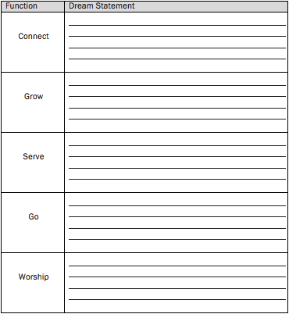
Discovering the Dreamscape for the Vision

Slide 100
Creating the Vision Statement
Your vision statement should address three areas:
Vertical to God
Horizontal to the church
Horizontal to the lost

Slide 101
Sample Vision Statements
“Love God, Love People, Share Hope”
“Honor God, Live the Faith, Reach the World.”
“Love God, Live the Life, Share Christ”

Slide 102
Group Assignments
As a group, join together in 13 Weeks of Prayer.
Bring your “I dream of a church” statements for the five functions of the church to Retreat 2.
Bring your vision statement to Retreat 2.
Read and discuss chapters 1-9 in A Spirit-Empowered Church: An Acts 2 Ministry Model

