Slide 1


Guiding Change
in the
Local Church

Slide 2


BUT…CHANGE IS HARD
5
REASONS PEOPLE ARE AT YOUR CHURCH

Slide 3
BUT…CHANGE IS HARD
5
PLACE
REASONS PEOPLE ARE AT YOUR CHURCH

Slide 4
BUT…CHANGE IS HARD
5
PLACE
PERSONALITY
REASONS PEOPLE ARE AT YOUR CHURCH

Slide 5
BUT…CHANGE IS HARD
5
PLACE
PERSONALITY
PROGRAMS
REASONS PEOPLE ARE AT YOUR CHURCH

Slide 6
BUT…CHANGE IS HARD
5
PLACE
PERSONALITY
PROGRAMS
PEOPLE
REASONS PEOPLE ARE AT YOUR CHURCH

Slide 7
BUT…CHANGE IS HARD
5
PLACE
PERSONALITY
PROGRAMS
PEOPLE
POSITION
REASONS PEOPLE ARE AT YOUR CHURCH

Slide 8
COVID ATTACKED EVERY REASON!
5
COVID kept me from the PLACE.
COVID separated me from that PERSONALITY.
COVID shut down my PROGRAM.
COVID quarantined me from PEOPLE.
COVID made my POSITION unnecessary.
REASONS
PEOPLE ARE AT YOUR CHURCH
Special thanks to Rev. Herbert Peak, Bristol, TN for this insight.

Slide 9
BUT…CHANGE IS HARD
1
ONLY REASON PEOPLE WILL SUPPORT CHANGE

Slide 10
BUT…CHANGE IS HARD
1
PURPOSE!
ONLY REASON PEOPLE WILL SUPPORT CHANGE

Slide 11
4 CRITICAL QUESTIONS
Do we know we need to change?

Slide 12
4 CRITICAL QUESTIONS
Do we know we need to change?
Are we willing to change?

Slide 13
4 CRITICAL QUESTIONS
Do we know we need to change?
Are we willing to change?
Do we know how to change?

Slide 14
4 CRITICAL QUESTIONS
Do we know we need to change?
Are we willing to change?
Do we know how to change?
Are we willing to do that?

Slide 15
“The real world is a world of chaos. Culture is changing so quickly, with so much diversity, in so many simultaneous directions, and using so many learning methods, that church groups organized around traditional principles can’t keep up. They find themselves spending more and more energy lamenting change, resisting change, struggling with change, expressing anger about change, desperately trying to ‘manage’ change, or just plain ‘surviving’ change. Change, however, will not go away. It is relentless – and accelerating.”
Thomas G. Bandy. Christian Chaos. Page 11

Slide 16
WHY PEOPLE RESIST CHANGE¹
Loss of security
¹ Portions of “Guiding Change in the Local Church” have been adapted from “Leading in Times of Change,”
Leadership Development Resources, LLC.

Slide 17
WHY PEOPLE RESIST CHANGE¹
Loss of security
Threatened personal status or position
¹ Portions of “Guiding Change in the Local Church” have been adapted from “Leading in Times of Change,”
Leadership Development Resources, LLC.

Slide 18
WHY PEOPLE RESIST CHANGE¹
Loss of security
Threatened personal status or position
Implied criticism of the past or present
¹ Portions of “Guiding Change in the Local Church” have been adapted from “Leading in Times of Change,”
Leadership Development Resources, LLC.

Slide 19
WHY PEOPLE RESIST CHANGE¹
Loss of security
Threatened personal status or position
Implied criticism of the past or present
Additional work
¹ Portions of “Guiding Change in the Local Church” have been adapted from “Leading in Times of Change,”
Leadership Development Resources, LLC.

Slide 20
WHY PEOPLE RESIST CHANGE¹
Loss of security
Threatened personal status or position
Implied criticism of the past or present
Additional work
Seems unnecessary or unhelpful
¹ Portions of “Guiding Change in the Local Church” have been adapted from “Leading in Times of Change,”
Leadership Development Resources, LLC.

Slide 21

3 STEPS FOR
INITIATING CHANGE
Explore the true urgency.

Slide 22
3 STEPS FOR
INITIATING CHANGE
Explore the true urgency.
Missional urgency is better than survival urgency.

Slide 23
3 STEPS FOR
INITIATING CHANGE
SURVIVAL URGENCY “We must or we close our doors” | MISSIONAL URGENCY “We must: we’re not fulfilling the mission”
Attendance in decline Church finances diminishing Key leaders have left Conflict is dividing us We have to change for the sake of the church! | Families in crisis in our community A people group we’re not reaching Concern for high school students People are hurting all around us We have to change for the sake of the lost!

Slide 24
3 STEPS FOR
INITIATING CHANGE
Explore the true urgency.
Missional urgency is better than survival urgency.
Your passion for the urgency is the single biggest
reason your team will accept change.

Slide 25
3 STEPS FOR
INITIATING CHANGE
Explore the true urgency.
Missional urgency is better than survival urgency.
Your passion for the urgency is the single biggest
reason your team will accept change.
Build the right team.

Slide 26
3 STEPS FOR
INITIATING CHANGE
Explore the true urgency.
Missional urgency is better than survival urgency.
Your passion for the urgency is the single biggest
reason your team will accept change.
Build the right team.
People who care, dream, believe, think

Slide 27
3 STEPS FOR
INITIATING CHANGE
Ask the best questions.

Slide 28
3 STEPS FOR
INITIATING CHANGE
Ask the best questions.
What is our vision?

Slide 29
3 STEPS FOR
INITIATING CHANGE
Ask the best questions.
What is our vision?
To fulfill our vision, what must our priorities be?

Slide 30
3 STEPS FOR
INITIATING CHANGE
Ask the best questions.
What is our vision?
To fulfill our vision, what must our priorities be?
What steps will we take to fulfill our vision?

Slide 31
3 STEPS FOR
INITIATING CHANGE
Ask the best questions.
What is our vision?
To fulfill our vision, what must our priorities be?
What steps will we take to fulfill our vision?
What should we continue doing?

Slide 32
3 STEPS FOR
INITIATING CHANGE
Ask the best questions.
What is our vision?
To fulfill our vision, what must our priorities be?
What steps will we take to fulfill our vision?
What should we continue doing?
What should we do differently?

Slide 33
3 STEPS FOR
INITIATING CHANGE
Ask the best questions.
What is our vision?
To fulfill our vision, what must our priorities be?
What steps will we take to fulfill our vision?
What should we continue doing?
What should we do differently?
What should we stop doing?

Slide 34
3 STEPS FOR
INITIATING CHANGE
Ask the best questions.
What is our vision?
To fulfill our vision, what must our priorities be?
What steps will we take to fulfill our vision?
What should we continue doing?
What should we do differently?
What should we stop doing?
When will we start?

Slide 35
MOSES’ AMAZING CHANGE JOURNEY
Life in the front of Moses’ journey:

Slide 36
MOSES’ AMAZING CHANGE JOURNEY
Life in the front of Moses’ journey: ~ 20%
They saw Moses and the other leaders frequently.
They received their information directly from Moses himself.
The journey and the destination felt exciting.
They imagined their destination might be just over the next sand dune.
They moved whenever Moses said, “Let’s go!”

Slide 37
MOSES’ AMAZING CHANGE JOURNEY
Life in the middle of Moses’ journey:

Slide 38
MOSES’ AMAZING CHANGE JOURNEY
Life in the middle of Moses’ journey: ~ 60%
They seldom have direct interaction with Moses and the other leaders.
Their information was passed along from others.
The journey felt longer and success often seemed less certain as they trudged through the footprints left by others.
Each day, this group knew the destination hadn’t yet been reached by those up front with Moses.
These wait to move until they see others moving and seeming to be successful as they do.

Slide 39
MOSES’ AMAZING CHANGE JOURNEY
Life at the back of Moses’ journey:

Slide 40
MOSES’ AMAZING CHANGE JOURNEY
Life at the back of Moses’ journey: ~ 15%
They have virtually no interaction with Moses and the other leaders.
Their information was passed along from others who got it from others, who also got it from others.
There are days when the journey back to where we came from is tempting and looks easier.
This group wonders if there is a Promised Land and if there will be a place for them if we get there.
These typically don’t move until they’re afraid they’ll be left in the desert if they don’t move.

Slide 41
MOSES’ AMAZING CHANGE JOURNEY
Those who rejected Moses’ journey

Slide 42
MOSES’ AMAZING CHANGE JOURNEY
Those who rejected Moses’ journey ~ 5%
They wanted to go another way and separated themselves from Moses and the people of Israel
Without vision, people perish…
In Hebrew, the word translated perish can also mean scattered. When people lack direction and scatter in the desert, they die!

Slide 43
MOSES’ AMAZING CHANGE JOURNEY
Early Adopters – 20%
Mid Adopters – 60%
Late Adopters – 15%
Non Adopters – 5%

Slide 44
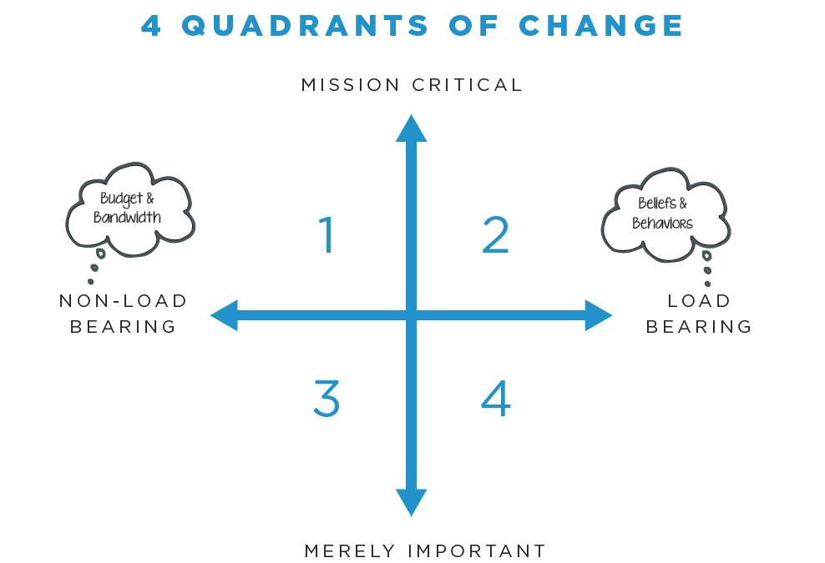

Slide 45
