Slide 1

Welcome to St. Mary’s Academy Pre-K – Grade 8
Open House
January 25, 2025
Virtual

Slide 2
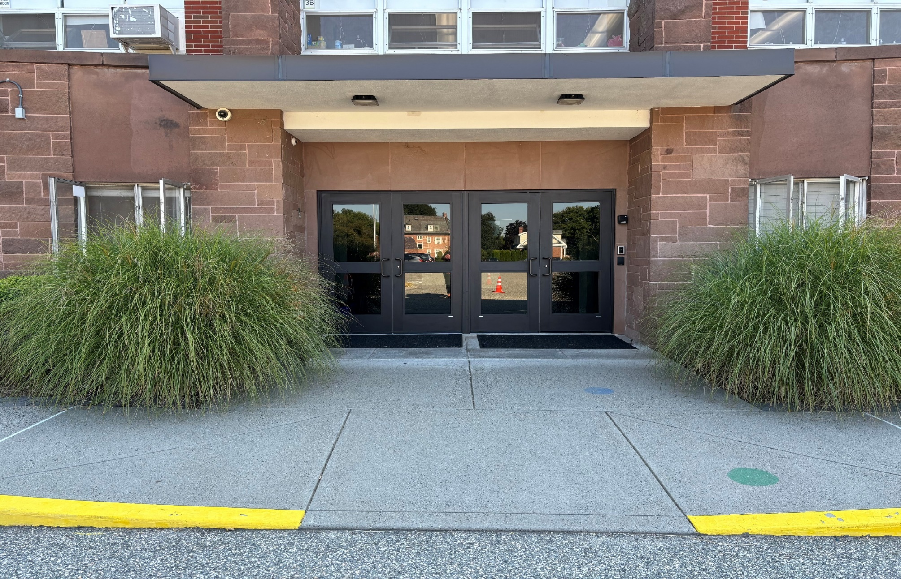
We are pleased with the many new security improvements installed in 2025 to ensure the safety of our students and staff.

Slide 3

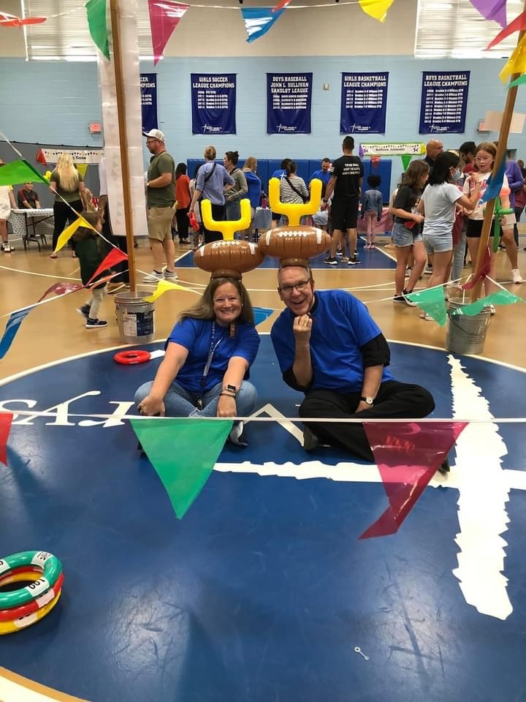
Carnival to welcome all of our new and returning students is held each year before school starts.

Slide 4
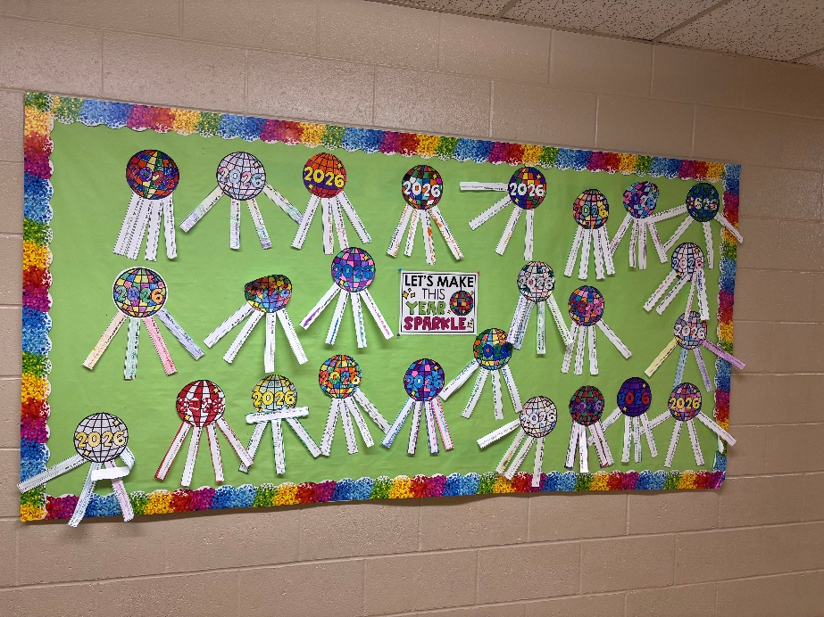
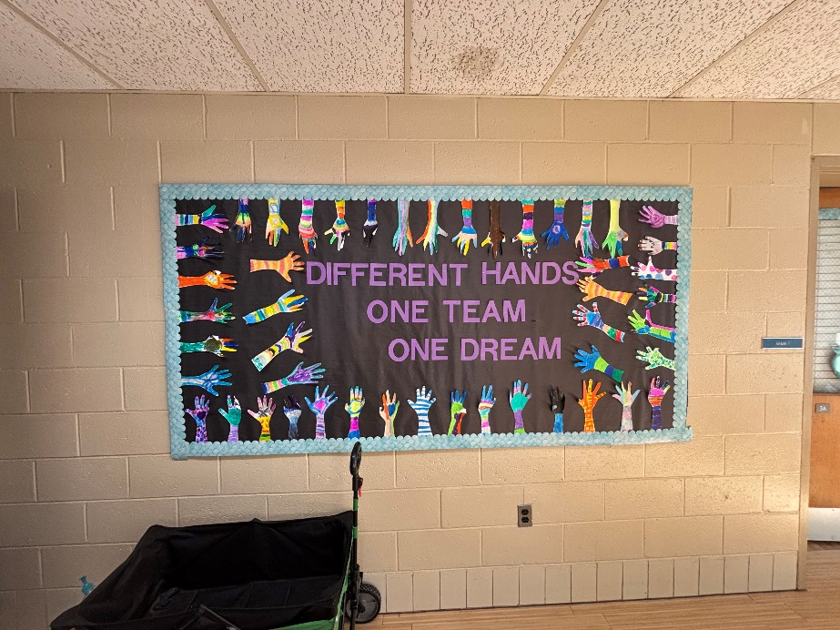
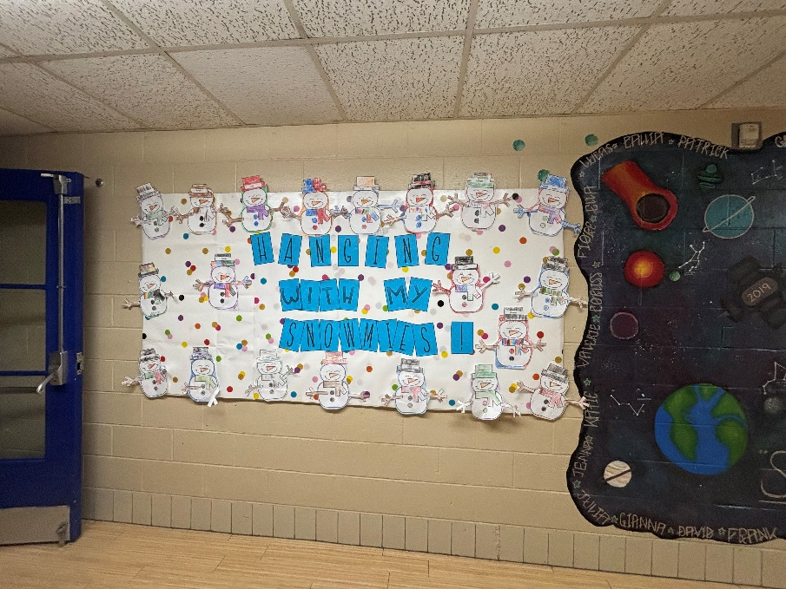
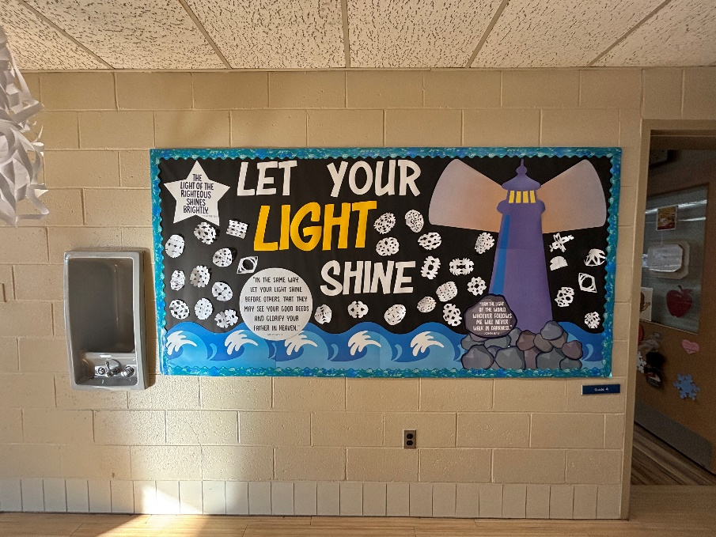
Our halls are festive with the many amazing bulletin boards outside of each room

Slide 5


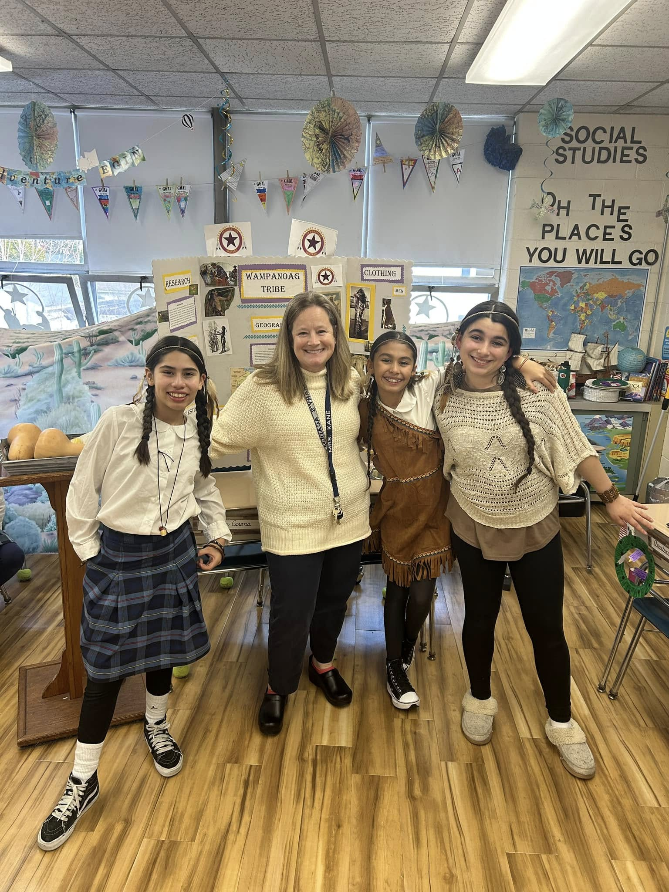
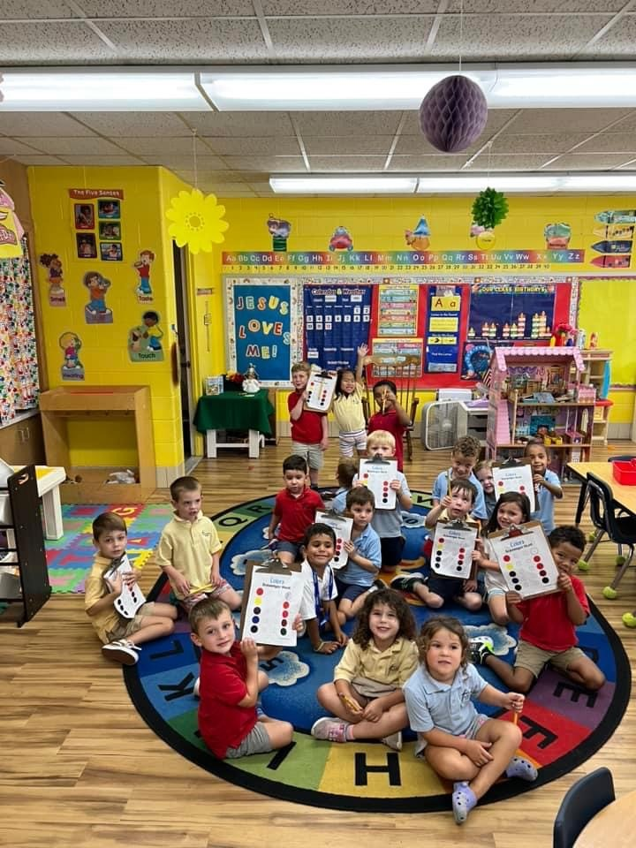
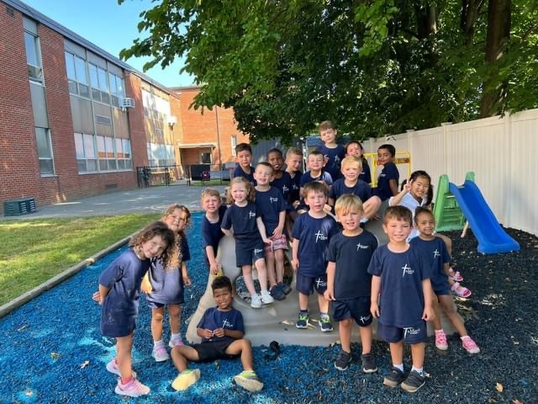
Friends

Slide 6
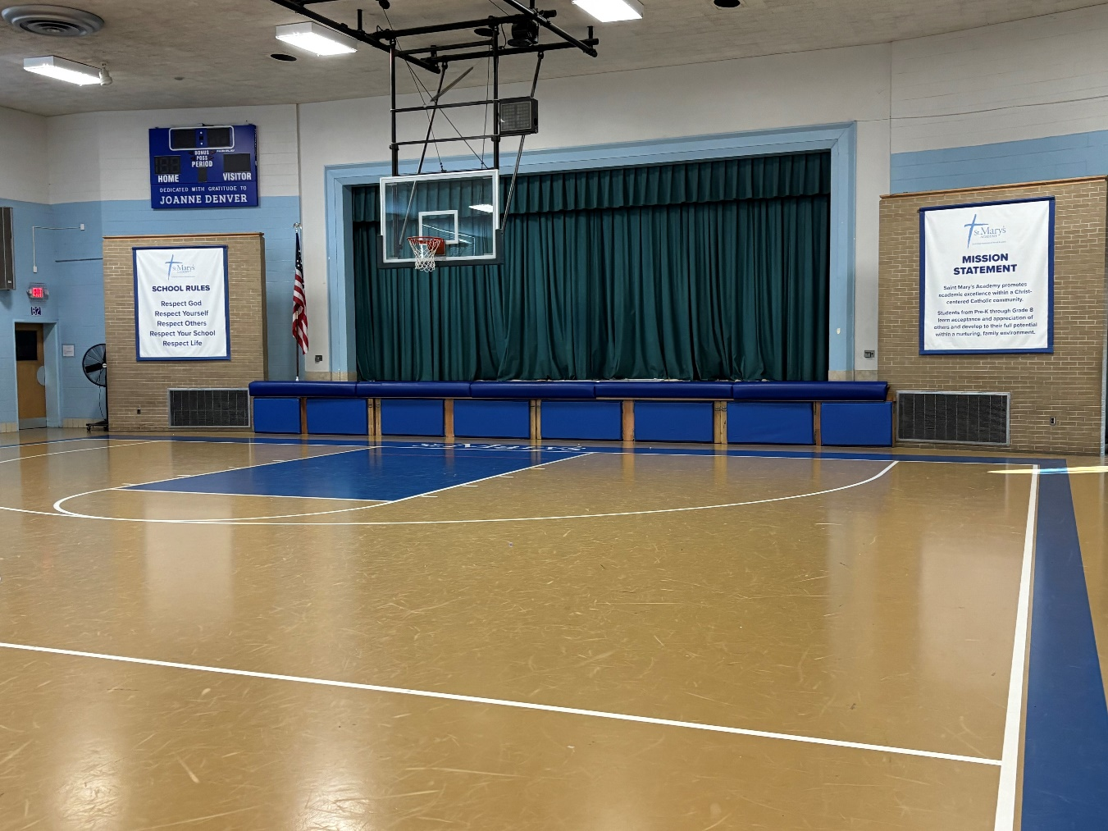
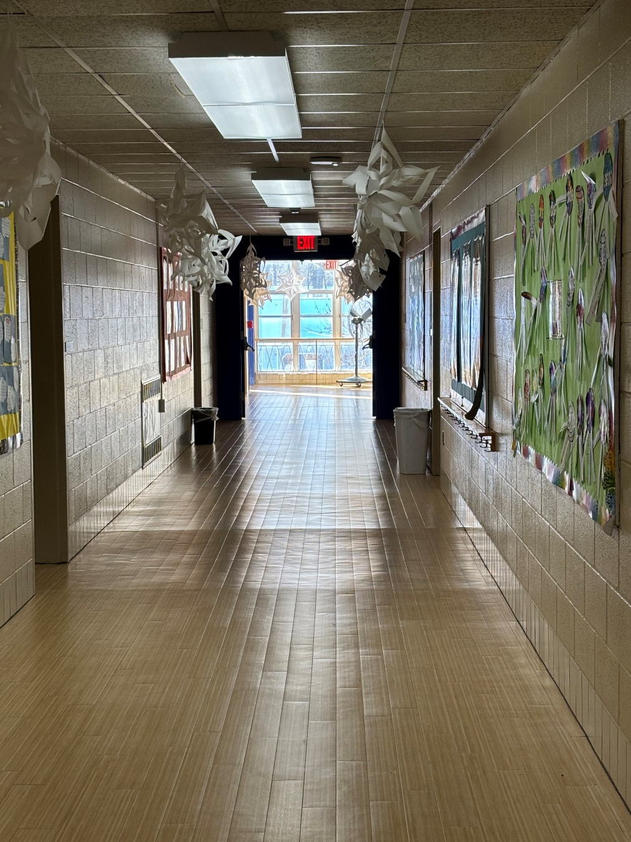
Nice Bright Hallways
Our Gym serves as not only the gym but the cafeteria, after school area, gathering for morning prayer.

Slide 7
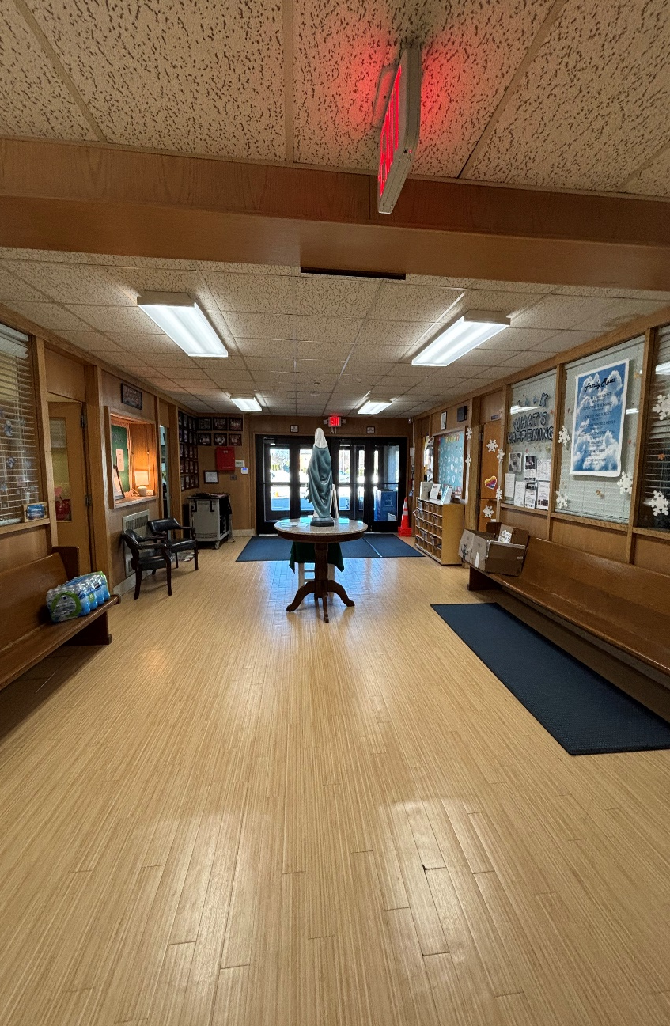
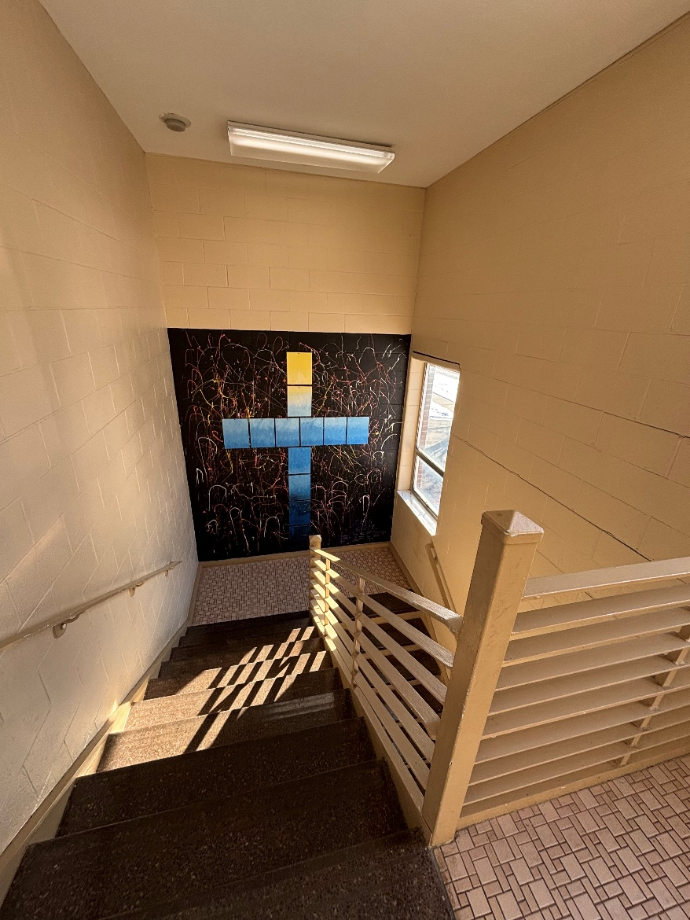
In this stair well you can find on of the many Grade 8 Mural’s that can be found around the school.
Bright and airy entrance and stairwells .

Slide 8
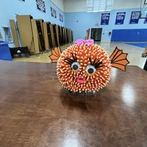
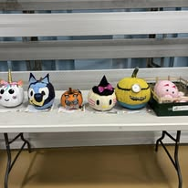
Pumpkin Contest Fun

Slide 9
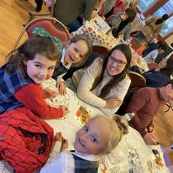
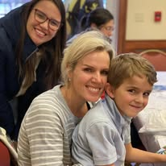
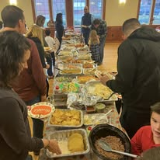
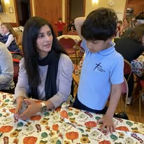
Kindergarten Cultural Day Lunch

Slide 10
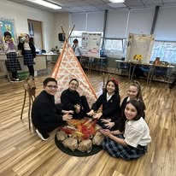
Native American Exhibit

Slide 11
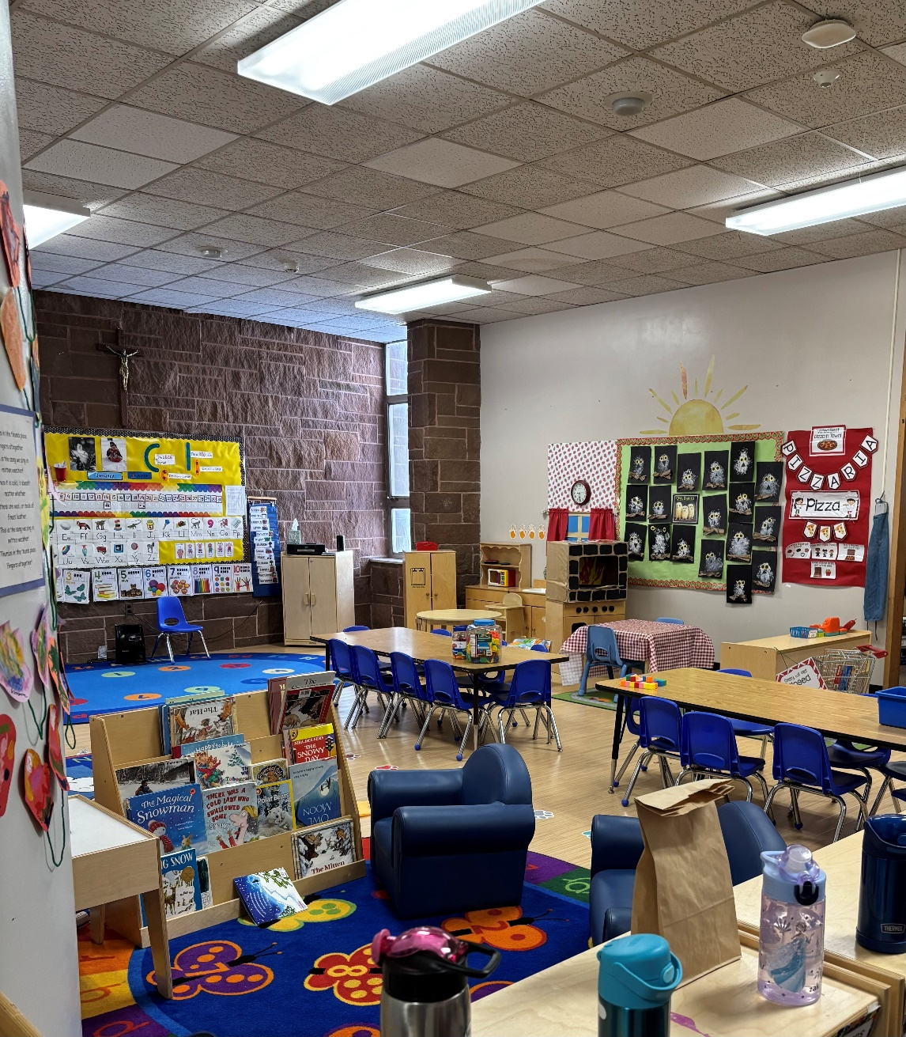
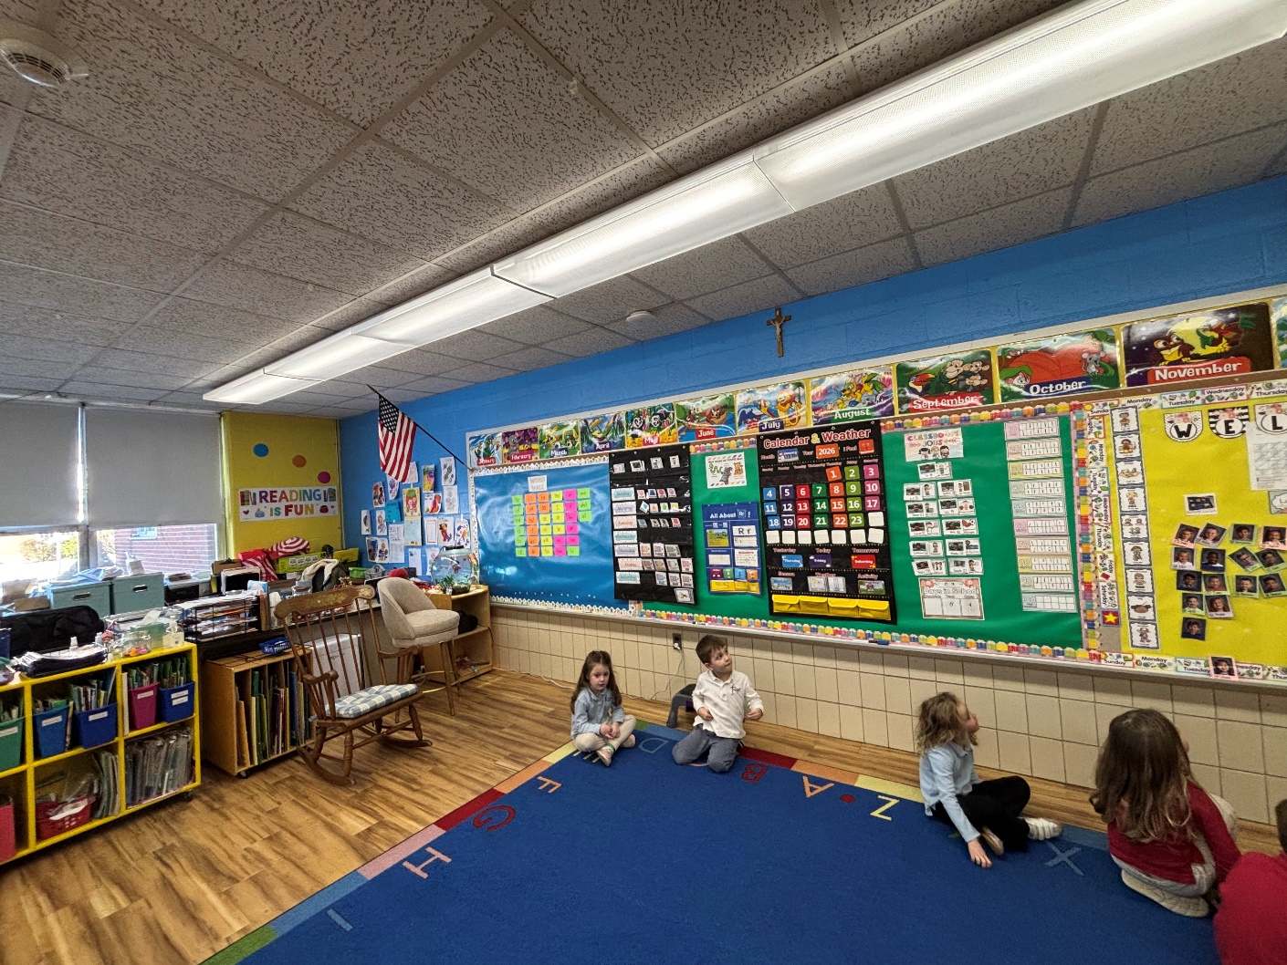
Vibrant and fun classroom set up for our PreK 3 and 4 Year-Old Students

Slide 12
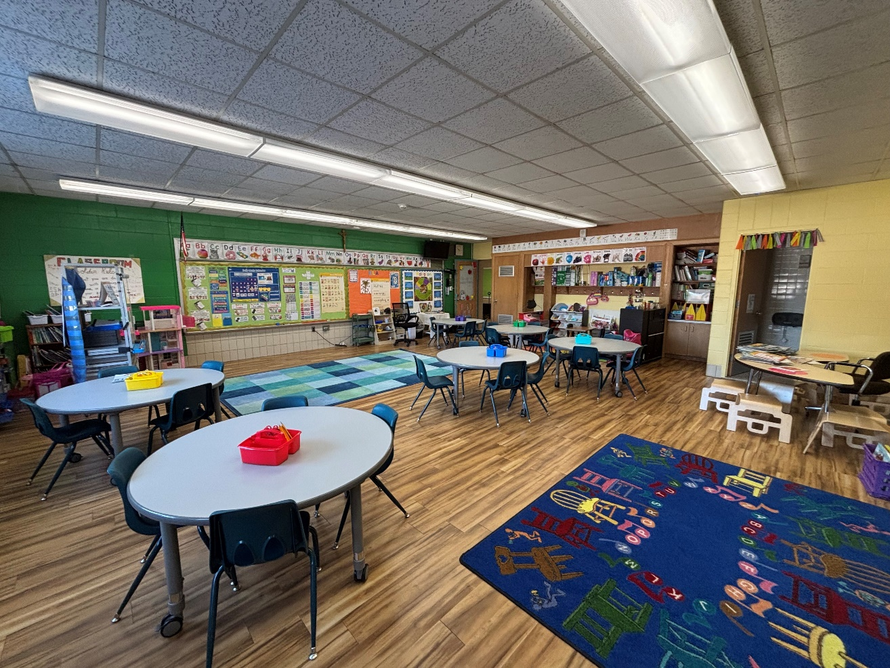
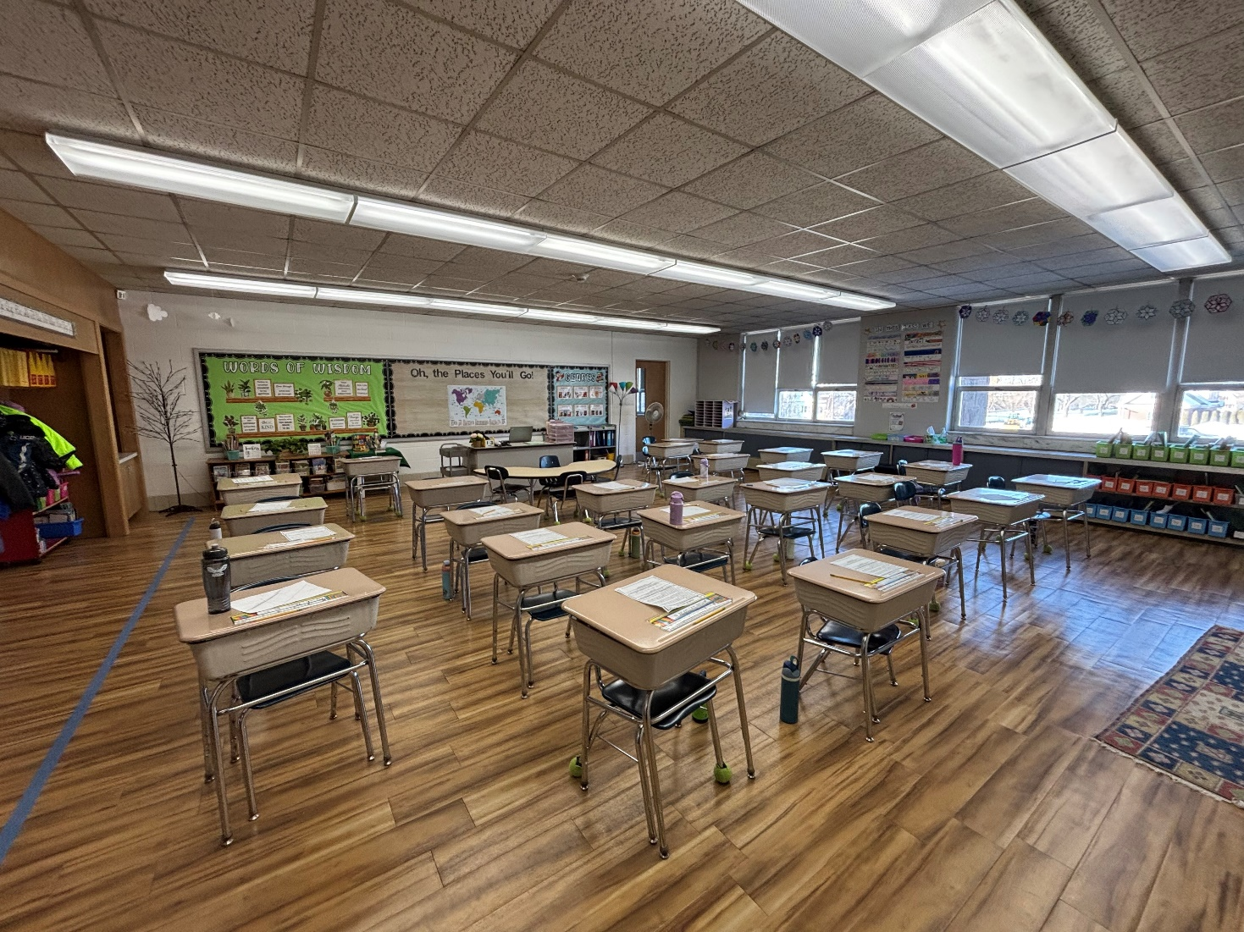
Classroom set up for students grade 1 to 8
Bright and sunny Kindergarten classroom

Slide 13

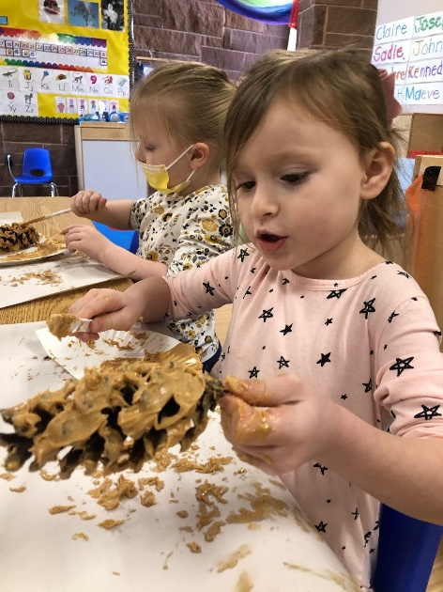
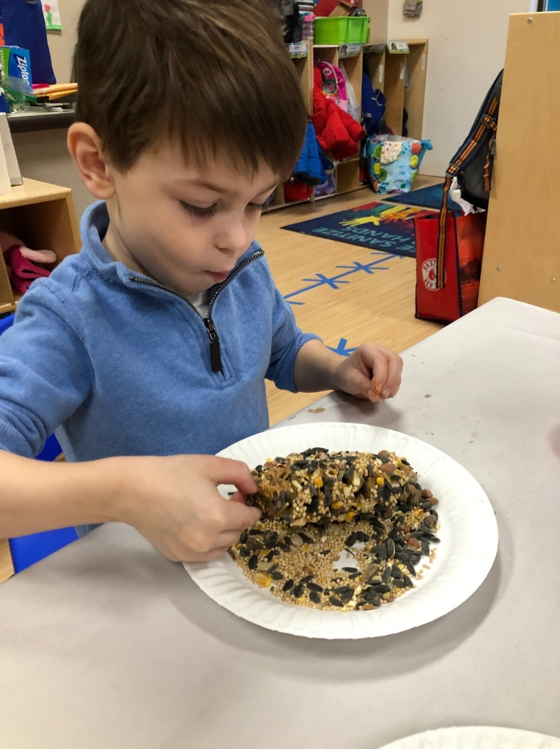
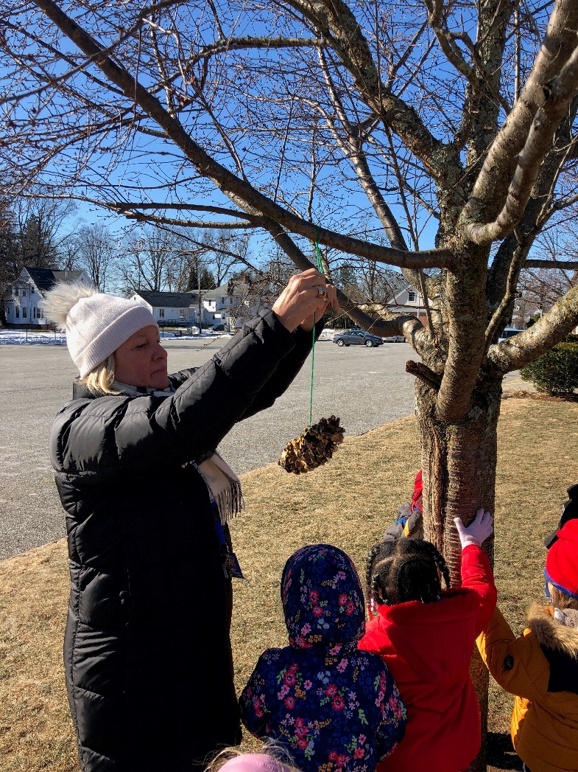

Bird Seed/Peanut Butter Bird Feeders

Slide 14
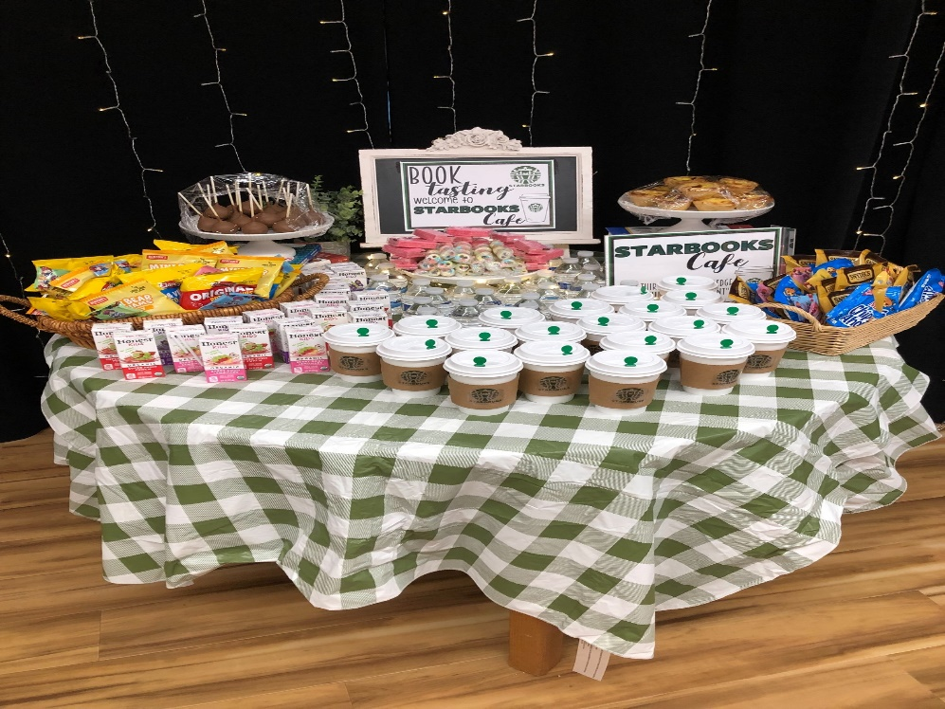

Book Tasting
In Grade 5

Slide 15
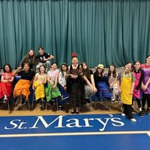
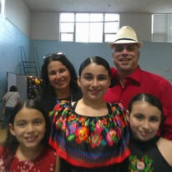
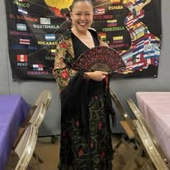
Salsa Night with Ms.Vasquez

Slide 16


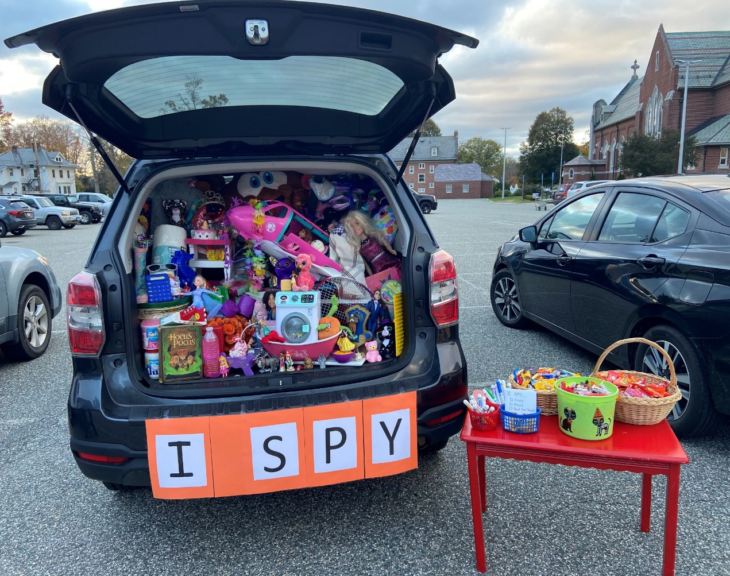
Trunk or Treat

Slide 17
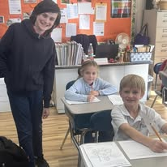
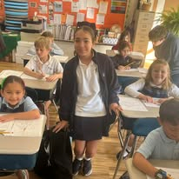
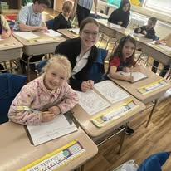
Our Buddies are Fun

Slide 18

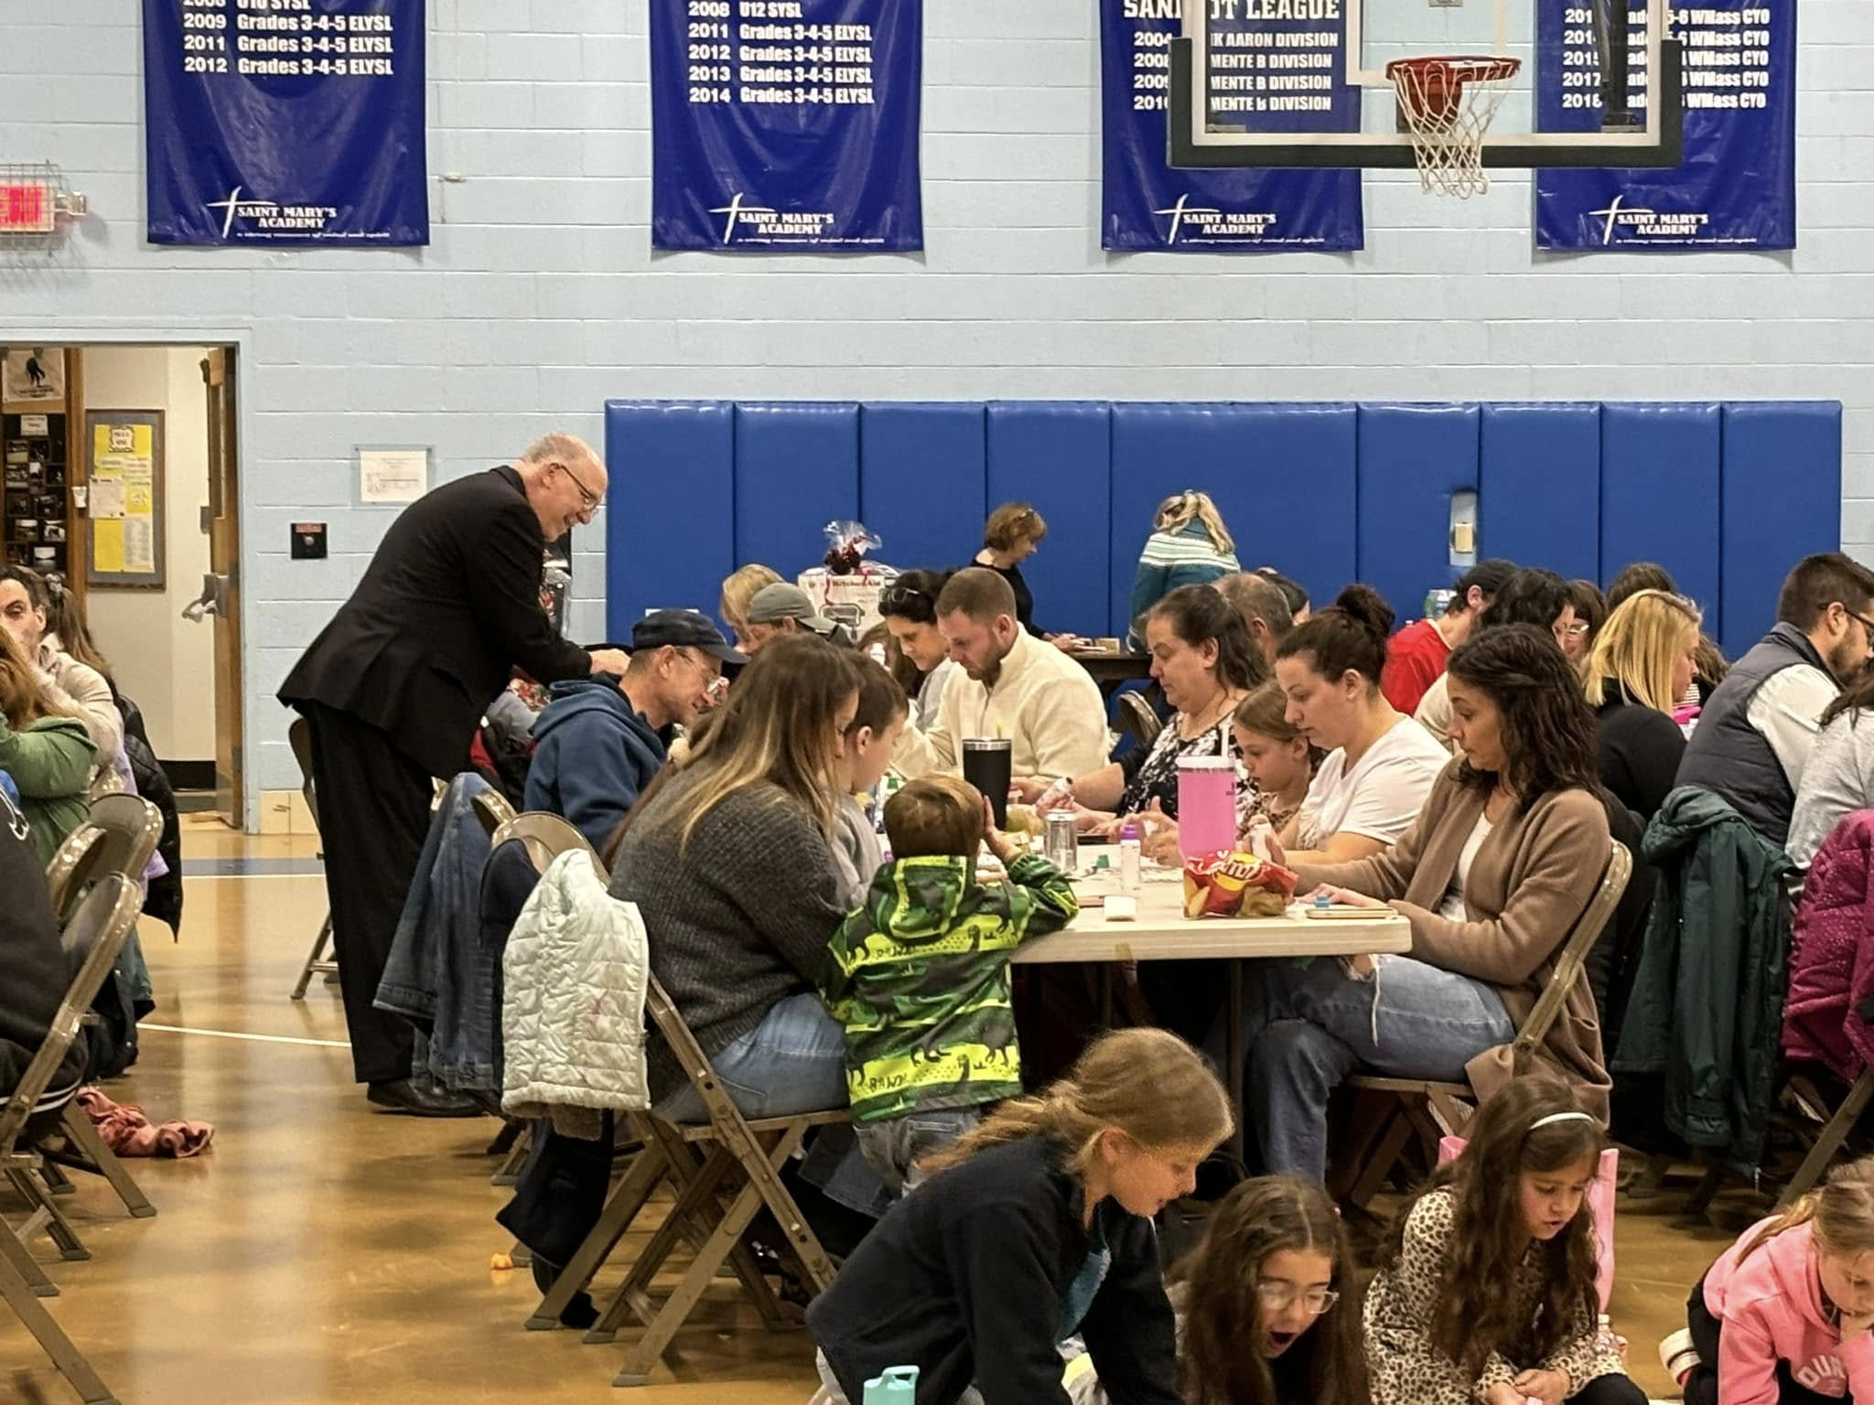
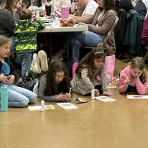
Family Bingo Night

Slide 19
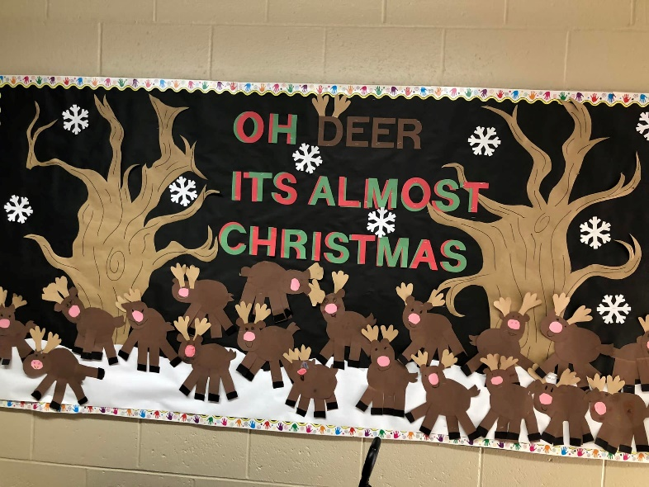
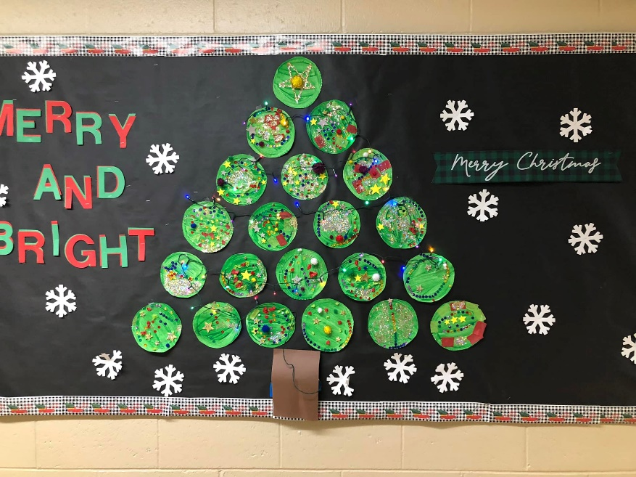
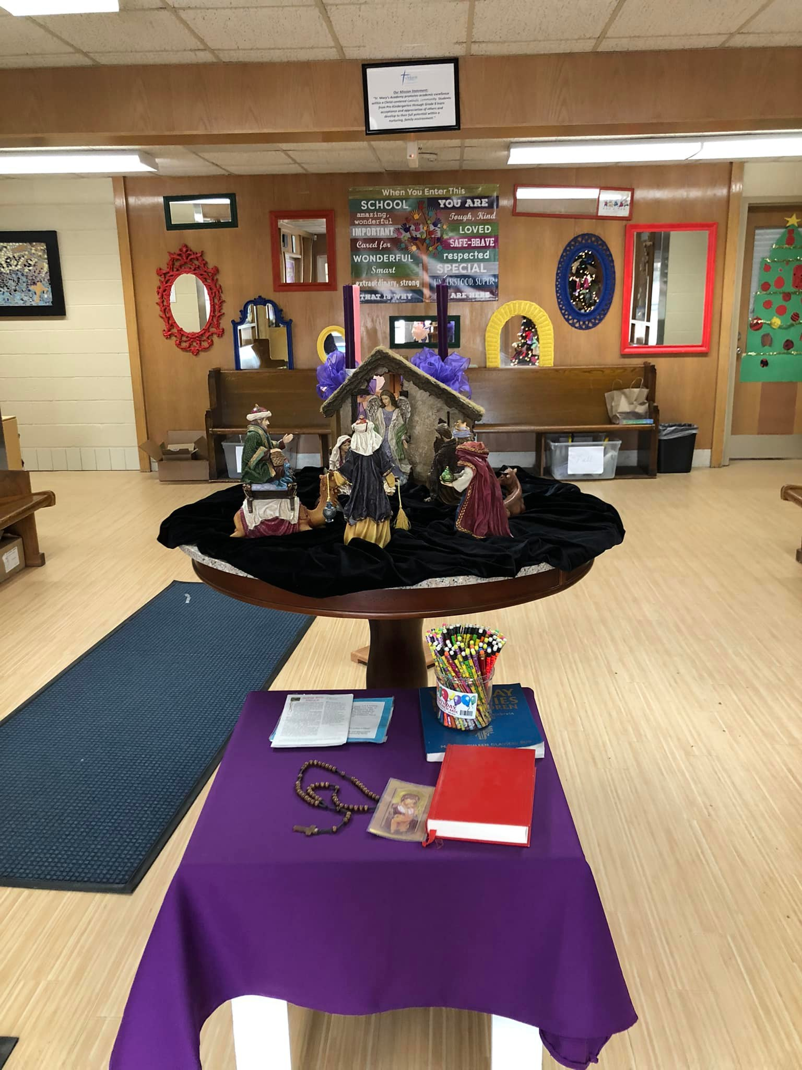

Festive Halls

Slide 20
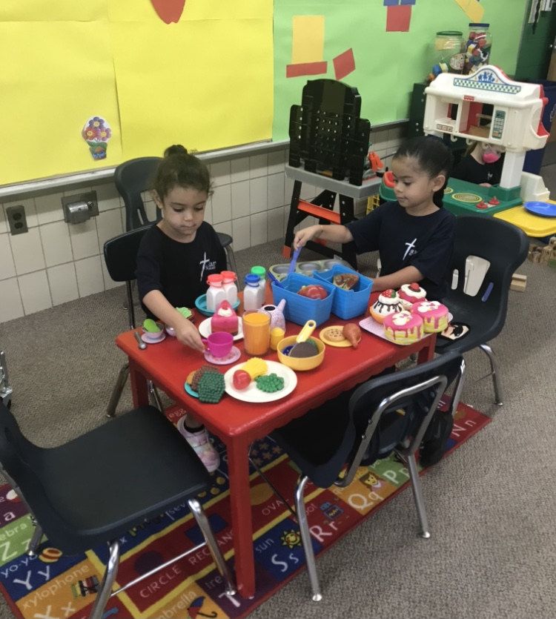
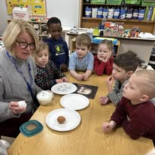
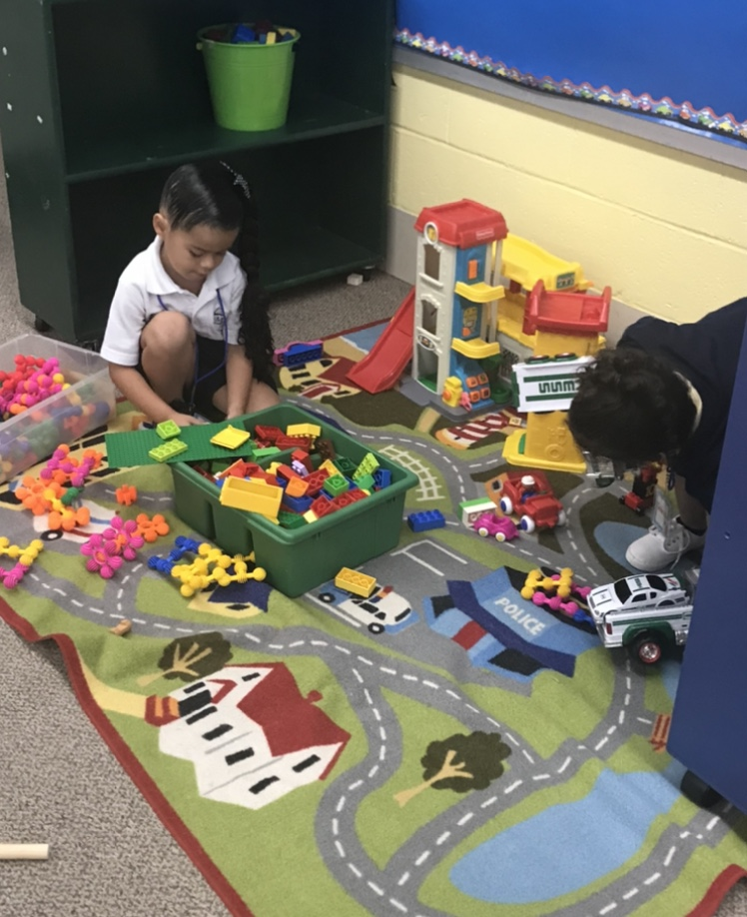

We learn thru play

Slide 21
Hear what students say
“Thank you for working hard for us and for keeping us safe! SMA is the best school ever!”
“Thank you for your warm welcome and smiling faces everyday.”
“Thank you for always making our school experience enjoyable.
“Thank you for lunch and recess with my friends”

Slide 22

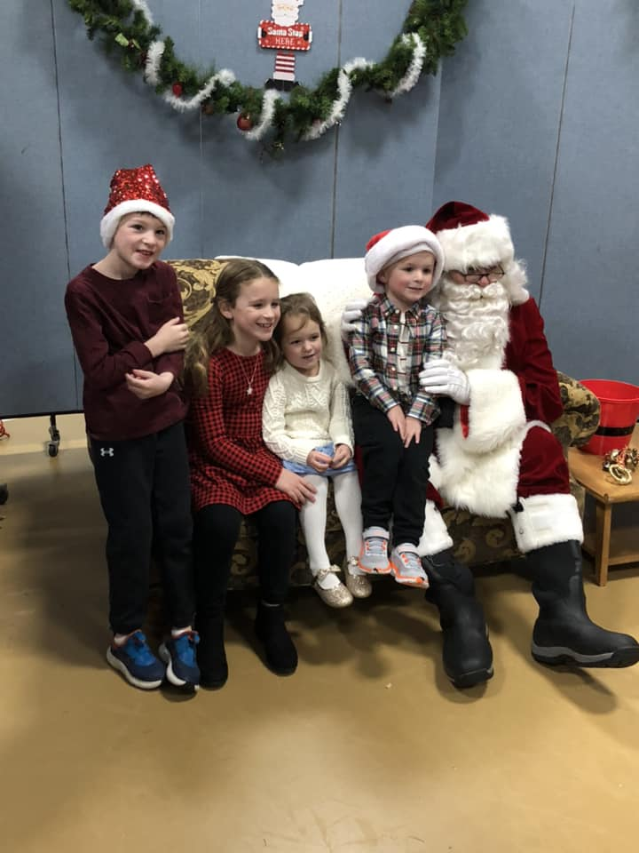
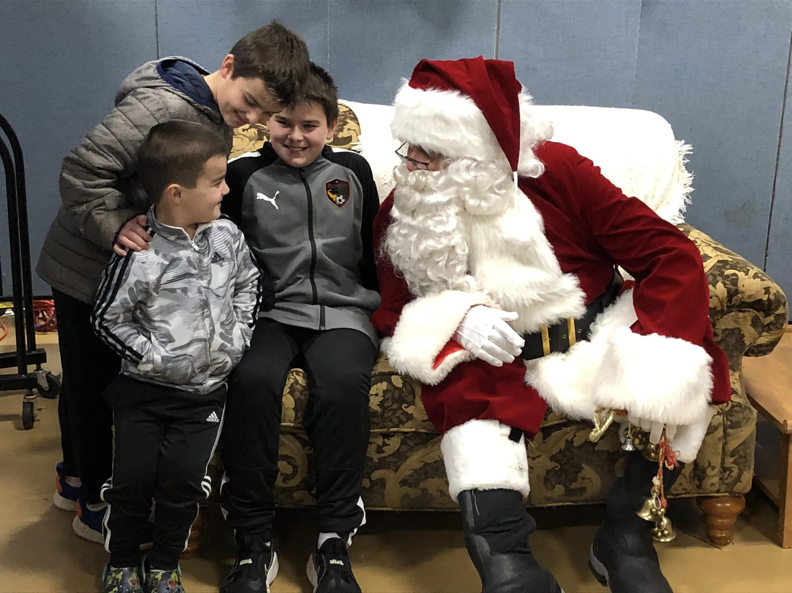
Breakfast with Santa

Slide 23

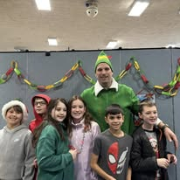
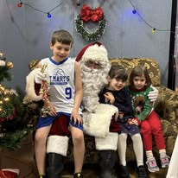
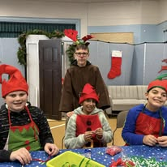
Christmas Fun

Slide 24

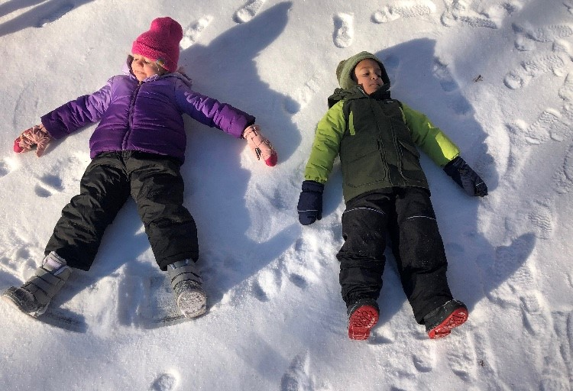
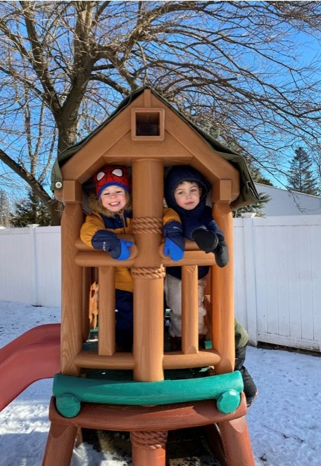

Winter Fun

Slide 25
Thank you for taking a moment to “tour” our school today! If you are interested in your child attending St. Mary’s Academy for the 2026-2027 school year, please see below for the next steps.
Applications are available for submission on a 1st come 1st serve basis starting at 1pm on Sunday, January 25th .
Each application will have a time stamp on it once submitted. This will help us honor our 1st come 1st serve policy at Open House.
On Sunday the hours of 1pm to 3pm will serve as our timeframe for Virtual Open House. Applications received during those hours will be considered as if you had attended Open House in person. Applications outside of that timeframe will be considered after the Virtual Open House applications.
If you are interested in a Preschool or Kindergarten spot please know space is limited. We recommend submitting an application on the earlier end of the Virtual Open House.
We welcome you sign up for an in person tour on Thursday January 29th by visiting the Sign Up Genius (free of charge to sign up) at https://www.signupgenius.com/go/30E0C4BADAB29A5FB6-61813093-welcome
If you have any questions during the Virtual Open House please feel free to contact academy@stmaryslongmeadow.org this email will be monitored during the Virtual Open House and our Development Coordinator will contact you.
Thank you for considering St. Mary’s Academy for your child’s education.
We look forward to meeting you soon!

Slide 26

Together We are St. Mary’s Family
ALONE WE ARE SMART. COLLECTIVELY WE ARE BRILLIANT.

Slide 27

Thank you for touring our school today!

