Slide 1
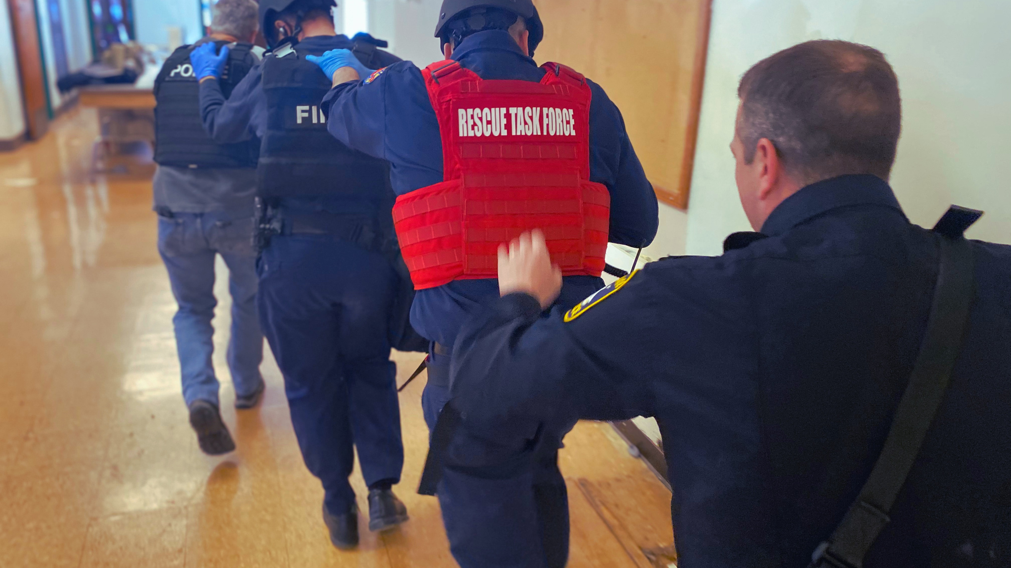

Rescue Task Force MEDICAL
02
Paramedic Focus in Rescue Task Force
RESCUE TASK FORCE | 2021 JUNE
Notes:
Welcome to the instructor notes component on the medical aspect of the rescue task force program for Cuyahoga County. This presentation and its content are and will always be a living document with total subject to updates and changes. It is the goal of this slide deck to convey important information as it relates to medical and operations within the rescue task force operation. It is recommended that a medical representative cover this section and that all content presented be inline with CoTCCC recommendations and directives, the Department Regional Protocol, and best practice. (All medical care provided will be inline with the protocol the provider is practicing under and with the authority of the Departments Medical Director. This course is meant to impower and educate not grant authority unauthorized by your Medical Control) All interventions performed by a provider must be:
In accordance with local policy and protocol
Within your authorized scope of practice
The Medical Director for the Cuyahoga County Rescue Task Force Initiative is Dr. Thomas Collins. The lead Medica instructors are Robert Crowe and David Sirl.
http://hospital.cecoms.cuyahogacounty.us/pdf/NEORegionalEMSProtocolRevision4.pdf

Slide 2
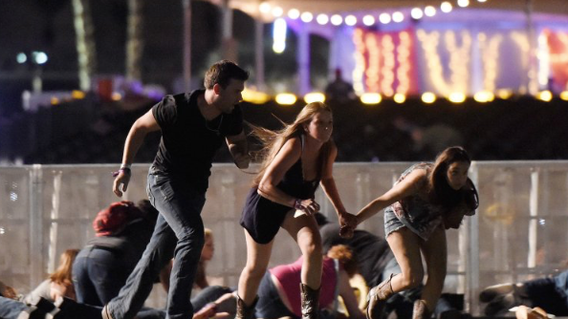
Rule #1
"IT Depends!!"
Notes:
Every single situation that involves a human component is dynamic and faceted. It is not advised to present to learners a “one way” and “always the way” approach. Principles and knowledge applied to critical decision making is a recommendation to apply to these complex scenarios. It is OK to answer questions or an approach to problem solving with a “it depends” thought process. All plans of care should be founded in good medicine, tactics, and practice under authorized protocol.
Casualty scenarios in dynamic events usually entail both a medical problem and a tactical problem.
Best possible outcome for the injured and the overall situation is desired (save as many people as possible).
Good medicine can sometimes be bad tactics, and bad tactics can get everyone killed and/or cause mission failure.
A medically correct intervention performed at the wrong time may lead to additional casualties.
These settings are different from conventional EMS and require a shift in focus. Settings include:
Hostile fire
Environmental extremes
Limited equipment
Need for tactical maneuvers
Long delays to hospital care
Different wounding epidemiology

Slide 3
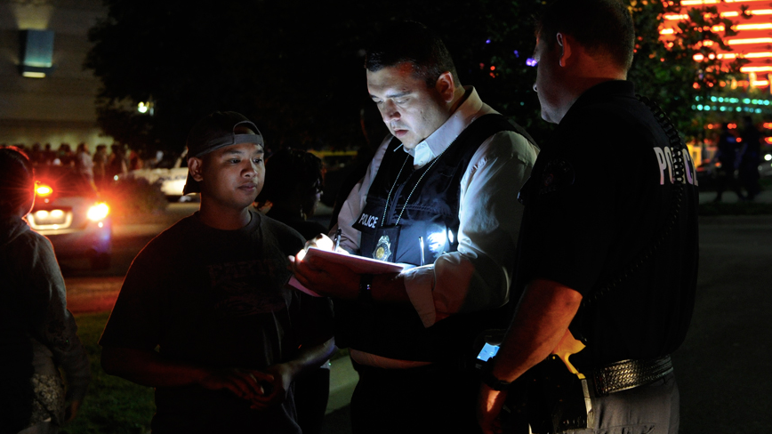
Rule #2
"This is a way, not the way!"
Notes:
Systematic approach and theory are key principles to install in leaners in the “second rule”. Frequency of these events are increasing but the majority of EMS providers have little experience in active shooter environments. The foundation of the tactical medicine components in this course are based on the systemic approach for timely, life saving intervention in trauma medicine from the CoTCCC and local trauma protocol direction. There are many ways to reach therapeutic intervention and this course recommends keeping an open and humble mind as we collectively work together to care for injured persons in this complex environment. It is highly recommended that after action reviews of active shooter events are studied so that actions maybe referenced both at the time of this slide and through out the course.
https://www.fbi.gov/file-repository/active-shooter-incidents-2000-2018.pdf/view

Slide 4
- Movement
Rule #3
Law Enforcement and Medical set the tempo
Notes:
Prompt integration of trained and equipped EMS medical rescue teams with law enforcement escort into an active shooter or other violent threat incident.

Slide 5
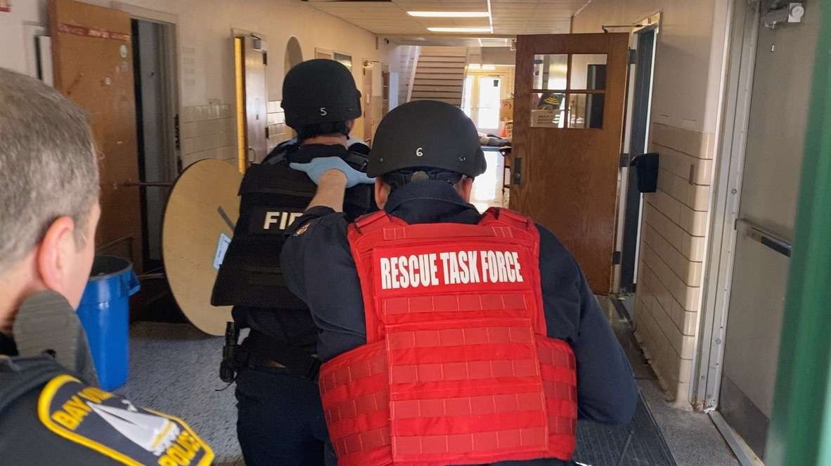
Notes:
Ask learners what they observed and to debrief the video. Conversations could be guided to discuss safe and affective movements, communication, processing, and patient assessment utilizing the MARCH exam (assessment) and triage with the START triage method.

Slide 6
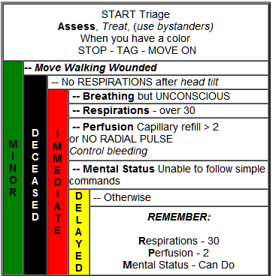

Notes:
http://hospital.cecoms.cuyahogacounty.us/pdf/NEORegionalEMSProtocolRevision4.pdf
Reference Start Triage and Trauma Protocol

Slide 7
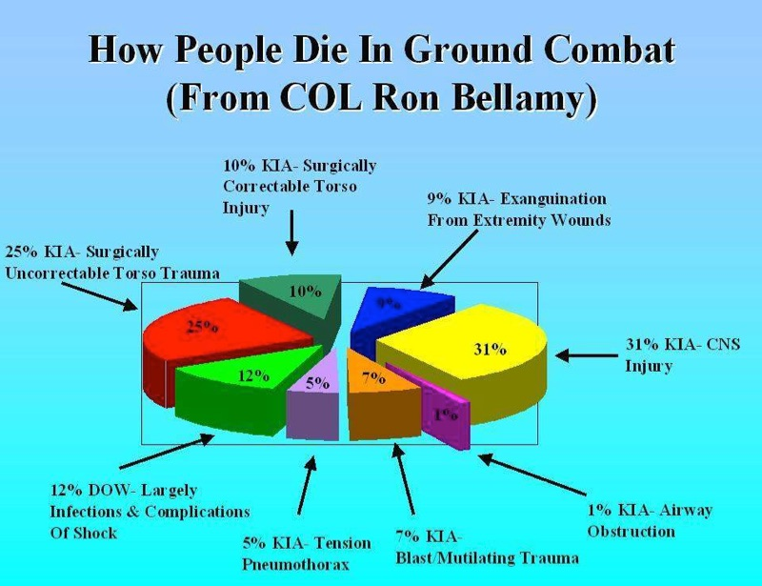
Notes:
"90% of combat deaths occur on the battlefield before the casualty ever reaches a medical treatment facility." -Col. Ron Bellamy
A Profile of Battlefield Injury
A Profile of Combat Injury
Howard R. Champion, FRCS(Edin), FACS, Ronald F. Bellamy, MD, FACS, COL, US Army, Ret., Colonel P. Roberts, MBE, QHS, MS, FRCS, L/RAMC, and Ari Leppaniemi, MD, PhD
The Journal of TRAUMA, Injury, Infection, and Critical Care
J Trauma. 2003;54:S13–S19.
Description with Key Points:
Traumatic combat injuries differ from those encountered in the civilian setting in terms of epidemiology, mechanism of wounding, pathophysiologic trajectory after injury, and outcome. Except for a few notable exceptions, data sources for combat injuries have historically been inadequate. Although the pathophysiologic process of dying is the same (i.e., dominated by exsanguination and central nervous system injury) in both the civilian and military arenas, combat trauma has unique considerations with regard to acute resuscitation, including (1) the high energy and high lethality of wounding agents; (2) multiple causes of wounding; (3) preponderance of penetrating injury; (4) persistence of threat in tactical settings; (5) austere, resource-constrained environment; and (5) delayed access to definitive care. Recognition of these differences can help bring focus to resuscitation research for combat settings and can serve to foster greater civilian-military collaboration in both basic and transitional research.

Slide 8
Airway
6.1%
Tension Pneumothorax
33.3%
Massive Extremity Hemorrhage
60.6%
Notes:
This diagram depicts the pre-hospital deaths that occur that are within the “20% prehospital preventable battlefield style” deaths.
https://books.allogy.com/web/tenant/8/books/4388d03c-aed0-42a0-8830-3abf3c4ff57d/

Slide 9
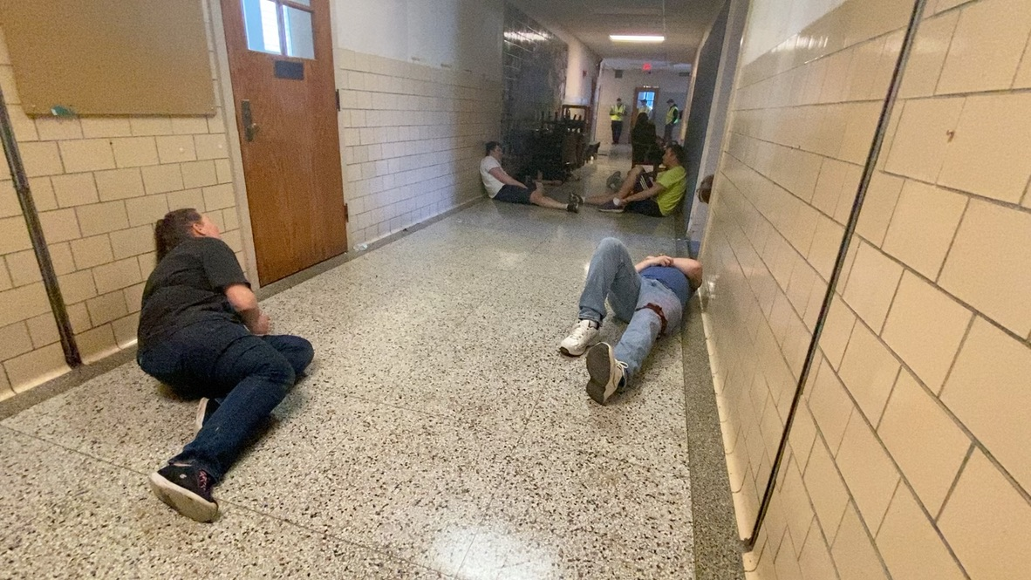
Notes:
Watch and debrief the video. Discuss methods of communicating to victims and movement once care is rendered. What are the steps to triage this mass casualty incident?

Slide 10
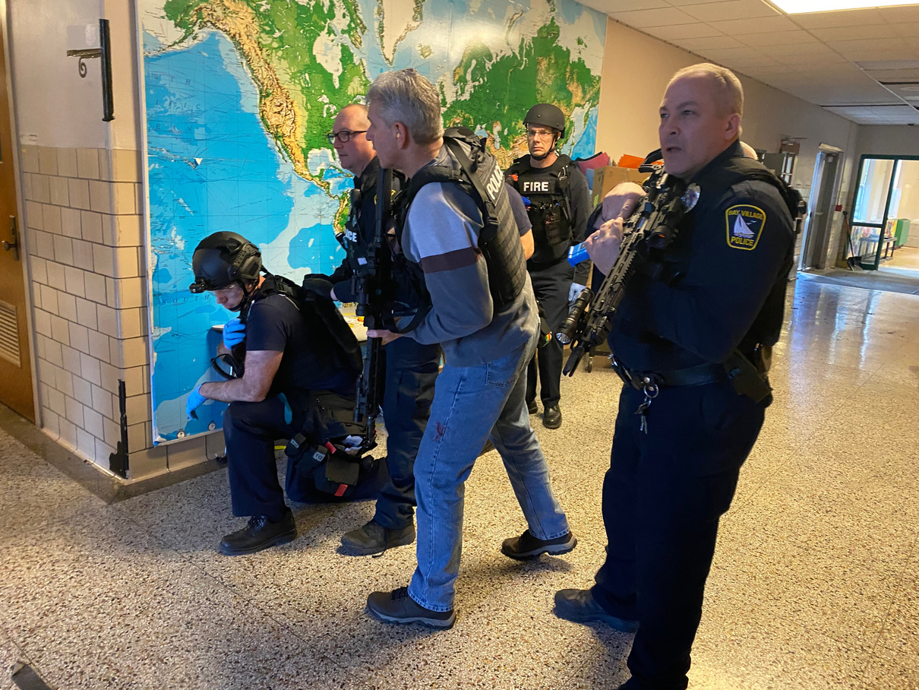
RESCUE TASK FORCE
"Rescue Task Force!"
"If you can hear the sound of my voice move toward the end of the hall!"
Start Triage
Notes:
This slide and the following slides is an exercise and discussion surrounding the use of START triage and the identification and sorting process.

Slide 11
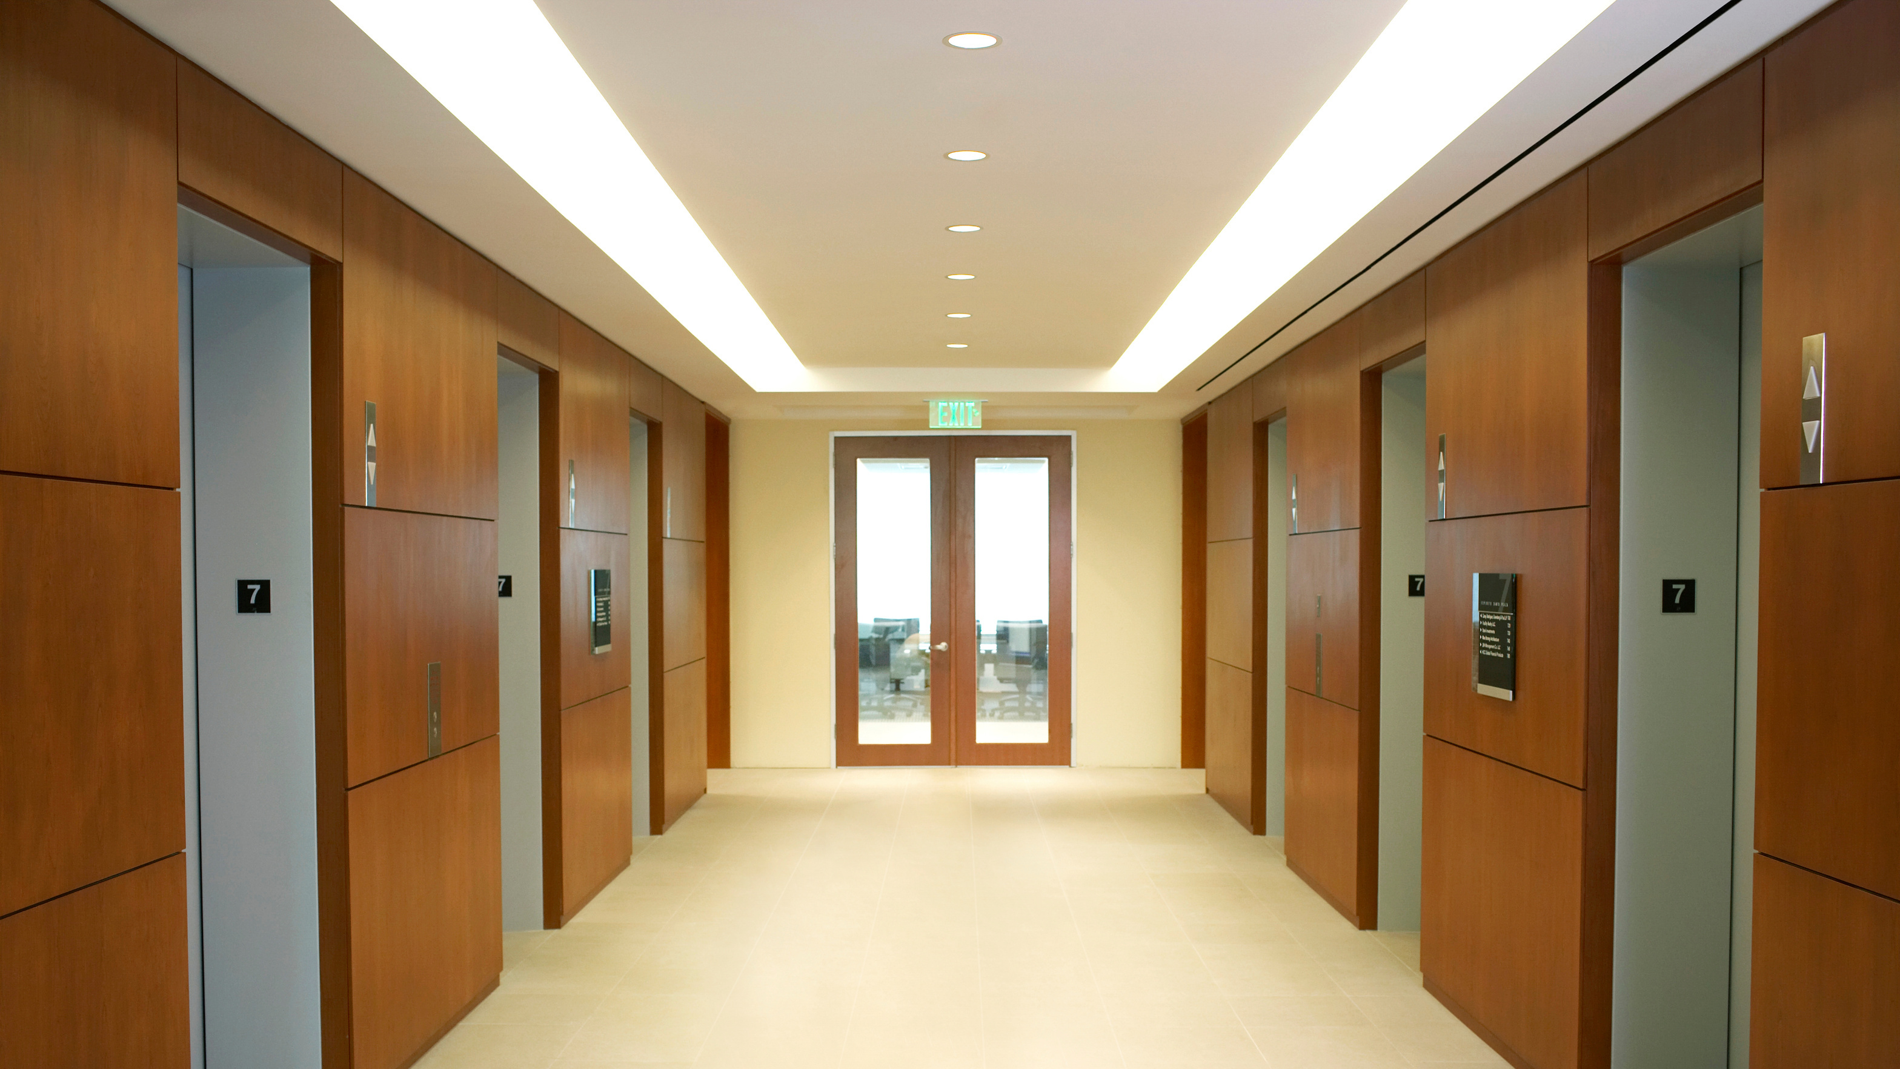
Notes:
Colored triangles represent the patient and the corresponding injury and START Triage status color. As you work through the exercise the triangles will change disappear from the image so that the focus may be directed on those most in need. In this image after using the previous slide verbal directive the green victims and one yellow will follow your verbal order. This demonstrates that the greens and one yellow are capable of following the provider directive and the focus may shift to those more in need.

Slide 12
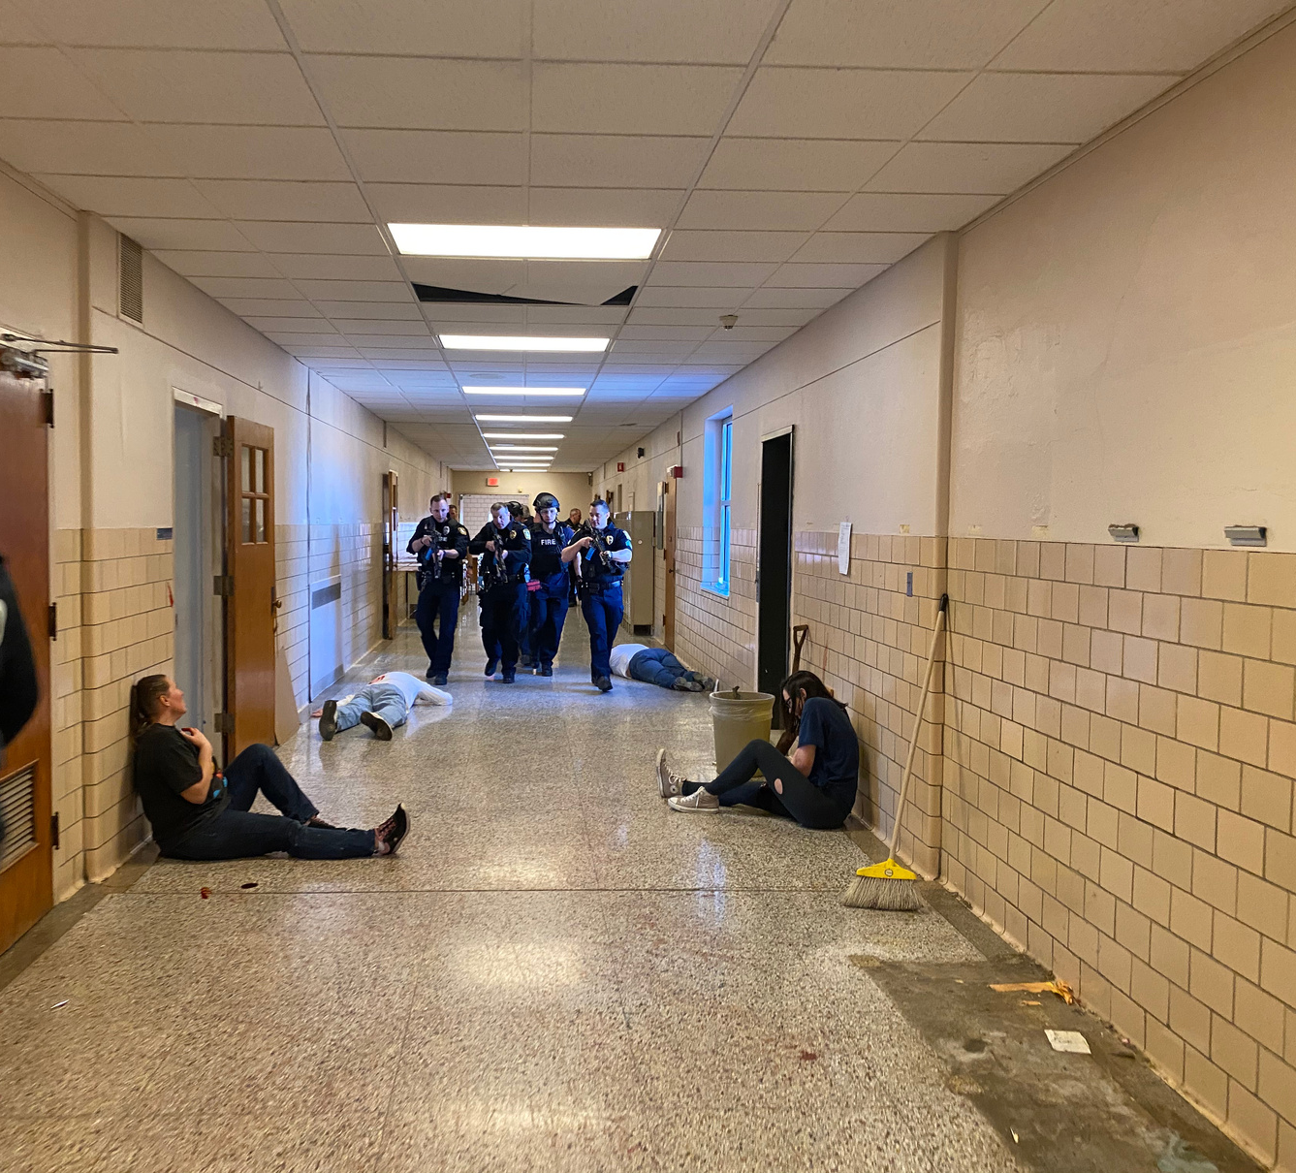
"If you can hear the sound of my voice raise your hand!"
Notes:
Ask learners about their personal experience with Start and how to determine who is “more red” or ‘more yellow” and how to determine who to treat vs whom to extricate in what orders.

Slide 13
Notes:
Remaining are the critical patients and the black victims. Leave the black victims in place unless otherwise directed by law enforcement. REMEMBER this is a crime scene and coordination with Law Enforcement is needed.

Slide 14
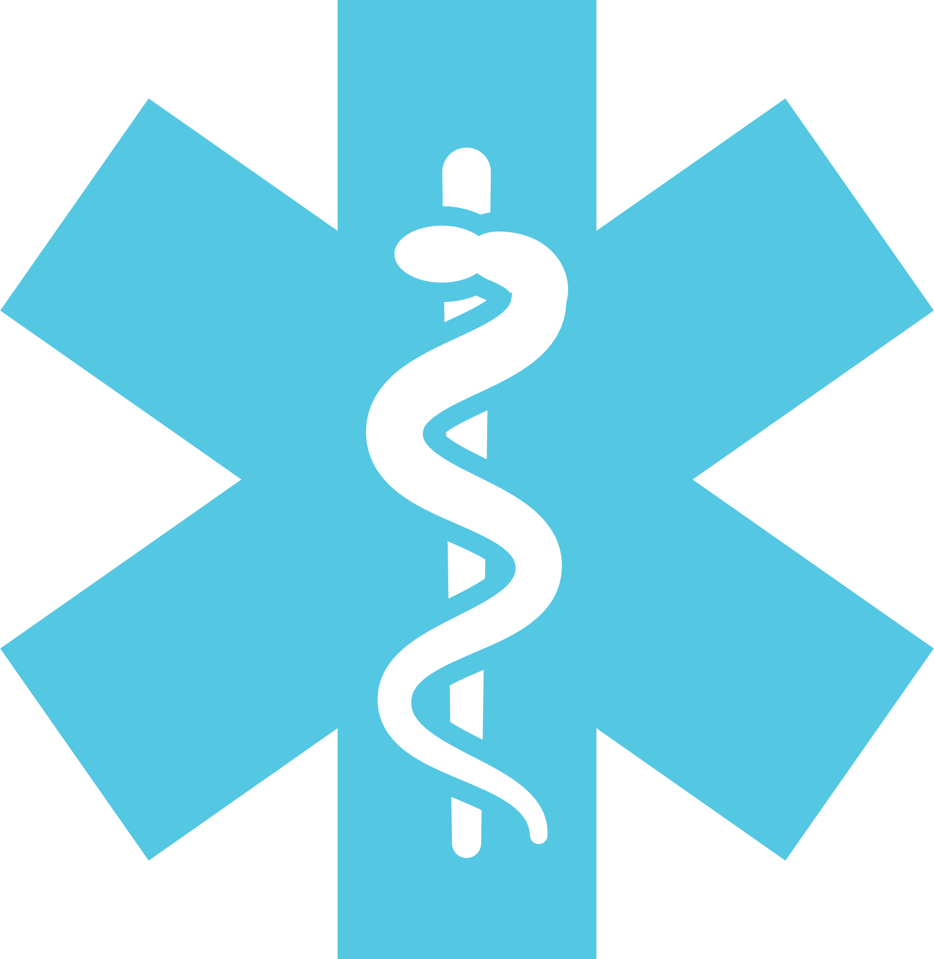
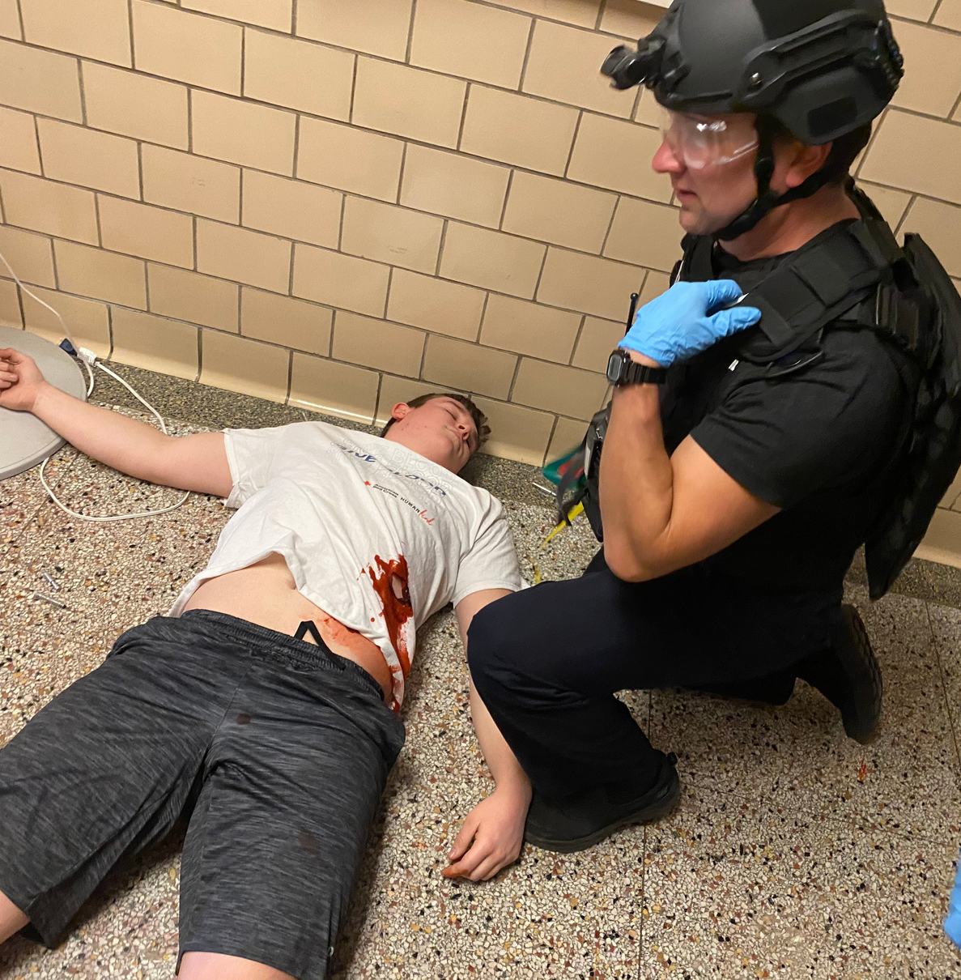
First: Move to the victims that respond via verbal direction
Then: Systematically move to the additional victims
Finally remember: IT DEPENDS!
Notes:
Have a plan for extrication and safe and affective movement of the victims. There are a variety of ways to approach this dynamic situation and there are a number of approaches to solve the problem that is presented. What is recommended is that providers approach the setting with a systematic approach that they can than plug in the number of victims with consideration to the acuity and the resources available to treat and move the victims to more definitive care.

Slide 15

Notes:
Treat the remaining red as needed and leave the “black tag” victim in place as it is a crime scene. Law Enforcement should secure.

Slide 16

Treat in Place
With delayed extraction
Treat in Place
With immediate extraction
Notes:
Phases of care and the environment that you are working in are dynamic. Utilize clinical decision making along with critical decision making and COMMUNICATE with your Fire/EMS partners as well as your Law Enforcement Partners!
Treat in place means to implement the MARCH assessment and treat the life threatening injuries as you find them. Expand the treatments as resources and time allow. Communicate your victim to command and coordinate operations. An example of this could be a rescue corridor approach, a CCP, or a temporary/hasty CCP where stabilization is performed prior to extrication.
Treat in place with immediate extraction would be applicable to the victim that is declining rapidly and the need for definitive care is necessary for survival. Treatments are those that are performed quickly with little time investment and event preferable that they maybe performed as you extricate. One example could be a TQ application and a chest seal and sending the victim out a hasty exit to definitive care providers. REMEMBER resources are limited inside locations to the providers and the equipment they have. In some cases it may be most appropriate to get the victim to someone else in order to have a favorable outcome.
Expand on the following points.
Reinforce need for agency coordination though unified command.
No freelancing
Coordinate movement to prevent friendly fire incidents.
Fire/rescue/EMS should utilize their breaching experience in a collaborative effort to rescue and extract casualties.
The most direct and safest route may not be along conventional corridors.
You may have to create your own access to patient.
Breaching walls, doors, etc.
Discuss egress using hasty but effective extraction routes, keeping away from threats (windows/drywall/cinder blocks)
The way you went in may not be the best way out.
Look for the most direct and safest route to evacuate casualties (for example, is a window more expedient than a door?)

Slide 17
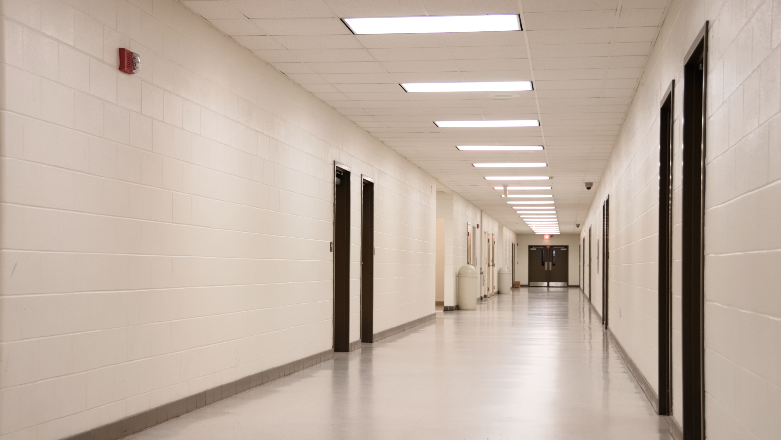


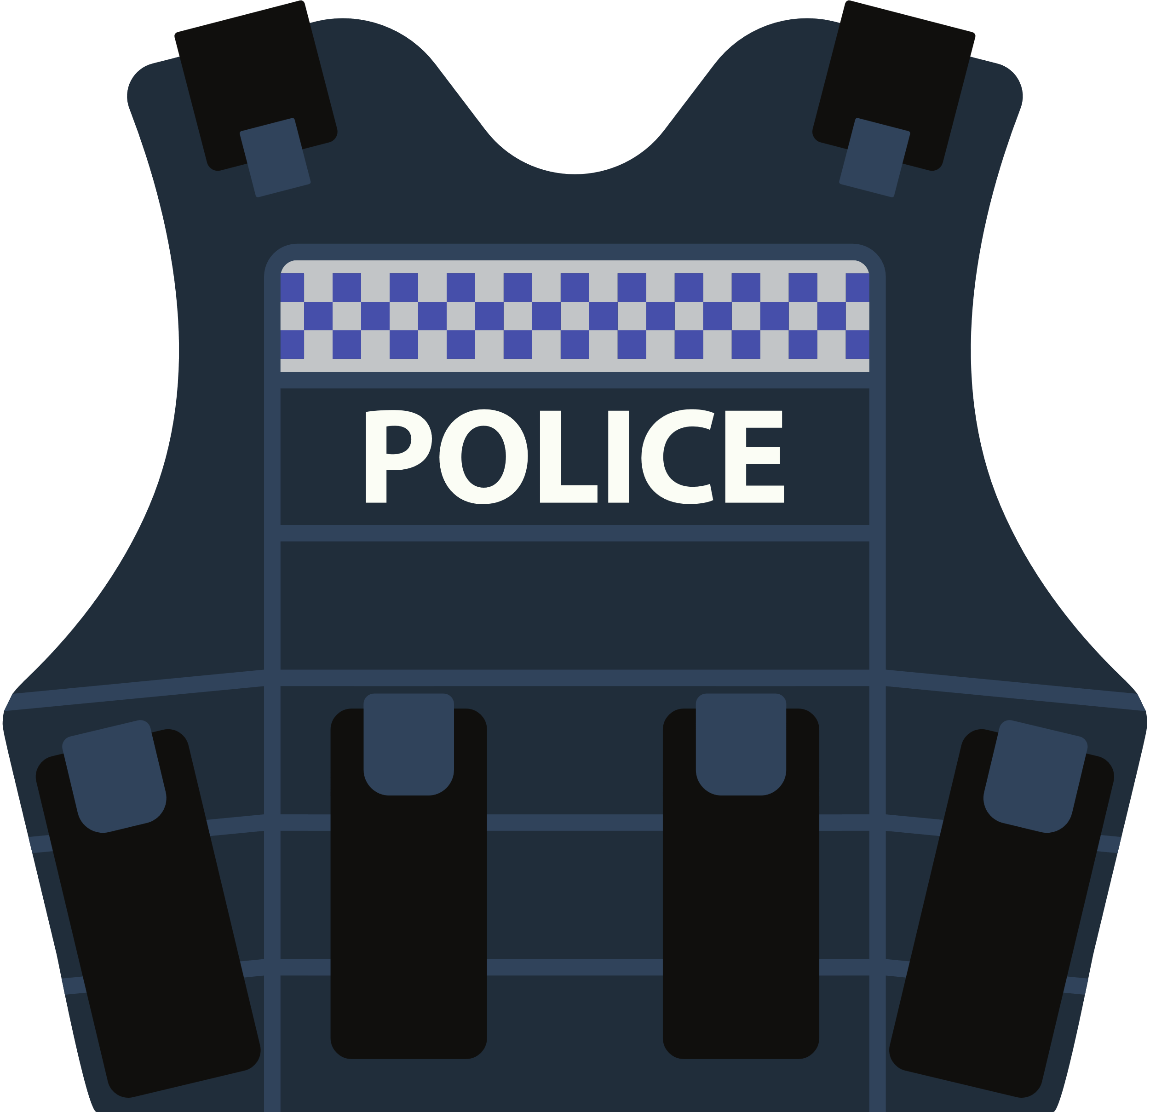
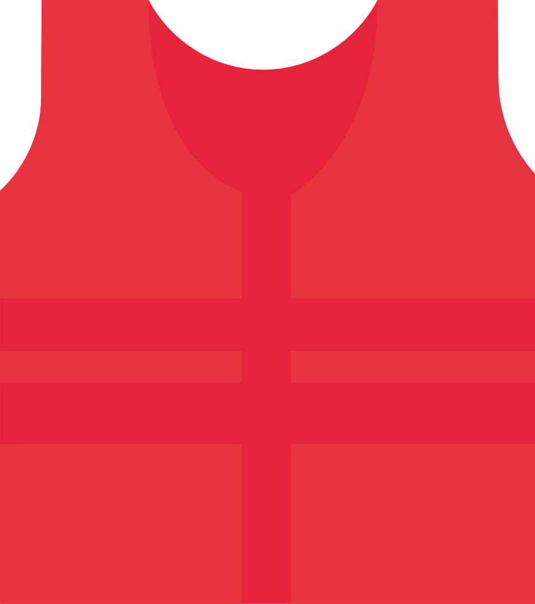
RTF
RTF
Notes:
This slide and the following slides demonstrate operations surrounding a safety corridor. This is an area that has been secured and providers may operate within the safety that the law enforcement providers have made available. We recommend that medics are able to “freely” operate in this area without the need for additional weapons up. Crossfire or blue on blue is common in leap-frog operations. THIS COURSE advises against leap-frog operations! The secondary provider in the hallway may also sort and organize victims to make it “easier” for additional responding RTF(s) to respond to their victims.
The RTF providers in this image have formed a “lead” and ”secondary” provider approach. In this operation the additional RTF teams will report to the lead medic and receive direction. The secondary medic will assist in coordinating and further direct teams. The secondary may also render care and continuously triage so that there is a seamless provider to provider transaction. ! The secondary provider in the hallway may also sort and organize victims to make it “easier” for additional responding RTF(s) to respond to their victims.

Slide 18
RTF
RTF
Notes:
This slide and the following slides demonstrate operations surrounding a safety corridor. This is an area that has been secured and providers may operate within the safety that the law enforcement providers have made available. We recommend that medics are able to “freely” operate in this area without the need for additional weapons up. Crossfire or blue on blue is common in leap-frog operations. THIS COURSE advises against leap-frog operations! The secondary provider in the hallway may also sort and organize victims to make it “easier” for additional responding RTF(s) to respond to their victims.
The RTF providers in this image have formed a “lead” and ”secondary” provider approach. In this operation the additional RTF teams will report to the lead medic and receive direction. The secondary medic will assist in coordinating and further direct teams. The secondary may also render care and continuously triage so that there is a seamless provider to provider transaction. ! The secondary provider in the hallway may also sort and organize victims to make it “easier” for additional responding RTF(s) to respond to their victims.

Slide 19

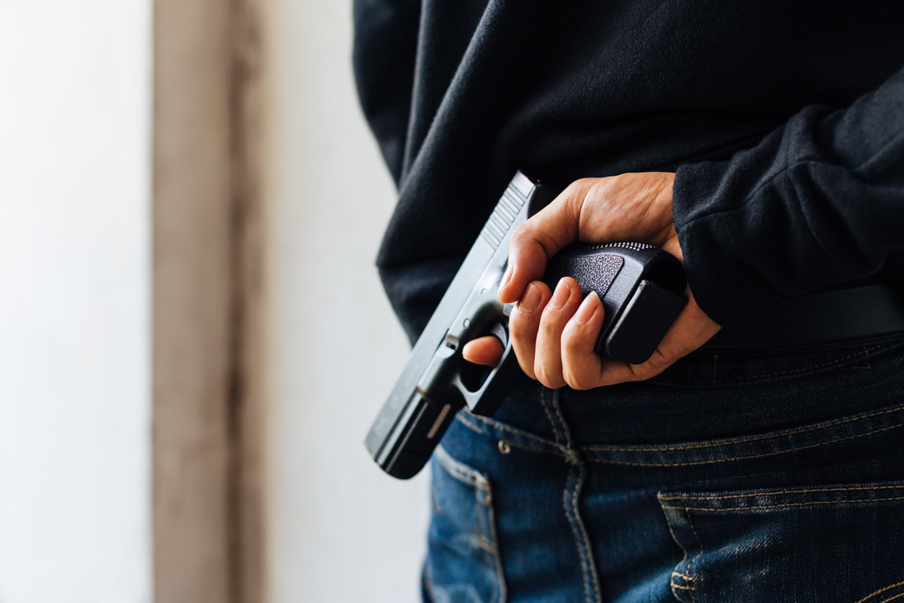
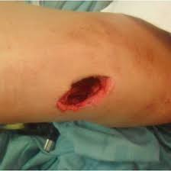

HOT ZONE (Direct Threat)
GET OFF THE X
take cover or find concealment
Hasty TQ
High and tight TQ
Rescue
Perform Emergency Move
Notes:
IT is unlikely that an RTF will be in a HOT zone however it could occur. If it should occur this is the operational recommendation from the CoTCCC
RTF under the direction and coordination of Law Enforcement should retreat to cover and concealment
Hasty TQ is the only intervention recommended to perform in addition to emergency moves. If the victim is able to move to the RTF this is preferred.
Expand on the following points.
Mitigation may involve extraction from an unstable building collapse.
Reminder that threat levels generally go up; rarely down.
Self-care is always the quickest action and limits exposure of other resources.
Picture allows for great discussion of priorities.
Instruct the (capable) patient to move to a safer position and apply self-aid.
Casualty should use available resources or environment (cover).
Medical interventions are limited when faced with a direct threat.
Expand on the following points.
Remote assessment methodology (RAM) techniques should be considered to identify patients who are dead or have apparently nonsurvivable wounds. RAM can be performed using:
Binoculars
Robots
Video cameras
Incident tempo and competing priorities (threat mitigation versus casualty care) may prevent a collaborative rescue. Police are focused on threat with all resources committed.
Use cover/concealment and safety equipment to your advantage.
Determine available rescue resources to include armored vehicles.
Have a plan.
Always consult with incident command.
Know who is doing what.
Know where you are going.
Do not risk lives/resources for a body recovery.

Slide 20
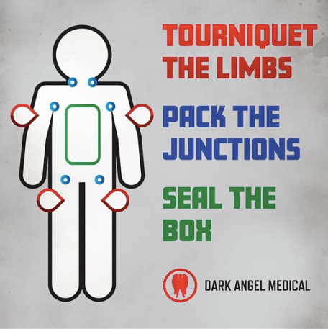

Notes:
Keep this one simple. No need expand. This is an opportunity to check in with your group on how to treat each from a table-top mentality.

Slide 21
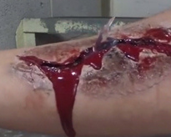
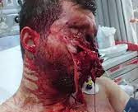
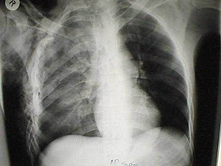
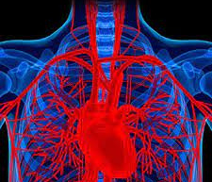
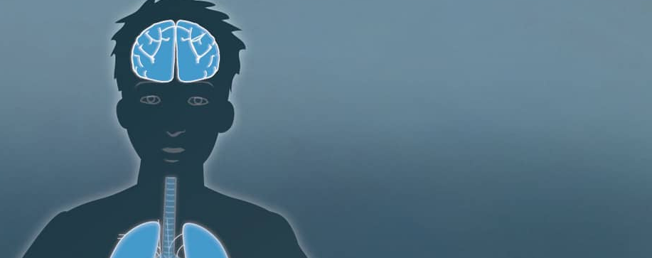
WARM ZONE (INDIRECT THREAT)
TRIAGE
MARCH EXAM
TREATMENT
M
A
R
C
H
Notes:
Describe each of the following in the MARCH assessment
M- Massive Hemorrhage
A- Airway
R- Respirations
C- Circulation
H- Hypothermia/Head Injury
Treatment:
Control massive hemorrhage
Establish and maintain airway
Decompress/seal/support
Treat for shock
Prevent/treat
https://deployedmedicine.com/content/835

Slide 22
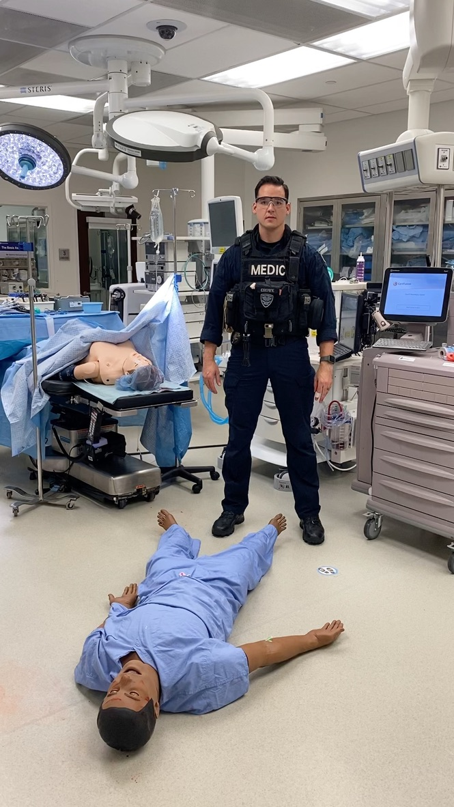
Notes:
This is a visual and audio demonstration on the MARCH exam. Updated 01/2022

Slide 23
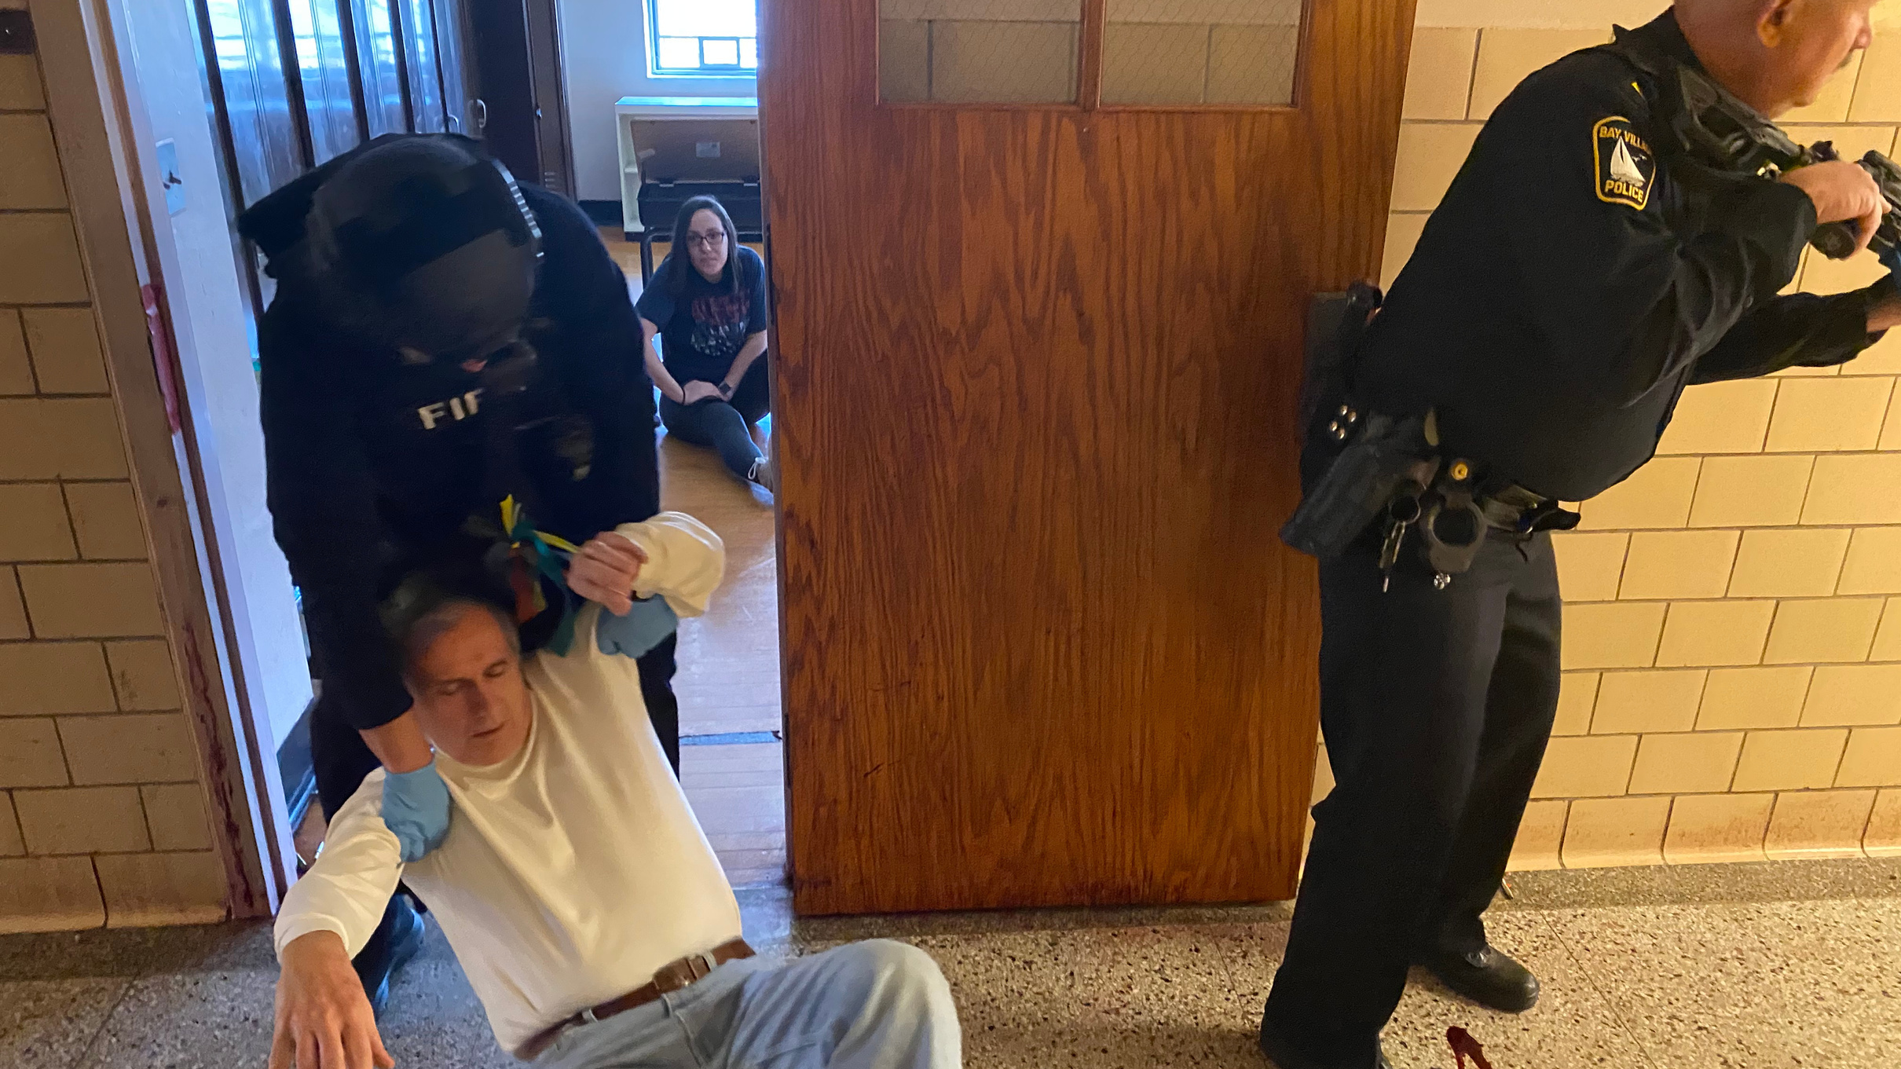
CASUALTY COLLECTION
POINT

Slide 24




Notes:
This slide demonstrates the challenges that a team could encounter by simply pulling victims into a space without the segregated option. Ask learners what their thoughts are on the image and inquire if they would perform it differently.

Slide 25






Notes:
This image illustrates the concept of the police interior command role and the medic command role in the room. Greens and yellows are organized in lateral spaces while the red tarp is set for the mittle pin wheel operation.

Slide 26

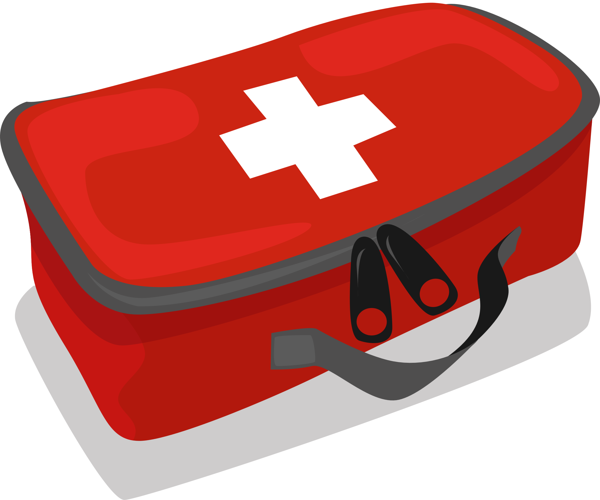
Notes:
Place two medics in the center and place medical equipment with providers.

Slide 27

Notes:
Red with heads in and pin wheel operation.

Slide 28
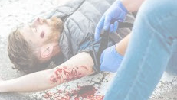

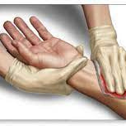
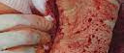


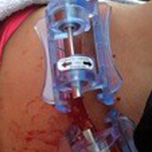

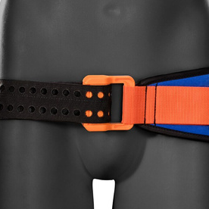
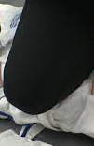
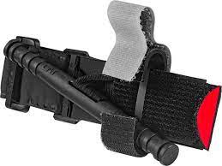


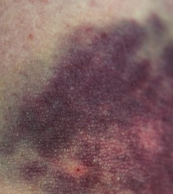
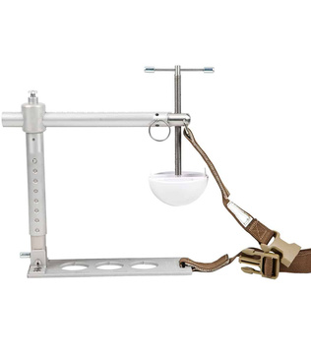
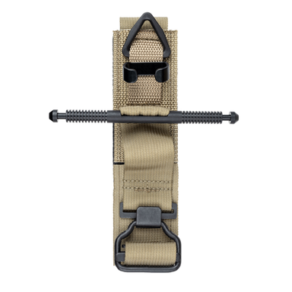
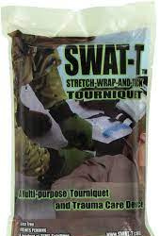
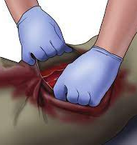
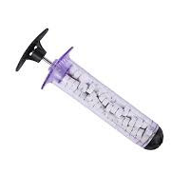
M
Notes:
Discuss the M in March. Identify the methods and ways to treat massive hemorrhage.

Slide 29
1
2
Extremity Hemorrhage
uncontrolled bleeding is the leading cause of preventable battlefield death
you bleed 1 ounce (30 ml) per heartbeat from a severed femoral artery
3
4
30 mL/beat x 140/bpm= 4200 mL. (4.21L/min)
once you reach 2500 ml (2.5 L) of blood loss it is irreversible (-40%-50%)
5
6
you could be incompacitated within 20 seconds but remember IT DEPENDS
a properly applied tourniquet will save lives

Slide 30

2,650 liters by volume
5 liters by volume
Average adult
average on an 80 lbs child

Slide 31
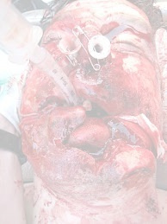
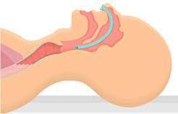
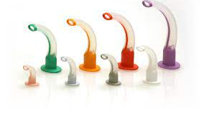
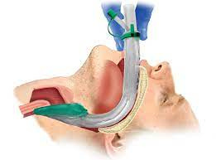
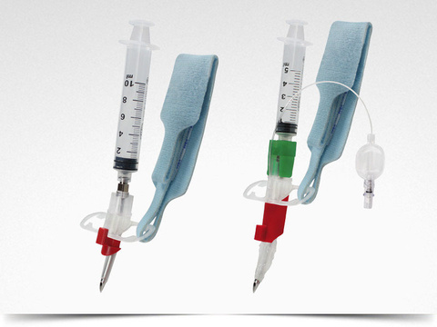
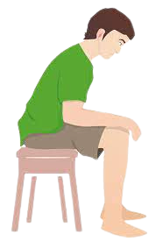
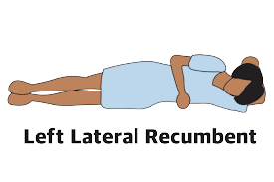
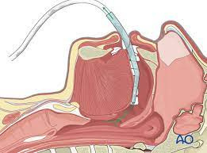
A
Notes:
Discuss the A in MARCH and the methods to treat and manage the airway.

Slide 32
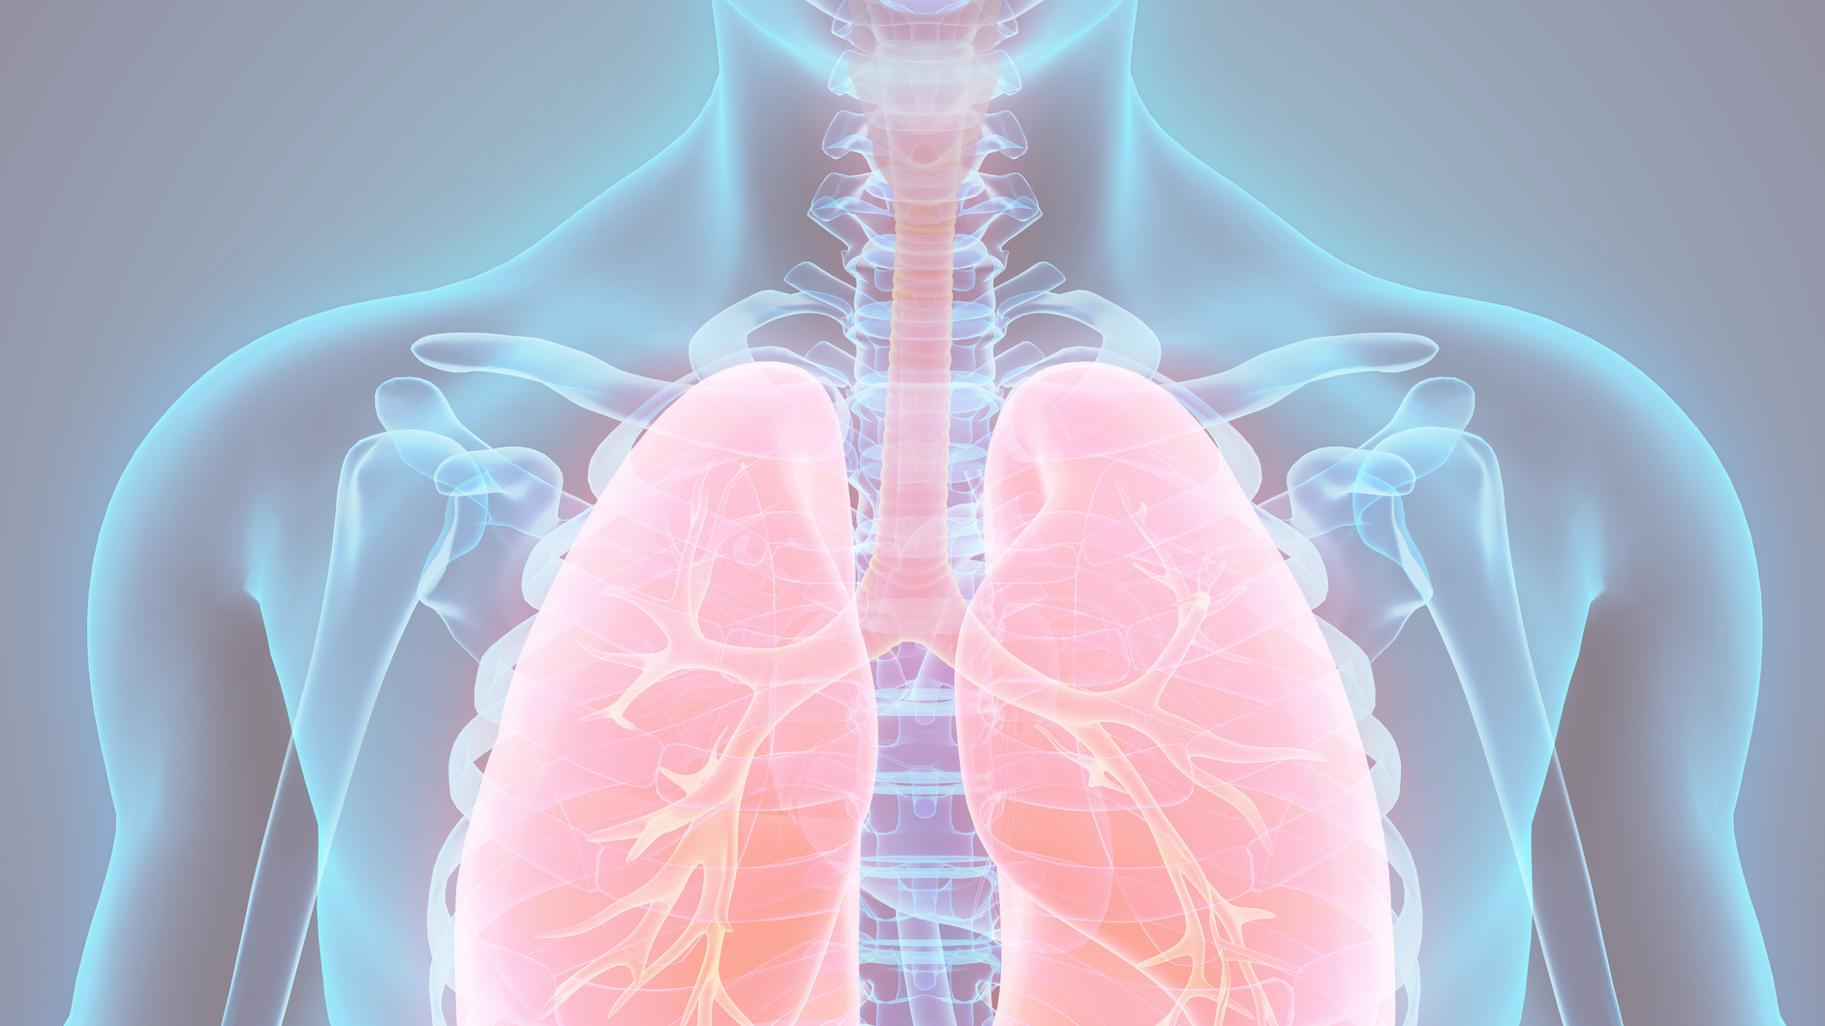
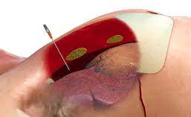
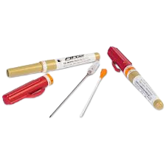

R
Notes:
Discuss the R in March and how to manage and treat respirations.

Slide 33


Notes:
Discuss the A/P on the thoracic cavity and how at different stages of the respiratory process injuries could present differently. Identify and discuss a collapsed lung, the cause, and treatments.

Slide 34










C
Notes:
Discuss the C in March and what options are available for management and treatment. Discuss the fluid bolus indications and control to obtain distal pulses. TCCC recommends whole blood on many and all cases.

Slide 35




H
Notes:
Discuss the H in March and how to prevent, manage, and treat hypothermia and head injury. 30 degree elevation recommended for head traumas and maintain a minimum systolic blood pressure of 90.

Slide 36





COLD ZONE (Evacuation Care)
28
Notes:
Discuss the options that departments have for lifting and moving. Wheels under victims help.. Work smarter and not harder. Discuss uncongenial ways to move and extricate victims.

Slide 37

Notes:
This slide is placed to stimulate conversation around operations and cold zone/evacuation care. The discussion should be a table top with take always to be discussed as a large group.

Slide 38

Notes:
Openly discuss ambulance operations and conventional and non-conventional EMS transport options.

Slide 39

Notes:
Highlight transport decisions and locations in the service area you serve. Discuss trauma center and general hospital capibilities.

Slide 40

Notes:
What emergency management systems are set up at the hospital you transport to? Discuss the possibility that the delivering crew may need to remain in the ambulance bay to receive and process victims being delivered.

