Slide 1

Fire Ground Ops Review
Euclid Fire Department
December 2024

Slide 2
Incident structure
Strategic
Tactical
Task
The Incident Commander
Provides overall strategic command direction from a central point (Command Post – Outside of the hazard zone)
Geographic and functional division/group supervisors
Supervise task-level work by being physically located right where the work is being performed
Mid-management direction
Where the manual labor is performed to directly solve the problem
Performed by firefighters
Directly supervised by Company Officers

Slide 3
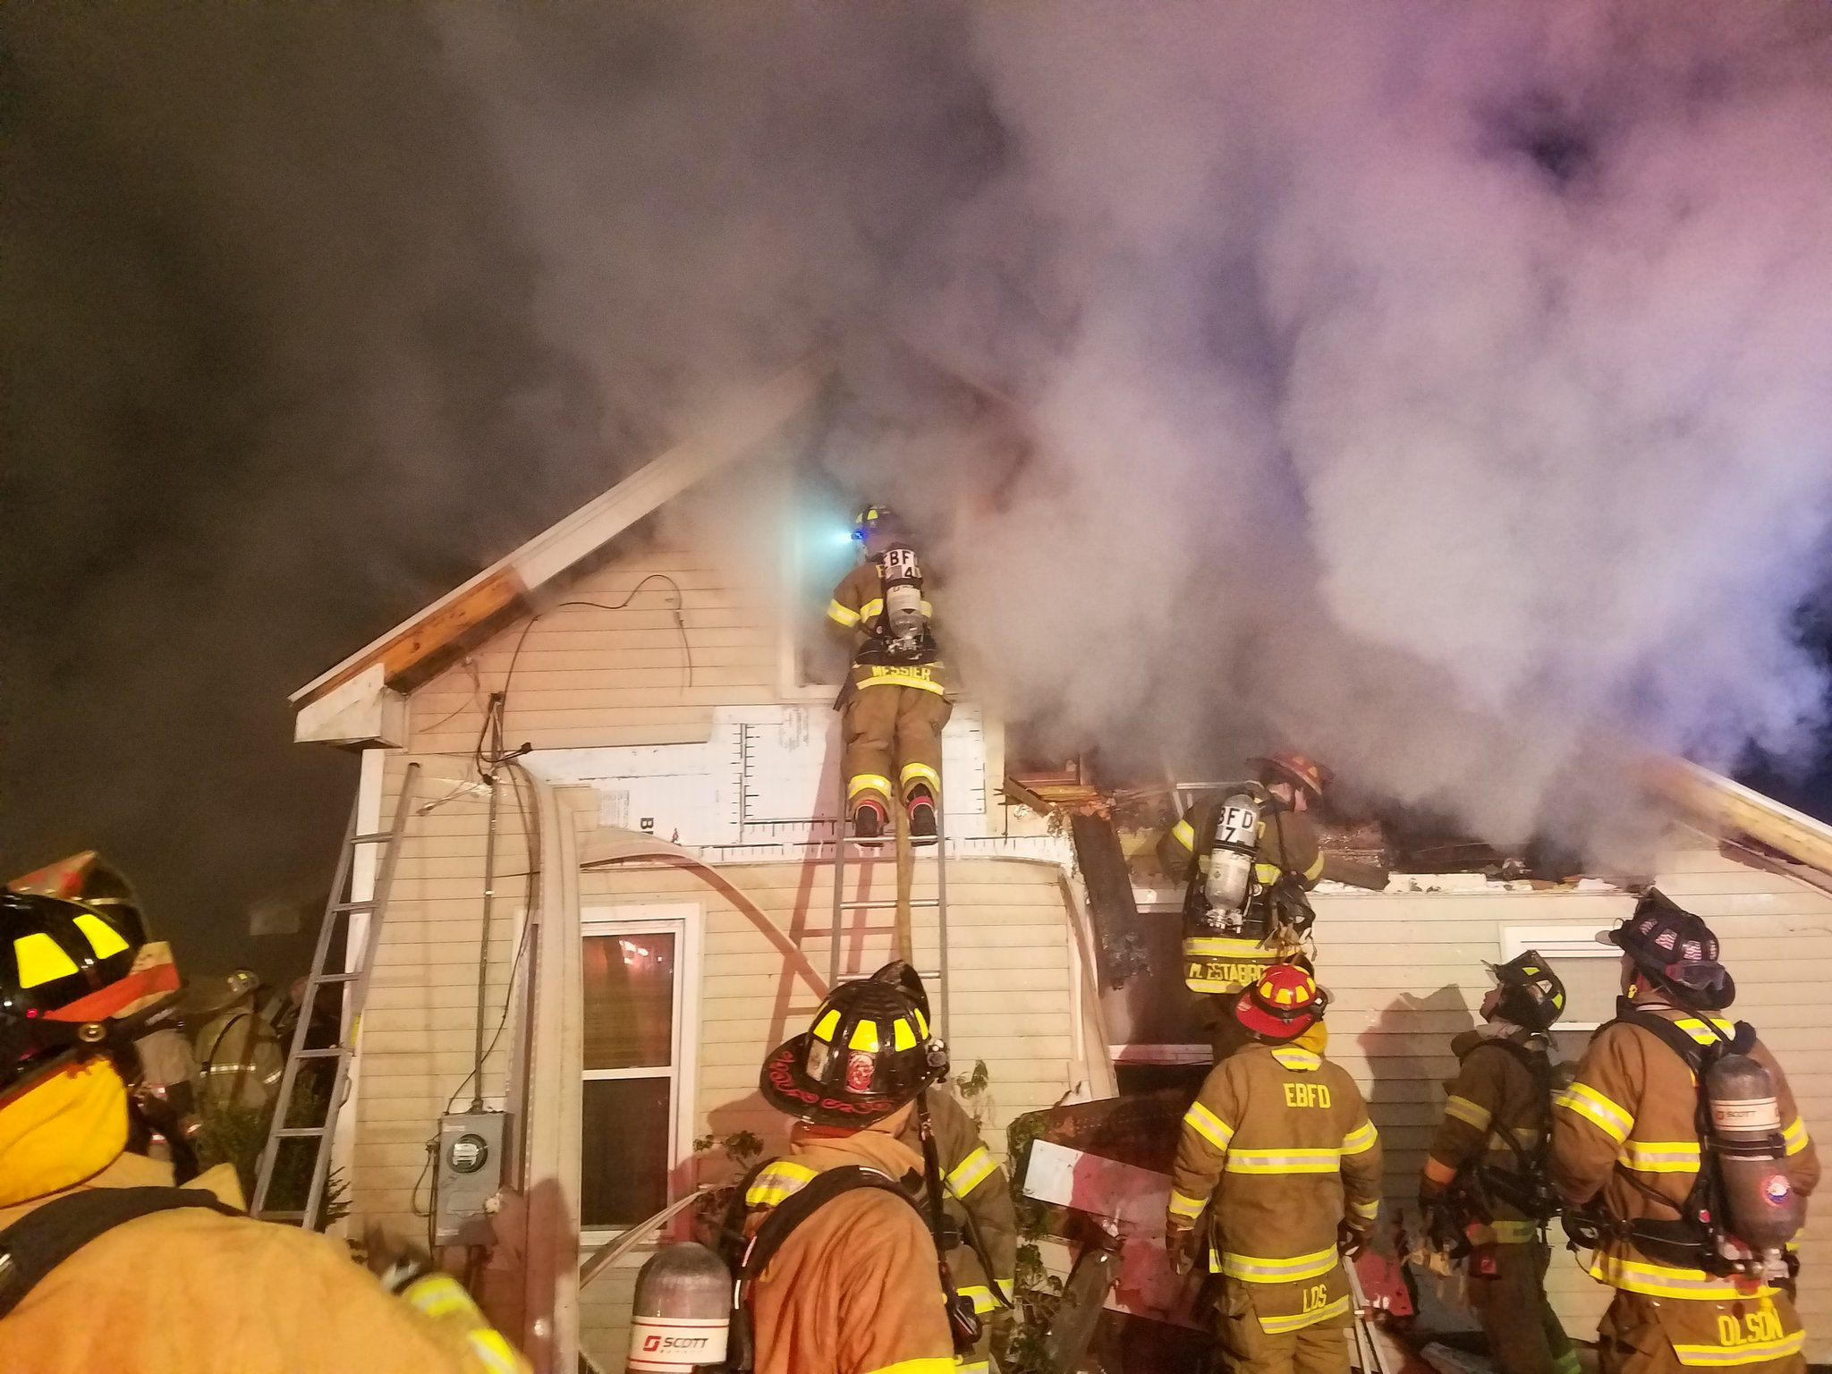
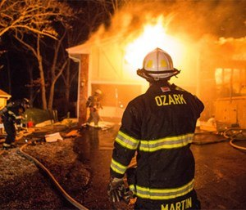
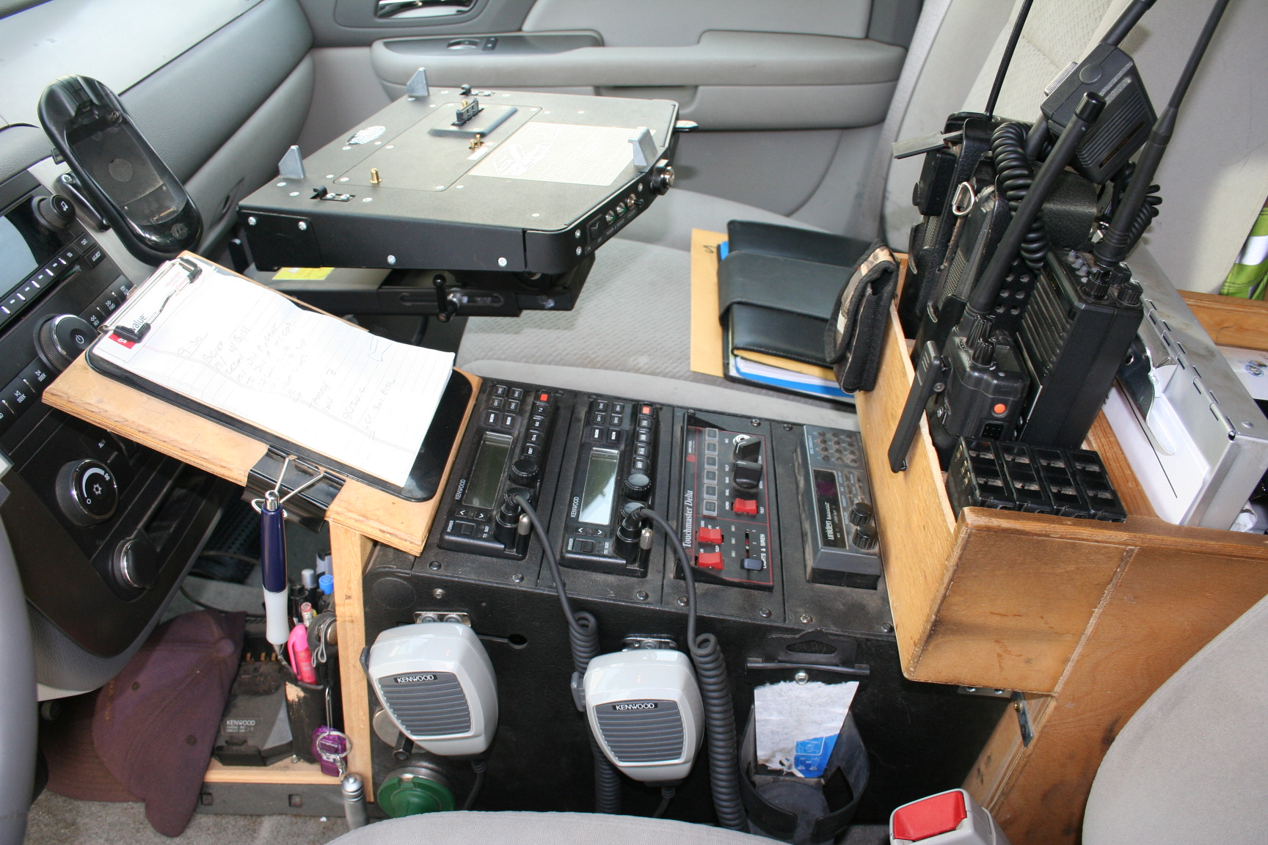
HOW THIS TRANSLATES TO THE FIREGROUND
TASK LEVEL
TACTICAL LEVEL
STRATEGIC LEVEL

Slide 4
Rules of 6
Strategic
Tactical
Task
Incident Command (IC) ensures safety for the entire event
Responsibility is all encompassing
360-degree safety zone
Division and group supervisors are responsible for the tactical deployment and supervision of all resources assigned to the hazard-zone in their division/group
60-foot safety zone
Firefighters and Company Officers are responsible for the safe completion of individual task level assignment(s)
Company Officers are responsible for the safety of their entire crew 16-foot zone
Firefighters are responsible for their own personal safety/workspace 6-foot zone

Slide 5
Terminology: LEVEL 1 STAGING
First Due station units respond directly to the scene
Remaining Units assign in their direction of travel, uncommitted, approx. 1 – 2 blocks from the scene
  “Level one” and direction of travel
  Engines should not pass last hydrant (think possible water supply needs)
  Trucks should not pass last access point (think possible placement for aerial use)

Slide 6
Terminology: LEVEL 2 STAGING
When requested by the Incident Commander or large-scale incidents
  Formal staging area designated by the Incident Commander
  Should be close enough to the scene to allow a quick and appropriate response but far enough away not to interfere with the events operation
The first arriving units Company Officer will become the incidents initial Staging Officer
  This can be reassigned to a subsequent arriving Officer (Usually a Chief Officer)
A Separate Radio Channel may be utilized for Level 2 Staging (“Staging”)

Slide 7
Terminology: on-deck
Resources located adjacent to attack positions, outside the hazard-zone.
Assignments that may be given to companies in a forward staging (on-deck) area include back-up, search, RIT, ventilation, etc. On-deck crews MUST ensure point of egress are secure, RIT bag is deployed, back-up line is pulled, and 360 is completed at a minimum.

Slide 8
On-Deck
Benefits:
  Places resources in the correct positions prior to their need
    Assists IC in forecasting the incident event
  Provides sufficient resources to get the job done
  Give relief crews ability to have face to face communication
  Improves the standard work cycle (recycle versus rehab)
  Allows Company Officers to manage the details of their area

Slide 9
On-Deck ready state
Minimum Equipment
Full turnout gear
SCBA (Bottle fully open)
Radio (Set to the tactical fireground channel)
TIC
Flashlight
Hand tools
RIT bag
Tasks/Activities to perform
360 and size-up of structure
Actively listening to tactical fireground channel
Hose line identification
Soften structure (Forcing doors, removing bars/gates, anything to gain rapid access/provide rapid egress) in your area
Portable lights
Staging equipment that may be needed (Stokes basket, fans, attic ladders, tools, lights)

Slide 10
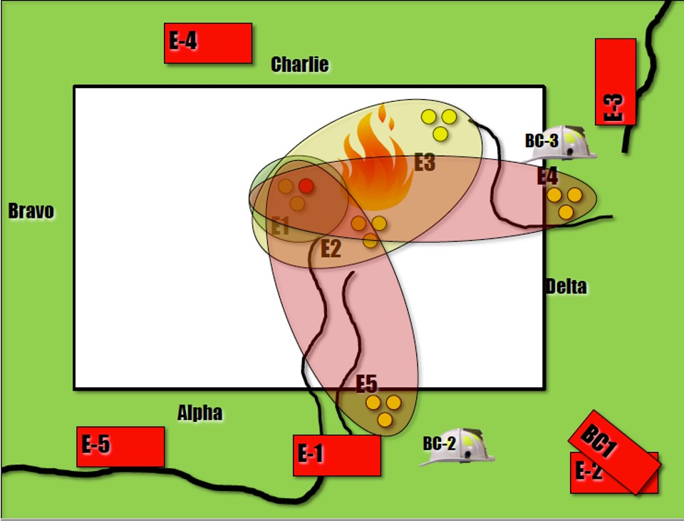
Rescue Group (RIT)
The primary responsibility of On-Deck companies is RESCUE for the companies operating inside of the hazard-zone

Slide 11
Terminology: recycle
A timely and efficient means of air replacement and rehydration
Occurs outside the hazard-zone in the division the company is assigned
  Important part of accountability

Slide 12
Terminology: rehab
Function and location for medical evaluation and treatment
Report to rehab after three (2-3) 30-minute SCBA bottles or TWO (2) 45-MINUTE SCBA BOTTLES- (*ESTIMATE*)
Report to rehab when individual feels they need rehab

Slide 13
RECYCLE VS. REHAB
An import aspect of fireground accountability
Important to understand:
  RECYCLE is completed within the assigned division
  REHAB is a designated assignment

Slide 14
Terminology: offensive strategy
Operations are conducted inside the hazard-zone
  Rescue
  Fire Control
  Primary searches
  Ventilation
  Under Control
  Post fire decontamination
  Incident Stabilization

Slide 15
Offensive Strategy
It is important to note that only the incident commander decides what the strategy is
  Companies do not assume anything based on tactics being employed
    Exterior streams
    Large caliber streams
    Other low frequency tactical options
  These are tactics that may be used offensively for a short period of time – Often to reset fires prior to entry

Slide 16
Terminology: defensive strategy
Operations are conducted outside the hazard-zone
  Define the hazard zone
  Establish cut-off points (stop the forward progress of the fire)
  Search exposures
  Protect exposures
  Number #1 tactical and task level goal at Defensive fires is no firefighter gets hurt

Slide 17
Terminology: Fire control or Attack
Tactical benchmark
The #1 priority of company assignments during any offensive fireground operation (if no apparent rescue exists)
The focus of the IC’s resources will initially be directed at achieving fire control
The act of isolating, confining, and extinguishing the fire in the hazard-zone
Fire has been confirmed as having no extension in a companies assigned geographical area (Interior)

Slide 18
Terminology: Primary All clear
Tactical benchmark
This is the number #1 tactical benchmark the IC needs to complete
  IC’s will need to “drive” the completion of the search and assign companies to cover all areas of the structure with primary searches
Indicates that an initial search for victims has been completed in a companies assigned geographical area
  Generally, reported for an entire floor or entire structure

Slide 19
Terminology: all clear
Tactical benchmark
Indicates a secondary search for victims has been completed in a companies assigned geographical area
  Generally, reported for an entire floor or entire structure

Slide 20
Primary & all clear
Primary searches are usually conducted in conjunction with fire attack
Secondary searches may or may not be completed after fire control is achieved
A thorough search must be completed in conjunction with fire control and ventilation
All searches should be conducted by different crews
Speed-fast yet thorough

Slide 21
Terminology: under control
Tactical benchmark
Overhaul and salvage operations revolve around minimizing damage and loss
Incident will be handled with resources already on scene

Slide 22
Terminology: commonly used unofficial benchmarks
“Working fire”: Indicates a situation that requires at least the commitment of all initially responding companies
“Water on the fire”: Indicates that a company found the seat of the fire and applied water
“Knockdown”: Indicates that the main body of fire has been controlled in a companies assigned geographic area. Overhaul may still need to be completed.

Slide 23
Radio communication order model
Caller contacts receiver
Receiver acknowledges caller
Caller transmits the message
Receiver confirms the message has been received
Properly following the Order Model will
reduce the overall amount of radio traffic
enhance the accountability process
prevent deployment mistakes, directional mistakes and freelancing

Slide 24
Radio discipline
The tactical fireground channel must remain as clear as possible for critical radio traffic (priority/emergency radio traffic, completion of tactical priorities, Maydays)
Once a company is assigned into the hazard-zone they should maintain radio silence unless they are contacted by the Incident Commander (This does not include achievement of tactical benchmarks, status changes, roof reports, priority radio traffic, Maydays)
Fireground radio traffic should be driven and controlled by the Incident Commander

Slide 25
Can reports
Provides task level firefighters a standard way to report back to the Incident Commander on their progress and needs
Keeps things simple and uniform
Delivers the Incident Commander the information needed to keep the incident strategy and action plan current

Slide 26
Can reporting
Conditions
Where are you and what are the conditions (Include location)
Actions
What actions are you taking and what affect are they having on the problem
Needs
What resources or support do you need (or NO NEEDS)

Slide 27
Can reporting
All reports should be given in the CAN format
Should include tactical objectives that have been completed
Standard, concise, and consistent

Slide 28
Status change reports
Important aspect of fireground accountability
Required when a company is moving from their assigned work location to a different geographical work location
Required when a company completed their work assignment or cannot complete their work assignment

Slide 29
Priority radio traffic
Used by task and tactical level members/companies to report immediate life safety finding to the Incident Commander
All individuals on the fireground are expected to IMMEDIATELY transmit priority radio traffic
Members/companies with priority traffic are allowed to break into the order model of routine radio traffic to deliver their message (Takes precedence over all standard fireground radio traffic)

Slide 30
Emergency radio traffic
Used to report Emergency Life Safety information to companies operating on the fireground
Primarily by the incident commander
Will often be associated with an EXIT/ABANDON order
Takes priority over all standard fireground radio traffic

Slide 31
Mayday
An event in which a firefighter becomes lost, down, or trapped and cannot safety exit the IDLH hazard zone. A May-Day may also be declared for any unit or member operating inside of an IDLH hazard zone who does not answer their portable radio after 3 attempts.
Repeat the Message three times- MAYDAY, MAYDAY, MAYDAY
  All others radio discipline
  Everyone else remain in their positions until told to do something else

Slide 32
MAYDAY, MAYDAY, MAYDAY
LUNAR vs WHO,WHAT, WHERE
  CAN reports
    (Location)Conditions
    Actions
    Needs
This is not a Mayday Class

Slide 33
TERMINOLOGY: SPAN OF CONTROL
Division
Group
Sector
A geographical subdivision of the incident site
Assigned companies report to and are supervised by one designated Division Supervisor
E.g. Division 4 = (4th floor), Division Charlie, Roof Division
A functional work group that is not tied to a specific location
Assigned companies report to and are supervised by one designated
Group Supervisor
E.g. Search and Rescue Group, Fire-Attack Group, Ventilation Group
Used to name both geographical and functional work groups
Generally reserved for large scale incidents
Group and Division Supervisors will report to one designated Sector Supervisor
E.g. East and West Sector, Sector 1 and Sector 2

Slide 34
TERMINOLOGY: Division Supervisor
SDG
Division Supervisors have 2 major responsibilities
  Tactical Level decisions
  Safety
Tactical Level Responsibility
  Division plan matches IC plan
  Completion of priorities (Benchmarks)
  Maintain Span of Control 3-5 (based on factors)
Communications now go through the SD Boss

Slide 35
Critical Fireground Factors are a list of basic items the IC must consider when evaluating tactical situations
Critical Fireground Factors fall into 8 Basic categories:
Building
Fire
Occupancy
Life Hazard
Arrangement
Resources
Action
Special Circumstances

Slide 36
Consider Fixed Factors
Manage Variable Factors
Fixed Factors
Variable Factors
Building*
Occupancy*
Arrangement
Fire*
Life Hazard*
Resources
Action
Special circumstances

Slide 37
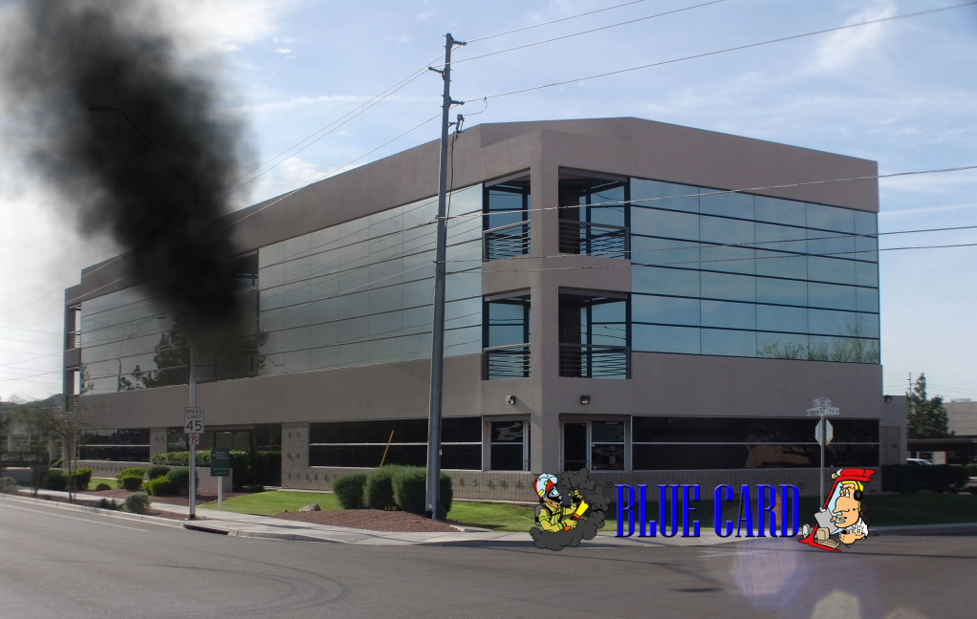
Critical Factor - Fixed
Building
Size – Area & Height
Interior arrangement
Construction type
Age
Condition
Value
Compartmentation/separation
Outside openings
Utility characteristics
Effect the fire has had on structure
Time projection on fire effects
How much is left to burn

Slide 38
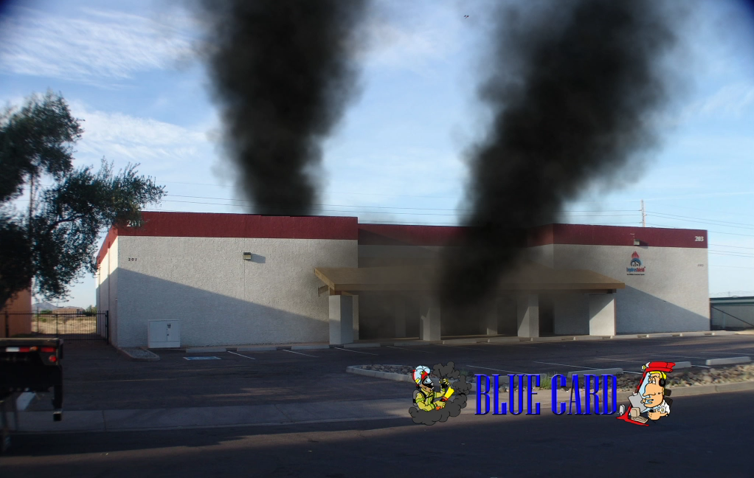
Critical Factors - Fixed
Occupancy
Specific occupancy type: business, mercantile, public assembly, institutional, industrial, residential, storage, high rise
Value associated with occupancy
Status: open, closed, occupied, vacant, abandoned, under construction
Type of contents associated
Time – as it affects use
Loss control
Morale hazard

Slide 39
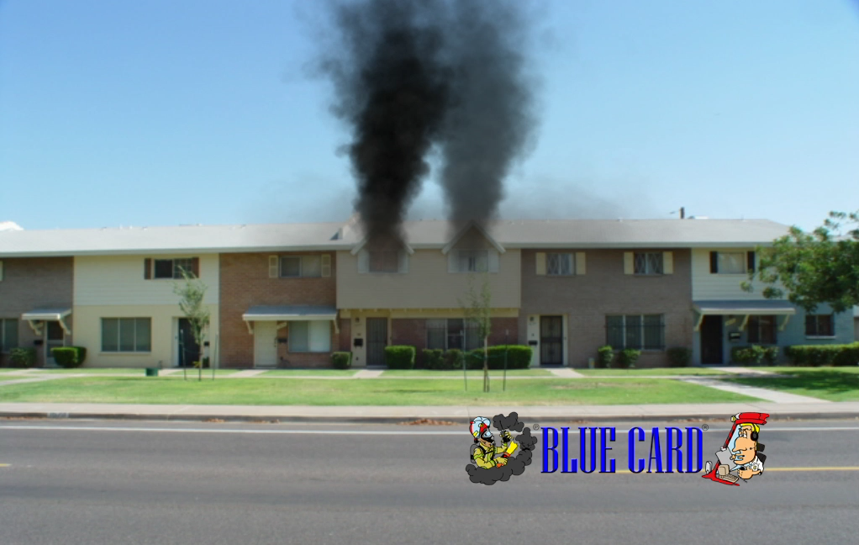
Critical Factors - Fixed
Arrangement
Distance of external exposures
Combustibility of exposures
Access, arrangement of internal exposures
Value of exposures
Most dangerous direction of fire ext.
Fire effect on exposures
Barriers or obstruction to operations
Limitations on apparatus movement
Multiple Buildings

Slide 40
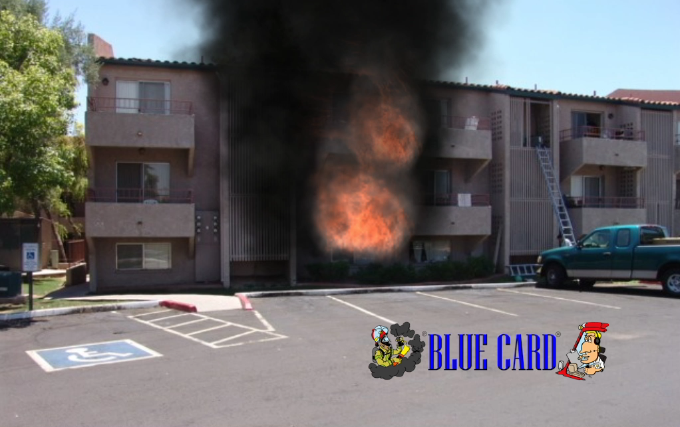
Critical Factor - Variable
FIRE #1
Size
Extent
Location (HUGE)
Stage – incipient, free burning, ventilation controlled, or decaying
Wind direction and speed
Most dangerous direction of travel
Time of involvement
Fire load
Type & amount of product left to burn
Product of combustion liberation
What is the fire perimeter
How widespread is the fire

Slide 41
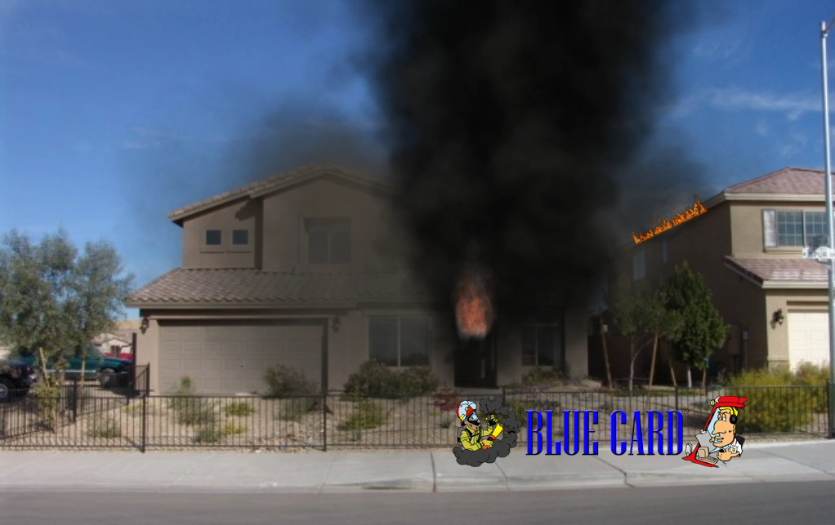
Critical Factor - Variable
Life Hazard
Fire control required for search
Location of occupants
Number of occupants
Condition of occupants
Incapacities of occupants
Resources required for search
EMS needs
Fire effect on victims
Exposures
Hazards for firefighters
Access to victims
Escape routes

Slide 42
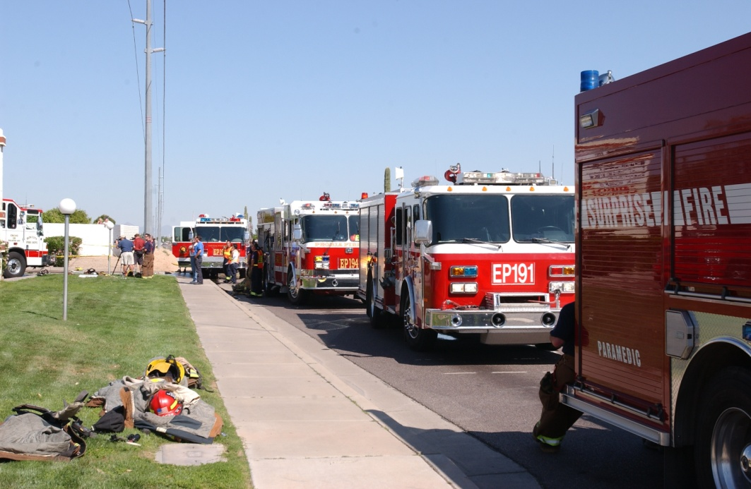
Critical Factors - Variable
Resources
Staffing & Equipment On-Scene
Staffing & Equipment Responding
Staffing & Equipment Available
Estimate on Response times
Condition of Responders
Capability of Personnel
Capability of PPE and Safety Systems
Capability of Command staff
Hydrants & Water Supply
Built-in Protection Systems

Slide 43

Critical Factors - Variable
Special Circumstances
Time of day/night
Day of week
Season
Holidays
Special Events
Weather / Wind
Social unrest

Slide 44
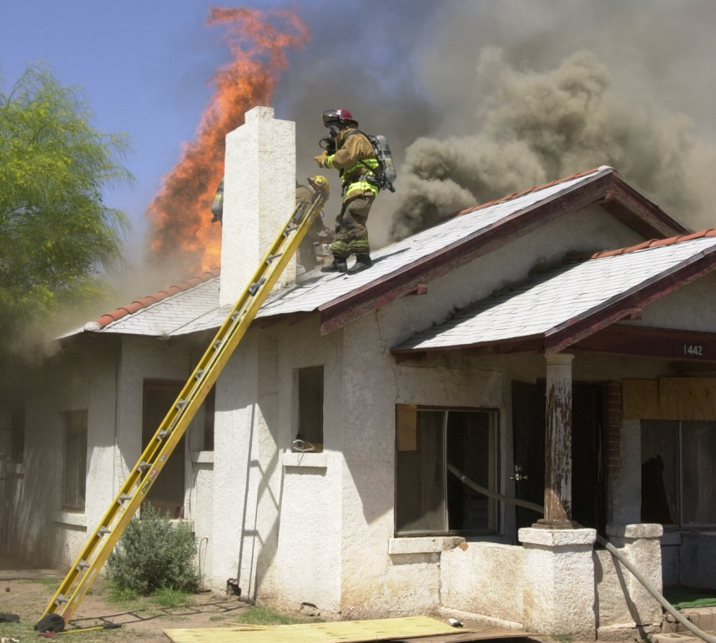
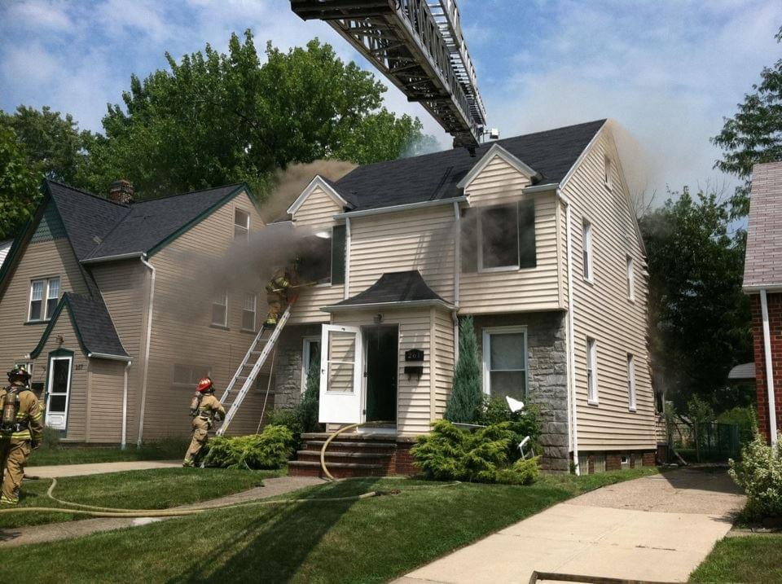
Critical Factors - Variable
Action
Is water on the fire?
Effect current action is having?
Areas not yet covered?
Stages of operation (tactical priorities)
Is a Strategic IC set-up?
Is an effective IAP in place?
Is an effective organization in place?
What is the worst thing that can happen?
Are operating positions effective?
Are there enough resources?
Are we operating safely?

Slide 45
Initial Radio Report (IRR)
“The initial radio report is probably THE most important communications we transmit throughout an entire incident”.

Slide 46
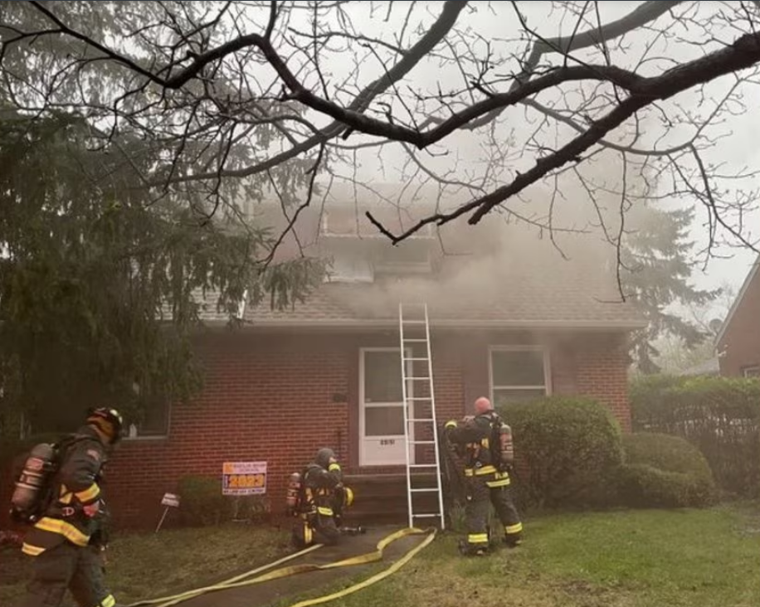

Slide 47
The Initial Radio Report must include:
Clear Alarm, announce your arrival on the scene
Building/area description
Describe the problem
**Action being taken – Initial I.A.P.**
Declaration of the Strategy
Resource Determination
Assuming and Naming of Command

Slide 48
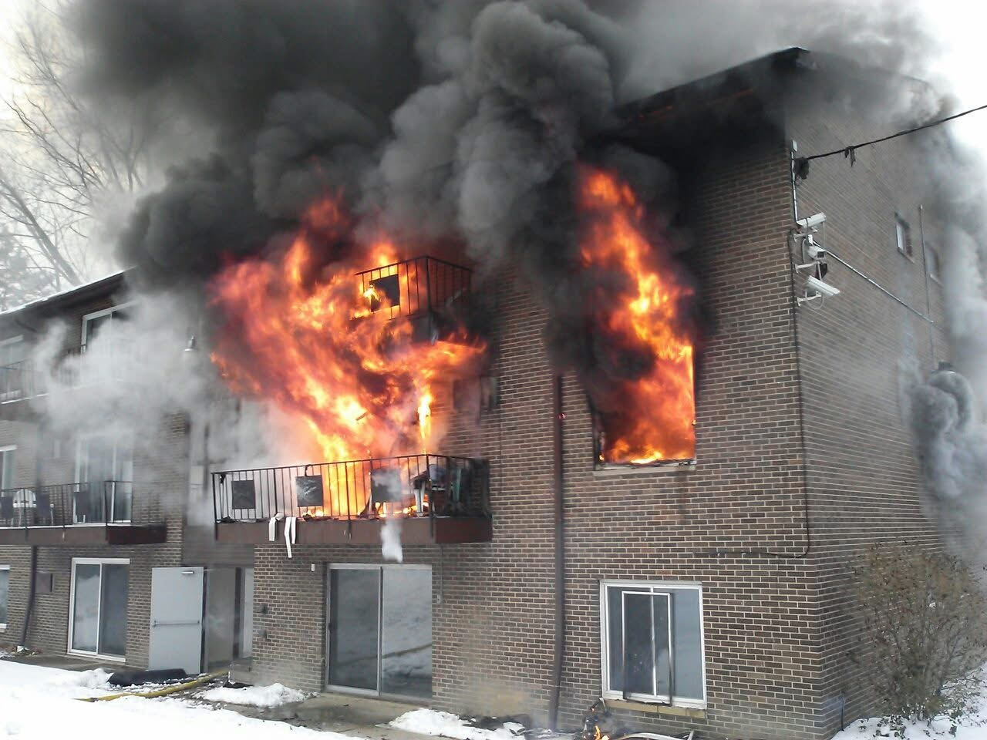

Slide 49
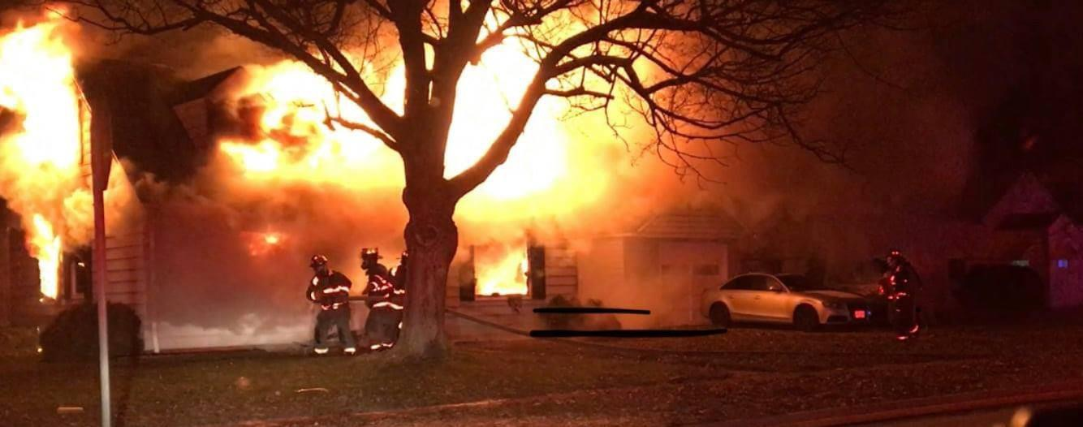

Slide 50
