Slide 1

Wyoming Department of Health
Healthcare Licensing and Surveys
WyLTC Association
September 10, 2026
Janelle Conlin, Acting SA Director
Tim Cozad, Chief LTC, Healthcare Surveillance Branch
Pat Davis, Chief Life Safety & Construction Branch

Slide 2
Wyoming Department of Health
Healthcare Licensing and Surveys
Agenda:
Staffing update
Health survey updates
CMS Nurse Staffing campaign update
Risk based survey (RBS) update
Construction/LSC/EP updates

Slide 3
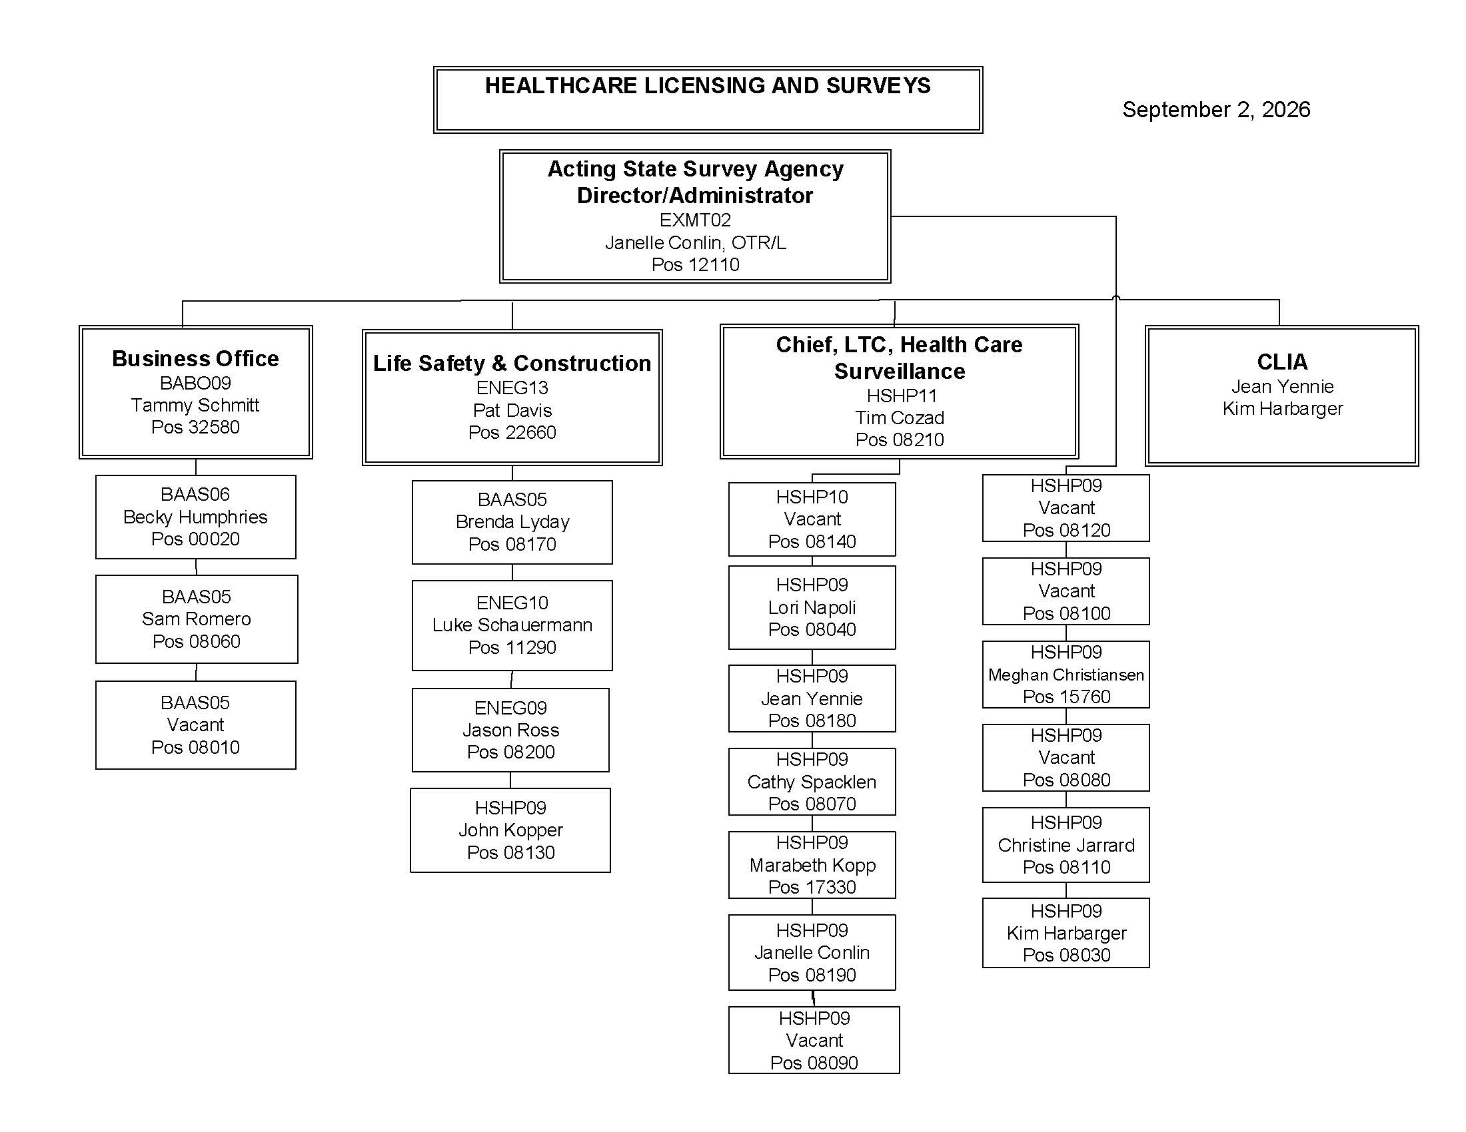

Slide 4
NURSING HOMES
TOP 10 CITED HEALTH DEFICIENCIES
Standard and Complaint Surveys
FFY2025
WYOMING |  |  |  | REGION |  |  |  | NATION
74 Surveys |  |  |  | 1,252 Surveys |  |  |  | 63,975 Surveys
Tag | Description | % |  | Tag | Description | % |  | Tag | Description | %
F880 | Infection Prevention & Control | 30% |  | F689 | Free of Accident Hazards/Supervision/Devices | 24% |  | F880 | Infection Prevention & Control | 11%
F600 | Free from Abuse and Neglect | 28% |  | F880 | Infection Prevention & Control | 22% |  | F689 | Free of Accident Hazards/Supervision/Devices | 10%
F689 | Free of Accident Hazards/Supervision/Devices | 16% |  | F600 | Free from Abuse and Neglect | 16% |  | F812 | Food Procurement, Store/Prepare/Serve-Sanitary | 8%
F609 | Reporting of Alleged Violations | 11% |  | F812 | Food Procurement, Store/Prepare/Serve-Sanitary | 13% |  | F684 | Quality of Care | 7%
F883 | Influenza and Pneumococcal Immunizations | 10% |  | F658 | Servicers Provided Meet Profession al Standards | 10% |  | F656 | Develop/Implement Comprehensive Care Plan | 6%
F684 | Quality of Care | 10% |  | F609 | Reporting of Alleged Violations | 9% |  | F761 | Label/Store Drugs and Biologicals | 6%
F605 | Right to be Free from Chemical Restraints | 10% |  | F684 | Quality of Care | 7% |  | F600 | Free from Abuse and Neglect | 5%
F725 | Sufficient Nursing Staff | 10% |  | F657 | Care Plan Timing and Revision | 7% |  | F609 | Reporting of Alleged Violations | 4%
F580 | Notify of Changes (Injury/Decline/Room, etc.) | 8% |  | F610 | Investigate/Prevent/ Correct Alleged Violations | 6% |  | F755 | Pharmacy Srvcs/Procedures/ Pharmacist/Records | 4%
 |  |  |  | F761 | Label/Store Drugs and Biologicals | 6%

Slide 5
NURSING HOMES
TOP 10 CITED HEALTH DEFICIENCIES
Standard and Complaint Surveys
FFY2026 YTD
WYOMING |  |  |  | REGION |  |  |  | NATION
47 Surveys |  |  |  | 689 Surveys |  |  |  | 37,259 Surveys
Tag | Description | % |  | Tag | Description | % |  | Tag | Description | %
F689 | Free of Accident Hazards/ Supervision/Devices | 30% |  | F689 | Free of Accident Hazards/ Supervision/Devices | 30% |  | F880 | Infection Prevention & Control | 11%
F880 | Infection Prevention & Control | 26% |  | F880 | Infection Prevention & Control | 30% |  | F689 | Free of Accident Hazards/ Supervision/Devices | 9%
F600 | Free from Abuse and Neglect | 23% |  | F600 | Free from Abuse and Neglect | 20% |  | F812 | Food Procurement, Store/ Prepare/Serve Sanitary | 8%
F761 | Label/Store Drugs and Biologicals | 21% |  | F812 | Food Procurement, Store/ Prepare/Serve Sanitary | 20% |  | F684 | Quality of Care | 7%
F628 | Discharge Planning | 19% |  | F761 | Label/Store Drugs and Biologicals | 16% |  | F761 | Label/Store Drugs and Biologicals | 6%
F812 | Food Procurement, Store/ Prepare/Serve Sanitary | 19% |  | F684 | Quality of Care | 15% |  | F656 | Develop/Implement Comprehensive Care Plan | 6%
F677 | ADL Care Provided for Dependent Residents | 13% |  | F609 | Reporting of Alleged Violations | 13% |  | F755 | Pharmacy Srvcs/Procedures/ Pharmacist/Records | 4%
F627 | Inappropriate Discharge | 13% |  | F610 | Investigate/Prevent/Correct Alleged Violation | 10% |  | F842 | Resident Records – Identifiable Information | 4%
F684 | Quality of Care | 13% |  | F695 | Respiratory/ Tracheostomy Care and Suctioning | 9% |  | F677 | ADL Car Provided for Dependent Residents | 4%
 |  |  |  | F628 | Discharge Process | 8% |  | F584 | Safe/Clean/Comfortable/ Homelike Environment | 4%

Slide 6
Complaint Data
NURSING HOMES
 | FFY20 | FFY21 | FFY22 | FFY23 | FFY24 | FFY25 | FFY26 YTD
TOTAL # | 132 | 111 | 121 | 151 | 227 | 256 | 310
SUBSTANTIATED | 37 | 32 | 39 | 55 | 84 | 107 | 81
 | 28.0% | 28.8% | 32.2% | 36.4% | 37.0% | 42.5% | 41.8%
UNSUBSTANTIATED | 95 | 79 | 82 | 96 | 143 | 145 | 113
 | 72.0% | 71.2% | 67.8% | 63.6% | 63.0% | 57.5% | 58.2%
# PENDING | 0 | 0 | 0 | 0 | 0 | 4 | 116

Slide 7
NURSING HOME STANDARD SURVEYS
AVERAGE # OF HEALTH DEFICIENCIES
FFY | WYOMING | REGION | NATION
2019 | 7.3 | 6.7 | 6.9
2020 | 6.3 | 6.2 | 6.4
2021 | 4.7 | 6.3 | 6.2
2022 | 5.5 | 6.3 | 6.9
2023 | 5.4 | 6.0 | 7.2
2024 | 4.5 | 6.6 | 7.7
2025 | 5.0 | 7.3 | 8.0
2026 YTD | 6.6 | 6.8 | 7.6

Slide 8
AVERAGE FULL SURVEY FREQUENCY
YEAR | NURSING HOMES (Months)
FFY20 | 11.91
FFY21 | 21.52
FFY22 | 15.49
FFY23 | 12.13
FFY24 | 13.19
FFY25 | 14.28
FFY26 YTD | 15.0

Slide 9
NURSING HOME INFORMAL
DISPUTE RESOLUTION
FEDERAL FISCAL YEAR | # SURVEYS REQUESTED | # OF TAGS | NO CHANGES | MODIFICATIONS | DELETED
2019 | 15 | 23 | 7 | 7 | 9 (39%)
2020 | 2 | 3 | 1 | 2 | 0 (0%)
2021 | 6 | 12 | 3 | 5 | 4 (33%)
2022 | 11 | 22 | 7 | 4 | 11 (50%)
2023 | 10 | 17 | 7 | 2 | 8 (47%)
2024 | 6 | 12 | 6 | 2 | 4 (33%)
2025 | 7 | 10 | 2 | 2 | 6 (60%)
2026 YTD | 6 | 7 | 5 | 0 | 2 (29%)
TOTAL | 63 | 106 | 38 | 24 | 44 (42%)

Slide 10
Wyoming Department of Health
Healthcare Licensing and Surveys
CMS Nursing Home Staffing Campaign update
Wyoming is contributing $376,240 from CMP funds and CMS is contributing $249,411.
QSO-26-08 Memo

Slide 11
Wyoming Department of Health
Healthcare Licensing and Surveys
CMS will be offering financial incentives to help recruit RNs/LPNs to work in nursing homes. Specifically, qualified RNs and LPNs will be able to receive up to $40,000 for loan repayment and/or a $10,000 stipend in return for working three years in a qualifying nursing home.

Slide 12
Wyoming Department of Health
Healthcare Licensing and Surveys
Target number of nurses to recruit in WY is 18
CMS determined eligible nursing homes and sent a list to each state
27 facilities are eligible in WY (target # of facilities is 1.5 times the target # of nurses)

Slide 13
Wyoming Department of Health
Healthcare Licensing and Surveys
CMS selected eligible nursing homes using the algorithm:
All NHs in rural-designated areas
All urban NHs that states submitted using a CMS-approved methodology
*All Wyoming NHs on the CMS list are in rural counties

Slide 14
Wyoming Department of Health
Healthcare Licensing and Surveys
CMS has selected the financial incentive administrators (FIAs).
WY will be served by Colorado Center for Nursing Excellence
FIAs will recruit nurses and maintain the list of open positions at qualifying nursing homes

Slide 15
Wyoming Department of Health
Healthcare Licensing and Surveys
https://www.cms.gov/priorities/nursing-home-careers/overview
(CMS nurse recruitment webpage)

Slide 16
Wyoming Department of Health
Healthcare Licensing and Surveys
Risk Based Survey (RBS)
Implemented September 8, 2026
This is a modified form of the long term care survey process (LTCSP) for higher performing facilities. Approximately 12% of NHs nationwide will qualify

Slide 17
Wyoming Department of Health
Healthcare Licensing and Surveys
The RBS process includes a streamlined review of all of the required areas and fewer activities. They are conducted in roughly half the time with fewer total surveyors.

Slide 18
Wyoming Department of Health
Healthcare Licensing and Surveys
CMS will provide each SA with a list of RBS qualified NHs at the end of each quarter. Facilities are eligible for the RBS for 6 months after the SA receives the list, unless the facility meets any of the disqualifying criteria after the list is sent.

Slide 19
Wyoming Department of Health
Healthcare Licensing and Surveys
To qualify, must NOT have:
Less than 5-star overall rating
Less than 3-star staffing ratio
Any citation for actual harm, IJ, or SQC in the last survey cycle
More than 18 months without standard survey
Any staffing waivers in effect

Slide 20
Wyoming Department of Health
Healthcare Licensing and Surveys
6. Failed PBJ staffing data audit
7. Failed MDS audit
8. Health inspection score higher than the 50th percentile in the State (lower score indicates better performance)
9. Two or more residents aged 65 or older that are coded with dx of Schizophrenia after being admitted without this dx.

Slide 21
Wyoming Department of Health
Healthcare Licensing and Surveys
10. A change in ownership since last standard survey
11. Special Focus Facility candidate
*SAs should conduct RBS surveys based on lists sent to them and the triggering of disqualification criteria, rather than what is displayed on the Nursing Home Care Compare website.

Slide 22
Wyoming Department of Health
Healthcare Licensing and Surveys
Disqualifying Criteria:
Citation at actual harm, IJ, or SQC that occurred on an investigation while the facility was listed as qualified
Pending intakes triaged at IJ
More than 3 pending intakes (complaints/facility reported incidents) triaged as medium or higher

Slide 23
Wyoming Department of Health
Healthcare Licensing and Surveys
4. CMS-approved nursing waivers
5. Change in ownership since last standard survey
* If a facility meets any of the exclusions, the SA must convert the RBS to a standard survey

Slide 24
Wyoming Department of Health
Healthcare Licensing and Surveys
Wyoming received our list from CMS and there are 7 NHs that are qualified.
7 out of 36 facilities=19%

Slide 25
Wyoming Department of Health
Healthcare Licensing and Surveys
RBS highlights:
Off-site prep:
Max of 3 active non-IJ intakes included
Contact the Ombudsman- if concerns, link residents and areas of concern

Slide 26
Wyoming Department of Health
Healthcare Licensing and Surveys
Offsite selected residents (system-generated)
Stage 3-4 PU not present on admission, fall with major injury, tube feeding with weight loss/dehydration, hospice, vent, dialysis

Slide 27
Wyoming Department of Health
Healthcare Licensing and Surveys
The only mandatory facility task is infection control. The others are triggered based on complaint intakes, Ombudsman concerns, or onsite concerns

Slide 28
Wyoming Department of Health
Healthcare Licensing and Surveys
Facility entrance:
*Special Entrance Conference Worksheet for RBS

Slide 29
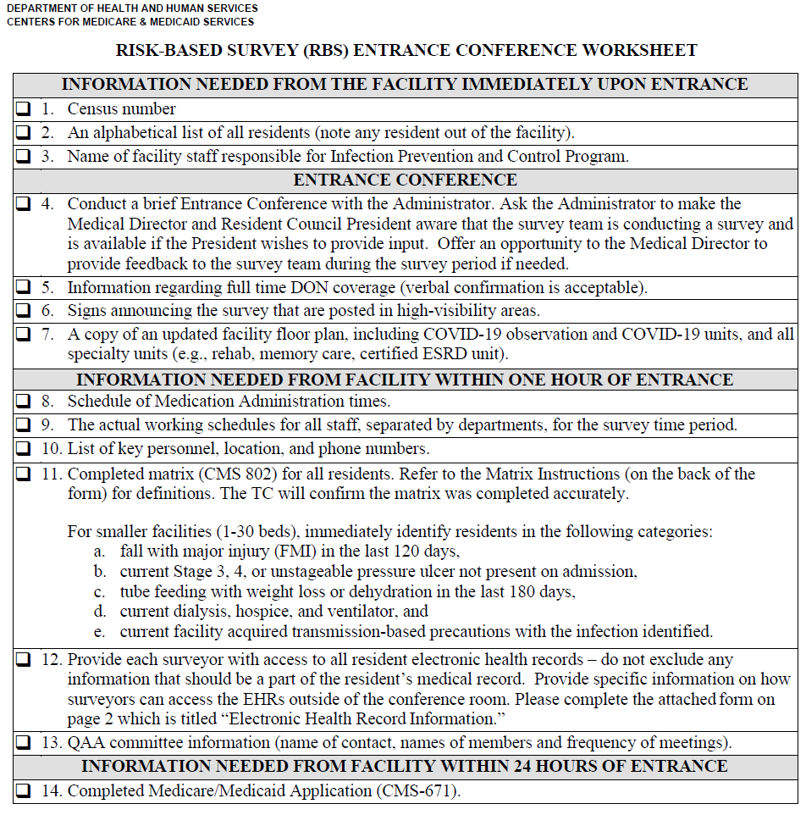

Slide 30
Wyoming Department of Health
Healthcare Licensing and Surveys
Screening categories (residents):
Offsite selected residents
High-risk matrix concerns (Stage 3-4 PU not present on admit, FMI, TF w/ wt loss or dehydration
Hospice, dialysis or ventilator
Transmission-based precautions (does not include enhanced barrier precautions)
Serious observation concerns

Slide 31
Wyoming Department of Health
Healthcare Licensing and Surveys
Recommended team size & initial pool size
Census 1-30: 1 surveyor; 3 pool size
Census 31-174: 2 surveyors; 6 pool size
Census 175 or more: 3 surveyors; 9 pool size
*if have more surveyors, pool size is same

Slide 32
Wyoming Department of Health
Healthcare Licensing and Surveys
Sample Selection:
No specific sample size required
Not required to review closed records
*At any point in the survey, the surveyors can expand the sample or areas to investigate based on concerns

Slide 33
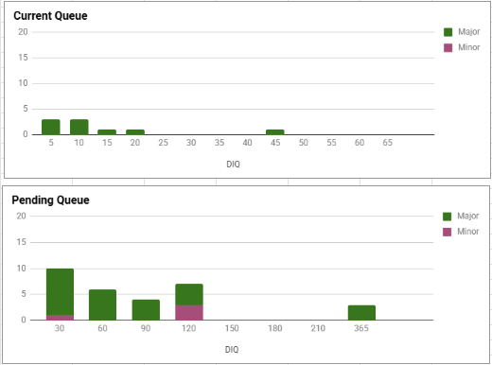
Construction Queue Updates
Current Vs. Pending

Slide 34
HLS Construction Project Submission
Chapter 3 Rules
  No updates at this time

Slide 35
HLS Construction Project Submission
Preliminary Plan Submission
  Should be submitted at Design Development, or approx. 30 % completion.
  Preferred Minimum Documentation Requirements
    Plans
      Code analysis indicating allowable square footage, building height etc. for new construction, or renovation projects.
      Overall plan indicating the area of work.
      Life Safety Plan is preferred if available.
      For major projects, final plan submission will not be waived. Preliminary plans should not be taken beyond 30%. Any information beyond the minimum requirements will typically be excluded from the preliminary review.
    Infection Control Risk Assessment (ICRA)
      ICRA should be approved by the owner.
      Templates are available from ASHE.org, or at the HLS Facility construction website, health.wyo.gov/aging/hls/healthcare-facility-construction.

Slide 36
HLS Construction Project Submission
Preliminary Plan Submission (Cont’d)
  Functional Program
    A Functional Program in accordance with the 2006 Guidelines for the Design and Construction of Health Care Facilities (FGI Guidelines) must be included.
    Note – Per the Chapter 3 Construction Rules and Regulations for Health Care Facilities, Adult Day Care Facilities, Assisted Living Facilities, Boarding Homes, and Hospice Facilities that do not provide inpatient care are exempted from the FGI Guidelines. Therefore, the ICRA and Functional Program are not required, but are useful in assisting HLS plan reviewers to better understand the scope of work.

Slide 37
HLS Construction Project Submission
Preliminary Plan Submission (Cont’d)
  The requirements for preliminary plan submission may be waived at the sole discretion of HLS engineers, based on the scope of the project.
  Preliminary plan acceptance will expire after 12 months if final plans have not been submitted and approved.
  Plans acceptance that has expired must be resubmitted for renewed acceptance.
  After preliminary plans are accepted, the final plans must be submitted for review. The owner may choose to retain an outside (3rd party) plan reviewer, at the owner’s expense, who has been qualified by HLS.
  3rd party plan review will not be applicable to codes or standards for which HLS has delegated review authority to the local AHJ.

Slide 38
HLS Construction Project Submission
Final Plan Submission
  Prior to beginning work, the owner must submit final plans to HLS for final plan acceptance, or provide documentation and a copy of the final plans that have been approved by a 3rd party and/or deligated AHJ. Work may not begin until HLS has authorized the project to proceed with construction.
  Documentation demonstrating plan acceptance by the WY. Department of Fire Prevention and Electrical Safety (DFPES), or their designee, must be provided to HLS before authorization to proceed with construction will be granted.
  HLS requests that the final plans have been coordinated with the local fire department regarding the location of fire department connections, access drives, etc. prior to being submitted for review.

Slide 39
HLS Construction Project Submission
Final Plan Submission (Cont’d)
  Documentation Requirements
    Plans should include all disciplines including Site Plans, Civil, Architectural, Structural, Mechanical, Plumbing, Electrical, IT/Data, etc.
    Plans must define the requirements for special inspections as required by the 2006 International Building Code. The requirements for deferred submittals such as fire alarm, sprinkler, or shielding (radiation or magnetic) must also be identified.
    Electrical plans will be reviewed by HLS only for compliance with NFPA 99, Health Care Facilities Code, NFPA 110, Standard for Emergency and Standby Power Systems, and the FGI Guidelines as applicable. Compliance with NFPA 70, National Electrical Code, must be determined by DFPES or their designee, and this acceptance must be provided to HLS.

Slide 40
HLS Construction Project Submission
Final Plan Submission (Cont’d)
  Note – All projects (especially demolition) must be coordinated with the WY. Asbestos Program. HLS will notify them of the project upon preliminary submittal, but it is the facility’s responsibility to ensure that all requirements have been satisfied. Notice of their acceptance is not required by HLS prior to final plan acceptance and notice to proceed with construction.

Slide 41
HLS Construction Project Submission
Final Plan Submission (Cont’d)
  Deferred FS and FA submittal packages must be one of the following:
    Stamped/signed by a WY licensed design professional (WLDP)
    Provided with a review letter prepared and signed by a WLDP
    Stamped and signed by a NICET IV or above.
  Deferred submittals should be reviewed and accepted by the architect or engineer of record prior to submission to HLS.
  Submittal packages should include the HLS project number and project description, and be delivered to HLS via the facility, the design team, or the GC. Submissions directly from the FS or FA contractor will not be accepted.
  The facility must ensure that HLS plan review comments are communicated to the construction team prior to installation. HLS has observed multiple instances of deficiencies cited during the licensure construction survey that were identified during plan review, but not addressed during installation.

Slide 42
HLS Interim Construction Inspections
Interim Construction Inspections
  It is the owners/facilities responsibility to request all necessary inspections by HLS.
  Minimum Inspection Requirements
    Under-slab plumbing
    Framing
    Mechanical/Plumbing (including med gases) rough-in
    Above-ceiling rough-in and fire-stop penetrations
  HLS can perform some interim inspections off-site via an affidavit form and necessary documentation. This should be coordinated with HLS on a case-by-case basis. Inspections are not approved until written notice has been provided by HLS.
  HLS may visit the site frequently to review progress.
  Inspections can be phased to accommodate the construction schedule, and should be coordinated with the HLS Engineer.

Slide 43
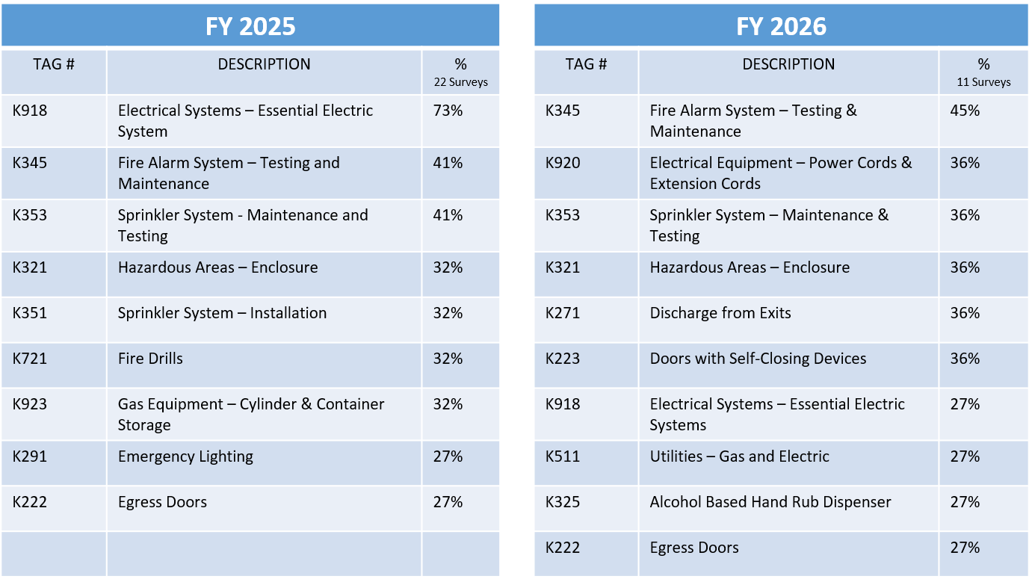
Nursing Homes
Wyoming Top 10 Deficiencies
Life Safety Code

Slide 44
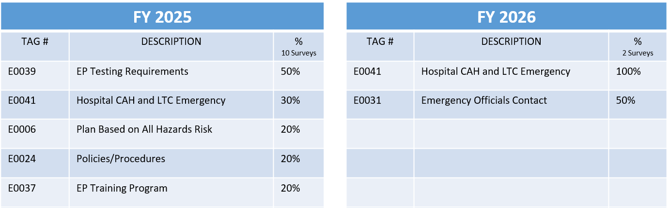
Nursing Homes
Wyoming Top 10 Deficiencies
Emergency Preparedness
E0041 has been cited along with K0918 regarding emergency power circuit breaker testing. CMS has issued revised guidance regarding this process. E0041 will now only be cited if the emergency generator is provided only as a part of the Emergency Preparedness Plan. As most facilities are required to have a generator, this will no longer apply to most surveys.

Slide 45


LSC Survey Items
K911 – Electrical Systems
  The following requirements are provided in NFPA 99, Health Care facilities Code:
  HLS has received documentation from most manufacturers indicating that testing via simulated overload trip conditions is not recommended.
  During a LSC survey, the facility will be require to provide a copy of their testing program, and documentation indicating that breakers have been inspected annually, and that all breakers have been periodically exercised per the testing program.

Slide 46
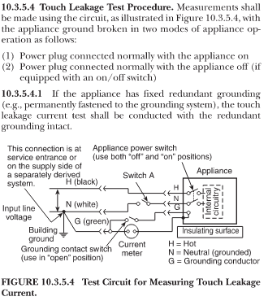
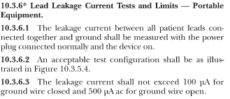
LSC Survey Items (Cont’d)
Patient Care-Related Electrical Appliances and Equipment (PCREE)
(K-921) Testing in accordance with 2012 NFPA 99, Sections 10.3.5.4 and 10.3.6.

Slide 47
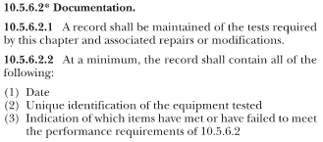

LSC Survey Items (Cont’d)
Patient Care-Related Electrical Appliances and Equipment (PCREE)
Documentation must be provided in accordance with 2012 NFPA, Section 10.5.6.2.

Slide 48
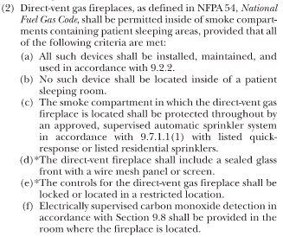
LSC Survey Items (Cont’d)
Direct-Vent Gas Fireplaces
The following must be provided in accordance with 2012 NFPA, Section 18.5.2.3(2).

Slide 49
Emergency Power
(Discussion)
The U.S. Department of Health and Human Services, Office of Inspector General (OIG), has shared a study performed to assess the reliability and adequacy of emergency power systems for nursing homes.
  Findings
    It is estimated that:
      73% of nursing homes have inadequate or unreliable emergency power systems
      53% of nursing homes have inadequate generator maintenance
      39% of nursing homes have generators with inadequate circuiting
      10% of nursing homes have generators that are 40 years of age or older
    It’s unclear what, if any, actions will be taken by CMS to address the findings of this study.
  CMS will be sharing this study with all nursing homes. Also available at:
https://oig.hhs.gov/reports/all/2026/most-nursing-homes-throughout-the-united-states-do-not-have-adequate-or-reliable-emergency-power-systems/

Slide 50
Emergency Preparedness
(Discussion)
Activation and Deployment of the Emergency Preparedness Plan (EPP)
  How is information shared?
  Do you have an easy way for staff to act quickly?
    Large EPPs can be all-inclusive, but are hard to navigate.
    Do your plans include abbreviated versions for staff that include only immediate action items?
  Who has access to the full EPP, and how is it stored?
    Large binders are cumbersome, and are easily locked in an office and inaccessible.
    Electronic versions often require passwords, and staff must know where to find them. How is this coordinated?
  Communication
    What methods are used for backup communication? Discussion.

Slide 51
Wyoming Department of Health
Healthcare Licensing and Surveys
Questions?

Slide 52

Wyoming Department of Health
Healthcare Licensing and Surveys

