Slide 1
Nursing Home Surveys in 2024
Jodi Eyigor | Director, Nursing Home Quality & Policy
LeadingAge | May 2024

Slide 2
Agenda
Survey Primer
LeadingAge Work on Surveys
Being Prepared
Feeling Empowered

Slide 3

Six Minute Souvenir
Divide a sheet of paper into 4 columns. Draw one of these figures at the top of each column:
  A book (for important facts)
  A lightbulb (for new ideas)
  A question mark (for any questions you have)
  A running stick figure (for “action plans”)
We’ll take a break at different points throughout the presentation to fill in the columns.

Slide 4

Survey Primer

Slide 5

Types of Survey
Standard recertification survey
Frequency: not to exceed 15 months
Could warrant revisit
Complaint survey
Immediate jeopardy: onsite within 3 business days
Actual harm (no IJ): onsite within 15 business days
Focused Infection Control survey
20% of providers each fiscal year

Slide 6
Survey Statistics
Wyoming, FY 2024
Only 3 (8.6%) providers exceed 15 months since last standard survey
Total: 81 surveys
  Standard: 14 (17%)
  Complaint: 35 (43%)
  Infection Control: 32 (40%)
National, FY 2024
27.8% of providers exceed 15 months since last standard survey
Total: 42,976 surveys
  Standard: 10%
  Complaint: 66%
  Infection Control: 24%

Slide 7
Federal Monitoring Surveys
“Validation Surveys”
Aimed at evaluating and advising state surveyors
At least 5% of providers in a state, no less than 5 each year
  Wyoming: 5 providers each year
3 types of health survey:
  Resource and Support
  Focused Concern
  Comparative

Slide 8
Federal Monitoring Surveys – Resource and Support
Side-by-side
Generally, first 6 months of fiscal year
Occurs with initial, standard, revisit, or complaint
Provide education, instruction, guidance to surveyors

Slide 9
Federal Monitoring Surveys – Focused Concern
Generally, second 6 months of fiscal year
Within 60 days of standard or complaint
Monitoring surveyor performance related to identified concerns
  At least 2 of the identified concerns
  Each of 3 concern areas covered by at least 50% of surveys
Resident sample: 60% of initial resident sample, not to exceed 5 residents

Slide 10
Focused Concern Areas
Selected every 2 years
3 concern areas identified for FY 2024/2025
Identified based on:
  Internal CMS data
  OIG recommendations
  White House initiative

Slide 11

Focus Concern 1: Nurse Staffing
Regulatory Groupings
§483.70 Administration
§483.35 Nursing Services
F-Tags
F851 Payroll Based Journal
F725 Sufficient Nurse Staffing
F727 RN 8 Hrs/7 days/Week, Full Time DON
Critical Element Pathway
Sufficient and Competent Nurse Staffing

Slide 12

Focus Concern 2: Unnecessary Psychotropic Medication
Regulatory Groupings:
§483.20 Resident Assessments
§483.21 Comprehensive Resident Centered Care Plan
§483.45 Pharmacy Services
F-Tags
F641 Accuracy of Assessments
F658 Services Provided Meet Professional Standards
F758 Free from Unnecessary Psychotropic Meds / PRN Use
Critical Element Pathways
Unnecessary Medications
Psychotropic Medications
Medication Regimen Review

Slide 13

Focus Concern 3: Facility-Initiated Discharge
Regulatory Groupings:
§483.15 Admission, Transfer, and Discharge
F-Tags
F622 Transfer and Discharge Requirements
F624 Preparation for Safe/Orderly Transfer/Discharge
F626 Permitting Residents to Return to Facility
Critical Element Pathways
Discharge

Slide 14
Federal Monitoring Surveys - Comparative
Look-back surveys
Within 60 days of standard
Monitor/evaluate surveyor performance

Slide 15
Prioritizing Surveys for Federal Monitoring
Data indicates risk of noncompliance with focused concern
History of noncompliance with focused concern
Allegations of noncompliance with focused concern
Good training opportunity (Resource Support Surveys only)

Slide 16
Risk-Based Survey Pilot
Announced in December 2023
Piloting currently in select states
Same survey elements, streamlined process
Less time on site, fewer surveyors
Would replace standard recertification survey

Slide 17
Risk-Based Survey Pilot
Criteria-based eligibility
Divert up to 10% of nursing homes in a state
  Wyoming: “3.5” providers, likely 3
  If fewer than 10% meet criteria, fewer than 10% are diverted

Slide 18
Risk-Based Survey Pilot - Considerations
Past survey history
  Rates and severity of noncompliance
  History of abuse
  Harm-level citations
Staffing
  Staffing levels
  Submission of PBJ data
Quality measures
  Rates of hospitalization
  Quality of care measures

Slide 19

Questions and Souvenirs
Take one minute: in the Book column, write a new fact you learned.

Slide 20
LeadingAge Survey Work

Slide 21
LeadingAge Survey Work
Began in summer 2023
Concerns about immediate jeopardy citations
Investigating interplay with psychosocial outcomes severity guide
November 2023: expand the scope

Slide 22
Initial Framework
Identified top concerns based on member feedback:
  Citation and enforcement inconsistency
  Surveyor approach
  Survey timelines
  Informal Dispute Resolution
  Facility-reported incidents (added after launch)
What can we do this year?

Slide 23
Citation and Enforcement Inconsistency
Increased federal oversight of state agencies
Federal standards for surveyor education, training, experience

Slide 24
Surveyor Approach
Surveyor evaluation and feedback opportunities
Communication / collaboration between state agencies and providers
Revised citation structure to focus on actual harm, immediate jeopardy

Slide 25
Survey Timelines
Prioritize complaint surveys to expand timeframe to 12-18 months
Use data to shorten standard recertification surveys

Slide 26
Informal Dispute Resolution
Include third party recommendations
Pathway to IDR scope and severity

Slide 27
Establishing Baseline
Interviewed all state partners
  41 states over 6 weeks
Focus of conversations:
  Concerns
  Priorities
  Bright spots

Slide 28
Additional Investigation
Survey citation and enforcement data past 5 years
State Performance Standards
Social Security Act and Code of Federal Regulation

Slide 29
Additional Qualitative Data
Alternative survey processes:
  Inpatient hospice
  Acute care, critical-access hospitals
  Accrediting organization
  Moving Forward Coalition (targeted recertification survey)
Expert insights on IDR:
  Member panelists in 3 states
  Law firm serving multiple states

Slide 30
What We Learned - Inconsistency
Not just state-to-state
  Regions within the state
  Among surveyor teams
Surveyor workforce is current issue
  Stretched thin, borrowing from other settings
  New surveyors with less experience, less training
Strengthened oversight will be passed down

Slide 31
What We Learned - Approach
Pressure to cite: society and CMS
Need to “humanize” both sides
Communication carries a risk
  Surveyor feedback participation would vary
  Prefer to go through state association
Revised citation structure would result in shift toward harm

Slide 32
What We Learned – Timelines
Look at past survey performance, staffing, quality measures
“If there’s an issue, the state will know.”
“They know where to look the second they cross the threshold.”
Work is being done:
  Moving Forward Coalition Action Plan
  CMS Risk-Based Survey pilot

Slide 33
What We Learned – IDR Processes
Processes vary widely by state
Few engage
Key reasons:
  Overwhelming/intimidating process
  Cost or resource prohibitive (easier to take the reduction)
  Doesn’t matter, state won’t overturn anyway

Slide 34
Outreach to CMS
January 2024 letter to CMS: Let us help!
March 2024 letter to CMS: Let’s talk!
April 2024 meeting with CMS: We have ideas!

Slide 35
Meeting with CMS
Questions:
  What is CMS doing to align survey processes across settings?
  How is CMS holding states accountable for consistency?
  What evidence supports positive correlation between citations and quality?
  What is the anticipated impact of risk-based survey on citation and enforcement?
Bright Spots:
  4 Bold Pillars of Change and professionalism training
  Long-Term Care Quality Improvement Program
  Case studies and deficient practice reviews
  Road shows

Slide 36
Next Steps
Education / resources for nursing homes
  Facility-reported incidents
  Informal Dispute Resolution
Advocacy and Action Steps
  Accreditation and deemed status
  5 Bright Spots
Follow up meeting with CMS

Slide 37
Questions and Souvenirs
Take one minute: in the Light Bulb column, write an idea that is brand new to you.

Slide 38
Being Prepared

Slide 39

What You Can Do to Be Prepared
Use the surveyor resources
QSEP trainings (Quality in Focus)
Critical Element Pathways
Appendix PP
Know the top citations

Slide 40
Use the Surveyor Resources

Slide 41
QSEP Surveyor Training
https://qsep.cms.gov/
Full curriculum of surveyor training
Learn regulations, survey procedures
Skills training: investigation, documentation, writing
Basic content (emergency preparedness, infection control, etc.)
Providers: use to understand how surveyors are trained to work

Slide 42


Slide 43
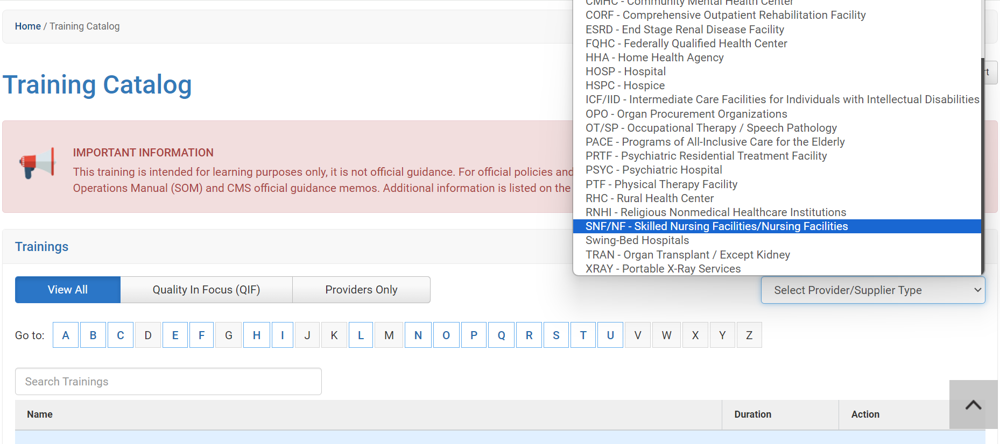

Slide 44
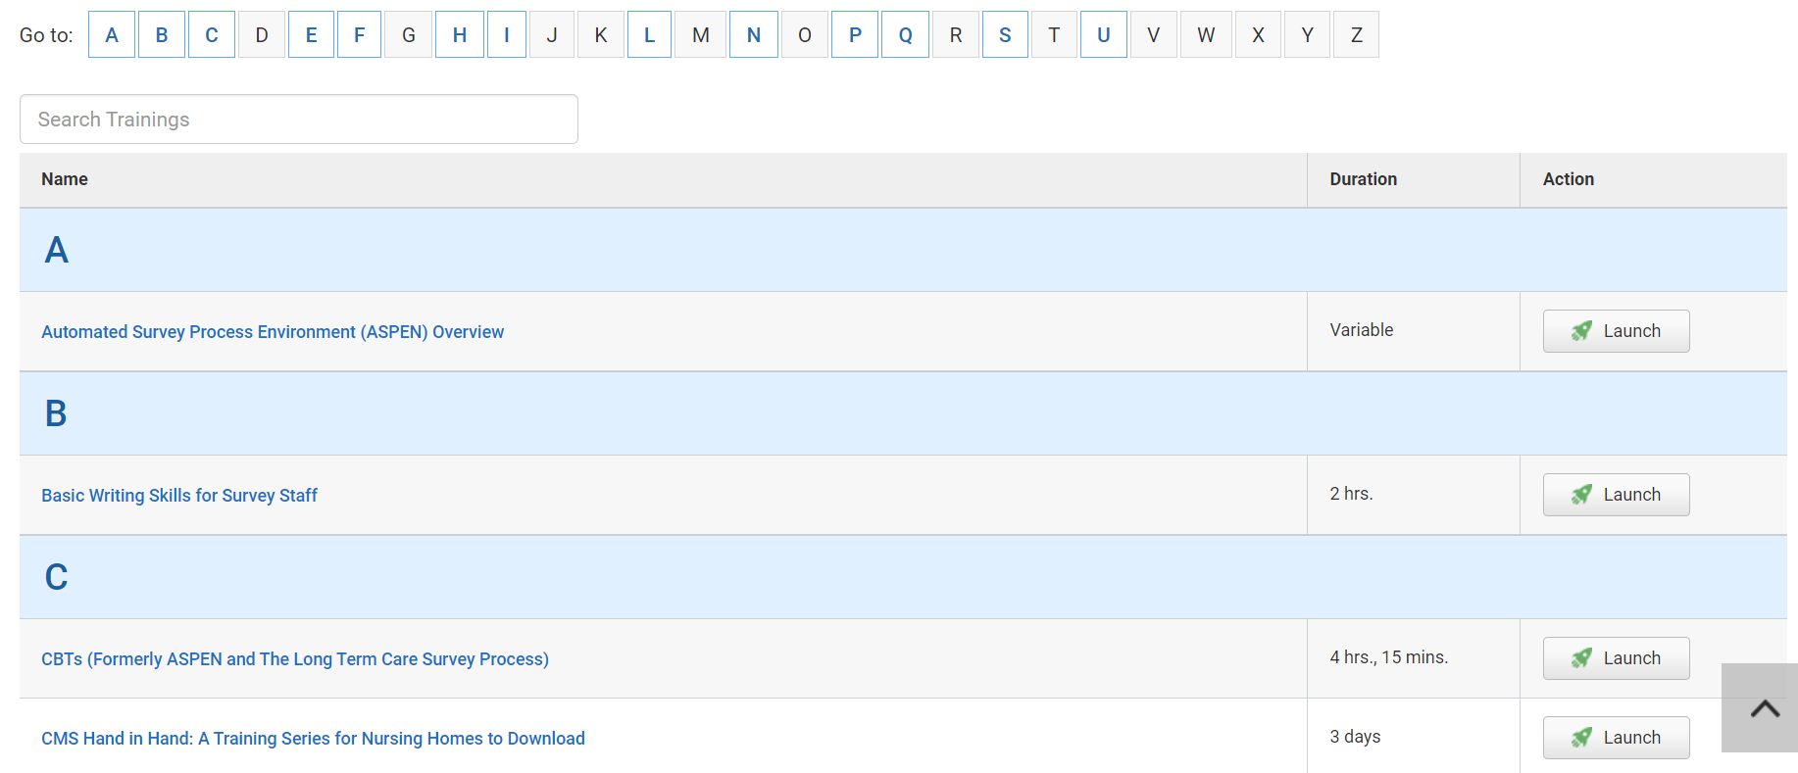

Slide 45
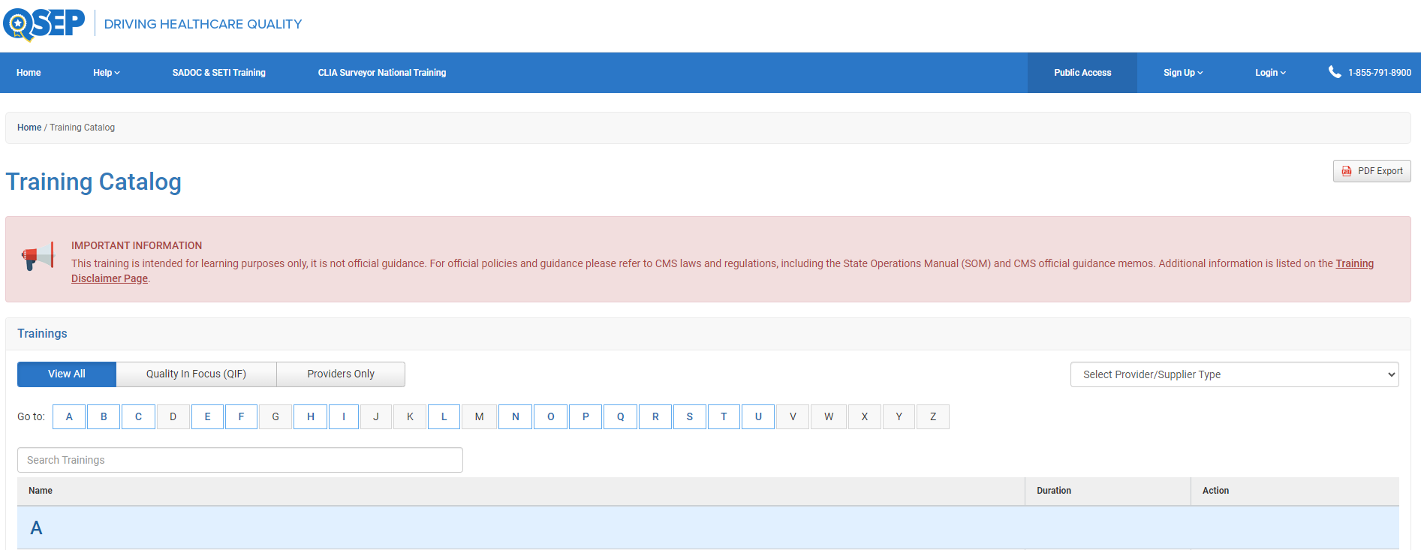

Slide 46
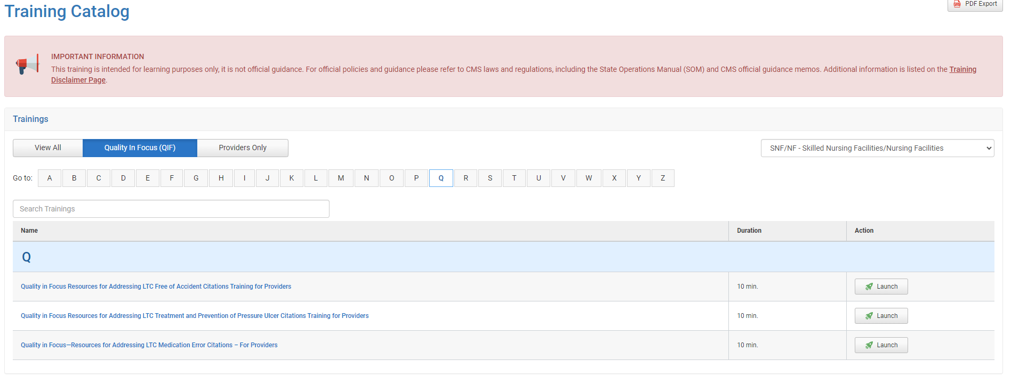

Slide 47
Survey Pathways / Critical Element Pathways
https://www.cms.gov/Medicare/Provider-Enrollment-and-Certification/GuidanceforLawsAndRegulations/Nursing-Homes
Investigation pathways
Outlines where and how surveyor will investigate issues
Step-by-step to determine whether and how to cite noncompliance
Providers: use to identify gaps in processes and systems

Slide 48
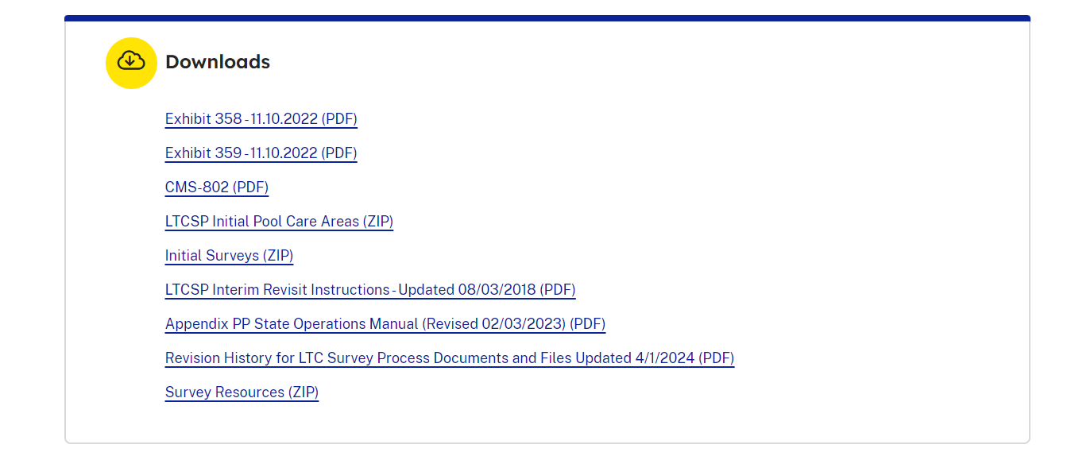

Slide 49
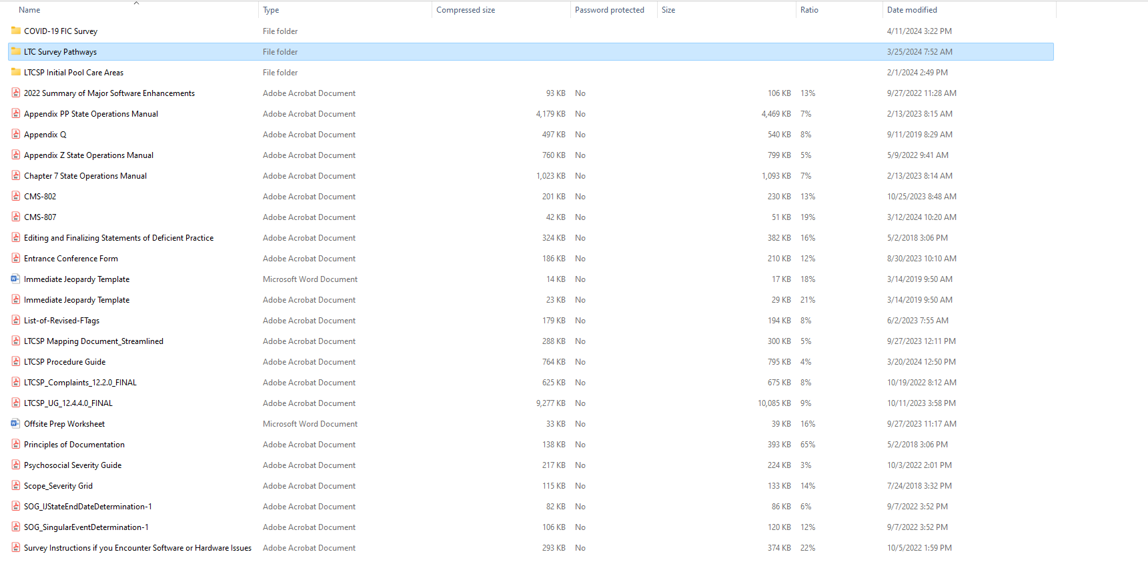

Slide 50
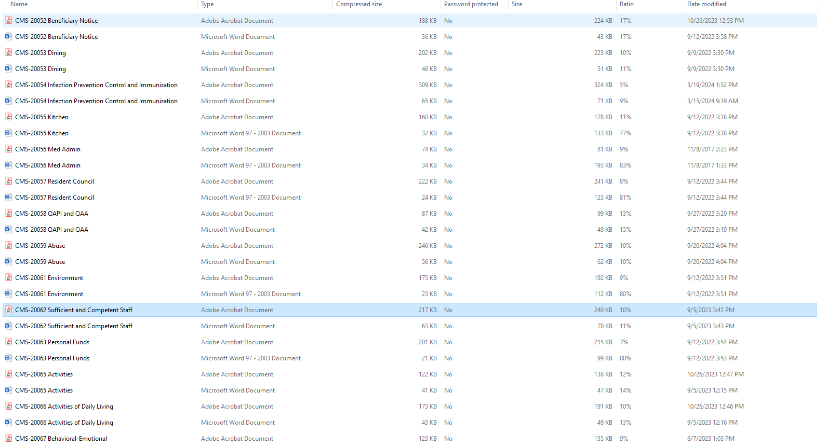

Slide 51
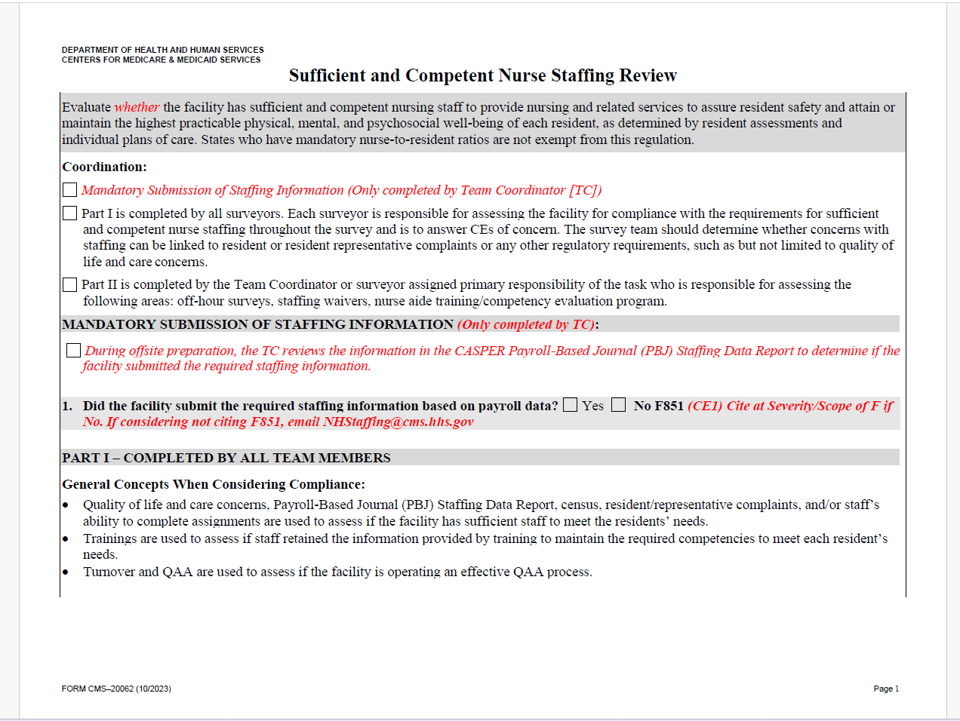

Slide 52
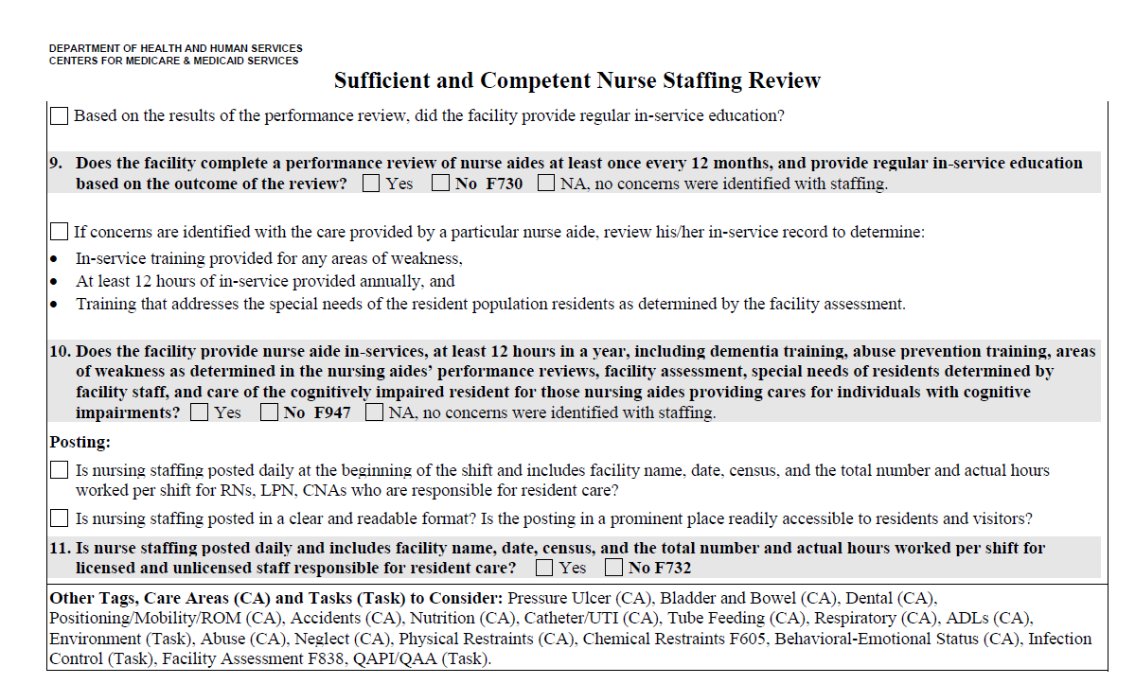

Slide 53
Appendix PP Surveyor Guidance
https://www.cms.gov/Medicare/Provider-Enrollment-and-Certification/GuidanceforLawsAndRegulations/Nursing-Homes
Guidance to surveyors
Organized by F-tag, includes:
  Regulation, definitions, intent
  Survey procedures, elements of non-compliance
  Examples of scope and severity, cross-tags
Providers: use to understand the requirements and identify interrelated issues

Slide 55
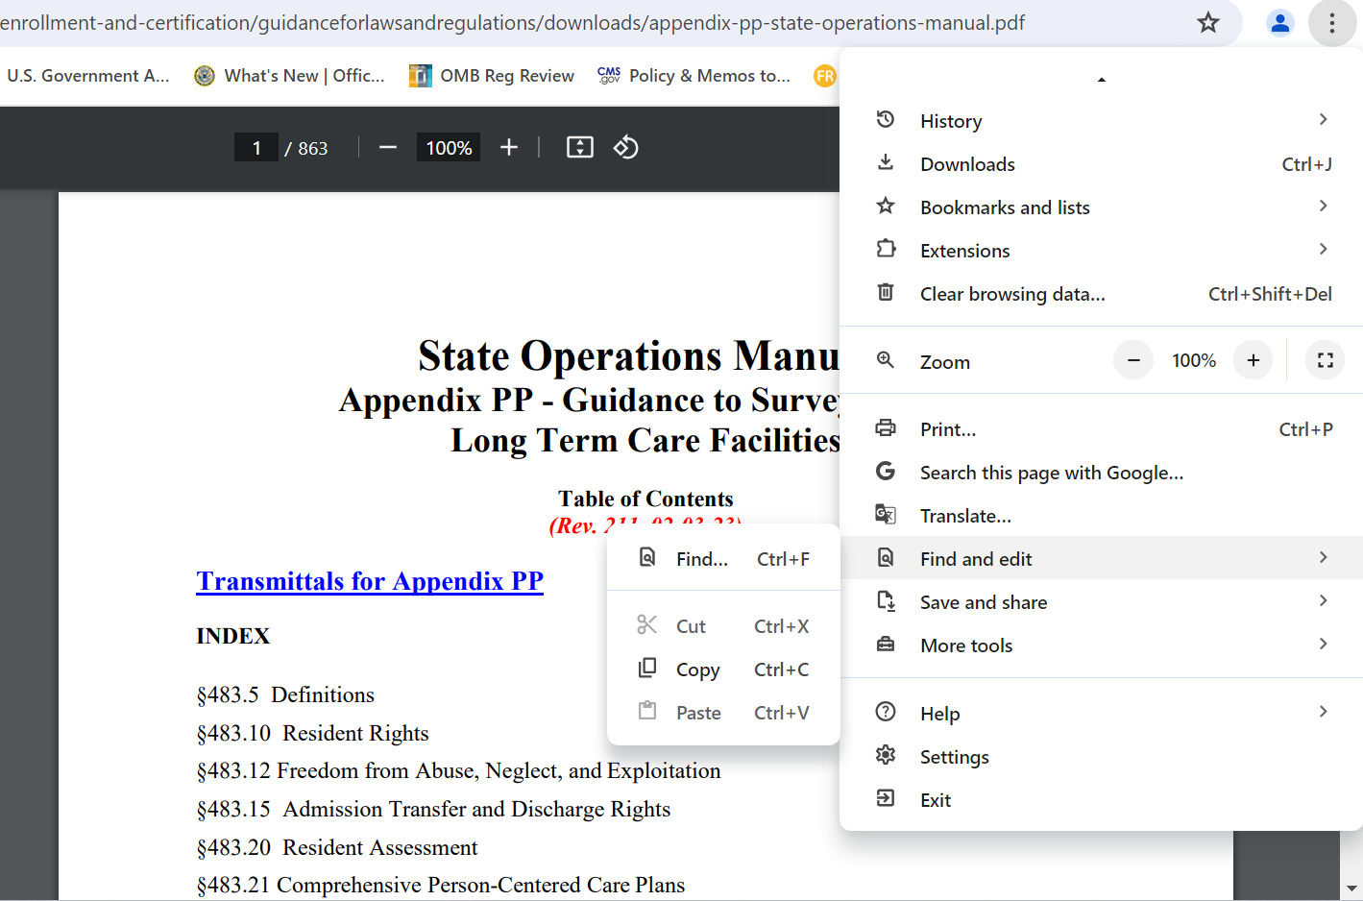

Slide 56
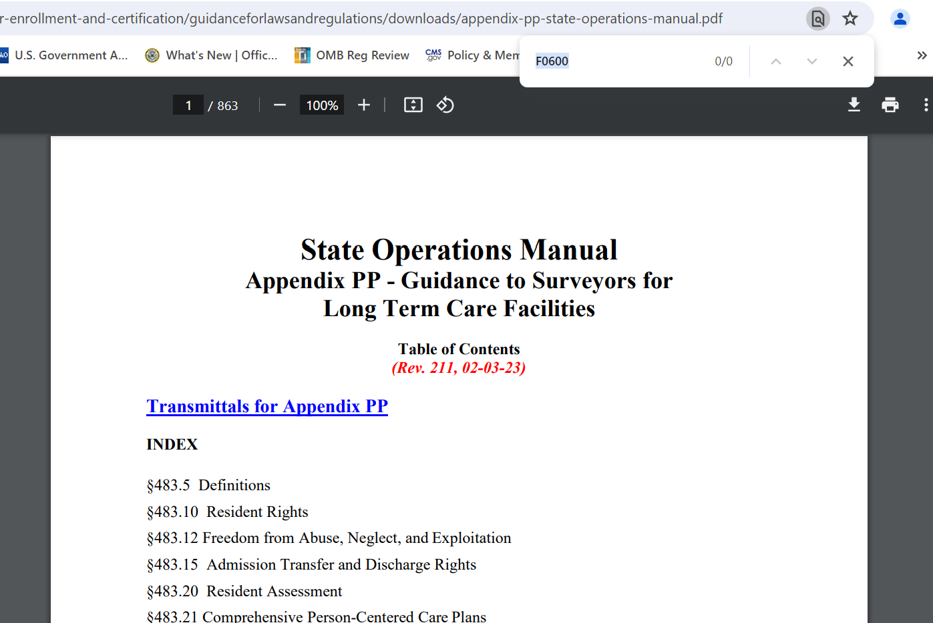

Slide 57
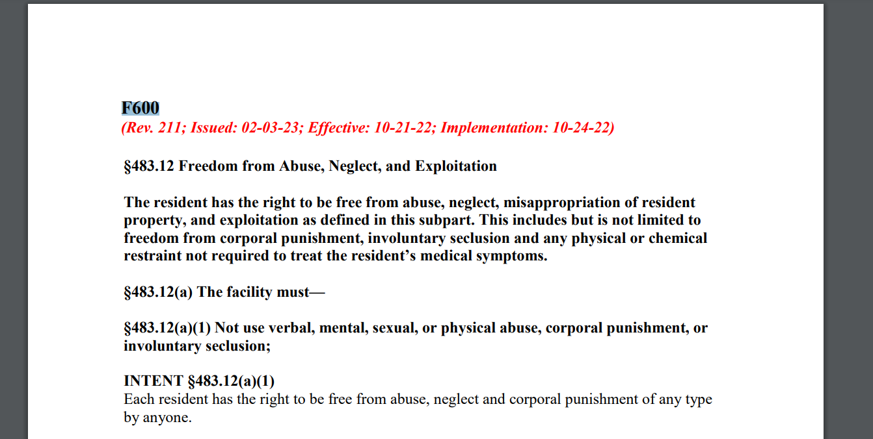

Slide 58
Know the Top Citations

Slide 59
Quality, Certification, and Oversight Reports (QCOR)
https://qcor.cms.gov/index_new.jsp
Real-ish-time data on survey activity
  Updated regularly
  Dependent upon surveyor data entry
Tells citations, enforcements
Breakdown CMS region, state, survey type, citation
Providers: use it to identify trends

Slide 60
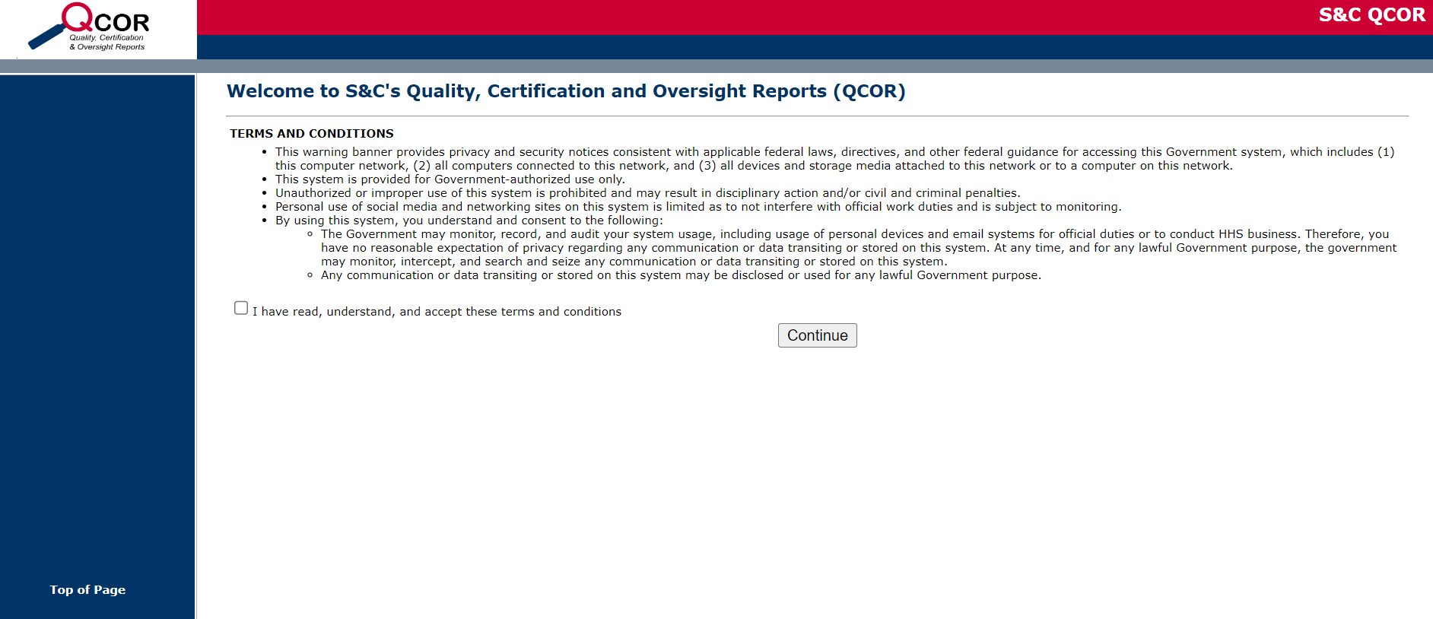

Slide 61
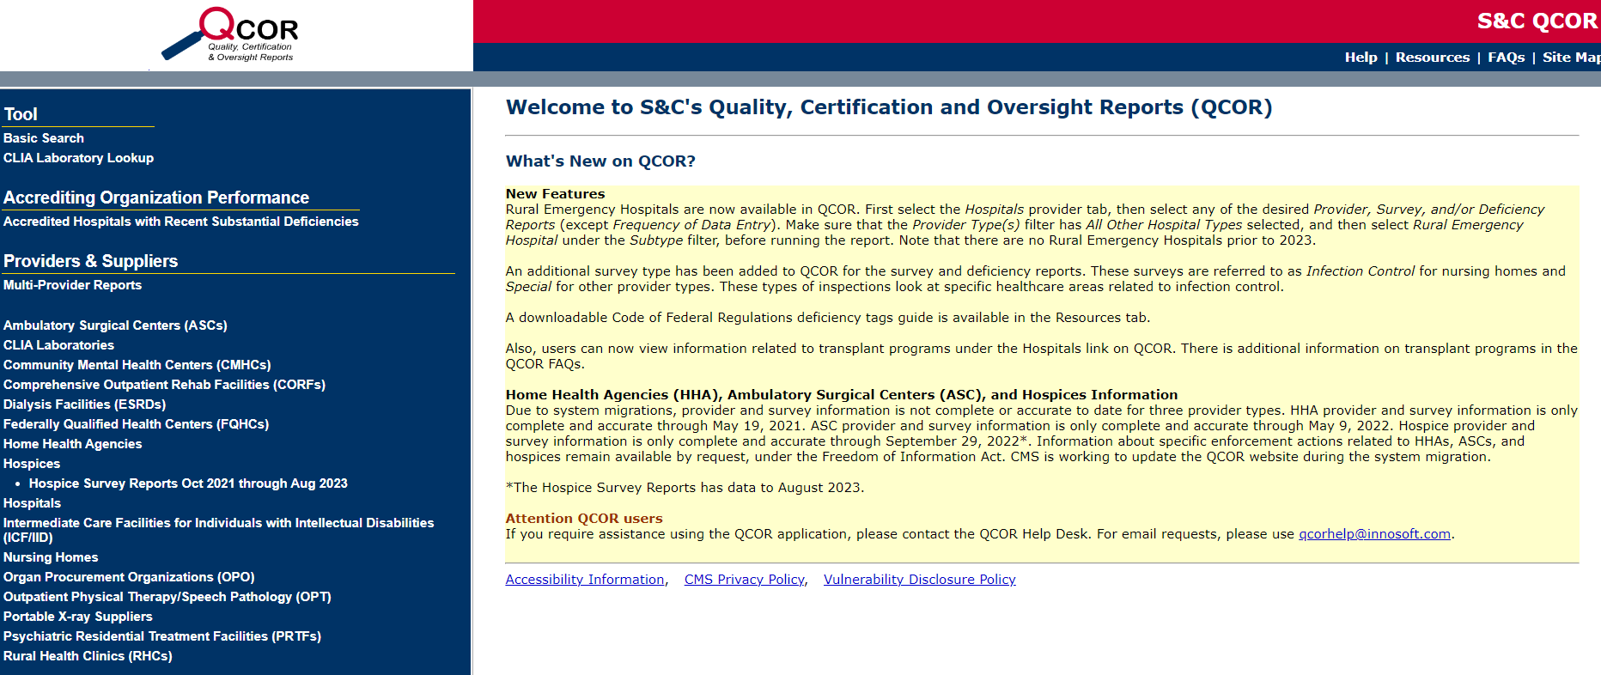

Slide 62
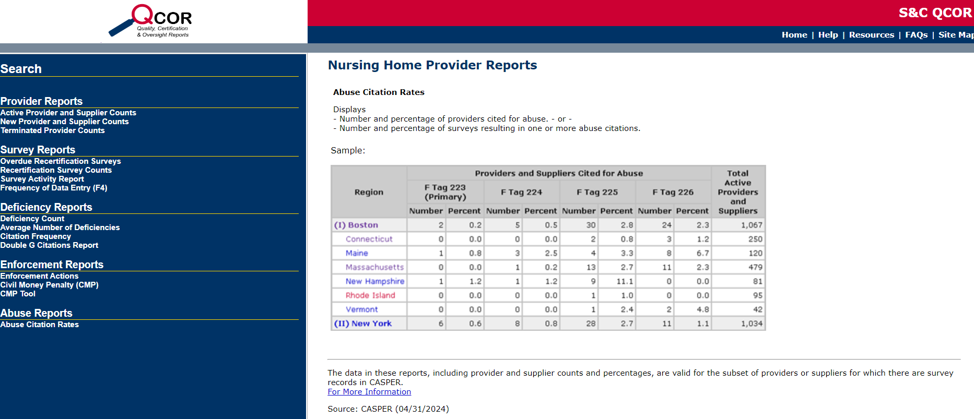

Slide 63
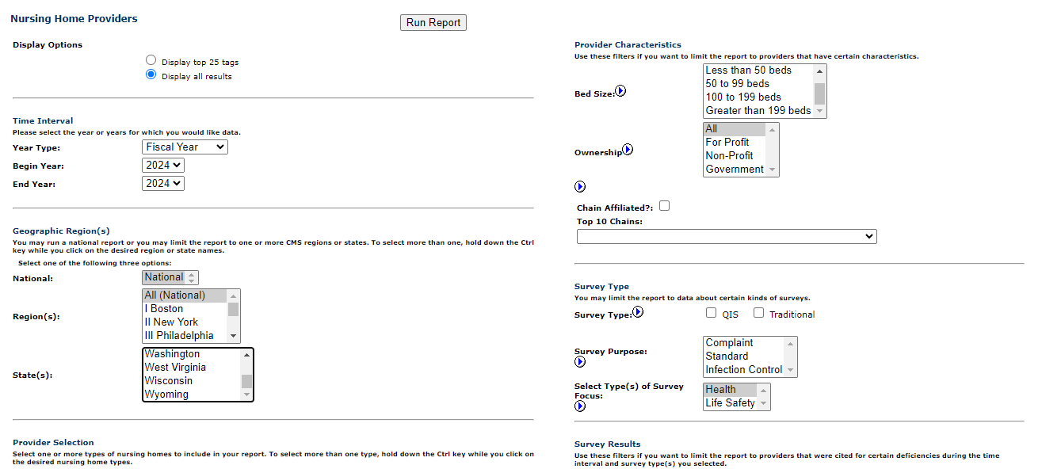

Slide 64
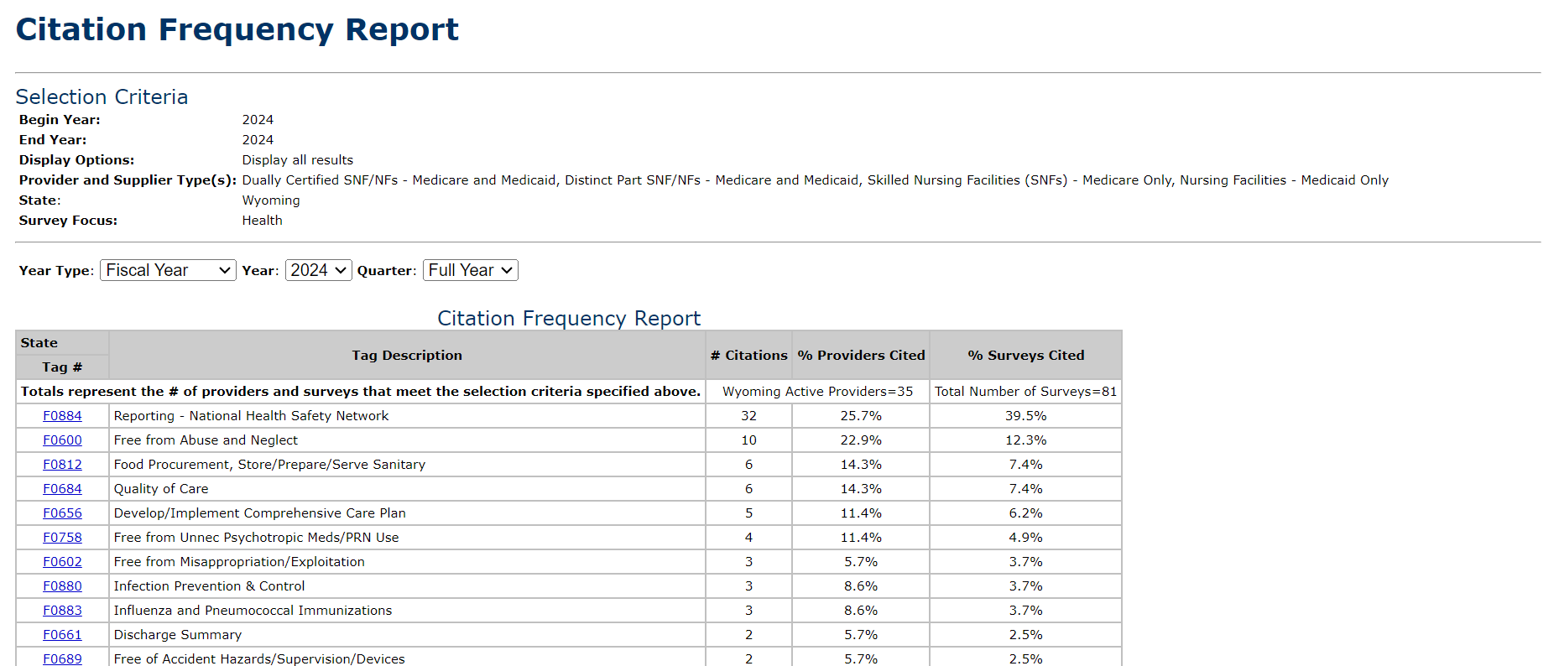

Slide 65
Top Citations FY 2024 To Date (WY)
F884 Reporting – National Healthcare Safety Network
F600 Free from Abuse and Neglect
F812 Food Procurement, Store/Prepare/Serve - Sanitary
F684 Quality of Care

Slide 66
F600 Free from Abuse
10 citations in FY 2024 to date
Scope/severity D and G (isolated, minimal/potential for harm and actual harm)
2 types: resident-to-resident and staff-to-resident
Resident perpetrator: physical altercations, unwanted sexual contact, cognitive impairment
Staff perpetrator: disrespectful language, rough treatment

Slide 67
F812 Food Procurement
6 citations in FY 2024 to date
Scope and severity F (widespread, no actual harm)
Beard restraints, hand hygiene when donning/doffing gloves, kitchen-safe hand antiseptic, temps: food, dishwasher, fridge/freezer

Slide 68
F684 Quality of Care
6 citations in FY 2024 to date
Scope and severity D-G (isolated, pattern, and widespread)
Lack of documentation, “other duties as assigned”

Slide 69
Questions and Souvenirs
Take one minute: in the Question Mark column, write a question you have.

Slide 70
Feeling Empowered

Slide 71
What You Can Do to Feel Empowered
Use the surveyor resources
Offsite Preparation Worksheet
Entrance Conference Form
Initial Pool Care Areas
LTC Survey Procedure Mapping Document

Slide 72
Offsite Preparation Worksheet
https://www.cms.gov/Medicare/Provider-Enrollment-and-Certification/GuidanceforLawsAndRegulations/Nursing-Homes
Tells surveyors what data to review prior to onsite survey
  CASPER reports, PBJ data
  Results from last standard survey
  Complaints, facility-reported incidents
  Abuse allegations or citations, enforcement cases
  Active waivers or variances
Indicates areas of concern on which to focus
Providers: use to identify likely areas of focus

Slide 73
Offsite Preparation Worksheet

Slide 74
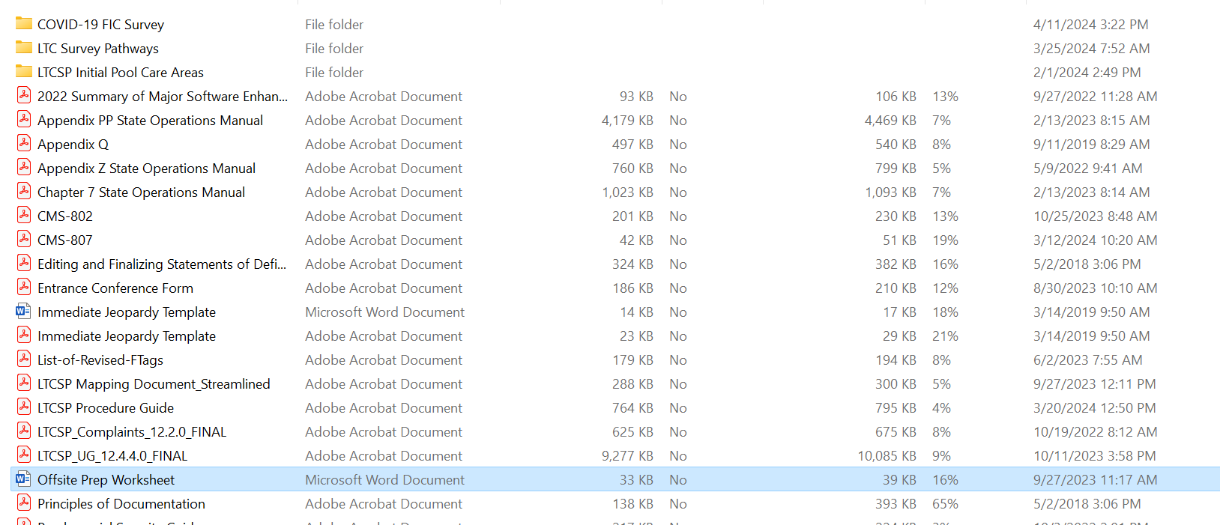

Slide 75
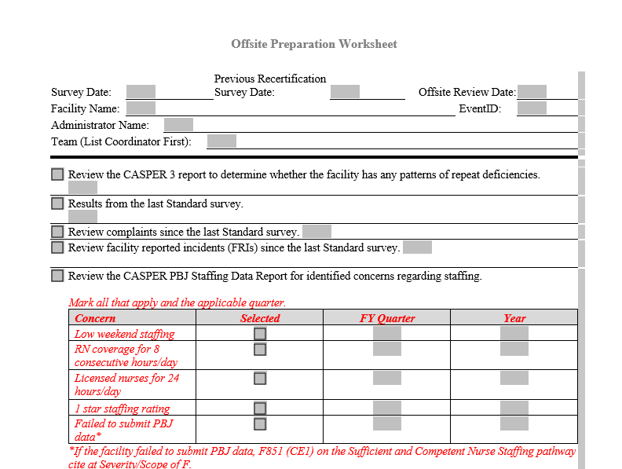

Slide 76
Entrance Conference Form
https://www.cms.gov/Medicare/Provider-Enrollment-and-Certification/GuidanceforLawsAndRegulations/Nursing-Homes
Organizes key required information
Helps identify specific resident samples
Early indicator of issues not identified through off-site preparation
Providers: use to identify issues before survey and to streamline actual survey by prepping documentation and processes

Slide 77
Entrance Conference

Slide 78
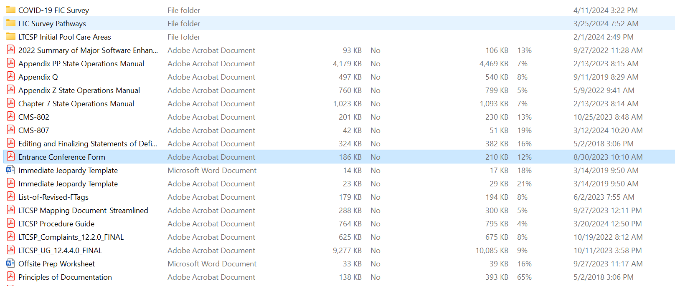

Slide 79
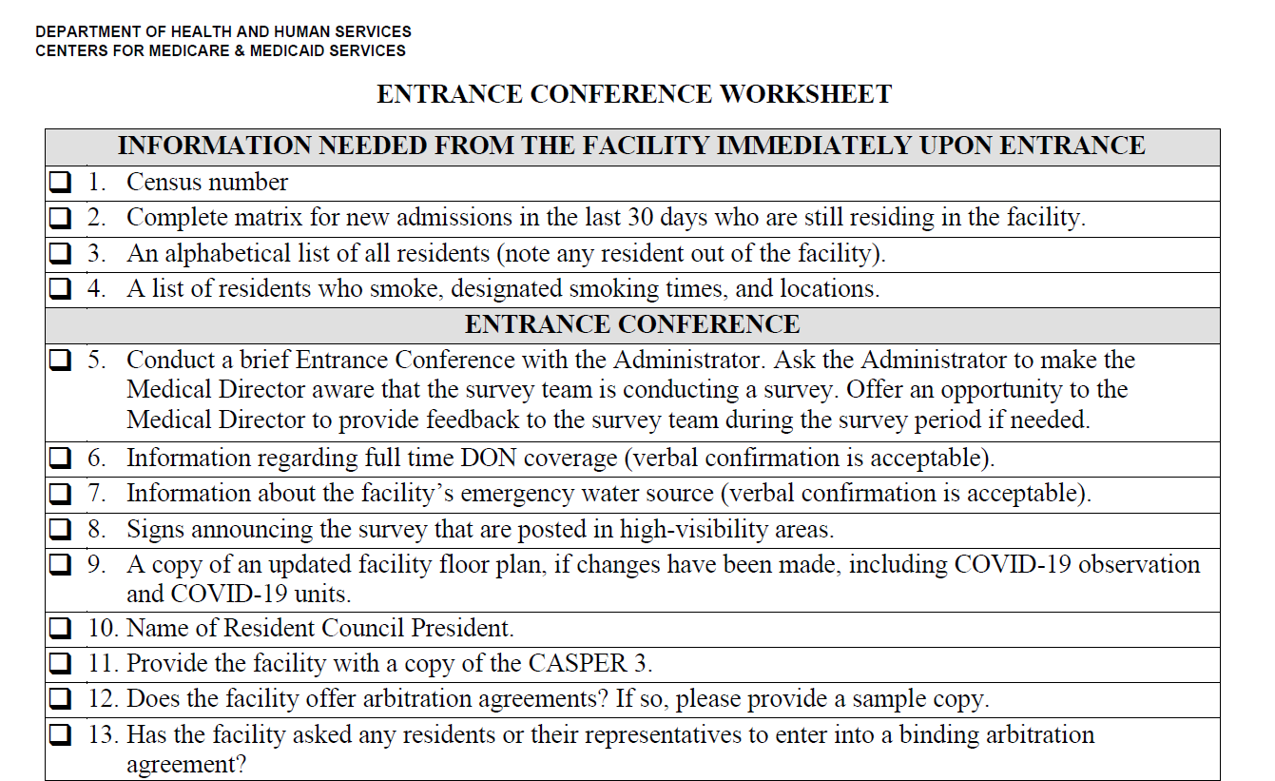

Slide 80
Initial Pool Care Areas and Mapping Document
https://www.cms.gov/Medicare/Provider-Enrollment-and-Certification/GuidanceforLawsAndRegulations/Nursing-Homes
Directs interviews, observations, and investigations
Helps surveyors identify concerns not identified through data
Guides surveyors through investigation of identified concerns
Directs determinations of noncompliance
Providers: use to track survey and stay a step ahead

Slide 81
Initial Pool Care Areas

Slide 82
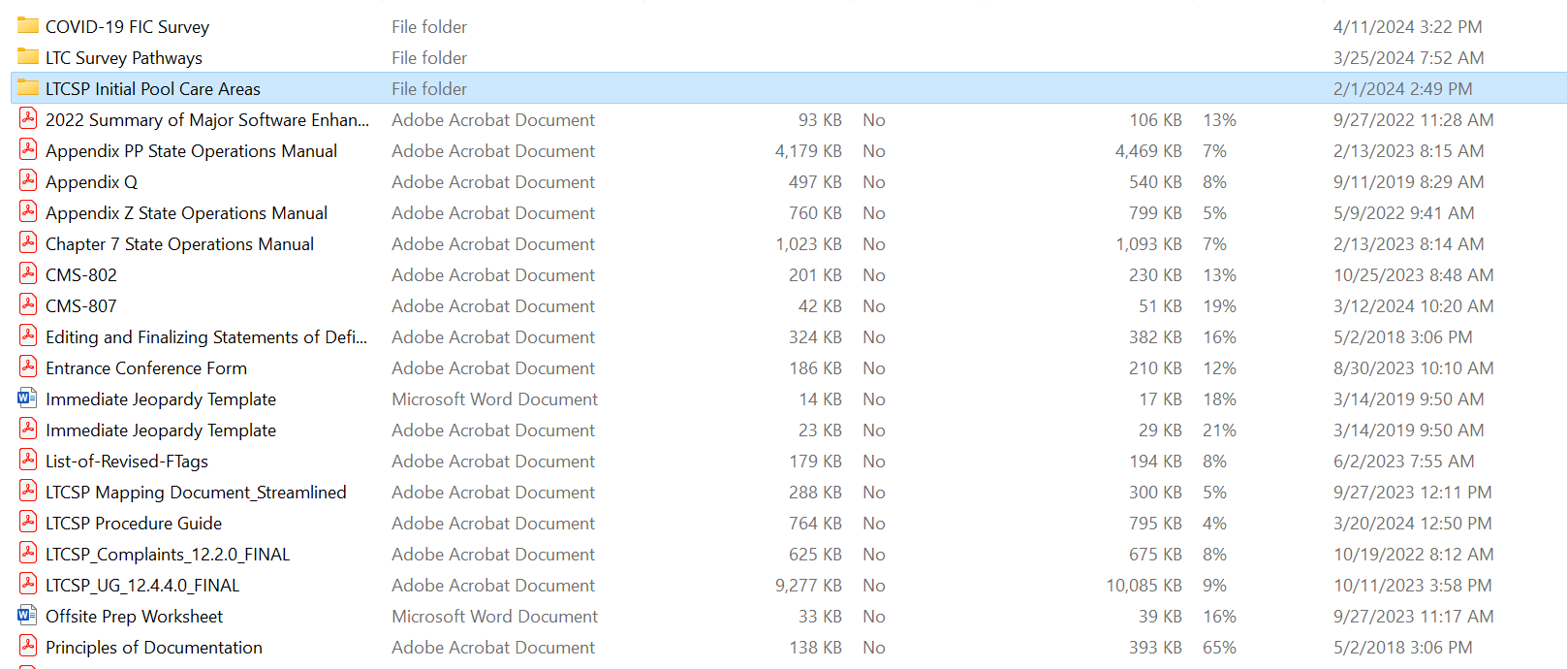

Slide 83
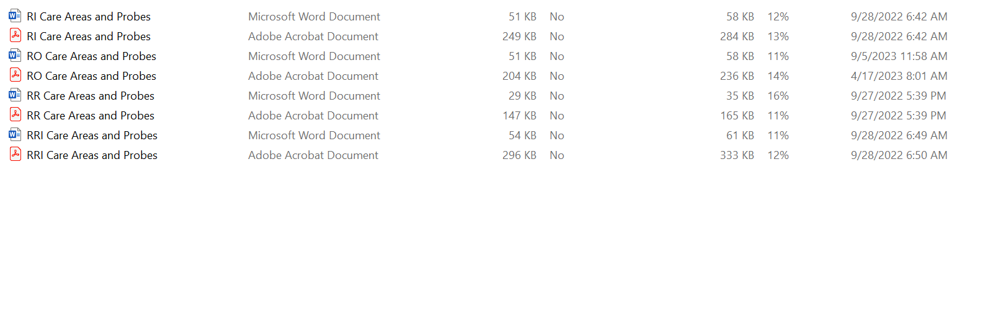

Slide 84
LTCSP Mapping Document

Slide 85
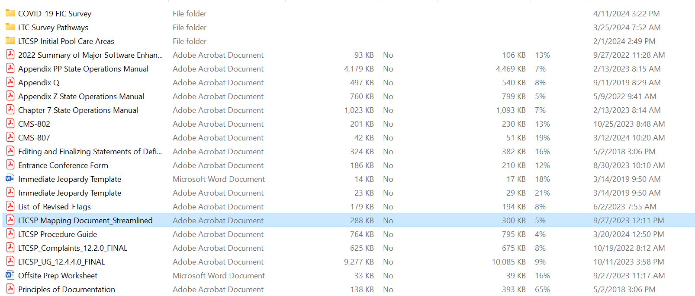

Slide 86
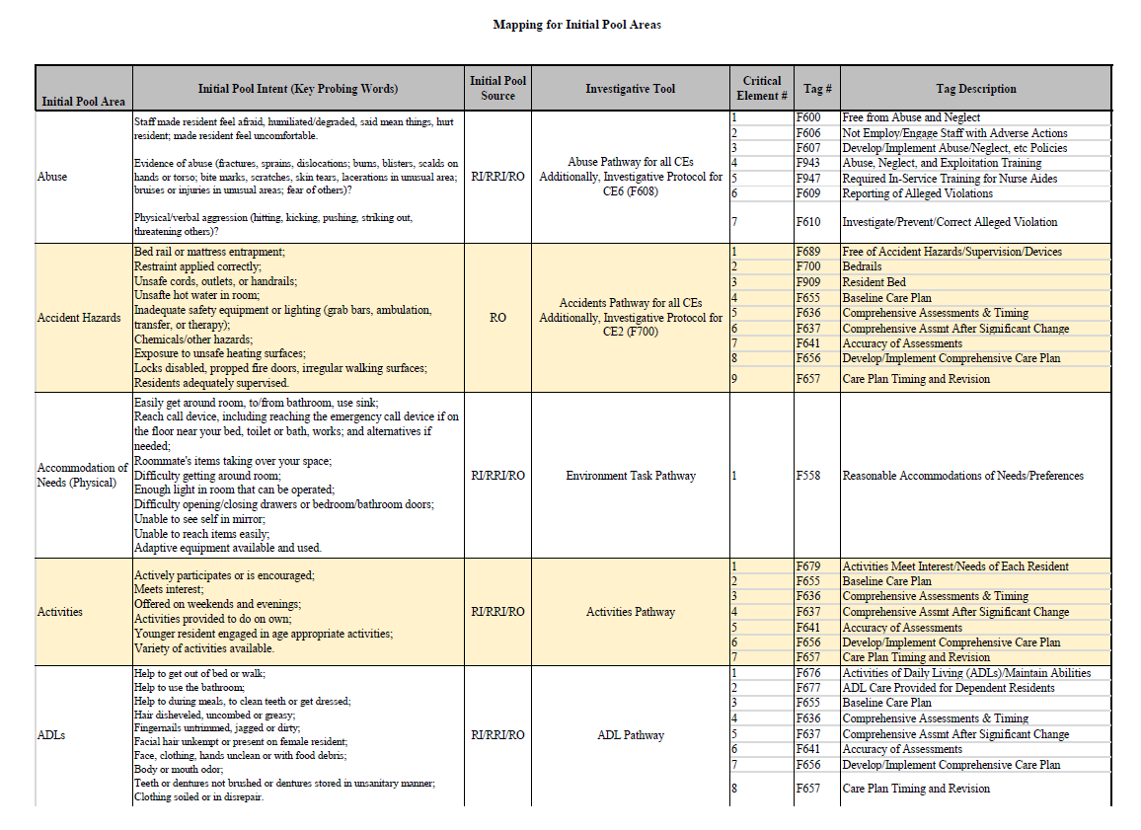

Slide 87

Time Out for Application

Slide 88
Survey Scenario
Survey team enters the building, locates Administrator, and introduces team. Surveyor 1 begins Entrance Conference with Administrator while Surveyor 2 begins Initial Tour with Director of Nursing. In Room 105-A, Surveyor 2 observes a call bell station affixed to the wall next to the bed. The call bell has an extended cord that is safely reachable in bed and is working properly. In the bathroom, Surveyor 2 observes a call bell station next to the toilet. The cord appears severed, but the call system is working properly. The surveyor is able to call the nurses’ station by depressing the red lever on the call bell panel and the charge nurse responds immediately.

Slide 89
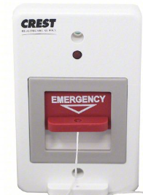

Slide 90
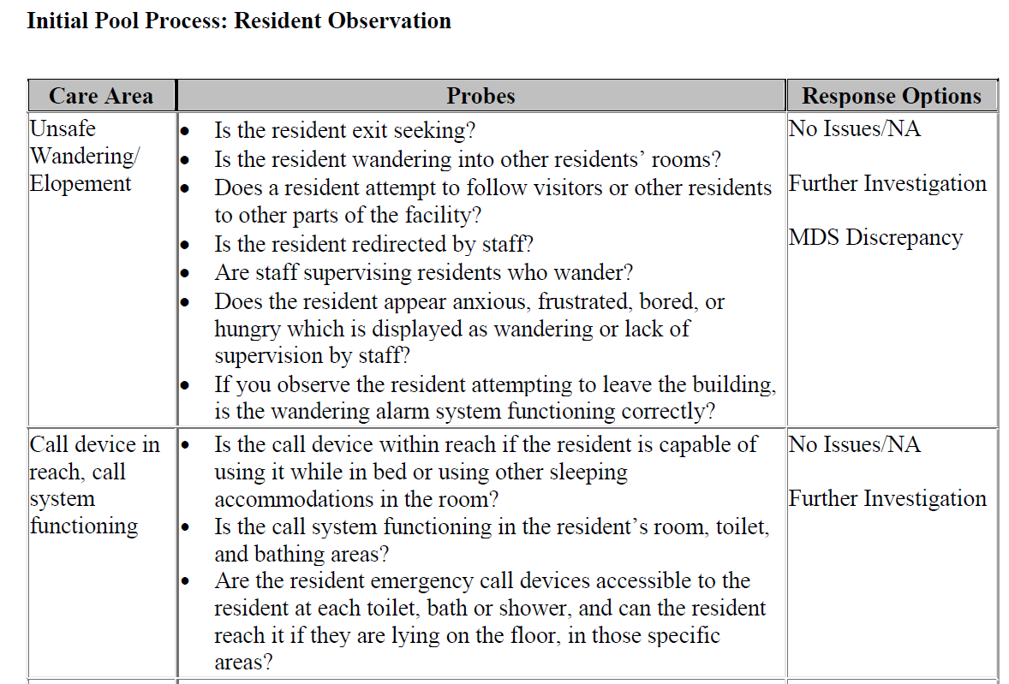

Slide 91
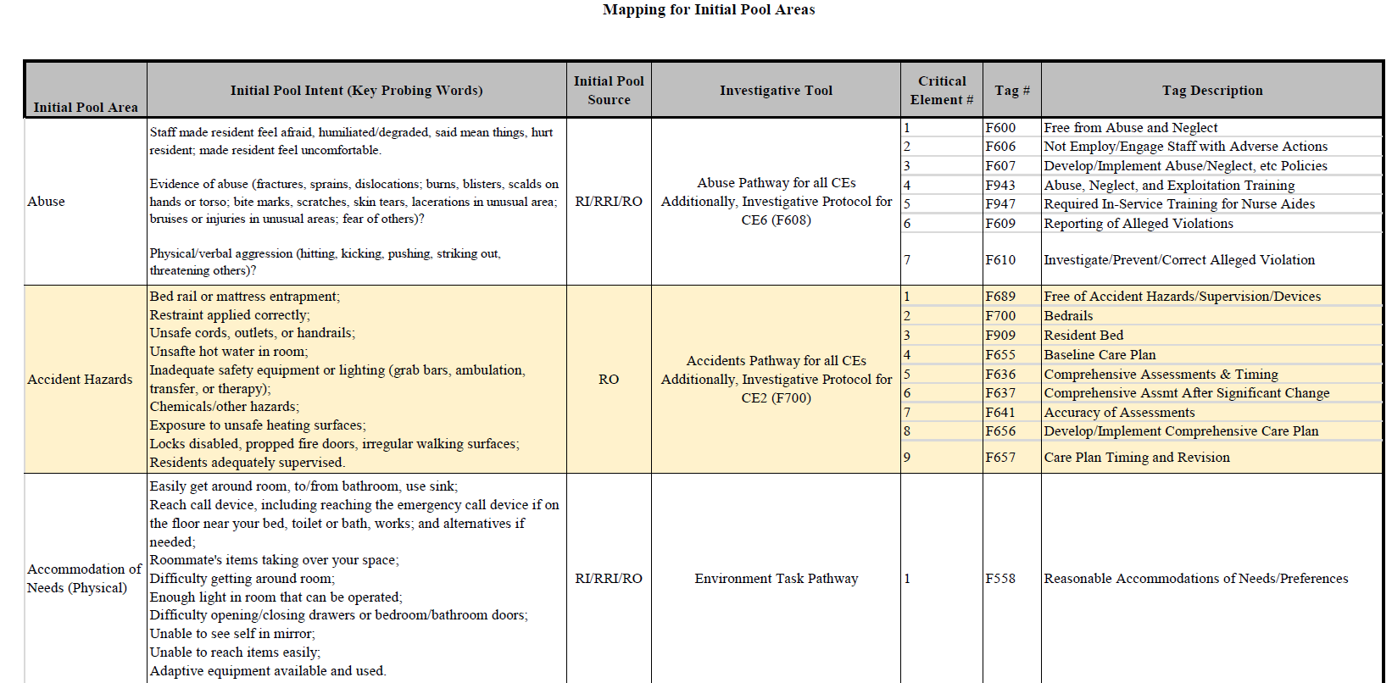

Slide 92
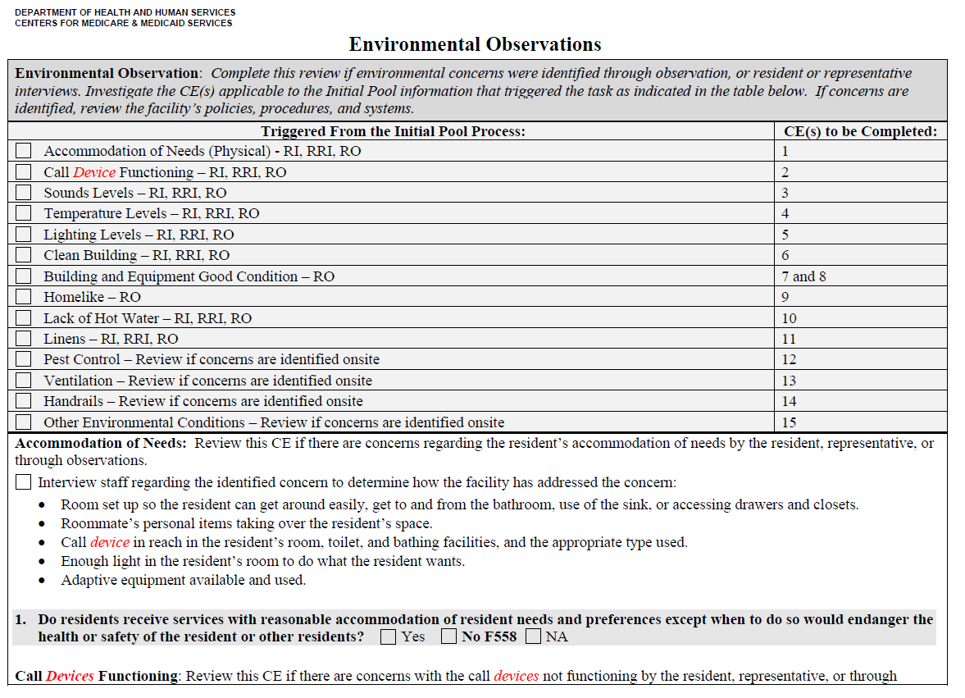

Slide 93
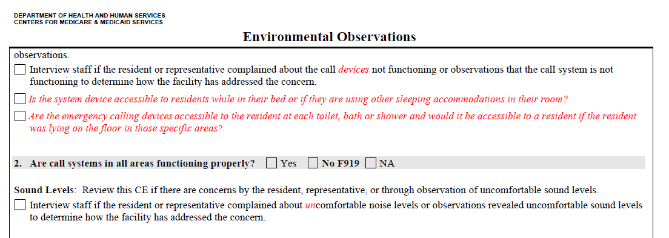

Slide 94
What Next?
Plan of Correction
  Correcting specific deficiency
  Identifying other potentially impacted residents
  Systemic changes to prevent reoccurrence
  Monitoring performance
  Dates for compliance
Read the 2567 carefully – answer the question that is asked.
Use Appendix PP

Slide 95
Questions and Souvenirs
Take one minute: in the Stick Figure column, write what you plan to do with what you have learned today.

Slide 96

Good Luck!
Please do not hesitate to contact me: Jodi Eyigor jeyigor@leadingage.org

Slide 97
Resources
CMS Nursing Homes page (Risk-Based Survey and Surveyor Resources)
CMS Memo Admin Info 24-12-NH (Focus Concerns)
LeadingAge Requirements of Participation Tools and Resources
Quality, Safety, and Education Portal (Surveyor Training)
Quality, Certification, and Oversight Reports (Top Tags)

Slide 98
Acronyms Used in This Presentation
CMS: Centers for Medicare & Medicaid Services
DON: Director of Nursing
FY: fiscal year
IDR: informal dispute resolution
IJ: immediate jeopardy
OIG: Office of Inspector General
QSEP: Quality, Safety, and Education Portal

