Slide 1
Nursing Home Policy Update
Jodi Eyigor | Director, Nursing Home Quality & Policy
LeadingAge | May 2024

Slide 2
Guess the Agenda!
I’ll be covering regulatory updates in 8 main topic areas today. Take a minute to write down 4 topics you hope to hear about. Mark them off as I cover the topic. If you’ve got anything left at the end, ask me!

Slide 3
Nursing Home Minimum Staffing Standards

Slide 4
Minimum Staffing Standard
Final rule released April 22
Scheduled to publish May 10
4 components:
  24/7 RN requirement
  HPRD requirements
  Expanded Facility Assessment
  Medicaid payment transparency reporting
Minimum standards: additional staff may be required

Slide 5
24/7 RN Requirement
On-site, available to provide care
Director of Nursing counts
Other administrative nurses?
Round-the-clock, not 24 payroll hours

Slide 6
HPRD Requirements
3.48 total nurse staffing
0.55 RN
2.45 nurse aide
All PBJ job codes count?
Additional 0.48 HPRD can be any combo of nursing staff

Slide 7
Facility Assessment
Evidence-based, data-driven
Adding “behavioral health issues”
Must inform staffing across shifts (including nights, weekends)
Include a recruitment and retention plan
Contingency planning

Slide 8
Who Must Be Involved
Leadership
Governing body
Direct Care Staff
Employee representative
Other staff
Rehab therapy
Residents
Family
Medical Director
Administrator
Director of Nursing
External representative
Dietician
Social Services
Activities
Resident Representative

Slide 9
Medicaid Payment Transparency
Reporting by state Medicaid agency to CMS
Percentage of Medicaid payment spent on compensation of direct care staff and support staff
Facility-level data
State and CMS will share publicly
Related requirement: HCBS Medicaid Access Rule

Slide 10
Implementation Timelines
3 phases from date of publication (May 10)
Staggered: rural vs. non-rural
“Rural” as defined by OMB

Slide 11
Implementation Timelines
Non-rural
90 Days
Facility Assessment
2 years
24/7 RN
3.48 total nurse HPRD
Rural
90 days
Facility Assessment
3 years
24/7 RN
3.48 total nurse HPRD
3 years
0.55 RN HPRD
2.45 nurse aide HPRD
5 years
0.55 RN HPRD
2.45 nurse aide HPRD

Slide 12
Exemptions
Applies to 24/7 RN, all HPRD requirements
  24/7 RN: exempt from only 8 hours
  Must have available “immediately by phone”: physician, physician assistant, nurse practitioner, or RN
Must be surveyed and cited to receive an exemption
Exemptions good until next standard survey
May be removed at any time due to exclusion criteria

Slide 13
Exemptions - Criteria
Workforce availability: 20% or more below national average
  Determined by CMS
  Based on BLS data
Good faith efforts to recruit and retain staff
  Job postings, number and duration of vacancies, job offers, competitive wages
Financial commitment
  Nurse staffing expenditures relative to revenue
Not finalized: geographic qualifier

Slide 14
Exemption Exclusions
Failure to submit PBJ data
Selection as a Special Focus Facility
Past 12 months: insufficient staffing pattern or widespread with actual harm
Past 12 months: insufficient staffing at immediate jeopardy

Slide 15
Exemptions – Notifications
Exemption status, degree to which standard is not met
Post in prominent and publicly viewable area in nursing home
Provide individual notice to current, prospective residents
Copy of notice to ombudsman
Posted on Care Compare

Slide 16
Congressional Activity
Bipartisan bills in House and Senate
  Only effective pre-rule
Congressional Review Act Resolution of Disapproval
  Working with House and Senate offices
  Cannot be introduced until rule is published
  President must sign off
Limitation language in appropriations
  FY 2025 HHS funding bill
  Working with House and Senate offices

Slide 17
What You Can Do Now
Update your Facility Assessment
Act As If . . .
  Staff up
  Pay attention to admissions
Talk to your Board
Take advocacy action

Slide 18
Questions and Group Discussion
How will you meet the staffing standard?

Slide 19
Enhanced Barrier Precautions

Slide 20
Background
Accepted national standard to prevent MDRO transmission in nursing homes
Alternative to more restrictive contact precautions
Recommended by CDC in 2022
Incorporated into June 2022 release of Appendix PP
Adopted as requirement March 2024

Slide 21
Indications
What
Gown
Gloves
For Whom
Chronic wounds
In-dwelling medical devices
When
High-contact care activities
When contact precautions are not indicated
Infected or colonized

Slide 22
Not Indicated
When contact precautions are indicated
  Infected or colonized with uncontained excretions/secretions
Completely enclosed in-dwelling devices
  Pacemakers, etc.
Non-chronic wounds
  Skin tears
Low contact, isolated care activities outside the resident room
  Assisting with sweater at activity
  Transferring from wheelchair to dining chair

Slide 23
Why Nursing Homes?
Infected/colonized but unaware
  CDC study: 2 in 10 documented, 6 in 10 infected/colonized
Maintain homelike environment
Hospitals use more restrictive contact precautions

Slide 24
Considerations
Flexibilities
Location
Signage
Concerns
Homelike environment
Cost of PPE
Resident dignity

Slide 25
What You Can Do Now
Know residents’ status
Explore work-flow options (remembering person-centered care)
Update your Facility Assessment
Track your PPE

Slide 26
Group Discussion
How are you handling enhanced barrier precautions in your nursing home?

Slide 27
Other Rules We’re Watching

Slide 28
FY 2025 SNF PPS Rule
Proposed rule published April 3
Comments due May 28
4.1% increase, policy revisions for SNF QRP and SNF VBP
Watch for: wage index revision, expanded CMP authority

Slide 29
SNF PPS: Wage Index Revision
Based on most recent decennial census
Revised delineation of Core Based Statistical Areas (CBSAs)
  CBSAs redesignated from rural to urban, urban to rural
  CBSAs split to form new CBSAs
  Counties shifted among CBSAs
Could result in change in wage index

Slide 30
SNF PPS: Expanded CMP Authority
Authority to enforce both types of CMPs in same survey
  Per instance for one deficiency, per day for another
Authority to enforce multiple CMPs for same noncompliance
  Per instance and per day for same noncompliance
  Multiple per instance CMPs for same noncompliance
Expanded look-back period
  Current: since last standard survey
  Proposed: since last 3 standard surveys
Likely to result in: increased CMPs, increased dollar amounts

Slide 31
What You Can Do Now
Submit comments by May 28
Know your regs, know your rights
  Past noncompliance
  Facility-reported incidents and CMP reduction
  Constructive waiver
Brush up on your IDR skills

Slide 32
Pending: Healthcare System Modernization and Resiliency
Currently under review at OMB
Proposed rule, likely a 60-day comment period
All CMS-certified settings
Emergency preparedness and cultural competence(?)

Slide 33
Emergency Preparedness
Planning for natural and man-made disasters
Coordination with emergency preparedness systems
Incorporating lessons learned and feedback from listening sessions

Slide 34
Cultural Competence
Governance
Resident Rights (nondiscrimination and accessibility)
Clinical quality standards
Quality Assessment and Performance Improvement
Staff training
Care planning and discharge planning

Slide 35
Mental and Behavioral Health

Slide 36
Top Issues
Managing behaviors
Admission/transfer/discharge
MDS coding
Antipsychotic usage

Slide 37
Managing Behaviors - Expectations
Meet the resident’s need
Address underlying triggers for behavior
Non-pharmacological interventions
Protect the population

Slide 38
Managing Behaviors - Concerns
Dementia
  Abuse, elopement, wandering, agitation
Behavioral disturbance due to mental illness
  Altercations, agitation, abuse
Substance use
  Overdose monitoring, illegal activity, AMA/elopement, Narcan

Slide 39
What You Can Do Now
QA your admissions process
Update your Facility Assessment
Document
  Assessments: H&P, social history, psych eval
  Notes: physician, nurse, social services
Care plan
  Non-pharmacological interventions, outcomes
Follow policies, know the regs

Slide 40
Discharges/Transfers
Appendix PP updated 2022
Facility-initiated vs. resident-initiated discharges
Transfer vs. discharge
Leaving AMA
Allowing resident to return

Slide 41
Discharges/Transfers
April 2024 OIG reports
  Allowable reasons but missing documentation, notification
  Questioning admitting practices
June 2023 Hospital memo
  Missing, inaccurate documentation to post-acute providers
  Mental health, behavioral health, substance use, community risks
  Treatments, interventions, psychotropic medications
Denying admission

Slide 42
Group Discussion
What does it mean to be “unable to meet resident needs”?

Slide 43
MDS Coding
February 2022: White House Fact Sheet
  “identify problematic diagnoses . . .bring down the inappropriate use of antipsychotic medications”
January 2023: off-site audits of MDS coding
  “patterns of potentially erroneous coding”
  High levels of post-admission schizophrenia diagnoses
  Documentation does not support diagnosis/coding
How do you know this resident has schizophrenia?

Slide 44
MDS Coding - Problems
No documentation
Very little, sporadic documentation
Documented dementia behaviors, not schizophrenia
Only in: checklists, assessments, H&Ps
Match the criteria and tell the story.

Slide 45
Antipsychotics
Not a zero-tolerance policy
Should be treatment of last resort
Document:
  Why medication is indicated
  Nonpharmacological interventions, outcomes
  What didn’t work
  Why is GDR not indicated

Slide 46
Group Activity
Documenting mental health interventions

Slide 47
Respiratory Viruses

Slide 48
COVID-Era Requirements
COVID data reporting
  Requirement expires December 31, 2024
Resident vaccination reporting
  Finalized FY 2024 SNF PPS for SNF QRP
  MDS reporting beginning October 2024
Healthcare personnel vaccination reporting
  Finalized FY 2022 SNF PPS for SNF QRP, updated FY 2024 SNF PPS
  Reporting through NHSN
  Change in frequency?
  HCP flu vaccination reporting finalized FY 2023 SNF PPS
Educate and offer rule
  Flu, COVID, pneumonia

Slide 49
CDC Recommendations
Public health recommendations revised March 2024
  Inclusive of all respiratory viruses
Nursing homes continue to follow healthcare settings recommendations
  Vulnerable population
  No established “COVID season”
CDC looking to more closely align respiratory virus mitigation

Slide 50
Preparing for 2024/25 Respiratory Virus Season
Vaccinations: COVID, flu, RSV, pneumonia
Mitigation measures: masks, physical distancing, isolation
  Visitors must follow healthcare setting recommendations
Access: vaccines, tests, PPE, isolation
Managing staff
  COVID restrictions
  Flu and other illness

Slide 51
Group Discussion
What works for vaccination and mitigation measures? What do you need?

Slide 52
Care Compare and the Five-Star Quality Rating System

Slide 53
Administrator Turnover Exclusion
Quietly updated July 2023
Previously, measure suppressed if:
  5 or more administrators
  12 or more days across 3 quarters
Since July 2023, suppressed if:
  5 or more administrators
  4 or more days in a quarter

Slide 54
Case Mix Measure Freeze
Case-mix adjustment methodology impacted by transition from RUG-IV to PDPM (Section G to GG)
Quality measures and staffing level measures frozen with April refresh
Staff turnover measures continue to update
Staffing levels: resume with July refresh
Quality measures:
  (Short stay) improvements in function: replace October 2024
  (Long stay) Activities of Daily Living: resume January 2025
  (Long stay) ability to move independently: resume January 2025
  (Long stay) pressure ulcers: resume January 2025

Slide 55
Lowest Score Policy
Implemented with April 2024 quarterly refresh
Applied to staff turnover measures
Failing to submit data / submitting erroneous data:
  Lowest score applied to turnover measure
  Will continue to be applied to quarter until timed out

Slide 56
Office of Inspector General Reports and Audits

Slide 57
Office of Inspector General
Provides oversight of HHS
Conducts audits and evaluations
Makes recommendations to CMS
Called upon in Congressional hearings

Slide 58
Recent Report and Audit Areas of Focus
COVID-19
  Series of 3 reports
  Impacts of COVID in nursing homes
  Recommendation: look at CNA training and certification
Emergency preparedness
  Ongoing for several years
  State-level audits
  Recommendations: standardized training, more frequent surveys / risk-based surveys
Facility-initiated discharges
  Mental/behavioral health at risk
  Inadequate documentation, notification
  Recommendation: better tracking of facility-initiated discharges

Slide 59
Current Work Plan
Potentially preventable readmissions
  Care provided matching care plans
Falls reporting
  Claims matching MDS
Drug use, overdoses, and med errors
  Interventions for drug use, med errors resulting in overdose
PBJ and staffing
  Accuracy of reported hours
Antipsychotics
  Use, coding, citations

Slide 60
Congressional Advocacy

Slide 61
CNA Lock-Out Bill
Ensuring Seniors’ Access to Quality Care (H.R. 3227 / S. 1749)
House: introduced May 2023
Senate: introduced May 2023
Would revise 2-year lock out on CNA training
  Resume training once nursing home comes back into compliance
  Exclusions apply: harm or IJ, abuse or substandard quality of care
  Access to National Provider Databank

Slide 62
3-Day Stay Bill
Improving Access to Medicare Coverage Act (H.R. 5138)
Introduced August 2023
Would count all days spent in hospital toward 3-day stay requirement

Slide 63
What You Can Do Now
Lobby Day / Fly-ins
Coffee Chats with Congress
Virtual Visits
Letter Writing

Slide 64
Questions
Please do not hesitate to contact me: Jodi Eyigor jeyigor@leadingage.org

Slide 65
Resources
2022 White House Fact Sheet
Nursing Home Minimum Staffing Standards
  CMS Fact Sheet
  LeadingAge Article
  Facility Assessment Toolkit
  Facility Assessment Webinar
Enhanced Barrier Precautions
  CMS Memo QSO-24-08-NH
  CDC Recommendation
  CDC Video
  CDC Slide Deck

Slide 66
Resources
FY 2025 SNF PPS Proposed Rule
  Analysis: FY 2025 SNF PPS Proposed Rule
  Tips for Commenting
Mental and Behavioral Health
  LeadingAge Transfer/Discharge Resources
  OIG Reports on Transfer/Discharge: Report 1 and Report 2
  CMS Memo QSO-23-05-NH (schizophrenia audits)
  LeadingAge Article on Schizophrenia Audits
Respiratory Virus Season
  CDC Recommendations for Healthcare Settings
  CDC Guidance Healthcare Personnel Return to Work

Slide 67
Resources
Care Compare / Five Star Rating System
  CMS Memo QSO-23-21-NH (ratings freeze and lowest score policy)
Office of Inspector General
  Nursing Home Reports
  Work Plan
Congressional Advocacy
  Action Alert: CNA Lock-Out Bill
  Congress in Your Neighborhood
  Advocacy Resources (one-pagers)

Slide 68
How to Create a LeadingAge Login
Step 1: Go to www.leadingage.org
Step 2: Select “Login” in upper right corner.
Step 3: Select “Create” or “Create an Account”
Step 4: Enter information using your work email.

Slide 69

Step 1: Go to www.leadingage.org
Step 2: Select “Login” in upper right corner.

Slide 70
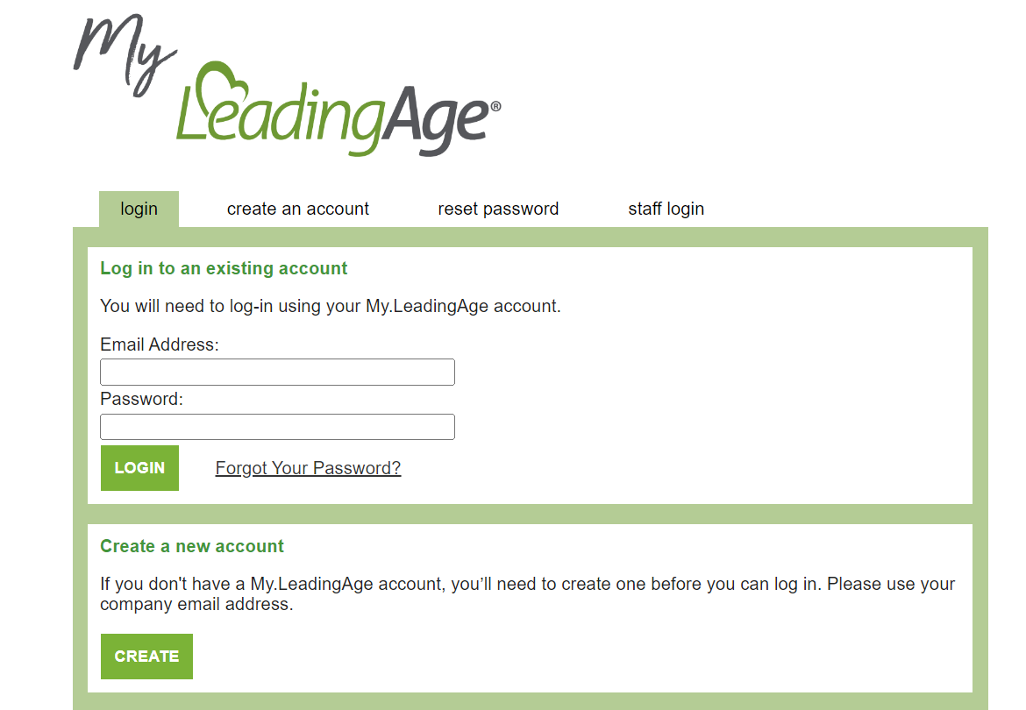
Step 3: Select “Create” or “Create an Account”

Slide 71
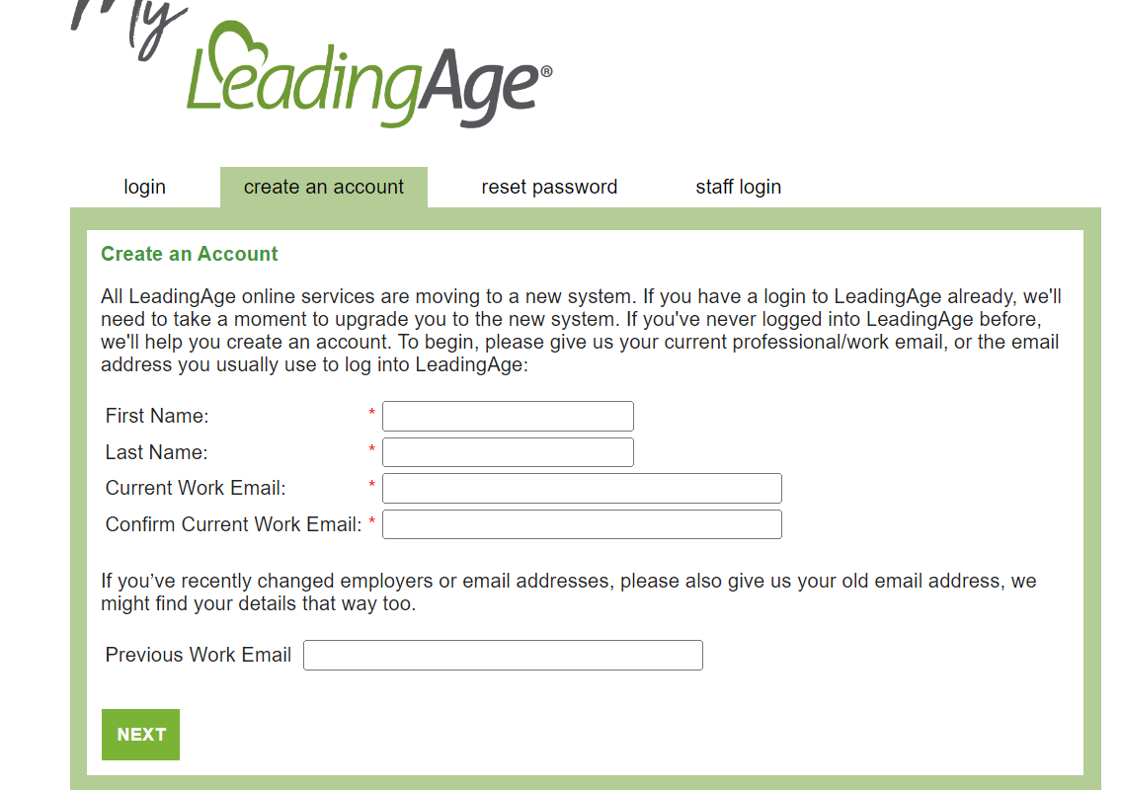
Step 4: Enter info using your work email.

Slide 72
Acronyms Used in This Presentation
AMA: Against Medical Advice
BLS: Bureau of Labor Statistics
CBSA: Core-Based Statistical Area
CDC: Centers for Disease Control & Prevention
CMP: Civil Money Penalty
CMS: Centers for Medicare & Medicaid Services

Slide 73
Acronyms Used in This Presentation
CNA: Certified Nurse Aide
GDR: Gradual Dose Reduction
H&P: History & Physical
HCBS: Home and Community Based Services
HCP: Healthcare Personnel
HHS: Health & Human Services

Slide 74
Acronyms Used in This Presentation
HPRD: hours per resident per day
IDR: informal dispute resolution
IJ: immediate jeopardy
MDRO: multidrug-resistant organisms
MDS: Minimum Data Set
NHSN: National Healthcare Safety Network

Slide 75
Acronyms Used in This Presentation
OIG: Office of Inspector General
OMB: Office of Management & Budget
PBJ: Payroll-Based Journal
PDPM: Patient-Driven Payment Model
PPE: personal protective equipment
QRP: Quality Reporting Program

Slide 76
Acronyms Used in This Presentation
RN: Registered Nurse
RUG-IV: Resource Utilization Group IV
SNF: Skilled Nursing Facility
VBP: Value-Based Purchasing

