Slide 1


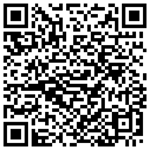
2026 Plan Rollout
MI
Elevate Your Portfolio
Nick Poirier
Regional Broker Manager
Michigan
Add me to your contacts →

Slide 2

2026 Product Overview
National
Elevate Your Portfolio
Teresa Lara
Broker Project Manager

Slide 3
Before We Begin
Disclaimer
This webinar is for Medicare insurance agents and marketing organizations who are contracted or interested in becoming contracted with Zing Health. The information to be covered is confidential and proprietary to Zing Health and is to be used for agent recruitment purposes only. Distribution to any person or company is prohibited. Plan and benefit information contained in this document is pending government approval and subject change.

Slide 4
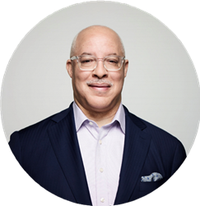

Welcome to Zing Health!
Our Name
The word Zing connotes energy, vigor, and excitement. Zing’s goal is to provide Medicare beneficiaries with the care, services, information, and wellness programs they need to achieve amaZing health.
Our History
Zing health is a physician-founded-and-led provider of Medicare Advantage health plans who seeks to drastically improve health outcomes in diverse populations that have been chronically underserved.
Our Mission
Zing Health has a singular mission: Providing managed care Medicare Advantage plans that address social determinants of health to reduce health care disparities among historically underserved populations.
Our Focus
Zing health focuses on offering many different types of benefit rich plans that meet the needs of our
members including chronic special needs plans especially designed for people with diabetes, chronic
heart failure, and other heart conditions, dual eligible special needs plans especially designed for people
on Medicaid and Medicare, and non-special needs plans to provide a wide variety of rich benefits. Zing takes a
collaborative approach to treating the “whole” person; partner with them to develop comprehensive, customized care
plans; connect them with resources relating to social determinants of health; and provide concierge-level customer service.
Eric E. Whitaker,
MD, MPH
Founder
Our Differentiators
With leading high value benefits around competitive drug pricing, free key medical devices, and supplemental benefits such as groceries, OTC card, transportation and more, Zing health builds plans with the members specific needs in mind. Zing health's personalized model of care keeps the member and their primary care provider at the center, while supporting them with a holistic care team that includes nurse care managers, behavioral health clinicians, social workers, and connections to community resources.

Slide 5
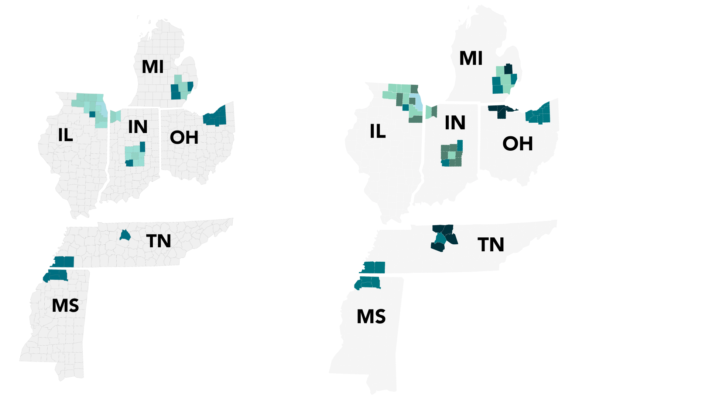
Our Story
Founded
2026
Service Area
2019
1 State | 1 County
2020
3 States | 15 Counties
2021
3 States | 23 Counties
2024
6 States | 43 Counties
2025
6 States | 52 Counties
2026

Slide 6


Gold Standard Performance Winner
Recipient of the Senior Choice Gold Award from HealthMetrix Research for Excellence in 2025 Medicare Plan Benefits Value & Performance! The recognition highlights our Select Care HMO $0 premium plan (Detroit, Memphis, & Nashville) and Elite Select HMO $0 premium plan (Akron, Cleveland, Chicago, & Indianapolis), both of which earned a 3.5-star rating. Additionally, our Elite Select HMO in Cook County, IL, was honored for offering the Best Part D Value for 90-day Mail Order.
Illinois – Chicago
Elite Select HMO
Indiana – Indianapolis
Elite Select HMO
Michigan – Detroit
Select Care HMO
Ohio – Akron & Cleveland
Elite Select HMO
Tennessee – Memphis & Nashville
Select Care HMO
Information gathered from https://www.medicarenewswatch.com/index.php/plan-awards-2025

Slide 7
Zing YOY Growth
Membership has climbed steadily year-over-year, growing by an impressive 260% from January 2024 to August 2025. This surge highlights the strong momentum behind our C-SNP-focused strategy and the growing demand for tailored plan options. With 70% of our members enrolled in a Chronic Special Needs Plan (C-SNP), Zing Health stands as a clear market leader in our region.
Membership Split
40,000
260%
32,699
30%
24,459
24,459
9,143
3,228

Slide 8
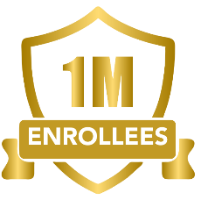


National C-SNP Growth
While overall Medicare Advantage and D-SNP growth slowed nationally this past AEP, C-SNP enrollments crossed ONE MILLION enrollees and continue to be the fastest growing MA Segment
C-SNP
Options
Over 226,000 NEW C-SNP Enrollees between 12/2024 and 02/2025
21% Growth in available
C-SNP plans offered nationally
Source: CMS SNP Report, Data through 2/1/2025, excludes Puerto Rico plans

Slide 9





















National C-SNP Landscape
C-SNP market leaders continue expansion, with Zing Health leading regional growth
Top C-SNP Carriers by Enrollment Totals
Rank
Carrier
Plan Type
Enrollment
Market Share
AEP Growth
National
555,398
51.7%
+49.1%
How Zing Stacks Nationally
National
219,001
20.4%
-1.5%
National
129,613
12.1%
+18.4%
Fastest growing established C-SNP carrier during AEP!
Primary CA
40,724
3.8%
+34.7%
Primary CA
27,262
2.5%
+32.1%
7th largest C-SNP carrier nationally, and 4th largest excluding California enrollment!
Primary CA
20,313
1.9%
-13.2%
Midwest
15,538
1.4%
+62.1%
Top 3 C-SNP offerings in every established market!
Primary CA
8,338
0.8%
+12.2%
Primary CA
8,035
0.7%
+17.9%
Oklahoma
6,469
0.6%
+17.9%
Source: CMS SNP Report, Data through 2/1/2025, excludes Puerto Rico plans

Slide 10
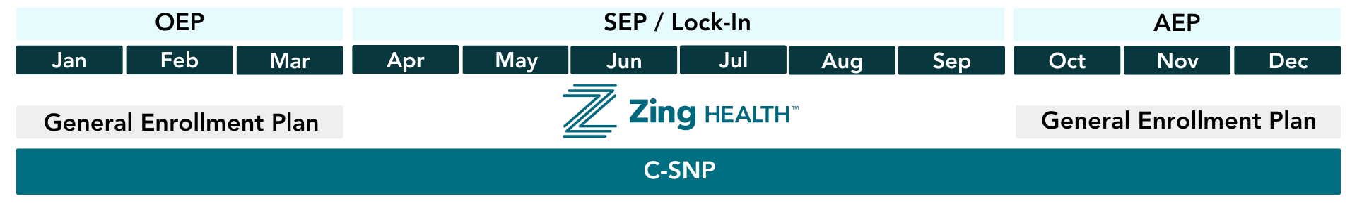
C-SNPs Offer Year-Round Growth
C-SNP market leaders continue expansion, with Zing Health leading regional growth
C-SNP Special Election Period
Any Medicare individual who qualifies for a C-SNP via chronic condition and is not currently on one, can enroll at any point in the year

Slide 11
Special Election Periods – What’s New
Changes to the Low Income Subsidy (LIS) election increase the importance of chronic special needs products for health plans looking to increase membership during Q2 and Q3.
2024
Beneficiaries with Low Income Subsidy (LIS) or who qualify for any level of Medicaid are offered a quarterly special election period (SEP) allowing them to switch to any Medicare Advantage plan they may be eligible for.
January 1, 2025
Fully dual eligible beneficiaries enrolled in a D-SNP will have a monthly SEP to switch, however may only go into a HIDE/FIDE plan.
Beneficiaries who qualify for LIS will have an SEP to leave their Medicare Advantage plan and return to Original Medicare and enroll in a prescription drug plan (PDP), which then triggers a monthly PDP SEP
Beneficiaries enrolled in a D-SNP will have an SEP to leave their Medicare Advantage plan and return to Original Medicare and enroll in a PDP, which then triggers a monthly PDP SEP

Slide 12




Overlapping Enrollment Periods
C-SNP Enrollment Periods
Type of Enrollment Period | When It Happens | When to use if there are overlapping circumstances
Initial Election Period (IEP) | If the person is newly eligible for Medicare due to age (65 or older) or disability, the IEP lasts for seven months. During this time, he/she can enroll in a C-SNP, among other Medicare plans, three months before they are 65 or during the 25th month of receiving disability benefits.
Annual Enrollment Period (AEP) | AEP runs from October 15 to December 7 each year. During this period, all Medicare beneficiaries can make changes to their existing plans, including enrolling in a C-SNP.
Open Enrollment Period (OEP) | OEP runs January 1 to March 31 each year. During this time, beneficiaries who are already enrolled in a Medicare Advantage (MA) plan can switch to a different MA plan or return to Original Medicare with or without Part D coverage. Also, if they meet the eligibility criteria, they may use this period to enroll in a C-SNP without using the C-SNP SEP.
Special Election Period (SEP) | SEPs are triggered by specific life events, such as moving, losing other health coverage, or the loss/gain of Extra Help. If someone has a qualifying event, meets qualifying conditions they can enroll in a C-SNP during the SEP outside of the standard enrollment periods.

Slide 13

2026 Plan Types Offered
We have a diverse product portfolio in line with our mission of providing choice and access to underserved beneficiaries by offering HMO, PPO, C-SNP, LIS and Dual-Focused products.^
Competitive
Standard MAPD Products
Core
Differentiating Products
HMO
C-SNP
ESRD/
Chronic Kidney Disease
HMO
C-SNP*
Overweight, Obesity, Metabolic Syndrome
HMO
C-SNP*
HMO
C-SNP
Duals Focused *
HMO*
PPO
PPO
C-SNP
HMO
C-SNP
LIS Focused*
*PSP plan options offered
Zing Health qualifying conditions include:
  Diabetes/Cardiovascular disorders/Chronic Heart Failure
  Chronic Kidney Disease / End Stage Renal Disease (ESRD) (with or without dialysis)
  Overweight, Obesity, Metabolic Syndrome
^Plan offerings vary by county

Slide 14






2026 Product Highlights
Member Access to Care
PPO Cost Share Parity
C-SNP CKD
Key Essentials
Transportation
C-SNP Enhancements
No referrals needed on all plans
Prior authorizations reduced or limited
In-home support (Papa) on most plans
PPO C-SNP plans offer in- and out-of-network cost parity for most services
Same INN & OON combined MOOP in IN and TN
C-SNP CKD available in all markets and counties
Enhanced benefits for ESRD/CKD stage 5 members
SSBCI now includes reduced cost-sharing for select Medicare services
Grocery, utilities & OTC on most plans
$0 insulin & competitive Part D on most plans
Dental, vision & hearing on all plans
Routine podiatry on all plans
$0 copay CGMs on all plans (with Rx, filled at pharmacy)
Transportation on all HMO plans
Unlimited transportation for ESRD members on CKD plans
Healthy foods, utilities, and OTC allowance on all plans
Expanded T6 drug list with $0 copay for key C-SNP meds on most plans
$0 copay for C-SNP specialists on most plans
Chronic meals included on all HMO C-SNP plans

Slide 15



Chronic Special Needs Plan (C-SNP)
Qualifying Conditions
Plans
C-SNP Specific Benefits
Cardiovascular Disorders
HMO C-SNP
PSP C-SNPs offer flexible ways to spend monthly “combined” allowance on OTC products, healthy foods, or utility services.⁽¹⁾
Enhanced drug coverage with a C-SNP specific formulary offering T1 $0 copay and T6 at $0 copay to lower cost.⁽²⁾
$0 copays for C-SNP specific specialists on most plans.⁽³⁾
PAPA Support Services
HMO C-SNP PSP
Chronic Heart Failure
HMO C-SNP Duals Focused
Diabetes
HMO C-SNP LIS PSP
PPO C-SNP
Chronic Kidney Disease
(with or without dialysis)
HMO C-SNP
Overweight, Obesity, Metabolic Syndrome
HMO C-SNP PSP
Member must qualify to receive benefits. Allowance is provided on a reloadable debit card and does not roll over
Tier #6 – includes various chronic condition drugs
(3) C-SNP-specific specialists: cardiologist, endocrinologist, gerontologist, nephrologist, ophthalmologist, and pulmonologist.

Slide 16




ESRD / Chronic Kidney Disease (CKD) C-SNP
Beneficiaries with Chronic Kidney Disease (with or without dialysis), are eligible to enroll in a CKD plan. Members of Zing’s CKD plan that require dialysis (ESRD/CKD Level # 5) will receive enhanced benefits through CMS’s Uniform Flexibility Benefit option.
  CKD Benefits for members with ESRD
  National Provider Partners
  $0 copay for dialysis
  $0 copay for Specialist visits
  Unlimited transportation
  Average Costs for Dialysis under Original Medicare and most Medicare Advantage Plans
  Patient Responsibility | 20% = Average of $60 per session
  Frequency | Most patients need 3 sessions per week (about 156 sessions per year)
  Average Annual out-of-pocket costs = $9,360
  Annual out-of-pocket costs while enrolled in a Zing ESRD C-SNP = $0
  Zing Health ESRD C-SNP members can save THOUSANDS of dollars each year!

Slide 17
Overweight, Obesity, Metabolic Syndrome C-SNP^
CMS has expanded their list of severe or disabling chronic conditions which defines a special needs individual. For 2026 Zing will be offering a C-SNP for Medicare beneficiaries who are overweight, obese or have metabolic syndrome with a specialized focus on promoting obesity behavioral therapy and diabetes prevention. This plan will be offered in select Michigan counties as a provider-specific plan (PSP).
Condition | Measurement Criteria Diagnosis Requirement
Overweight | BMI Range: 25-29.9
Obese | BMI Range: ≥30
Metabolic Syndrome | Metabolic Syndrome is diagnosed if a person has three or more of the following: Abdominal Obesity High blood pressure High blood sugar High Triglycerides Low HDL
GLP-1s
T6 medications, including GLP-1s, have an $11 copay (compared to $47 on GE plans and $0 on other Zing C-SNP plans).
Medicare has not approved GLP1 medications for anti-obesity treatment alone.
GLP-1 medications are only covered for members who also have diabetes.
Members with existing chronic conditions may be better served by our other Zing C-SNP plans.
Members who become diabetic while on the Elite Balance plan will have an SEP to enroll into a Diabetes C-SNP Plan.
Plan will include expanded wellness benefits such as:
Monthly nutritional counseling
Elevated fitness benefits, with live coaching options, fitness kits, and activity trackers
Plus 28 lifestyle transition meals
^Plan types and benefit offerings vary by county

Slide 18





Calculating BMI | How to Assist Members
Body Mass Index (BMI) is a simple tool used to estimate whether someone is underweight, at a healthy weight, overweight, or obese based on their height and weight.
It’s not a diagnosis, but a screening tool to help determine if a health plan might be a good fit.
Use Trusted Tools
Review and share BMI Categories
NIH BMI Calculator
Calculate Your BMI | NHLBI, NIH
or
Calculate Manually
BMI = (weight in pounds ÷ [height in inches]²) × 703
Category | BMI Range
Underweight | Below 18.5
Healthy | 18.5-24.9
Overweight | 25.0-29.9
Obesity | 30.0 or above
Communication Tips
Ask Permission First: Check if it is okay to discuss personal health details
Explain Purpose: Clarify why the information is relevant.
Be Neutral & Sensitive: Use clinical terms and avoid judgement.
Focus on Health: Frame around wellness and medical needs.
Sources: NIH – Calculate Your BMI | CDC – Adult BMI Categories | NIDDK – Talking with Your Patients about Weight

Slide 19







Preferred Provider Organization (PPO)^
PPO
General Enrollment
PPO C-SNP
Diabetes / CVD / CHF
Zing’s C-SNP PPO plans have in-network (INN) and out-of-network (OON) cost share parity
for most Medicare Part A and Part B services.
Competitive Maximum Out of Pocket Limits
PPO plans also offer mandatory supplemental benefits, Special Supplemental Benefits for the Chronically Ill (SSBCI).
^Benefits, MOOP, cost share, service area varies by plan. Coinsurance required for select supplemental services received OON
Notes:
For beneficiaries concerned about their risk of developing chronic conditions, the goal of our Elite Balance plan is to prevent the onset of these conditions and improve overall health and wellness.

Slide 20
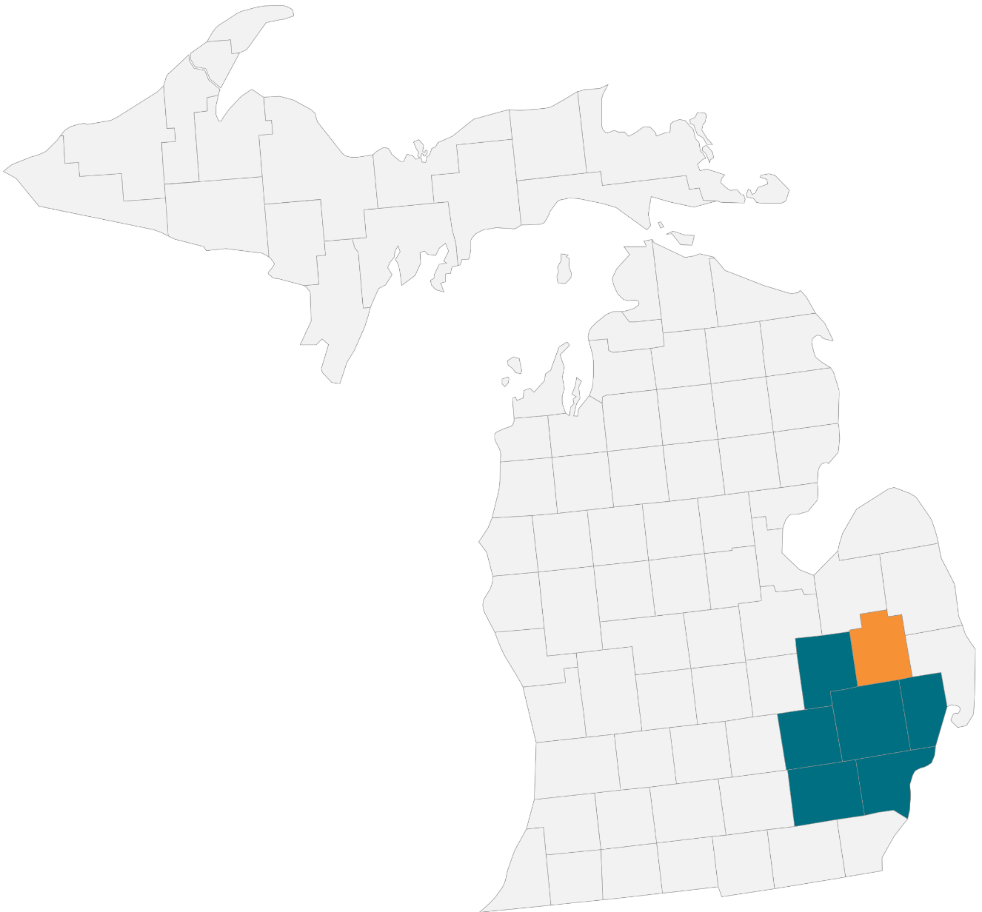
Michigan Service Area
Ann Arbor and Detroit Metro
New County
Counties (7)
Genesee Lapeer* Livingston Macomb Oakland Washtenaw Wayne *New for 2026
Lapeer
Genesee
Macomb
2025 Footprint
2026 Expansion County
Livingston
Oakland
Washtenaw
Wayne

Slide 21
2026 Michigan Plan Portfolio
General Enrollment Plans
Plan ID | Plan Type | PSP | Plan Status (New/Renewing) | 2026 Plan Name | Service Area Counties
H4624-006 | HMO | N | Renewing with Expansion | Zing Select Care MI (HMO) | Genesee, Livingston, Macomb, Oakland, Washtenaw, Wayne 2026 Expansion: Lapeer
H4624-022 | HMO | Y | Renewing | Zing Elite Select MI (HMO) | Macomb, Oakland, Wayne
H6876-001 | Local PPO | N | Renewing with Expansion | Zing Open Choice MI (PPO) | Livingston, Macomb, Oakland, Washtenaw, Wayne 2026 Expansion: Genesee, Lapeer
Special Needs Plans
Plan ID | Plan Type | PSP | Plan Status (New/ Renewing/ Termination) | SNP | SNP Type | 2026 Plan Name | Service Area Counties
H4624-012 | HMO | N | Renewing with Expansion | C-SNP | CVD, CHF, and/or Diabetes | Zing Select Diabetes & Heart MI (HMO C-SNP) | Genesee, Livingston, Macomb, Oakland, Washtenaw, Wayne 2026 Expansion: Lapeer
H4624-019 | HMO | N | Termination | C-SNP Dual Focus | Medicare Zero-Dollar Cost Sharing | Zing Dual Complete Select MI (HMO D-SNP) | 2026 Plan Termination. Counties impacted: Genesee, Livingston, Macomb, Oakland, Washtenaw, Wayne
H4624-023 | HMO | N | Renewing with Expansion | C-SNP | CKD / ESRD | Zing ESRD Select MI (HMO C-SNP) Zing Select Dialysis MI (HMO C-SNP) | Genesee, Livingston, Macomb, Oakland, Washtenaw, Wayne 2026 Expansion: Lapeer
H4624-032 | HMO | Y | Renewing | C-SNP | CVD, CHF, and/or Diabetes | Zing Elite Diabetes & Heart MI (HMO C-SNP) | Macomb, Oakland, Wayne
H4624-046 | HMO | Y | New | C-SNP | Overweight, Obesity, and/or Metabolic Syndrome | Zing Elite Balance MI (HMO C-SNP) | Macomb, Oakland, Wayne
H6876-002 | Local PPO | N | Termination | C-SNP Dual Focus | Medicare Zero-Dollar Cost Sharing | Zing Dual Complete Open Choice MI (PPO D-SNP) | 2026 Plan Termination. Counties impacted: Livingston, Macomb, Oakland, Washtenaw, Wayne
H6876-003 | Local PPO | N | Renewing with Expansion | C-SNP | CVD, CHF, and/or Diabetes | Zing Open Choice Diabetes & Heart MI (PPO C-SNP) | Livingston, Macomb, Oakland, Washtenaw, Wayne 2026 Expansion: Genesee, Lapeer
^2026 county expansion pending CMS approval.

Slide 22
2026 Michigan Plan Types
PLAN TYPE |  | PLAN TYPE
 | HMO C-SNP | Dialysis ESRD / Chronic Kidney Disease |  | HMO | Elite General Enrollment PSP
 | HMO C-SNP | Elite Diabetes, CVD, CHF PSP |  | HMO | Select General Enrollment
 | HMO C-SNP | Diabetes & Heart Diabetes, CVD, CHF |  | PPO | Open Choice General Enrollment
 | PPO C-SNP | Open Choice Diabetes & Heart Diabetes, CVD, CHF
 | HMO C-SNP| Balance Overweight, obesity, and metabolic syndrome PSP
Benefit Richness
Benefit Richness
“Our plans are differentiated by their benefit offerings, level of benefit richness, and overall value, which is determined by the type of plan”
NEW
^Plan types and benefit offerings vary by county

Slide 23
2026 Michigan Highlights
County Expansion
Plan Additions
C-SNP CKD
Lapeer
HMO C-SNP: Overweight, Obesity, and/or Metabolic Syndrome
Offered in all counties
$0 Dialysis
Unlimited transportation for dialysis members
Reduction in Cost Sharing (RICS) option
Key Benefit Highlights
MOOPs range between $4,250 - $5,445
Part A & B medical copays and cost-shares remain unchanged in 2026
$0 copays for C-SNP-specific specialists*
Grocery, Utilities and OTC offered on majority plans. Combined benefit “purses” range from $1,260- $3,264 per year.
Select C-SNP members may use SSBCI funds for reimbursement of AC Filters / Units
Transportation will be offered on all HMO plans (12 - 30 one-way trips | ESRD members unlimited )
Updated Part D T6 formulary with $0 copay for key C-SNP related brand name drugs for most plans
$0 Insulin and No Part D Deductibles.
Dental coverage varies between $1,500 - $2,500
Vision coverage varies between $200 - $350
Hearing coverage is $750 per year, every 3 years
Routine Podiatry offered on all plans
Chronic Meal offering on all C-SNPs
*C-SNP Specialists: Cardiologist, Endocrinologist, Gerontologist, Nephrologist, Ophthalmologist, Pulmonologist
Qualifying Conditions: Cardiovascular Disorders, Chronic Heart Failure, Diabetes, Chronic Kidney Disease/ESRD, Overweight, Obesity, Metabolic Syndrome

Slide 24

 | Zing Select Care MI (HMO) | Zing Elite Select MI (HMO) | Zing Open Choice MI (PPO)
 | H4624-006 | H4624-022 | H6876-001
Plan Type | General Enrollment | General Enrollment PSP | General Enrollment
Service Area | Genesee, Lapeer, Livingston, Macomb, Oakland, Washtenaw, Wayne | Macomb, Oakland, Wayne | Genesee, Lapeer, Livingston, Macomb, Oakland, Washtenaw, Wayne
MOOP (In-Network) | $4,250 | $4,500 | $4,950
MOOP (INN & OON Combined) | No OON Benefits | No OON Benefits | $8,950
PCP | $0 | $0 | $0
SNP SPC | $25 | $20 | INN: $20 / OON: $30
SPC | $25 | $20 | INN: $20 / OON: $30
Dental Allowance (Yr) | $2,000 | $2,500 | $2,000
Eyewear Allowance (Yr) | $250 | $300 | $200
Hearing Aid Allowance (3 yr) | $750 | $750 | $750
Inpatient Hosp (Days 1-6) | $300 | $295 | INN: $310 / OON $375
Transportation (One-Way) | 12 | 32 | Not Covered
Flex Card | Not Covered | Not Covered | Not Covered
Standalone OTC Allowance | $120 | $150 | $120
Frequency | Quarterly | Quarterly | Quarterly
SSBCI Allowance | $55 / Month^ | $122 / Month^ | $50 / Month^
SSBCI Inclusion | Food, Utilities | Food, Utilities | Food, Utilities
RX | $0 / $5 / $47 / 25% / 33% | $0 / $5 / $47 / 25% / 33% | $0 / $8 / $47 / 25% / 33%
MICHIGAN
General Enrollment
ALL PLANS Premium Target:
Part C = $0
Part D = $0
Sildenafil is included with plan shown
SSBCI Qualifications^
Member must have TWO or more clinically confirmed** diagnosis of:
Cancer, Cardiovascular Disorders, Chronic Heart Failure, Chronic Kidney Disease, Chronic Lung Disorders, Dementia, Diabetes
*Clinically confirmed using data from: Medical claims, pharmacy claims, or MMR. Members will receive a letter when they qualify for SSBCI.

Slide 25
 | Zing Select Diabetes & Heart MI (HMO C-SNP) | Zing Elite Diabetes & Heart MI (HMO C-SNP) | Zing Open Choice Diabetes & Heart MI (PPO C-SNP)
 | H4624-012 | H4624-032 | H6876-003
Plan Type | Chronic: CHF/CVD/Diabetes | Chronic PSP: CHF/CVD/Diabetes | Chronic: CHF/CVD/Diabetes
Service Area | Genesee, Lapeer, Livingston, Macomb, Oakland, Washtenaw, Wayne | Macomb, Oakland, Wayne | Genesee, Lapeer, Livingston, Macomb, Oakland, Washtenaw, Wayne
MOOP (In-Network) | $4,500 | $4,500 | $4,950
MOOP (INN & OON Combined) | No OON Benefits | No OON Benefits | $8,950
PCP | $0 | $0 | $0
SNP SPC | $0 | $0 | $0
SPC | $20 | $20 | $20
Dental Allowance (Yr) | $2,500 | $2,500 | $2,000
Eyewear Allowance (Yr) | $300 | $350 | $250
Hearing Aid Allowance (3 yr) | $750 | $750 | $750
Inpatient Hosp (Days 1-6) | $285 | $300 | $310
Transportation (One-Way) | 28 | 30 | Not Covered
Flex Card | Not Covered | Not Covered | Not Covered
Standalone OTC Allowance | $90 | Not Covered | $75
Frequency | Quarterly | Not Covered | Quarterly
SSBCI Allowance | $77 / Month | $157 / Month | $95 / Month
SSBCI Inclusion | Food, Utilities, AC | OTC, Food, Utilities, AC | Food, Utilities, AC
RX | $0 / $5 / $47 / 25% / 33% / $0 | $0 / $5 / $47 / 25% / 33% / $0 | $0 / $5 / $47 / 25% / 33% / $0
MICHIGAN
C-SNP
ALL PLANS Premium Target:
Part C = $0
Part D = $0
Sildenafil is included with plan shown
AC benefit offered

Slide 26
 | Zing Select Dialysis MI (HMO C-SNP)
 | H4624-023
Plan Type | Chronic: CKD/ESRD
Service Area | Genesee, Lapeer, Livingston, Macomb, Oakland, Washtenaw, Wayne
MOOP (In-Network) | $5,445
MOOP (INN & OON Combined) | No OON Benefits
PCP | $0
SNP SPC | $25 / ESRD Members $0
SPC | $25
Dental Allowance (Yr) | $2,500
Eyewear Allowance (Yr) | $350
Hearing Aid Allowance (3 yr) | $750
Inpatient Hosp (Days 1-6) | $250
Transportation (One-Way) | 30 Rides Non ESRD members / ESRD Members Unlimited
Flex Card | Not Covered
Standalone OTC Allowance | Not Covered
Frequency | Not Covered
SSBCI Allowance | $137 / Month
SSBCI Inclusion | OTC, Food, Utilities, AC, RICS
RX | $0 / $5 / $47 / 25% / 33% / $0
MICHIGAN
C-SNP
ALL PLANS Premium Target:
Part C = $0
Part D = $0
Sildenafil is included with plan shown
RICS benefit offered
AC benefit offered
Standout benefits for members with
ESRD / CKD Level 5
$0 Dialysis
$0 SNP SPC
Unlimited Transportation

Slide 27
 | Zing Elite Balance MI (HMO C-SNP)
 | H4624-046
Plan Type | Chronic PSP: Overweight, Obesity, and Metabolic Syndrome
Service Area | Macomb, Oakland, Wayne
MOOP (In-Network) | $4,500
MOOP (INN & OON Combined) | No OON Benefits
PCP | $0
SNP SPC | $20
SPC | $20
Dental Allowance (Yr) | $2,500
Eyewear Allowance (Yr) | $300
Hearing Aid Allowance (3 yr) | $750
Inpatient Hosp (Days 1-6) | $295
Transportation (One-Way) | 12
Flex Card | Not Covered
Standalone OTC Allowance | $150
Frequency | Quarterly
SSBCI Allowance | $60 / Month for qualifying members
SSBCI Inclusion | Food, Utilities
RX | $0 / $5 / $47 / 25% / 33% / $11 T6 3 month mail order = $33
MICHIGAN
C-SNP
ALL PLANS Premium Target:
Part C = $0
Part D = $0
Sildenafil is included with plan shown
GLP-1s
Tier 6 medications, including GLP-1s, have an $11 copay (compared to $47 on GE plans and $0 on other Zing C-SNP plans).
Medicare has not approved GLP1 medications for anti-obesity treatment alone.
GLP-1 medications are only covered for members who also have diabetes.
Members with existing chronic conditions may be better served by our other Zing C-SNP plans.
Members who become diabetic while on the Elite Balance plan will have an SEP to enroll into a Diabetes C-SNP Plan.

Slide 28

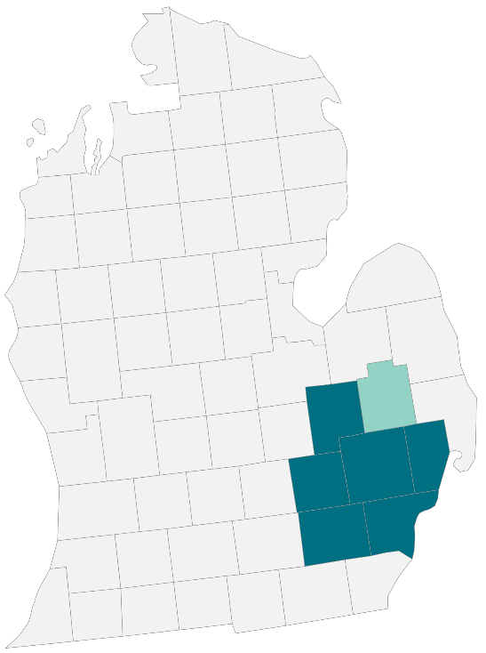

2026 Michigan C-SNP Opportunity
1,049,019
Medicare Eligibles
 | CVD | CHF | DIABETES | ANY OF CVD / CHF / DIABETES | ESRD
Estimated # of Eligibles | 287,021 | 158,461 | 300,630 | 496,703 | 8,579
Prevalence | 27% | 15% | 29% | 47% | 0.82%
Notable Market FAQs
ANY FIVE STAR PLANS AVAILABLE |  |  |  | NONE
HIDE / FIDE PLANS AVAILABLE – IN GENERAL |  |  |  | YES
# OF ZING C-SNPs OFFERED |  |  |  | 5
*CMS MA State/County Penetration July 2025; 2023 CMS 5% Sample

Slide 29







Michigan Provider Partners
Confidential information. Not to be shared with the general public. For agent recruitment use only by Zing Health

Slide 30



2026 Supplemental Benefits
Dental / Vision / Hearing
We proudly offer a large suite of non-Medicare covered supplemental benefits.
Dental Benefits
Preventive and comprehensive benefits provided for all plans!
Allowance: Members receive an annual allowance and zero cost-share for covered routine preventive and comprehensive dental services. Service limitations apply for preventive services. $0 copay for in-network providers.
Vision Benefits
Eye exam: 1 routine eye exam every year for $0 copay (in-network)
Eyewear: Annual allowance for eyewear.
Hearing Benefits
Hearing exam: 1 routine hearing exam every year for $0 copay (in-network)
Hearing Aids: Hearing aid allowance per ear, every three years (in-network)
^Benefit offerings vary by plan/Subject to CMS approval.

Slide 31




2026 Supplemental Benefits
Debit Card
We proudly offer a large suite of non-Medicare covered supplemental benefits.
Card FAQs
New members will be mailed a reloadable debit card that will contain separate “purses” for each allowance/benefit type.
Purses will fund monthly, quarterly, or one time.
Amounts vary by plan and benefit.
Benefits do not roll-over to the next benefit period.
Over-the-Counter (OTC) Items Allowance
All plans will offer an OTC benefit allowance. This is either a mandatory supplemental benefit or an SSBCI benefit.
Special Supplemental Benefits for the Chronically Ill (SSBCI): Food and Utility Allowance
This allowance may also include OTC allowance, and/or AC Units/Filter allowance, and/or Reduction in Cost Sharing (RICS) allowance.
Eligibility: SSBCI benefits are offered on most Zing plans. Eligibility criteria, verification of chronic conditions and benefit start date vary by plan.
Reduction in Cost Sharing (RICS)
Eligibility: Members must be eligible for the SSBCI offering in their plan.
Rewards and Incentives
This is a quality improvement program, not a Medicare supplemental benefit.
Eligibility: Members who complete a qualifying health activity will receive a “reward” in the form of a purse/allowance on their debit card. Activities will be tracked through claims data.
^Benefit offerings vary by plan/Subject to CMS approval.

Slide 32

2026 New SSBCI Benefits
Air Conditioner Filters / Window Air Conditioner Unit Allowance
Members of select C-SNP plans in Michigan will be able to use their SSBCI allowance for reimbursement of AC Filters / Units up to their SSBCI allowance.
Appx 20-30% of Zing C-SNP members have Lung Disorders
Reduction in Cost Sharing (RICS)
Members of Chronic Kidney Disease (CKD) C-SNP plans will be able to use their SSBCI allowance to pay for select Medical copays / coinsurance using their Zing debit card.
Zing will add select healthcare Merchant Category Codes for members use.
^Benefit offerings vary by plan/Subject to CMS approval.

Slide 33



2026 Supplemental Benefits
Food and Meal
We proudly offer a large suite of non-Medicare covered supplemental benefits.
Healthy Food/Grocery Allowance
Members who qualify for the SSBCI benefit will have an option to use their available monthly allowance toward healthy foods.
Allowance will be provided through our reloadable debit card. See “Benefits provided by Debit Card” for more information.
Meals: Post Discharge
Eligibility: Members of select plans who are discharged from a hospital or facility.
Benefit: Qualifying members will receive 14 prepared meals following each hospital discharge to mitigate health-related risks associated with nutritional management. Members will be contacted after an inpatient hospital stay to make arrangements for delivery of their meals. No limit to the number of benefit periods per year. Meals will be delivered to the member’s home.
Meals: Chronic Conditions
Eligibility: Members of select plans that have a chronic condition who are part of a supervised program designed to transition the enrollee to lifestyle modifications, must be Physician Ordered.
Benefit: Qualifying members will receive 14 or 28 meals, limited to once per year. Meals will be delivered to the member’s home.
^Benefit offerings vary by plan/Subject to CMS approval.

Slide 34





2026 Supplemental Benefits
Support and Safety Services
We proudly offer a large suite of non-Medicare covered supplemental benefits.
In Home Support Services
Eligibility: Available to members of select plans. This is a mandatory supplemental benefit available to all members of qualifying plans.
Personal Emergency Response System (PERS)
Eligibility: Available to members of select plans. This is a mandatory supplemental benefit available to all members of qualifying plans.
Bathroom Safety Devices
Eligibility: Available to members of select plans. This is a mandatory supplemental benefit available to all members of qualifying plans.
Utility Allowance
Eligibility: Members who qualify for the SSBCI benefit will have an option to use their available monthly or quarterly allowance toward utilities (electric, gas, heating oil, sanitary, water (does not include gas at the pump)). See “Benefits provided by Debit Card” for more information.
NEW Indoor Air Quality Equipment and Services Allowance
Eligibility: Members with chronic lung disorders in select plans will be able to use their SSBCI allowance for a reimbursement on air conditioning unit filters or window air conditioning units.
^Benefit offerings vary by plan/Subject to CMS approval.

Slide 35


2026 Supplemental Benefits
Transportation (Non-Emergency)
We proudly offer a large suite of non-Medicare covered supplemental benefits.
Non-Emergency Transportation
Benefit: Members can schedule one-way rides to plan approved health related locations. Not offered on PPO plans. Benefit limits vary by plan.^
In-Home Support Services
Eligibility: Members have the option to use their annual in-home support services hours (provided by Papa) for non-emergency transportation services. Rides must be scheduled through Papa. Benefit limits vary by plan.^
^Benefit offerings vary by plan/Subject to CMS approval.

Slide 36



2026 Supplemental Benefits
Wellness and Worldwide Services
We proudly offer a large suite of non-Medicare covered supplemental benefits.
Fitness/Gym
Members of most plans will receive the fitness benefit. This is a mandatory supplemental benefit available to all members of qualifying plans (not offered on CKD plans).
Nutrition and Dietary Counseling
Eligibility: Available to members of select plans. This is a mandatory supplemental benefit available to all members of qualifying plans.
Worldwide Emergency/Urgently Needed Care
Eligibility: All plans offer worldwide coverage.
^Benefit offerings vary by plan/Subject to CMS approval.

Slide 37


2026 Supplemental Benefits
Telehealth
We proudly offer a large suite of non-Medicare covered supplemental benefits.
Nurse Advice Line
24/7 availability, $0 copay
Members may call the nurse advice line when they have questions about symptoms they may be experiencing, whether they should see a doctor or go to a hospital, or other health-related issues.
Telemedicine
Primary Care and Behavioral Health services when a member’s doctor is not available.
$0 copay for telemedicine benefits received through Zing’s preferred telehealth vendor(s).
Standard provider copays will incur for telemedicine services provided by other network providers.
^Benefit offerings vary by plan/Subject to CMS approval.

Slide 38
2026 Tier 6 Brand Name Drugs
Members with Diabetes, CVD/CHF, or CKD continue to benefit from select high-impact brand name medications at $0 copay - reinforcing our commitment to affordability and chronic care support.^
Medication Brand / Generic Name | Common Associated Condition
Entresto | Cardiovascular
Janumet | Diabetes
Januvia | Diabetes
Mounjaro | Diabetes
Ozempic | Diabetes
Rybelsus | Diabetes
Trulicity | Diabetes
Sales Strategy Tip:
Agents can use this list to proactively identify prospects who are on these medications and highlight saving and support available through Zing Health plans.
NEW
^ Subject to CMS approval. Drug may also appear on a higher priced tier depending on drug form (i.e. tablets, capsules, liquids, powders, gel, injectable, etc.)

Slide 39
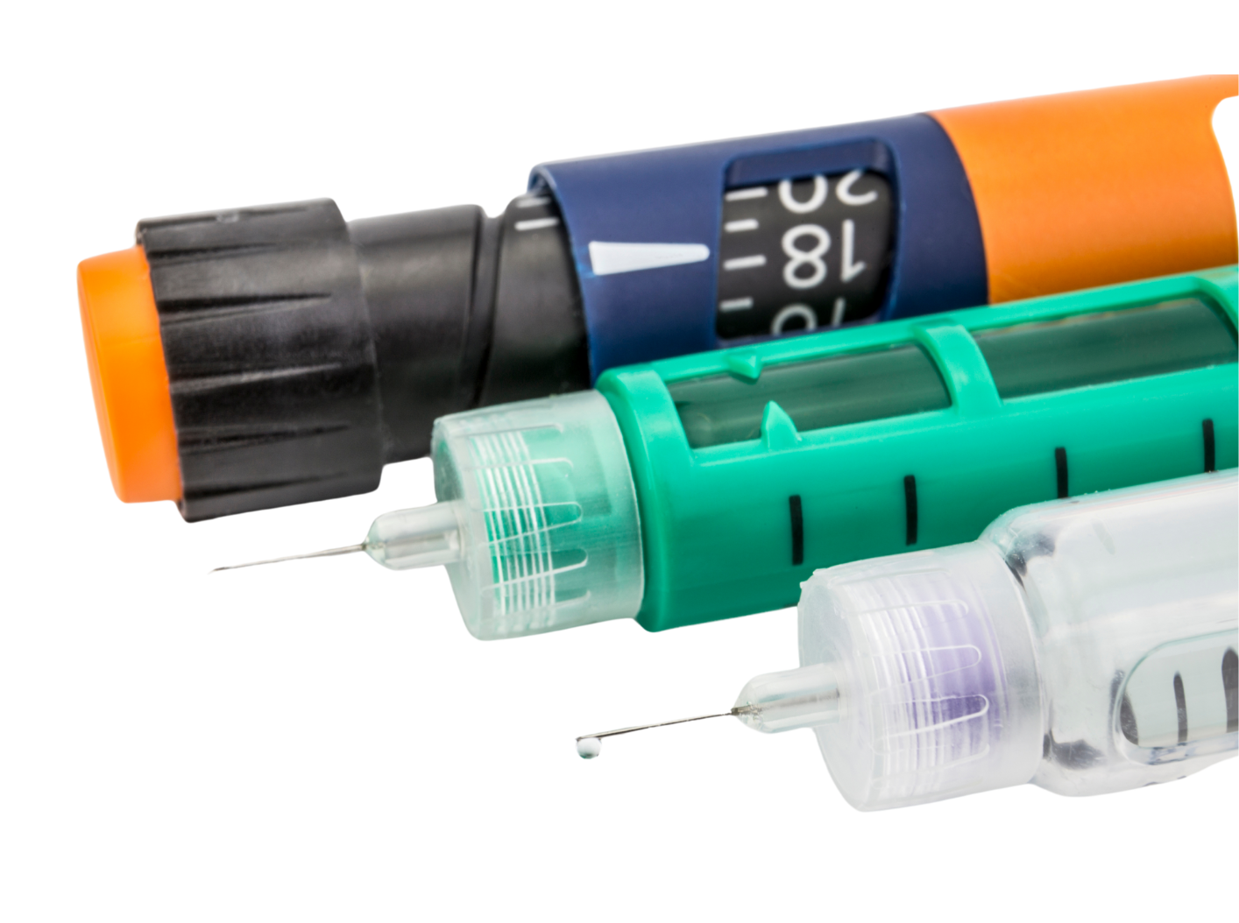
Formulary Insulins
We will continue to have $0 copay for formulary insulins shown below across the majority of our plans.^
ADMELOG INJ 100U/ML
ADMELOG SOLO INJ 100U/ML
FIASP 100 UNIT/ML CARTRIDGE
FIASP 100 UNIT/ML PEN INJ
FIASP 100 UNIT/ML INJ
HUMULIN R 500 UNIT/ML PEN INJ
HUMULIN R 500 UNIT/ML INJ
LANTUS 100 UNIT/ML PEN INJ
LANTUS 100 UNIT/ML INJ
NOVOLIN 70-30 UNIT/ML PEN INJ
NOVOLIN N 100 UNIT/ML PEN INJ
NOVOLIN R 100 UNIT/ML PEN INJ
NOVOLIN 70-30 UNIT/ML INJ
NOVOLIN N 100 UNIT/ML INJ
NOVOLIN R 100 UNIT/ML INJ
NOVOLOG MIX 100 UNIT/ML PEN INJ
NOVOLOG MIX 70-30 UNIT/ML PEN INJ
NOVOLOG 100 UNIT/ML INJ
NOVOLOG MIX 70-30UNIT/ML INJ
TOUJEO 300 UNIT/ML PEN
TOUJEO 300 UNIT/ML PEN INJ (3ML)
SOLIQUA INJ 100/33
XULTOPHY INJ100/3.6
^ Benefit offerings vary by plan/ Subject to CMS approval.
Drug may also appear on a higher priced tier depending on drug form (i.e. tablets, capsules, liquids, powders, gel, injectable, etc.)

Slide 40
Continuous Glucose Monitor (CGM)
Our members have a $0 copay for CGMs when prescribed by a physician.
What is a CGM? A CGM is a monitoring device that automatically tracks glucose levels every five minutes with a painless sensor placed onto the skin. This allows members with diabetes to see their glucose levels anytime using a smart device and/or receiver.
Using the data from the continuous readings, a CGM system can predict glucose directions and provide trends and insights that can help members stay on top of their diabetes.
The CGM technology means better diabetes management with zero finger sticks!
How to get a CGM^: The member will speak with their provider about the benefits of a CGM. The provider will write a prescription for the member. The member takes the prescription to their pharmacy and has it dispensed to them.
CGM brand: Dexcom g6 and G7
Member Testimony:
“ I am absolutely delighted with how it has improved my life. I feel so much more “secure” and “in control” and no longer afraid of dropping too low.”
^ CGMs billed via DME will incur a 20% coinsurance.

Slide 41
Preferred Diabetic Test Strips
Our members have a $0 copay for Preferred Test Strips when prescribed by a physician.
What are test strips? Test strips are used with blood glucose meters to help people with diabetes monitor their blood sugar levels. They’re a key part of daily diabetes management.
  Requires only a small blood sample
  Fast and accurate results
  Easy to handle-even for older adults
  Trusted for consistent performance
  Preferred Test Strip : Accu-check Test Strips and True Metrix Test Strips
Member Testimony:
“At 68 years old, managing my type 2 diabetes has become part of my daily routine. Accu-Chek test strips are easy to use, even with arthritis, and I get accurate results every time. They’ve helped me stay on track without stress."
^ Test strips billed via DME will incur a 20% coinsurance.

Slide 42

Men’s Health
Helping our members get their ZING back!
Sildenafil (generic Viagra) is used to treat erectile dysfunction.
Most plans will cover certain Erectile Dysfunction (ED) drugs for the 2026 benefit year.
Erectile Dysfunction drugs are covered under Tier 2 (copays vary by plan).
Covered medications: Sildenafil 25, 50, and 100 mg^
^Quantity limit of 6 pills per 30 days.

Slide 43




Coordinated Care Model Partners
Zing collaborates with partners to increase member engagement and clinical results by using its care model, member experience and data.
Condition-specific value-based partners:
Advanced Diabetes Supply (ADS): Leading national distributor of Durable Medical Equipment (DME) specializing in the diabetes supply industry.
Karoo Health: Healthcare provider that augments cardiovascular care using technology and the integration of wraparound support for patients.
Perry Health: Diabetes experts that work with providers to offer members a remote continuous health system for patients living with diabetes.
Strive Health: Healthcare partner that is the nation’s leader in value-based kidney care.
^ Partner services may vary by condition.

Slide 44

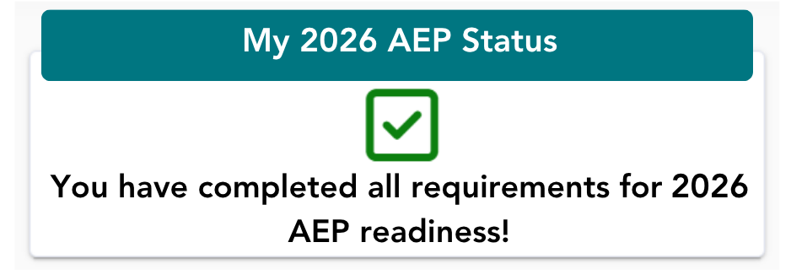
2026 Product Certification
Our broker certification is completed from within our broker portal.
The Zing Health Agent Portal can be found at: ZING Login (evolvenxt.com)
Certification FAQs
25 questions
3 attempts to pass
Must score 85% or higher to complete
Open-book friendly (download the Training Guide for support)
You can review answers and retake if additional study is needed
Verify your RTS status from your broker portal dashboard
Our certification guides will walk you through the process!
Broker Certification Guide
Agency Certification Guide

Slide 45

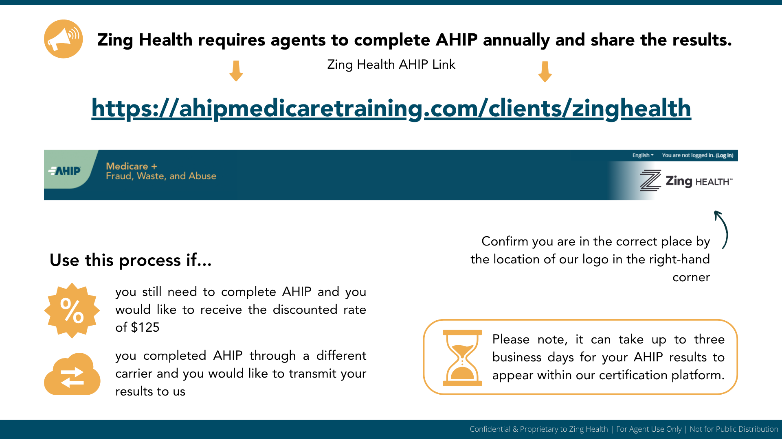
2026 AHIP
Zing Health requires agents complete AHIP annually and share the results. Using our link, also allows you to take AHIP at a discounted rate of $125!
Zing Health AHIP Link
https://ahipmedicaretraining.com/clients/zinghealth
Confirm you are in the correct place by the location of our logo in the right-hand corner.
Visit our AHIP Information sheet for additional details and troubleshooting tips.

Slide 46


Broker Portal
Our broker portal has been enhanced to provide a number of self-service tools to manage your business.
The Zing Health Broker Portal can be found at: ZING Login (evolvenxt.com)
What you’ll find:
Quick links to popular tools and portals
Profile information & license management
Commission statements (direct pay only)
Hierarchy information
Onboarding and downline management (agencies only)
Ready-to-Sell reporting (agencies only)
Book of Business management, including self-service reporting to view:
Application Status, Pending RFIs, C-SNP Verification Status, Member ID Cards, Member Termination Date
Whether you are an individual agent or agency principal, the below reference guides will help you navigate the portal.
Broker Guide
Agency Guide

Slide 47


New 2026 Enrollment Platform
A new Zing Health enrollment platform powered by SunFire is coming! This will will be offered to all agents for enrollment purposes and replace Ascend. The platform will offer a modern and efficient way for agents to submit applications, compare plans, streamline enrollment, and complete the HRA.
POWERED BY
More details and training coming soon!

Slide 48



Additional Enrollment Methods
Zing Health plans can be found on a number of approved enrollment platforms like:
Paper applications can be submitted the following ways
Fax Submissions
Fax completed application to 1-855-946-4458

Slide 49
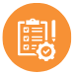


Health Risk Assessment (HRA)
C-SNP HRA Requirement
For members enrolled in a Chronic Special Needs Plan (C-SNP), a completed HRA is required to maintain their SSBCI allowance (for use towards food and utilities, but may also include OTC, RICS & AC allowance).
Deadline
For agents to receive payment, the HRA must be completed prior the member’s effective date, or December 7 for AEP business.
C-SNP HRA Compensation
$100 HRA compensation will be paid when enrolling a beneficiary into a Zing Health C-SNP. Payments will be processed 90-days after the effective date.
The HRA will be embedded within the enrollment platform available for completion immediately after an enrollment.

Slide 50
2026 SSBCI HRA Requirement
HRA Requirement | Plan Type or SSBCI Qualifying conditions
 | General Enrollment HMO & PPO Plans | Overweight, Obesity, Metabolic Syndrome C-SNP HMO | Cardiovascular Disorders / Chronic Heart Failure / Diabetes | Chronic Kidney Disease
 | NO | YES | YES | YES
 | Members in these plans must qualify to receive SSBCI benefits. See below
SSBCI Qualifications*
Member must have TWO or more clinically confirmed** diagnosis of:
Cancer, Cardiovascular Disorders, Chronic Heart Failure, Chronic Kidney Disease, Chronic Lung Disorders, Dementia, Diabetes
*This applies to members in a general enrollment HMO & PPO plans, as well as members of our Overweight, Obesity, Metabolic Syndrome C-SNP
**Clinically confirmed using data from: Medical claims, pharmacy claims, or MMR. Members will receive a letter when they qualify for SSBCI.
SSBCI Benefits Start Date
Eligible members may receive this benefit for the first 90 days of their effective date.
New Zing HMO Members: To maintain benefit, members must complete a Health Risk Assessment (HRA) within 90 days of their effective date otherwise SSBCI benefits will stop.
Returning Zing HMO Members with an established HRA due date: To maintain benefit, members must complete the HRA within 11 months of their annual HRA due date otherwise SSBCI benefits will stop.
Benefits will start again on the first day of the month after members completes their HRA.

Slide 51







C-SNP Verification
85%
Verification Rate (YTD)
PCP
Provider details captured at time of enrollment.
Zing initiates verification to provider.
30-Day Window
If not verified within 30 days, member receives Loss of C-SNP notification letter.
Zing calls unverified beneficiaries for telephonic verification; assists with plan change if requested.
Plan Change
Assist member with plan change as requested.
AOR – Agent of Record
Original enrolling agent remains AOR: outreach to AOR if needed to assist member and avoid coverage loss.
60-Day Window
Provider must validate condition within 60 days of effective date to prevent disenrollment.
Involuntary disenrollment letter mailed if condition not verified.

Slide 52

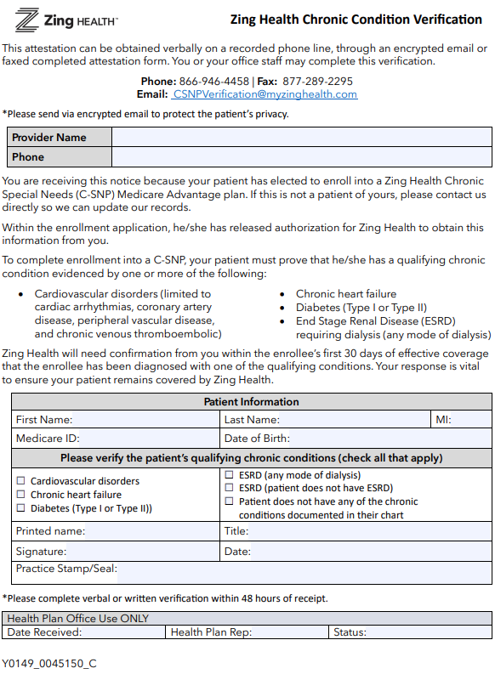


C-SNP Verification
How Agents Can Help with the Process
Confirm Qualifying Condition
Ensure member meets C-SNP requirements before enrollment.
Capture Provider Information
Include name & phone of provider who can verify the condition.
Educate using the VCC Form
Review form at point-of-sale and explain verification importance.
Leave a Copy
Give member the VCC form to take to their provider for verification.
Follow-up after 45 Days
Assist with plan change if verification is not complete.
Download
the Form
Critical Deadline: If Zing Health does not receive verification from the provider within 60 days of enrollment, the member will be involuntarily disenrolled from the health plan.

Slide 53

C-SNP Enrollment Ineligibility
If the beneficiary’s chronic condition is not verified by their provider within 60 days of enrollment, the member will be involuntarily disenrolled from the plan and have an SEP to enroll into a different plan.
If post-enrollment verification does not confirm the qualifying condition, the member will receive an SEP to enroll in another Zing Health plan.
START
This SEP starts when the plan notifies the member of ineligibility in month two and lasts through that month plus the next two months.
The SEP ends when the member makes a new election, or at the end of the second month after notification-whichever comes first.
END
Example:
Mr. Smith enrolled in the Zing Select Dialysis C-SNP plan effective March 15. The required qualifying chronic condition could not be confirmed within 60 days of enrollment. Mr. Smith is now eligible for a Special Enrollment Period to select a different Zing Health plan starting in April and continuing through May and June.

Slide 54
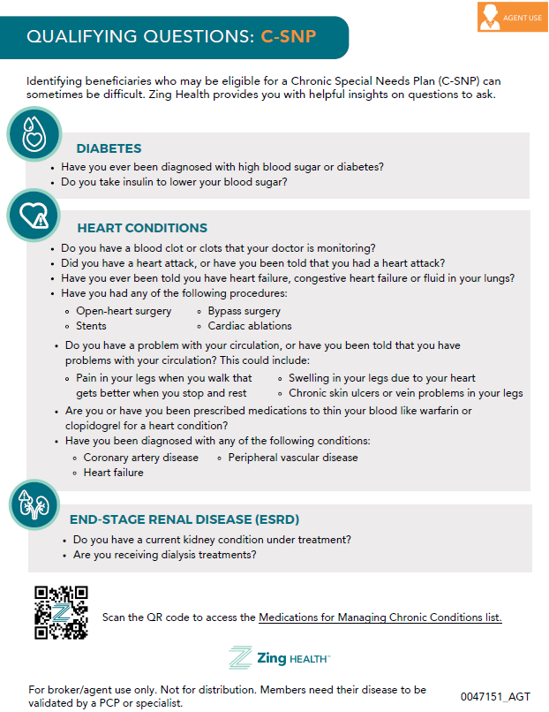

Identifying C-SNP Eligibles
C-SNP Questions
Medication List
Identifying beneficiaries who may be eligible for a Zing Chronic Special Needs Plan (C-SNP) can sometimes be a challenge, but just a little information can be helpful.
Our C-SNP Qualifying Questionnaire provides examples of compliant questions agents can ask during an interaction.
When used alongside our Medications for Managing Chronic Conditions list, it can be an effective way to help identify potential eligibles.

Slide 55

C-SNP Prospecting
Prospecting is the process of initiating and developing new business by searching for potential customers, clients, or buyers for your products or services. The goal is to move these prospects through until they convert to revenue-generating customers.
Prospecting allows you to identify good-fit partners
for your business. This leads to finding leads who
truly need your product or service to solve their challenges and pain points.
Prospecting provides organizations that are qualified and align with your target audience.

Slide 56

Prospecting Ideas
Grocery &
Retail Stores
Physician
Offices
Remember the C-SNP specialists!
Community & Faith Based Organizations
Churches, Senior Centers,
Wellness Programs
Lead
Organizations
Patient-centric Organizations
American Diabetes Association (ADA)
American Heart Association (AHA)
Chronic Disease Coalition
American Kidney Fund (AKF)
Condition Specific Support Groups
Local
Pharmacies
Diversify your events!

Slide 57
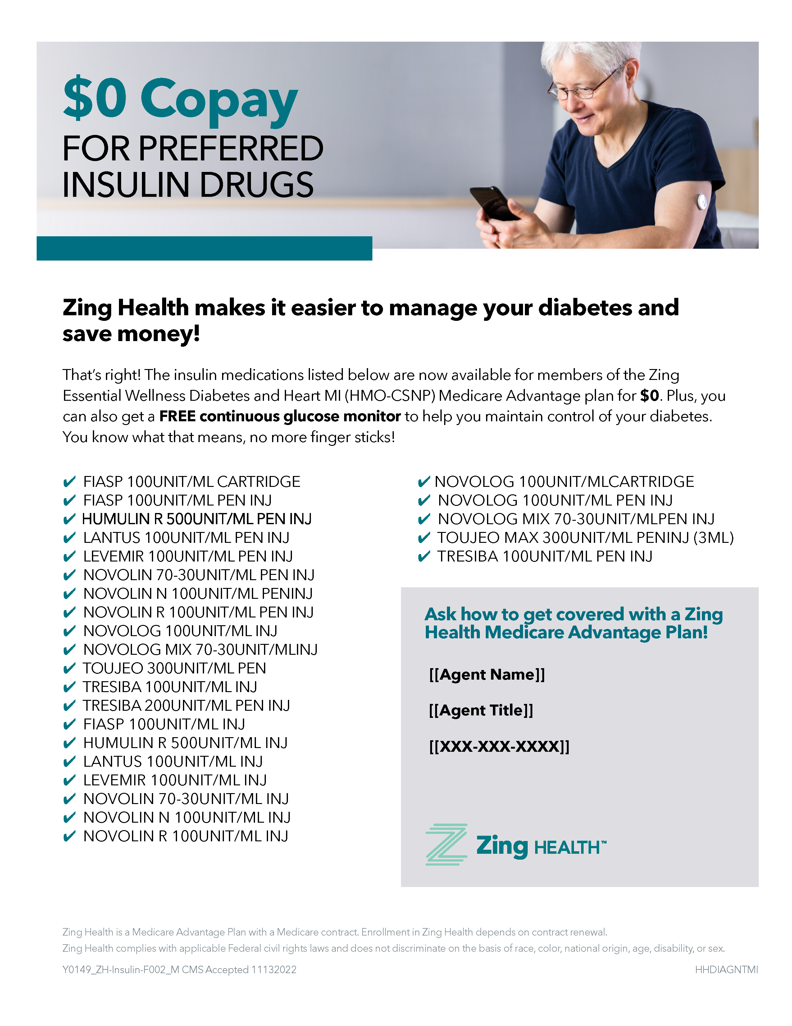
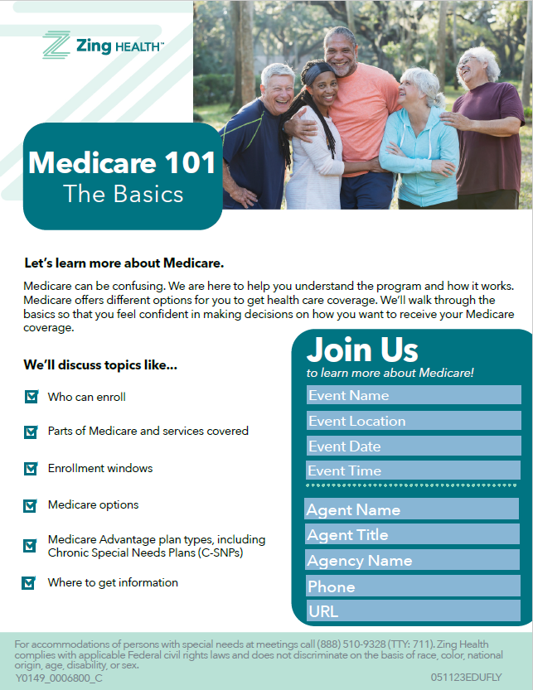
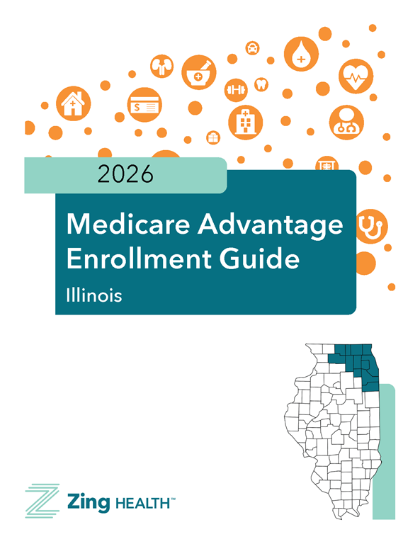
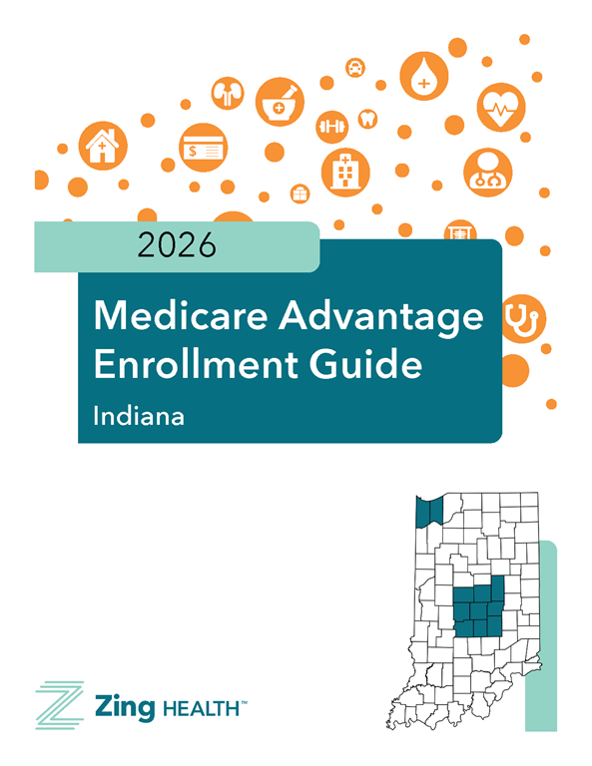
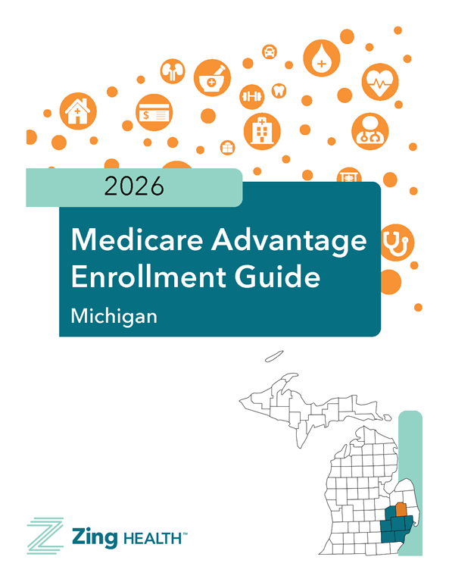
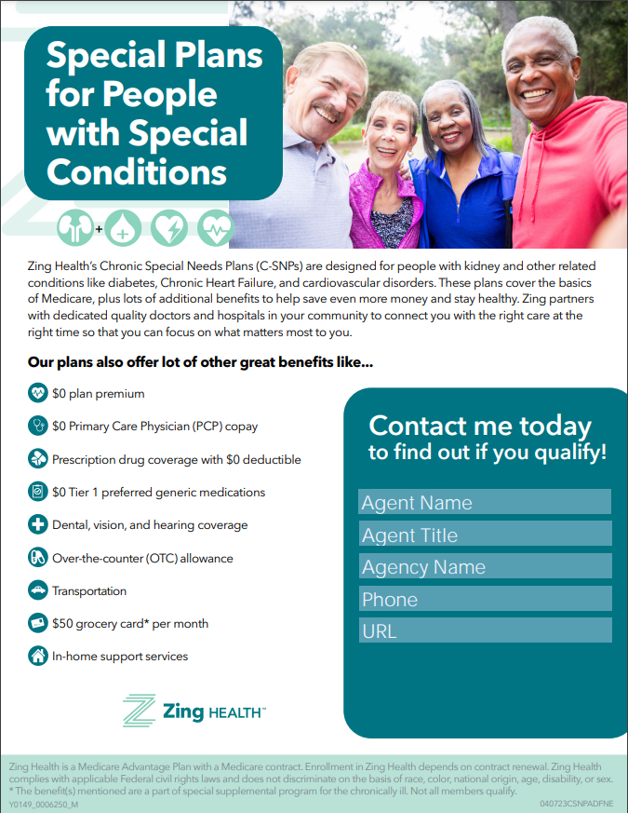

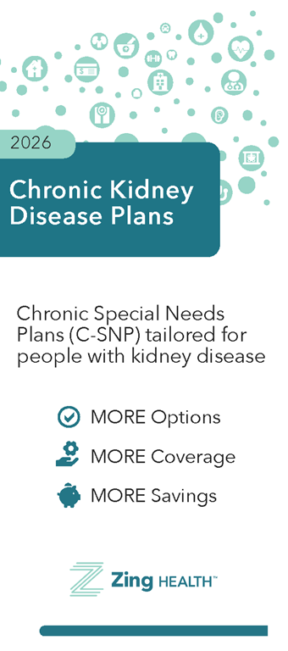
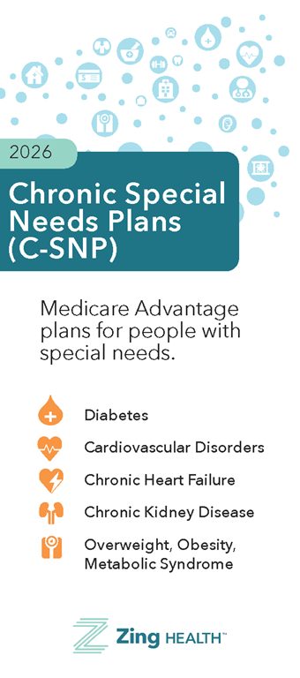
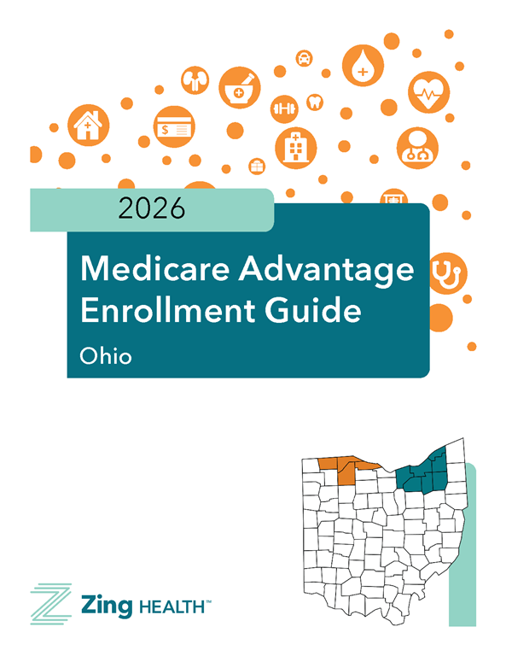
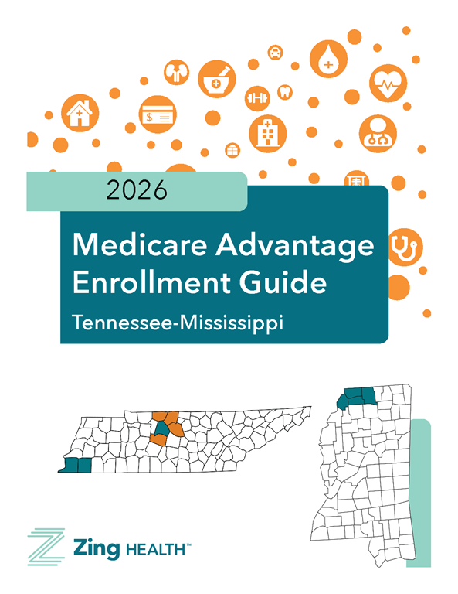
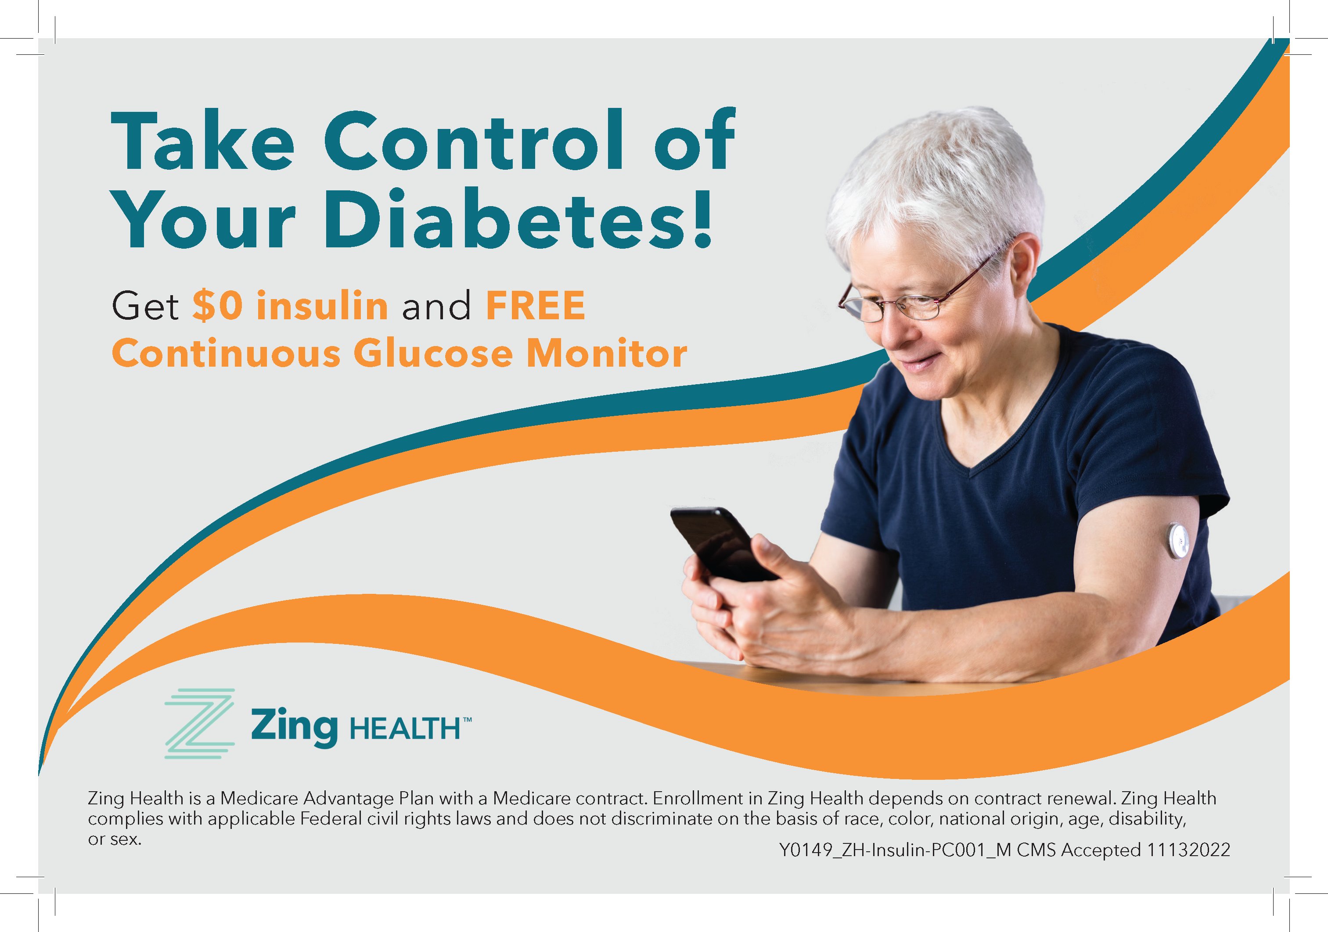
Sales and Field Marketing Materials
2026 sales materials are available for pre-order now!
Visit the supply portal to place your order today and have your custom-printed pieces ready to power your AEP.
View a summary of what is available for 2025: Marketing Material Summary

Slide 58
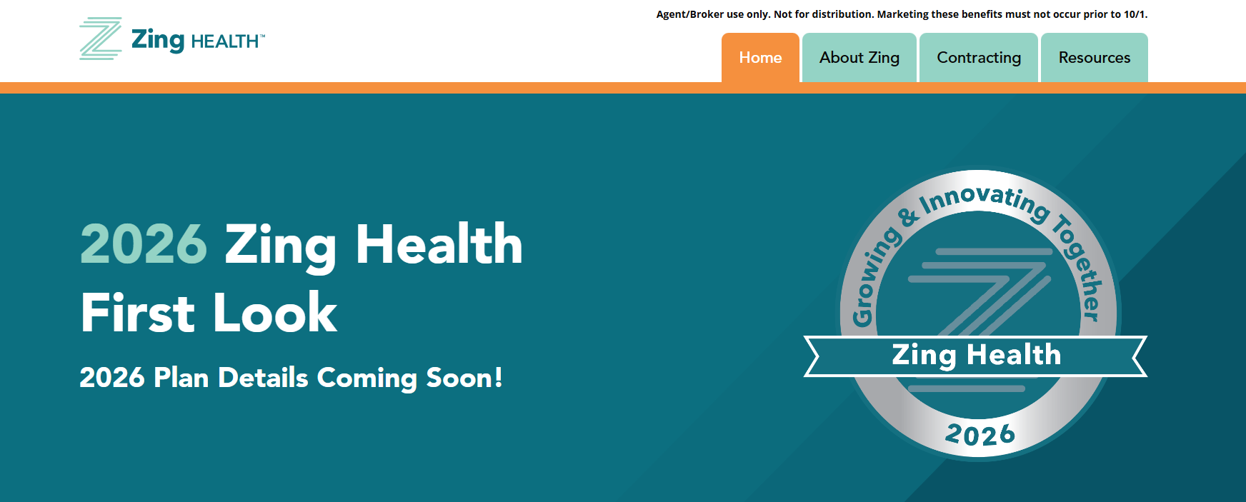
Information at your Fingertips
First Look Website | zingfirstlook.com

Slide 59

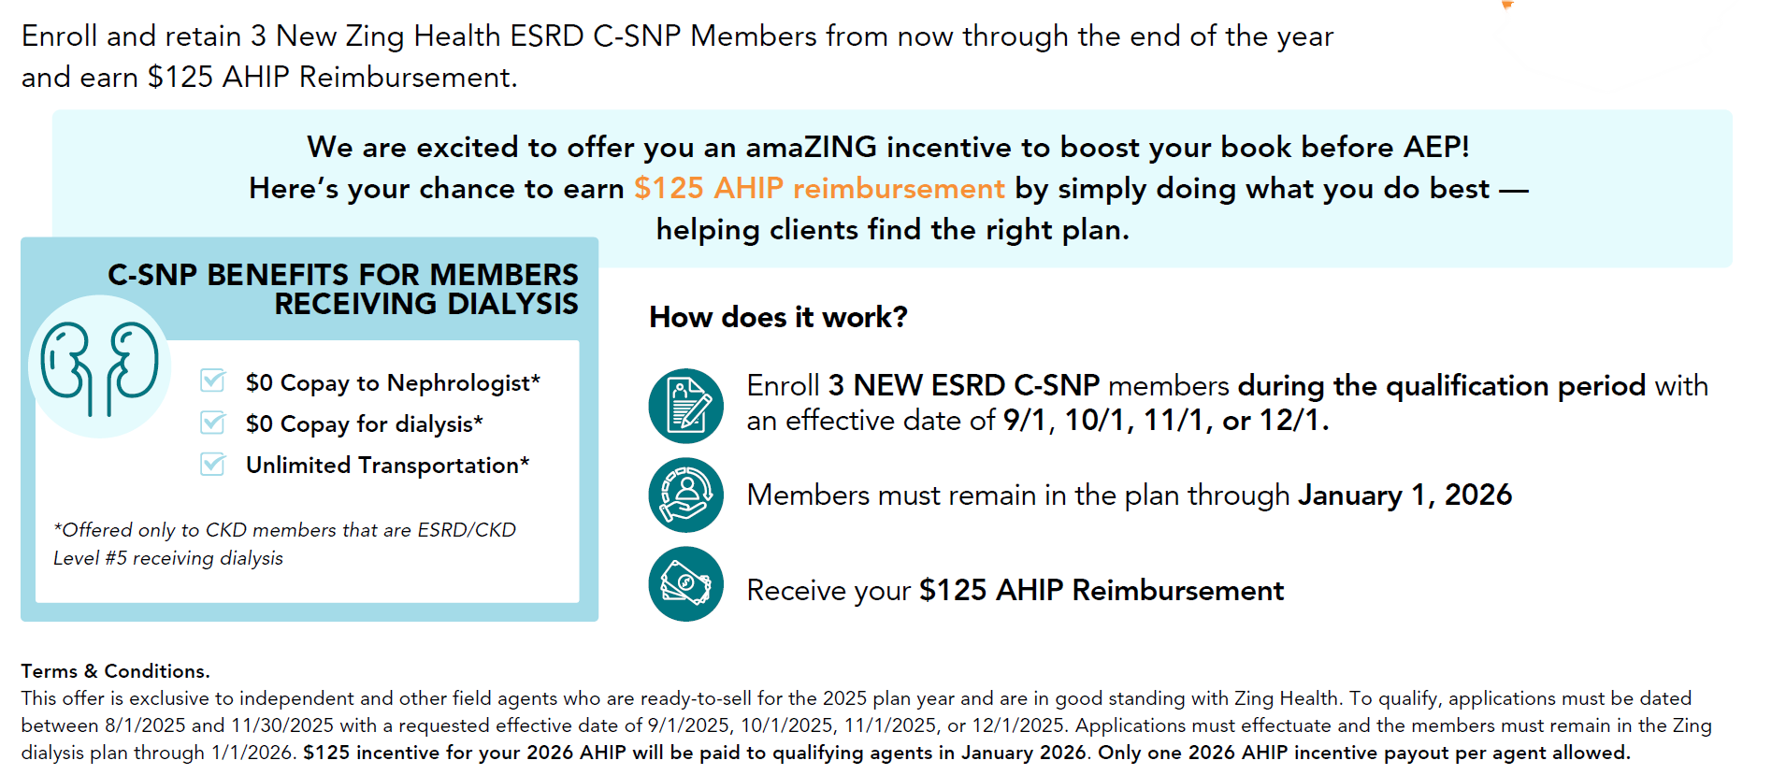
End of Year Incentive
2025
ESRD
Lock-In Incentive
Click to download

Slide 60

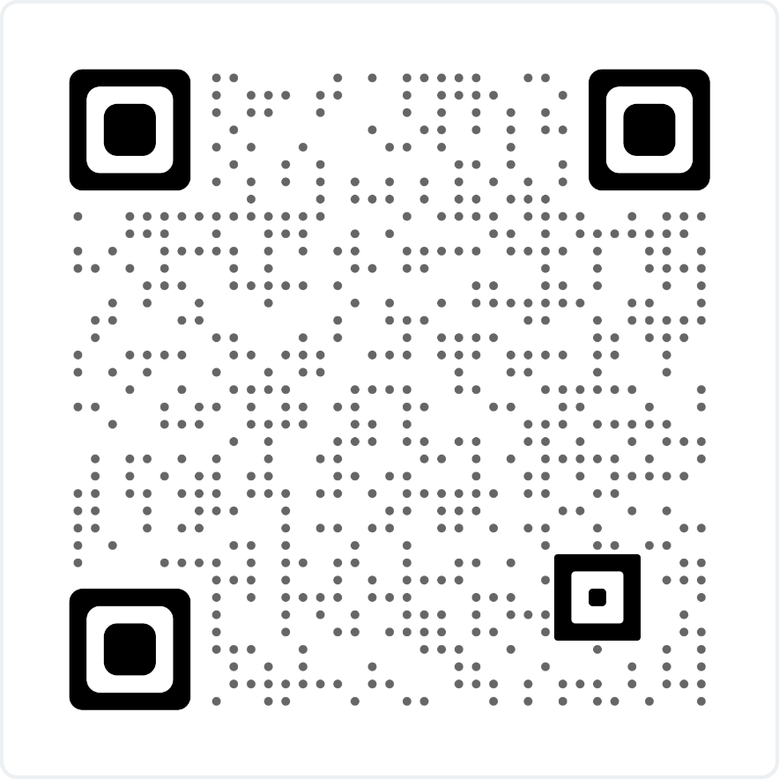

Slide 61


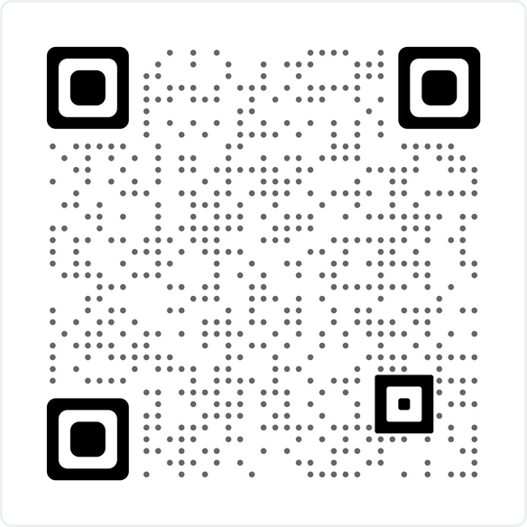


JOIN US
AUG 26
9-11 AM
12-2 PM
43337 Joy Road, Canton, MI 48185
Scan to register

Slide 62

JOIN US
AUG 28
9-11 AM
12-2 PM
COLLEGE
Troy Campus - 3838 Livernois Road, Troy, MI 48083
Scan to register

Slide 63






2026
Coming to a City Near You...
BROKER
ROADSHOWS
Scan to register!
ILLINOIS
INDIANA
MICHIGAN
OHIO
MISSISSIPPI & TENNESSEE
AEP Roadshows
AEP Roadshows
AEP Roadshows
Cleveland Roadshows
Memphis Roadshows
08/21 - Oak Brook
08/22 - Schaumburg
08/26 - Rockford
09/03 - Chicago
09/05 - Oak Brook (AM)
09/05 - Oak Brook (PM)
09/12 - Schaumburg
09/17 - Oak Brook
10/03 - Rockford
10/07 - Oak Brook (Span)
08/27 - Indianapolis (AM)
08/27 - Indianapolis (PM)
08/28 - Pendleton
08/26 - Canton (AM)
08/26 - Canton (PM)
08/28 - Troy (AM)
08/28 - Troy (PM)
08/21 - Beachwood (AM)
08/21 - Beachwood (PM)
09/09 - Perrysburg (AM)
09/09 - Perrysburg (PM)
08/26 - Memphis (AM)
08/26 - Memphis (PM)
08/28 - Memphis (AM)
08/28 - Memphis (PM)
Toledo Roadshows
Nashville Roadshows
Discover our 2026 plans - connect, learn, and have some fun!
We’ll cover what’s new and exciting, plus there’ll be raffles, giveaways, and a few laughs along the way!
08/14 - Nashville (AM)
08/14 - Nashville (PM)
09/09 - Nashville (AM)
09/09 - Nashville (PM)

Slide 64
Thank You
Questions? Our team is here for you!
Reach out to your local contact or our Broker Services team
by phone at 1-844-946-4226 or via email at brokers@myzinghealth.com
8:00AM - 5:00PM CT Monday - Friday

