Slide 1


Silver & Fit Benefit
with
Physicians Mutual Medicare Supplements

Slide 2
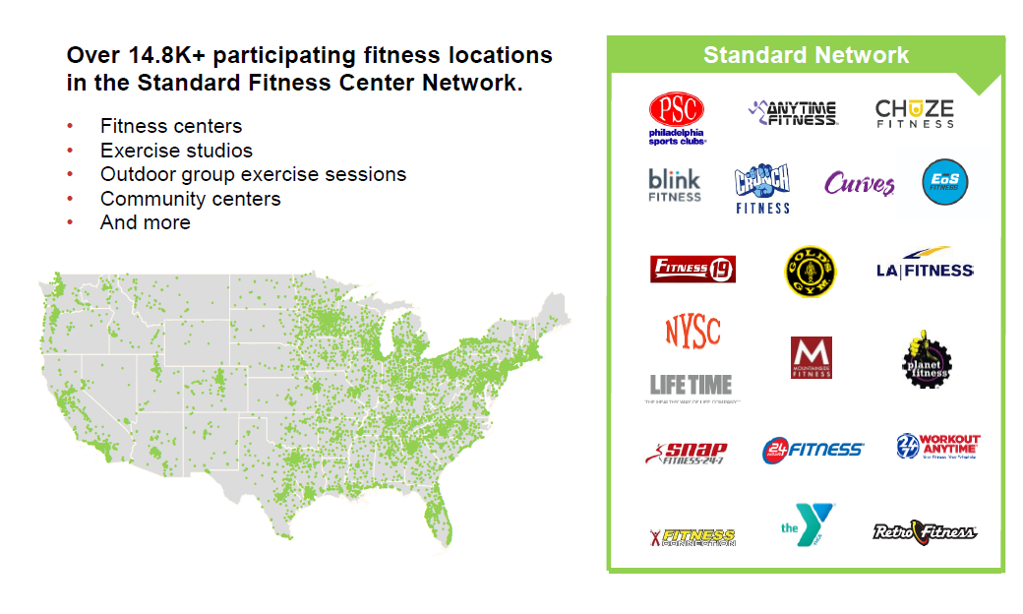
Standard Network = Free Gym Membership

Slide 3
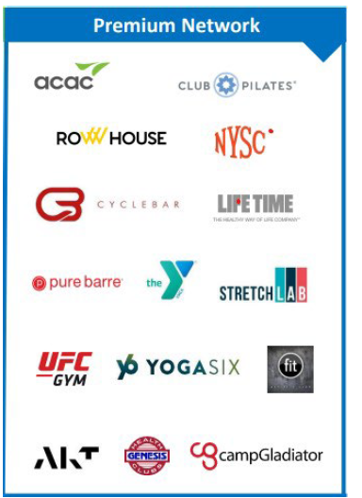
Premium Network = Discounted Gym Membership
Over 5K participating fitness locations in the Premium Fitness Center Network.
Discounted member price
Fitness centers
Fitness studios
Activity-based locations

Slide 4
Lifestyle Coaching
-Personalized, behavioral based coaching over-the-phone or digital
-Fall prevention
-Physical Activity
-Social Isolation Prevention
-Lifestyle Choices – good habit
-Physician Engagement – What to ask your Dr.
-Managing Health I ssues
-Healthy Eating
-Brain Health
-17 years of experience
-2.2 million coaching sessions

Slide 5
Silver&Fit – Well-Being Club
Well-being Club page (member log-in):
Live virtual classes, social events, and social groups.
  Virtual workouts, workshops, and tours that members can participate in from the comfort of their homes.
Through virtual events, members can connect with other members virtually.
  For example, members can participate in a virtual Cardio Dance Mix 30-minute live workout and/or attend a virtual March Madness social event.

Slide 6
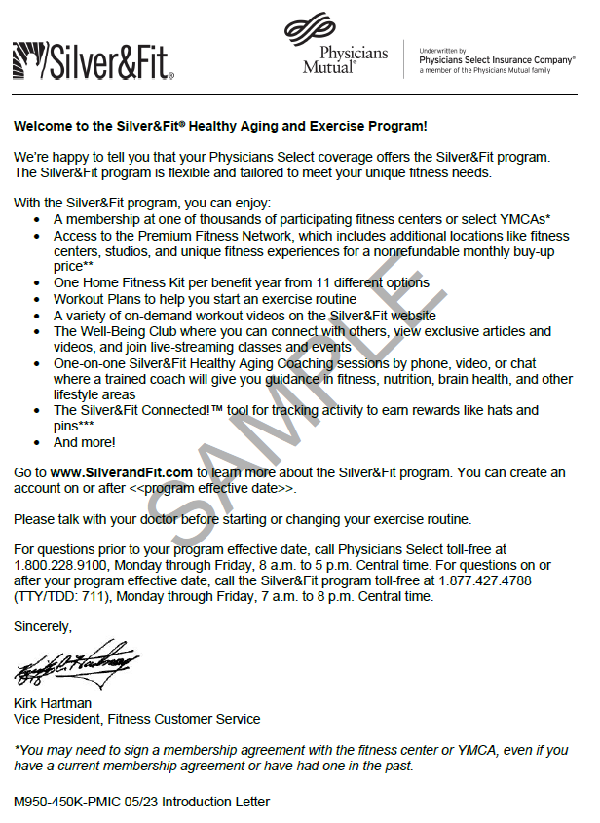
Your client will receive a Welcome letter with their Physicians Mutual Medicare Supplement policy.
They can go to www.SilverandFit.com to check eligibility and create an account.
Website
Toll-Free Number

Slide 7
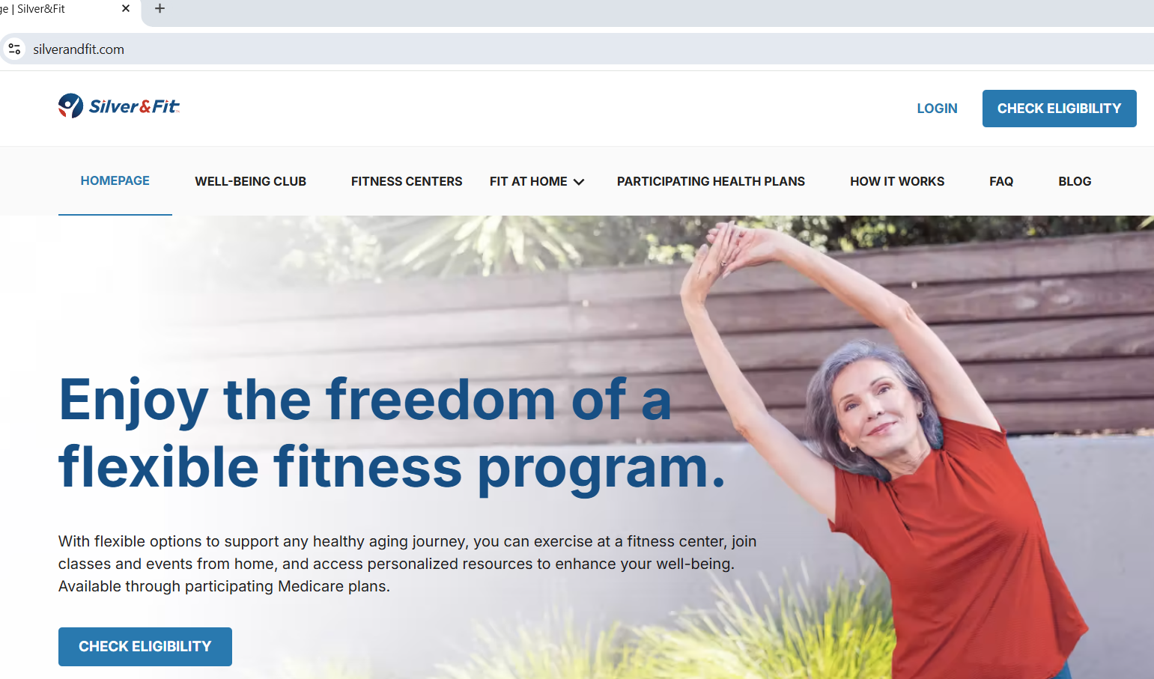
Click Here
NOTE: Customers must wait to check their eligibility until on or after the Physicians Mutual Medicare supplement policy EFFECTIVE DATE. Their policy must be in force.

Slide 8
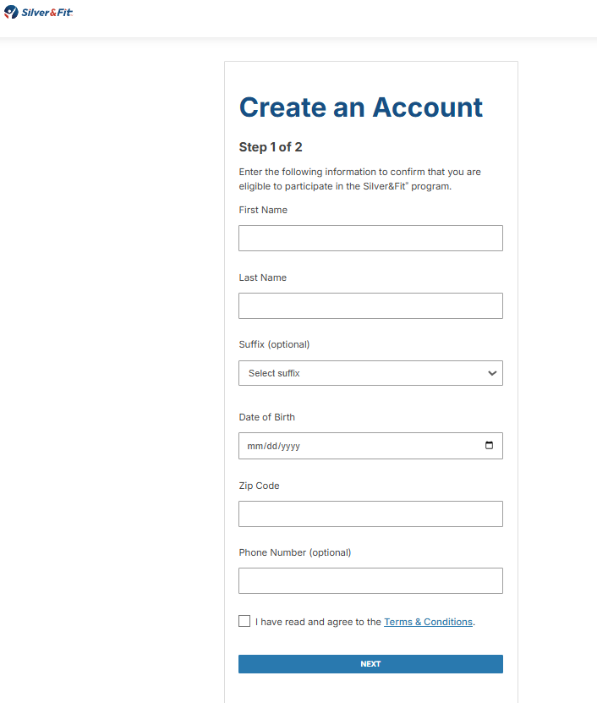
Enter Info
Your client will enter the following information to confirm that they are eligible to participate in the Silver&Fit program.
If eligible, your client can proceed with creating an account.
Click Here

Slide 9
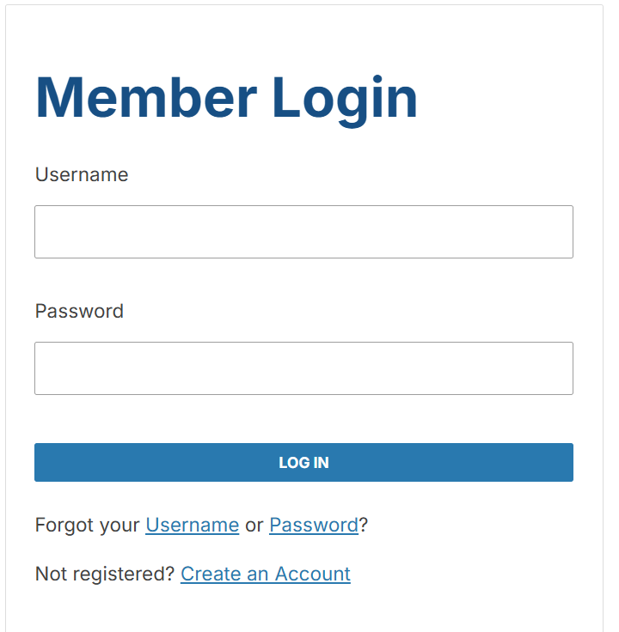

Slide 10
Searching for Fitness Centers in the Physicians Mutual Silver & Fit Network
Below you will find a Silver&Fit test account that is exclusive to agents/brokers that sell Physicians Mutual. This is what it will look like when your client logs in.
You can use this to search for fitness centers in network.
Again, this is for Physicians Mutual only – as you can see by the branded page.
https://www.silverandfit.com/
PM Broker/Sales Agent Test Account:
Username: PMDemo1
Password: PMDemo1!

Slide 11
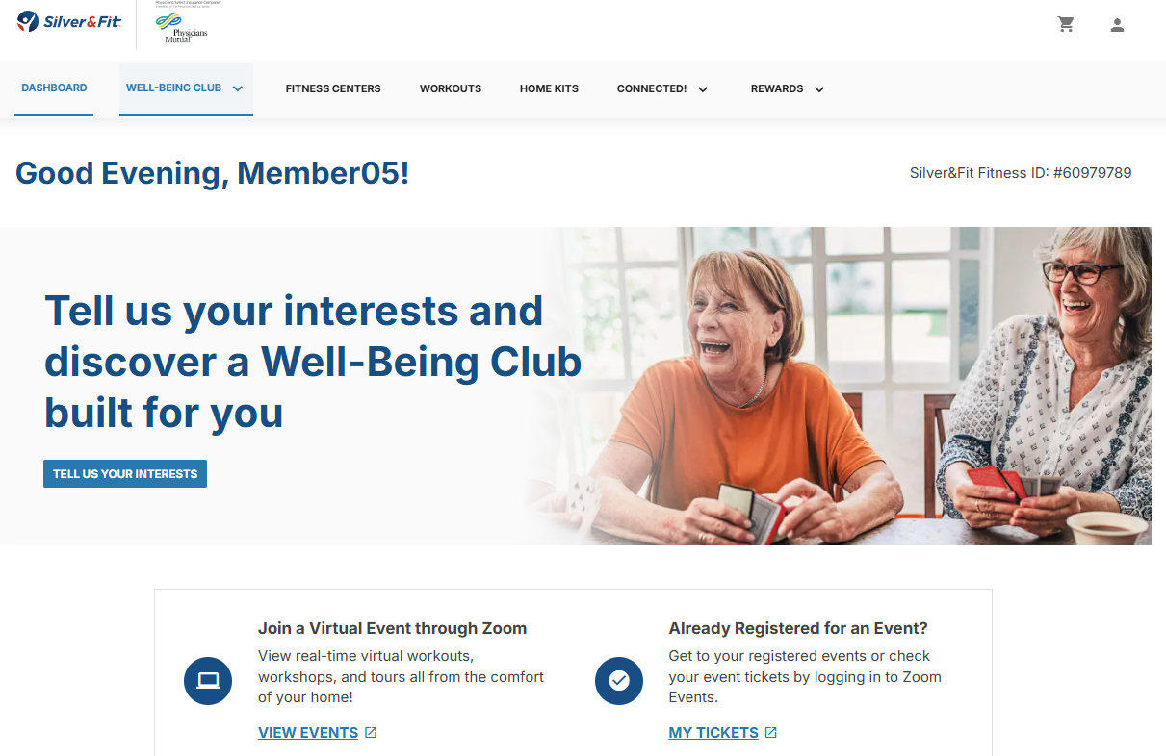
Fitness Centers
Fitness ID

Slide 12
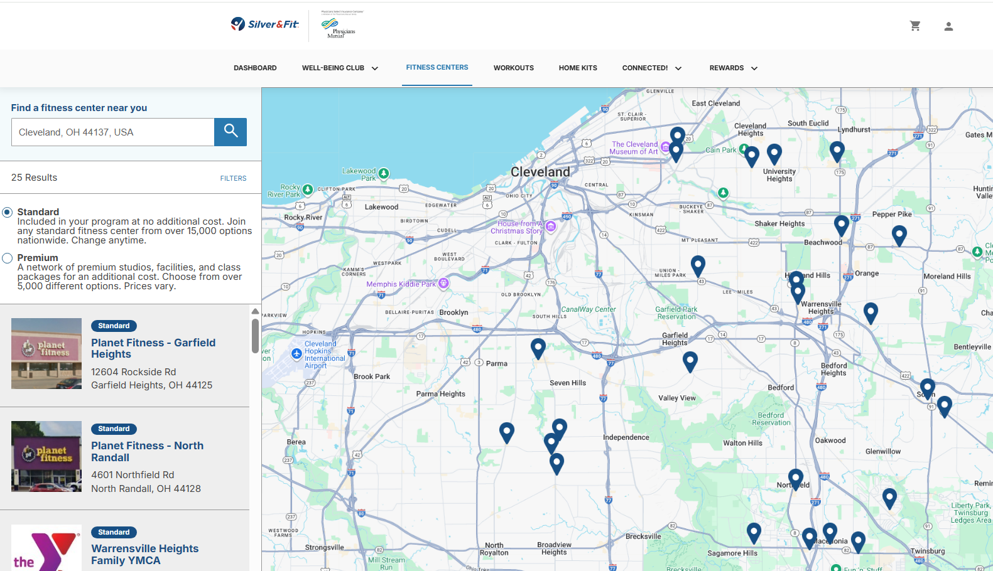
Standard
Scroll Bar

Slide 13
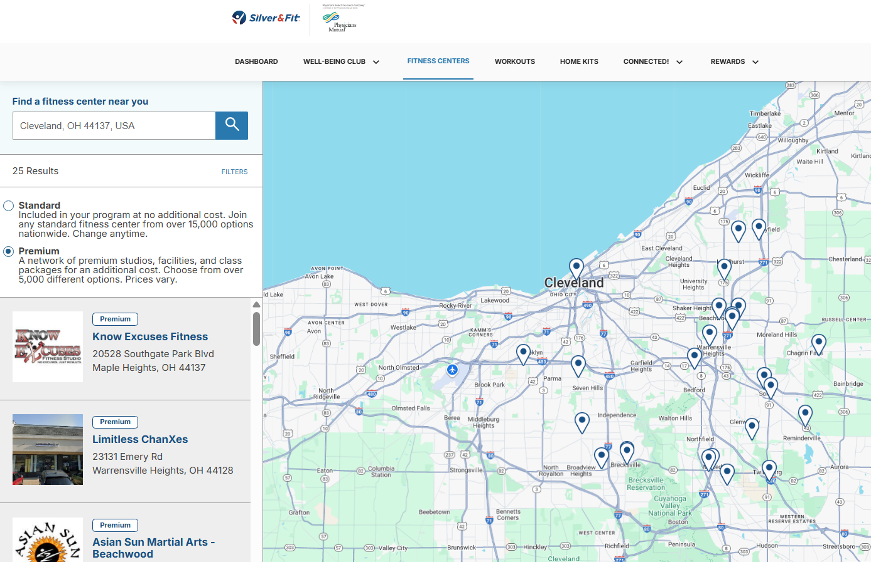
Premium
Scroll Bar

