Slide 1



PACE Association of Michigan Brought to Agents by RYIS
2026 Broker Certification

Slide 2
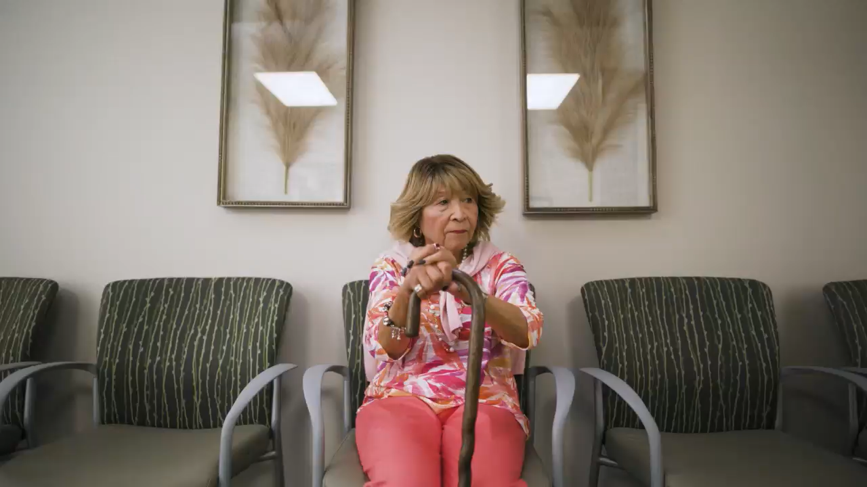

Slide 3
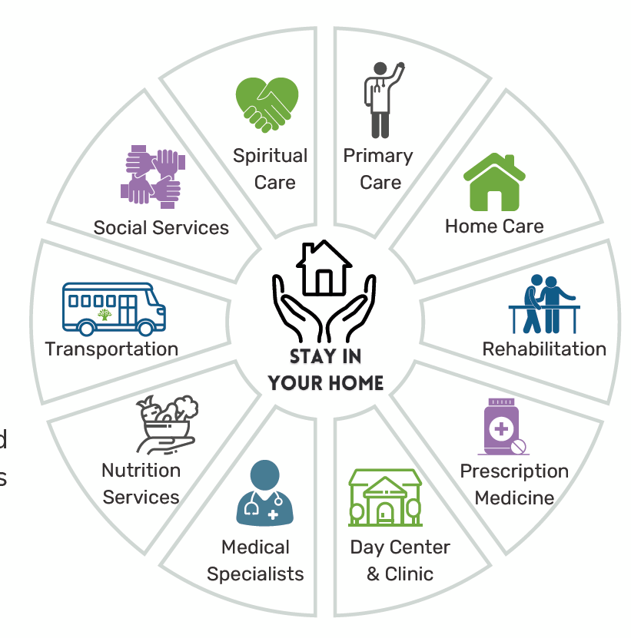
About PACE: Program of All-inclusive Care for the Elderly
The PACE business model is centered on the belief that it is better for the well-being of seniors with chronic care needs and their families to be served in the community whenever possible.

Slide 4
What is PACE?
PACE is known nationally, started in California – came to Michigan as a pilot in 1994.
Interdisciplinary and coordinated approach to care- enhancing the well-being of its participants allowing them to age in place at home.
PACE provides full medical, physical & social support.
PACE Southeast Michigan is a non-profit, 501c3.
Sponsored by Henry Ford Health System and Presbyterian Villages of Michigan.
PACE is both the insurance (payor) and provider of all services for participants in the program.
PACE is fully at risk financially. Funded by Medicare and Medicaid. Manages the cost of care for its participants. The most proactive care model where the focus is on the whole person.

Slide 5
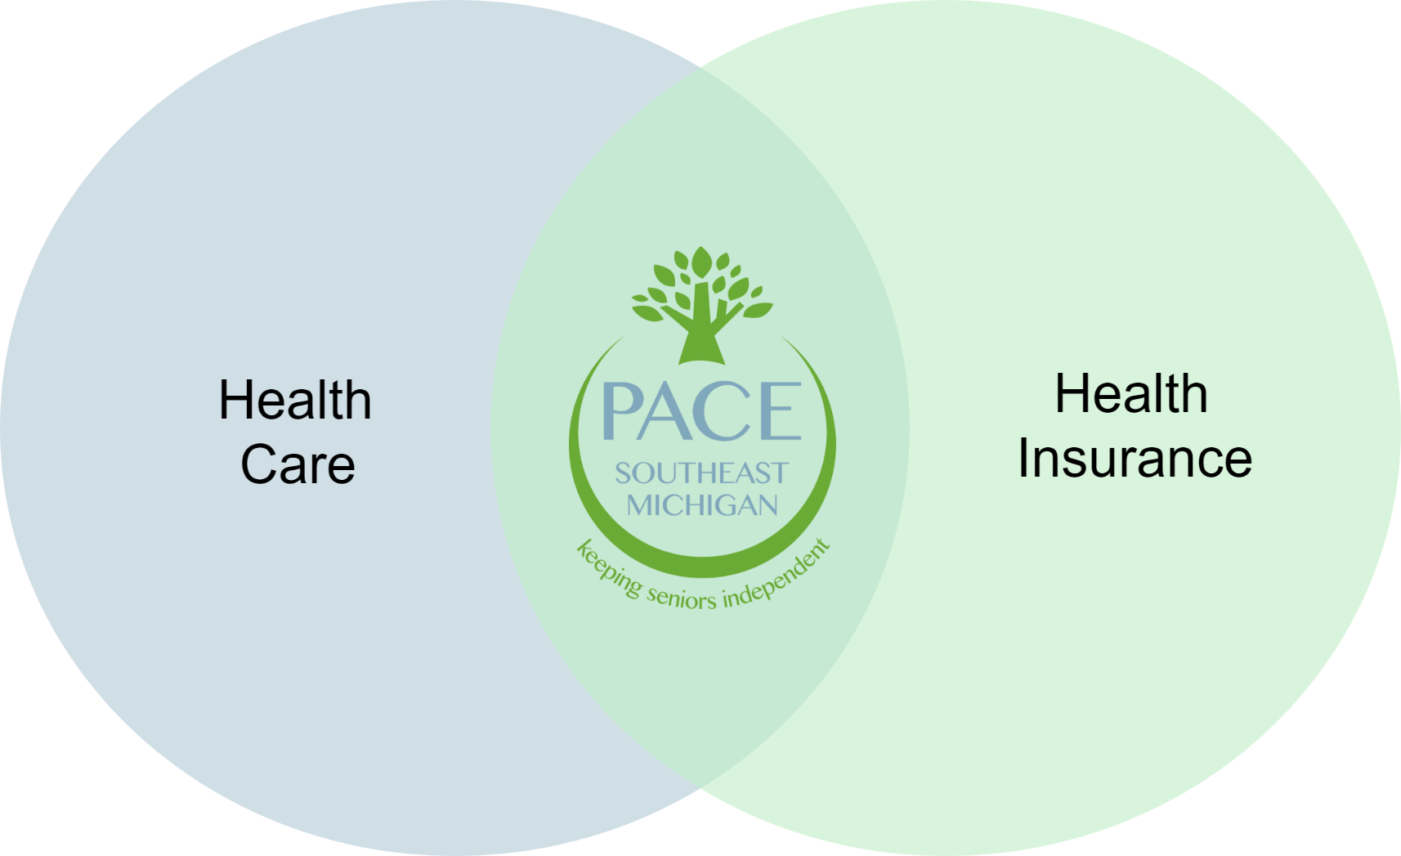
The PACE Care Model

Slide 6
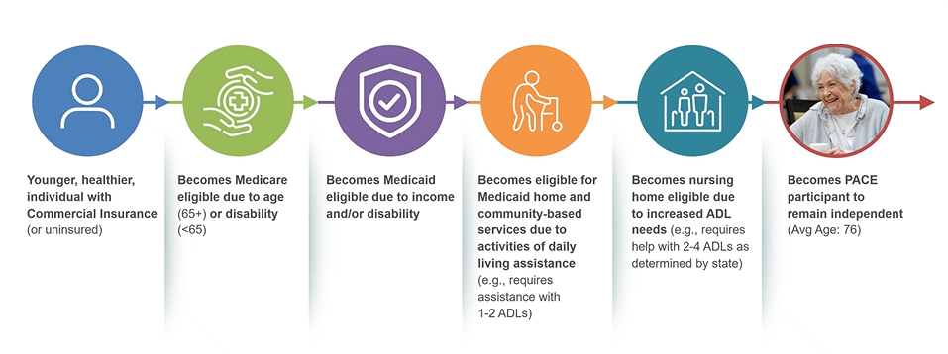
PACE is positioned towards the end of the healthcare continuum

Slide 7
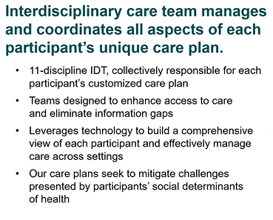
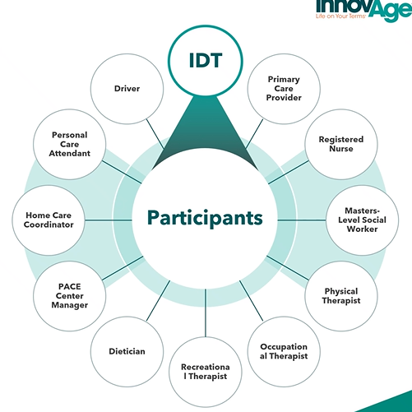
Interdisciplinary Team

Slide 8
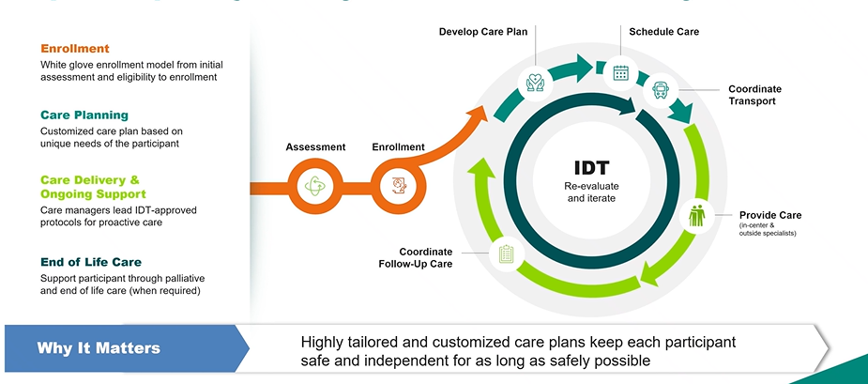
PACE has standardized each phase of the participant journey to ensure continuity of care

Slide 9
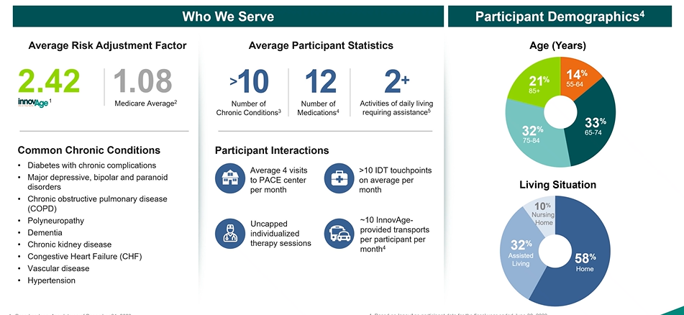
PACE offers the most comprehensive healthcare benefits.
Senior Care Services for Living Independently | Innovage

Slide 10

Why PACE for seniors living in the community?
Senior apartments lose residents to hospitals and nursing homes
Lack of activity in the home
No medical oversight or VERY hard getting in timely to see doctor
Caregivers not present or able to help with needs
No medications available (no coverage, cannot afford or no way to get)
No transportation to appointments
Access to food is limited, unable to cook or eat balanced meals
Care is not coordinated or proactive
Cannot afford supplies, durable medical equipment, other care needs
PACE CAN MAKE A DIFFERENCE IN ALL THESE AREAS!

Slide 11

Identifying Participants
Who PACE Serves
Whose independence is a priority
Whose living situation can be improved with an increased level of support
Whose social life has virtually diminished
Whose support network is weak
Has recent changes in medical, marital or other status that concerns loved ones
Who financial status Is unstable, but do see individuals paying for PACE out of own funds and it is lower cost than LTC.
Whom finds transportation is a challenge

Slide 12

Who is eligible for PACE?
MUST meet all 4 eligibility factors
Individual must be 55 years or older
Qualifies for nursing home level of care
(NFLOC Determination Form used)
Lives within PACE MI service area
Capable of living safely at home with support from PACE SEMI

Slide 13
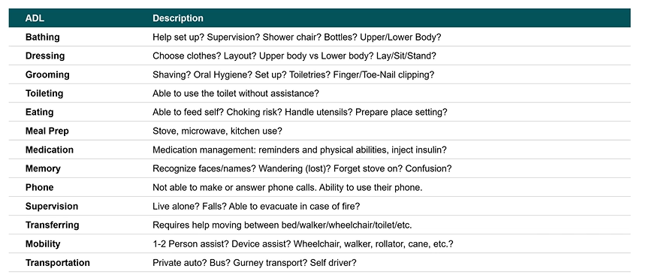
Common Activities of Daily Living (ADLs)
PACE ADL definitions and requirements vary by state. Brokers should identify at least two ADL’s before submitting referral form.

Slide 14
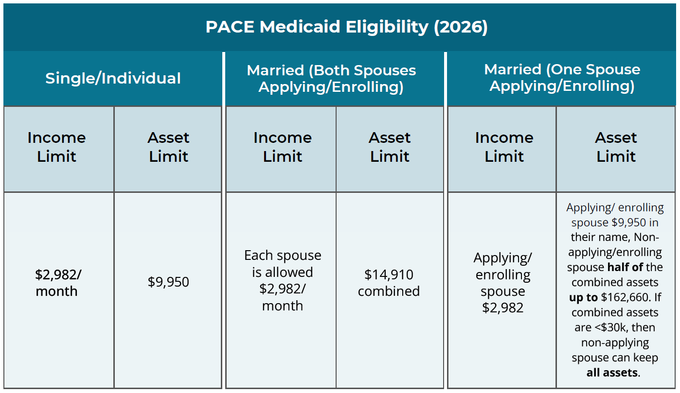
Financial limitations for PACE?

Slide 15
What is the cost to be a participant with PACE?
All services and benefits are at no cost to those who qualify who are Medicaid eligible.
Income (gross) for individual not over $2,982.
Assets not over $9,950 (includes life insurance cash values, bank balances, CDs, stocks, IRA, etc.)
Those not eligible for Medicaid can pay privately.

Slide 16
The Enrollment Process
We work closely with our partners for a smooth transition into enrollment and managed care.
Enrollment occurs the 1st of every month
Enrollment closes on the 24th of every month
Home visit with both a social worker and home care nurse
IDT creates a Person-Centered Care Plan with participant and caregiver(s)
Intake process typically takes a few days

Slide 17

RYIS PACE Partners
PACE SE Michigan
PACE Huron Valley
PACE Care Resources
PACE North
Includes the following counties:
Allegan, Barry, Benzie, Grand Traverse, Ionia, Kalkaska, Kent, Leelanau, Macomb, Monroe, Oakland, Ottawa, Wayne, Washtenaw, Wexford

Slide 18
Frequently asked questions?
Am I required to change my physicians and specialist ?
In some cases, Care Resources PACE can coordinate with your current medical team.
Is respite a service offered under PACE ?
Yes, Care Resources Day Center can provide respite. Out of home respite can also be offered based on the person-centered plan.
Can I be enrolled in PACE and another program at the same time ?
PACE is an all- inclusive program designed to be the payor and provider; someone is not able to be enrolled in PACE and another program at the same time.
Is day center attendance required to enroll in Care Resources PACE ?
No but you may want to attend to the day center weekly for all the fun activities !
Can I keep my current paid caregiver if I enroll in Care Resources PACE ?
Sometimes a current paid caregiver is eligible to become a paid caregiver once you enroll in Care Resources PACE. This can be determined during the enrollment process.

Slide 19
Next Steps
Complete
Complete Agent contract
Complete
Complete test with a score of 85% or higher
Read
Read broker agreement
Finish by
Finish by signing Docusign contract

Slide 20

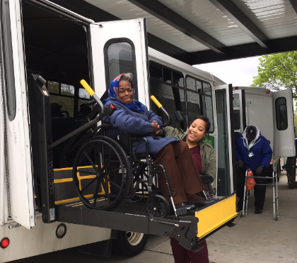
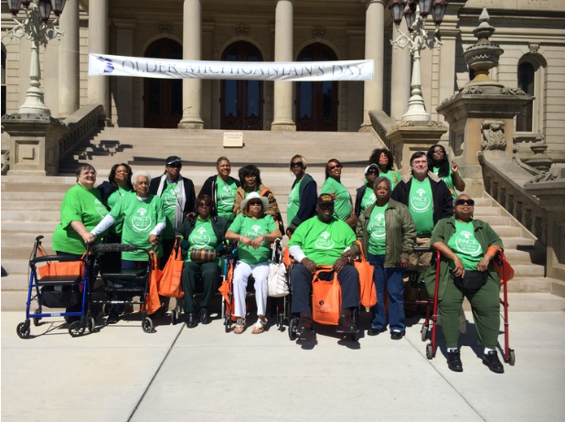
Thank you for joining us today!
Questions? Contact Dustin VanDuine at Dustin@rickyounginsurance.com

