Slide 1


McLaren Medicare
2027 Product
Overview
Agent/Broker use only. Confidential and proprietary. Not to be distributed or shared with Medicare beneficiaries. Distribution to any person or company is prohibited and may be grounds for contract termination. The plan and benefit information contained in this document is pending government approval and subject to change. Final 2027 plan and benefit information may be discussed with beneficiaries on or after October 1.
2027

Slide 2
Agent/Broker use only. Confidential and proprietary. Not to be distributed or shared with Medicare beneficiaries. Distribution to any person or company is prohibited and may be grounds for contract termination. The plan and benefit information contained in this document is pending government approval and subject to change. Final 2027 plan and benefit information may be discussed with beneficiaries on or after October 1.
About McLaren Health Plan
Government programs - Individual, Medicare and Medicaid products
Anchored by the McLaren Health Care System, we also contract with top health care systems in Michigan
Based in Flint, MI
Comprehensive and continually growing provider network
Subsidiary of McLaren Health Care Corporation, one of Michigan’s largest integrated health systems

Slide 3
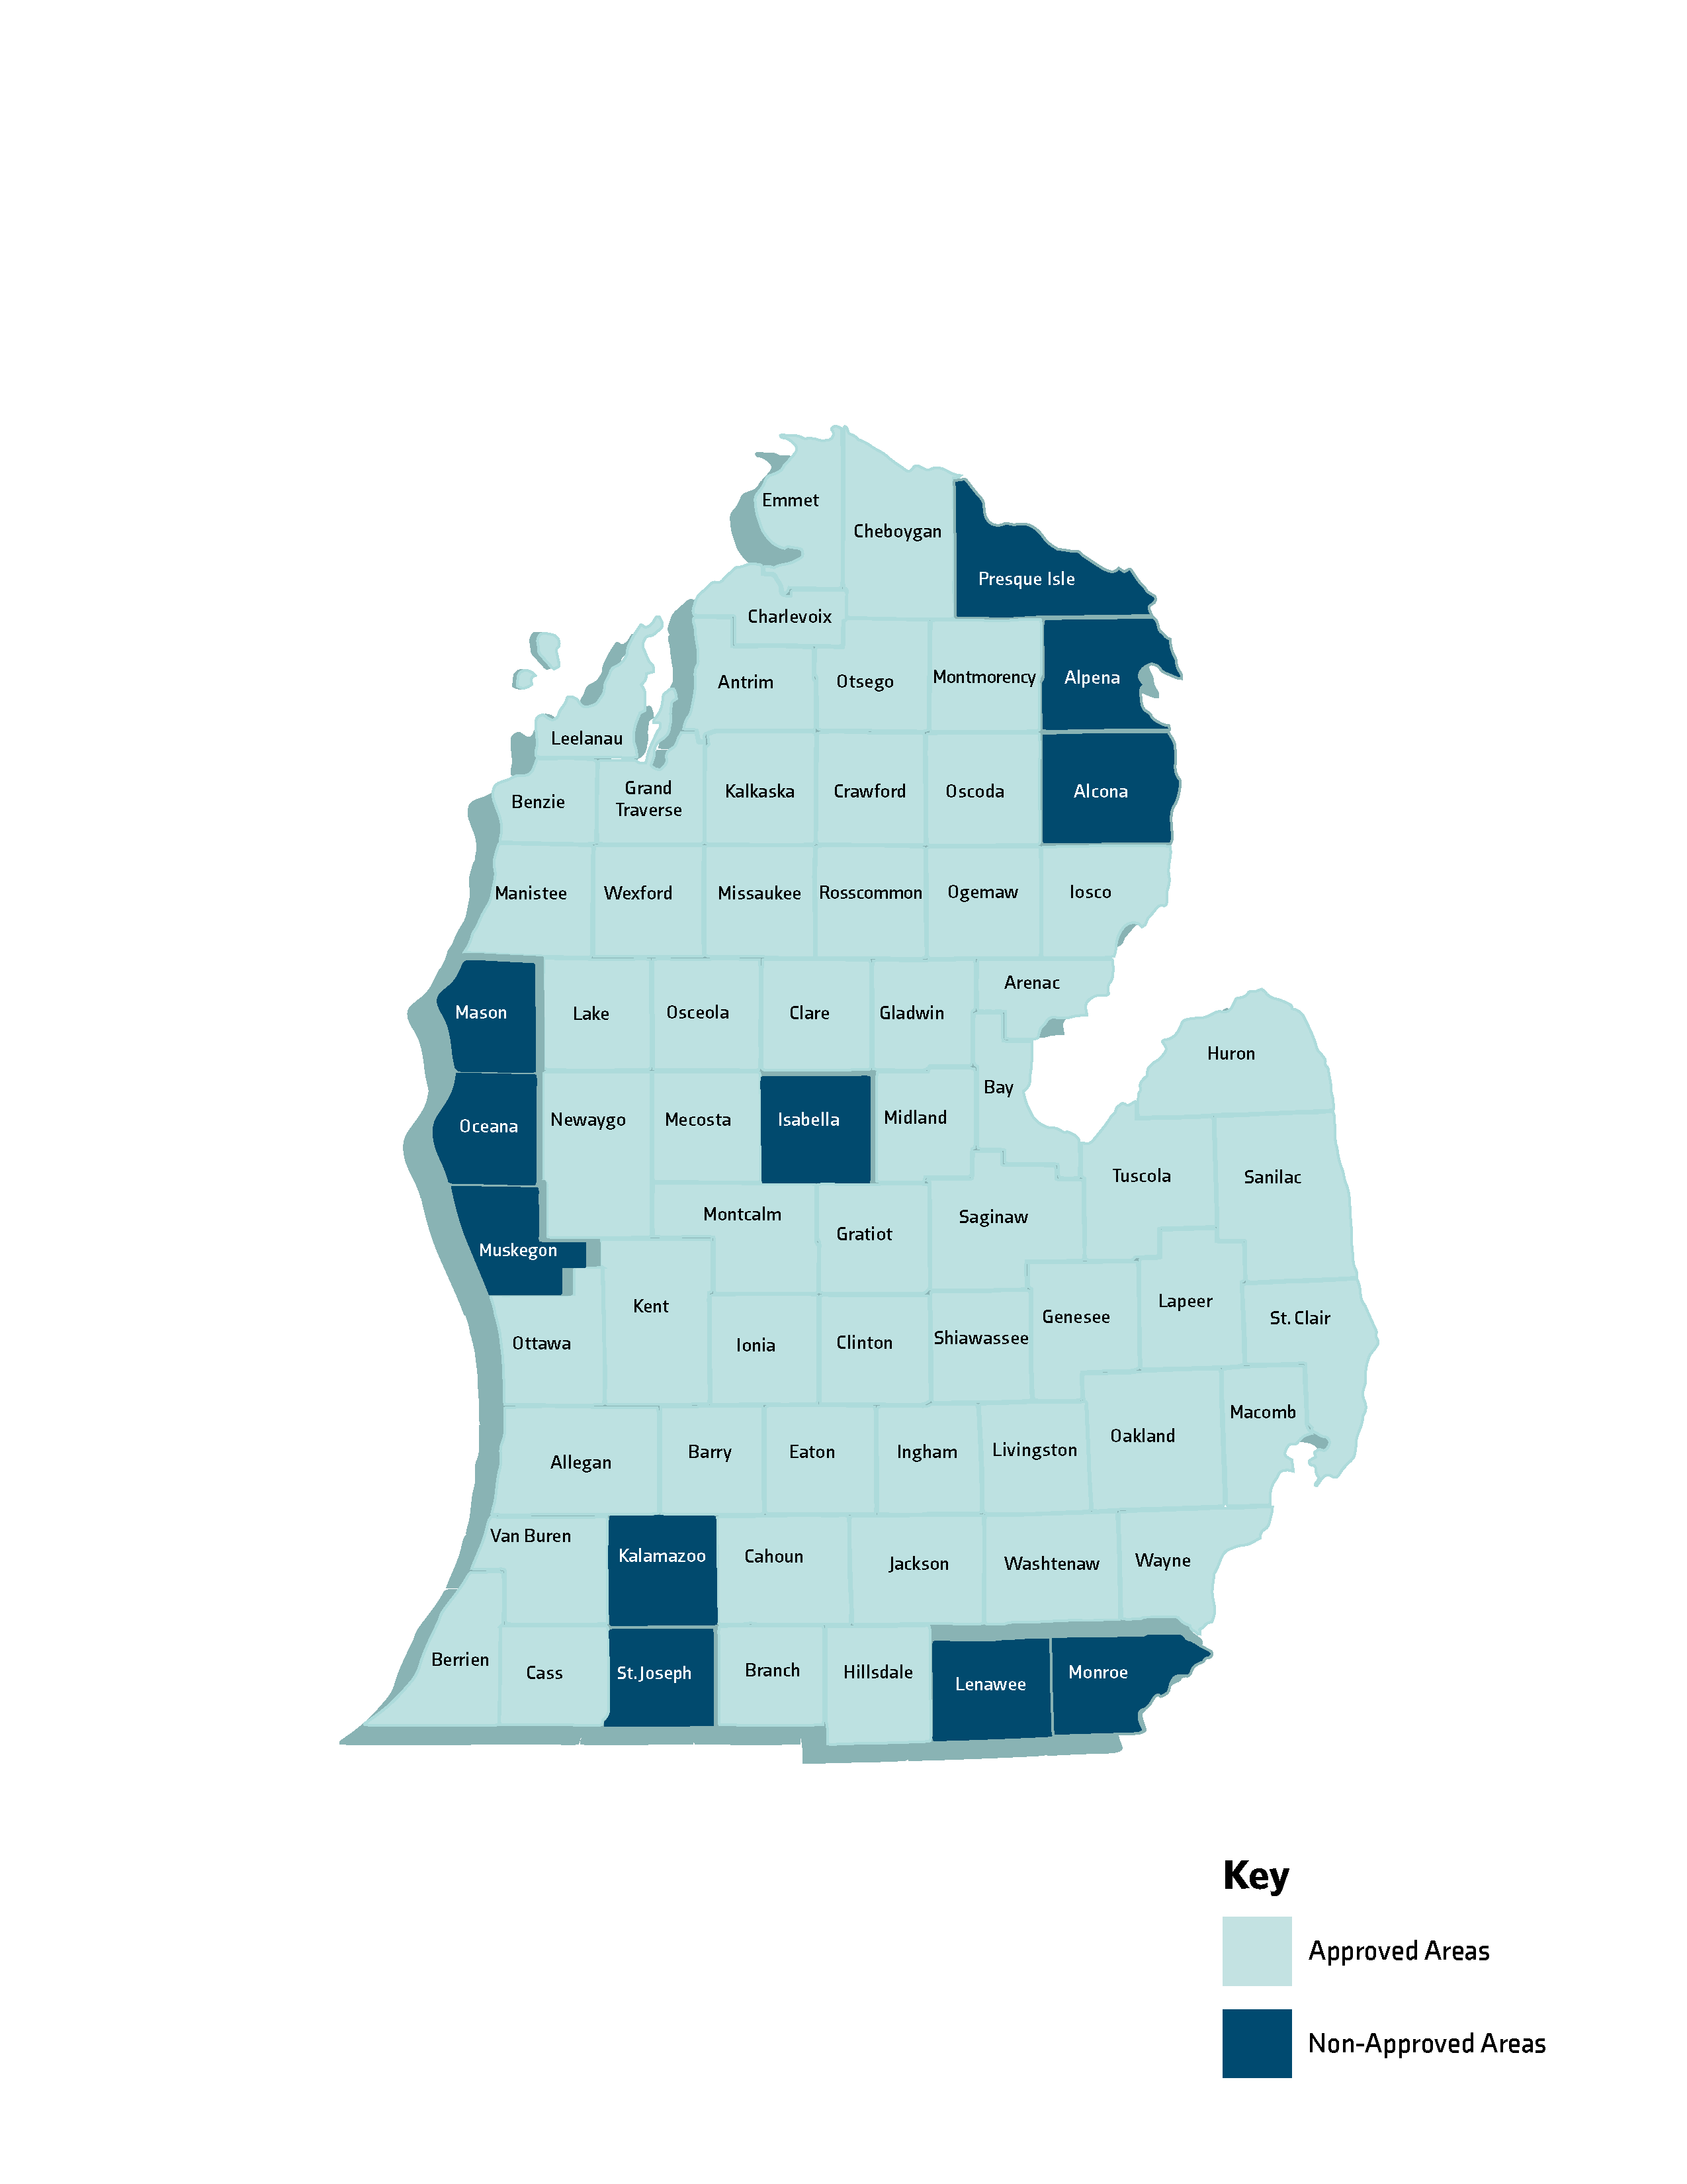








McLaren Medicare
2027 Service Area
Agent/Broker use only. Confidential and proprietary. Not to be distributed or shared with Medicare beneficiaries. Distribution to any person or company is prohibited and may be grounds for contract termination. The plan and benefit information contained in this document is pending government approval and subject to change. Final 2027 plan and benefit information may be discussed with beneficiaries on or after October 1.
Serving 57 counties in Michigan’s lower peninsula
  Leaving Alcona, Alpena, Presque Isle.
Comprehensive network of providers and hospitals to choose from, including:
3

Slide 4
Agent/Broker use only. Confidential and proprietary. Not to be distributed or shared with Medicare beneficiaries. Distribution to any person or company is prohibited and may be grounds for contract termination. The plan and benefit information contained in this document is pending government approval and subject to change. Final 2027 plan and benefit information may be discussed with beneficiaries on or after October 1.
McLaren Medicare
Plan Changes for 2027
NEW for 2027 – The Inspire Plan now has a tiered network. Still $0 Premium
  Tier 1 = McLaren Providers/Facilities
  Tier 2 = Other contracted providers
  Lower cost share for some benefits if services received from Tier 1 providers
Cost share changes by Plan begin on next page

Slide 5
McLaren Medicare - Inspire HMO NEW! Tiered Network
Agent/Broker use only. Confidential and proprietary. Not to be distributed or shared with Medicare beneficiaries. Distribution to any person or company is prohibited and may be grounds for contract termination. The plan and benefit information contained in this document is pending government approval and subject to change. Final 2027 plan and benefit information may be discussed with beneficiaries on or after October 1.
McLaren Inspire HMO - Premium: $0
H6322-001
MOOP: | $6,600
Part C Deductible: | $0
Part D Deductible (Tiers 3-5): | $615
Inpatient Hospital (Days 1-5): | $450 T1/$550 T2
Skilled Nursing Facility (Days 1-20): (Days 21 – 100) | $0 $221/day
Partial Hospitalization: | $80/day
Observation: | $350
ER/UC: | $130/$50
Ground/Air Ambulance Services: | $220
Ambulatory Surgical Center: | $350 T1/$450 T2
Outpatient Hospital Services: | $350 T1/$525 T2
Diagnostic Radiological Services: | $200
Diagnostic Procedures/Tests: | $20 - $200 T1 $20 - $375 T2
Therapeutic Radiological Services: 20%
Outpatient X-Ray Services: $25 - $200 T1
$25 - $375 T2
Lab Services: $0
Primary Care Physician Services: $0
Telehealth Benefits - McLarenNow : $0
Physician Specialist Services: $40 T1/$45 T2
Chiropractic Services: $15
Podiatry Services: $40 T1/$45 T2
Individual Psychiatric Services: $45
Physical Therapy/Speech Services: $35
Occupational Therapy Services: $35
Cardiac Rehabilitation Services: $30
Pulmonary Rehabilitation Services: $25
Home Health Services: $0
Durable Medical Equipment : 20%
Diabetic Supplies: $0
Diabetic Shoes/Inserts: 20%
Dialysis Services: 20%
Medicare Part B Insulin Drugs: $35
Medicare Part B Chemotherapy: 20%
Other Medicare Part B Drugs: 20%
Worldwide Emergency/Urgent Care: $130 copay/$50 copay
$50,000/year combined limit for Emergency and Urgent Care services
Legend:
T1 = McLaren providers/facilities
T2 = All other McLaren Medicare contracted providers

Slide 6
Agent/Broker use only. Confidential and proprietary. Not to be distributed or shared with Medicare beneficiaries. Distribution to any person or company is prohibited and may be grounds for contract termination. The plan and benefit information contained in this document is pending government approval and subject to change. Final 2027 plan and benefit information may be discussed with beneficiaries on or after October 1.
McLaren Medicare - Inspire Plus HMO
McLaren Inspire Plus HMO - Premium: $20
H6322-002
MOOP: | $5,900
Part C Deductible: | $0
Part D Deductible (Tiers 3-5): | $500
Inpatient Hospital: | $550 days 1-5
Skilled Nursing Facility (Days 1-20) (Days 21 – 100): | $0 $221/day
Partial Hospitalization: | $80/Day
Observation: | $150
ER/UC: | $130/$50
Ground/Air Ambulance Services: | $200
Ambulatory Surgical Center: | $150
Outpatient Hospital Services: | $150
Diagnostic Radiological Services: | $300
Diagnostic Procedures/Tests: | $20-$150
Therapeutic Radiological Services: | 20%
Outpatient X-Ray Services: | $25-$150
Lab Services: | $0
Primary Care Physician Services: | $0
Telehealth Benefits - McLarenNow | $0
Physician Specialist Services: | $35
Chiropractic Services: | $15
Podiatry Services: | $35
Individual Psychiatric Services: | $35
Physical Therapy/Speech Services: | $25
Occupational Therapy Services: | $35
Cardiac Rehabilitation Services: | $20
Pulmonary Rehabilitation Services: | $20
Home Health Services: | $0
Durable Medical Equipment : | 20%
Diabetic Supplies: | $0
Diabetic Shoes/Inserts: | 20%
Dialysis Services: | 20%
Medicare Part B Insulin Drugs: | $35
Medicare Part B Chemotherapy: | 20%
Other Medicare Part B Drugs: | 20%
Worldwide Emergency/Urgent Care: $130 copay/$50 copay
$50,000/year combined limit for Emergency and Urgent Care Services

Slide 7
Agent/Broker use only. Confidential and proprietary. Not to be distributed or shared with Medicare beneficiaries. Distribution to any person or company is prohibited and may be grounds for contract termination. The plan and benefit information contained in this document is pending government approval and subject to change. Final 2027 plan and benefit information may be discussed with beneficiaries on or after October 1.
McLaren Medicare - Inspire Giveback HMO
McLaren Inspire Giveback HMO - Premium: $0 w/$70 Part B Buy Down
H6322-008
MOOP: | $6,750
Part C Deductible: | $0
Part D Deductible (Tiers 2-5): | $615
Inpatient Hospital (Days 1-5): | $550
Skilled Nursing Facility (Days 1-20): (Days 21-100) | $0 $221/day
Partial Hospitalization: | $80/day
Observation: | $550
ER/UC: | $130/$50
Ground/Air Ambulance Services: | $350
Ambulatory Surgical Center: | $450
Outpatient Hospital Services: | $550
Diagnostic Radiological Services: | $150-$350
Diagnostic Procedures/Tests: | $20-$350
Therapeutic Radiological Services: | 20%
Outpatient X-Ray Services: | $25-$350
Lab Services: | $0
Primary Care Physician Services: $0
Telehealth Benefits - McLarenNow: $0
Physician Specialist Services: $50
Chiropractic Services: $15
Podiatry Services: $50
Individual Psychiatric Services: $50
Physical Therapy/Speech Services: $45
Occupational Therapy Services: $50
Cardiac Rehabilitation Services: $25
Pulmonary Rehabilitation Services: $20
Home Health Services: $0
Durable Medical Equipment : 20%
Diabetic Supplies: $0
Diabetic Shoes/Inserts: 20%
Dialysis Services: 20%
Medicare Part B Insulin Drugs: $35
Medicare Part B Chemotherapy: 20%
Other Medicare Part B Drugs: 20%
Note: Inspire Select is now called Inspire Giveback
Worldwide Emergency/Urgent Care: $130 copay/$50 copay
$50,000/year combined limit for Emergency and Urgent Care Services

Slide 8
McLaren Medicare –
Extra Benefits Not Included in Original Medicare
Agent/Broker use only. Confidential and proprietary. Not to be distributed or shared with Medicare beneficiaries. Distribution to any person or company is prohibited and may be grounds for contract termination. The plan and benefit information contained in this document is pending government approval and subject to change. Final 2027 plan and benefit information may be discussed with beneficiaries on or after October 1.
Hearing - $0 exam - $699/$999 copay per hearing aid, one per ear every two years – powered by TruHearing
2027 Flex Card:
Loaded with an Annual Amount
Use for any combination of the following benefits:
OTC
Fitness membership
Vision
Additional out-of-pocket dental costs
Inspire | Inspire Plus | Inspire Giveback
$325 | $450 | $250
Dental – preventive plus, $1,500 annual benefit – powered
by Delta Dental (using Delta Medicare Advantage PPO network)
Meals – post hospital – two meals per day for two weeks – covered at $0 copay
Personal Emergency Response System (PERS) – covered at $0 (Inspire Plus plan only)
*The benefits mentioned are a part of a special supplemental program for the chronically ill. Eligibility for this benefit cannot be guaranteed based solely on your condition. All applicable eligibility requirements must be met before the benefit is provided. Qualifying conditions may include but are not limited to the following: heart failure, diabetes, cancer, chronic lung disorders like COPD, and stroke. Contact us to confirm your eligibility for these benefits.
Grocery and/or utilities - $50 per month (Inspire Plus plan only) – paid with Benefits Mastercard® Prepaid Card (SSBCI* benefit only, member must qualify)
Transportation – 20 one-way trips per year up to 50 miles one way (Inspire Plus plan only)
8

Slide 9


Agent/Broker use only. Confidential and proprietary. Not to be distributed or shared with Medicare beneficiaries. Distribution to any person or company is prohibited and may be grounds for contract termination. The plan and benefit information contained in this document is pending government approval and subject to change. Final 2027 plan and benefit information may be discussed with beneficiaries on or after October 1.
McLaren Medicare - Network Partners
Hearing/Hearing Aids
TruHearing
  Call TruHearing at 888-936-5512 to schedule an appointment
Dental
Delta Dental of Michigan
  Delta Dental Medicare Advantage PPO network
  Delta Dental Medicare Advantage Premier network
    Available when you purchase Optional Dental package
9

Slide 10
Agent/Broker use only. Confidential and proprietary. Not to be distributed or shared with Medicare beneficiaries. Distribution to any person or company is prohibited and may be grounds for contract termination. The plan and benefit information contained in this document is pending government approval and subject to change. Final 2027 plan and benefit information may be discussed with beneficiaries on or after October 1.
McLaren Medicare - Vendor Partners
2027 Flex Card
Members will receive a Mastercard® Prepaid Benefits Card in the mail loaded with an annual amount based on the plan they choose. They can use their card for any combination of OTC, fitness membership, vision, or additional out-of-pocket dental costs. They can also shop online through NationsBenefits and get free home delivery on OTC products.
For more information, members can call Member Services at 833-358-2404 (TTY:711) or visit the NationsBenefits website at: www.McLarenMedicare.NationsBenefits.com.
Groceries for SSBCI Members (Special Supplemental Benefits for the Chronically Ill)
Members with certain chronic condition(s) who meet additional criteria may be eligible for supplemental benefits for the chronically ill. Prior authorization is required.
Call Member Services at 833-358-2404 (TTY:711) to see if you qualify. (Inspire Plus plan only)
10

Slide 11
McLaren Medicare
Part D (Rx), Dental & Optional Supplemental Dental
Agent/Broker use only. Confidential and proprietary. Not to be distributed or shared with Medicare beneficiaries. Distribution to any person or company is prohibited and may be grounds for contract termination. The plan and benefit information contained in this document is pending government approval and subject to change. Final 2027 plan and benefit information may be discussed with beneficiaries on or after October 1.
2027

Slide 12
McLaren Medicare –
2027 Part D Prescription Benefits
Agent/Broker use only. Confidential and proprietary. Not to be distributed or shared with Medicare beneficiaries. Distribution to any person or company is prohibited and may be grounds for contract termination. The plan and benefit information contained in this document is pending government approval and subject to change. Final 2027 plan and benefit information may be discussed with beneficiaries on or after October 1.
Standard Pharmacy 1-Month Supply
 | Deductible | Tier 1 Preferred Generic | Tier 2 Generic | Tier 3 Preferred Brand | Tier 4 Non-Preferred Brand | Tier 5 Specialty (1-month supply only) | Tier 6 Select Care Drugs
Inspire | $615 | $0 | $12 | 25% | 25% | 25% | $0
Inspire Plus | $500 | $0 | $12 | 25% | 25% | 25% | $0
Inspire Giveback | $615 | $0 | $12 | 25% | 25% | 25% | $0
Part D Insulins* | N/A | $0 | $10 | $35 | $35 | $35 | $0
*The deductible does not apply to insulins on any tier. Insulins are capped at $35 or 25% (whichever is less).
12

Slide 13
McLaren Medicare –
2027 Part D Prescription Benefits
Agent/Broker use only. Confidential and proprietary. Not to be distributed or shared with Medicare beneficiaries. Distribution to any person or company is prohibited and may be grounds for contract termination. The plan and benefit information contained in this document is pending government approval and subject to change. Final 2027 plan and benefit information may be discussed with beneficiaries on or after October 1.
Mail Order 3-Month Supply
 | Deductible | Tier 1 Preferred Generic | Tier 2 Generic | Tier 3 Preferred Brand | Tier 4 Non-Preferred Brand | Tier 5 Specialty (1-month supply only) | Tier 6 Select Care Drugs
Inspire | $615 | $0 | $27 | 25% | 25% | 25% | $0
Inspire Plus | $500 | $0 | $27 | 25% | 25% | 25% | $0
Inspire Giveback | $615 | $0 | $27 | 25% | 25% | 25% | $0
Part D Insulins* | N/A | $0 | $23 | $79 | $79 | $79 | $0
*The deductible does not apply to insulins on any tier. Insulins are capped at $35/month supply or 25% (whichever is less).
13

Slide 14

Agent/Broker use only. Confidential and proprietary. Not to be distributed or shared with Medicare beneficiaries. Distribution to any person or company is prohibited and may be grounds for contract termination. The plan and benefit information contained in this document is pending government approval and subject to change. Final 2027 plan and benefit information may be discussed with beneficiaries on or after October 1.
McLaren Medicare - MSB Dental
McLaren Medicare - Dental Benefits |  | MSB
 | Services | Network: Delta Dental PPO
Diagnostic | Oral Exams | 100%
 | Bitewing Radiographs | 100%
 | Full-Mouth Series Xray/Panoramic Film | 100%
 | Additional Tests & Examinations | Not covered
Preventive | Dental Prophylaxis | 100%
 | Fluoride Treatment | 100%
Restorative | Amalgams | 50%
 | Resin Based Composites | 50%
 | Onlays and Crowns | Not covered
 | Crown Repairs | 50%
Periodontics | Perio Maintenance | 100%
 | Perio Non-Surgical Procedures | 50%
Prosthodontics, removeable | Dentures & Denture Relines/Repairs | Not covered
Oral & Maxillofacial Surgery | Simple Extractions | 50%
 | Brush Biopsy | 100%
Adjunctive General Services | Emergency Palliative Treatment | 100%
Deductible | (Per person total per calendar year) | $0
Maximum Plan Payment | (Per person total per calendar year on all services) | $1,500
Note: The coinsurance amounts are what the plan pays.
14

Slide 15
McLaren Medicare - Optional Dental Buy Up
Agent/Broker use only. Confidential and proprietary. Not to be distributed or shared with Medicare beneficiaries. Distribution to any person or company is prohibited and may be grounds for contract termination. The plan and benefit information contained in this document is pending government approval and subject to change. Final 2027 plan and benefit information may be discussed with beneficiaries on or after October 1.
McLaren Medicare - Optional Dental Buy Up |  | OSB 1 $32.00 per month | OSB 2 $56.00 per month
 |  | Network: PPO and Premier
 | Services | Member Responsibility | Member Responsibility
Restorative | Onlays and Crowns | 75% | 50%
Endodontics | Endodontics (Root Canals) | 50% | 20%
Periodontics | Perio Surgical Procedures | 50% | 20%
Prosthodontics, removeable | Dentures | 75% | 50%
 | Denture Relines/Repairs | 50% | 20%
Implant Services | Implant Services | 75% | 50%
 | Implant Repairs | 50% | 20%
Prosthodontics, fixed | Bridges | 75% | 50%
 | Bridge Repairs | 50% | 20%
Oral & Maxillofacial Surgery | Surgical Extractions/Oral Surgery | 50% | 20%
Adjunctive General Services | Occlusal Guards/Occlusal Adjustments | 50% | 20%
 | Anesthesia | 50% | 20%
Deductible |  | $0 | $0
Maximum Plan Payment | (Per person total per calendar year on all services) | $1,000 | $1,500
Optional Dental Coverage
We are partnering with Delta Dental to provide members with the option to purchase additional coverage to supplement the dental benefits provided in McLaren Medicare MAPD plans
No deductible for either plan
No waiting period
Delta Dental Medicare Advantage PPO & Premier providers
15

Slide 16
McLaren Medicare
2027 Agent Tools &
Contacts
Agent/Broker use only. Confidential and proprietary. Not to be distributed or shared with Medicare beneficiaries. Distribution to any person or company is prohibited and may be grounds for contract termination. The plan and benefit information contained in this document is pending government approval and subject to change. Final 2027 plan and benefit information may be discussed with beneficiaries on or after October 1.
2027

Slide 17

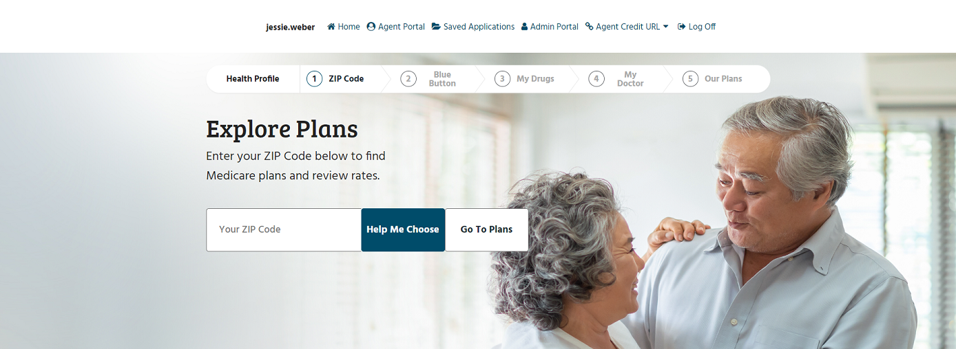
McLaren Medicare - Enrollment Platform
Agent/Broker use only. Confidential and proprietary. Not to be distributed or shared with Medicare beneficiaries. Distribution to any person or company is prohibited and may be grounds for contract termination. The plan and benefit information contained in this document is pending government approval and subject to change. Final 2027 plan and benefit information may be discussed with beneficiaries on or after October 1.

Slide 18
New! McLaren Medicare
Will be available on HealthSherpa Medicare!
Agent/Broker use only. Confidential and proprietary. Not to be distributed or shared with Medicare beneficiaries. Distribution to any person or company is prohibited and may be grounds for contract termination. The plan and benefit information contained in this document is pending government approval and subject to change. Final 2027 plan and benefit information may be discussed with beneficiaries on or after October 1.
McLaren Health Plan is expanding our partnership with HealthSherpa!
For 2027 McLaren Medicare enrollments, agents will be able to view and enroll beneficiaries on the HealthSherpa Medicare platform!
Stay tuned for updates and available trainings on the HealthSherpa Medicare platform.
18

Slide 19
Agent/Broker use only. Confidential and proprietary. Not to be distributed or shared with Medicare beneficiaries. Distribution to any person or company is prohibited and may be grounds for contract termination. The plan and benefit information contained in this document is pending government approval and subject to change. Final 2027 plan and benefit information may be discussed with beneficiaries on or after October 1.
Sales and Marketing Materials
Order
Order materials
Visit
Visit www.mhpagents.allegra-okemos.com
Click
Click ‘Create an Account’ (lower right corner of box)
Enter
Enter contact information, including primary/default shipping address
Log in and Select
Log in and select materials
Check Out
Check out (Note– the shipping address will default to your primary address. You can add a new address for shipment at the checkout screen or under ‘my account’,)
Receive
Receive confirmation email
19

Slide 20

Get Appointed!
McLaren Medicare
Agent/Broker use only. Confidential and proprietary. Not to be distributed or shared with Medicare beneficiaries. Distribution to any person or company is prohibited and may be grounds for contract termination. The plan and benefit information contained in this document is pending government approval and subject to change. Final 2027 plan and benefit information may be discussed with beneficiaries on or after October 1.
Not appointed with McLaren Health Plan?
Appointing is easy!
To get started, click on the QR Code or link below:
You’ll need your:
  Valid Resident Producer (or Non-Resident Producer) License
  E & O Coverage $1,000,000
  AHIP, Pinpoint, Miramar. or NABIP Certificate
https://mclarenhealthcare.my.site.com/agentportal/s/appointment-application
20

Slide 21
McLaren Medicare –
2027 Agent/Broker Commissions
Agent/Broker use only. Confidential and proprietary. Not to be distributed or shared with Medicare beneficiaries. Distribution to any person or company is prohibited and may be grounds for contract termination. The plan and benefit information contained in this document is pending government approval and subject to change. Final 2027 plan and benefit information may be discussed with beneficiaries on or after October 1.
To be eligible for payment, agents must complete annual Medicare core certification (AHIP, NABIP, Miramar, or Pinpoint); pass MHP Medicare certification training and the exam with a score of 85% or higher; and maintain a valid Michigan producer’s license.
Enrollment Type | All Effective Dates
Initial Enrollment (New to MA) Paid on or before last business day of the full month following member enrollment⁽¹⁾⁽³⁾ | $725
Renewal⁽²⁾ Paid annually in a lump sum payment | $363
(1) There will be a 20% withhold which will be paid after the 93rd consecutive date of member’s initial enrollment in the plan
(2) Renewal means the member who is enrolled in the plan product in the current CMS Contract Year remains enrolled in the Plan Product in the immediately following CMS Contract Year; or an eligible beneficiary enrolls in a “like plan type.” (Change from one MA plan to enroll with McLaren Medicare)
(3) Plan changes during initial year will be pro-rated according to CMS regulations. If enrollment is the result of a change from one type of plan to another, agent will receive a pro-rated payment. For example, payment for enrollment effective July 1 would be $362.50 ((6/12) x $725)
21

Slide 22
Contact Information - Your Team
Agent/Broker use only. Confidential and proprietary. Not to be distributed or shared with Medicare beneficiaries. Distribution to any person or company is prohibited and may be grounds for contract termination. The plan and benefit information contained in this document is pending government approval and subject to change. Final 2027 plan and benefit information may be discussed with beneficiaries on or after October 1.
MHPagentservices@mclaren.org
or call us at:
1-888-327-0671, Option 3
Get appointed with McLaren
Application issues
General questions
Commission inquiry
Anne (Betsy) Condon, Sales Representative
m: 810-391-3948
e: anne.condon@mclaren.org
Jessie Weber, Supervisor,
Sales & Marketing
m: 810-730-8740
e: jessie.weber@mclaren.org
Louann Hinton, Director,
Sales & Marketing
m: 810-394-0136
e: louann.hinton@mclaren.org
Jennifer Mason
Sales & Agent Support
m: 810-733-9592
e: jennifer.mason@mclaren.org
McLaren Medicare Member Services
833-358-2404 (TTY:711)
April 1 – September 30: Mon. – Fri. 8 a.m. to 8 p.m.
October 1 – March 31: 7 days a week, 8 a.m. to 8 p.m.
(Except Thanksgiving and Christmas days)
22

Slide 23
Agent/Broker use only. Confidential and proprietary. Not to be distributed or shared with Medicare beneficiaries. Distribution to any person or company is prohibited and may be grounds for contract termination. The plan and benefit information contained in this document is pending government approval and subject to change. Final 2027 plan and benefit information may be discussed with beneficiaries on or after October 1.
McLaren Medicare
Thank you!
23

