Slide 1
2026 Michigan Individual MA Plans
Agent Sales Presentation
August 12, 2025

Slide 2








2026 Blue Cross MA Plans | Medicare Sales and Support Staff
Email Address
nwingate@bcbsm.com
Phone Number
248-665-4580
Mike Zehrer
Marketing and Growth Strategy
Nichole Wingate
Individual
Medicare Sales Consultant
Our team is committed to partnering with you to support your needs and serve our members.
Email Address
CGrillo@bcbsm.com
Phone Number
616-494-6617
Connie Grillo
Medicare Support Consultant

Slide 3



2026 Blue Cross MA Plans | Social Mission
As we’ve been for over 80 years,
Blue Cross Blue Shield of Michigan is here and ready to help.
Our Social Mission
BCBSM / BCN Medicare Advantage
Increasing access to affordable health care
We are a leader in innovating new approaches to improving health outcomes by partnering with our broad provider network on healthcare quality initiatives and value-based care
Enhancing quality of care for patients
We have an established track record of deep partnerships across the local communities we serve
Improving the health of Michigan communities
We are consistently ranked as a leader in diversity, equity and inclusion and are considered a top employer

Slide 4











2026 Blue Cross MA Plans | Why Blue
Access to more than 74,000 active providers
$0 PCP copays on all plans
$0 premium MAPD plans available statewide and premium based products with richer benefits
During travel, access our nationwide network of Blue plan doctors and hospitals with MA PPO and HMO-POS plans
Non-Medicare covered world-wide emergency coverage and transportation
Silver sneakers fitness program on most plans
Advantage dollars – OTC + food on most plans
User-friendly mobile app

Slide 5
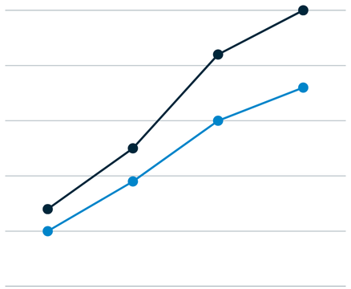



2026 Blue Cross MA Plans | Where Do Health Insurance Premiums go?
Skyrocketing Drug Prices
Paying for Care
Benefit/Premium Pressures
Surging Medical Costs
Notes:
Expensive medical care, prescription drug prices growing at rates well above inflation and surging utilization have put enormous pressure on health insurance costs. From 2000 to 2024, prices for medical care increased 40% faster than everyday prices, like groceries and gas. In 2023, pharmaceutical companies priced new U.S. drugs 35% higher than 2022. We also have increasingly unhealth and aging population that are using this expensive system more. Blue Cross Blue Shield of Michigan paid an average of $100 million per day for care and benefits of members in 2024. that is $12 million more per day than 2023.
In 2024, for every $1 Blue Cross Blue Shield of Michigan collected in premiums, we paid $1.04 for our members’ care. This resulted in a loss of $1.02 on enterprise revenue. Of all of these numbers demonstrate, that there is no one single factor driving up the cost of health insurance. Together, these factors are creating a complex cost equation that is showing up in premiums.

Slide 6






2026 Blue Cross MA Plans | Where Do Health Insurance Premiums go?
9¢
21¢
Administration
47¢
Hospital
Inpatient and outpatient hospital and ambulatory care
Pharmacy
Prescription Drugs
Health Insurance Company Cost
This portion of the health care dollar accounts for staffing, equipment, technology, marketing and other resources
25¢
Professional
Doctors and other medical professionals
2¢
For every $1 BCBSM took during 2024, it paid out $1.04 in member care.
Taxes, Fees and Commissions
Notes:
How are these pressures affecting premium dollars? The majority of premium dollars go directly to medical care. This is how premium dollar in 2024 at Blue Cross actually breaks down. Hospitals, doctors, prescription drugs – these are the real cost drivers. Less than 10% goes to administrative costs. And that’s by design.
Blue Cross Blue Shield of Michigan is a nonprofit. As a nonprofit mutual insurer, our purpose is to pay for care and make it more affordable, accessible and effective. Rather than maximize profit, our objective is to be a responsible steward of our members’ financial investment. In 2024, you’ll see those extra pennies – we paid out $1.04 for every $1 we collected in premiums, leading to a negative operating margin of 4.2% and over the last 10 years, we have averaged an operating margin of less than 1% If we are feeling the pressure of these costs, we know it is weighing heavily on those we serve.
To learn more about affordability visit MIBlueDaily.com/Affordability

Slide 7

3 New Plans to be Launched
Value
Secure
Giveback

Slide 8
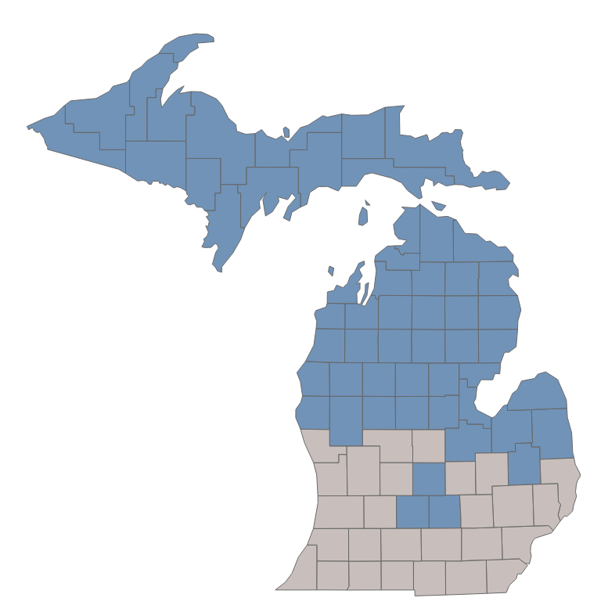
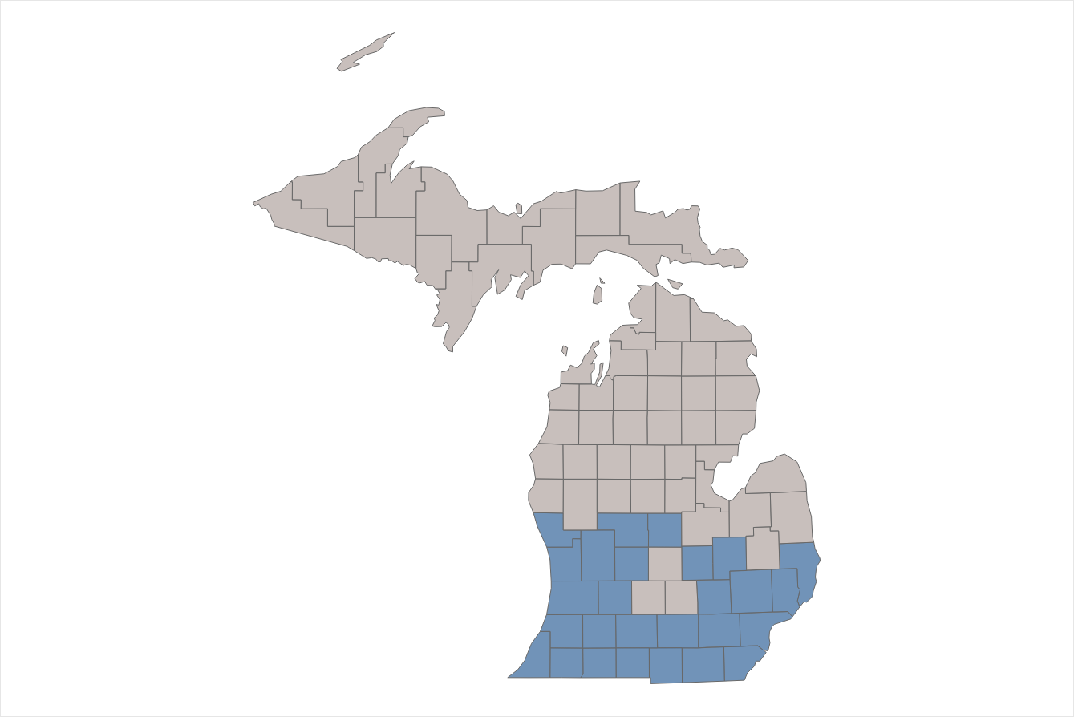

2026 Blue Cross MA Plans | Plan Updates
Our new plans offer a $0 premium or a Part-B giveback.
Value
Secure
Giveback
$0 coverage for Northern MI and UP
$0 coverage for Southern MI
Same service area as Secure with a Part-B giveback

Slide 9
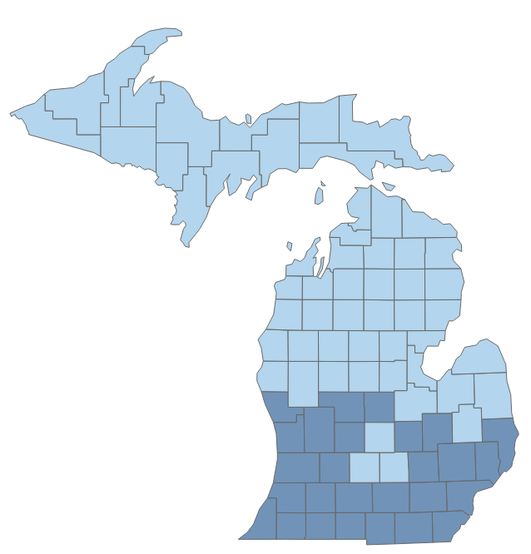

2026 Michigan Bid Strategy | NEW Plans to be Launched
New Plan Footprints
Counties Entered for Launch of New Plans
Value |  |  |  | Secure and Giveback Plans
Alcona | Delta | Gogebic | Newaygo | Allegan | Livingston
Alger | Dickinson | Grand Traverse | Oceana | Barry | Macomb
Alpena | Eaton | Houghton | Ogemaw | Berrien | Monroe
Antrim | Emmet | Huron | Ontonagon | Branch | Montcalm
Arenac | Gladwin | Ingham | Osceola | Calhoun | Muskegon
Baraga | Iosco | Mackinac | Oscoda | Cass | Oakland
Bay | Iron | Manistee | Otsego | Genesee | Ottawa
Benzie | Isabella | Marquette | Presque Isle | Gratiot | St. Clair
Charlevoix | Kalkaska | Mason | Roscommon | Hillsdale | St. Joseph
Cheboygan | Keweenaw | Mecosta | Saginaw | Ionia | Shiawassee
Chippewa | Lake | Menominee | Sanilac | Jackson | Van Buren
Clare | Lapeer | Midland | Schoolcraft | Kalamazoo | Washtenaw
Clinton | Leelanau | Missaukee | Tuscola | Kent | Wayne
Crawford | Luce | Montmorency | Wexford | Lenawee

Slide 10

3 Plans to Reduce Footprint
Prime Value
Essential
+Meijer

Slide 11
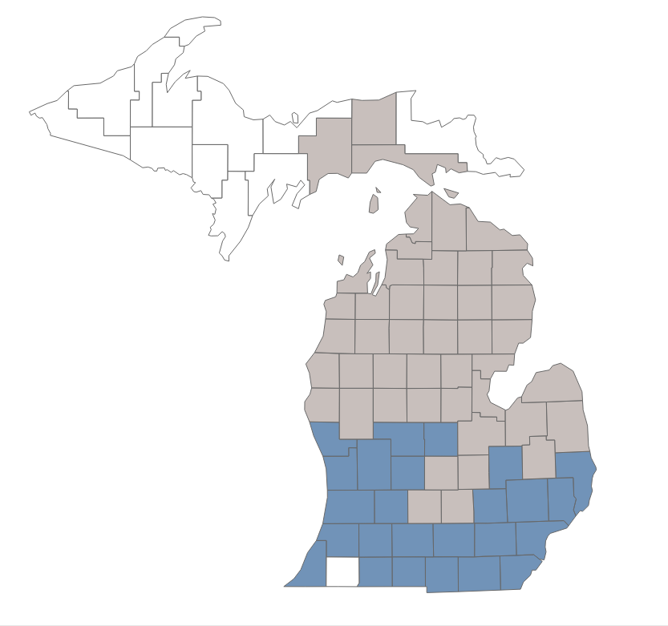
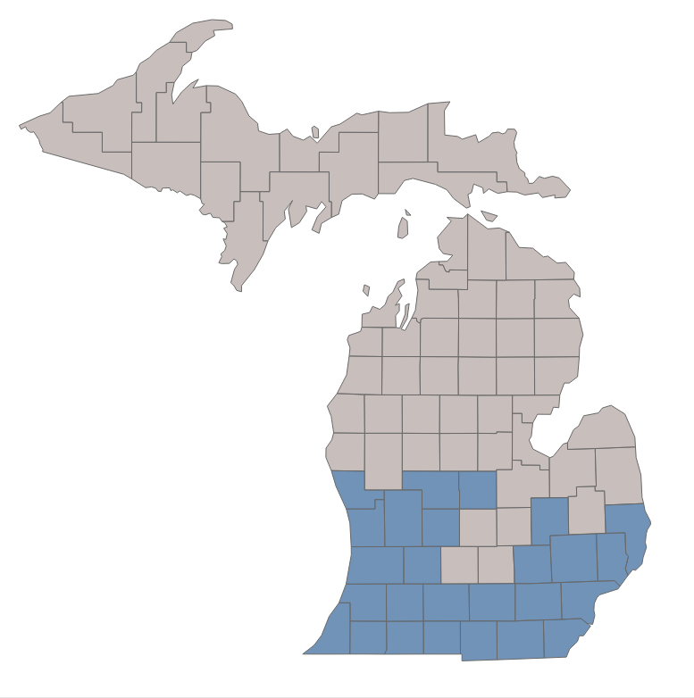
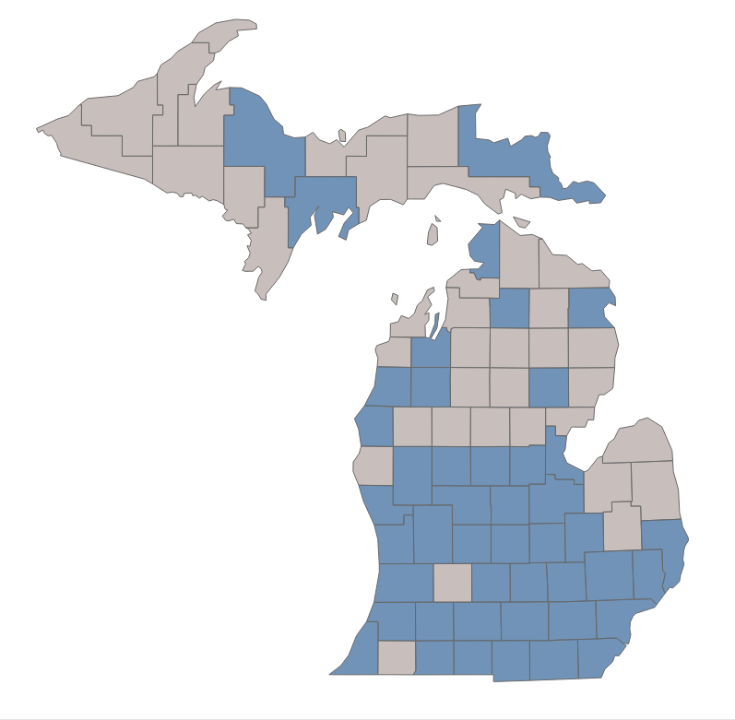
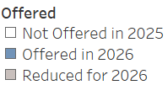

2026 Blue Cross MA Plans | Plan Updates
Prime Value, Essential, and +Meijer are adding a premium and reducing footprints
Prime Value
Essential
+Meijer
$35 premium
$25 premium
$35 premium
*Exception of Huron and Lapeer counties

Slide 12
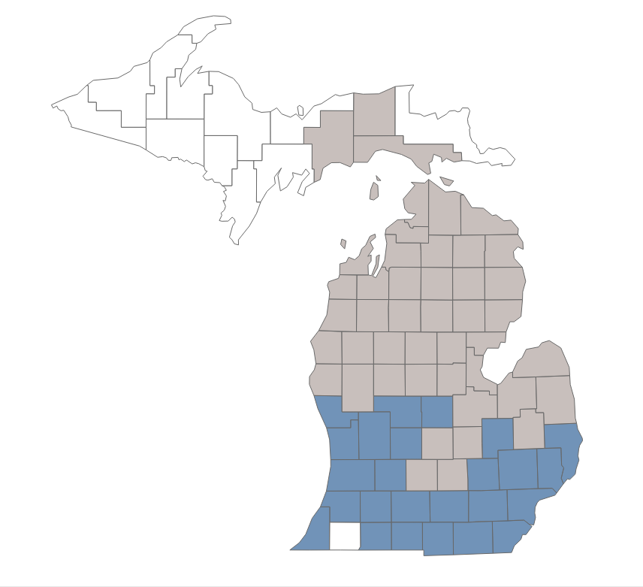
2026 Michigan Bid Strategy | Plans to Reduce Footprint – Prime Value
Prime Value Footprint
Counties Exited for Footprint Reduction of Prime Value
Alcona | Huron | Montmorency
Alpena | Ingham | Newaygo
Antrim | Iosco | Oceana
Arenac | Isabella | Ogemaw
Bay | Kalkaska | Osceola
Benzie | Lake | Oscoda
Charlevoix | Lapeer | Otsego
Cheboygan | Leelanau | Presque Isle
Clare | Luce | Roscommon
Clinton | Mackinac | Saginaw
Crawford | Manistee | Sanilac
Eaton | Mason | Schoolcraft
Emmet | Mecosta | Shiawassee
Gladwin | Midland | Tuscola
Grand Traverse | Missaukee | Wexford

Slide 13
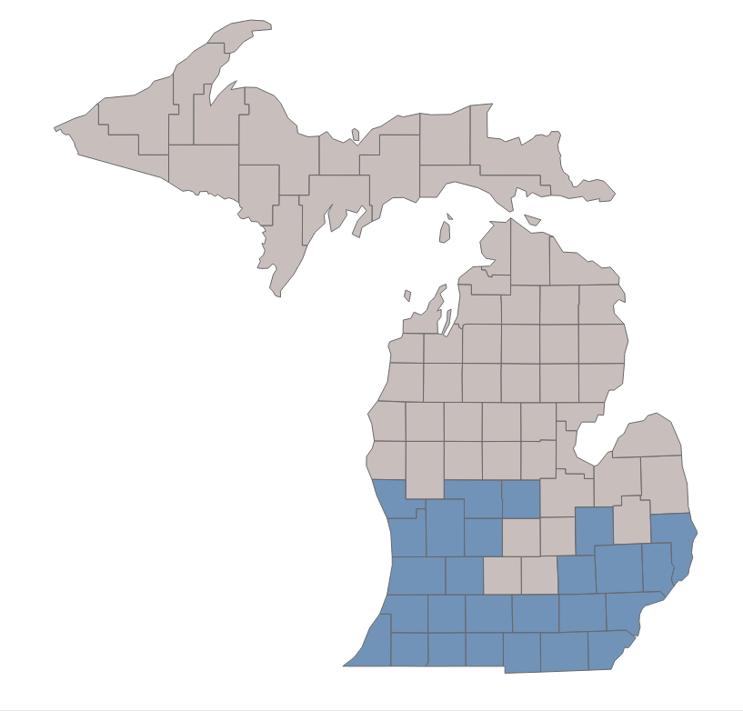
2026 Michigan Bid Strategy | Plans to Reduce Footprint – Essential
Essential Footprint
Counties Exited for Footprint Reduction of Essential
Alcona | Dickinson | Lapeer | Ontonagon
Alger | Eaton | Leelanau | Osceola
Alpena | Emmet | Luce | Oscoda
Antrim | Gladwin | Mackinac | Otsego
Arenac | Gogebic | Manistee | Presque Isle
Baraga | Grand Traverse | Marquette | Roscommon
Bay | Houghton | Mason | Saginaw
Benzie | Huron | Mecosta | Sanilac
Charlevoix | Ingham | Menominee | Schoolcraft
Cheboygan | Iosco | Midland | Shiawassee
Chippewa | Iron | Missaukee | Tuscola
Clare | Isabella | Montmorency | Wexford
Clinton | Kalkaska | Newaygo
Crawford | Keweenaw | Oceana
Delta | Lake | Ogemaw

Slide 14
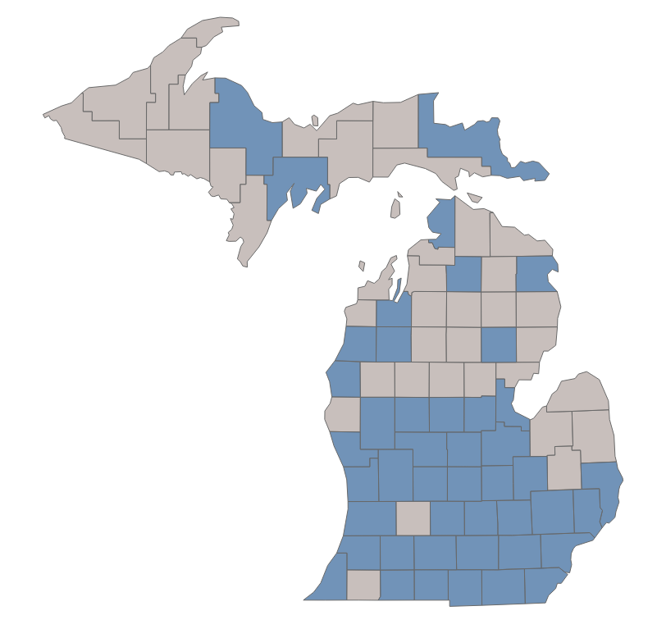
2026 Michigan Bid Strategy | Plans to Reduce Footprint – +Meijer
+Meijer Footprint
Counties Exited for Footprint Reduction of +Meijer
Alcona | Gladwin | Menominee
Alger | Gogebic | Missaukee
Antrim | Houghton | Montmorency
Arenac | Huron | Oceana
Baraga | Iosco | Ontonagon
Barry | Iron | Osceola
Benzie | Kalkaska | Oscoda
Cass | Keweenaw | Presque Isle
Charlevoix | Lake | Roscommon
Cheboygan | Lapeer | Sanilac
Clare | Leelanau | Schoolcraft
Crawford | Luce | Tuscola
Dickinson | Mackinac

Slide 15

3 Plans to be Closed
Community Value
Local HMO
Part B Credit

Slide 16



2026 Blue Cross MA Plans | Key Updates
In 2026, Blue Cross has some key plan updates that your members should be aware of when making their plan decisions.
Formulary
Inpatient Hospital
Additional Benefits
All plans will follow a single formulary and will be switching to Tier 3 coinsurance. Rx deductible on some plans (Tiers 3-5, except Value with Tiers 2-5)
The benefit period for inpatient hospital is being changed to a per stay period in place of 60-day readmittance.
Mobile app, 24-hour nurse line, discounted gym membership, Blue 365, Household discount, Medicare Advantage OSB* buy up, Well Being program
*Only available on select plans
Note that not all plans will have print marketing materials available. Digital materials will be available for all plans.

Slide 17
2026 Blue Cross MA Plans | Northern Michigan Plans
Northern Michigan Plans: From $0 to Premium, Options for Every Need
Benefit | Value | Vitality | Assure
Premium | $0 | $38.50 – $84.70 | $191.60 – $298.60
Med Deductible | $675 | No deductible | No deductible
RX Deductible | $615 | No deductible | No deductible
MOOP | $6,750 | $5,000 | $4,000
Specialist | $50 | $30 | $10
IP Hospital | $430 (days 1-7) | $250 (days 1-7) | $100 (days 1-7)
OTC | $25/quarter | $50/quarter | $50/quarter
Dental | Preventive Only | $1,500 max | $1,500 max

Slide 18
2026 Blue Cross MA Plans | Southern Michigan Plans
From Giveback to Premium, Southern Michigan has it all
Benefit | Giveback | Secure | Vitality | Assure
Premium | $70 Giveback | $0 | $38.50 – $84.70 | $191.60 – $298.60
Medical Deductible | $650 | No deductible | No deductible | No deductible
RX Deductible | $150 | $150 | No deductible | No deductible
Medical Out Of Pocket | $9,250 | $6,750 | $5,000 | $4,000
Specialist | $55 | $45 | $30 | $10
IP Hospital | $385 (days 1-7) | $375 (days 1-7) | $250 (days 1-7) | $100 (days 1-7)
OTC | Not covered | $40/quarter | $50/quarter | $50/quarter
Dental | Preventive Only | $1,000 max | $1,500 max | $1,500 max

Slide 19

2026 Blue Cross MA Plans | Medicare Supplement
Two Medicare Supplement plans | May be best for
Plan G | Members who want comprehensive coverage with predictable costs and minimal out-of-pocket expenses
High-Deductible Plan G | Healthier members seeking lower monthly premiums and willing to cover more upfront costs before the plan pays
While there are 10 standard Medigap plans and two high-deductible options available nationally, Blue Cross highlights Medicare Supplement Plan G and High-Deductible Plan G as recommended choices for most members.
Service | What Members Pay
Medicare Part A hospital coverage
Deductible | $0
First 60 days of care | $0
Emergency care outside of US | $250 deductible
Medicare Part B physician and outpatient services
Deductible (annual) | $257
Durable Medical Equipment | $0

Slide 20



2026 Blue Cross MA Plans | Agent Tools
To assist you with the increased change this year, we want to highlight some of the tools available to you when helping your member choose the best plan for them.
Member Profile
Agent Portal
Agent Community
Review medication coverages for current medications
Review most utilized providers network status
Compare cost sharing from year to year in the core benefits of the member’s preferred plan
Quick and easy access to Commission Statements
Stay up to date on news happening with Blue Cross
Ability to submit Agent Support Requests to update agent information, book transfers, etc.
Reporting available to help agents manage business including:
  Forced to shop report to support disrupted members
  BCN RFI report for any applications needing more information
Quoting & Enrollment for Medicare business and case submissions

Slide 21

THANK YOU
Questions?

