Slide 1

Application Training

Slide 2
Two Ways to Take an Application + Signature Options:
1. E-app (preferred method) using the Agent Platform (or launch from CGS, Connecture etc.)
- In-Person: sign via mouse or stylist pen
- Remote: sign via DocuSign or IVR
2. Paper application
- Required for underage Med supp apps and apps signed by POA (must be wet)
- Wet signature or DocuSign (sent once paper application is received)
- Upload via the secure document upload (except for claims) on the Agent Platform
- Email Sales Support at Sales.Support@PhysiciansMutual.com
*DocuSign Code is the LAST 4 DIGITS of the PHONE NUMBER provided on the application.

Slide 3
Payment Options
Paper Application:
ABW: complete ABW form (keep $5/month discount)
Quarterly, semi-annual, and annual direct bill (keep $5/month discount). Not available via ABW or credit card. Collect check.
Monthly direct bill (lose $5/month discount). Collect check.
E-App:
In person: all payment options above are available.
Virtual: ABW (keep $5/mo. Discount) or monthly credit or debit card (lose $5/month discount).
Mail checks to :
Physicians Mutual
601 Galvin Rd S ATTN: Agency 5th Floor
Bellevue, NE 68005
*If paying by check, application will not issue until received.

Slide 4
Payment Method Discounts
Payment methods that receive the $5/month discount include:
Monthly ABW
Quarterly, semi-annual or annual direct bill paid via check or credit card.
*Monthly credit or debit card payments and monthly direct bill by check do not receive the $5/month discount.

Slide 5
Initial and Subsequent Premiums
First premium is always taken immediately at issue even if the effective date is future and pays for the first month’s premium as a binder.
Issued vs. Effective: Policies are issued on the date approved. Policies are effective on the date that coverage becomes active.
Scheduling subsequent premium deductions for ABW:
Subsequent premium withdrawal date is determined by customer’s choice of withdrawal date
Withdrawal Dates of 1st -10th (for policies that begin on the 1st) of the month (grace period) will be deducted in the month the premium is due.
Dates 11th-28th will be deducted the month BEFORE the premium is due.
Dates 29^{th,} 30th, 31st are not permitted.
Selecting the due date for ABW is recommended (My Account Discussion).
Examples. Questions?

Slide 6
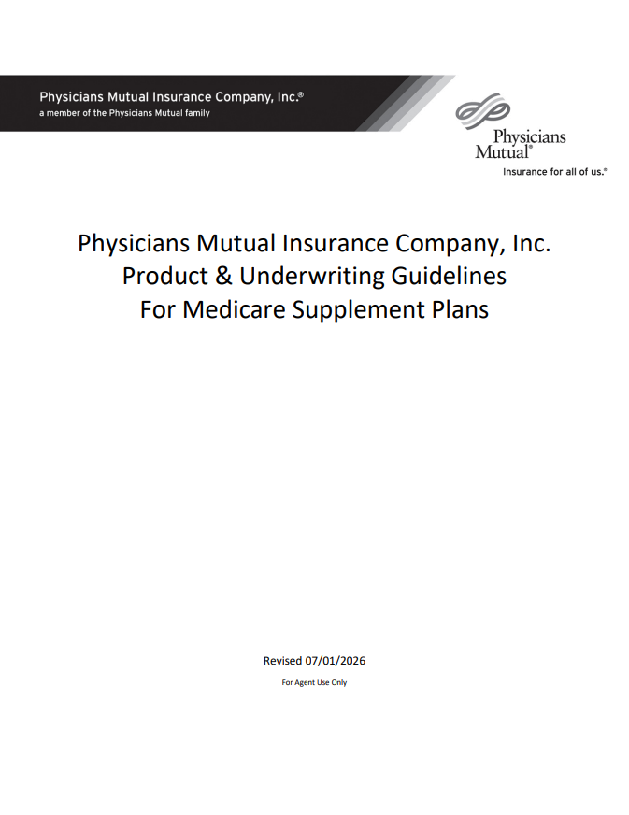
Application requirements can be found in the Underwriting Guidelines on the Agent Platform
Outstanding/pending requirements can be found in the mobile Agent Assistant app or contact Sales Support.

Slide 7
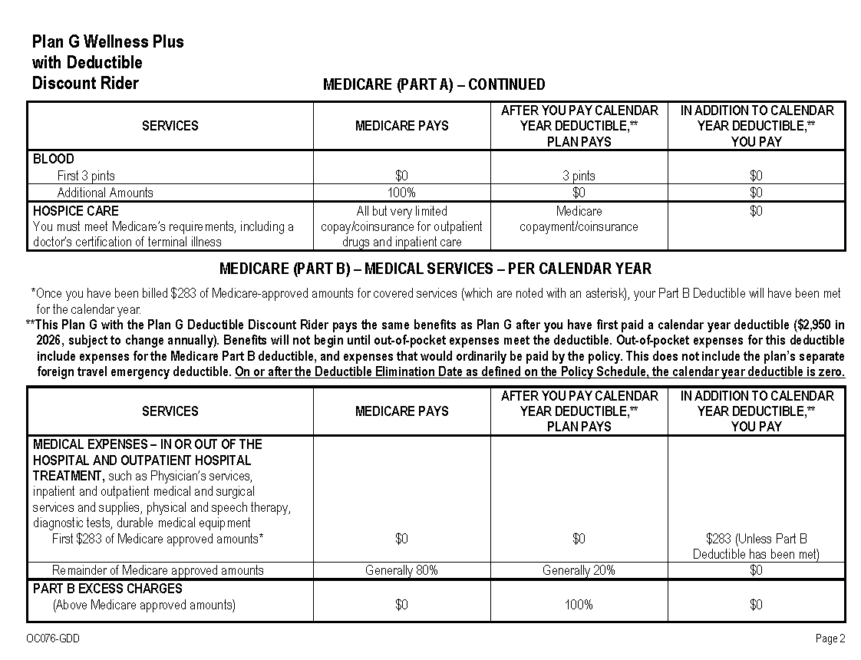
NOTE: It is required to provide your client with the Medicare Supplement Outline of Coverage & Disclosures, as well as the Choosing a Medigap Policy Booklet Available for download from S3.
Disclosures can be sent with a push of a button when taking an electronic application and an email address is provided.

Slide 8
AEP Apps
When?
AEP applications (for clients coming off an MA plan) can be submitted as early as October 1st for a January 1st effective date
No Coverage Overlap
Make sure that current MA plan is cancelled
When replacing an MA plan, proof of current coverage disenrollment is not required (unless it is a GI/SEP app).
However, PMIC will send a letter to your client asking for a disenrollment letter, as a “nice to have” to avoid overlapping coverage.
Your client will not lose their PMIC plan if they don’t provide this.
However, if the client submits a disenrollment letter that shows that coverage did not end on December 31st, OEP will be used instead of AEP and the effective date will be moved.

Slide 9
Medicare Advantage OEP
When?
January 1-March 31 OR
Within the first 3 months you get Medicare
What can you do?
Switch to another Medicare Advantage Plan with or without drug coverage.
Drop your Medicare Advantage Plan and go back to Original Medicare.
Join a Medicare drug plan
Coverage starts:
First of the month after the plan gets your request.

Slide 10
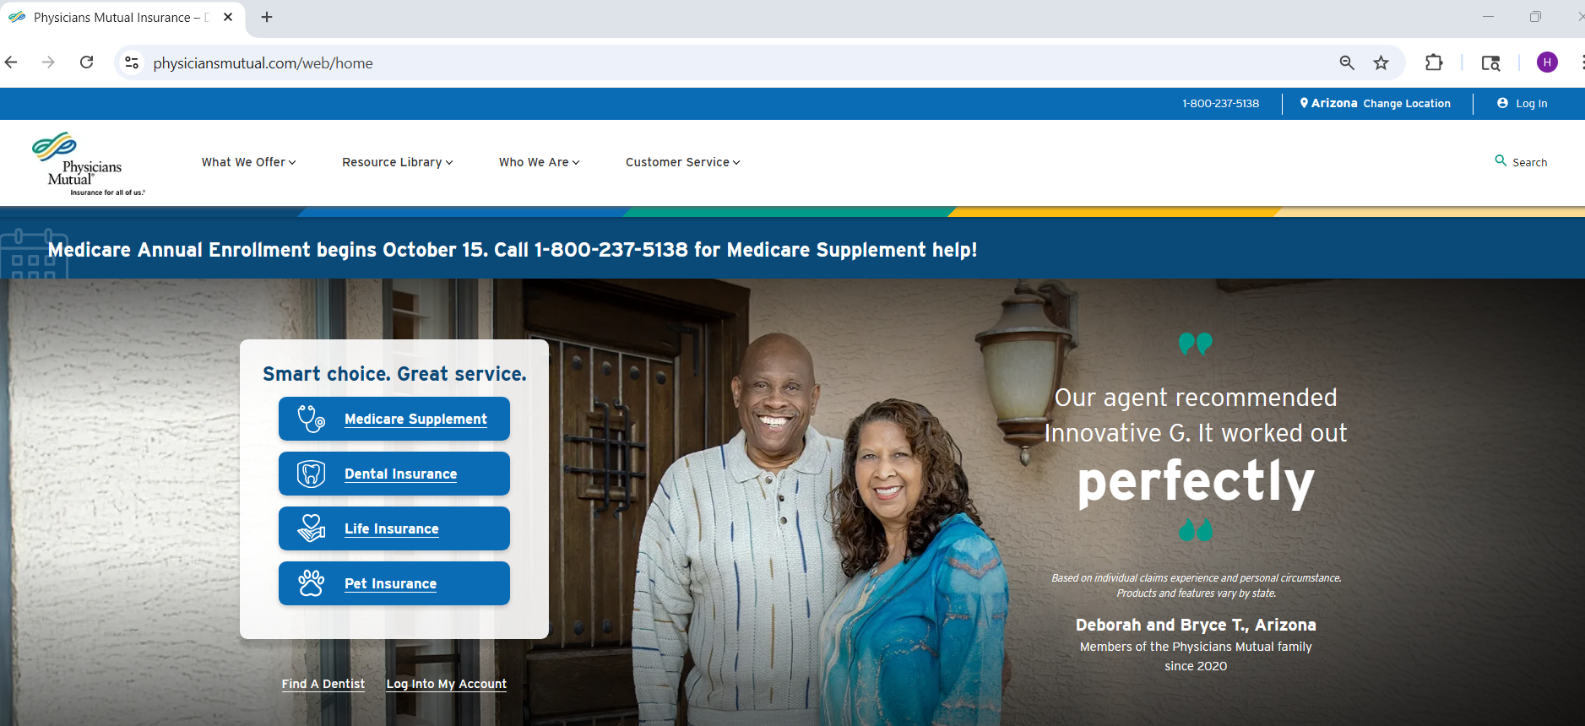
Let’s Take a Med supp e-App!
Log In

Slide 11
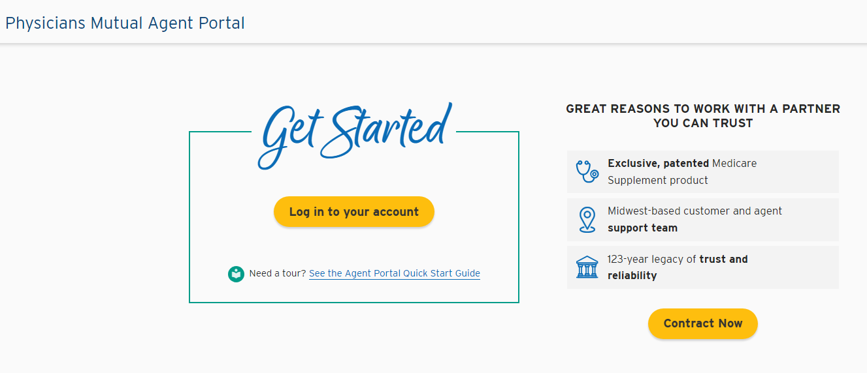
Bookmark: https://portal.physiciansmutual.com/eselfcare/login
Click Here

Slide 12
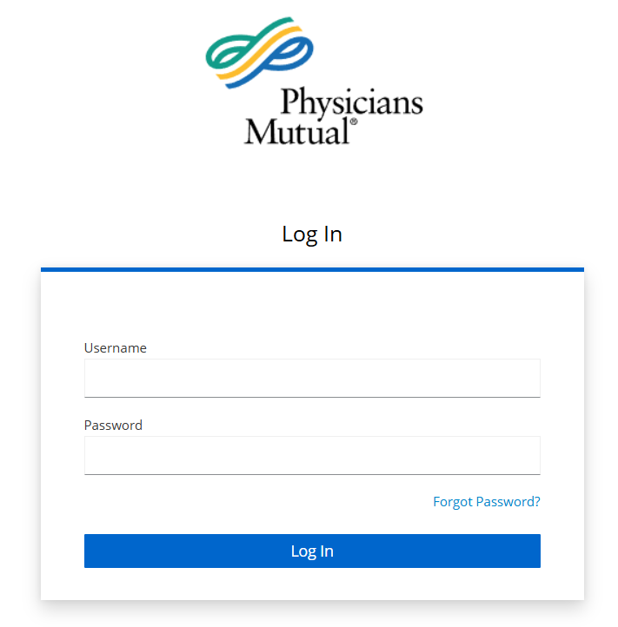
Your Username is your NPN.
The first time you log in click Forgot Password to create a password via email link.

Slide 13
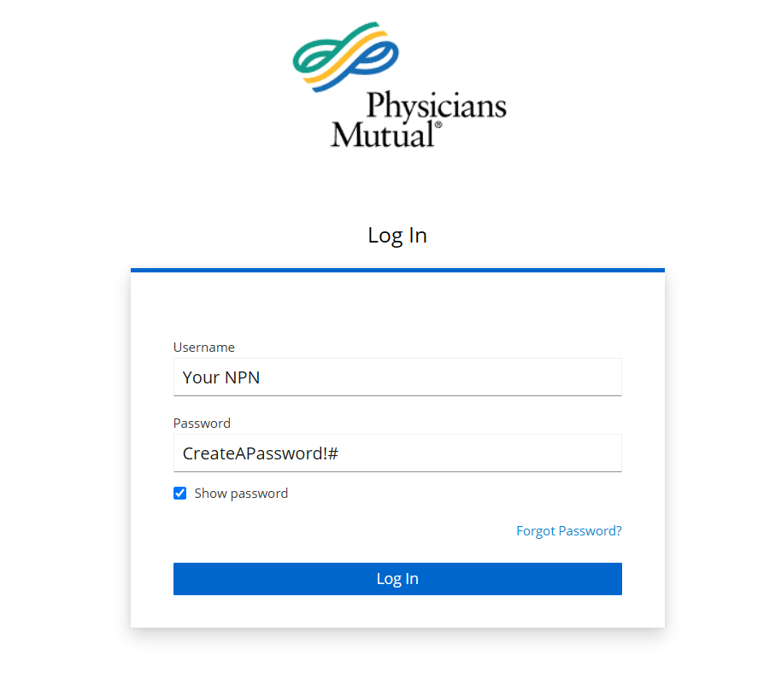
Click Here

Slide 14
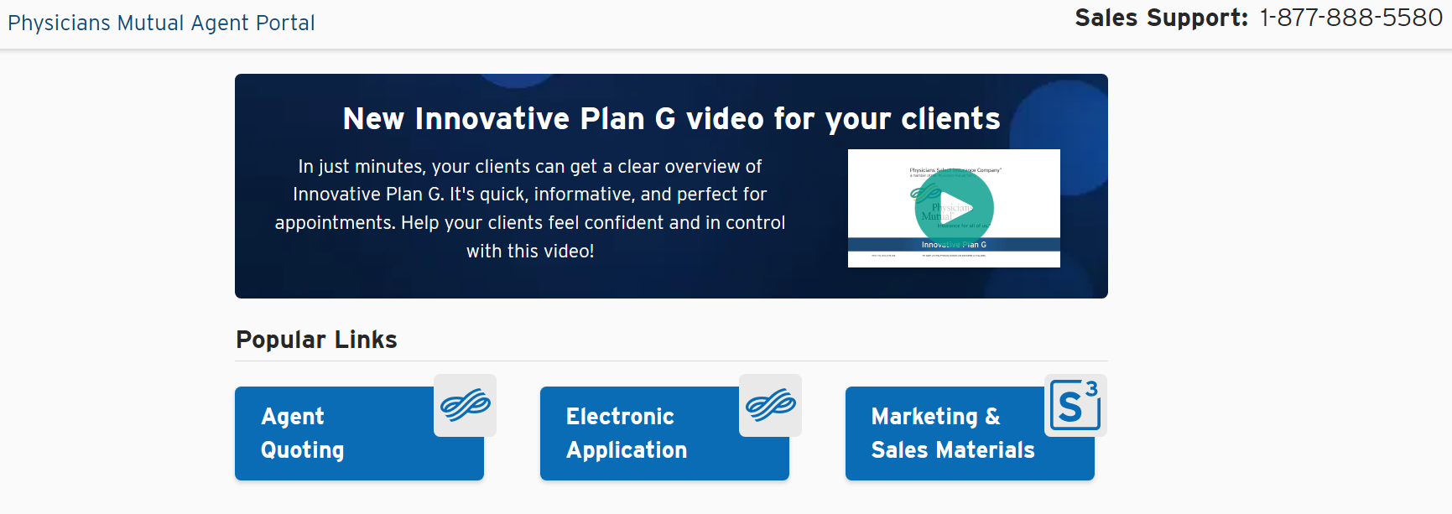
Write App

Slide 15
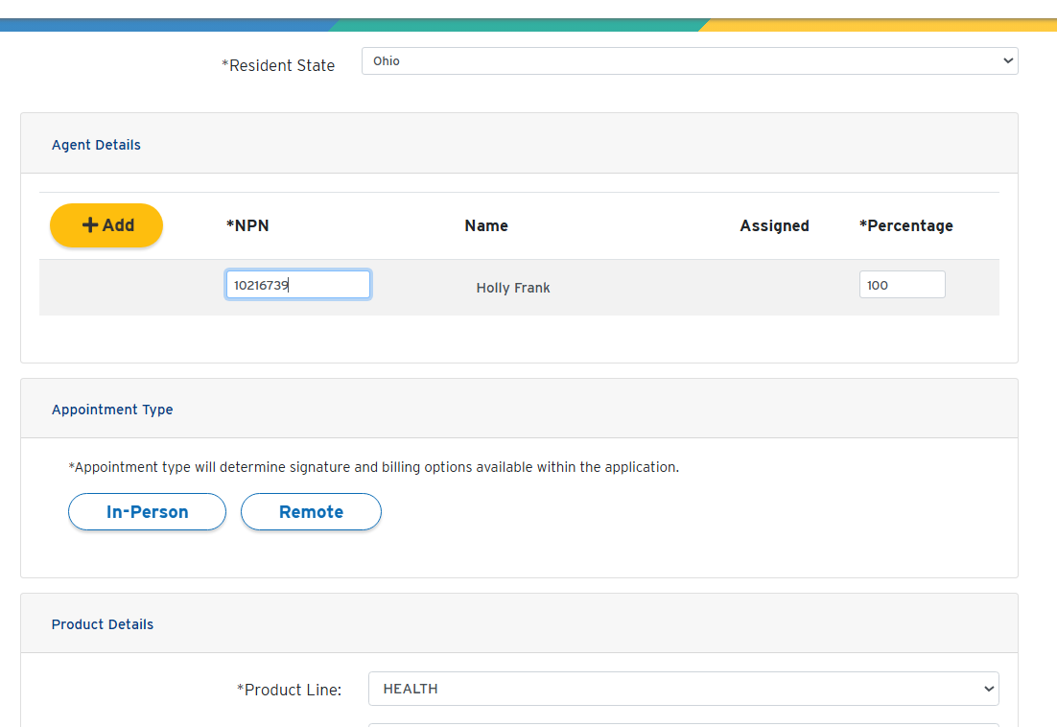
Select State
Enter NPN #
Select In-Person or Remote
Health or Life

Slide 16
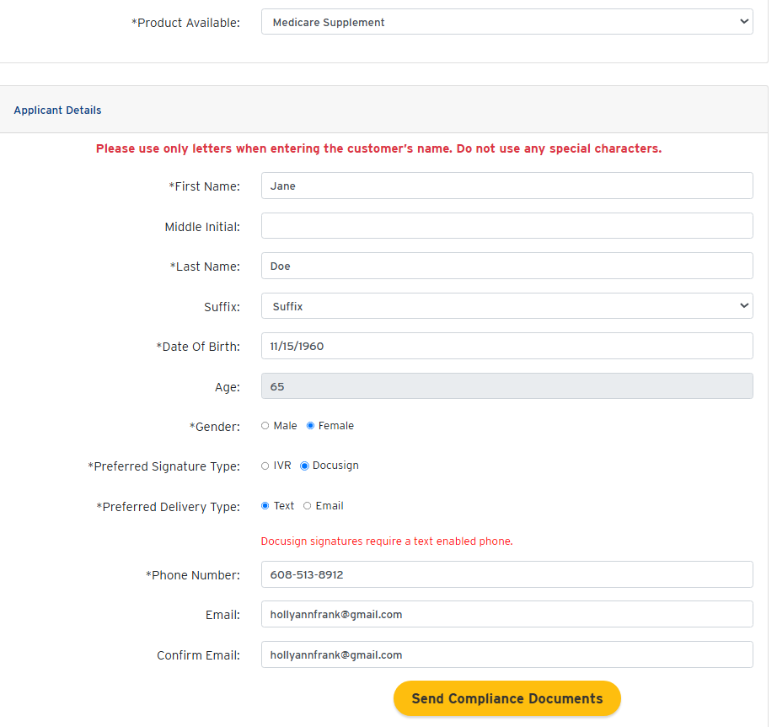
Select Product
See Dental Training to see a dental app
Signature Type
Delivery Type
Send Documents

Slide 17
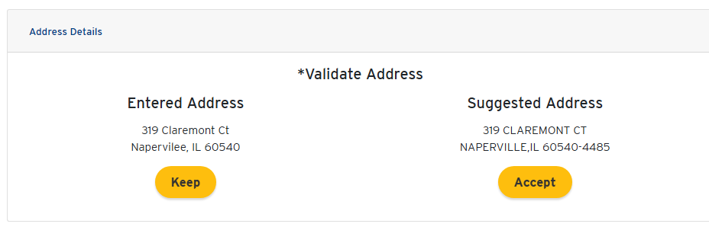
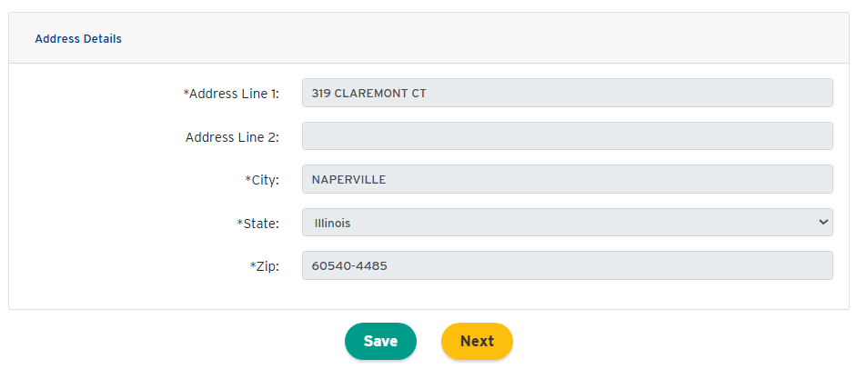
Click Here
Click Here

Slide 18
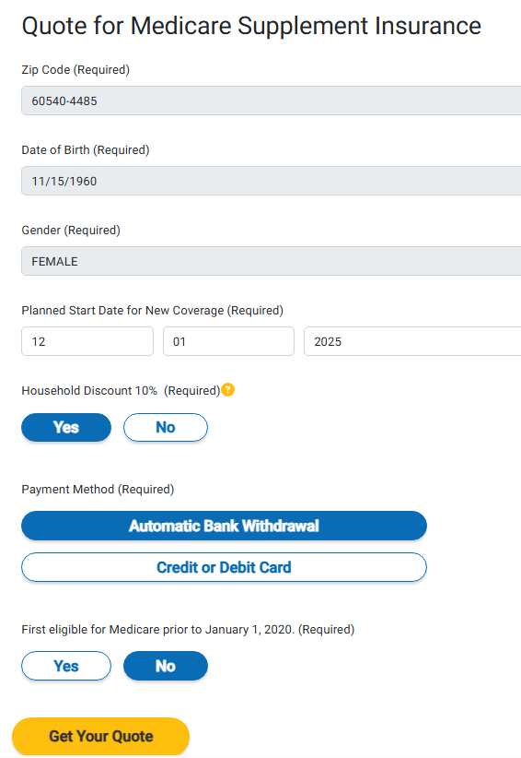
Household Discount rules vary by state. See state product summary for more.
Click for HH Disc Rules

Slide 19
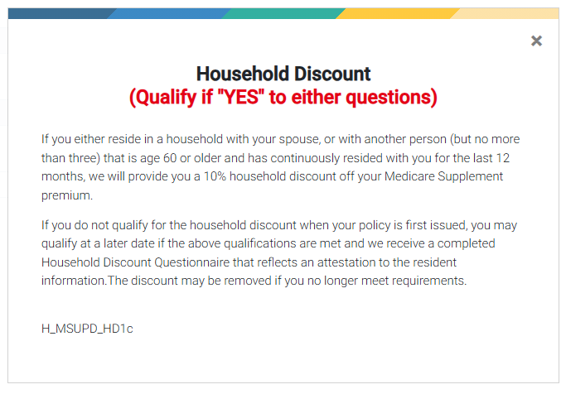

Slide 20
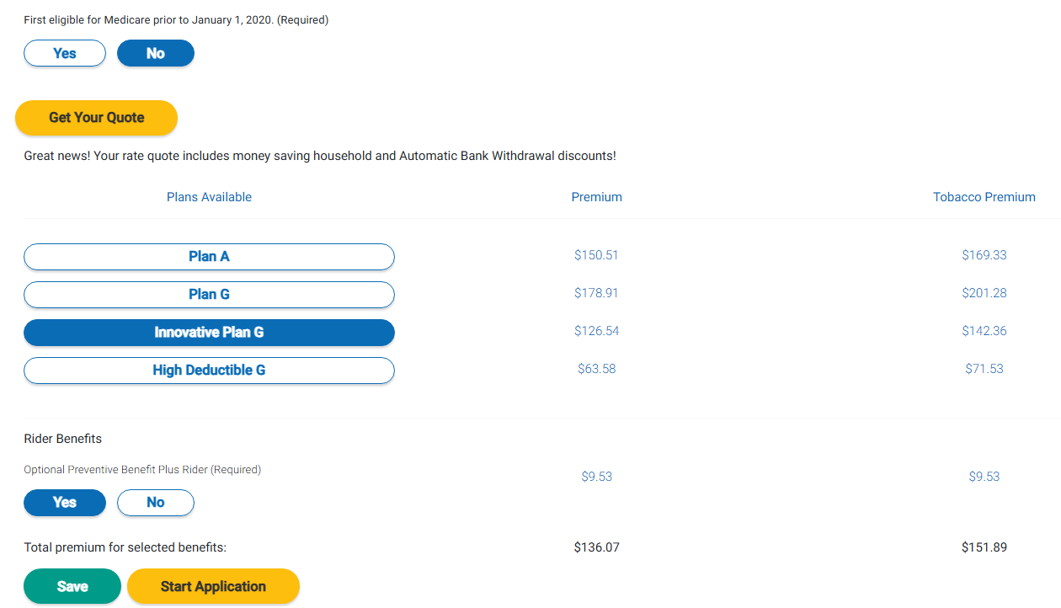
Click Here
Select Plan
Optional Rider
Click Here

Slide 21
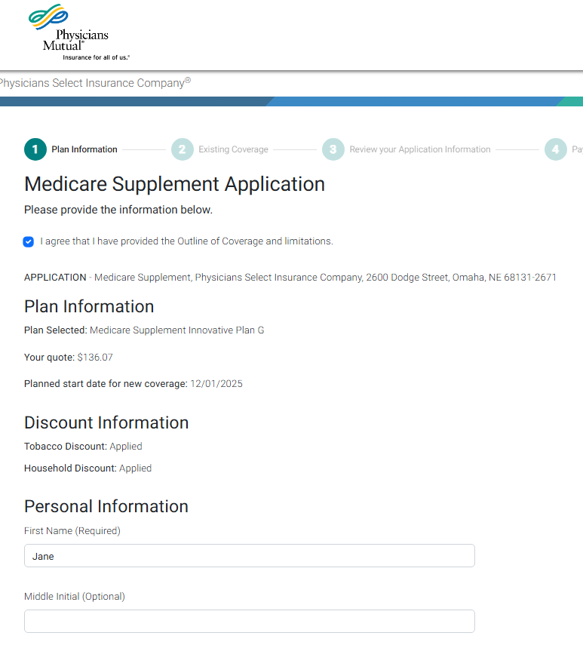
Check Box

Slide 22
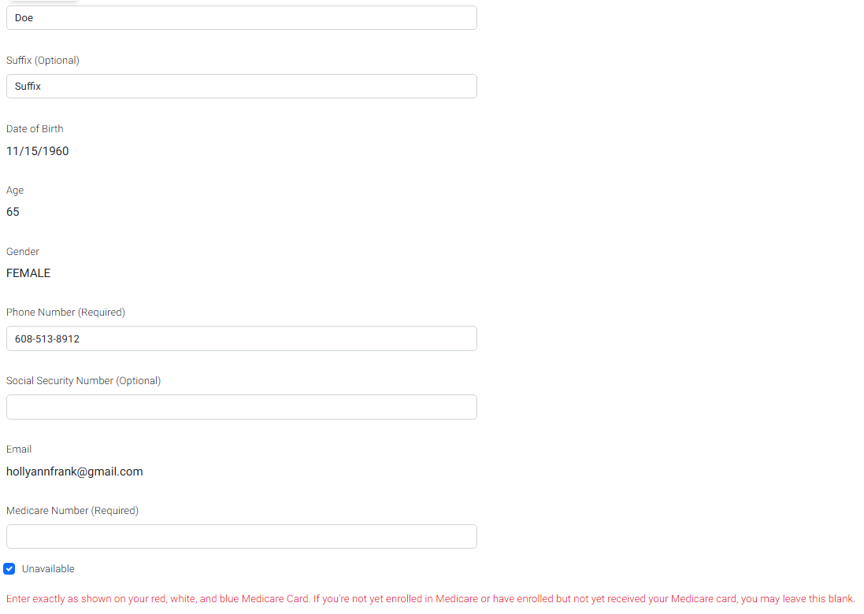
Optional
No need to wait for Medicare #!
Unavailable

Slide 23
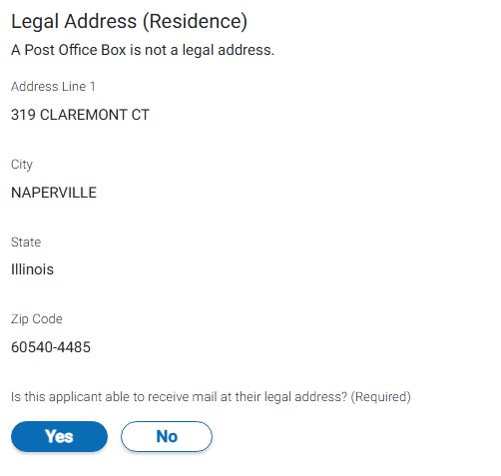
Click Here

Slide 24
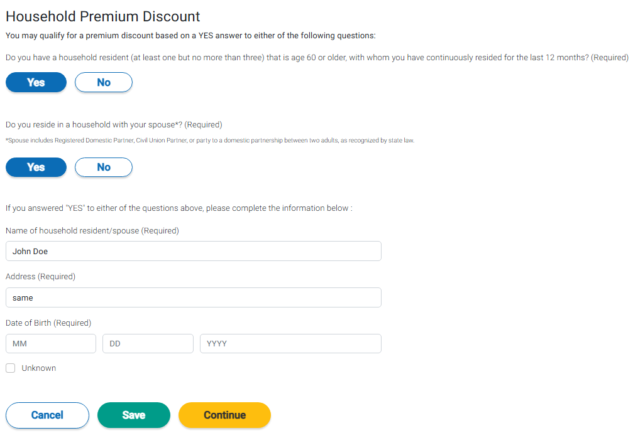
Enter Info
Click Here

Slide 25
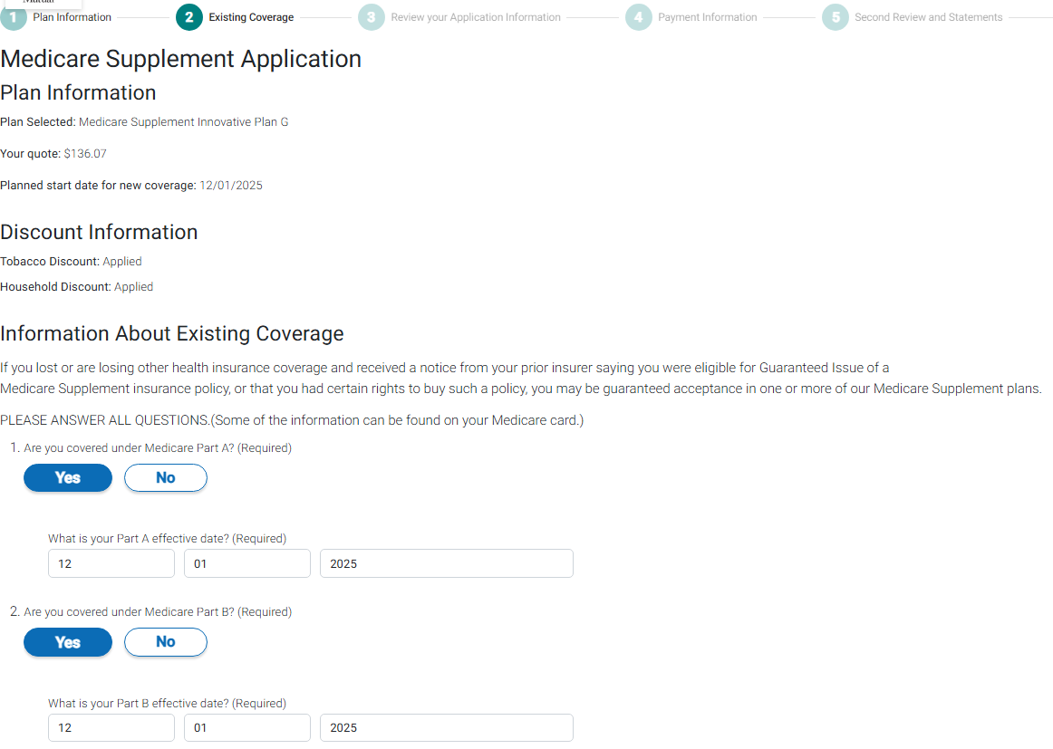

Slide 26
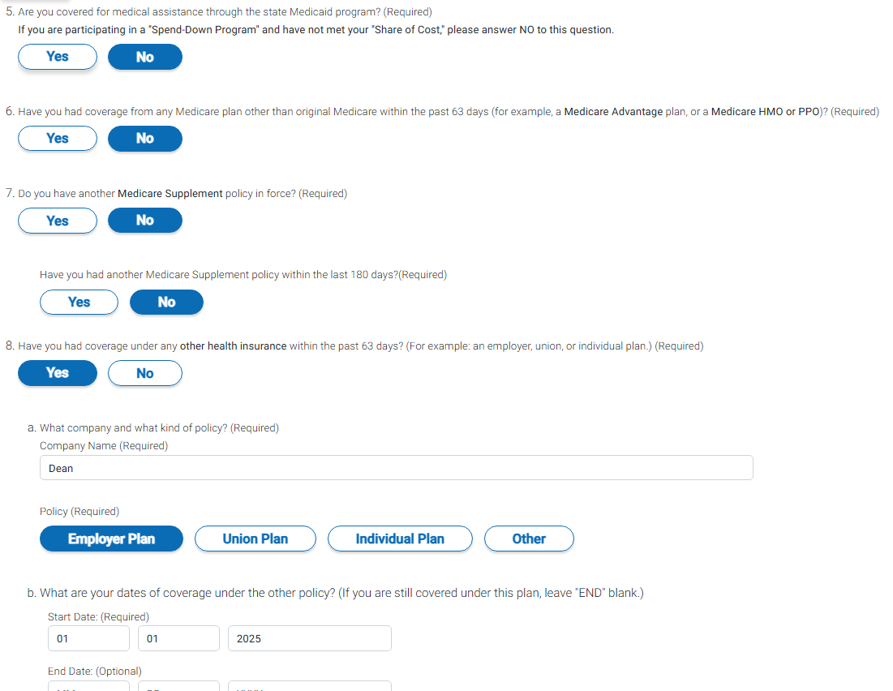
For questions #5-8, about existing coverage, only one can be answered Yes.

Slide 27
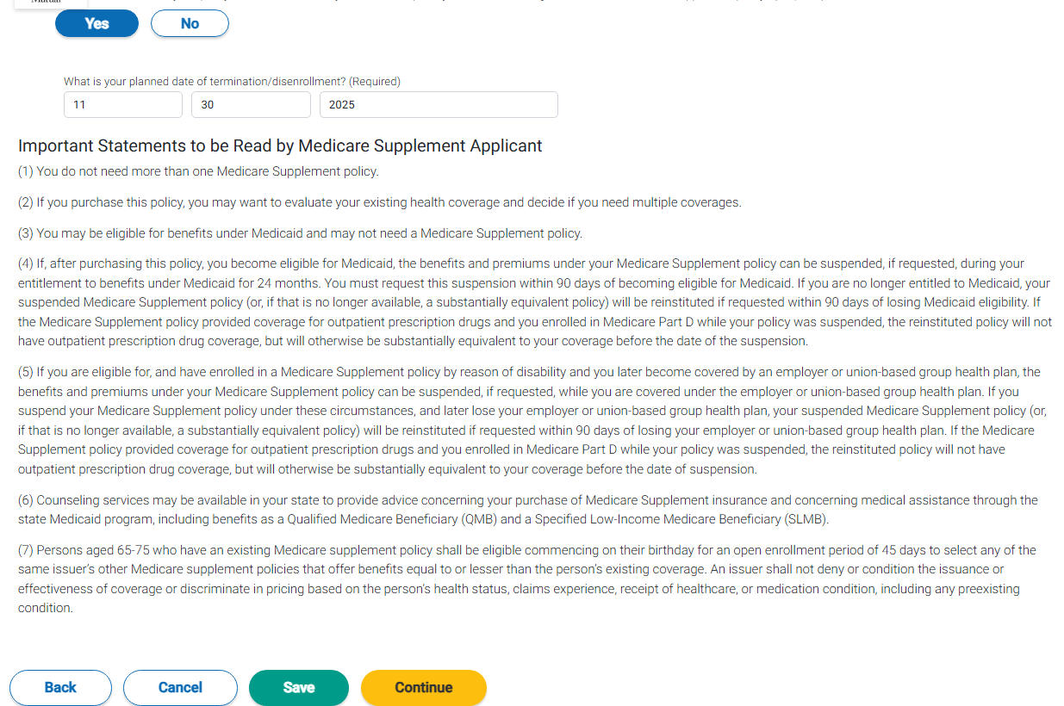
Cannot Overlap
Click Here

Slide 28
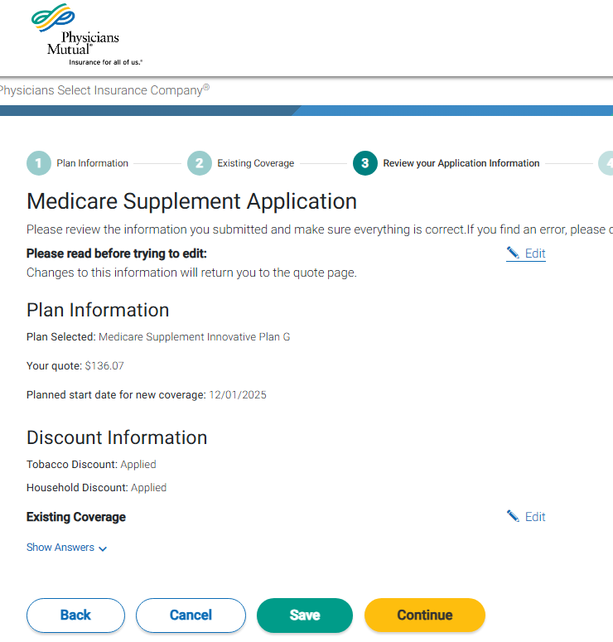
Click Here

Slide 29
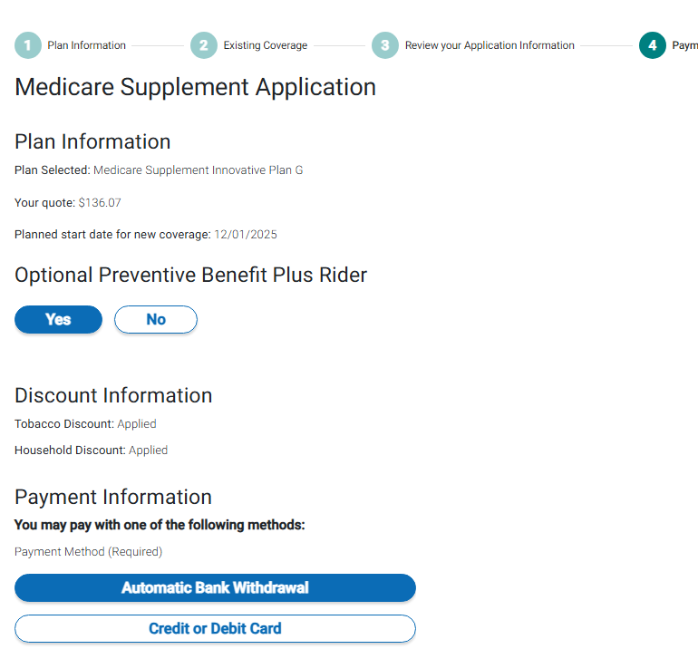
Click Here

Slide 30
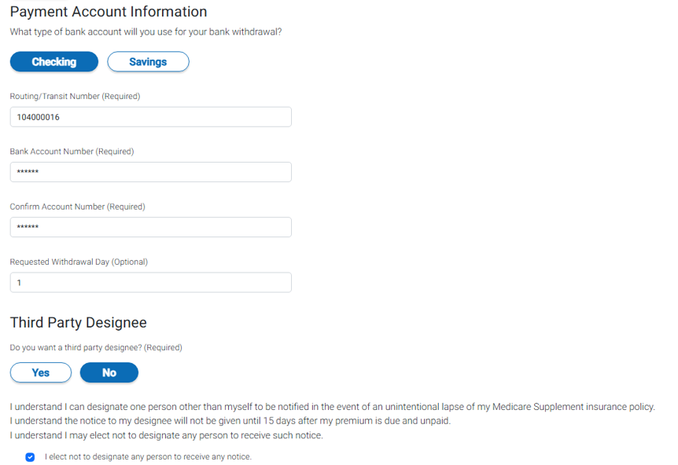
Enter Twice
Can always add this at a later date.

Slide 31
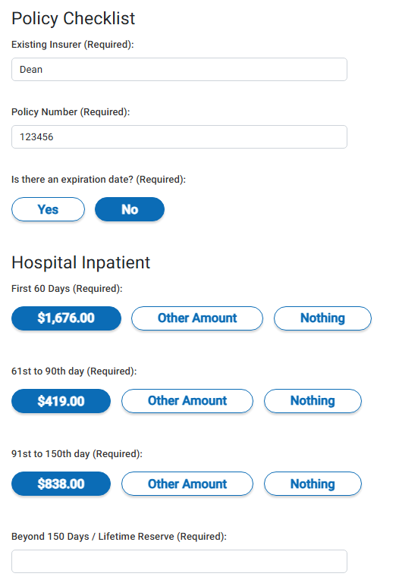
Illinois apps only

Slide 32
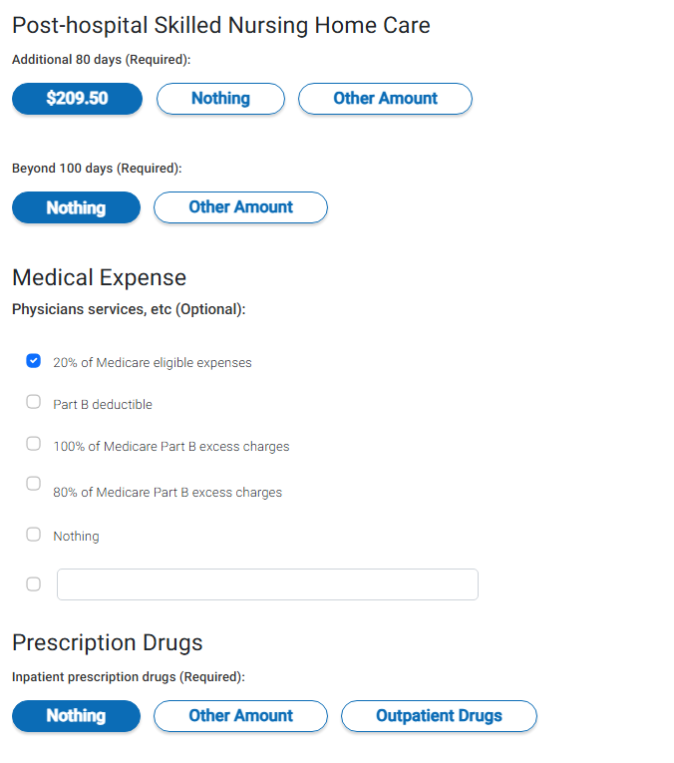
Illinois apps only

Slide 33
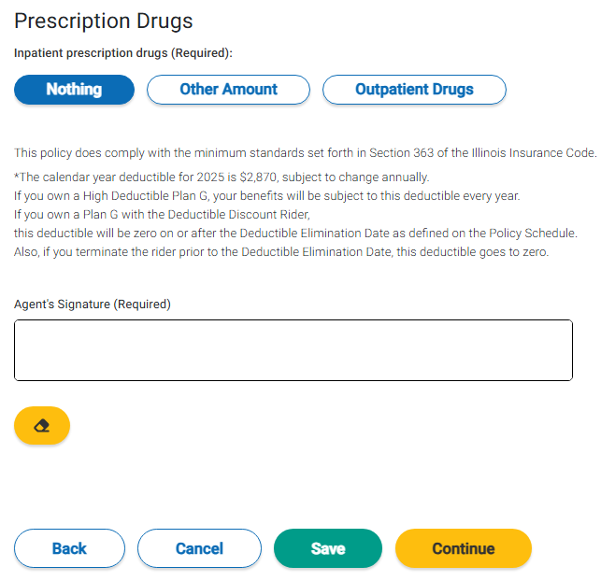
Illinois apps only
Sign Here
Click Here

Slide 34
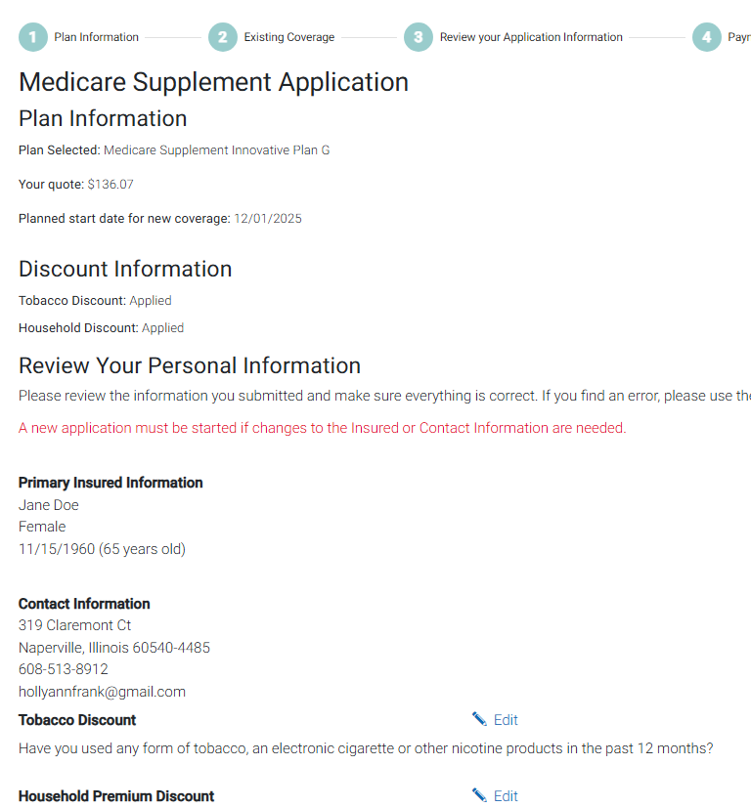

Slide 35
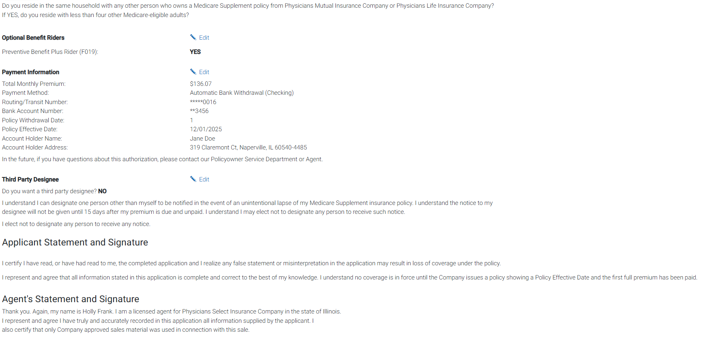
Review Information. Select Edit or back arrow within the e-App if changes are necessary. Never click the browser back arrow!

Slide 36
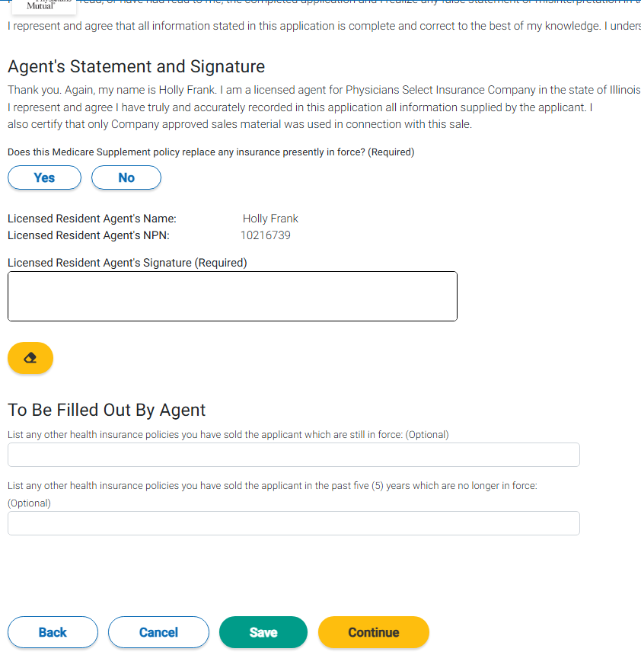
Click Here
Sign Here
Optional
Click Here

Slide 37
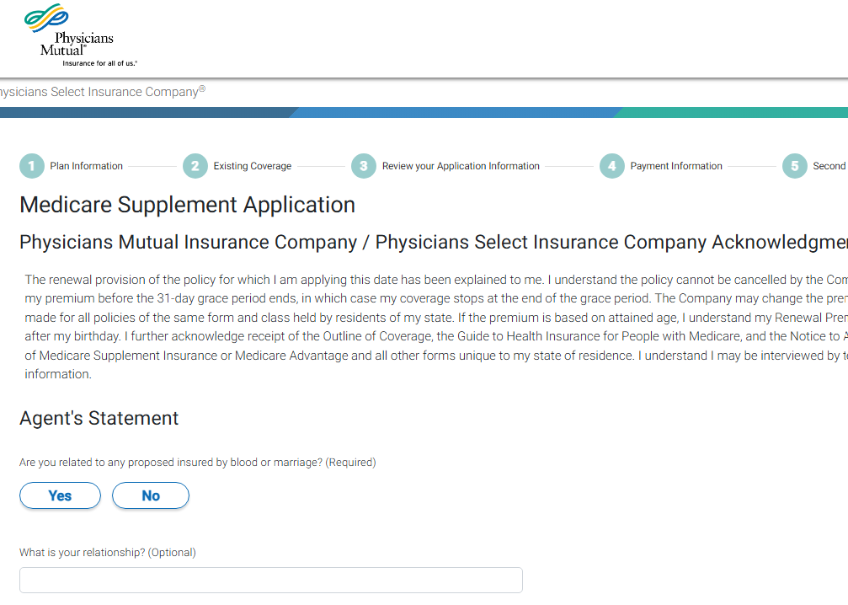
This is Allowed

Slide 38
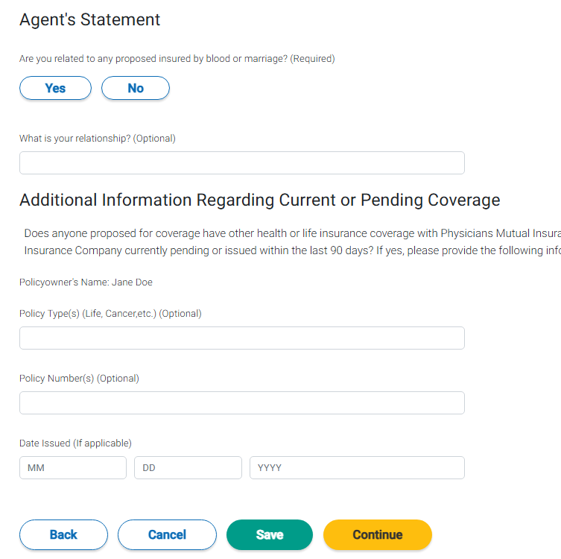
Optional
Click Here

Slide 39
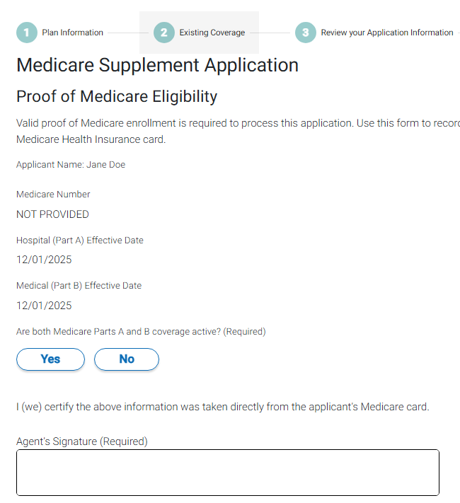
Click Here
Sign Here

Slide 40
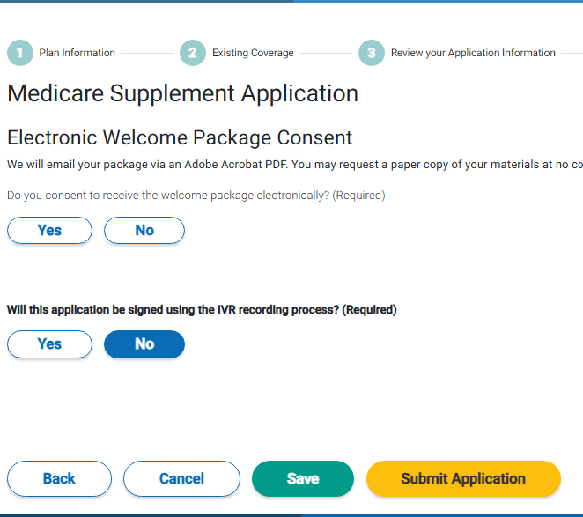
Paperless?
Click yes if customer does not want to sign via DocuSign. IVR (interactive voice recording) involves a 3-way call for voice signature.
If using DocuSign, remind client to enter the last 4 digits of their phone number for the access code.
Submit

Slide 41
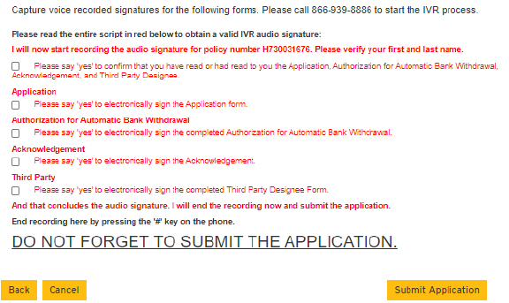
If the client will sign via IVR, the number and script will appear in the e-app

Slide 42
After the application is submitted:
You will receive a confirmation with the client name, policy name, policy number, and premium amount.
The tobacco rate may appear on your screen (Post 65 apps). If eligible for the non-tobacco discount, it will be applied at issue.
You’ll receive an email once it has issued.
Check status on the Agent Assistant App

Slide 43

Call us with questions BEFORE the Sale

Slide 44

Call with questions AFTER the Sale + Application Status

Slide 45
Questions?
Thank You!

