Slide 1


2027
Medicare
Plans
Blue Cross Blue Shield and
Blue Care Network Medicare Plans
Updated July 2026. Blue Cross Blue Shield of Michigan and Blue Care Network are PPO, HMO, HMO-POS plans with Medicare contracts. Enrollment in Blue Cross Blue Shield of Michigan and Blue Care Network depends on contract renewal.
Blue Cross Blue Shield of Michigan and Blue Care Network are nonprofit corporations and independent licensees of the Blue Cross and Blue Shield Association.
Notes:
Open by positioning this as a consultative Medicare planning conversation, not a one-size-fits-all recommendation.
Set expectations that we will compare Blue Cross Medicare options, confirm fit, and use current plan documents before any enrollment decision.
Ask the member to have their doctors, prescriptions, preferred pharmacy, and county of residence ready.

Slide 2
Blue Cross Blue Shield of Michigan | 2027 Product Sales Deck
What we’ll cover today
1
2
3
4
5
6
7
8
Getting
Started
Advantage Plans at a Glance
PPO Plans at a Glance
HMO and HMO-POS Plans at a Glance
Medicare Advantage Extras
Medicare Supplement Plans at a Glance
PDP Plans at a Glance
Next Steps
Blue Cross Blue Shield of Michigan and Blue Care Network are nonprofit corporations and independent licensees of the Blue Cross and Blue Shield Association.
For training purposes only.
Notes:
Frame the agenda around decision support: ratings and programs, Medicare Advantage, Medicare Supplement, and final decision factors.
Let the member know the goal is to narrow options based on fit, not simply to choose the lowest premium.
Invite questions throughout, especially around providers, prescriptions, and expected care needs.

Slide 3
Blue Cross Blue Shield of Michigan | 2027 Product Sales Deck
Start with what matters most to you
Keep this information handy so you can compare plans side by side.
Your doctors
Your prescriptions
Your care
Your extras
+ Primary care
+ Specialists
+ Hospitals
+ Drug names
+ Dosage
+ Refill frequency
+ Preferred pharmacy
+ Labs
+ Imaging
+ Surgeries
+ Chronic care needs
+ Dental
+ Vision
+ Hearing
+ Fitness
+ Over-the-counter
+ Travel coverage
See our
doctor network.
<bcbsm.com>
See our prescription list.
<bcbsm.com>
Tip: The best plan is the one that fits your providers, prescriptions and expected use — not just the lowest monthly premium.
Blue Cross Blue Shield of Michigan and Blue Care Network are nonprofit corporations and independent licensees of the Blue Cross and Blue Shield Association.
For training purposes only.
Notes:
Lead with discovery questions: doctors, prescriptions, expected care, and extras the member values.
Emphasize that provider and drug fit can matter more than premium alone.
Sales cue: ask what changed since last year, such as new specialists, medications, surgeries, or travel plans.
Transition by saying the next step is understanding when coverage changes can be made.

Slide 4

Getting Started
Notes:
Use this as a transition into discovery.
Explain that before comparing products, a good agent starts by understanding how the member uses care today.
Set a collaborative tone: we will gather facts first, then match those facts to plan features.

Slide 5



Blue Cross Blue Shield of Michigan | 2027 Product Sales Deck
Enroll anytime
You can choose a plan any time throughout the year with different premium ratings.
Oct. 15 – Dec. 7
Jan. 1 – March 31
Ongoing
Medicare annual enrollment period
Medicare Advantage open enrollment
Medigap open enrollment window
Make or change Medicare Advantage or Part D plans.
One-time switch if enrolled in a Medicare Advantage plan.
A 6-month window, anytime throughout the year, that begins the first month you are 65 or older and have enrolled in Medicare Part B.
Timing matters: Enrollment windows determine when coverage changes can begin.
Blue Cross Blue Shield of Michigan and Blue Care Network are nonprofit corporations and independent licensees of the Blue Cross and Blue Shield Association.
For training purposes only.
Notes:
Explain enrollment timing in simple terms and confirm which window applies to the member.
Reinforce that effective dates and eligibility rules matter before discussing enrollment.
Sales cue: if the member is unsure, offer to verify their current coverage and timing before recommending next steps.
Transition to the Blue Cross Medicare Advantage plan family.

Slide 6
Blue Cross Blue Shield of Michigan | 2027 Product Sales Deck
Find the plan that fits your needs
PPO
HMO
+ Flexibility to choose any healthcare provider
+ You may pay more for care outside of the network
+ Your PCP coordinates care and provides referrals
HMO-POS
Medicare Supplement
+ Works like an HMO
+ You're allowed to receive certain out-of-network
services at in-network costs
+ Flexibility to choose any healthcare provider who
accepts Original Medicare at no additional cost
+ Fills the gaps in Original Medicare by covering some
or all of your out-of-pocket costs
Blue Cross Blue Shield of Michigan and Blue Care Network are nonprofit corporations and independent licensees of the Blue Cross and Blue Shield Association.
For training purposes only.
Notes:
Explain PPO as flexibility, HMO as coordinated care through a PCP, and HMO-POS as an HMO with some out-of-network flexibility.
Keep the language practical: where the member gets care and how much provider flexibility they want should guide the plan type.
Sales cue: ask whether the member travels, sees out-of-state providers, or prefers a primary care relationship.
Transition to the benefits available across Blue Cross Medicare Advantage options.

Slide 7

Advantage Plans at a Glance
Notes:
Use this section divider to reset attention and introduce Medicare Advantage as an all-in-one plan option.
Position the upcoming slides as a high-level tour before narrowing to individual plan fit.
Remind the member that county, network, and prescription details still need to be verified.

Slide 8
Blue Cross Blue Shield of Michigan | 2027 Product Sales Deck
9 reasons to choose Blue Medicare Advantage Plans
Access to nearly 79,000 quality, active providers¹
Prescription drug coverage included in all but one plan option²
Preventive dental services including cleaning, X-rays, dental exams
and fluoride
No-cost routine eye exam
Hearing aid benefit³ through TruHearing
Blue Cross Well-being℠, online well-being resources
No-cost PCP office visits
While traveling, access worldwide urgent and emergency care or our nationwide network of Blue plan doctors and hospitals with Medicare Advantage PPO and HMO-POS plans
Your 24/7 online member account connects
you to your virtual member ID card, claim documents and the status of prior authentication and referral requests
Blue Cross has promoted healthy living for individuals, families and communities across the Great Lakes State for more than 80 years.
¹ Blue Cross Blue Shield of Michigan Provider Counts report, June 2026.
² No prescription drug coverage with Elements.
³ Hearing aid benefit not available with Essential and Prime Value.
See our
doctor network.
<bcbsm.com>
See our prescription list.
<bcbsm.com>
*Source: Ready to Help 2026 brochure / MA PPO Active Provider Counts report, July 2025.
Blue Cross Blue Shield of Michigan and Blue Care Network are nonprofit corporations and independent licensees of the Blue Cross and Blue Shield Association.
For training purposes only.
Notes:
Highlight the value story: broad provider access, drug coverage on most options, preventive benefits, no-cost PCP visits, travel support, and digital tools.
Use the 79,000-provider point as a confidence builder, but still verify each provider for the member.
Sales cue: ask which of these benefits matters most to them so you can prioritize the comparison.
Transition by explaining the difference among PPO, HMO, and HMO-POS choices.

Slide 9
Blue Cross Blue Shield of Michigan | 2027 Product Sales Deck
Blue Cross Medicare Advantage plans at a glance
0
$
Premiums available statewide
Plan availability and rates vary by plan and county.
Primary care provider visits
In-network PCP visits for all Medicare Plus Blue PPO plans.
Medical deductible options
Available on many PPO plan options.
Broad network
Dental, vision and hearing
Access to Michigan and nationwide providers.
Embedded and optional supplemental benefits vary by plan.
OTC allowance
Travel support
Quarterly Advantage Dollars on select plans.
Worldwide emergency, urgent care and emergency transportation.
*Excludes Essential
Blue Cross Blue Shield of Michigan and Blue Care Network are nonprofit corporations and independent licensees of the Blue Cross and Blue Shield Association.
TruHearing® is an independent company that contracts with Blue Cross Blue Shield of Michigan and Blue Care Network to offer supplemental hearing benefits for certain plans. All content ©2026 TruHearing, Inc. All Rights Reserved. TruHearing® is a registered trademark of TruHearing, Inc.
Blue Cross Blue Shield of Michigan and Blue Care Network are nonprofit corporations and independent licensees of the Blue Cross and Blue Shield Association.
For training purposes only.
Notes:
Use this as a benefits-at-a-glance summary, not a full benefit review.
Call out $0 premium options, $0 PCP visits, dental/vision/hearing extras, OTC allowances, and travel support as areas to compare.
Sales cue: remind the member that availability and amounts vary by plan and county, so the next step is narrowing by location and needs.
Transition to prescription drug savings.

Slide 10
Blue Cross Blue Shield of Michigan | 2027 Product Sales Deck
Prescription savings made simple
$0
$0
62K+
Tier 1 preferred generic copay
100-day Tier 1 and 90-day Tier 2 supply
network pharmacies nationally
When using a preferred pharmacy; exclusions vary by plan.
Available on most plans at a preferred pharmacy.
Members can choose preferred pharmacies to save money.
One drug list (formulary) across all plans*
*Excludes Value
See the full Medicare Plus Blue PPO network at bcbsm.com/medicare/help/using-your-plan/find-participating-pharmacy/
The same drug list on every plan makes comparing your coverage simple.
Blue Cross Blue Shield of Michigan and Blue Care Network are nonprofit corporations and independent licensees of the Blue Cross and Blue Shield Association.
For training purposes only.
Notes:
Position pharmacy as one of the biggest fit checks in Medicare planning.
Explain the $0 preferred generic and extended-supply examples, then caution that pharmacy choice and drug tier can change member costs.
Sales cue: ask for the member's medication list and preferred pharmacy, and offer to compare preferred pharmacy savings.
Transition to supplemental benefits.

Slide 11
Blue Cross Blue Shield of Michigan | 2027 Product Sales Deck
Dental, vision and hearing benefits designed around you
Dental
Vision
Hearing
$750–$1,500
$0 routine exam
$0 exam
+ Preventive and comprehensive annual maximum on Secure, Vitality and Assure
+ Preventive-only coverage on Giveback
+ Secure includes up to $100 eyewear allowance
+ Assure includes up to $150 eyewear allowance
+ Vitality and some plans include routine exam only
+ $0 routine hearing exam and fitting/evaluation
+ Hearing aid copays through TruHearing® network
Benefits and annual maximums vary by plan. Review the Summary of Benefits for full details.
Blue Cross Blue Shield of Michigan and Blue Care Network are nonprofit corporations and independent licensees of the Blue Cross and Blue Shield Association.
For training purposes only.
Notes:
Summarize dental, vision, and hearing as added value that can reduce separate out-of-pocket spending.
Avoid overpromising: benefit maximums and copays vary by plan and network.
Sales cue: ask whether the member already pays for dental work, eyewear, hearing exams, or hearing aids.
Transition to the OTC allowance.

Slide 12
Blue Cross Blue Shield of Michigan | 2027 Product Sales Deck
Extra dollars for your everyday health needs
Use quarterly dollars for eligible health items — and food or produce when eligible.
$25–$75
Some items that can purchased:
per quarter on select plans
Eligible members may use the allowance toward over-the-counter health items. Members with qualifying chronic conditions may be able to use the allowance toward food and produce at plan-approved locations.
Smart scales
Toothpaste
Online
Retailers
Fitness trackers
Heating pads
Order approved items.
Shop plan-approved locations.
See eligible OTC items.
<bcbsm.com>
Air purifiers
Pain relievers
Source: 2026 Medicare Plus Blue PPO Summary of Benefits. Unused amounts do not carry forward.
Blue Cross Blue Shield of Michigan and Blue Care Network are nonprofit corporations and independent licensees of the Blue Cross and Blue Shield Association.
For training purposes only.
Notes:
Explain the OTC allowance as quarterly dollars for eligible health items, with food or produce eligibility for qualifying chronic conditions when available.
Clarify that unused amounts do not carry forward and eligible retailers/items are plan-defined.
Sales cue: ask whether the member currently buys OTC health items regularly.
Transition to wellness and fitness support.

Slide 13

Blue Cross Blue Shield of Michigan | 2027 Product Sales Deck
Fitness that fits your life
A no-cost fitness and wellness benefit with in-person, online and at-home options
FREE
fitness and wellness support
Available through participating SilverSneakers® locations and digital channels.
At participating locations
Exercise equipment, classes and amenities.
Online and on demand
Live classes, workshops and hundreds of workout videos.
Mobile and at home
GO app, well-being resources and at-home fitness kits.
*Excludes Giveback and Essential PPO plans and Prime Value HMO-POS
SilverSneakers is a registered trademark of Tivity Health, Inc. 2026 Tivity Health, Inc. All rights reserved. Tivity Health is an independent corporation retained by Blue Care Network to provide health and fitness services to its Medicare Advantage members.
Blue Cross Blue Shield of Michigan and Blue Care Network are nonprofit corporations and independent licensees of the Blue Cross and Blue Shield Association.
For training purposes only.
Notes:
Present SilverSneakers as a no-cost wellness benefit for eligible plans, with in-person, online, mobile, and at-home options.
Mention this is especially useful for members who value routine activity or community fitness classes.
Sales cue: ask whether the member currently uses a gym, online classes, or at-home fitness resources.
Transition to the PPO plan lineup.

Slide 14
Blue Cross Blue Shield of Michigan | 2027 Product Sales Deck
Value plan services not subject to a medical deductible
Diabetes-related care
Screenings & exams
Primary care & education
Diabetic supplies
Diabetic monitors
Diabetic therapeutic shoes/inserts
Diabetes self-management training
Glaucoma screening
Digital rectal exams
EKG following welcome visit
Primary care physician services
Kidney disease education services
Blue Cross Blue Shield of Michigan and Blue Care Network are nonprofit corporations and independent licensees of the Blue Cross and Blue Shield Association.
For training purposes only.
Notes:
Explain that some services do not require the member to meet the deductible first, including certain core medical, preventive, and supplemental benefits.
Use this slide to reduce confusion, but direct detailed questions to plan documents.
Sales cue: ask which services the member expects to use early in the year.
Transition to the deeper deductible example.

Slide 15

PPO Plans
at a Glance
Notes:
Use this divider to shift from general Medicare Advantage benefits into PPO-specific options.
Set up the comparison by saying we will look at premium, deductible, PCP, specialist, and OTC differences.
Remind the member that the best PPO fit depends on county, providers, prescriptions, and expected use.

Slide 16
Blue Cross Blue Shield of Michigan | 2027 Product Sales Deck
How our PPO plans stack up
Plan | Premium | Giveback amount | Deductible | PCP | Specialist | OTC / quarter
Assure | $191.90–$298.60 | - | $0 | $0 | $10 | $50
Value | $0 | - | $525 | $0 | $50 | $25
Vitality | $74.30–$111.00 | - | $0 | $0 | $30 | $40
Secure | $0 | $0 | $100 | $0 | $45 | $25
Giveback | $0 | $50 | $650 | $0 | $55 | -
Meijer | $45 | - | $0 | $0 | $50 | $75
Essential | $35.80–$41.00 | - | $0 | $0 | $45 | -
Signature | $120.00–$168.00 | - | $0 | $0 | $30 | $50
Based on currently available 2026 plan information in this deck; values vary by plan and county.
Blue Cross Blue Shield of Michigan and Blue Care Network are nonprofit corporations and independent licensees of the Blue Cross and Blue Shield Association.
For training purposes only.
Notes:
Walk across the PPO comparison slowly: premium, deductible, PCP, specialist, and OTC allowance.
Use Secure and Value to discuss lower-premium choices, then Vitality and Assure for members who may value richer supplemental or cost-sharing features.
Sales cue: ask whether the member prefers predictable monthly premium, lower visit copays, or stronger extras.
Do not recommend from this grid alone; use it to decide which plan details to review next.

Slide 17
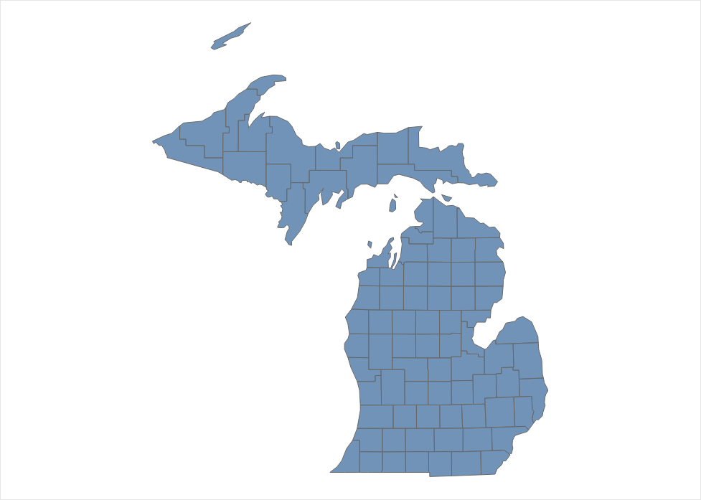

Blue Cross Blue Shield of Michigan | 2027 Product Sales Deck
Assure
4.5 Star CMS Rating
Premium
$199.60 – $305.60
Specialist Office Visit | $10
Urgent Care Copay | $0 - $40
Emergency Room | $130
Inpatient Hospital (days 1-7) | $225
Outpatient & Diagnostic Services | $0 - $150
Maximum Out Of Pocket | $6,200
Prescriptions (Preferred Pharmacy)
Tier 1 (Preferred Generic) Copay | $0
Tier 2 (Generic) Copay | $5
Tier 3-5 Copay | Subject to deductible and coinsurance
Deductible | $100 (Tier 3-5)
Deductible
$0
Primary Care
$0
Supplemental Benefits†
Dental
Preventative & comprehensive allowance
Vision
Annual exam & eyewear allowance
OTC
$50/quarter
Hearing
Annual exam & aid allowance
Fitness
SilverSneakers included
† Optional enhanced buy-up benefits available
Blue Cross Blue Shield of Michigan and Blue Care Network are nonprofit corporations and independent licensees of the Blue Cross and Blue Shield Association.
For training purposes only.
Notes:
Position Assure as a PPO option with broad coverage features and supplemental benefits.
Confirm the member's county and provider fit before discussing price or enrollment.
Sales cue: this plan may appeal to members who are comfortable with a higher premium if the benefit mix better fits their expected care.
Transition by comparing it with the next PPO option.

Slide 18
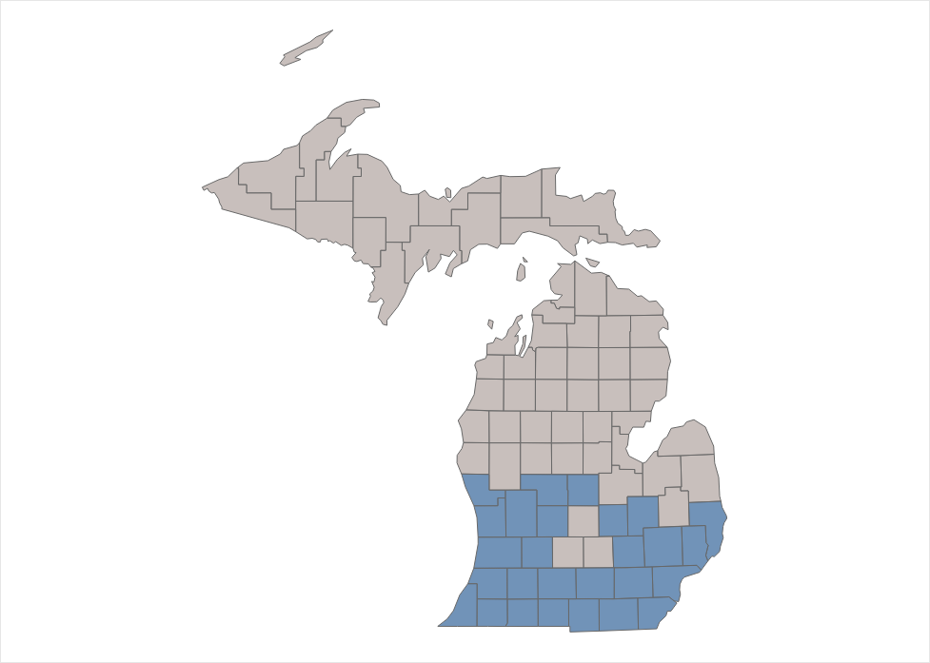
Blue Cross Blue Shield of Michigan | 2027 Product Sales Deck
Secure
4.5 Star CMS Rating
Premium
$0
Specialist Office Visit | $45
Urgent Care Copay | $0 - $40
Emergency Room | $130
Inpatient Hospital (days 1-7) | $375
Outpatient & Diagnostic Services | $0 - $400
Maximum Out Of Pocket | $7,000
Prescriptions (Preferred Pharmacy)
Tier 1 (Preferred Generic) Copay | $0
Tier 2 (Generic) Copay | $7
Tier 3-5 Copay | Subject to deductible and coinsurance
Deductible | $435 (Tier 3-5)
Deductible
$100
Primary Care
$0
Supplemental Benefits†
Dental
Preventative & comprehensive allowance
Vision
Annual exam & eyewear allowance
OTC
$25/quarter
Hearing
Annual exam & aid allowance
Fitness
SilverSneakers included
† Optional enhanced buy-up benefits available
Blue Cross Blue Shield of Michigan and Blue Care Network are nonprofit corporations and independent licensees of the Blue Cross and Blue Shield Association.
For training purposes only.
Notes:
Position Secure as a PPO option that keeps the core Blue Cross value story while maintaining local support and supplemental benefits.
Verify premium, county availability, and prescription costs before presenting it as a fit.
Sales cue: use Secure when the member wants PPO flexibility and a balanced benefit package.
Transition to Value as another PPO choice.

Slide 19
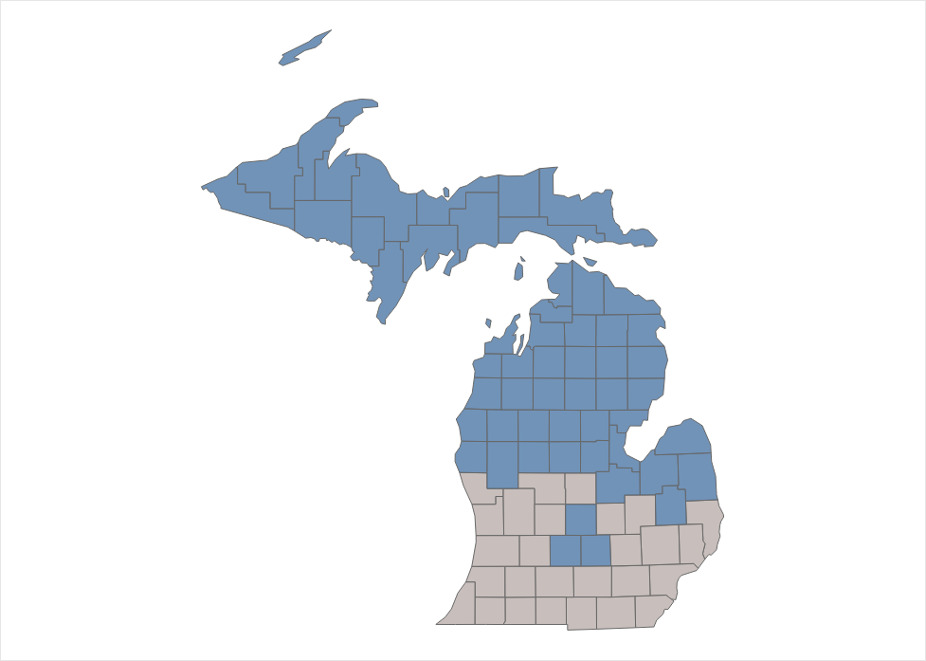
Blue Cross Blue Shield of Michigan | 2027 Product Sales Deck
Value
4.5 Star CMS Rating
Premium
$0
Specialist Office Visit | $50
Urgent Care Copay | $0 - $50
Emergency Room | $130
Inpatient Hospital (days 1-7) | $430
Outpatient & Diagnostic Services | $0 - $400
Maximum Out Of Pocket | $6,750
Prescriptions (Preferred Pharmacy)
Tier 1 (Preferred Generic) Copay | $2
Tier 2 (Generic) Copay | $7
Tier 3-5 Copay | Subject to deductible and coinsurance
Deductible | $700 (Tier 2-5)
Deductible
$525
Primary Care
$0
Supplemental Benefits†
Dental
Preventative & comprehensive allowance
Vision
Annual exam & eyewear allowance
OTC
$25/quarter
Hearing
Annual exam & aid allowance
Fitness
SilverSneakers included
† Optional enhanced buy-up benefits available
Blue Cross Blue Shield of Michigan and Blue Care Network are nonprofit corporations and independent licensees of the Blue Cross and Blue Shield Association.
For training purposes only.
Notes:
Position Value as a PPO option for members who prioritize lower monthly premium and are comfortable understanding deductible tradeoffs.
Be clear that deductible, copays, and drug costs should be modeled together to estimate total cost.
Sales cue: ask how often the member expects to use specialist, imaging, or outpatient services.
Transition to Vitality.

Slide 20
Blue Cross Blue Shield of Michigan | 2027 Product Sales Deck
Vitality
4.5 Star CMS Rating
Premium
$57.50 – $92.70
Specialist Office Visit | $30
Urgent Care Copay | $0 - $50
Emergency Room | $130
Inpatient Hospital (days 1-7) | $250
Outpatient & Diagnostic Services | $0 - $220
Maximum Out Of Pocket | $5,000
Prescriptions (Preferred Pharmacy)
Tier 1 (Preferred Generic) Copay | $0
Tier 2 (Generic) Copay | $5
Tier 3-5 Copay | Subject to deductible and coinsurance
Deductible | $250 (Tier 3-5)
Deductible
$0
Primary Care
$0
Supplemental Benefits†
Dental
Preventative & comprehensive allowance
Vision
Annual exam & eyewear allowance
OTC
$40/quarter
Hearing
Annual exam & aid allowance
Fitness
SilverSneakers included
† Optional enhanced buy-up benefits available
Blue Cross Blue Shield of Michigan and Blue Care Network are nonprofit corporations and independent licensees of the Blue Cross and Blue Shield Association.
For training purposes only.
Notes:
Position Vitality as a PPO option that may balance premium, medical cost sharing, and supplemental benefits.
Reconfirm county availability and the member's providers before narrowing.
Sales cue: this can be a good comparison point when the member wants extras without jumping immediately to the highest premium option.
Transition to HMO and HMO-POS plans.

Slide 21
Blue Cross Blue Shield of Michigan | 2027 Product Sales Deck
Giveback
4.5 Star CMS Rating
Premium
$0 ($50 Giveback)
Specialist Office Visit | $55
Urgent Care Copay | $0 - $40
Emergency Room | $115
Inpatient Hospital (days 1-7) | $385
Outpatient & Diagnostic Services | $0 - $425
Maximum Out Of Pocket | $9,250
Prescriptions (Preferred Pharmacy)
Tier 1 (Preferred Generic) Copay | $0
Tier 2 (Generic) Copay | $0*
Tier 3-5 Copay | Subject to deductible and coinsurance
Deductible | $600 (Tier 3-5)
Deductible
$650
Primary Care
$0
Supplemental Benefits†
Dental
Preventative allowance
Vision
Annual exam & eyewear allowance
Hearing
Annual exam & aid allowance
*Copay as low as $0 with a 90-day supply at a preferred pharmacy
† Optional enhanced buy-up benefits available
Blue Cross Blue Shield of Michigan and Blue Care Network are nonprofit corporations and independent licensees of the Blue Cross and Blue Shield Association.
For training purposes only.

Slide 22
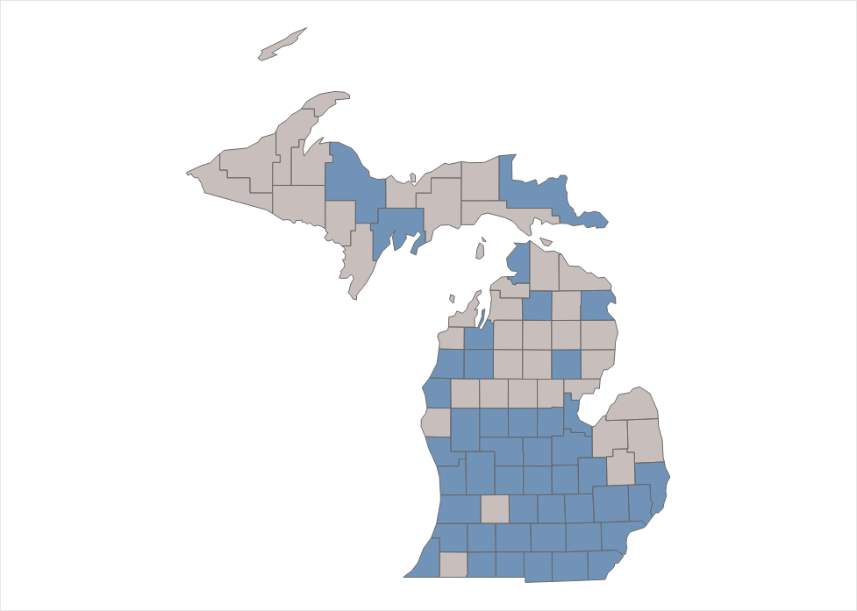
Blue Cross Blue Shield of Michigan | 2027 Product Sales Deck
Meijer
4.5 Star CMS Rating
Premium
$45
Specialist Office Visit | $50
Urgent Care Copay | $0 - $50
Emergency Room | $130
Inpatient Hospital (days 1-7) | $360
Outpatient & Diagnostic Services | $0 - $375
Maximum Out Of Pocket | $6,750
Prescriptions (Preferred Pharmacy)
Tier 1 (Preferred Generic) Copay | $0
Tier 2 (Generic) Copay | $7
Tier 3-5 Copay | Subject to deductible and coinsurance
Deductible | $400 (Tier 3-5)
Deductible
$0
Primary Care
$0
Supplemental Benefits†
Dental
Preventative & comprehensive allowance
Vision
Annual exam & eyewear allowance
OTC
$75/quarter
Hearing
Annual exam & aid allowance
Fitness
SilverSneakers included
*Copay as low as $0 with a 90-day supply at a preferred pharmacy
† Optional enhanced buy-up benefits available
Blue Cross Blue Shield of Michigan and Blue Care Network are nonprofit corporations and independent licensees of the Blue Cross and Blue Shield Association.
For training purposes only.

Slide 23
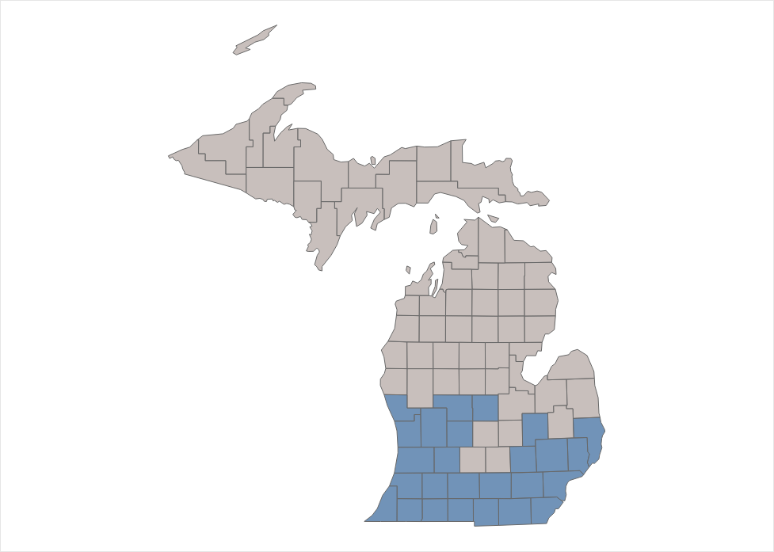
Blue Cross Blue Shield of Michigan | 2027 Product Sales Deck
Essential
4.5 Star CMS Rating
Premium
$35.80 – $41.00
Specialist Office Visit | $45
Urgent Care Copay | $0 - $50
Emergency Room | $130
Inpatient Hospital (days 1-7) | $350
Outpatient & Diagnostic Services | $0 - $350
Maximum Out Of Pocket | $7,150
Prescriptions (Preferred Pharmacy)
Tier 1 (Preferred Generic) Copay | $0
Tier 2 (Generic) Copay | $5
Tier 3-5 Copay | Subject to deductible and coinsurance
Deductible | $400 (Tier 3-5)
Deductible
$0
Primary Care
$0
Supplemental Benefits†
Dental
Preventative & comprehensive allowance
Vision
Annual exam
† Optional enhanced buy-up benefits available
Blue Cross Blue Shield of Michigan and Blue Care Network are nonprofit corporations and independent licensees of the Blue Cross and Blue Shield Association.
For training purposes only.

Slide 24
Blue Cross Blue Shield of Michigan | 2027 Product Sales Deck
Signature
4.5 Star CMS Rating
Premium
$120 – $168
Specialist Office Visit | $30
Urgent Care Copay | $0 - $50
Emergency Room | $130
Inpatient Hospital (days 1-7) | $250
Outpatient & Diagnostic Services | $0 - $205
Maximum Out Of Pocket | $4,300
Prescriptions (Preferred Pharmacy)
Tier 1 (Preferred Generic) Copay | $0
Tier 2 (Generic) Copay | $5
Tier 3-5 Copay | Subject to deductible and coinsurance
Deductible | $200 (Tier 3-5)
Deductible
$0
Primary Care
$0
Supplemental Benefits†
Dental
Preventative & comprehensive allowance
Vision
Annual exam & eyewear allowance
OTC
$50/quarter
Hearing
Annual exam & aid allowance
Fitness
SilverSneakers included
† Optional enhanced buy-up benefits available
Blue Cross Blue Shield of Michigan and Blue Care Network are nonprofit corporations and independent licensees of the Blue Cross and Blue Shield Association.
For training purposes only.

Slide 25

HMO and
HMO-POS Plans
at a Glance
Notes:
Use this section divider to introduce the HMO and HMO-POS family.
Explain that these plans may appeal to members comfortable with a coordinated network model and PCP-centered care.
Set expectations that provider participation and service area are especially important in this section.

Slide 26
Blue Cross Blue Shield of Michigan | 2027 Product Sales Deck
Our Medicare Advantage HMO/HMO-POS plans snapshot
Plan | Premium | Giveback amount | Deductible | PCP | Specialist | OTC / quarter
Elements | - | $20 | $0 | $0 | $35 | $50
Classic | $93.00–$145.00 | - | $0 | $0 | $30 | $30
Prestige | $194.00–$282.00 | - | $0 | $0 | $25 | $50
Prime Value | $39.30–$48.00 | - | $0 | $0 | $35 | N/A
Plan
Premium
Deductible
PCP
Specialist
OTC / quarter
Plan | Premium | Giveback amount | Deductible | PCP | Specialist | OTC / quarter
Connected Care HMO | $50 | $0 | $0 | $0 | $35 | $25
Based on currently available 2026 plan information in this deck; values vary by plan and county.
Blue Cross Blue Shield of Michigan and Blue Care Network are nonprofit corporations and independent licensees of the Blue Cross and Blue Shield Association.
For training purposes only.
Notes:
Walk through the HMO/HMO-POS comparison using the same cost categories: premium, deductible, PCP, specialist, and OTC.
Clarify that the second mini-table separates Connected Care HMO from the HMO-POS options.
Sales cue: ask whether the member is comfortable staying in network and using a PCP relationship for care coordination.
Use the grid to decide which HMO/HMO-POS plan detail slide to review next.

Slide 27
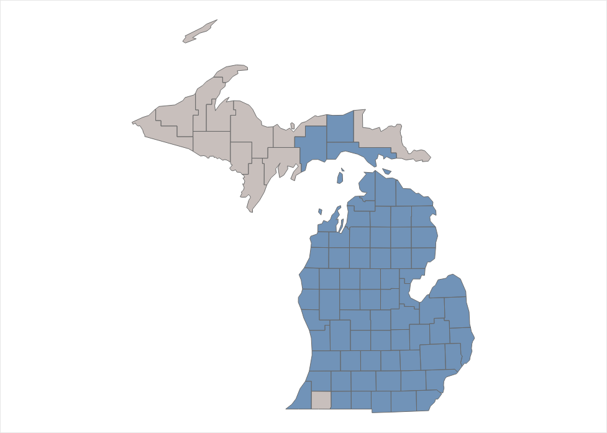
Blue Cross Blue Shield of Michigan | 2027 Product Sales Deck
Elements
4.5 Star CMS Rating
Giveback amount
$20 (no premium)
Specialist Office Visit | $35
Urgent Care Copay | $0 - $45
Emergency Room | $130
Inpatient Hospital (days 1-7) | $250
Outpatient & Diagnostic Services | $0 - $200
Maximum Out Of Pocket | $4,500
Prescriptions (Preferred Pharmacy)
Tier 1 (Preferred Generic) Copay | -
Tier 2 (Generic) Copay | -
Tier 3-5 Copay | -
Deductible | -
Deductible
$0
Primary Care
$0
Supplemental Benefits†
Dental
Preventative & comprehensive allowance
Vision
Annual exam & eyewear allowance
OTC
$50/quarter
Hearing
Annual exam & aid allowance
Fitness
SilverSneakers included
† Optional enhanced buy-up benefits available
Blue Cross Blue Shield of Michigan and Blue Care Network are nonprofit corporations and independent licensees of the Blue Cross and Blue Shield Association.
For training purposes only.
Notes:
Position HMO-POS Elements as an accessible plan option with the core Blue Cross benefits shown here.
Verify county, PCP, specialists, pharmacies, and referral expectations with the member.
Sales cue: this may fit members who want a lower-premium HMO-POS style plan and are comfortable with network rules.
Transition to Classic for comparison.

Slide 28
Blue Cross Blue Shield of Michigan | 2027 Product Sales Deck
Classic
4.5 Star CMS Rating
Premium
$107.00 – $158.00
Specialist Office Visit | $30
Urgent Care Copay | $0 - $40
Emergency Room | $130
Inpatient Hospital (days 1-7) | $250
Outpatient & Diagnostic Services | $0 - $225
Maximum Out Of Pocket | $4,800
Prescriptions (Preferred Pharmacy)
Tier 1 (Preferred Generic) Copay | $0
Tier 2 (Generic) Copay | $7
Tier 3-5 Copay | Subject to deductible and coinsurance
Deductible | $200 (Tier 3-5)
Deductible
$0
Primary Care
$0
Supplemental Benefits†
Dental
Preventative & comprehensive allowance
Vision
Annual exam & eyewear allowance
OTC
$30/quarter
Hearing
Annual exam & aid allowance
Fitness
SilverSneakers included
0
† Optional enhanced buy-up benefits available
Blue Cross Blue Shield of Michigan and Blue Care Network are nonprofit corporations and independent licensees of the Blue Cross and Blue Shield Association.
For training purposes only.
Notes:
Position HMO-POS Classic as a step-up comparison point in the HMO-POS lineup.
Explain that higher premium should be evaluated against the member's expected care and benefit preferences.
Sales cue: ask whether specialist copays, OTC allowance, and supplemental benefits are meaningful to the member.
Transition to Prestige.

Slide 29
Blue Cross Blue Shield of Michigan | 2027 Product Sales Deck
Prestige
4.5 Star CMS Rating
Premium
$194.00 – $282.00
Specialist Office Visit | $25
Urgent Care Copay | $0 - $35
Emergency Room | $130
Inpatient Hospital (days 1-7) | $200
Outpatient & Diagnostic Services | $0 - $200
Maximum Out Of Pocket | $4,400
Prescriptions (Preferred Pharmacy)
Tier 1 (Preferred Generic) Copay | $0
Tier 2 (Generic) Copay | $5
Tier 3-5 Copay | Subject to deductible and coinsurance
Deductible | $100 (Tier 3-5)
Deductible
$0
Primary Care
$0
Supplemental Benefits†
Dental
Preventative & comprehensive allowance
Vision
Annual exam & eyewear allowance
OTC
$50/quarter
Hearing
Annual exam & aid allowance
Fitness
SilverSneakers included
† Optional enhanced buy-up benefits available
Blue Cross Blue Shield of Michigan and Blue Care Network are nonprofit corporations and independent licensees of the Blue Cross and Blue Shield Association.
For training purposes only.
Notes:
Position HMO-POS Prestige as a richer HMO-POS option for members who value the plan's overall benefit package.
Avoid assuming it is best because of premium; compare total expected cost and provider fit.
Sales cue: this may resonate with members who prefer a more comprehensive package and have predictable network usage.
Transition to Prime Value.

Slide 30

Blue Cross Blue Shield of Michigan | 2027 Product Sales Deck
Prime Value
4.5 Star CMS Rating
Premium
$39.30 – $48.00
Specialist Office Visit | $35
Urgent Care Copay | $0 - $45
Emergency Room | $130
Inpatient Hospital (days 1-7) | $350
Outpatient & Diagnostic Services | $0 - $375
Maximum Out Of Pocket | $6,000
Prescriptions (Preferred Pharmacy)
Tier 1 (Preferred Generic) Copay | $0
Tier 2 (Generic) Copay | $0
Tier 3-5 Copay | Subject to deductible and coinsurance
Deductible | $600 (Tier 3-5)
Deductible
$0
Primary Care
$0
Supplemental Benefits†
Dental
Preventative & comprehensive allowance
Vision
Annual exam
† Optional enhanced buy-up benefits available
Blue Cross Blue Shield of Michigan and Blue Care Network are nonprofit corporations and independent licensees of the Blue Cross and Blue Shield Association.
For training purposes only.
Notes:
Position HMO-POS Prime Value as a specific-fit option and call out that some extras may differ, such as OTC availability.
Verify the member's county and PCP before discussing it as a viable choice.
Sales cue: ask whether the premium level or provider access is the stronger decision driver.
Transition to Connected Care.

Slide 31
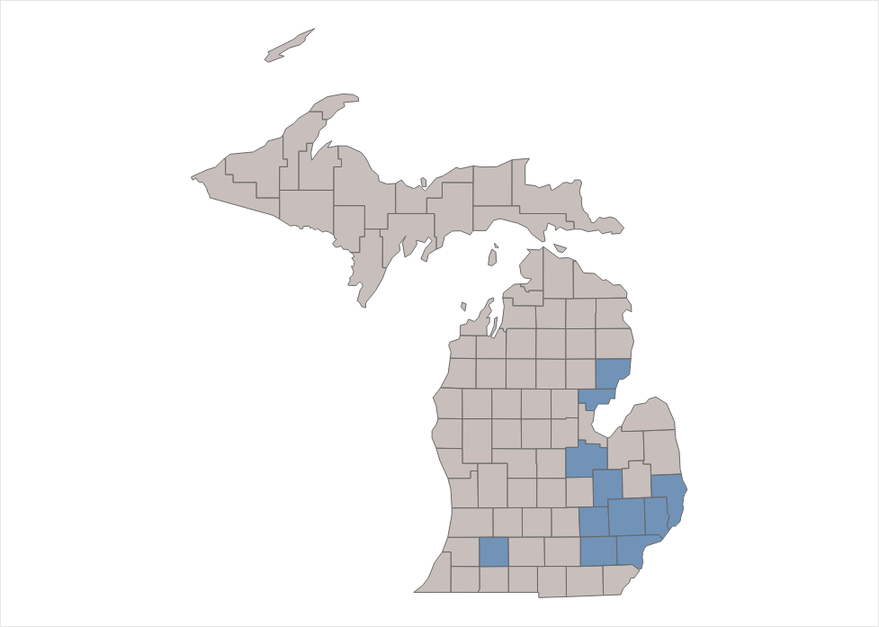
Blue Cross Blue Shield of Michigan | 2027 Product Sales Deck
ConnectedCare
4.5 Star CMS Rating
Premium
$50
Specialist Office Visit | $35
Urgent Care Copay | $0 - $45
Emergency Room | $130
Inpatient Hospital (days 1-7) | $325
Outpatient & Diagnostic Services | $0 - $225
Maximum Out Of Pocket | $4,800
Prescriptions (Preferred Pharmacy)
Tier 1 (Preferred Generic) Copay | $0
Tier 2 (Generic) Copay | $0
Tier 3-5 Copay | Subject to deductible and coinsurance
Deductible | $100 (Tier 3-5)
Deductible
$0
Primary Care
$0
Supplemental Benefits†
Dental
Preventative & comprehensive allowance
Vision
Annual exam & eyewear allowance
OTC
$25/quarter
Hearing
Annual exam & aid allowance
Fitness
SilverSneakers included
† Optional enhanced buy-up benefits available
Blue Cross Blue Shield of Michigan and Blue Care Network are nonprofit corporations and independent licensees of the Blue Cross and Blue Shield Association.
For training purposes only.
Notes:
Position HMO-POS Connected Care as a network-coordinated option with the benefits shown.
Emphasize that confirming doctors, hospitals, pharmacies, and referral expectations is essential.
Sales cue: this can be a fit for members who prefer a structured care model and local support.
Transition to additional coverage options.

Slide 32

Medicare Advantage Extras
Notes:
Open by framing this as comparison, not new teaching — you've already walked them through each plan, so now you're just lining the extras up side-by-side.
Before you open a grid, confirm whether they're PPO or HMO/HMO-POS so you land on one table, not both. Once you're there, skip the full narration: point to only the 2-3 columns that fit their county and providers, ask which benefit matters most to them, and trace just that row, translating jargon as you go — PERS, for instance, just means the medical alert button.
Treat the whole section as helping them confirm a decision they're already leaning toward, not teaching them something new.

Slide 33
Blue Cross Blue Shield of Michigan | 2027 Product Sales Deck
High-level supplement benefits by plan: PPO
Supplemental Benefit |  | Assure | Signature | Vitality | Meijer | Essential | Giveback | Secure | Value
 | Eyewear | ✓ | ✓ | ─ | ✓ | ─ | ─ | ✓ | ─
 | Hearing Aids | ✓ | ✓ | ✓ | ✓ | ─ | ✓ | ✓ | ✓
 | Fitness (SilverSneakers) | ✓ | ✓ | ✓ | ✓ | ─ | ─ | ✓ | ✓
 | OTC/Food and Produce | ✓ | ✓ | ✓ | ✓ | ─ | ─ | ✓ | ✓
 | Home-Delivered Meals | ✓ | ✓ | ✓ | ✓ | ─ | ─ | ✓ | ✓
 | PERS | ─ | ─ | ─ | ─ | ─ | ─ | ─ | ─
 | Mobile Mental Health | ✓ | ✓ | ✓ | ✓ | ✓ | ✓ | ─ | ─
 | Ambulance No Transport | ✓ | ✓ | ✓ | ✓ | ✓ | ✓ | ─ | ─
 | Routine Chiropractic | ✓ | ✓ | ✓ | ─ | ─ | ─ | ─ | ─
Legend: ✓ Included — Not included
Blue Cross Blue Shield of Michigan and Blue Care Network are nonprofit corporations and independent licensees of the Blue Cross and Blue Shield Association.
For training purposes only.

Slide 34
Blue Cross Blue Shield of Michigan | 2027 Product Sales Deck
High-level supplement benefits by plan: HMO / HMO-POS
 | Supplemental Benefit | Prestige | Classic | Connected Care | Prime Value | Elements
 | Eyewear | ✓ | ✓ | ─ | ─ | ✓
 | Hearing Aids | ✓ | ✓ | ✓ | ─ | ✓
 | Fitness (SilverSneakers) | ✓ | ✓ | ✓ | ─ | ✓
 | OTC/Food and Produce | ✓ | ✓ | ✓ | ─ | ✓
 | Home-Delivered Meals | ✓ | ✓ | ✓ | ─ | ✓
 | PERS | ✓ | ✓ | ─ | ─ | ─
 | Mobile Mental Health | ✓ | ✓ | ✓ | ✓ | ✓
 | Ambulance No Transport | ✓ | ✓ | ✓ | ✓ | ✓
 | Routine Chiropractic | ✓ | ✓ | ✓ | ─ | ✓
Legend: ✓ Included — Not included
Blue Cross Blue Shield of Michigan and Blue Care Network are nonprofit corporations and independent licensees of the Blue Cross and Blue Shield Association.
For training purposes only.

Slide 35
Blue Cross Blue Shield of Michigan | 2027 Product Sales Deck
See more to smile about | Extra Dental and Vision
Medicare Advantage Optional Supplemental Buy-up (OSB)
PPO
HMO / HMO-POS
$27.10
$26.60
Blue Cross Blue Shield of Michigan and Blue Care Network are nonprofit corporations and independent licensees of the Blue Cross and Blue Shield Association.
For training purposes only.
Notes:
Explain the optional dental and vision buy-up as an additional monthly premium for members who want more coverage.
Point out availability differences, including the Prime Value limitation shown on the slide.
Sales cue: ask about expected dental work, eyewear needs, and whether the extra premium is worth the added coverage.
Transition to prescription drug plan options.

Slide 36

Blue Cross Medicare Supplement Plans
at a Glance
SM
Notes:
Use this divider to introduce Medicare Supplement as a different path from Medicare Advantage.
Explain that Medicare Supplement works with Original Medicare and may pair with separate Part D coverage.
Set the expectation that the next section is about fit, provider flexibility, and enrollment status.

Slide 37
SM
Blue Cross Blue Shield of Michigan | 2027 Product Sales Deck
Medicare Supplement fit checklist
No network restrictions
+ Nationwide coverage helpful for snowbirds and frequent travelers
+ Helps lower out-of-pocket costs
+ Optional Dental Vision Hearing Package for an additional premium
+ Well-Being Program resources
+ Keep your own doctor, as long as they accept Original Medicare
+ Cover all or a portion of Original Medicare deductibles and coinsurances
Use any provider who accepts Original Medicare.
No specialist referrals
See specialists who accept Original Medicare.
10%
household
discount
Get a 10% household discount on your monthly premium when you and another person in your home choose a Blue Cross Medicare Supplement plan.
Reminder: Medicare Supplement plans do not include Part D prescription drug coverage.
Blue Cross Blue Shield of Michigan and Blue Care Network are nonprofit corporations and independent licensees of the Blue Cross and Blue Shield Association.
For training purposes only.
Notes:
Lead with the core Medicare Supplement value: no network restrictions, no specialist referrals, and potential household discount.
Clarify that Medicare Supplement does not include Part D, so prescription drug coverage must be addressed separately.
Sales cue: this option may appeal to members who travel, see many specialists, or value provider flexibility.
Mention the household discount only after confirming eligibility and application requirements.

Slide 38
Blue Cross Blue Shield of Michigan | 2027 Product Sales Deck
Medicare Supplement fit checklist
Questions to think through as you compare
Access
Do your doctors and specialists accept Original Medicare?
Premiums
What monthly premium range is comfortable for you?
Enrollment status
Are you in a guaranteed issue window, or will health questions apply?
Prescription drugs
Will you need a separate Part D prescription drug plan?
Optional package
Would the Dental Vision Hearing Package add value for you?
Discounts
Could the 10% household discount apply to you?
Thinking through these questions will help you decide whether Blue Cross Medicare Supplement plans fit your situation.
Blue Cross Blue Shield of Michigan and Blue Care Network are nonprofit corporations and independent licensees of the Blue Cross and Blue Shield Association.
For training purposes only.
Notes:
Use the checklist as a structured discovery tool before quoting a supplement plan.
Confirm doctor acceptance of Original Medicare, budget, guaranteed issue status, drug needs, optional package interest, and possible discounts.
Sales cue: if the member is outside a guaranteed issue window, explain that underwriting may affect eligibility and timing.
Transition to guaranteed versus nonguaranteed issue.

Slide 39
Blue Cross Blue Shield of Michigan | 2027 Product Sales Deck
Guaranteed issue vs. nonguaranteed issue
When you apply affects your eligibility and your premium.
Guaranteed issue
Nonguaranteed issue
Applies during the six-month Medigap open enrollment period or under special circumstances. Applicants can’t be denied coverage and generally aren’t required to answer health questions.
Applies when the applicant is outside a guaranteed issue window. Medical underwriting may apply, and the applicant may need to answer health questions.
Rates are based on age, gender and geography.
Decision point: Confirm your enrollment window before comparing premiums — your agent can help you check.
Blue Cross Blue Shield of Michigan and Blue Care Network are nonprofit corporations and independent licensees of the Blue Cross and Blue Shield Association.
For training purposes only.
Notes:
Explain guaranteed issue as the window where the applicant generally cannot be denied, and nonguaranteed issue as the path where underwriting may apply.
Keep this factual and avoid promising approval.
Sales cue: confirm the member's Part B effective date and any qualifying special circumstances before discussing premium expectations.
Transition to the optional Dental Vision Hearing Package.

Slide 40
Blue Cross Blue Shield of Michigan | 2027 Product Sales Deck
Dental Vision Hearing package
Consolidated overview of what you can add and when you can enroll
$37.75
$0
$0
$250
additional monthly premium
dental exams, cleanings, X-rays and fluoride
hearing exam every 12 months
allowance for contacts or frames
Premium subject to change annually.
In-network preventive services.
Savings at TruHearing® providers.
Every calendar year for in-network services.
Enrollment timing
Network support
New members can add the package at enrollment or within 30 days of their effective date. Current members can add it each year Feb. 1 through April 30.
Dental network and vision/hearing vendor details remain available in the appendix benefit tables.
Blue Cross Blue Shield of Michigan and Blue Care Network are nonprofit corporations and independent licensees of the Blue Cross and Blue Shield Association.
For training purposes only.
Notes:
Position the Dental Vision Hearing Package as an optional add-on for Medicare Supplement members who want additional nonmedical benefits.
Explain the monthly premium, preventive dental, hearing exam, enrollment timing, and network support at a high level.
Sales cue: ask whether the member expects dental, eyewear, or hearing needs that could make the package valuable.
Remind them that package details and timing should be verified before enrollment.

Slide 41

Blue Cross Blue Shield of Michigan | 2027 Product Sales Deck
Exclusive services you can use after enrollment
Help is always close by — from real nurses to everyday discounts.
24-Hour Nurse Line
Registered nurses can answer questions and help with at-home treatment decisions.
Virtual Well-Being℠
Webinars and resources that support ongoing health and well-being.
Blue365® deals
Discounts on popular products & memberships, including:
Fitness & health: Garmin®, Fitbit®, Oura®, Tivity Health®, Aaptiv®
Travel: Walt Disney World® Resort, Universal Orlando Resort™, Hertz®
Lifestyle: Skechers®, Allbirds®, Philips Sonicare®
Blue Cross Blue Shield of Michigan and Blue Care Network are nonprofit corporations and independent licensees of the Blue Cross and Blue Shield Association.
Garmin®, Fitbit®, Oura®, Tivity Health®, Aaptiv®, Walt Disney World® Resort, Universal Orlando Resort™, Hertz®, Budget®, Skechers®, Allbirds®, and Philips Sonicare® are trademarks or registered trademarks of their respective owners.
Blue365® offers are provided by independent vendors. Blue Cross Blue Shield of Michigan and Blue Care Network do not endorse or guarantee the products or services offered by Blue365 vendors. Offers are subject to change and may vary by location and eligibility.
For training purposes only.
Notes:
Position these resources as part of the post-enrollment value of Blue Cross.
Highlight the 24-Hour Nurse Line, well-being resources, discounts, and digital account tools.
Sales cue: reassure the member that support continues after enrollment and that the agent can help them know where to go.
Transition to the online account.

Slide 42

Blue Cross Blue Shield of Michigan | 2027 Product Sales Deck
Managing your plan
Your online member account and BCBSM mobile app put your plan at your fingertips.
Online Member Account
Available from a smartphone, tablet or computer.
Register at bcbsm.com or download the BCBSM app to get started.
Find providers and pharmacies
Search participating doctors, hospitals and preferred pharmacies.
View plan coverage
Check premiums, copays, deductibles and out-of-pocket balances.
Use a virtual ID card
Access member ID information from the app.
Track claims and statements
Review claims, explanation of benefits and statements.
Blue Cross Blue Shield of Michigan and Blue Care Network are nonprofit corporations and independent licensees of the Blue Cross and Blue Shield Association.
For training purposes only.
Notes:
Frame the online account as a convenience tool for managing coverage, providers, ID cards, claims, and plan details.
Do not turn this into a technical demo unless the member asks.
Sales cue: ask whether the member prefers mobile, computer, phone support, or paper materials so you can tailor the follow-up.
Transition to Medicare Supplement options.

Slide 43

PDP Plans
at a Glance
Notes:
Use this divider to move beyond core medical plan comparisons.
Explain that some members may want optional benefits or separate drug coverage, depending on the plan and coverage path.
Set up the next slides as add-on or adjacent choices, not automatic recommendations.

Slide 44
Blue Cross Blue Shield of Michigan | 2027 Product Sales Deck
Access to medications | PDP Plans
PDP Plan Premiums
PDP Select
PDP Premium
$49.80
$80.30
Tier 1: $2
Tier 2: $5
Tier 3: 23%
Tier 4: 25%
Tier 5: 25%
Tier 1: $1
Tier 2: $5
Tier 3: 25%
Tier 4: 26%
Tier 5: 31%
$700
$125
Deductible
Deductible
Blue Cross Blue Shield of Michigan and Blue Care Network are nonprofit corporations and independent licensees of the Blue Cross and Blue Shield Association.
For training purposes only.
Notes:
Present PDP Select and PDP Premium as separate prescription drug plan choices when a standalone Part D plan is needed.
Compare premium and deductible at a high level, then explain that the real decision depends on the member's medications and pharmacy.
Sales cue: run the drug list instead of relying only on premium.
Transition to how out-of-pocket costs work.

Slide 45

Next Steps
Notes:
Use this divider to move from education into action.
Signal that the next step is not pressure to enroll, but a structured review of the member's personal information.
Prepare the member for what you will need to verify before a recommendation.

Slide 46


Blue Cross Blue Shield of Michigan | 2027 Product Sales Deck
Ready to enroll?
Your Blue Cross–authorized independent agent can help you:
+ Confirm doctors, hospitals and pharmacies
+ Review prescription drugs and estimated costs
+ Compare monthly premium and expected out-of-pocket costs
+ Complete enrollment when you are ready
Agent contact
<Name / phone / email
(add before presenting)>
Bring your doctor list, prescriptions and preferred pharmacy to the next conversation.
Your healthcare needs can change over time. Your agent can help you now and in the future.
Blue Cross Blue Shield of Michigan and Blue Care Network are nonprofit corporations and independent licensees of the Blue Cross and Blue Shield Association.
For training purposes only.
Notes:
Close with a clear, compliant next step: confirm doctors, hospitals, pharmacies, prescriptions, premiums, and expected out-of-pocket costs.
Invite the member to provide or update the agent contact information before presenting.
Sales cue: ask for permission to schedule the next conversation or complete enrollment only when the member is ready.
Reinforce that the agent remains a resource after enrollment.

Slide 47

Appendix
Notes:
Use this as a transition into reference materials.
Tell the audience the appendix is available for deeper questions and documentation support.
Do not present every appendix slide unless it helps answer a specific member need.

Slide 48
Blue Cross Blue Shield of Michigan | 2027 Product Sales Deck
Optional Supplemental Dental + Vision
An add-on package — not base plan premium — for Medicare Advantage PPO members
$27.10
$1,500
$250
additional monthly premium
additional dental maximum
optional vision maximum
Shown separately from base plan premium.
In addition to embedded dental value where applicable.
For eligible PPO plan options; review plan-specific details.
Good to know: This premium is in addition to your base plan premium, and these benefits add to any dental and vision coverage already built into your plan.
Source: 2026 Medicare Plus Blue PPO Summary of Benefits; plan eligibility and benefits vary.
Blue Cross Blue Shield of Michigan and Blue Care Network are nonprofit corporations and independent licensees of the Blue Cross and Blue Shield Association.
For training purposes only.

Slide 49
Blue Cross Blue Shield of Michigan | 2027 Product Sales Deck
Medicare Advantage plans dental details
 |  | Prime Value HMO | Essential PPO | Giveback PPO Value PPO | Meijer PPO Secure PPO | HMO: Elements, Classic, Prestige, ConnectedCare PPO: Assure, Signature, Vitality
Preventive | $0 for 2 oral exams every year | Embedded coverage at 100% | Embedded coverage at 100% | Embedded coverage at 100% | Embedded coverage at 100% | Embedded coverage at 100%
 | $0 for 2 cleanings (routine or periodontal)
 | $0 for one fluoride treatment every year
 | $0 for bitewing or periapical X-rays every 2 years
Comprehensive | $0 for resin and amalgam fillings every 48 months | Embedded coverage $950 annual coverage limit | Embedded coverage $950 annual coverage limit | Optional buy-up $1,500 annual coverage limit $30.50 monthly premium | Embedded coverage $1,000 annual coverage limit | Embedded coverage $1,500 annual coverage limit
 | $0 for crowns every 84 months
 | $0 for root canals, once per tooth per lifetime
 | $0 for deep cleaning every 24 months
 | $0 for simple extractions, once per tooth per lifetime
 | $0 for oral surgery, twice per tooth per lifetime
 | 25% for onlays | Not offered | Optional buy-up $1,500 annual coverage limit $30.50 monthly premium |  | Optional buy-up $1,500 annual coverage limit $30.50 monthly premium | Optional buy-up $1,500 annual coverage limit $17.90 (HMO) $30.50 (PPO) monthly premium
 | 25% for periodontal surgery
 | 25% for dentures
 | 25% for bridges
 | 25% for implants
 | 25% for anesthesia and consultation exams
Blue Cross Blue Shield of Michigan and Blue Care Network are nonprofit corporations and independent licensees of the Blue Cross and Blue Shield Association.
For training purposes only.

Slide 50
Blue Cross Blue Shield of Michigan | 2027 Product Sales Deck
Medicare Advantage plan service areas
Service area 1 | Allegan, Barry, Ionia, Kalamazoo, Mason, Muskegon, Newaygo, Oceana, Ottawa
Service area 2 | Berrien, Branch, Calhoun, Eaton, Gratiot, Hillsdale, Ingham, Jackson, Monroe, Montcalm, St. Joseph, Van Buren
Service area 3 | Alcona, Alger, Alpena, Arenac, Baraga, Bay, Charlevoix, Cheboygan, Chippewa, Clare, Crawford, Gladwin, Huron, Iosco, Kalkaska, Keweenaw, Luce, Mackinac, Montmorency, Ogemaw, Ontonagon, Oscoda, Presque Isle, Roscommon, Saginaw, Sanilac, Schoolcraft, Shiawassee, Tuscola
Service area 4 | Antrim, Benzie, Cass, Clinton, Delta, Dickinson, Emmet, Genesee, Gogebic, Grand Traverse, Houghton, Iron, Isabella, Kent, Lake, Lapeer, Leelanau, Lenawee, Livingston, Manistee, Marquette, Mecosta, Menominee, Midland, Missaukee, Osceola, Otsego, St. Clair, Wexford
Service area 6 | Macomb, Oakland, Washtenaw, Wayne
 | All 83 Michigan counties
Blue Cross Blue Shield of Michigan and Blue Care Network are nonprofit corporations and independent licensees of the Blue Cross and Blue Shield Association.
For training purposes only.
Notes:
Use this slide only when service area questions come up.
Confirm plan availability by county before discussing any plan as an option.
Sales cue: ask for the member's residential county and any alternate address or travel pattern that could affect plan fit.

Slide 51
Blue Cross Blue Shield of Michigan | 2027 Product Sales Deck
Blue Cross Medicare Supplement plans
Plans C, F and high-deductible F cover the Part B deductible and are only available to those who have Medicare start dates before Jan. 1, 2020.
Features | Plan A | Plan C | Plan D | Plan F | High-deductible Plan F* | Plan G | High-deductible Plan G* | Plan N**
Medicare Part A coinsurance and hospital costs up to an additional 365 days after Medicare benefits are used up | ✓ | ✓ | ✓ | ✓ | ✓ | ✓ | ✓ | ✓
Medicare Part B coinsurance or copayment | ✓ | ✓ | ✓ | ✓ | ✓ | ✓ | ✓ | ✓
Blood (first 3 pints) | ✓ | ✓ | ✓ | ✓ | ✓ | ✓ | ✓ | ✓
Part A hospice care coinsurance or copayment | ✓ | ✓ | ✓ | ✓ | ✓ | ✓ | ✓ | ✓
Skilled nursing facility care coinsurance |  | ✓ | ✓ | ✓ | ✓ | ✓ | ✓ | ✓
Medicare Part A deductible |  | ✓ | ✓ | ✓ | ✓ | ✓ | ✓ | ✓
Medicare Part B deductible |  | ✓ |  | ✓ | ✓
Medicare Part B excess charges |  |  |  | ✓ | ✓ | ✓ | ✓
Foreign travel emergency*** |  | ✓ | ✓ | ✓ | ✓ | ✓ | ✓ | ✓
* High-deductible plans F and G – benefits are only paid after the beneficiary reaches the annual deductible amount of $2,950 ** Plan N – subject to copayments for certain services (up to $20 for office visits and up to $50 for emergency room) *** Foreign travel emergency care – the member is responsible for a $250 deductible, 20% coinsurance up to a $50,000 lifetime maximum
Members can add the Dental Vision Hearing Package for an additional $37.75 monthly cost. Premium is subject to change each year.
Blue Cross Blue Shield of Michigan and Blue Care Network are nonprofit corporations and independent licensees of the Blue Cross and Blue Shield Association.
For training purposes only.
Notes:
Use this Medicare Supplement appendix slide for eligibility and plan-availability context.
Point out that Plans C, F, and high-deductible F have eligibility tied to Medicare start dates before Jan. 1, 2020.
Sales cue: verify the member's Medicare effective dates before discussing these plan choices.

Slide 52
Blue Cross Blue Shield of Michigan | 2027 Product Sales Deck
2027 Blue Cross MA Plans | PPO Medical Deductible
45
9
Services covered after deductible
Services before deductible
✓ Inpatient hospital (acute)
✓ Inpatient hospital (psychiatric)
✓ Skilled Nursing Facility (SNF)
✓ Cardiac rehabilitation
✓ Intensive cardiac rehabilitation
✓ Pulmonary rehabilitation
✓ SET for PAD services
✓ Partial hospitalization
✓ Intensive outpatient program services
✓ Home health services
✓ Chiropractic services
✓ Occupational therapy
✓ Specialty provider visits
✓ Mental health specialty services
(individual sessions)
✓ Mental health specialty services
(group sessions)
✓ Podiatry
✓ Other health care professional
✓ Psychiatric services (individual sessions)
✓ Psychiatric services (group sessions)
✓ PT / speech-language pathology
✓ Additional telehealth benefits
✓ Opioid treatment program services
✓ Diagnostic procedures/tests
✓ Lab services
✓ Diagnostic radiology
✓ Therapeutic radiology
✓ Outpatient X-ray services
✓ Outpatient hospital services
✓ Observation services
✓ Ambulatory Surgical Center (ASC)
✓ Outpatient substance abuse
(individual sessions)
✓ Outpatient substance abuse (group
sessions)
✓ Outpatient blood services
✓ Ground ambulance
✓ Air ambulance
✓ Durable Medical Equipment (DME)
✓ Prosthetic devices
✓ Medical supplies
✓ Dialysis services
✓ Medicare Part B chemo/radiation drugs
✓ Other Medicare Part B drugs
✓ Medicare dental services
✓ Eye exams
✓ Eyewear
✓ Hearing exams
✓ Primary care physician services
✓ Diabetic supplies
✓ Diabetic therapeutic shoes/inserts
✓ Diabetic monitors
✓ Kidney disease education services
✓ Glaucoma screening
✓ Diabetes self-management training
✓ Digital rectal exams
✓ EKG following Welcome Visit
Summary only — refer to plan documents for questions about specific coverage.
Blue Cross Blue Shield of Michigan and Blue Care Network are nonprofit corporations and independent licensees of the Blue Cross and Blue Shield Association.
For training purposes only.
Notes:
Use this appendix slide when a member asks how the PPO medical deductible works.
Explain that the services on the left are generally covered before the member meets the medical deductible, while the services on the right may apply after the deductible.
Emphasize that this is a summary for discussion only; always verify details against the plan documents and Summary of Benefits.
Call out the practical takeaway: deductible rules can vary by service, so members should not assume every service is handled the same way.

Slide 53

Blue Cross Blue Shield of Michigan | 2027 Product Sales Deck
Medicare Supplement Dental Vision Hearing Package
What’s included as preventive care — and what the optional package adds
Preventive care — included
Dental exams, cleanings, fluoride and X-rays are covered as $0 preventive services at in-network dentists.
No deductible applies to preventive dental services.
Supplemental coverage — added value
Comprehensive services — fillings, root canals, extractions, crowns, repairs and implants — are covered with coinsurance, up to the annual maximum.
Vision and hearing details are on the following pages.
Blue Cross Blue Shield of Michigan and Blue Care Network are nonprofit corporations and independent licensees of the Blue Cross and Blue Shield Association.
For training purposes only.

Slide 54
Blue Cross Blue Shield of Michigan | 2027 Product Sales Deck
Medicare Supplement Dental Vision Hearing Package
Vision services
 | In network¹ | Out of network
Frames or Elective contact lenses | $300 allowance for frames Or Elective contact lenses every 12 months | Frames reimbursed up to $70 or elective contact Lenses reimbursed up to $105 every 12 months
Lenses | Standard lenses* are covered in full every 12 months | Reimbursement every 12 months, up to: Single-vision lenses: $30 Bifocal lenses: $50 Trifocal lenses: $65 Lenticular lenses: $100
Exams | $20 copayment; offered every 12 months | Reimbursed up to $45 every 12 months
*Standard lenses include single vision lenses, bifocal lenses and trifocal lenses.
¹Visit vsp.com to find a VSP® network eye care provider or to find out if your eye care provider participates. VSP is an independent company that provides vision services for Blue Cross members.
Blue Cross doesn't control the third-party websites referred to in this publication and is not responsible for their content.
Blue Cross Blue Shield of Michigan and Blue Care Network are nonprofit corporations and independent licensees of the Blue Cross and Blue Shield Association.
For training purposes only.

Slide 55
Blue Cross Blue Shield of Michigan | 2027 Product Sales Deck
Medicare Supplement Dental Vision Hearing Package
Hearing services
Hearing exam | One exam every 12 months
Frequency | One hearing aid per ear every 12 months
Network | TruHearing®
Hearing aids
 | Basic | Standard | Advanced | Premium
You pay | $495 per ear | $895 per ear | $1,295 per ear | $1,695 per ear
Preferred listening environment | Best for quiet or mild environments, such as one-on-one conversations | Best for predictable environments, such as home | Best for more challenging environments, such as offices or when in motion | Best for challenging environments, such as restaurants or when in large groups of people
Features | Limited noise reduction Basic feedback cancellation | Noise reduction Adjustable speech enhancement | Noise reduction Adjustable speech enhancement Artificial intelligence technology | Automatic noise reduction Adjustable speech enhancement Adaptive directional microphone Impulse sound management
You must use a TruHearing ® provider to receive benefits. TruHearing ® is an independent company contracted to provide hearing services on behalf of Blue Cross Blue Shield of Michigan. Blue Cross does not control the third-party websites referred to in this publication and is not responsible for their content.
Blue Cross Blue Shield of Michigan and Blue Care Network are nonprofit corporations and independent licensees of the Blue Cross and Blue Shield Association.
For training purposes only.

Slide 56
Blue Cross Blue Shield of Michigan | 2027 Product Sales Deck
Required notices: Medicare Supplement
Like Medicare, Blue Cross Medicare Supplement coverage is accepted nationwide — use any health care provider who accepts Medicare. Simply present your Blue Cross Medicare Supplement member ID card with your red, white and blue Medicare health insurance card whenever you receive health care services. We’ll coordinate payment with Medicare and your health care providers. This is a solicitation of insurance. We may contact you about buying insurance. Medicare supplement plans offered through Blue Cross aren’t connected with or endorsed by the U.S. government or the federal Medicare program.
Sales and alternate formats
This presentation may be available in an alternate format. Sales agents or other individuals employed by or contracted with Blue Cross Blue Shield of Michigan may be paid based on your enrollment. Out-of-network/noncontracted providers are under no obligation to treat Medicare Plus Blue or BCN Advantage members, except in emergency situations. Please call Customer Service or see your Evidence of Coverage for more information, including the out-of-pocket costs that apply to out-of-network services.
Nondiscrimination and language assistance
Blue Cross Blue Shield of Michigan and Blue Care Network comply with applicable federal civil rights law and don’t discriminate on the basis of race, color, national origin, age, disability or sex. Interpreter services are available at no cost to answer any questions you may have about our health or drug plans. To speak with an interpreter, please call the number on the back of your member ID card.
Blue Cross Blue Shield of Michigan and Blue Care Network are nonprofit corporations and independent licensees of the Blue Cross and Blue Shield Association.
For training purposes only.
Notes:
Treat the first paragraph as required legal reference language, not a sales pitch.
If a member asks about nationwide acceptance, explain that Medicare Supplement coverage is accepted by providers who accept Medicare.
Sales cue: avoid paraphrasing beyond approved language; point to official plan materials for final disclosures.
Internal: Final disclosure and language-assistance wording must be confirmed by Legal before member use.
Use the second paragraph to disclose sales and accessibility information when required.
If asked, explain that materials may be available in alternate formats and that agents may be compensated based on enrollment.
Sales cue: keep the conversation transparent and direct the member to official materials for complete details.
Use the third paragraph as required nondiscrimination and language assistance reference language.
Do not summarize in a way that changes the meaning; point to official documents for complete notices.
Sales cue: if a member needs language or accessibility support, help connect them to the appropriate Blue Cross resource.

Slide 57
Blue Cross Blue Shield of Michigan | 2027 Product Sales Deck
Required Notices: SSBCI Disclaimer
The benefits described are Special Supplemental Benefits for the Chronically Ill. Those with qualifying chronic conditions can purchase food items with your allowance. Eligibility for this benefit cannot be guaranteed based solely on your condition. All applicable eligibility requirements must be met before the benefit is provided. Your plan will notify you when you’re eligible. For details, please contact us. Qualifying chronic conditions include arthritis; autoimmune disorders (polyarteritis nodosa, polymyositis rheumatica, polymyositis, systemic lupus erythematosus); cancer (excluding precancer conditions or in-situ status); cardiac arrhythmias; chronic alcohol and/or other drug dependence; chronic cardiovascular disorders (coronary artery disease [CAD], peripheral vascular, chronic venous thromboembolic disorder); chronic and disabling mental health conditions; chronic heart failure; chronic lung disorders (chronic obstructive pulmonary disease [COPD]; dementia; diabetes; pre-diabetes; end stage liver disease; end stage renal disease (ESRD) requiring dialysis; HIV/AIDS; hypertension; neurologic disorders; severe hematologic disorders (aplastic anemia, hemophilia, immune thrombocytopenic purpura, myelodysplastic syndrome, sickle-cell disease [excluding having the sickle-cell trait], chronic venous thromboembolic disorder); and/or stroke.
Every year, Medicare evaluates plans based on a 5-star rating system.
Blue Cross Blue Shield of Michigan and Blue Care Network are nonprofit corporations and independent licensees of the Blue Cross and Blue Shield Association.
For training purposes only.
FINAL_ Y0074_27AllPrdSlsPrnMdSup_M CMS Approved 09252026

