Slide 1

2026 Medicare
Product Certification
CONFIDENTIAL
[NO release until October 1, 2025.]

Slide 2




Why Priority Health
Our value for you
Exceptional Service
Consistent Quality
Strong Network
2
CONFIDENTIAL. NO release until October 1, 2025

Slide 3
2026 Summary
of changes

Slide 4
2026 plan enhancements
No plan terminations
No vendor changes
Wound care no longer follows OP/ ASC and is the same as a specialty copay across all plans ranges $35-$55 (does hit deductible).
Cardiac rehabilitation, intensive cardiac rehabilitation, pulmonary rehab, SET for PAD services are now $10 across all plans and ahead of deductible
Medicare-covered and routine chiropractic are now $15 on all plans (routine chiro is not included on Medicare, Merit or Value)
PriorityMedicare Value and PriorityMedicare Thrive Plus now have $2,500 comprehensive dental, $5,000 if Enhanced Dental Vision plan is purchased
All Enhanced Dental Vision plans now include a regular cleaning; members have access to a total of three cleanings per plan year.
Priority Health eligibility criteria removed from the Galleri® cancer screening benefit on Wellness product line.
4
CONFIDENTIAL. NO release until October 1, 2025

Slide 5
2026 plan adjustments
Plan modifications
All plans except PriorityMedicare and PriorityMerit will have a Rx deductible
All $0 plans have an increased medical deductible
There has been a premium increase across every premium plan
ER/Observation has increased to $130 across all existing plans ($115 on Smart Savings)
SNF copay has increased across all plans to $218
PriorityMedicare Value no longer has OTC
Value Based Insurance Design (VBID) has ended on D-SNP plan
Plan expansions
New high Part B giveback plan, PriorityMedicare Smart Savings (HMO-POS) in regions 1, 2 and 5.
New HIDE D-SNP plan, PriorityMedicare Dual Premier (HMO D-SNP), available in:
  Barry, Berrien, Branch, Calhoun, Cass, Kalamazoo, Macomb, St, Joseph, Van Buren and Wayne county
  PriorityMedicare D-SNP (HMO) will no longer be offered in the above counties and members will be cross walked into Dual Premier.
5
CONFIDENTIAL. NO release until October 1, 2025

Slide 6
Deductibles & premiums

Slide 7
Medical Deductible
What applies and what doesn’t
Services covered ahead of deductible
Services after the deductible
Ambulatory Surgical Center (ASC)
Diagnostic radiology
Dialysis Services
Inpatient hospital – acute
Inpatient hospital – psychiatric
Medicare Part B Chemotherapy/Radiation Drugs
Other Medicare Part B Drugs (not Part B insulin)
Outpatient blood services
Outpatient hospital services
Outpatient x-rays and ultrasounds
Skilled Nursing Facility (SNF)
Therapeutic radiology
Wound care
Does not roll up to the deductible
Acupuncture services (Medicare-covered and routine)
Ambulance
Cardiac rehabilitation
Chiropractic services (Medicare-covered and routine)
Diabetic supplies and diabetic therapeutic shoes/inserts
DME, prosthetic devices, medical supplies
ER, UC and observation
Home Health Services
Intensive cardiac rehabilitation
Kidney disease education services
Outpatient labs
Does not roll up to the deductible
Outpatient mental health, psychiatric services, substance abuse and opioid treatment program services
Outpatient tests
Part B insulin
Partial Hospitalization
Podiatry
Preventive services
Primary Care provider visits
PT/OT/ST
Pulmonary rehab
SET for PAD services
Specialty provider visits
7
CONFIDENTIAL. NO release until October 1, 2025

Slide 8
2026 Product
portfolio

Slide 9
2026 products
$0 Premium with deductible
PriorityMedicare Edge (PPO)
PriorityMedicare Key (HMO-POS)
PriorityMedicare Thrive (PPO)
PriorityMedicare Vital (PPO)
PriorityMedicare Smart Savings (HMO-POS) – New
Premium with $0 in-network deductible
PriorityMedicare Medicare (HMO-POS)
PriorityMedicare Merit (PPO)
PriorityMedicare Value (HMO-POS)
PriorityMedicare Thrive Plus (PPO)
PriorityMedicare Vintage (HMO-POS)
Dual Eligible plans
PriorityMedicare D-SNP (HMO)
PriorityMedicare Dual Premier (HMO D-SNP) - New
$0 Premium with
Medical deductible
Premium with $0
Medical deductible
Dual Eligible plans
9
CONFIDENTIAL. NO release until October 1, 2025

Slide 10


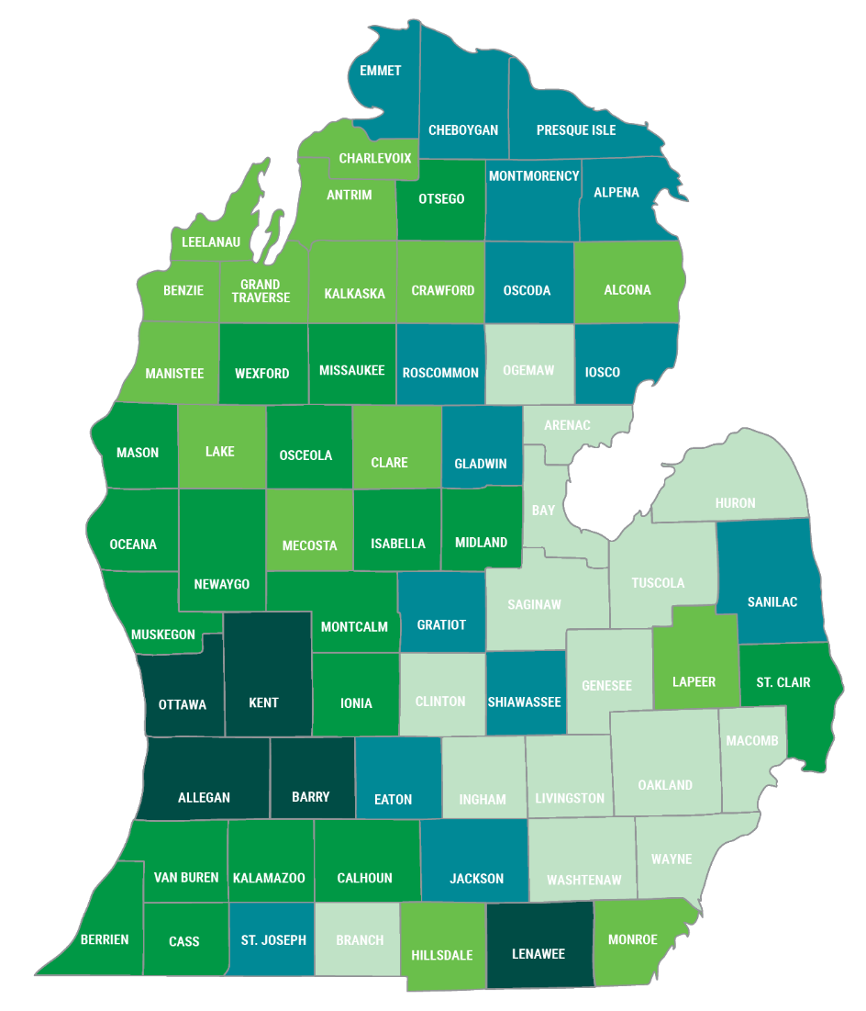
$0 premium plans
 | Region 1 | Region 2 | Region 3 | Region 4 | Region 5 | EDV Buy-up
PriorityMedicare D-SNP (HMO) | ✓ | ✓ | ✓ | ✓ | ✓ | N/A
PriorityMedicare Dual Premier (HMO D-SNP) | Barry, Berrien, Branch, Calhoun, Cass, Kalamazoo, Macomb, St. Joseph, Van Buren and Wayne |  |  |  |  | N/A
PriorityMedicare Edge (PPO) | ✓ | ✓ | -- | -- | ✓ | $49
PriorityMedicare Key (HMO-POS) | ✓ | ✓ | ✓ | ✓ | ✓ | $43
PriorityMedicare Smart Savings (HMO-POS) | ✓ | ✓ | -- | -- | ✓ | $49
PriorityMedicare Thrive (PPO) | ✓ | ✓ | ✓ | ✓ | ✓ | $43
PriorityMedicare Vital (PPO) | ✓ | ✓ | -- | -- | ✓ | $43
10
CONFIDENTIAL. NO release until October 1, 2025

Slide 11
Premium plans
 | Region 1 | Region 2 | Region 3 | Region 4 | Region 5 | EDV Buy-up
PriorityMedicare (HMO-POS) | $81 | $72 | $120 | $110 | $66 | $49
PriorityMedicare Merit (PPO) | $70 | $83 | $115 | $129 | $106 | $49
PriorityMedicare Thrive Plus (PPO) | $49 | $49 | $49 | $49 | $49 | $37
PriorityMedicare Value (HMO-POS) | $32 | $43 | $80 | $55 | $43 | $37
PriorityMedicare Vintage (HMO-POS) | $8.80 | $8.80 | -- | -- | $8.80 | $49
11
CONFIDENTIAL. NO release until October 1, 2025

Slide 12

Wellness & prevention coverage
PriorityMedicare Thrive (PPO)
PriorityMedicare Thrive Plus (PPO)
Our wellness & preventive plans were designed for those individuals looking to prioritize their physical, mental and sexual health.
12
CONFIDENTIAL. NO release until October 1, 2025

Slide 13
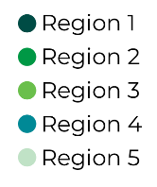

PriorityMedicare
Thrive (PPO)
Premium | $0
MOOP | $6,200
Medical Deductible | $270 ($600 in region 3 & 4)
PCP | $0
Specialist | $40
Inpatient | $375 (days 1-7)
Outpatient | $400
PT/OT | $20
Outpatient Mental Health | $5
Rx Deductible | $250 (tiers 3-5)
Rx Tiers | $2 / $8 / 21% / 25% / 30%
Supplemental Drug List | ED drugs
Galleri Cancer Screening Test | $150 every other year
Dental | $1,500/C
ThriveFlex | $60/Q OTC $285/Y to use towards fitness/wellness
All regions
Target aging in consumer who is actively engaged in their health and values prevention
$0 0pen network plan, deductible may apply
Supplemental drug list to cover ED drugs to aid in wellness
Galleri® cancer screening test
Annual allowance towards fitness/wellness
13
CONFIDENTIAL. NO release until October 1, 2025

Slide 14
PriorityMedicare
Thrive Plus (PPO)
Premium | $49
MOOP | $5,600
Medical Deductible | $0
PCP | $0
Specialist | $40
Inpatient | $300 (days 1-7)
Outpatient | $350
PT/OT | $15
Outpatient Mental Health | $0
Rx Deductible | $100 (tiers 3-5)
Rx Tiers | $1 / $7 / 22% / 35% / 31%
Supplemental Drug List | ED drugs
Galleri Cancer Screening Test | $75 every other year
Dental | $2,500/C (+50% coins.)
ThriveFlex | $50/Q OTC $385/Y to use towards fitness/wellness
All regions
Target aging in consumer who is actively engaged in their health and values prevention
NOW an open network plan
Supplemental drug list to cover ED drugs to aid in wellness
Galleri® cancer screening test
Increased annual allowance towards fitness/wellness
Labs and procedures and tests are now $0
14
CONFIDENTIAL. NO release until October 1, 2025

Slide 15
Open network plans
We offer three open network PPO plans:
  PriorityMedicare Vital (regions 1, 2 and 5)
  PriorityMedicare Thrive
  PriorityMedicare Thrive Plus
This means that members of these three plans will have the same cost-share whether they see an in- or- out-of-network provider.
PriorityMedicare Thrive and PriorityMedicare Vital members may have higher cost-share out-of-network until they meet their medical deductible.
15
CONFIDENTIAL. NO release until October 1, 2025

Slide 16
Well-rounded coverage
PriorityMedicare Key (HMO-POS)
PriorityMedicare Value (HMO-POS)
Our well-rounded coverage plans were designed to meet the needs of everyone. If they are looking for solid medical coverage with some extras, one of these is the plan for them.
16
CONFIDENTIAL. NO release until October 1, 2025

Slide 17
PriorityMedicare
Key (HMO-POS)
Premium | $0
MOOP | $5,800
Medical Deductible | $375
PCP | $0
Specialist | $40
Inpatient | $350 (days 1-7)
Outpatient | $350
PT/OT | $25
Rx Deductible | $200 (tiers 3-5)
Rx Tiers | $2 / $8 / 22% / 25% / 30%
Dental | $1,500/C
OTC | $75/Q (1&2), $45/Q (3&4), $60/Q (5)
All regions
Key is the #1 selling plan in Michigan.
Appeals to all different membership types.
Preventive and comprehensive dental remains the same
Rx deductible added on tiers 3-5, all tiers have lower cost-share
17
CONFIDENTIAL. NO release until October 1, 2025

Slide 18
PriorityMedicare
Value (HMO-POS)
Premium | $32-$80
MOOP | $5,100
Medical Deductible | $0
PCP | $0
Specialist | $35
Inpatient | $325 (days 1-7)
Outpatient | $325
PT/OT | $15
Rx Deductible | $100 (tiers 3-5)
Rx Tiers | $2 / $10 / 22% / 35% / 31%
Dental | $2,500/C (+50% services)
All regions
This plan is designed for those that are looking for extra dental benefits while maintaining solid medical coverage.
$0 PCP and low PT/OT/ST costs.
Highest tier of dental offered by PH MAPD plans.
No longer has OTC benefit
18
CONFIDENTIAL. NO release until October 1, 2025

Slide 19
Part B Giveback
PriorityMedicare Smart Savings (HMO-POS)
PriorityMedicare Vital (PPO)
Designed for healthy members who want a giveback towards their Part B premium. Plan options for veterans that have separate Part D coverage.
19
CONFIDENTIAL. NO release until October 1, 2025

Slide 20

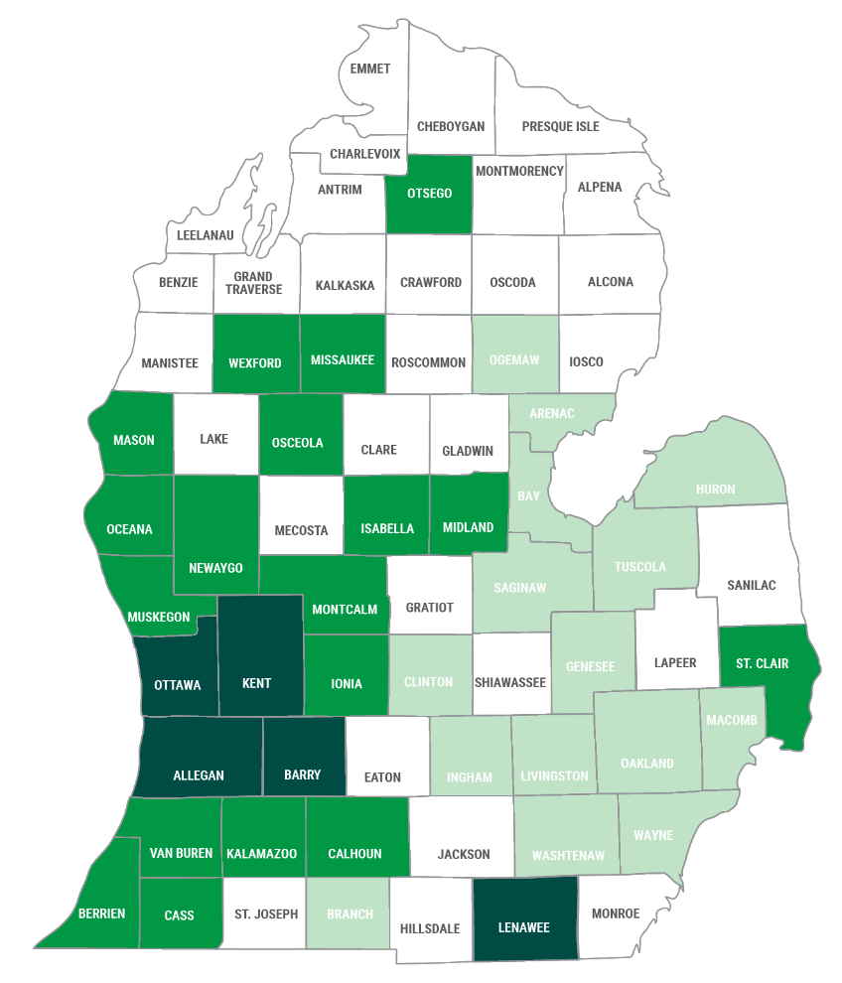
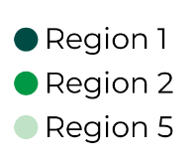
PriorityMedicare
Smart Savings (HMO-POS)
NEW PLAN
Premium | $0
MOOP | $9,250
INN Medical Deductible | $650
PCP | $0
Specialist | $55
Inpatient | $380 (days 1-7)
Outpatient | $450
PT/OT | $35
Rx Deductible | $500 (tiers 3-5)
Rx Tiers | $1 / $8 / $42 / 25% / 27%
Dental | Preventive
Part B Giveback | $100 (1&2) $120 (5)
Regions 1, 2 and 5
Targets healthy members who do not utilize their medical benefits.
$100 Part B giveback in regions 1 and 2, $120 in region 5
$42 Tier 3 copay
Preventive dental
$295-$1,495 copay range for TruHearing aids, one per ear, per year
20
CONFIDENTIAL. NO release until October 1, 2025

Slide 21
PriorityMedicare
Vital (PPO)
Premium | $0
MOOP | $6,300
Medical Deductible | $500
PCP | $0
Specialist | $50
Inpatient | $350 (days 1-7)
Outpatient | $350
PT/OT | $30
Rx Deductible | $450 (tiers 3-5)
Rx Tiers | $1 / $10 / $42 / 25% / 27%
Dental | $1,500/C
OTC | $45/Q
Part B Buyback | $45
Regions 1, 2 and 5
$0 open network PPO, deductible may apply
$42 Tier 3 copay
Preventive and comprehensive dental
$99-$399 for advanced or premium TruHearing® aids, one per ear, every two years
OTC is now quarterly
21
CONFIDENTIAL. NO release until October 1, 2025

Slide 22
Core medical coverage
PriorityMedicare Edge (PPO)
This plan is designed for those looking for core medical coverage over the "extras". Members who want a $0 plan while feeling confident in their coverage and get high quality, affordable medical care.
22
CONFIDENTIAL. NO release until October 1, 2025

Slide 23
PriorityMedicare
Edge (PPO)
Premium | $0
MOOP | $6,000
Medical Deductible | $275
PCP | $0
Specialist | $35
Inpatient | $350 (days 1-7)
Outpatient | $350
PT/OT | $40
Rx Deductible | $200 (tiers 3-5)
Rx Tiers | $2 / $8 / 22% / 25% / 30%
Dental | Preventive
OTC | $55/Q
Regions 1, 2 and 5
A $0 PPO plan that has good medical coverage and a medical deductible that is less than one day inpatient stay.
Now has a quarterly OTC allowance
Unlimited caregiver support
23
23
23
23
CONFIDENTIAL. NO release until October 1, 2025

Slide 24
Low-income subsidy (LIS) coverage
PriorityMedicare Vintage (HMO-POS)
A plan designed for those receiving ‘extra help’. An option for those that do not qualify for HIDE or have lost their full dual status from Medicaid redetermination.
24
CONFIDENTIAL. NO release until October 1, 2025

Slide 25
PriorityMedicare
Vintage (HMO-POS)
Premium | $8.80
MOOP | $5,600
Medical Deductible | $0
PCP | $0
Specialist | $35
Inpatient | $400 (days 1-7)
Outpatient | $350
PT/OT | $25
Rx Deductible | $615 (tiers 1-5)
Rx Tiers | $0 / $8 / 25% / 35% / 25%
Dental | Preventive
OTC Plus | $40/Q
Regions 1, 2 and 5
This plan has been redesigned for those members receiving ‘Extra Help’ and/or losing partial coverage in HIDE counties
CMS covers the premium and RX deductible. Lowers Rx cost-share to LIS copay amounts
Preventive dental, $100 eyewear allowance and a $295-$1,495 copay structure for hearing aids are included.
No longer has Saferide and Carallel
Will have a premium of $8.80
Now has OTC and if eligible*, healthy food and produce
25
CONFIDENTIAL. NO release until October 1, 2025

Slide 26
High medical coverage
PriorityMedicare (HMO-POS)
PriorityMedicare Merit (PPO)
Our highest premium plans also offer our highest medical coverage. These plans are designed for those who want a predictable and reliable health plan. With low MOOPs, no INN deductibles and low copays – these are our two longest standing plans for a reason.
26
CONFIDENTIAL. NO release until October 1, 2025

Slide 27
PriorityMedicare
(HMO-POS)
Premium | $66-$120
MOOP | $4,500
Medical Deductible | $0
PCP | $0
Specialist | $40
Inpatient | $225 (days 1-6)
Outpatient | $175
PT/OT | $35
Rx Deductible | $0
Rx Tiers | $1 / $8 / 25% / 33% / 33%
Dental | Preventive
All regions
Medicare is the longest-standing PH MAPD plan for a reason – it is a reliable plan with great benefits
Low-cost medical coverage on a HMO-POS that acts like a PPO.
27
CONFIDENTIAL. NO release until October 1, 2025

Slide 28
PriorityMedicare
Merit (PPO)
Premium | $70-$129
MOOP | $4,200
Medical Deductible | $0
PCP | $0
Specialist | $45
Inpatient | $275 (days 1-6)
Outpatient | $225
PT/OT | $35
Rx Deductible | $0
Rx Tiers | $2 / $10 / 25% / 32% / 33%
Dental | Preventive
All regions
Merit is a reliable PPO for current membership.
28
CONFIDENTIAL. NO release until October 1, 2025

Slide 29
Special needs coverage
PriorityMedicare D-SNP (HMO)
PriorityMedicare Dual Premier (HMO D-SNP)
Plans designed for individuals with full Medicaid and Medicare coverage who need higher support services.
29
CONFIDENTIAL. NO release until October 1, 2025

Slide 30
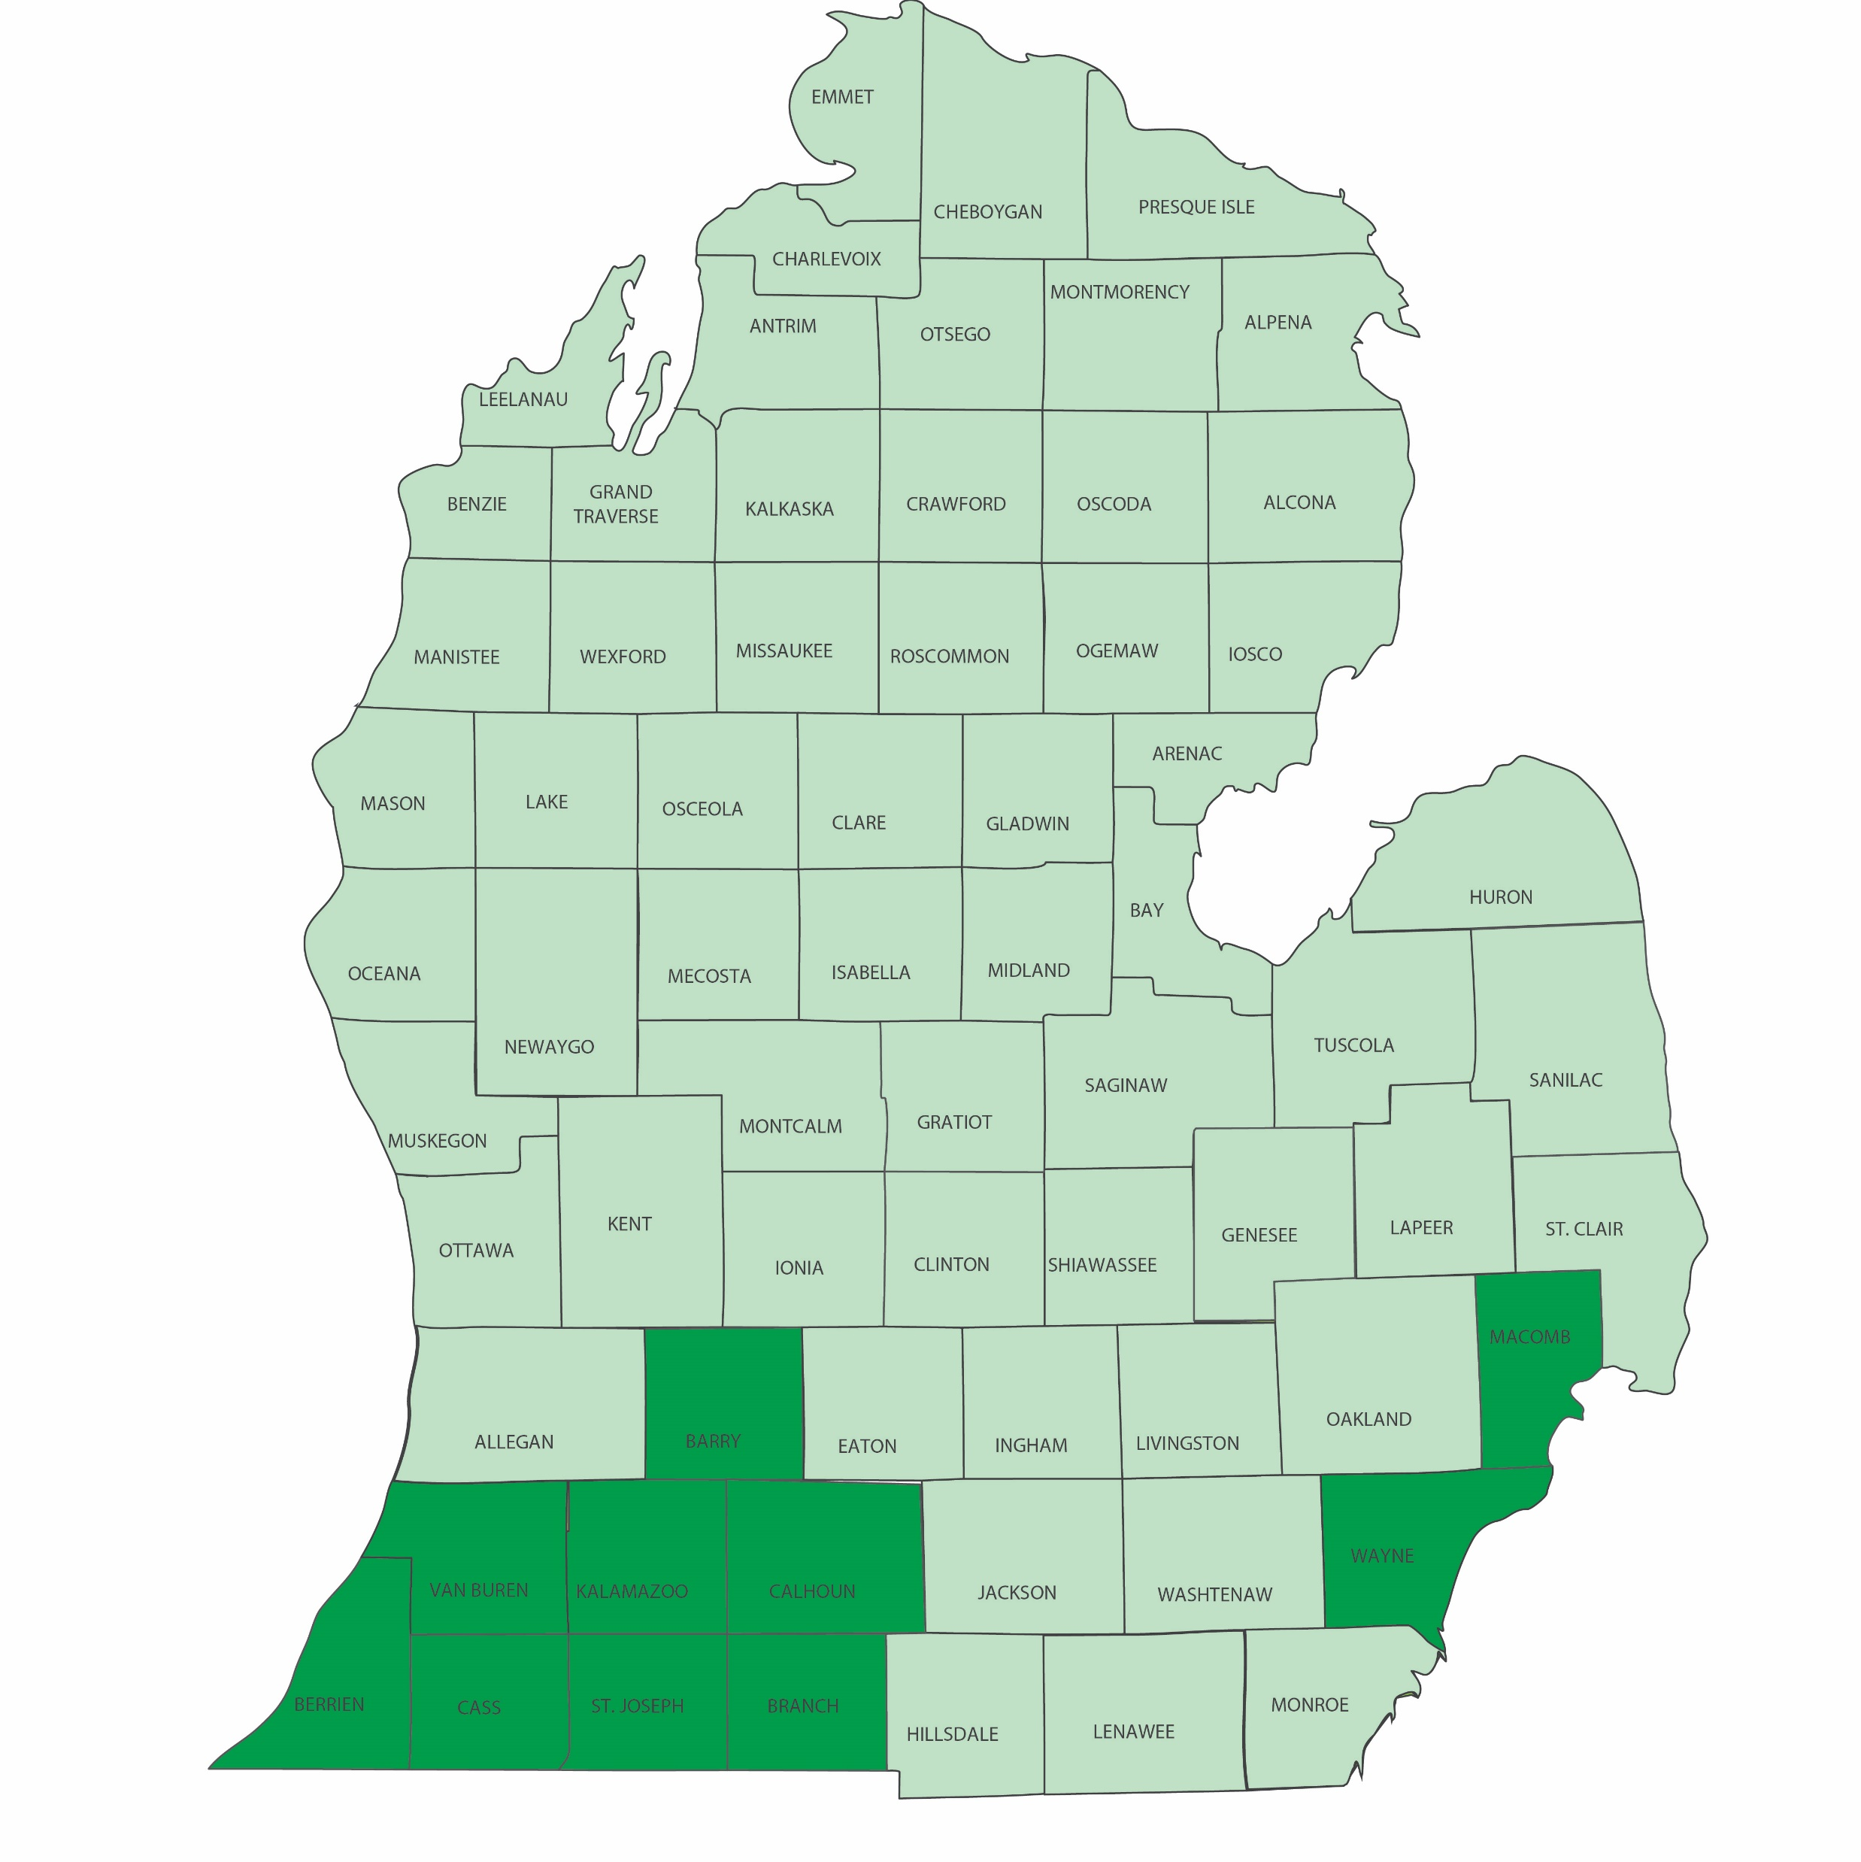
PriorityMedicare
Dual Premier (HMO D-SNP)
NEW HIDE PLAN
Rx Deductible | $615 (tiers 3-5)
Rx Tiers | $0 / $0 / 25% / 25% / 25%
Dental | Coverage obtained through Medicaid benefits
Hearing | $0 for advanced aids, once per ear every THREE years PLUS ear molds
PriorityFlex | $96/M (region 1) $70/M (regions 2-4)
Caregiver support | $0 for unlimited caregiver support
Fitness | Full access
PERs | Coverage for device and services
HIDE regions
Dual Premier is a highly integrated dual eligible special needs plan. Combines Medicare, Medicaid and long-term support services (LTSS) into one plan.
Member must have full Medicaid coverage to enroll into this plan.
Medical cost-share is $0, even in deeming period
$0 prescription drug copays on tiers 1-2
PriorityFlex card includes OTC, and if eligible*, healthy food and produce, select utilities, pest control and online meal delivery, personal care items and household supplies
Unlimited caregiver support
D-SNP members in Barry, Berrien, Branch, Calhoun, Cass, Kalamazoo, Macomb, St. Joseph, Van Buren and Wayne will be cross walked into this plan.
30
CONFIDENTIAL. NO release until October 1, 2025
All services covered by Original Medicare are a $0 liability to the D-SNP member

Slide 31
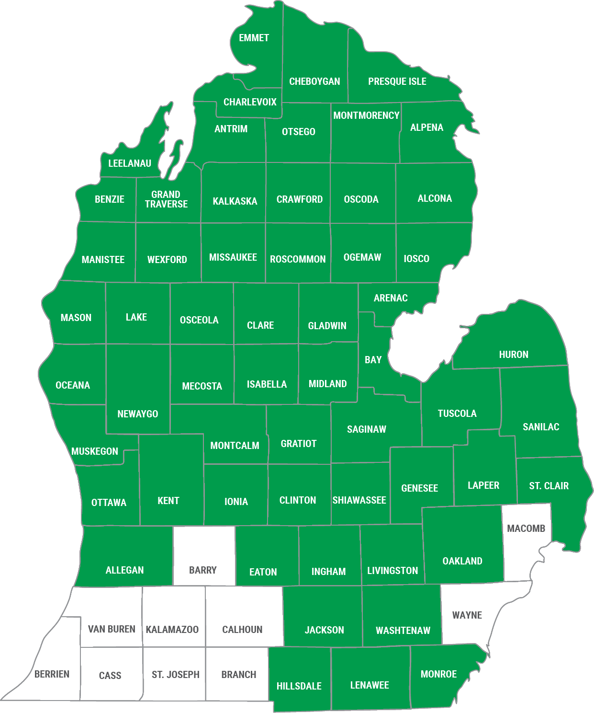
PriorityMedicare
D-SNP (HMO)
Rx Deductible | $615 (tiers 3-5)
Rx Tiers | $0 / $0 / 25% / 25% / 25%
Dental | $1,500 max with preventive services only
Hearing | $0 for advanced aids, one per ear every two years plus ear molds
Vision | $200 allowance
PriorityFlex* | $70/M
Caregiver support | $0 for unlimited caregiver support
Fitness | Full access
PERs | Coverage for device and services
Transportation | 30 rides at 100 miles (reimbursement)
D-SNP region
Members must have full Medicaid coverage to be a D-SNP member
Medical cost-share is $0 – if member falls into the grace period there will be a cost-share for most medical benefits
PriorityFlex card includes OTC, and if eligible*, healthy food and produce, select utilities, pest control and online meal delivery.
Two cards, two carriers
31
All services covered by Original Medicare are a $0 liability to the D-SNP member
CONFIDENTIAL. NO release until October 1, 2025

Slide 32
D-SNP vs. HIDE-SNP
What stays the same?
Medicare remains primary, and the eligibility requirements continue to be the same.
What’s the difference? | CO D-SNP (Today) | HIDE-SNP (Future)
Includes Medicare & Medicaid in one plan | No | Yes
Members must be full-dual eligible to enroll | Plan chooses* | Yes
Includes Long-Term Services & Supports (for those who are eligible) | No | Yes
Members have one ID card and one member ID | No | Yes
Providers submit one claim to health plan | No | Yes
Health plan must have integrated appeals & grievances | No | Yes
One customer service team handles Medicare & Medicaid questions | No | Yes
Coverage through the “grace period” or “deeming period” (loss of Medicaid) | Yes, 6 months | Yes, 3 months
Face-to-face Health Risk Assessment (HRA) done by licensed clinician | No | Yes
32
*PriorityMedicare D-SNP only accepts full-dual eligibles. Other plans may accept partial dual eligibles.
CONFIDENTIAL. NO release until October 1, 2025

Slide 33
What are LTSS?
Long-term services and supports (LTSS) is a broader term that encompasses both institutional care (like nursing homes) and Home and Community-Based Services (HCBS), which is a broad term for a variety of services delivered in the home or community to help people with disabilities or other needs maintain or improve their functional abilities, quality of life, and well-being.
LTSS includes:
Nursing home care
Intermediate care facilities
Home health services
Adult day care
Assisted living
HCBS
HCBS includes:
Personal Care: Assistance with activities of daily living (ADLs) like bathing, dressing, and eating.
Home Health: Skilled nursing care, PT, and other medical services provided in the home.
Adult Day Services: Community-based centers that offer social and support services.
Respite Care: Temporary relief for caregivers
Non-medical transportation
Home-delivered meals
33
CONFIDENTIAL. NO release until October 1, 2025

Slide 34
Where are LTSS provided?
 | Home and Community-Based Care (HCBS) | Institutional Care
Services | Medical and personal services to help with daily living tasks. | Medical and personal services to help with daily living tasks.
Client location | In their own home, or with a family member. | In a facility designed to provide LTSS to patients who live there.
Service location | By caregivers who visit the home, or by going out to visit providers in the community. | Many services are provided by onsite caregivers who work at the facility.
Who is reimbursed | Family members can sometimes be certified as live-in or visiting caregivers, depending on the state's requirements. Other care can be provided by medical providers in the community. | Caregivers are the professional medical staff who work at or visit the facility.
34
CONFIDENTIAL. NO release until October 1, 2025

Slide 35
How do my clients enroll in LTSS?
They don’t. Priority Health coordinates members' LTSS moving forward.
Clients already receiving LTSS via State will be identified by Priority Health via the CHAMPS file and sent directly to the appropriate internal team or to AAA to administer, to ensure services continue with no disruption.
Clients who are not receiving LTSS but may be eligible:
  Will be identified based on answers on the HRA (also known as the Level I assessment) or by a Priority Health Care Manager during their interactions.
  If identified as possibly needing LTSS, they will be sent to AAA for assessment
  They will recommend services, which PH must approve
  Once approved, client will be sent to appropriate internal Priority Health team or to AAA to administer LTSS
35
CONFIDENTIAL. NO release until October 1, 2025

Slide 36
How is the level of LTSS determined?
Functional Needs Assessments
  Purpose:
    Measure an individual's ability to perform daily tasks, including; Activities of daily living (ADLs), Instrumental activities of daily living (IADLs), cognition, vision, and communication, plus, health status, psychosocial issues, and behavioral concerns
    Determine the “level” of LTSS which is generally categorized by the intensity and setting (home-based support to facility-based care) of the care provided.
  Frequency: Completed at least once a year for existing members and within 90 days of enrollment for new members.
Assessment Levels
  Level I Assessments (also referred to as an HRA): A State standardized assessment to identify individuals with LTSS needs. Determines the amount, scope, and duration of personal care services needed.
  Level II Assessments:
    Comprehensive evaluation for those identified in Level I as possibly needing nursing facility level of care (NFLOC), which Level I cannot assess. NFLOC requires demonstrating a need for constant care and skilled supervision typically provided in a nursing home.
    Includes medical and functional assessments (ADLs and IADLs).
36
CONFIDENTIAL. NO release until October 1, 2025

Slide 37
How quickly will by client get LTSS?
Clients Not Currently Receiving LTSS
HRAs (Level I assessments) must be completed within the first 90 days, prioritizing high-risk members.
Outreach to start coordination of LTSS occurs within 20 days of a need being identified by a Care Manager during this assessment.
Clients Currently Receiving LTSS via the State
Priority Health receives daily CHAMPS files from the State, detailing enrolled programs.
Our system automatically identifies these members and sends them to the appropriate LTSS resource within 24 hours.
Outreach to continue coordinating their LTSS occurs within 20 days of receipt.
37
CONFIDENTIAL. NO release until October 1, 2025

Slide 38
Why is LTSS important for you & your clients?
LTSS are vital for supporting your clients' health, independence, and overall well-being. With an aging population, these services help older adults maintain their independence and quality of life, ensuring vulnerable individuals receive the care they need in the most suitable setting.
Independence and Enhanced Quality of Life: LTSS helps clients maintain their independence and stay in their homes, which is often their preference. HCBS enable older adults and people with disabilities to live at home or in local settings, improving their health and independence. These services also enhance the well-being of individuals with disabilities and chronic conditions.
Cost Savings: LTSS can reduce the need for expensive hospitalizations and institutional care, offering a more cost-effective solution.
Comprehensive Care: LTSS provides integrated and coordinated care, ensuring all aspects of a client's health are managed effectively.
Support for Family Caregivers: LTSS offers training, counseling, support groups, and respite care to family members caring for older adults and people with disabilities.
38
CONFIDENTIAL. NO release until October 1, 2025

Slide 39
Pharmacy

Slide 40
2026 Pharmacy updates
IRA updates continue with the introduction of Medicare Fair Pricing Drugs (MFP). 10 drugs will be capped in 2026, 15 will be added in 2027 and the program will continue from there.
All plans will see Rx changes in 2026
Tier 1 retail and mail-order are moving from 90-day fills to 100-day fills
  $0 copay still applies in retail/mail-order for preferred pharmacies
  Cost-share will apply at non-preferred pharmacies, 90-day rate for 100-day fills
Part D insulin do NOT hit Rx deductibles at any point in the plan year
  The same applies for ED drugs on Thrive/Thrive Plus
Amazon will be a preferred mail-order pharmacy in 2026
ESI is no longer offering 30-day fills for mail-order
40
CONFIDENTIAL. NO release until October 1, 2025

Slide 41
2026 Formulary changes
Maintained one formulary across all plans
Most notable changes:
  Symbicort generic inhaler moving back down to T2 from T3
  Paxlovid (Covid) moving up to T2
  Humalog/Humulin will be non-formulary and Novolog/Novulin will be on T3 (MFP drugs- insulin)
  Entresto (heart disease) is moving from T3, QL to T4, Quantity Limits remain in place
  Ibuprofen is moving from T1 to T2
41
CONFIDENTIAL. NO release until October 1, 2025

Slide 42
2026 Medicare Fair Pricing (MFP)
Drug Name | Condition | Negotiated Price 2026 | Current List Price
Januvia | Diabetes | $113 | $527
Flasp, Novolog | Diabetes | $119 | $495
Farxiga | Diabetes, Heart, CKD | $178.50 | $556
Enbrel | RA, Psoriasis | $2,355 | $7,106
Jardiance | Diabetes, Heart, CKD | $197 | $573
Stelara | Psoriasis, Crohn’s disease, UC | $4,695 | $13,836
Xarelto | Blood clots, Coronary Disease | $197 | $517
Eliquis | Blood clots | $231 | $521
Entresto | Heart failure | $295 | $628
Imbruvica | Blood cancers | $9,319 | $14,934
Example: Eliquis | Vital 2025 | Vital 2026 | Key 2025 | Key 2026 | Thrive Plus 2025 | Thrive Plus 2026
Drug cost | $521 | $231 | $521 | $231 | $521 | $231
Rx deductible | $350 (3-5) | $450 (3-5) | $0 | $200 (3-5) | $0 | $100 (3-5)
Tier 3 | $42 | $42 | 25% | 22% | 25% | 22%
Annual member cost | $983 | $954 | $1,563 | $809 | $1,563 | $709
*This example assumes the member is only on one drug.
**25% accumulates towards the TrOOP when members cost-share is less.
These drugs max on TrOOP of $2,100.
42
CONFIDENTIAL. NO release until October 1, 2025

Slide 43
Dental, vision
and hearing

Slide 44
 |  |  | Tier 1 |  | Tier 2 |  | Tier 3
 |  |  | Medical coverage focused plans with preventive only |  | $0 plans with comprehensive coverage |  | Premium plans with highest level of comprehensive coverage
 |  |  | PM, PM Merit PM Edge PM Vintage PM Smart Savings |  | PM Key PM Vital PM Thrive |  | PM Value, PM Thrive Plus
Preventive | $0 for 2 preventive exams |  | Embedded prevention covered at 100% |  | Embedded prevention covered at 100% |  | Embedded prevention covered at 100%
 | $0 for 2 cleanings (regular or periodontal)
 | $0 for one set up bitewing x-rays
 | $0 for periapical radiographs
 | $0 for 1 brush biopsy
 | $0 for radiographs (full-mouth or panoramic x-rays)
Comprehensive | $0 for simple extractions |  | EDV $2,500 annual coverage limit $49/M premium |  | Embedded comprehensive coverage $1,500 max |  | Embedded comprehensive coverage $2,500 max
 | $0 for fillings
 | $0 crown repairs
 | 50% for root canals
 | 50% for root canals |  |  |  | EDV $2,500 annual coverage limit $43/M premium
 | 50% for crowns |  |  |  |  |  | EDV $5,000 combined annual coverage limit $37/M premium
 | $0 for routine cleaning (regular) and fluoride *Does not apply towards max
 | 50% for surgical extractions
 | 50% for implant and implant related services
 | 50% for dentures
 | 50% for denture/bridge relines and repairs
 | 50% for bridges |  | Not covered |  | Not covered
Dental benefit
44
CONFIDENTIAL. NO release until October 1, 2025

Slide 45
Dental benefit
 |  |  |  | Dual Premier |  |  | D-SNP
 |  |  |  | Delta Dental Medicaid Network |  |  | Delta Dental PPO network for Medicaid comprehensive dental benefits
Preventive | $0 for 2 preventive exams |  |  | Coverage obtained through Medicaid benefits |  |  | Embedded prevention covered at 100% up to $1,500
 | $0 for 2 cleanings (regular or periodontal)
 | $0 for one set up bitewing x-rays
 | $0 for periapical radiographs
 | $0 for 1 brush biopsy
 | $0 for radiographs (full-mouth or panoramic x-rays)
Comprehensive | $0 for simple extractions |  |  |  |  |  | Coverage obtained through Medicaid benefits
 | $0 for fillings
 | $0 for crown repairs
 | $0 for root canals
 | $0 for scaling, root planing, sealants
 | $0 for surgical extractions
 | $0 for implant and implant related services
 | $0 for dentures
 | $0 for denture/bridge relines and repairs
45
CONFIDENTIAL. NO release until October 1, 2025

Slide 46
Enhanced dental and vision
​ | Merit, Medicare, Edge, Smart Savings & Vintage​ | Key, Vital & Thrive​ | Value & Thrive Plus
Monthly premium​ | $49 ​ | $43 ​ | $37 ​
Dental ​ (Delta Dental®)​ | $0 copay for an additional regular cleaning, fillings, crown repairs, emergency treatment of dental pain, anesthesia and one fluoride treatment​ 50% of the total cost for crowns/onlays, root canals, dentures, denture relines & repairs, bridge repairs, simple extractions and surgical extractions/oral surgery, implants & implant repairs $2,500 annual coverage limit​ to use towards enhanced comprehensive dental services. | $0 copay for an additional regular cleaning, emergency treatment of dental pain, anesthesia and one fluoride treatment​ 50% of the total cost for crowns/onlays, root canals, dentures, denture relines & repairs, bridge repairs, surgical extractions/oral surgery, implants & implant repairs $2,500 annual coverage limit to use towards enhanced comprehensive dental services. | $0 copay for an additional regular cleaning, emergency treatment of dental pain, anesthesia and one fluoride treatment​ 50% of the total cost for crowns/onlays, dentures, bridges, denture relines & repairs, bridge repairs, surgical extractions/oral surgery​, implants & implant repairs $5,000 annual coverage limit to use towards both embedded and enhanced comprehensive dental services.
Vision (EyeMed®)​ | $150 additional eyewear allowance per year with OON reimbursement option. ​ | $150 additional eyewear allowance per year with OON reimbursement option ​
46
CONFIDENTIAL. NO release until October 1, 2025

Slide 47
Vision hearing and other extras
Routine vision through EyeMed®
  Vital has a $125 allowance
  All other non-D-SNP plans have $100 allowance embedded
  D-SNP and Dual Premier have a $200 allowance
Routine hearing through TruHearing®
  D-SNP: $0 copay for up to two (2) TruHearing brand ‘Advanced’ hearing aids, one per ear every two years.
  Dual Premier: $0 copay for up to two (2) TruHearing brand ‘Advanced’ hearing aids, one per ear every three years.
  Vital: $99 copay for ‘Advanced’ hearing aids and $399 copay for ‘Premium’ hearing aids, one per ear, every two years. Includes ear molds.
  All other plans have a $295-$1,495 copay range for hearing aids
47
CONFIDENTIAL. NO release until October 1, 2025

Slide 48
Embedded
extras

Slide 49
Supplemental Benefit | Medicare | Merit | Value | Thrive Plus | Edge | Key | Vital | Smart Savings | Thrive | Vintage | D-SNP | Dual Premier
Mental Health (Teladoc Health Mental Health®) | ✓ | ✓ | ✓ | ✓ | ✓ | ✓ | ✓ | ✓ | ✓ | ✓ | ✓ | ✓
Travel Pass & Assist America® | ✓ | ✓ | ✓ | ✓ | ✓ | ✓ | ✓ | ✓ | ✓ | ✓ | - | -
Fitness (One Pass®) | ✓ | ✓ | ✓ | ✓ | ✓ | ✓ | ✓ | ✓ | ✓ | - | ✓ | ✓
Memory Fitness (CogniFit® through One Pass®) | ✓ | ✓ | ✓ | ✓ | ✓ | ✓ | ✓ | ✓ | ✓ | - | ✓ | ✓
Cancer Screening (Galleri®) | - | - | - | $75 copay every 2 years | - | - | - | - | $150 copay every 2 years | - | - | -
PERs (Connect America®) | - | - | - | - | - | - | - | - | - | - | ✓ | ✓
Transportation (Saferide®) | - | - | - | - | - | - | - | - | - | - | ✓ | -
Caregiver Support (Carallel®) | - | - | - | - | ✓ | - | - | - | - | - | ✓ | ✓
OTC (Lynx®) | - | - | - | $50/Q | $55/Q | $75/Q (1&2) $45/Q (3&4) $60/Q (5) | $45/Q | - | $60/Q | - | - | -
OTC Plus* (Lynx®) OTC, healthy food and produce, home and bathroom safety devices and modifications | - | - | - | - | - | - | - | - | - | $40/Q | - | -
PriorityFlex* (Lynx®) OTC, food, meals, select utilities, household supplies, personal care items, and pest control | - | - | - | - | - | - | - | - | - | - | $70/M | $96/M (1) $70/M (2-5)
ThriveFlex (Lynx®) fitness facilities, equipment and nutrition support | - | - | - | $385/Y | - | - | - | - | $285/Y | - | - | -

Slide 50

Over-the-counter (OTC)
Powered by Lynx
The flexibility to use OTC allowance in-store, online, or by phone.
Online ordering through the Priority Health app or priorityhealth.com/OTC and Walgreens.com.
In-store Retailers: Costco, CVS, Dollar General, Kroger, Meijer, Walgreens and Walmart.
An easy-to-use mobile app branded throughout with Priority Health.
Home and bathroom safety devices and modifications included in allowance.
All non-SNP plans with OTC have a quarterly allowance, no rollover
Renewing members will NOT receive a new card or catalog – messaging will go out letting them know to keep their current card/catalog.
Cards for new to Priority Health members with an OTC, OTC Plus, PriorityFlex and ThriveFlex benefit will not read ‘Over-the-Counter’.
50
CONFIDENTIAL. NO release until October 1, 2025

Slide 51
OTC Plus
Powered by Lynx
OTC Plus will be included on PriorityMedicare Vintage
  $40/Q (no rollover)
  One purse, which means members can use their benefit how they want.
Member must have SSBCI to receive healthy food and produce
If member qualifies for SSBCI mid- benefit period Lynx will turn on their added benefits within 3 business days.
A debit card will be issued to members that can use toward:
  OTC items
  Healthy food and produce, if eligible*
  Home and bathroom safety devices and modifications
51
CONFIDENTIAL. NO release until October 1, 2025

Slide 52
PriorityFlex
Powered by Lynx
PriorityFlex is offered on D-SNP and Dual Premier
  $70/M - $96/M, depending on plan and region (no rollover)
  One purse, which means members can use their benefit how they want.
A debit card will be issued to members that can use toward:
  OTC
  Member must be eligible for SSBCI to receive the following:
  Healthy food and produce
  Pest control services through individually contracted companies or through a partnership with The Helper Bees
  Utilities (water, sewer, trash, septic, gas, electric, internet, phone)
  Home and bathroom safety devices and modifications
  Online meal delivery through Modify Health
  Household supplies and personal care items, NEW in 2026
  **If member qualifies for SSBCI mid-benefit period Lynx will turn on added benefits within 3 business days.
52
CONFIDENTIAL. NO release until October 1, 2025

Slide 53
SSBCI
Available for members on PriorityMedicare D-SNP, Dual Premier and Vintage
Member must have one of the following chronic conditions, a high risk of hospitalization and a need for care management.
  Autoimmune disorders
  Cancer
  Cardiovascular disorders
  Chronic alcohol use disorder and substance abuse disorder
  Chronic and disabling mental health conditions
  Chronic back pain
  Chronic conditions that impair vision, hearing (deafness), taste, touch and smell
  Chronic gastrointestinal disease
  Chronic heart failure
  Chronic kidney disease
  Chronic lung disorders
  Conditions that may cause cognitive impairment
  Conditions that may cause functional challenges
  Conditions that require continued therapy services in order for individuals to maintain or retain function
  Dementia
  Diabetes mellitus (includes pre-diabetes)
  HIV/Aids
  Chronic Hypertension
  Immunodeficiency and immunosuppressive disorders
  Neurologic disorders
  Osteoporosis
  Overweight, obesity, and metabolic syndrome
  Post-organ transplantation care
  Severe hematologic disorders
  Stroke
53
CONFIDENTIAL. NO release until October 1, 2025

Slide 54
ThriveFlex
Powered by Lynx
ThriveFlex will be on Thrive and Thrive Plus
Two purses on this flex card – OTC (quarterly) and wellness (yearly)
OTC will work as explained on the previous slide.
Wellness purse can be used to purchase things like fitness equipment, fitness facilities and nutrition support.
 | OTC Allowance | Flex Allowance
Thrive | $60/Q | $285/Y
Thrive Plus | $50/Q | $385/Y
54
CONFIDENTIAL. NO release until October 1, 2025

Slide 55
One Pass™
Powered by Optum
Fitness is available on all plans except PriorityMedicare Vintage.
PriorityMedicare D-SNP and Dual Premier will now have access to an in-person fitness experience. Perks of One Pass
  Holland Aquatic Center and Evergreen Commons are in the One Pass network PLUS facilities like the GR YMCA and Detroit area YMCAs as well as boutique gyms like Pure Barre, Orange Theory and Stretch Lab.
  Brain health partnership through CogniFit
  Fitness Kits (strength, yoga or dance) designed for members who prefer to workout at home
  Access to the Fitbit community and Fitbit Premium (no Fitbit needed)
55
CONFIDENTIAL. NO release until October 1, 2025

Slide 56
Memory Fitness
Powered by Optum
Memory fitness benefit offered by CogniFit ® through the One Pass network.
  Available on all plans except Vintage
Perks of CogniFit
  A memory fitness program that includes a collection of brain games and tailors the training the member receives specifically towards what the member needs.
  Continuously adjusts the difficulty level to challenge and keep members from becoming bored or frustrated while using.
  Provides a comprehensive workout by training more than 20 cognitive skills that we use daily, including working memory, perception, attention, reasoning and coordination.
  Available in 18 languages
56
CONFIDENTIAL. NO release until October 1, 2025
Notes:
Not available on Vintage

Slide 57
Galleri® cancer screening
What is the Galleri® multi-cancer early detection test from GRAIL?
Multi-cancer early detection test that looks for a signal shared by 50+ types of cancer with a single blood test
Only 5 cancers have recommended screening tests. Using Galleri in addition to these tests can increase the chance of finding cancer early, to allow for earlier treatment
Early detection can save lives!
New for 2026
Eligibility criteria has been removed. The test is available to those who are not pregnant or undergoing current cancer treatment and 65 or older.
Member experience
Member has a pre-screening virtual visit with Grail
Receives Galleri kit in the mail
Schedules/get lab draw at a in-network Grail lab (500+ in MI including Quest®)
Mail Galleri kit back to Grail’s lab (10–14-day turnaround)
Receive results
If positive test result - PCP on intake form is notified and receives a phone call from Grail
57
CONFIDENTIAL. NO release until October 1, 2025

Slide 58
Transportation
Powered by SafeRide®
Available on D-SNP, members will have a benefit of 30 one-way trips per year to assist with their transportation needs. Each one-way trip is limited to 100 miles. Trips do not need authorization, but they must meet the stipulated guidelines listed below.
Guidelines:
The trip must be to or from “a related health location” (e.g., doctor’s appointment, pharmacy, etc.)
Rides must be scheduled at least 48 hours before desired pick-up time.
Members can call less than 48 hours before to see if there is availability, but it is not guaranteed.
Rides must be cancelled at least three (3) hours before the pick-up time, or the trip will be counted against the member’s total # of rides.
Members may submit for mileage reimbursement if they'd prefer to utilize their trip allowance this way. This will count toward their 30 one-way trip allowance and will also be limited to 100 miles.
Rides can also be scheduled in the Saferide app. however, members will need to call Saferide first to complete Mobility Assessment before using the app.
Dual Premier members will have access to transportation through their Medicaid benefit.
58
CONFIDENTIAL. NO release until October 1, 2025

Slide 59
Personal Emergency Response System (PERS)
Powered by Connect America®
Available on D-SNP and Dual Premier through Connect America®
A PERs device is provided to give members direct access to care in the case of an emergency and to support social determinants of health needs.
Device can be an in-home (landline or cellular),on-the-go mobile unit or smartwatch.
Access to 24/7/365 response center, and a member support service center
Members/caregivers can also download the Connect Notify app – this app helps caregivers know the member they care for is safe by locating a PERs device.
59
CONFIDENTIAL. NO release until October 1, 2025

Slide 60
Caregiver support
Powered by Carallel®
Available on D-SNP, Dual Premier and Edge
Guidelines:
Caregiver support is provided by Carallel to either the member and/or their family
Carallel’s care advocates provide support and research on topics such as:
Emotional support
Guidance on financial matters and legal concerns
Health insurance
Housing
Stress management
Transportation
60
CONFIDENTIAL. NO release until October 1, 2025

Slide 61
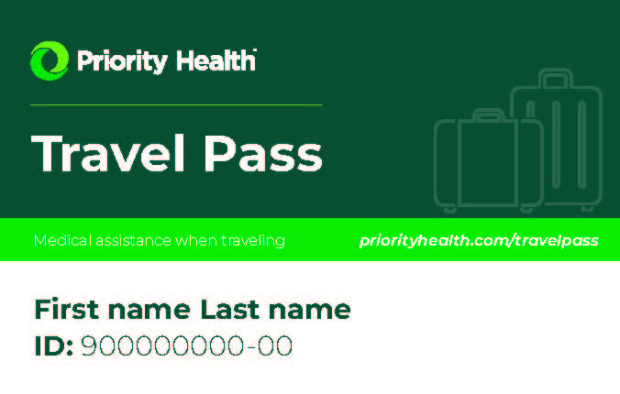
Priority Health Travel Pass
Priority Health Travel Pass bundles the following together:​
Members pay in-network prices when seeking care from Medicare accepting providers anywhere in the U.S. outside of the lower peninsula of Michigan.​
Members may see any Medicare participating provider when traveling- however, they may have to pay out-of-pocket and submit for reimbursement.​
Worldwide urgent and emergent coverage​
Worldwide travel assistance through Assist America® when more than 100 miles from home ​
D-SNP and Dual Premier members only have access to Worldwide Urgent and Emergent care
61
CONFIDENTIAL. NO release until October 1, 2025

Slide 62
Medigap

Slide 63
Benefits of a Priority Health Medigap plan
New Priority Health Medigap members who’ve never before had Priority Health Medigap coverage previously are eligible for a 6.5% reduction in their monthly premium for the first year of enrollment.
Members are eligible for a 12% reduction in premium if another person in their household currently has or is enrolling in a Priority Health Medigap plan.
12-month rate guarantee, with renewals on members’ enrollment anniversary date each year.
Fast-track underwriting for applicants who are age 65+ and within three years of Part B enrollment – minimal health questions.
No hidden fees, and no application or association fees, so your clients start saving money sooner.
Billing starts when the plan goes into effect.
Low or no cost sharing for your clients.
Members have access to Assist America® for global travel assistance when more than 100 miles from home or in a foreign country at no extra cost.
Hearing aid coverage through TruHearing® plus discounted rates with Connect America® (PERS) and EyeMed® (vision).
63
CONFIDENTIAL. NO release until October 1, 2025

Slide 64
Agent
experience

Slide 65
AEP reminders
Don’t forget, you now have one point of contact at Priority Health for all your questions, needs and support for all Consumer Market products
Pre-enrollment packet envelopes will have the same design in 2026, please take necessary steps to differentiate plan years
Call volumes are high in January. For a faster response, email our agent servicing team at medicareagent@priorithealth.com
Do not order 2026 member ID cards through the Book-of-Business until January. If ordered in 2025, a 2025 card will be triggered
Don’t miss our agent bulletin emails full of important information like upcoming events and webinars, plan changes, operational updates and more
The Agent Center is Priority Health’s online portal that provides quick and easy access to valuable information such as plan documents, enrollment tool, commissions, book of business and much more. Be sure to bookmark https://agent.priorityhealth.com/agents/s/login
65
CONFIDENTIAL. NO release until October 1, 2025

Slide 66
Reimagined Elite program
2026 criteria
Two simple ways to qualify:
Book-of-Business: Achieve 500 members in combined CM product BOB at 2025 YE; OR
New Enrollment: Achieve top 5% of combined CM annual new enrollments*
*5% new enrollment qualifier will be based on Territory Manager's assigned territories.
Emerald Elite
Formerly Elite+, awarded to agents who achieve both criteria
66
CONFIDENTIAL. NO release until October 1, 2025

Slide 67
Reimagined Elite program
Elite Benefits
Dedicated agent service line
Dedicated Elite email
$500 allowance for marketing, PH brand store, or RetireFlo
Elite logo and email signature
Friends & Family referral program
Monthly Elite events
Additional Emerald Benefits
Marketing allowance increased to $1,500
Annual Emerald appreciation event
Exclusive participation in
Agent Advisory Council
Paid MA certification
Business listing within Agent Directory
Emerald logo and email signature
67
CONFIDENTIAL. NO release until October 1, 2025

