Slide 1
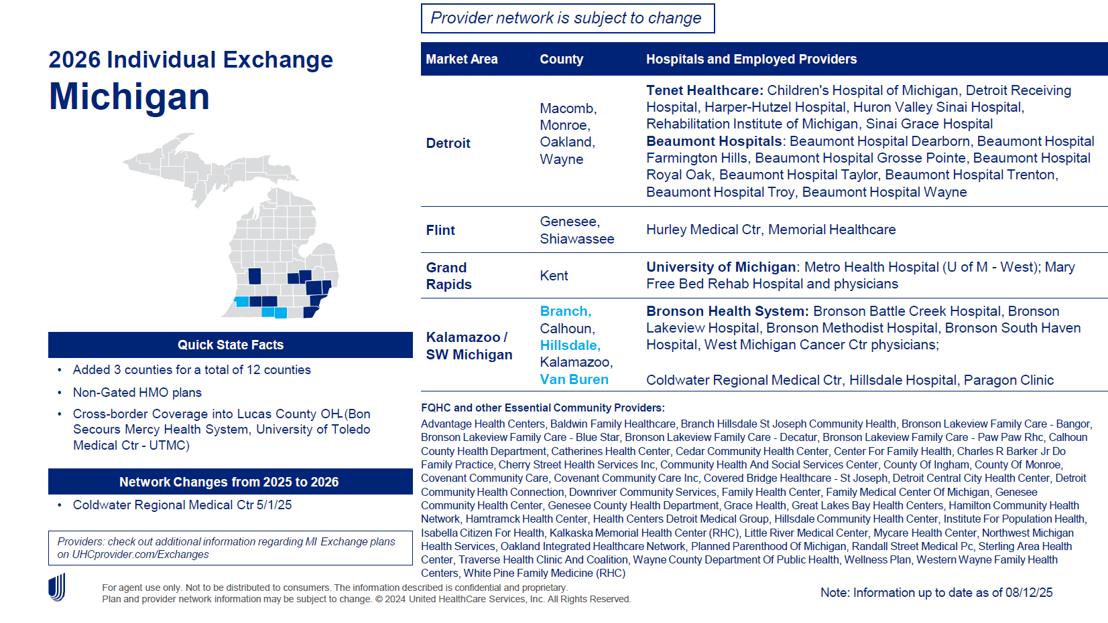
http://image.ifp.uhc.com/lib/fe5815707d600c747111/m/1/20c584c3-c920-49b8-b308-c9a51276f1e5.pdf

Slide 2

http://image.ifp.uhc.com/lib/fe5815707d600c747111/m/1/8e98651f-245c-4b3c-b8ef-dd8704b2acc4.pdf

