Slide 1
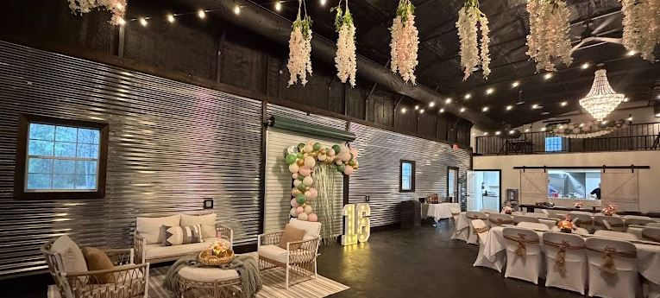

The Barn
at Geronimo
May 1, 2026
Exclusive Preview Event
GERONIMO ADVENTURE PARK · SPRING, TEXAS
3,200 sq ft barn & 1,600 sq ft covered porch — where rustic charm meets adventure.
● Up to 200 guests ● Indoor & Outdoor ● Adventure park on-site
RENTAL PRICING
STANDARD
Most Popular
Weekday
STANDARD
FLEXIBLE
Weekend
Hourly Add-On
Monday – Thursday
Friday – Sunday
Any day · beyond included block
$3,000
$4,500
$200
flat rate · 8-hour access block
flat rate · 10-hour access block
per hour · pre-arranged only
✓ 8-hour venue access
✓ 10-hour venue access
✓ Early-access hours available
✓ Tables & chairs included
✓ Tables & chairs included
✓ Additional setup or breakdown time
✓ Indoor climate-controlled barn
✓ Indoor barn & covered porch & deck
✓ Must be booked in advance
✓ Covered porch & deck access
✓ On-site event coordinator contact
✓ Subject to availability
✓ Parking for guests
✓ Parking for guests
$5,500
Peak Season Saturdays · March–May & December
Prime Texas wedding & event season. Reserve early — these dates fill first.
VENUE DETAILS
Always Included
Available for Use with Rental
Barn — 3,200 sq ft
Tables:
20 five-ft round, 20 cocktail, 12 eight-ft rectangle
Climate-controlled with HVAC
Indoor Balcony
200 chairs
Overlooks the main room — ideal DJ or AV setup
Guest Private Lounge & Dressing Room
4×8 ft movable stage
Storage space for your event supplies
Decorative arch — ceremony or photo backdrop
Serving Kitchen
Two 100" display monitors
Refrigerator, microwave, sink, ice maker, washer/dryer, drinking fountain with bottle filler. No stove or oven.
www.geronimoadventurepark.com
Two Private Bathrooms
Helpful Extras
Covered Porch — 1,600 sq ft
Ample Guest Parking
Outdoor covered entertaining space
Preferred Vendor List Available
Open Deck — 750 sq ft
Additional outdoor gathering area
Outside Vendors Welcome

Slide 2
The Barn at Geronimo
Finishing Touches & Adventure Park Add-ons
GERONIMO ADVENTURE PARK · SPRING, TEXAS
Open House — May 1, 2026
FINISHING TOUCHES
Linens & Décor Rentals
20 Ivory, Taffeta, Round Tablecloths
$200
200 Chair Covers
$150
120” Floor Length, Seamless Accordion Crinkle
White Spandex Stretch
20 White, Polyester, Round Tablecloths
$100
$100
200 Burlap Chair Bows
120” Floor Length
With 12 burlap lace table runner with lights
12 White, Polyester, Rectangle Tablecloths
$60
50 Wisteria Hanging Flowers
$100
120” Floor Length
White, pink & blue
20 White, Cocktail Table Covers
$100
30 Wood Slices for Centerpieces
$100
Fitted Stretch Spandex
12-13 inch, round, natural wood
A complete list of rental decorations is available upon request.
A space where every event can be an adventure.
Geronimo Adventure Park · Spring, TX · www.geronimoadventurepark.com
2 Fire Pits
$100 / 2 hrs
Ziplining
$40 / $60 / $80
Adventure Park
Managed by Geronimo staff · Add s'mores kit & bamboo skewers $5/person
Special pricing for 1, 2, or all 3 courses · price is per person · book in advance with rental
Add-Ons
Open
Grounds Play
The Range
$450 / 2 hrs
$500 / 2 hrs
8 lanes – includes axes,
ninja stars & throwing knives
Led by a Geronimo “Ax-pert”
Enhance your event with exclusive Geronimo experiences. All add-ons available to book with your barn rental.
Full grounds access for up to 200 event guests.
Must be booked in advance.
Rock Wall
$250 / 2 hrs
Full Park Rental
$7,500 / 4 hrs
Managed by Geronimo staff
Ziplining (up to 130), Throwing, Rock Wall, & Grounds (up to 200)
BOOKING POLICIES
— 50% deposit required to hold your date
— Balance due 30 days before the event
— Refundable security deposit: $500
— Date changes allowed with 90 days notice
— Events end by 11:00 pm
— After-hours available by prior arrangement
— Certificate of liability insurance required
— 5% discount for events booked at open house
5% Off
Open House Exclusive · May 1st Only
Book any event date at the May 1st Open House and receive a 5% discount off your rental. New venue — introductory offer. Don't miss it!
Based on the 2026 price list. Prices are subject to change.
EMAIL
PHONE
ADDRESS
WEBSITE
monica@geronimozip.com
(830) 365-5867
6749 FM 2920, Spring, TX 77379
www.geronimoadventurepark.com

